Slide 1
The 2016 Louisiana Flood: A Failure of Risk Perception
For additional information about the 2016 flood, see: http://sites.law.lsu.edu/coast/2016/08/why-was-the-louisiana-flood-of-august-2016-so-severe/
Edward P. Richards, JD, MPH
Clarence W. Edwards Professor of Law
LSU Law School, Climate Change Law Project
richards@lsu.edu
Blog - http://sites.law.lsu.edu/coast/

Slide 2
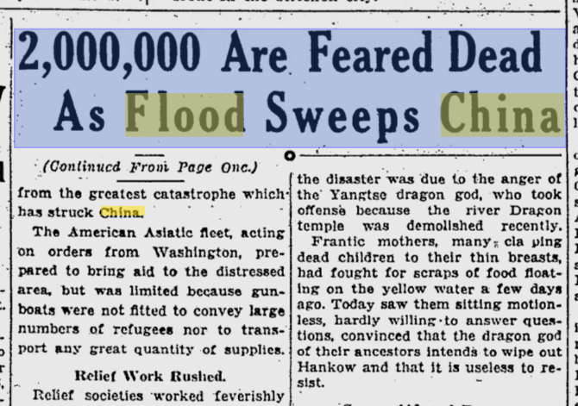

Slide 4
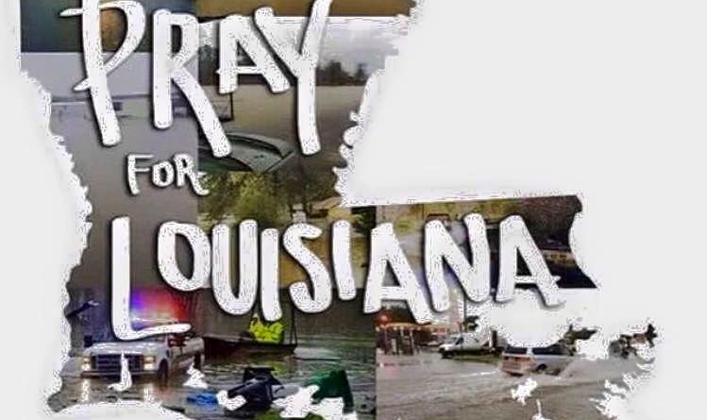

Slide 5
Floods are the Easiest Disasters to Predict and the Hardest to Avoid
Anonymous (frustrated) hydrologist

Slide 6
Predicting Rain - 100, 500, 1000 year events
100 year
1% chance each year
26% chance during a 30 year mortgage
80% chance during a lifetime
500 year
0.2% per year
> 5% chance during a 30 year mortage
1000 year
0.1% per year
0.1% risk per year of a toxic injury would be considered huge

Slide 7
Determining Rainfall Frequency
Determining the probably of a rainfall event by measuring requires that you have a rainfall record that twice as long as the projected return period.
100 year rainfall requires 200 years of data
500 year rainfall requires 1000 years of data
1000 year rainfall requires 2000 years of data
In most places in LA, robust flood data goes back less than 100 years.
If you do not have the data, you have to use models.
The models assume that the present is like the past and thus underestimate extreme events.

Slide 8
Does a 100 Year Rain = a 100 Year Flood?
This is a natural system

Slide 9
What Natural Factors Drive Flood Depth?
Topography
Flash floods in canyons
Broad, low floods on the pre-leveed Mississippi
Permeability
Is the ground already soaked?
Are the drainage channels already flooded?
Near the coast, is storm surge backing up the rivers that drain the area?

Slide 10
Topography of Baton Rouge

Slide 11
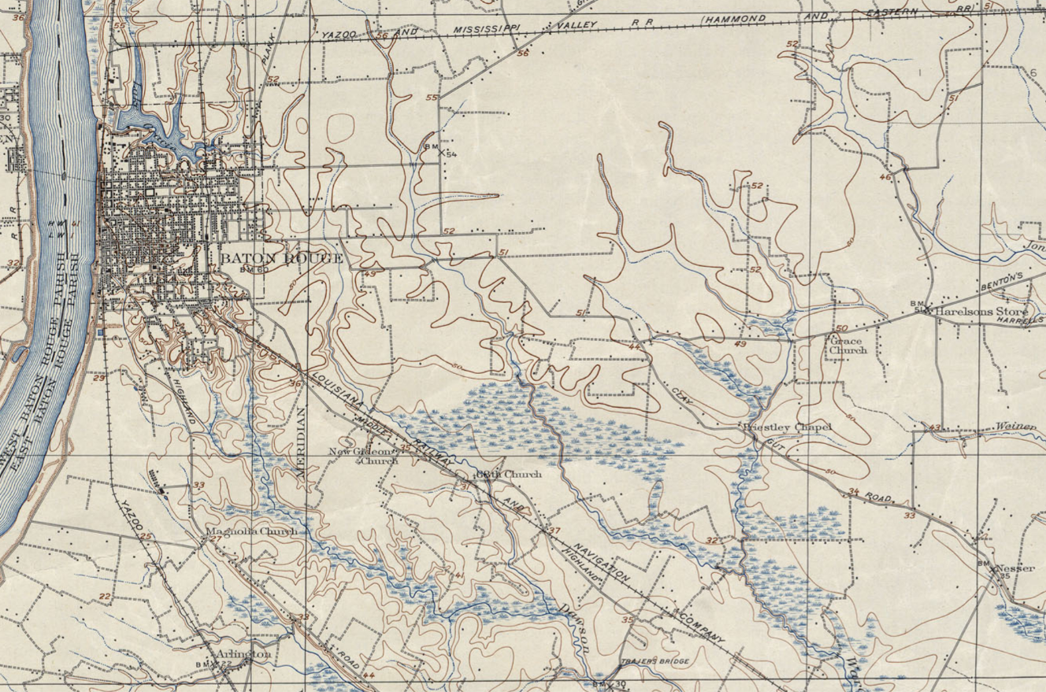
1906

Slide 12
How Does Development Change Topography?
Roads as dams and rivers
New drainage paths are created by ditching
Old drainage paths are filled with houses
Absorbent ground covered by impermeable surfaces
Major drainage projects import water as well as export it
Levees increase subsidence
Levees increase river flood height in the channel, increasing risk when the levees fail

Slide 13
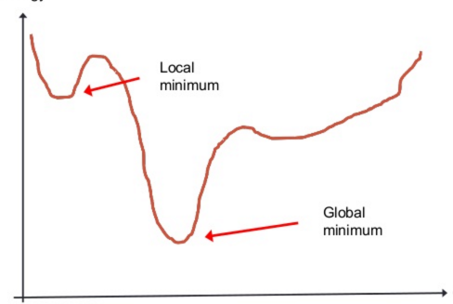
Elevation Doesn't Do It – Local Minimums

Slide 14
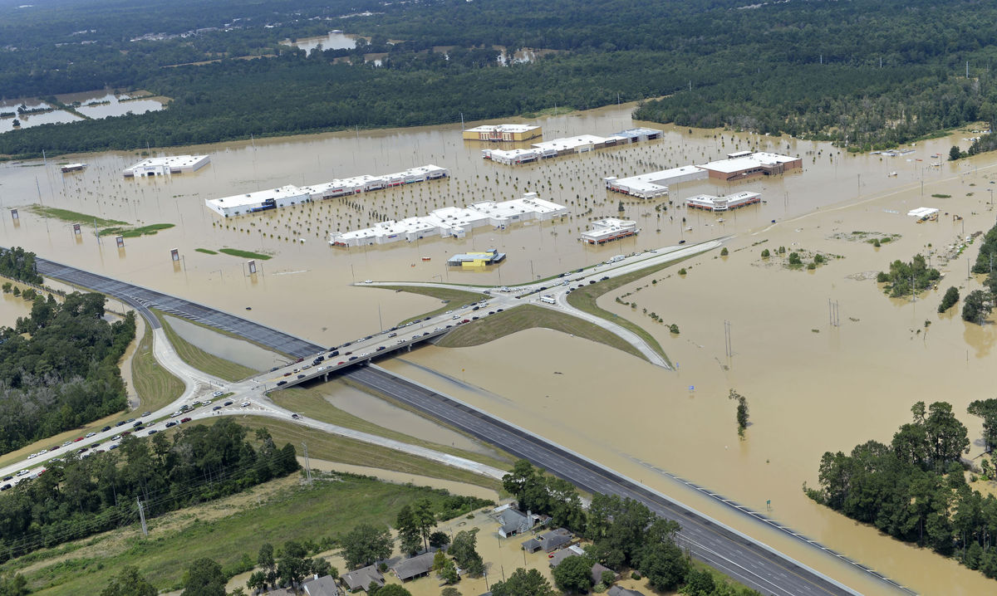

Slide 15
The Federalization of Flood Risk

Slide 16
History of Disaster Relief
In 1803, a Congressional Act was passed to provide financial assistance to a New Hampshire town devastated by fire. This is the first example of Federal government involvement in a local disaster.
1930's - Reconstruction Finance Corporation and the Bureau of Public Roads were both given authority to make disaster loans available
This becomes Civil Defense during the 1950s
Kennedy expands this after the Hebgen Lake Earthquake and Hurricanes Donna and Carla
FEMA is formed in 1978

Slide 17
Flood Insurance
Private market until 1968
After Hurricane Betsy in 1965 and additional floods, the cost of private flood insurance goes up and availability goes down.
Congress creates the National Flood Insurance Program, which displaces most private flood insurance.

Slide 18
Theory of the Original NFIP
Conservative (broad) definition of a high risk flood zone.
Subsidized insurance for existing structures in a high risk flood zone.
End of new development in high risk flood zones as a condition of community participation in the NFIP
Intended to be a federal spending power driven national land use plan for high risk flood areas.

Slide 19
Reality of NFIP
Very narrow definition of the high risk flood zone
Rejection of flooding as a continuous risk
In the 100 year zone, you need flood insurance and are regulated
One inch out of the 100 year flood zone, and you do not need insurance
State and local governments game flood designations and escape from the land use regulations.

Slide 20
Impact of Federalization of Flood Risk
Massive exodus to high risk riverine and coastal flood zones since 1968.
Equation of not having to buy flood insurance outside the 100 year flood zone with the not being at risk of flooding outside the zone.
50% of claims come from outside the 100 zone
The feds provide relief to people who do not have flood insurance in big disasters.
Road Home
The feds provide massive infrastructure rebuilding as part of flood relief.

Slide 21
Disaster Economics
The poor are always worse off after disasters
The middle class and the rich may do fine or better economically.
Converting housing into insurance payments or federal relief money is a huge economic boost to construction and engineering businesses, who are very important to local politicians.
Federal relief will rebuild dilapated governmental infrastructure to new standards at from zero to 35% state cost.

Slide 22
Does it Make Political Sense to Prevent Disasters?
New Orleans would look a lot more like Detroit today without Katrina.
Stricter flood elevation requirements in building codes reduce development and thus jobs and property taxes.
Local politicians get to play the hero during disasters and bolster their reputations.
Limitations on rebuilding hurt the poor, which provides political cover for allowing rebuilding in flood zones.
Bottom-line: it does not make political sense to prevent future disasters.

Slide 23
Are FEMA and NFIP Really Bipartisan Jobs Programs?

