Slide 1
The Challenge of Steady State Coastal Law in the Time of Rising Oceans
Edward P. Richards
Professor of Law
LSU Law Center
richards@lsu.edu
http://biotech.law.lsu.edu/cphl/slides/ITECOL-2012.htm

Slide 2
Thesis
Coastal law and disaster management are based on a steady state world.
The incentives to preserve the status quo are overwhelming.
They corrupt science and policy.
People will die and the wetlands will disappear unless scientists fight back.

Slide 3
The Reality of Coastal Louisiana

Slide 4
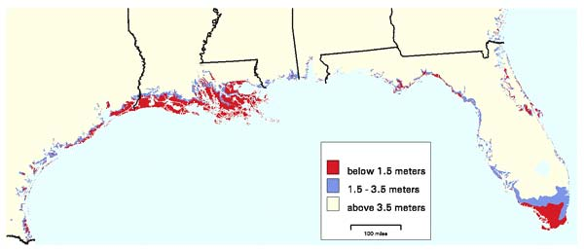
Coastal Elevations

Slide 5
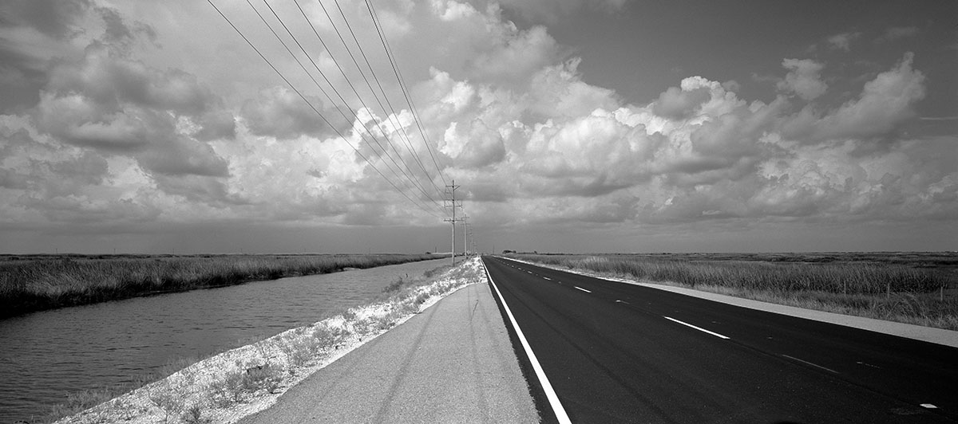
How Flat is it Really?

Slide 6
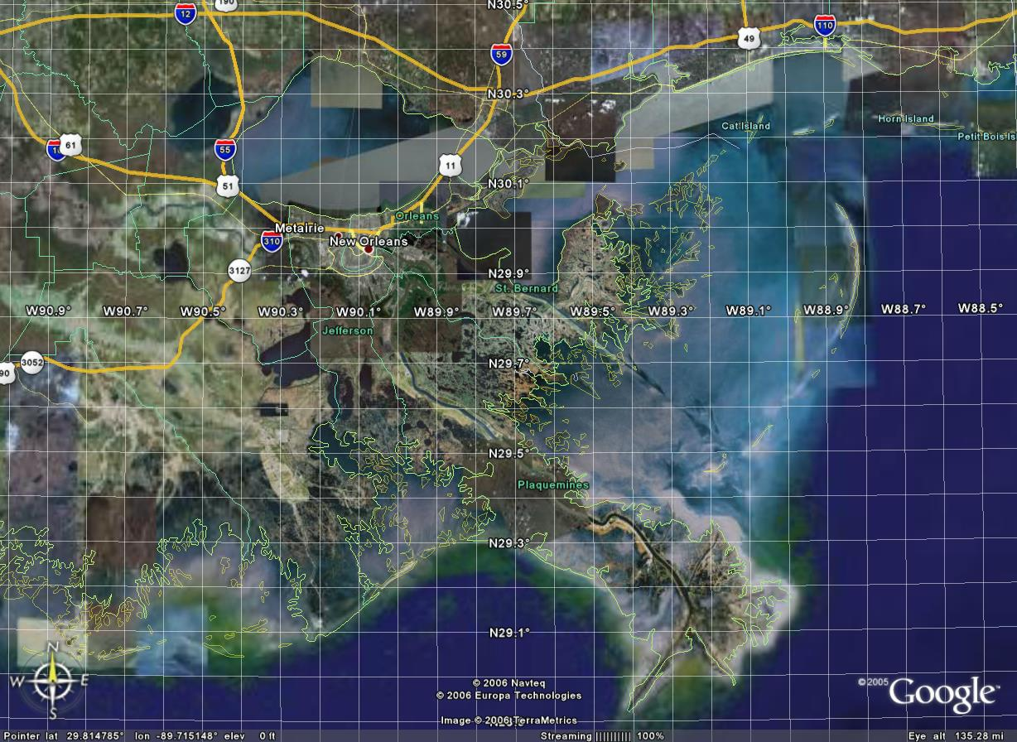

Slide 7
2100 Blum and Roberts (optimistic assumptions)

Slide 8
What are the Implications of Accepting this Future?
Accepting global warming and subsidence.
Rejection of the legal premise that you get to live on your land forever.
Accepting that the government does not owe people protection against nature.
Accepting that there are problems man cannot fix.

Slide 9
The Louisiana Coastal Restoration Plan
The logical policy response to a steady state legal and policy framework

Slide 10
The Coastal Restoration Plan
Extensive levees to wall off much of the eastern half of the state to protect population centers.
River diversions to build land to protect against hurricane surge
No population relocation, restrictions on development, or other land use restrictions to reduce populations at risk.

Slide 11
The Geometric Impossibility of Restoration
Imagine a large, very flat coastal plane, that is barely above sea level tens of miles inland
The plane is sinking and the water is rising
What happens if you pile up dirt at sea level (diversions) on the edges of the plane?
Deltas do not build from the edge
Deltas do not build in the face of significant sea level rise
You might get some mudflats
Marsh grass on flats does not affect hurricane surge

Slide 12
What about the Levees?
The real heart of the plan
Levees destroy the land on both sides
Cannot resist hurricanes in the long term
Katrina did not hit NO, just brushed it
Structural issues
Feds and state will lose interest
Require maintenance - LA? USA?
The Dutch do not have hurricanes or coastal wetlands

Slide 13
If it can’t work, and destroys wetlands, why do it?
How does the steady state legal and political system create incentives to do things that are doomed to failure?

Slide 14
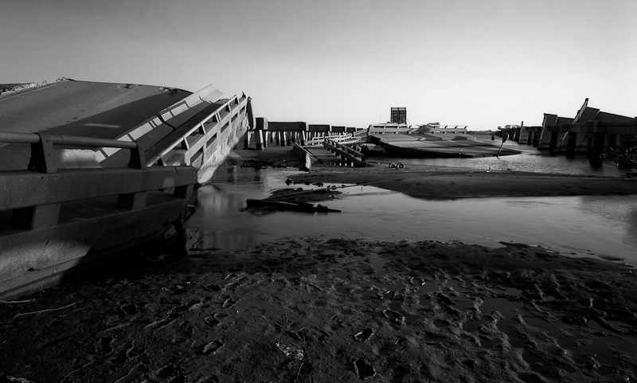

Slide 15
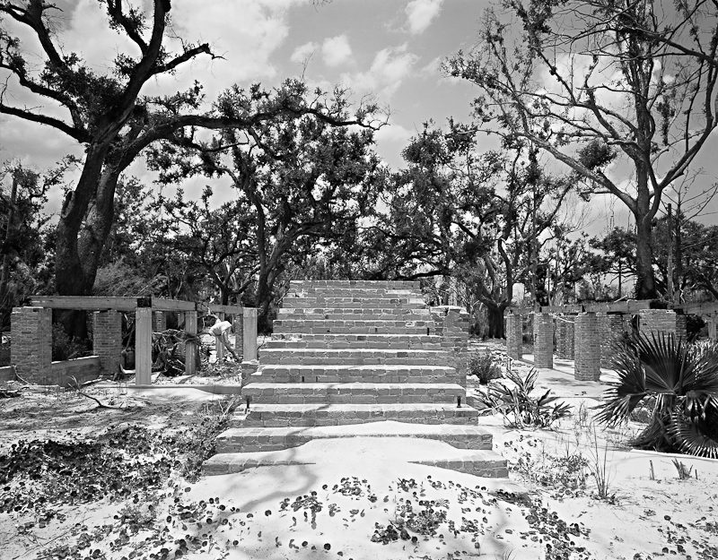

Slide 16
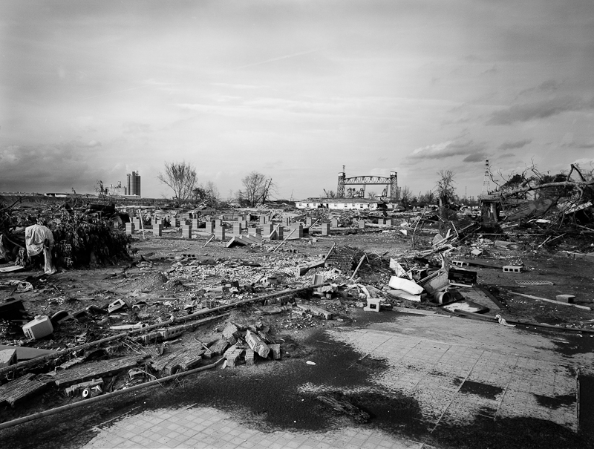

Slide 17
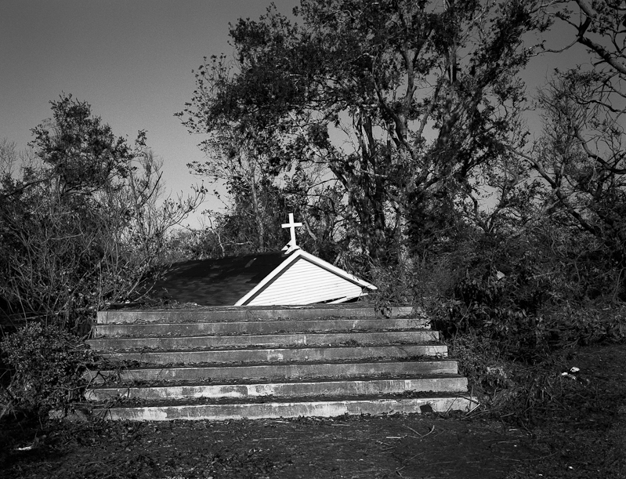

Slide 18
The Economics of Coastal Restoration
Louisiana is not planning on spending its own tax money.
Estimated costs of the plan are $50B
Realistic costs $200B+
Results
Long term economic development funded by federal money
Politicians friends get very rich from contracts

Slide 19
What Happens when it Fails?
Disasters are great for business
National Flood Insurance Program
Wind insurance
Stafford Act/FEMA
Congressional pity money
A dollar spend on mitigation saves five later
Why spend my own dollar now when I can get five latter and keep my dollar?

Slide 20
The Political Consequences of Disaster
None, as long as you can blame someone else.
Hurricane Katrina was about bad land use decisions and failure to maintain levees by local officials, not the federal government.
The only one who was not reelected whined on television, rather than blaming the feds
Look at Bobby Berms

Slide 21
The Political Consequences of Mitigation
You make an enemy of every developer and contractor
You are called a racist for not wanting to move the poor back into the highest risk areas
You eliminate your own voters by limiting redevelopment in your district
No hostages to extort federal money

Slide 22
Where are the Scientists and Environmentalists?
Most environmental groups would rather have a seat at the table and get a piece of the restoration pie than make enemies by defending the wetlands.
Some brave scientists tell the truth
Most keep their heads down, their mouths shut, and their hands out.

Slide 23
What Should Coastal Scientists be Doing?
National scientists need to take a hard and unsentimental look at the Louisiana Coastal Restoration Plan
#1 priority – stop the levees
Scientists need to recognize that the economics and politics of disasters apply everywhere in the US that there is a coastal community subject to hurricanes.

