Slide 1
National Security Impacts of Climate Change
Edward P. Richards, JD, MPH
Clarence W. Edwards Professor of Law
LSU Law School
richards@lsu.edu

Slide 2
National Security Threats
Destabilization of political regimes and demographic catastrophes
Extreme weather events including catastrophic storms
Health impacts including emerging infectious diseases

Slide 3
Destabilization of political regimes and demographic catastrophes

Slide 4
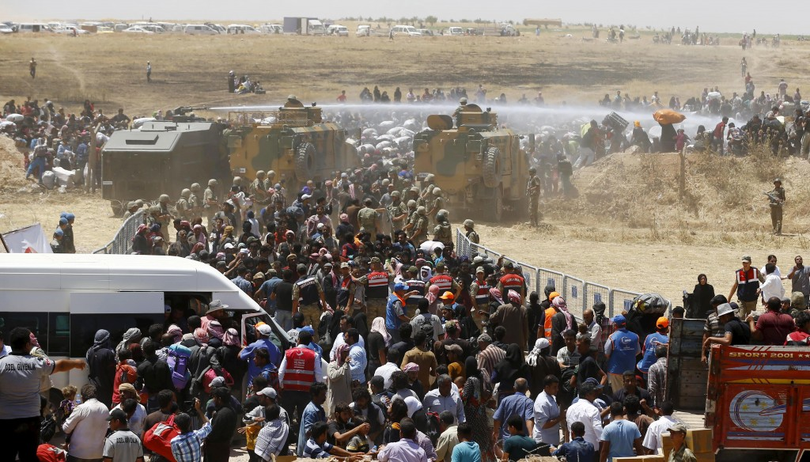

Slide 5
Syria – The Future Paradigm
Major drought drove people from the land into the cities.
This exacerbates the political unrest from the Arab Spring.
Political conflict, not climate (economic) refugees pour into surrounding countries
Syria to Bangladesh is subject to climate change destabilization.

Slide 6
Legal Issues
Humanitarian aid
Military action
Diplomatic actions
Presidential Powers
  Commander in Chief
  Sole organ of foreign policy
Will Congress follow?

Slide 7
Extreme weather events including catastrophic storms

Slide 8
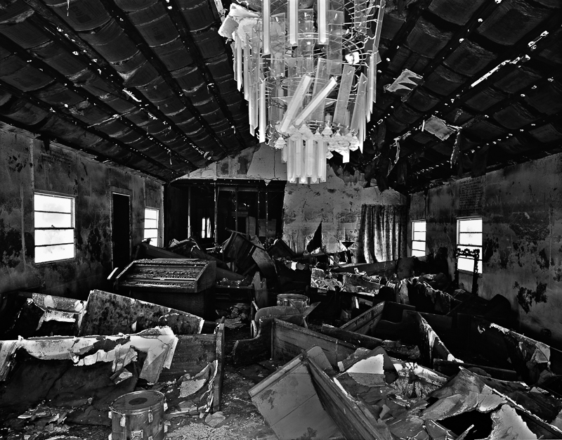

Slide 9
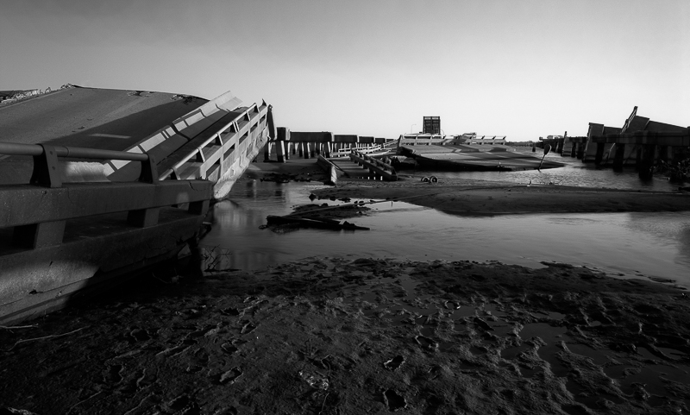

Slide 10
Sea Level Rise and Tropical Cyclones
At least 2 meters – not if, just when
Warmer oceans = storms farther north
Every river delta will retreat
Low land floods – Miami, Bangladesh
Coastal restoration is nonsense
Only coasts with elevation can be defended
Massive relocations need decades

Slide 11
Legal Issues
Federal Government
Stop subsidizing bad decisions
  National Flood Insurance Program
  Road Home and other programs that rebuild in the same place
Relocate critical infrastructure
  Mississippi River cargo
  Federal facilities
Incentivize relocation

Slide 12
Legal Issues
State and Local Government
No more coastal restoration mythology
No more building in dangerous areas
Incentivize relocation
Relocate critical infrastructure
Don’t subsidize bad decisions with insurance regulation

Slide 13
Health impacts, including emerging infectious diseases

Slide 14
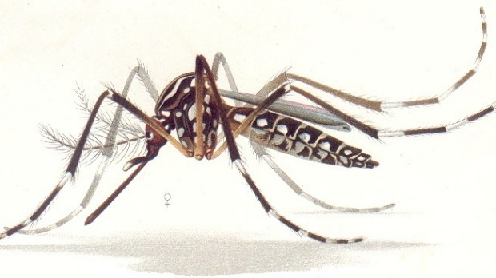

Slide 15

Climate change connects to many health outcomes
Some expected impacts will be beneficial but most will be adverse. Expectations are mainly for changes in frequency or severity of familiar health risks
Modulating
influences
Health effects
Temperature-related illness and death
Extreme weather- related health effects
Air pollution-related health effects
Water and food-borne diseases
Vector-borne and rodent- borne diseases
Effects of food and water shortages
Effects of population displacement
Human exposures
Regional weather
changes
Heat waves
Extreme weather
Temperature
Precipitation
Contamination
pathways
Transmission
dynamics
Agroecosystems,
hydrology
Socioeconomics,
demographics
CLIMATE
CHANGE
Based on Patz et al, 2000
Notes:
Reference: Patz, J.A., Engelberg, D. and Last, J., 2000. The effects of changing weather on public health. Annual Review of Public Health, 21: 271-307.

Slide 16
Some of the largest disease burdens
are climate-sensitive
Each year:
- Undernutrition kills 3.5 million.
- Diarrhoea kills 2.2 million.
- Malaria kills 900,000.
- Extreme weather events kill 60,000.
WHO estimates that the climate change that has occurred since the 1970s already kills over 140,000 per year.
Notes:
References for all figures given in WHO, 2009. Protecting Health From Climate Change: Connecting Science, Policy and People, World Health Organization, Geneva; page 7. http://www.who.int/globalchange/publications/reports/9789241598880/en/index.html
Image from CDC Public Health Image Library.

Slide 17
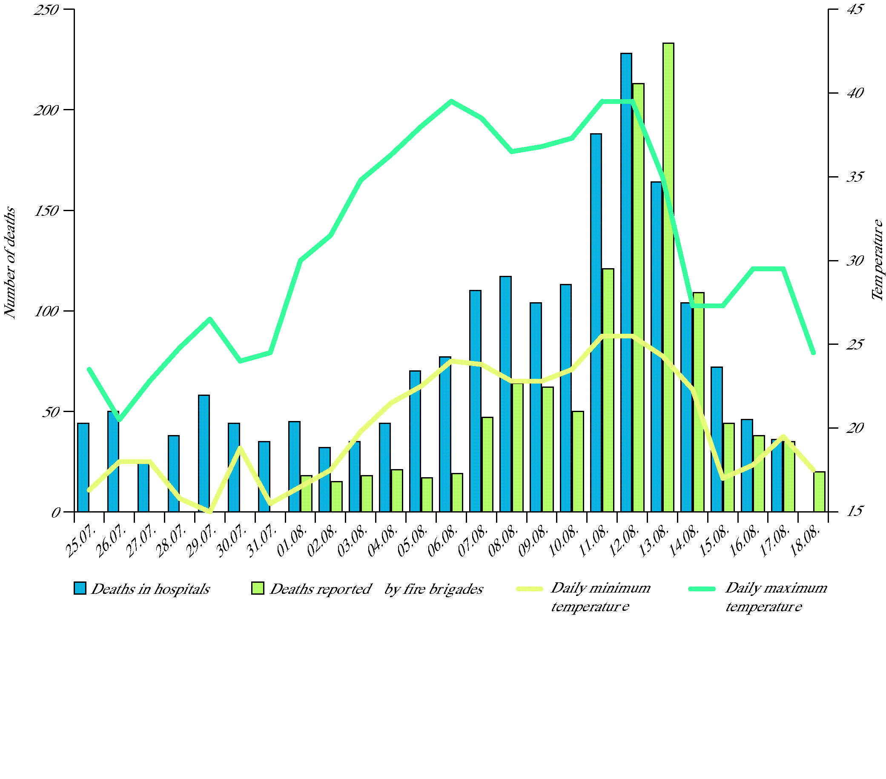
Weather-related disasters kill thousands in rich and poor countries
Deaths During Summer Heatwave. Paris Funeral Services (2003)
Notes:
References:
1) European Environment Agency: http://www.eea.europa.eu/data-and-maps/figures/number-of-reported-deaths-and-minimum-and-maximum-temperature-in-paris-during-the-heatwave-in-summer-2003 , based on data from IVS (2003): Impact sanitaire de la vague de chaleur en France survenue en aout 2003, Rapport d'etape, 29 aout 2003. Saint-Maurice, Institut de Veille Sanitaire.
2) NASA: http://www.nasa.gov/images/content/126421main_image_feature_398a_ys_full.jpg

Slide 18
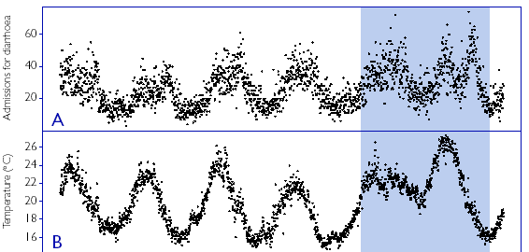

Increases in diseases of poverty
may be even more important
Diarrhoea is related to temperature and precipitation. In Lima, Peru, diarrhoea increased 8% for every 1⁰C temperature increase.
(Checkley et al, Lancet, 2000)
Notes:
Reproduced with permission from Elsevier/Lancet. Checkley, W. et al., 2000. Effects of El Nino and ambient temperature on hospital admissions for diarrhoeal diseases in Peruvian children. Lancet, 355(9202): 442-450.

Slide 19
Emerging Infectious Diseases
HIV/AIDS
  Habitat and cultural disruption
West Nile, Saint Louis Encephalitis
Dengue Fever, Zika, Chikungunya Virus
  Cultural practices – water storage
Malaria, Yellow Fever, Ebola
Pandemic flu and bioterrorism
Who knows what?

Slide 20
Legal Issues
Local Public Health
Public health is uniquely local
Public health infrastructure and expertise has been gutted
Feds and locals conspire to cover up the problems
  Local example – rates of new AIDS cases
Bad leadership at the CDC and Homeland Security

