Slide 1
Learning from Life Insurance: Lessons for Structuring Insurance for Properties Facing Progressive Climate Risk
Edward P. Richards, JD, MPH
Director, Program in Law, Science, and Public Health
LSU Law School
richards@lsu.edu
Blog - http://sites.law.lsu.edu/coast/
http://ssrn.com/author=222637
Notes:
Next 3 slides
Environmentalists think of preservation and sustainability
in short-term, steady state earth terms.
Looking back at paleo climate and geologic cycles
allows us to look forward in time.
Our horizon should be at least 100 years.
This talk will show how looking forward 100 years
changes the notion of sustainability for the
Mississippi Delta

Slide 2
The Paleoclimate Perspective

Slide 3
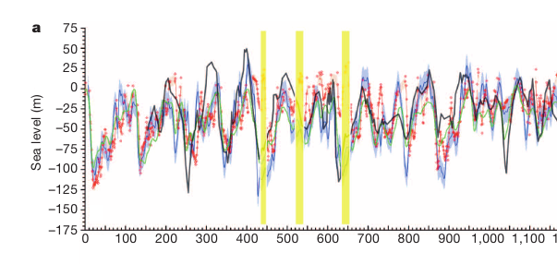
1,000,000 years of Sea Level
Rohling, EJ, GL Foster, KM Grant, G Marino, AP Roberts, ME Tamisiea, and F Williams. “Sea-Level and Deep-Sea-Temperature Variability over the Past 5.3 Million Years.” Nature, 2014.

Slide 4
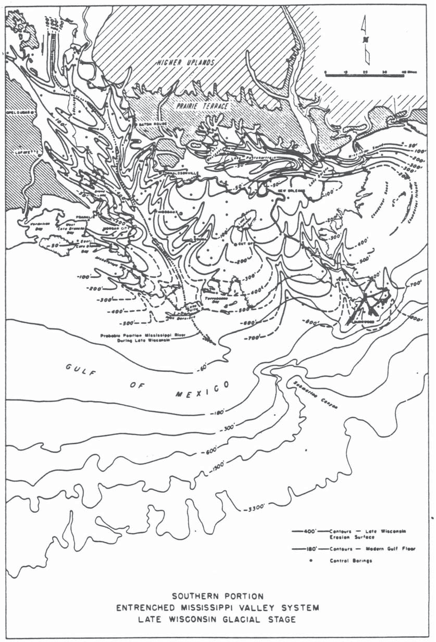
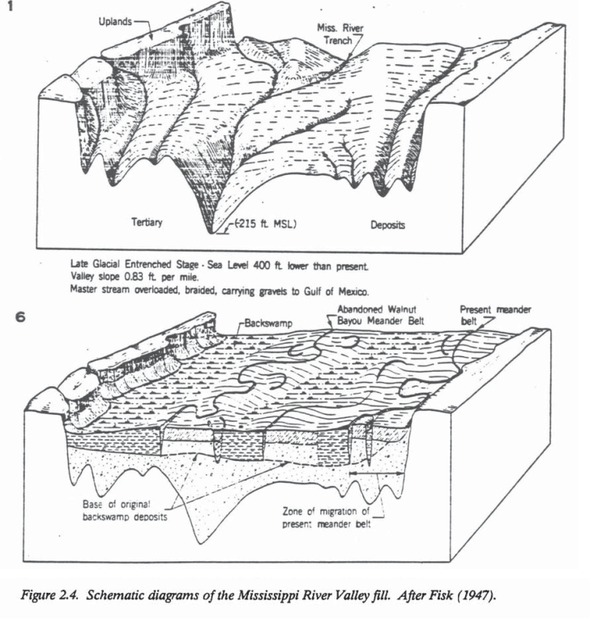
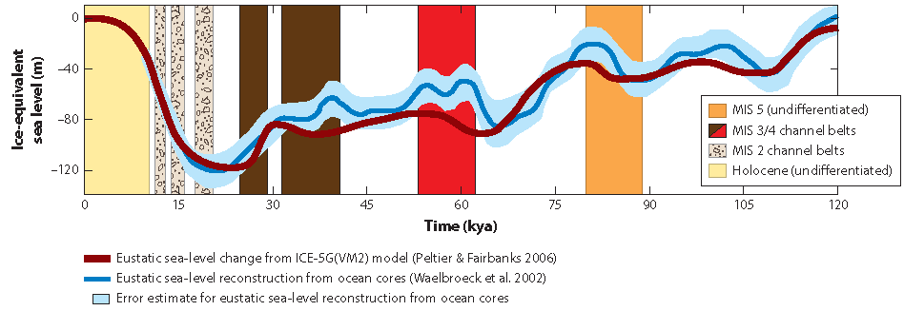
When Sea Level is Low, the Delta is Far out in the Gulf at the Continental Shelf
Higher Uplands
Pleistocene Terrace
Pleistocene erosional surface
Exposed Shelf
Shelf-edge
Delta
Shoreline
BLUM & ROBERTS, 2011
FISK, 1944

Slide 5
As Sea Level Rises, the Coast Migrates Inland
Higher Uplands
Braided stream aggradation
Pleistocene Terrace
Holocene delta deposits
BLUM & ROBERTS, 2011
FISK, 1944
Notes:
What Happened When the Ice Melts?
The Mississippi becomes a flooding torrent for thousands of years and carries much more sediment than at any other time.
Despite this mountain of sediment, the coastal edge – what we call the delta – retreats inland.
Lesson for sea level rise from climate change: sea level rise trumps sediment.

Slide 6
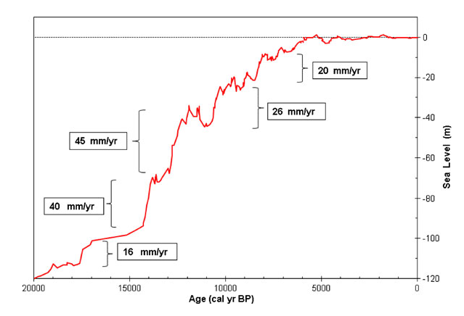
The Magic 5,000 Years
.
Notes:
Donoghue, Joseph F. “Sea Level History of the Northern Gulf of Mexico Coast and Sea Level Rise Scenarios for the near Future.” Climatic Change 107, no. 1–2 (2011): 17–33

Slide 7
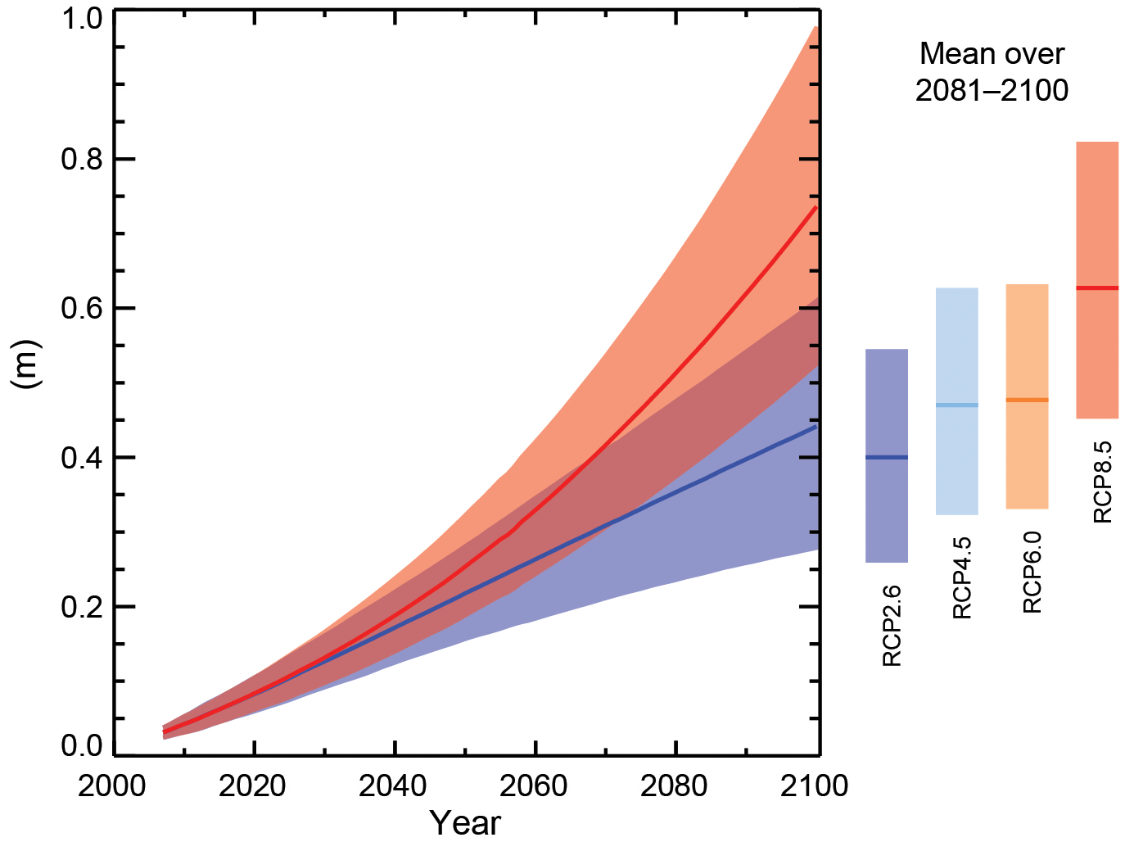
IPCC Sea Level Projections

Slide 8
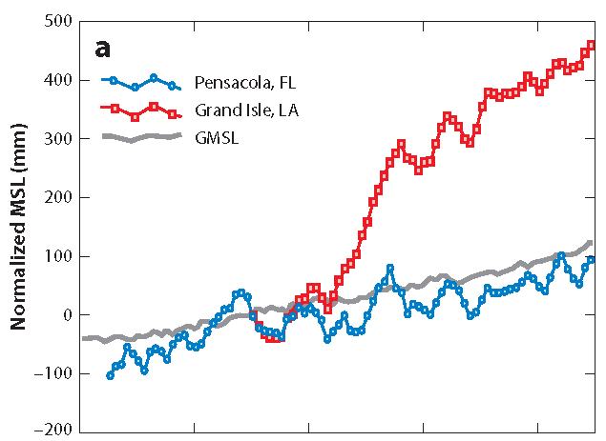
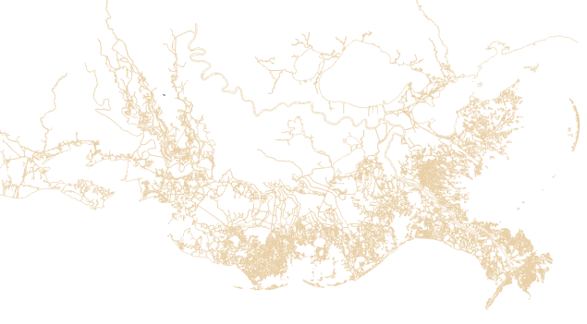
Additional Subsidence Risk for Deltas
500 mm = 20”
total relative sea
level rise since 1932
subsidence
sea level rise
1932

Slide 9
Today
2100
Notes:
Louisiana with 1 meter of relative sea level rise
caused by subsidence and sea level rise.
This is a conservative view.
It assumes no major hurricanes.
These would breach the levees
and free the river.
They will also flood New Orleans
more dramatically than Katrina.

Slide 10
Population At Risk
Globally – more than 600,000,000 in the low elevation coastal zone (LECZ)
Many in Asian river delta cities
The United States
South Florida
Atlantic coast
Gulf Coast
Cites on coastal rivers and estuaries

Slide 11
Protection in Place
Critical variables
Elevation gradient
Value
Geology
Not feasible in most places for 1 meter+
New York City is the best case for protection in place

Slide 12
Relocation
Most areas will eventually relocate or be destroyed through catastrophic flooding
The idea is orderly relocation
The ideal is politically impossible in the US under current policies

Slide 13
The Moral Hazard Problem
Since 1968, the National Flood Insurance Program has subsidized flood insurance for homes under $250 and businesses under $500k.
Disaster relief, such as after Hurricanes Katrina and Sandy, subsidizes communities and those who are under/uninsured.
There is no political will to use the NFIP to force relocation.

Slide 14
What Drives the Policy Failure?
Property rights expectations evolved for a steady state world.
As long as there is an expectation that property is eternal, then policy will follow.
“Buy land, they are not making any more.”

Slide 15
The Life Insurance Model
Everyone dies.
The insurance bet is when.
The policy structure is a predictable increase in rates as the individual ages.
The expectation is that at some given age, the cost of the insurance will exceed its value, if the insured is still alive.
Individualized rating factors can be added.

Slide 16
Applied to Coastal Property
Flood insurance underwriting would include a projected schedule for premium increases as sea level rises.
This would effectively create a life span for property.
Like human life expectancy, it would not be certain because of the uncertainty of sea level rise and property value fluctuations.

Slide 17
Effects of a Property Lifetime
Rethinking long term financing such as 30 year mortgages.
Buyout cost for relocation goes down with time.
Encourages more realistic risk assessment.
Puts a ceiling on the value of reconstruction after disasters.
Makes paid relocation more palatable.

Slide 18
Could this be Implemented?
No, if the failure of NFIP reform in an indication.
Yes, for large commercial property interests.
No subsidy
Reinsurers will eventually price them off the coast.
Insurance regulators could require a projection of future rates based on sea level rise.
Seeing the impact on business could change the politics for homeowners.

