Slide 1
The Evolution of Policy as Politics Change

Slide 2
What Drives Laws?
First, there is popular concern
Individual stories
Then interest groups
FDA and the Jungle
MADD
Insurance industry - what is their interest?
Starting in the 1970s, plaintiffs' attorneys
Then pressure on elected officials
Sometimes this is compressed as the legislature reacts to a crisis
Very seldom does the legislature pass a law just because it is a good thing

Slide 3
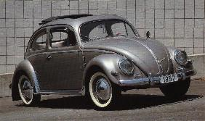
In the Beginning

Slide 4
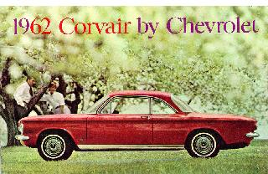
Ralph Nader and Public Interest
Unsafe at any Speed - 1965

Slide 5
The Seat Belt Saga I
Congress passes the Traffic and Motor Vehicle Safety Act
1967 - regulation requiring seatbelts
1972 - realized that people were not wearing the seatbelts
Regulation requiring automatic seatbelts or airbags by 1975

Slide 6
The Seat Belt Saga II
Required cars between 1973 and 1975 to have automatic seatbelts or ignition interlocks
Chrysler v. DOT affirmed the regs
Industry choose interlocks - why?
1974 - Congress passed a law banning regs requiring interlocks and said that all future regs on passive restraints had to be submitted to Congress for legislative veto
Chadha fixes that

Slide 7
The Seat Belt Saga III
DOT under Ford withdrew the regs
DOT under Carter (a few months later) promulgated new passive restraint regs for 1982 and Congress did not veto them
1979 - Regs were affirmed in Pacific Legal Foundation v. DOT

Slide 8
The Seat Belt Saga IV
1981 - DOT under Reagan withdrew the regs because the car companies were going to use automatic seatbelts that could be disconnected.
1983 - Motor Vehicles Manufacturers Assoc. v State Farm hit the United States Supreme Court.

Slide 9
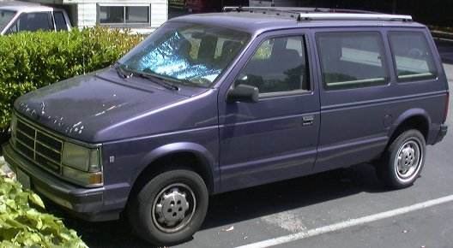
What Else is Going On: Crashworthiness Regulations
The Unintended Consequences

Slide 10
The Seat Belt Saga V
1984 - DOT (Libby Dole) promulgated a reg requiring automatic seatbelts or airbags in all cars after 1989, unless
2/3 of the population were covered by state seatbelt laws, and
the laws met certain criteria
What did some states do?
$5 penalty
No stop
No meaningful seatbelt defense
Most State laws did not meet the criteria

Slide 11
The Seat Belt Saga VI
Late 1980s safety becomes a selling point and the market changes.
1997 - most newer cars had airbags
1998 - airbags kill grannies and little kids!
Nothing new - known at the time
Save many more
1999 - You can get your airbag disconnected
Products liability issues?

Slide 12
What are the new issues in automobile safety?
Crashworthiness
Antilock brakes
All wheel drive
Traction control
Roll over prevention
Fly by wire errors
Automatic braking
Google cars

Slide 13
Environment and Economic Security
Gasoline mileage
Lighter cars
Smaller cars
What is the trade off for safety?
Small, safe = expensive
Big trucks roll because they are diven by morons
Can the DOT admit this?
How do they cover it up?
Carbon emissions

