Slide 1
Nuclear Power Plant Basics

Slide 2
What are the advantages of nuclear power?
Nuclear Energy Institute
Economic Cost
What was the promise of nuclear power?
How did that work out?
Environmental costs of alternatives
Did we care about global warming in 1975?
Coal
Wind farms
Strategic issues
Why has France pushed for 100% nuclear power?

Slide 3
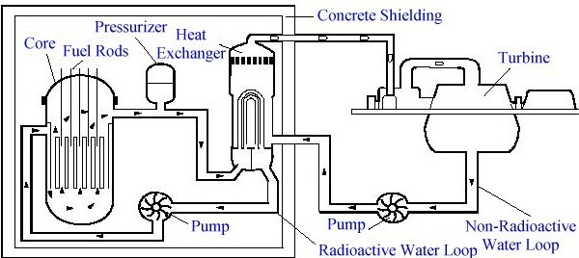
Reactor Design - Traditional

Slide 4
Reactor Safety
What are the design issues?
Reactors are steam engines
Do they fail safe or do they melt down?
How do you protect the environment?
Containment
Self-moderating - heavy water
Pellet bed reactors

Slide 5
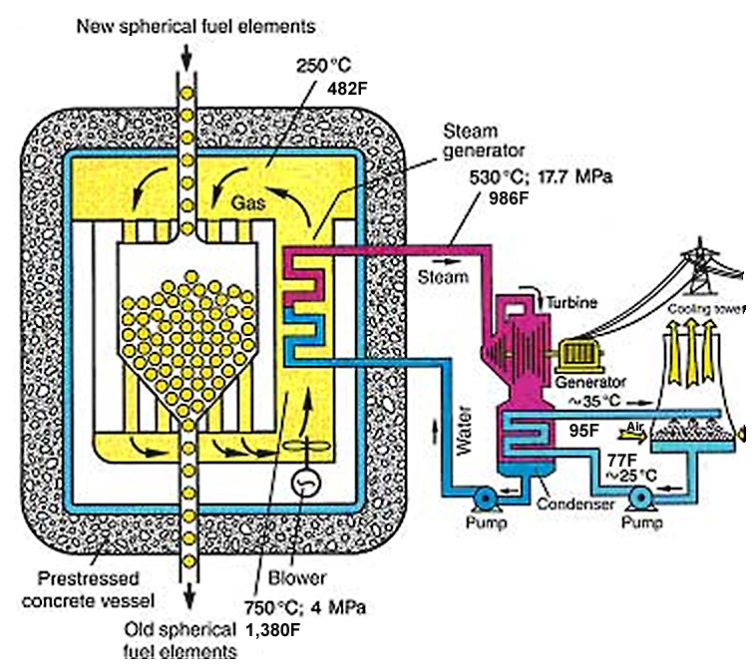
Pebble Bed Reactor: A Proposed Fail-safe Design

Slide 6
The Problem of Nuclear Waste
Why not just take nuclear waste to the land fill or burn it up?
How long does it last?
Where do we dispose of nuclear power plant waste in the US?
What has stopped the development of a central depository at Yucca Mountain?
Where is the waste kept now?
Is preventing the disposal of waste a smart strategy for stopping nuclear power?

Slide 7
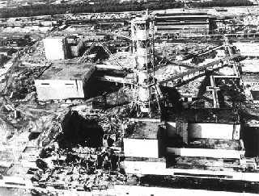
Chernobyl
A graphite reactor without a containment vessel. The reactor itself burned when it melted and created a huge cloud of radioactive particles.

Slide 8
Who Pays if there is an Accident?
Price-Anderson Act
Allows claims, but limits liability of the industry
1st $300m - private insurance
$300M-$10B - risk pool
Over $10B - federal government
What would the costs of a big accident include?
How is this like Katrina?
Who really pays if there is a huge accident?

Slide 9
The Opposition to Nuclear Power
Site specific opposition
Mothers for Peace
General Opposition
NRDC

Slide 10
Fukushima Accident 2011
Images
Information on the accident:
http://www.world-nuclear.org/info/fukushima_accident_inf129.html

