Slide 1
Vermont Yankee Nuclear Power Corp. v. NRDC, 435 U.S. 519 (1978)
Strategic Delay in Derailing Public Policy

Slide 2
What are the advantages of nuclear power?
Nuclear Energy Institute
Economic Cost
What was the promise of nuclear power?
How did that work out?
Environmental costs of alternatives
Did we care about global warming in 1975?
Coal
Wind farms
Strategic issues
Why has France pushed for 100% nuclear power?

Slide 3
Why are Nuclear Power Plants Controversial?
What do they use as fuel?
What are the by-products?
How long do they last?
What is the terrorist issue?
What if it gets into the environment?
Think about how panicked we were over the anthrax spores in the Senate Office Building

Slide 4
The Opposition to Nuclear Power
Site specific opposition
Mothers for Peace
General Opposition
NRDC

Slide 5
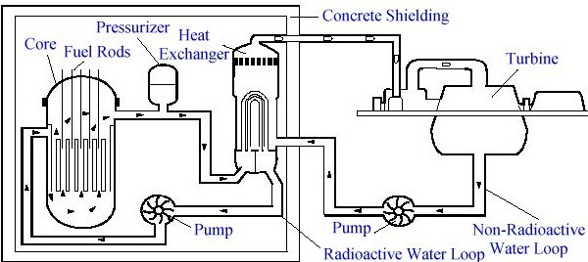
Reactor Design

Slide 6
Reactor Safety
What are the design issues?
Reactors are steam engines
Do they fail safe or do they melt down?
How do you protect the environment?
Containment
Self-moderating - heavy water
Pellet bed reactors

Slide 7
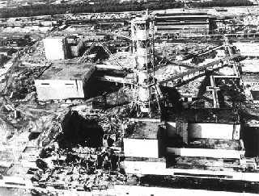
Chernobyl
A graphite reactor without a containment vessel. The reactor itself burned when it melted and created a huge cloud of radioactive particles.

Slide 8
What was the Public Reaction in the US?
What would an accident like Chernobyl mean near a US city?
Shortly after Chernobyl:
China Syndrome - Three Mile Island
Why did public opinion in the US shift back to nuclear power during the last decade?
The wild card

Slide 9
Who Pays if there is an Accident?
Price-Anderson Act
Allows claims, but limits liability of the industry
1st $300m - private insurance
$300M-$10B - risk pool
Over $10B - federal government
What would the costs of a big accident include?
How is this like Katrina?
Who really pays if there is a huge accident?

Slide 10
Nuclear Power Plant Regulation
Originally regulated by the Atomic Energy Commission
Charged with regulation and promotion of nuclear power
Regulation was split off to the Nuclear Regulatory Commission because of conflicts of interest
Environmental impact analysis was added through NEPA, which complicated the licensing of plants

Slide 11
Nuclear Power Plant Licensing
What type of agency action is nuclear plant licensing?
What are the two different licenses a plant needs?
Is there a public hearing?
How does the public hearing process potentially slow down and complicated licensing?

Slide 12
The Problem of Nuclear Waste
Why not just take nuclear waste to the land fill or burn it up?
Where do we dispose of nuclear power plant waste in the US?
What has stopped the development of a central depository at Yucca Mountain?
Where is the waste kept now?
Is preventing the disposal of waste a smart strategy for stopping nuclear power?

Slide 13
AEC and Disposal of Waste
Why is waste disposal a big problem for licensing hearings?
How does the AEC want to change this by rulemaking?
Classic narrowing of adjudication issues by rulemaking
What sort of process is the AEC using for rulemaking?
Does this go beyond the APA requirements?

Slide 14
The Administrative Law Back-Story
How was the federal circuit's 1960s-70s jurisprudence on agency rulemaking related to the Warren Court's views of government?
Why was the court suspicious of agency rulemaking in this case?
What did it want to require to provide greater public protections?

Slide 15
DC Circuit
What does the DC circuit want the AEC to do to improve the due process in their rulemaking?
Is this required by the APA?
What is the lower court's theory about the APA requirements?
Floor or ceiling?
Who does the court think should decide on the appropriate procedures?

Slide 16
The Substantive Issue
What is the DC court's real problem with the rulemaking on waste management?
What is the AEC's plan?
What sort of technology does it depend on?
We are 30+ years latter - who was right about the technology?
Is this the court's call?

Slide 17
Energy Conservation
What is the energy conservation issue?
What law does this come from?
How could this affect the permitting of new reactors?
The lower court found that the agency did not properly evaluate the alternative of energy conservation.

Slide 18
The United States Supreme Court
What does the United States Supreme Court think about the role of the APA in setting process?
Who gets to make the call - agency or courts?
In the court's view, what is the real issue?
"The fundamental policy questions appropriately resolved in Congress and in the state legislatures are not subject to reexamination in the federal courts under the guise of judicial review of agency action. Time may prove wrong the decision to develop nuclear energy, but it is Congress or the States within their appropriate agencies which must eventually make that judgment. "

