Slide 1
Louisiana Coastal Elevations
Slides from Prof. Roy Dokka

Slide 2
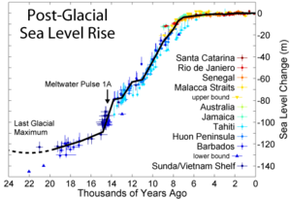
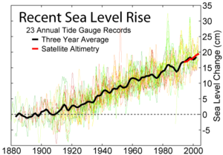
The Seas Are Rising
Global sea-level has been slowing since the last glacial maximum.
Global sea-level has been constant over the past 100 years.

Slide 3
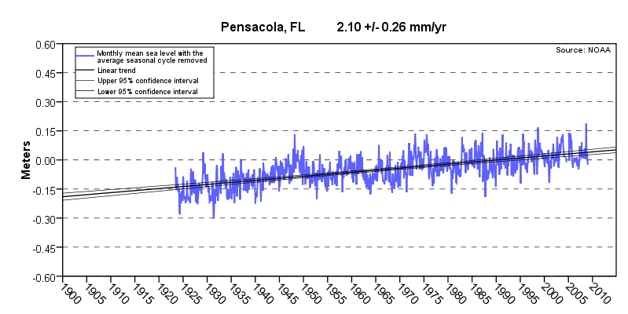
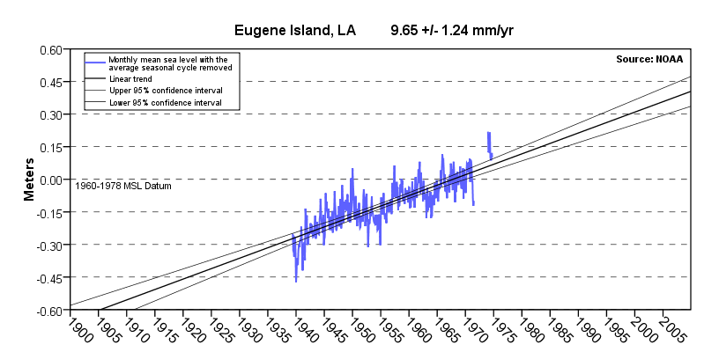
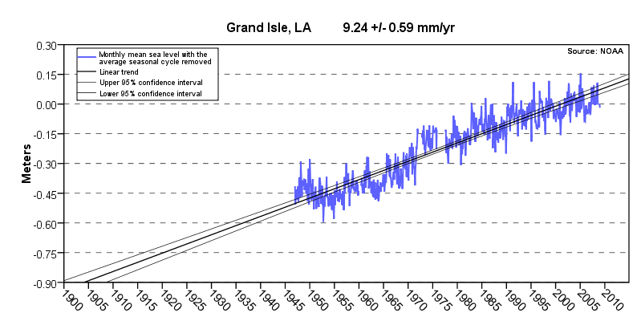
Gulf
of
Mexico

Slide 4
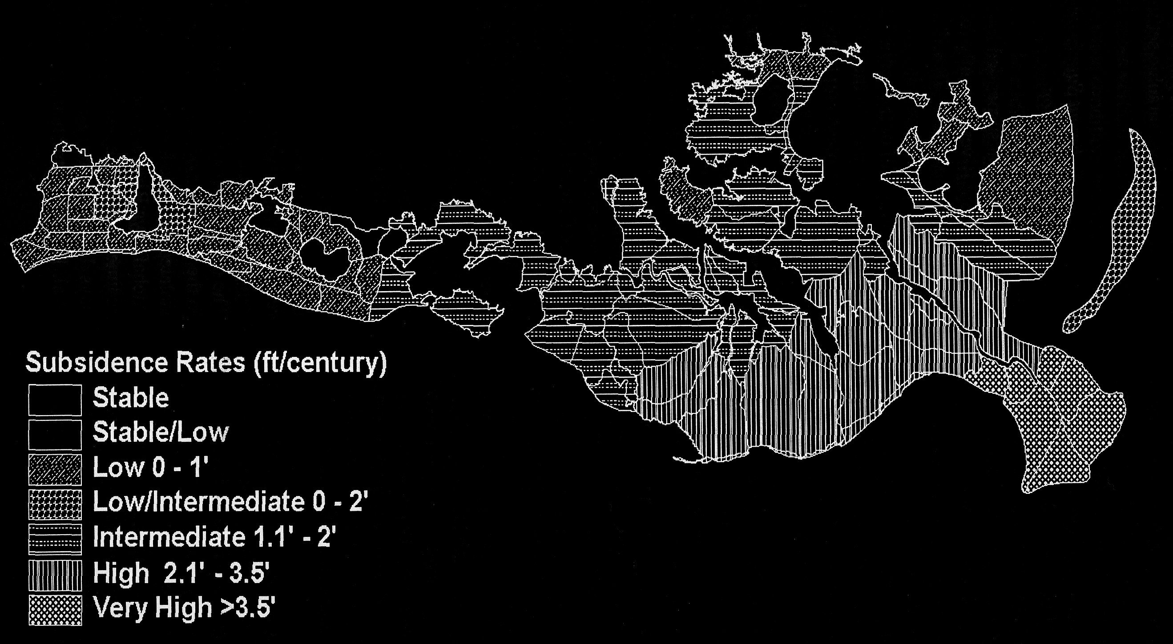
The Paradigm (red) underpinning plans to restore the Louisiana coast cannot explain the observed subsidence. It is not just the wetlands, it is entire coast.
2.0’
1.5’
0.0’
2.7’
0.0’
0.0’
0.0’
0.0’
4.0’
5.4’
0.0’
4.0’
0-0.1’
2.1-3.5’
6.0’
1.1-2’
6.0’
8.3’
2.1-3.5’
>3.5’
Plans to save the coast based on red rates.

Slide 5
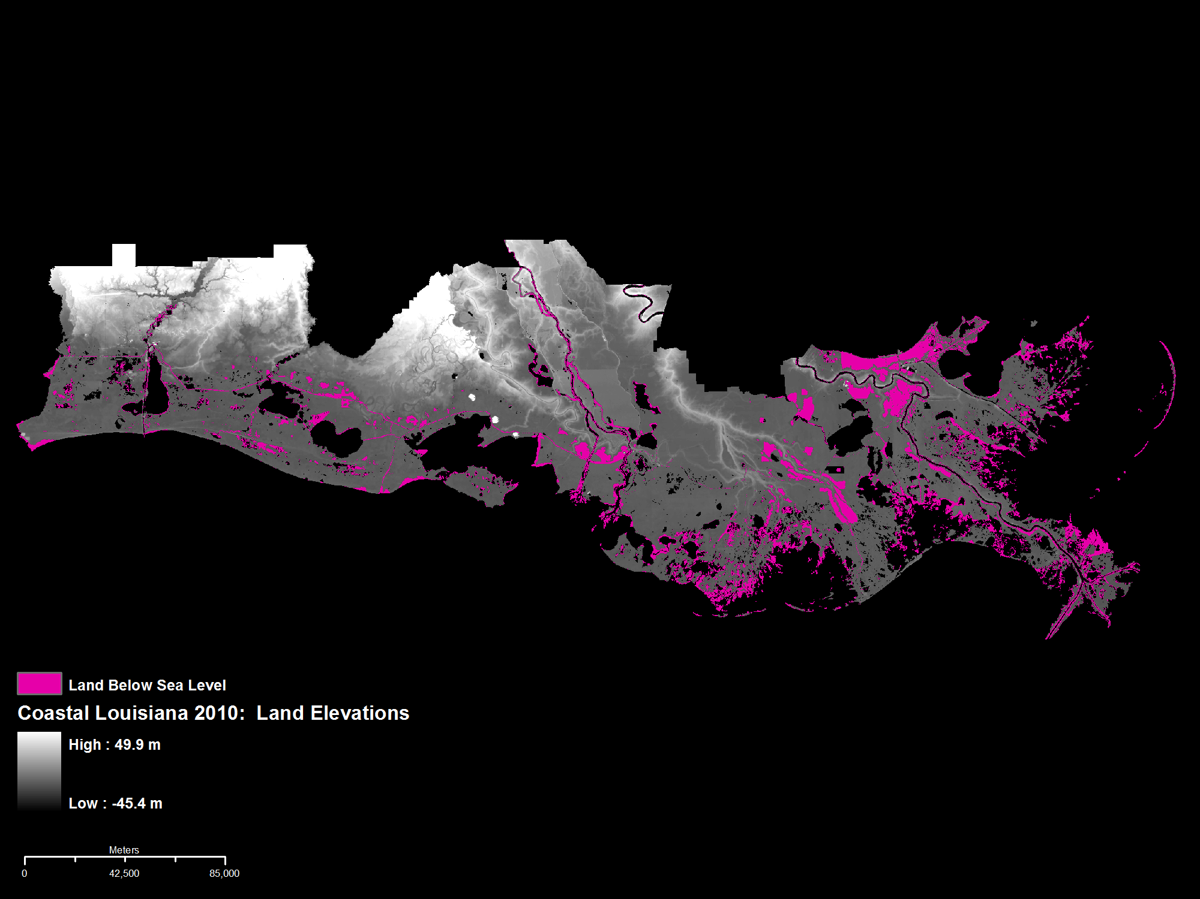
2010 DEM Elevations
8.9% Land Area at or below Sea Level
Approximately 897 miles² (2.3 million km²)

Slide 6
2050 DEM Elevations
15.5% Land Area at or below Sea Level
Approximately 1,558 miles² (4 million km²)

Slide 7
2100 DEM Elevations
27.1% Land Area at or below Sea Level
Approximately 2,724 miles² (7 million km²)

