Slide 1
Careers in Administrative Law and Regulatory Practice
Jonathan J. Rusch
Last Retiring Chair
Administrative Law and Regulatory Practice Section
American Bar Association
Louisiana State University Law School
Baton Rouge, Louisiana
March 7, 2012

Slide 2
Background

Slide 3
Continuing Volatility in Legal Profession Responses to Economy
Jennifer Smith, Wall Street Journal, January 30, 2012 (http://online.wsj.com/article/SB10001424052970203363504577186913589594038.html):
“ . . . many elite firms have shrunk their ranks of entry-level lawyers by as much as half from 2008 . . .”
Robert Half Survey (January 2012)
200 lawyers at law firms and corporations surveyed
31 percent expect to hire legal personnel in 1Q 2012
Lawyers (88 percent)
Increase from 25 percent in 4Q 2011
Strongest areas of growth expected: bankruptcy and foreclosure, litigation, and labor and employment
Law firms’ continued focus in hiring: senior and partner-level lawyers with books of business and expertise in high-demand practice areas
Northwestern Law Center for Career Strategy and Advancement (January 2012)
“Legal hiring increased in 2011, an improvement over the last two years, though opportunities remain well below pre-economic downturn levels. Hiring appears to be taking a top-down approach, with lateral partners and experienced laterals a higher priority than entry-level hires.”

Slide 4
It’s Not Personal – Really
Corporations Closely Scrutinize Legal Bills
Economics of Private Law Practice
Partners own the business, associates are mere employees
Focus on more profitable work
As supply of work diminishes or fluctuates, firms look critically at staffing levels
Current focus on reducing support staff, “deequitizing” or reducing number of partners
Also greater use of contract attorneys or outsourcing of tasks

Slide 5
Demand for Regulatory Work
Northwestern Law Center for Career Strategy and Advancement (January 2012)
“According to Robert Denney & Associates' legal industry overview, a number of practice areas enter 2012 quite strong, including banking, health care, energy, IP, white collar, regulatory, commercial litigation, and labor and employment. Real estate is picking up while financial services will likely cool throughout the year.”

Slide 6
Possible Areas of Regulatory Practice
Agriculture
Antitrust and Trade Regulation
Banking and Financial Services
Benefits
Beverage Alcohol Practice
Communications
Consumer Products Regulation
Criminal Process
Education
Elections
Energy
Environmental and Natural Resources Regulation
Food and Drug
Government Personnel
Health and Human Service

Slide 7
Possible Areas of Regulatory Practice
Government Affairs and Legislative Process (i.e., Lobbying)
Government Information and Right to Privacy
Homeland Security and National Defense
Housing and Urban Development
Immigration and Naturalization
Insurance
Intellectual Property
International Law
International Trade and Customs
Labor and Employment
Postal Matters
Securities, Commodities, & Exchanges
Transportation
Veterans Affairs

Slide 8
Possible Types of Regulatory Practice
Private Practice
Not just Big Law in big cities
ABA Journal (March 2011): “10 Surprising Legal Markets”
Average salaries between $130,000 and $150,000
Augusta (GA), Birmingham (AL), Bloomington and Normal (IL), Chattanooga (TN) and Catoosa County (GA), El Paso (TX), Greensboro and High Point (NC), Modesto (CA), Odessa and Midland (TX), Reno-Sparks (NV), Rockford (IL)
El Paso lawyers’ average salary greater than those in Baltimore, Cincinnati, and Salt Lake City
Rockford lawyers had higher median incomes than Chicago lawyers in 2008
Firms in smaller markets may match starting associate salaries in larger markets
Successful regulatory practices include solo firms through megafirms

Slide 9
Possible Types of Regulatory Practice
Government Agencies
Local
State
Regional
Agencies created by interstate compact (e.g., Washington Metro)
U.S. Government-created corporations (e.g., St. Lawrence Seaway Development Corporation, Tennessee Valley Authority)
Federal

Slide 10
Possible Types of Regulatory Practice
Self-Regulatory Organizations
Securities and commodities (FINRA, National Futures Association)
Public Interest Organizations

Slide 11
A Strategy for Law Students

Slide 12
Key Points
Career Management Is Critical
“[B]egin managing your career during law school” (Alison Bernard and Niki Kopsidas, New York Law Journal, July 20, 2010)
“For a successful long-term career, do not look to your company or industry to take care of you. As in every other arena of life, you must take care of yourself.” (Dr. Judith Sills)
Career Management Begins with Branding and Business Intelligence

Slide 13
Branding
Branding Critical to Increasing Your Marginal Value to Employers
Dr. Judith Sills: You are your own brand
“. . . the professional identity you create in the minds of others” (http://www.psychologytoday.com/rss/index.php?term=20080118-000009&page=1)
Branding includes more than just your “professional name”
It may include –
Demonstrating potential niche expertise
Sending clear signals about key attributes (e.g., consistency, reliability, delivering on time)

Slide 14
Developing Branding
Look for Opportunities to Start Developing Niche Expertise
Law review note or development
Research for law professor or legal organization
Do good work on summer employment topic, then ask supervisor (partner/supervising attorney) what else you could learn about the topic

Slide 15
Business Intelligence
Intelligence That Identifies Profitable Areas of Practice That You Are Interested in Pursuing
You Are Your Own Intelligence Unit
Intelligence about –
Your possible/prospective employers
Areas of regulatory knowledge important to them
Continuing trends in legal profession and economy

Slide 16
Developing Business Intelligence
Research on Areas of Practice Relevant to Employers
Firm, agency summaries, resumes
Google Alerts - http://www.google.com/alerts?hl=en
Set delivery frequency
Legal blogs and newssites
Above the Law - http://abovethelaw.com/
Am Law Daily Blog - http://amlawdaily.typepad.com/amlawdaily/
Law Blog Law.com - http://www.law.com/jsp/law/index.jsp
Newswire - http://store.law.com/registration/register.asp?subscribeto=nw
Legal Pad - http://legalpad.typepad.com/
Overlawyered - http://overlawyered.com/
Wall Street Journal Law Blog- http://blogs.wsj.com/law/
Business publications
Financial Times - http://www.ft.com/home/us
Wall Street Journal - http://online.wsj.com/home-page (includes Careers section)

Slide 17
Developing Business Intelligence
Research on Areas of Practice Relevant to Employers
Section Facebook Page

Slide 18
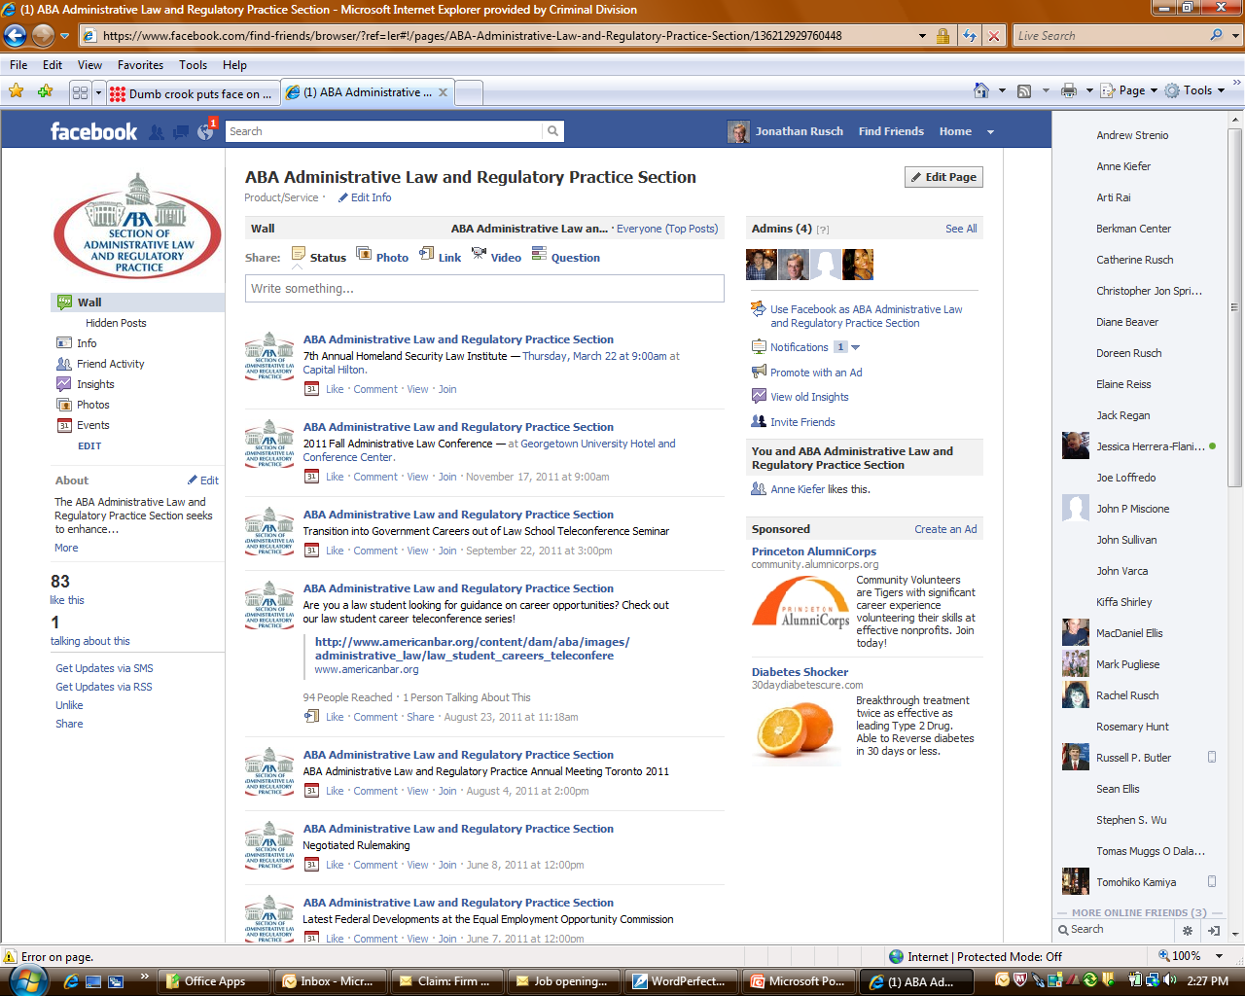

Slide 19
Applying Business Intelligence
Know What Kind of Work Constitutes “Regulatory Practice” Before You Apply
Rulemaking
Drafting regulations
Identifying policy goals that regulation is designed to advance
Determining how well regulation advances those goals
Identifying incentives and disincentives for compliance
Does regulation create externalities (e.g., ambiguities in coverage, disproportionate burdens)?
Revising proposed regulation in light of public comment and policy goals

Slide 20
Applying Business Intelligence
Know What Kind of Work Constitutes “Regulatory Practice”
Rulemaking
Interpreting Regulations
For agency
For regulated entities
For other agencies

Slide 21
Applying Business Intelligence
Know What Kind of Work Constitutes “Regulatory Practice”
Adjudication
Litigation counsel
Before agency adjudicators (e.g., administrative law judges)
Before appellate courts
Adjudicators
Adversary litigation
Dispute resolution

Slide 22
Applying Business Intelligence
Identify Alternative Possibilities for Employment
Geographic: Other cities/states
Private and public sector opportunities vary widely region to region
Firm/agency size: Solo, small firms and smaller agencies may be more adaptable, flexible in response to changing conditions
Quality of life: “Try to find a practice that enables you to maintain a human existence … time for your family, your church or synagogue, community … boy scouts, little league.” (Justice Scalia, February 13, 2012)
“Find a job . . . even if it may not be what you had hoped or expected. Get in somewhere.” (Partner)

Slide 23
Merging Branding and Business Intelligence
Start Networking During Law School
Within employer(s)
Supervisors as potential mentors
Beyond employer
Mandatory and voluntary bar associations
Specialty areas of practice
Improvements in legal system
General bar associations (e.g., ABA, state or local bars)

Slide 24
Merging Branding and Business Intelligence
Explore Where You Want to Be in Two to Three Years Out of Law School
“As in every other arena of life, you must take care of yourself.” (Dr. Judith Sills)

Slide 25
Further Guidance
James T. O’Reilly, Careers in Administrative Law and Regulatory Practice (2010)

Slide 26
Joining the ABA
Law Student ABA Dues:
General Membership in ABA: $25/year
Membership in Section (must have general ABA membership): $0
Law Student Enrollment Form: https://apps.americanbar.org/join/lsd_enroll/pm/enrollment.shtml
Contact Section Director Anne Kiefer for Details
202-662-1690, anne.kiefer@americanbar.org

Slide 27
Contact Data
Jonathan Rusch
202-514-0631
Jonathan.Rusch2@usdoj.gov

