Slide 1
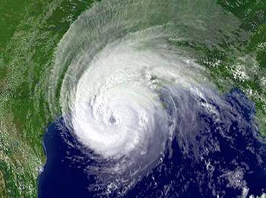


Storm Surge:
Myths, Misconceptions, and Facts
Maurice Wolcott
Coastal GIS Specialist
LSU AgCenter / Louisiana Sea Grant Program
LA Department of Natural Resources
Local Coastal Programs Quarterly Meeting
Baton Rouge, LA October 7, 2009
Image Courtesy of NOAA

Slide 2
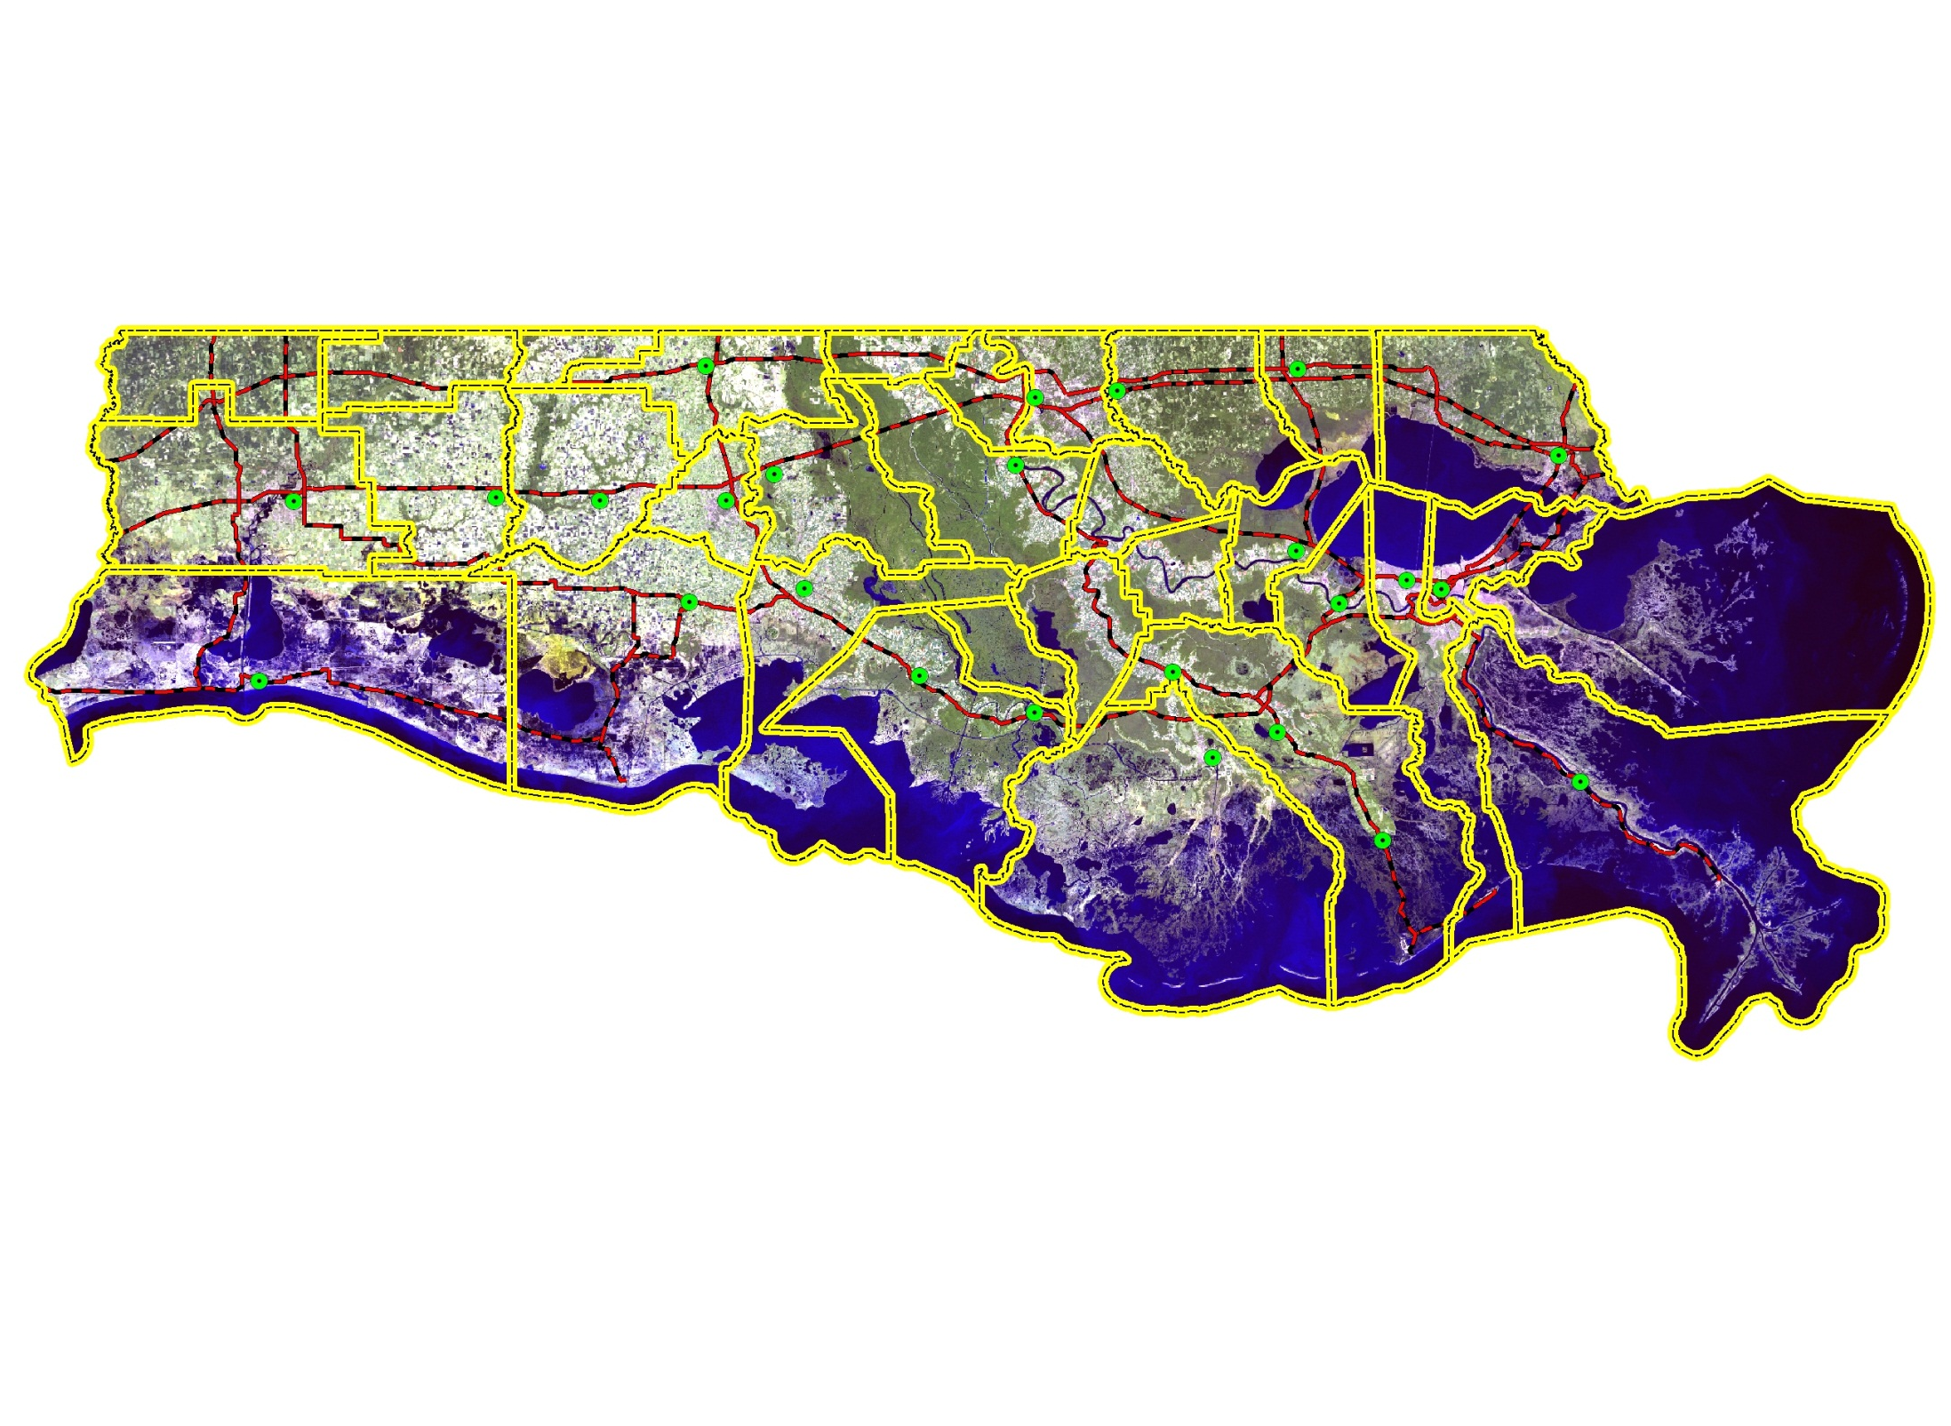
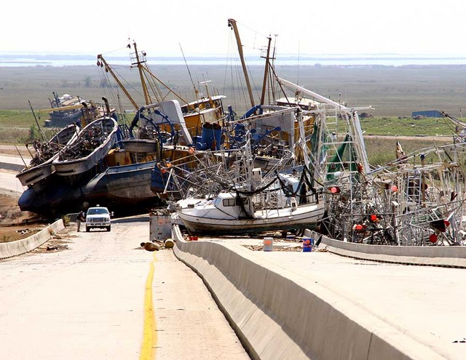
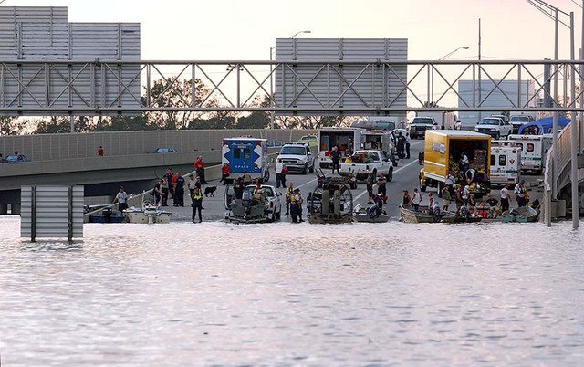
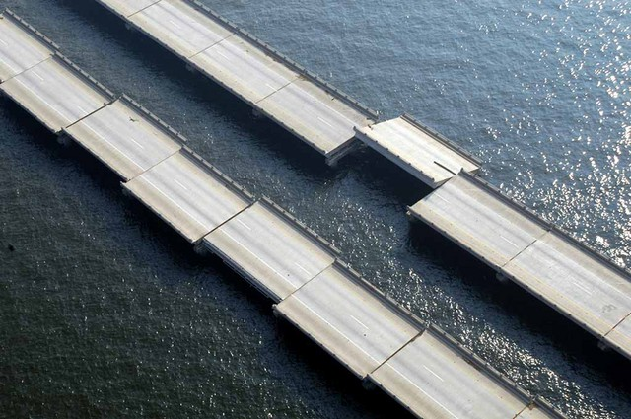
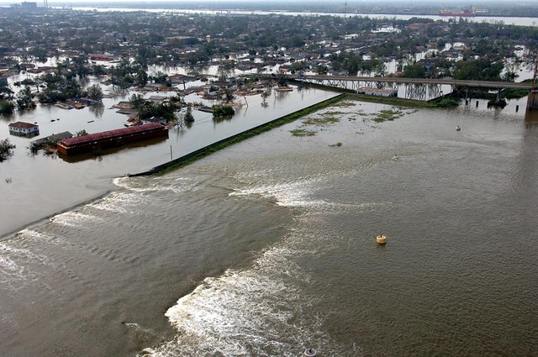
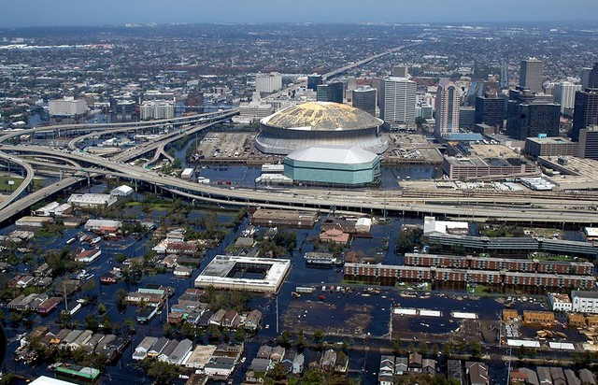
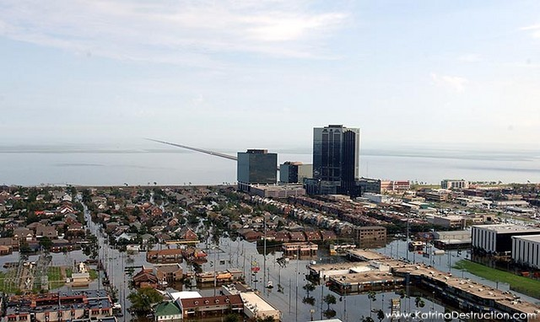
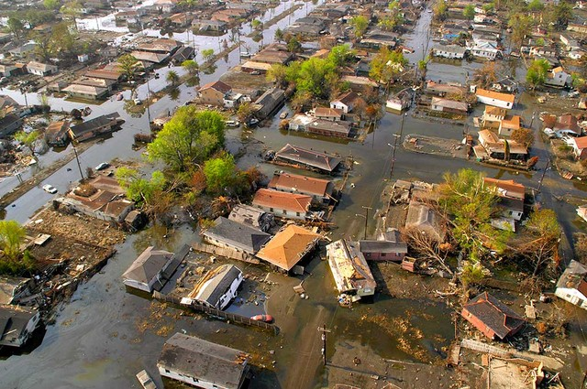
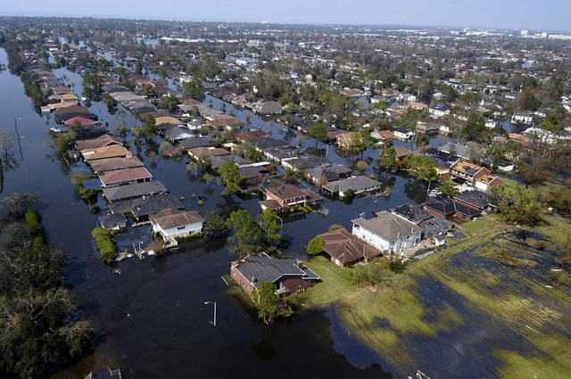
The Louisiana Coast
A Vulnerable Area for Storm Surge
Beauregard
Allen
Evangeline
Saint
Landry
E.B.R.
Saint
Tammany
W.B.R.
Livingston
Jeff
Davis
Acadia
St
Martin
Tangipahoa
Calcasieu
Iberville
Ascension
St
John
Iberia
Lafayette
St
James
Cameron
St Bernard
Vermilion
Assumption
St Charles
St Mary
Lafourche
Jefferson
Plaquemines
Terrebonne
LEGEND
Katrina
Aug. 2005
CITIES
Storm Surge Record: 28+ ft
PRIMARY ROADS
PARISH BOUNDARY

Slide 3
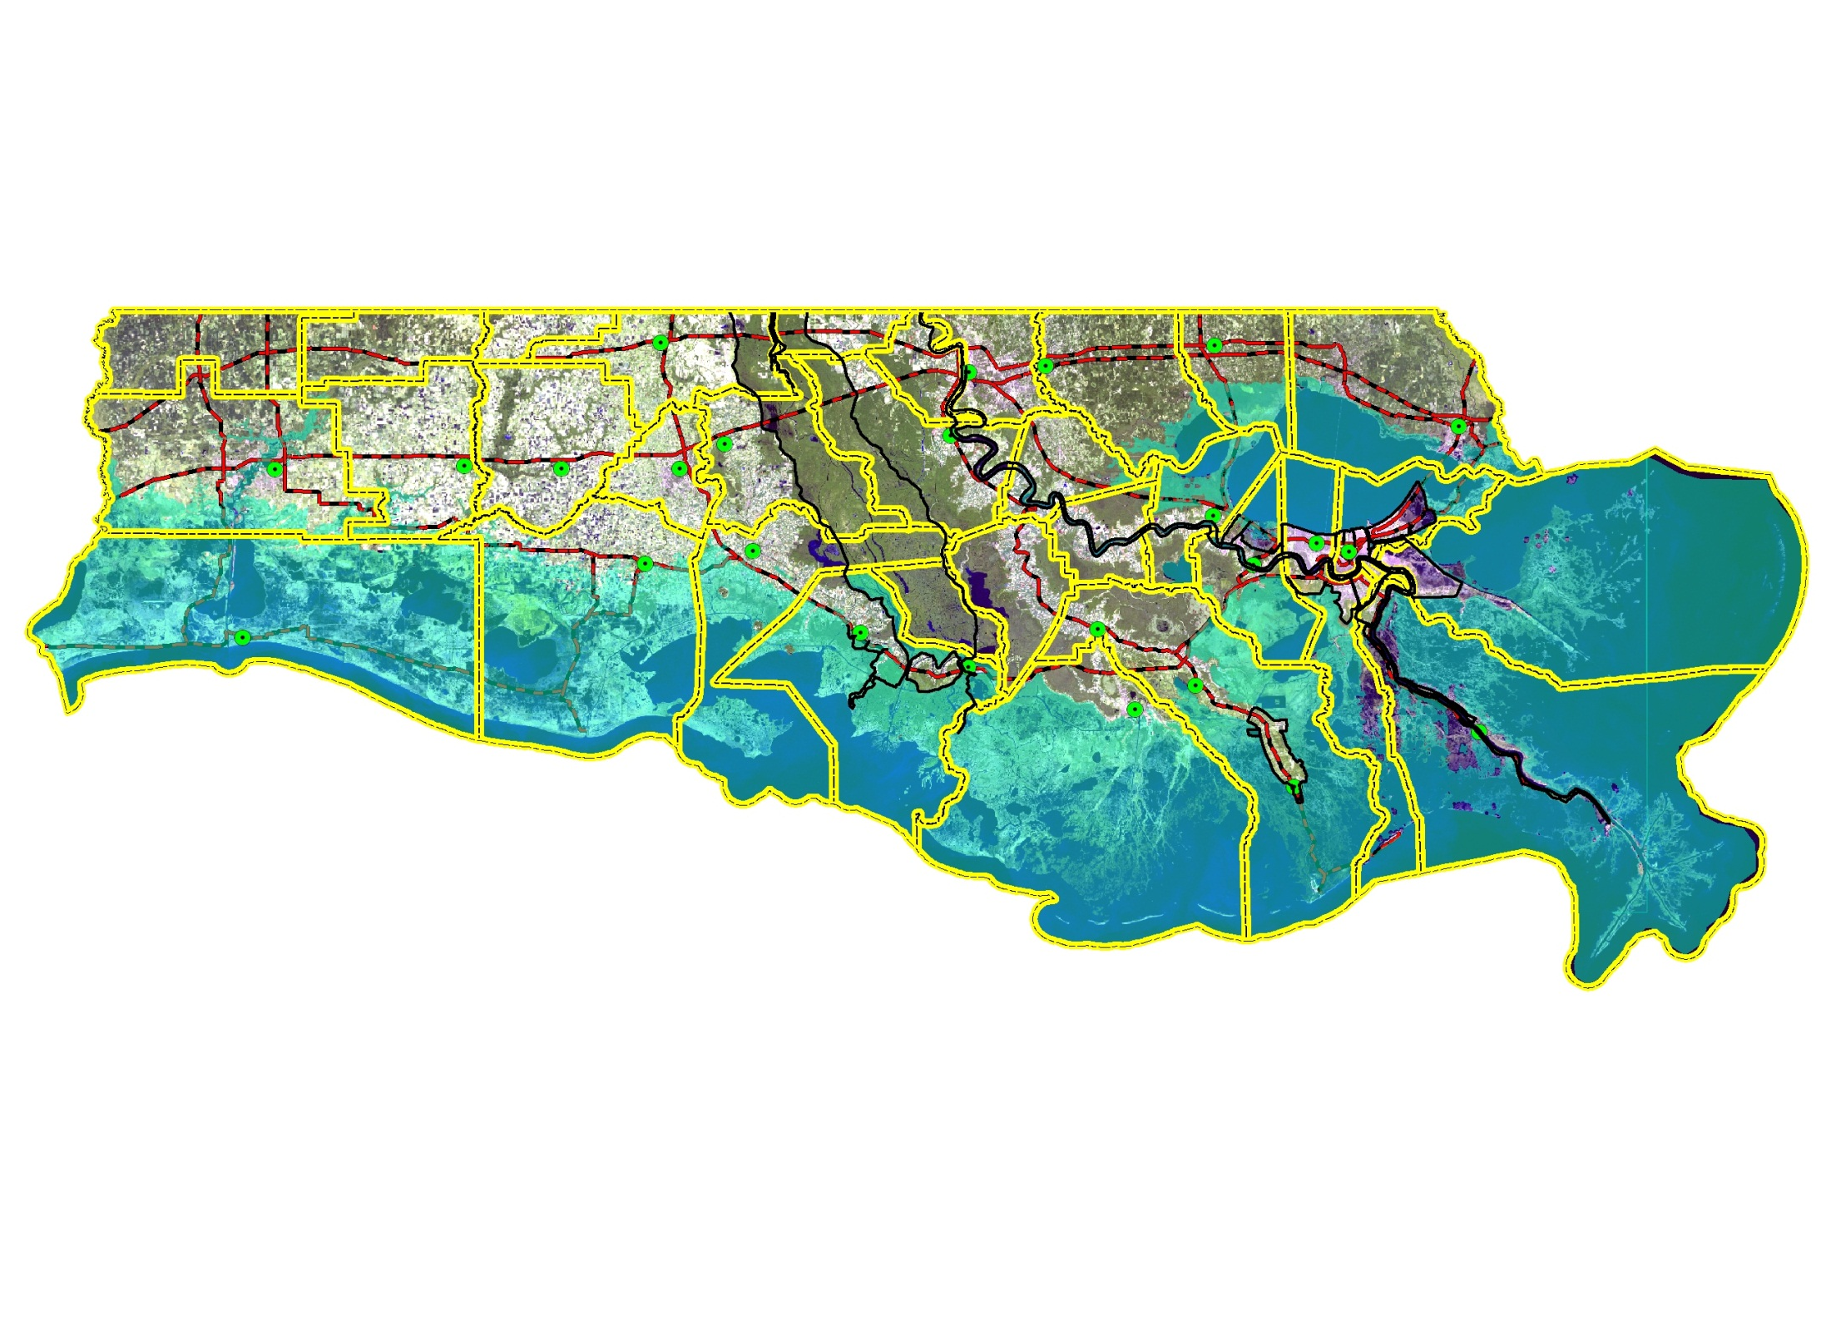
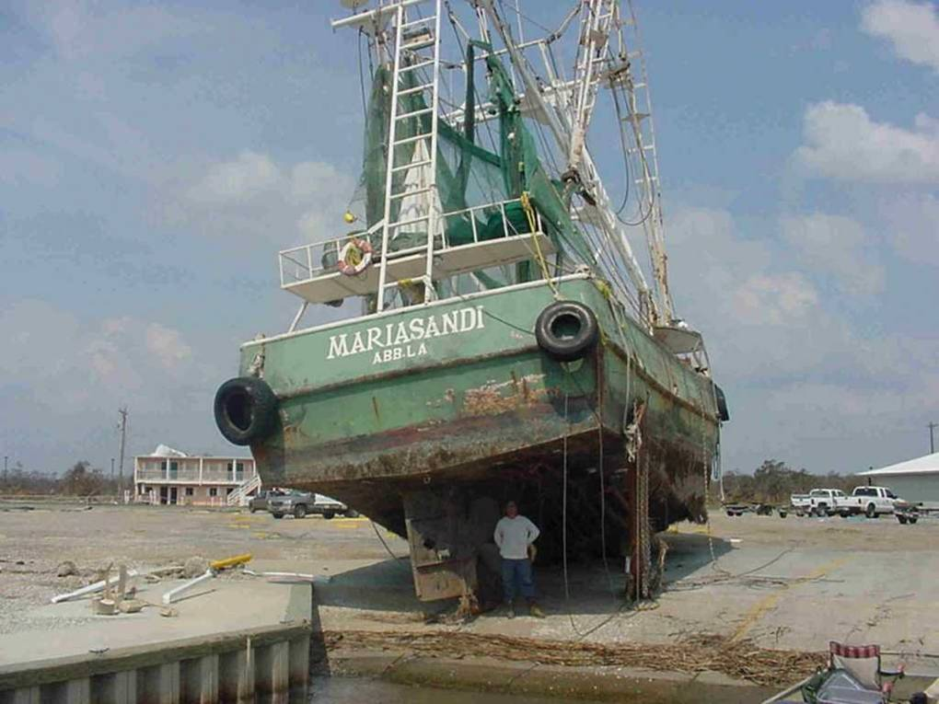
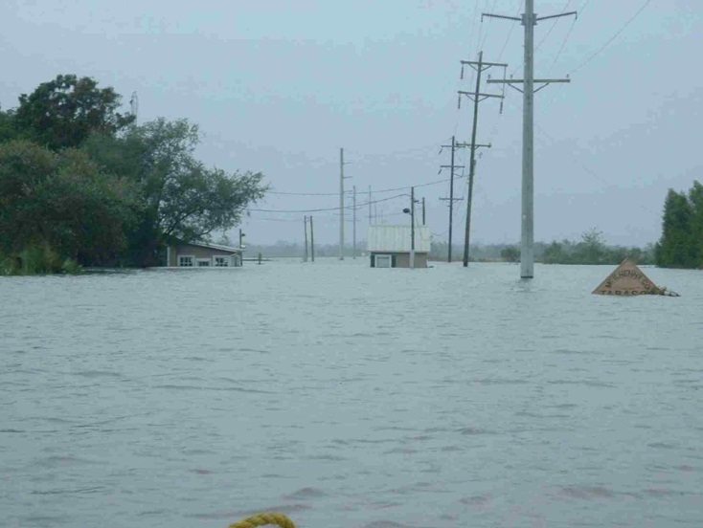
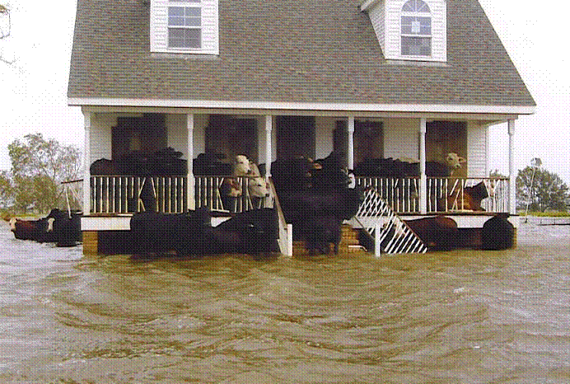
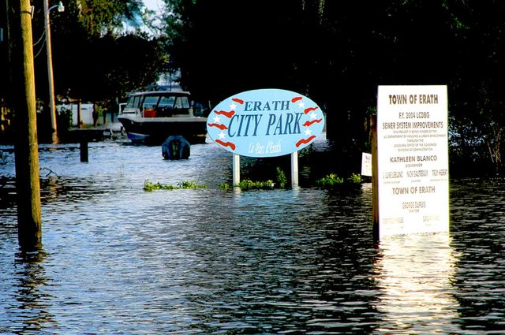
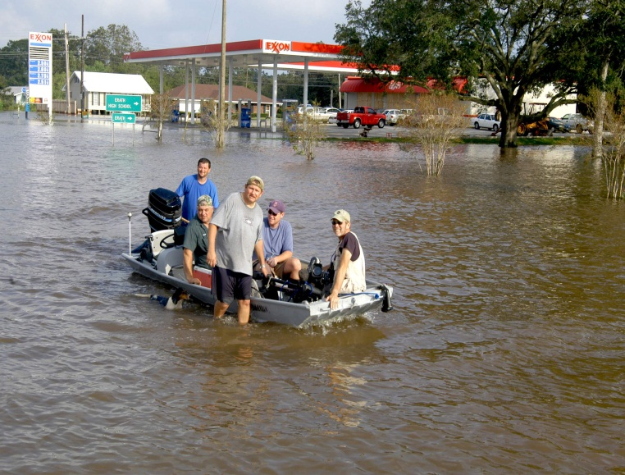
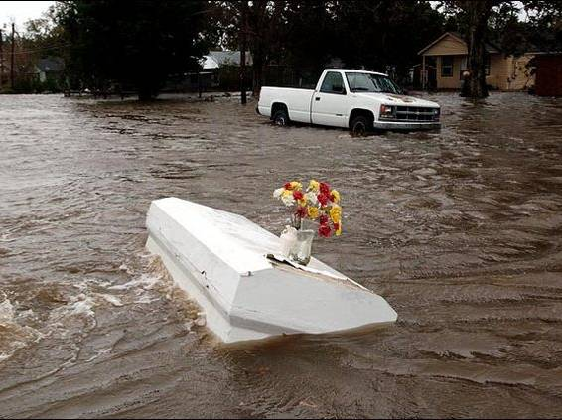
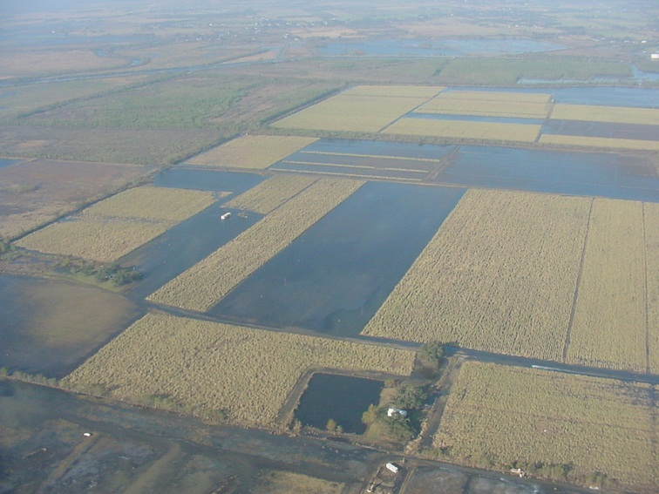
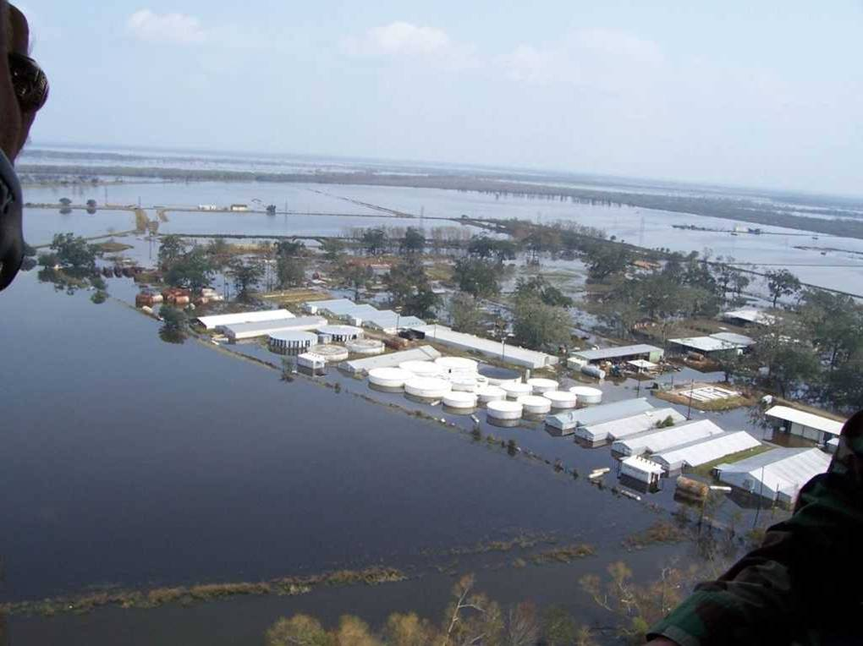
The Louisiana Coast
A Vulnerable Area for Storm Surge
Hurricane Rita Storm Surge
Beauregard
Allen
Evangeline
Saint
Landry
E.B.R.
Saint
Tammany
W.B.R.
Livingston
Jeff
Davis
Acadia
St
Martin
Tangipahoa
Calcasieu
Iberville
Ascension
St
John
Iberia
Lafayette
St
James
Cameron
St Bernard
Vermilion
Assumption
St Charles
St Mary
Lafourche
Jefferson
Plaquemines
Terrebonne
Rita
Sept. 2005
LEGEND
LEGEND
CITIES
CITIES
PRIMARY ROADS
PRIMARY ROADS
FLOOD AREA
FLOOD AREA
PARISH BNDRY
PARISH BNDRY

Slide 4

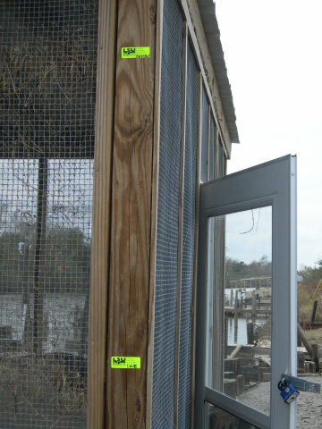


The Louisiana Coast
A Vulnerable Area for Storm Surge
Hurricane Gustav Storm Surge
Beauregard
Allen
Evangeline
Saint
Landry
E.B.R.
Gustav
Saint
Tammany
W.B.R.
Livingston
Jeff
Davis
Acadia
St
Martin
Tangipahoa
Calcasieu
Iberville
Ascension
St
John
Iberia
Lafayette
St
James
Cameron
St Bernard
Vermilion
Assumption
St Charles
St Mary
Lafourche
Jefferson
Plaquemines
Terrebonne
LEGEND
LEGEND
CITIES
Gustav
Sept. 2008
CITIES
PRIMARY ROADS
PRIMARY ROADS
Ike
FLOOD AREA
FLOOD AREA
PARISH BNDRY
PARISH BNDRY

Slide 5

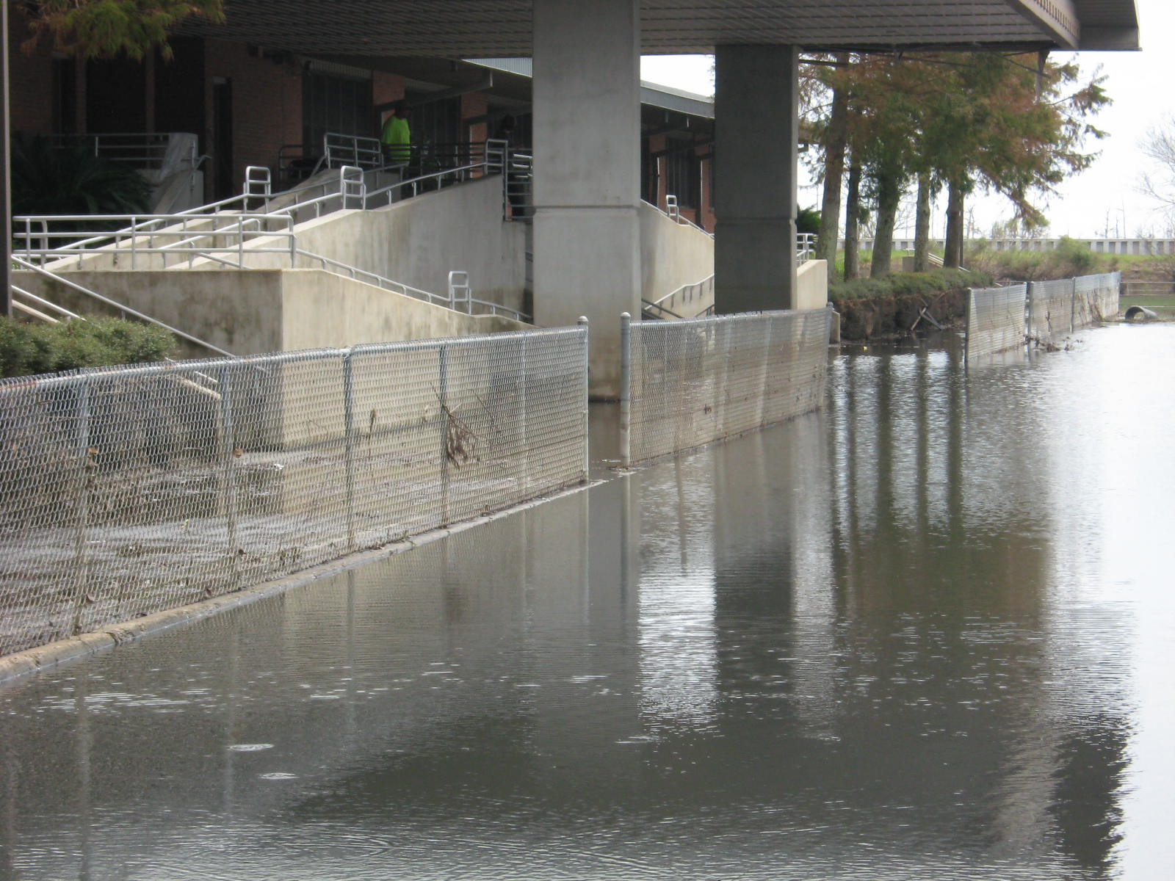
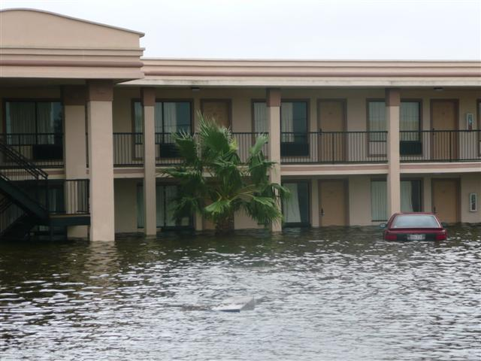
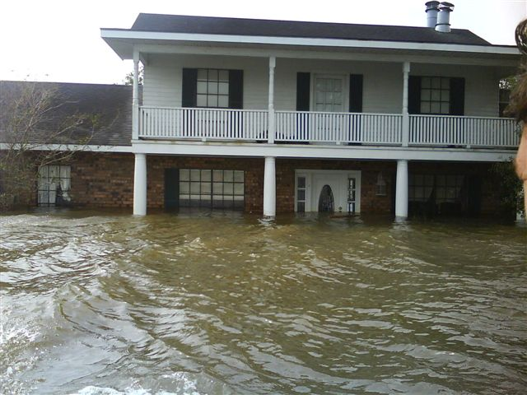
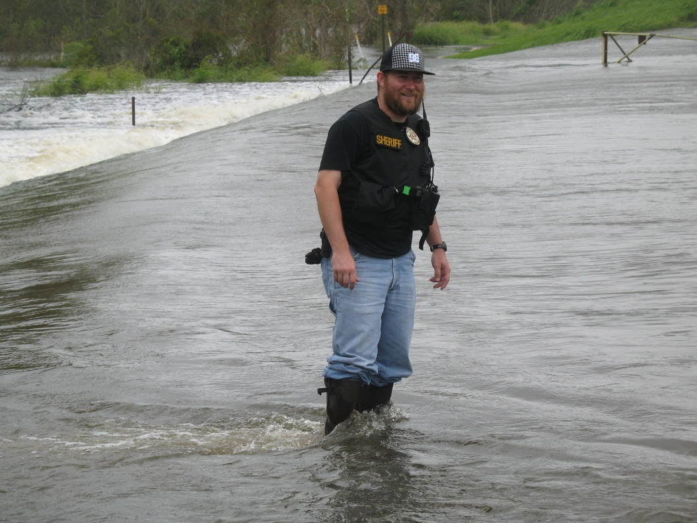
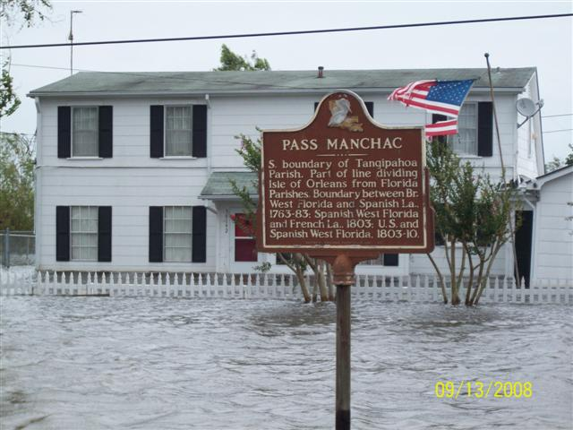
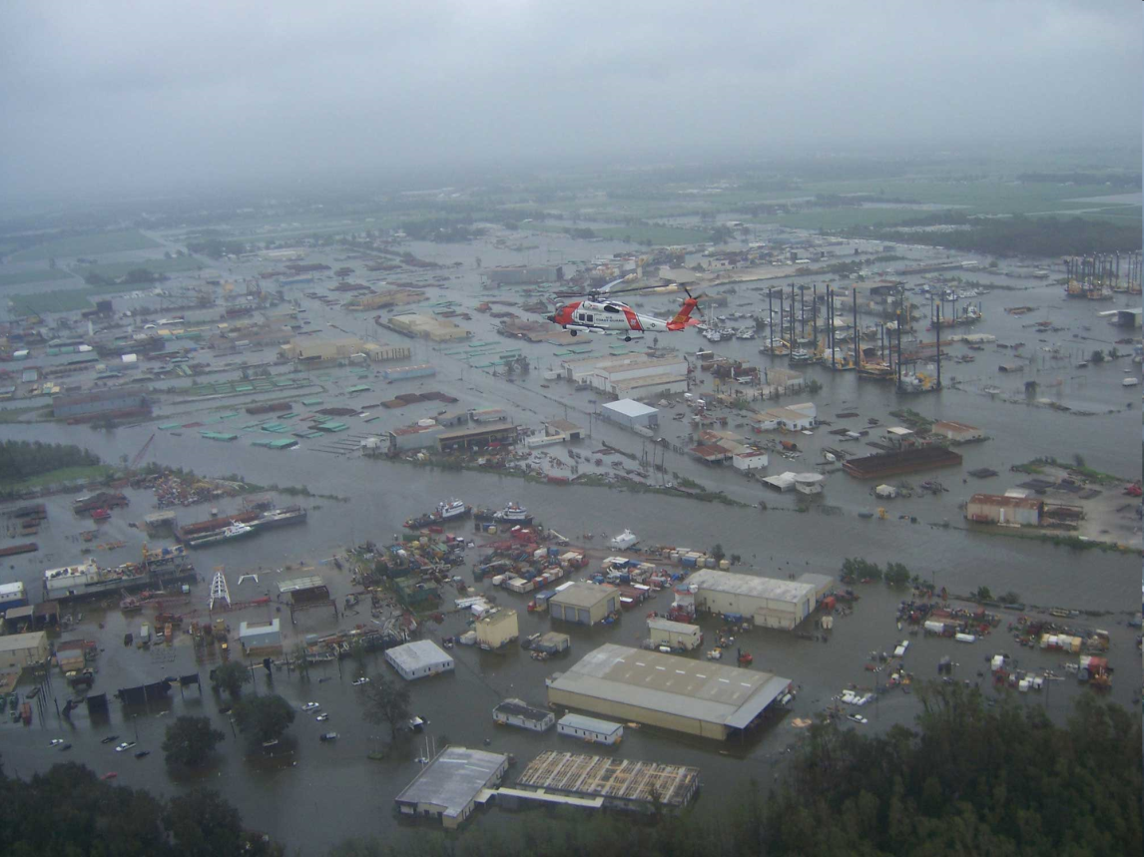
The Louisiana Coast
A Vulnerable Area for Storm Surge
Hurricane Ike Storm Surge
Beauregard
Allen
Evangeline
Saint
Landry
E.B.R.
Saint
Tammany
W.B.R.
Livingston
Jeff
Davis
Acadia
St
Martin
Tangipahoa
Calcasieu
Iberville
Ascension
St
John
Iberia
Lafayette
St
James
Cameron
St Bernard
Vermilion
Assumption
St Charles
St Mary
Lafourche
Jefferson
Plaquemines
Terrebonne
LEGEND
LEGEND
CITIES
CITIES
Ike
Sept. 2008
PRIMARY ROADS
Ike
Sept. 2008
PRIMARY ROADS
FLOOD AREA
FLOOD AREA
PARISH BNDRY
PARISH BNDRY

Slide 6
The Louisiana Coast
A Vulnerable Area for Storm Surge
Beauregard
Allen
Evangeline
Saint
Landry
E.B.R.
Saint
Tammany
W.B.R.
Livingston
Jeff
Davis
Acadia
St
Martin
Tangipahoa
Calcasieu
Iberville
Ascension
St
John
Iberia
Lafayette
St
James
Cameron
St Bernard
Vermilion
Assumption
St Charles
St Mary
Lafourche
Jefferson
Plaquemines
Terrebonne
LEGEND
Camille
1969
CITIES
PRIMARY ROADS
PARISH BOUNDARY
Storm Surge Record: 24.6 ft

Slide 7
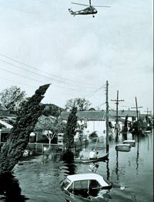
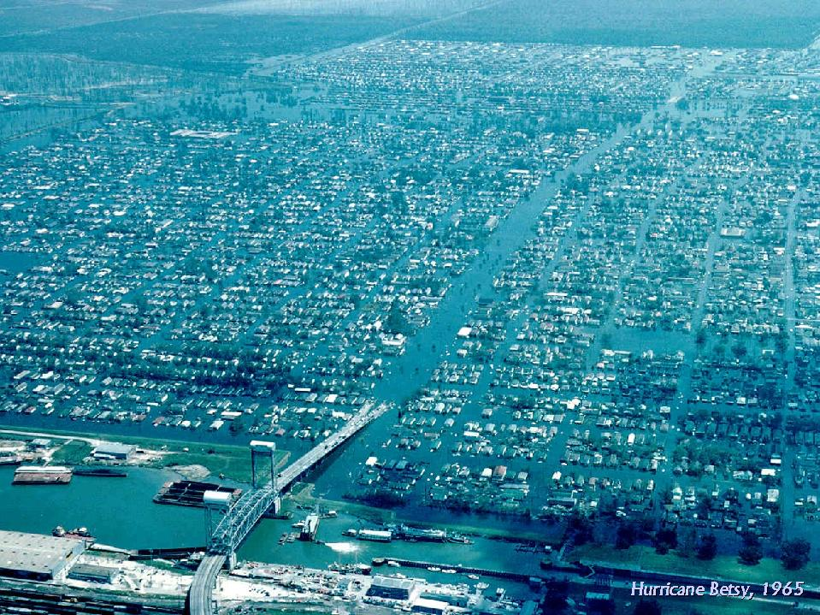
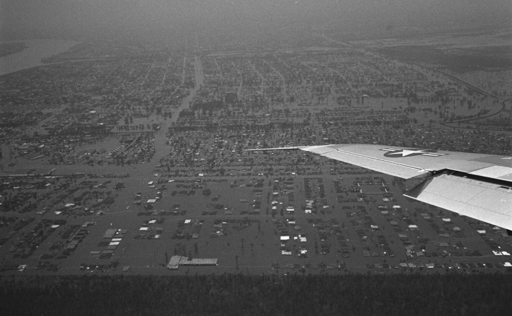
The Louisiana Coast
A Vulnerable Area for Storm Surge
LEGEND
CITIES
Betsy
1965
PRIMARY ROADS
FLOOD AREA
PARISH BNDRY

Slide 8
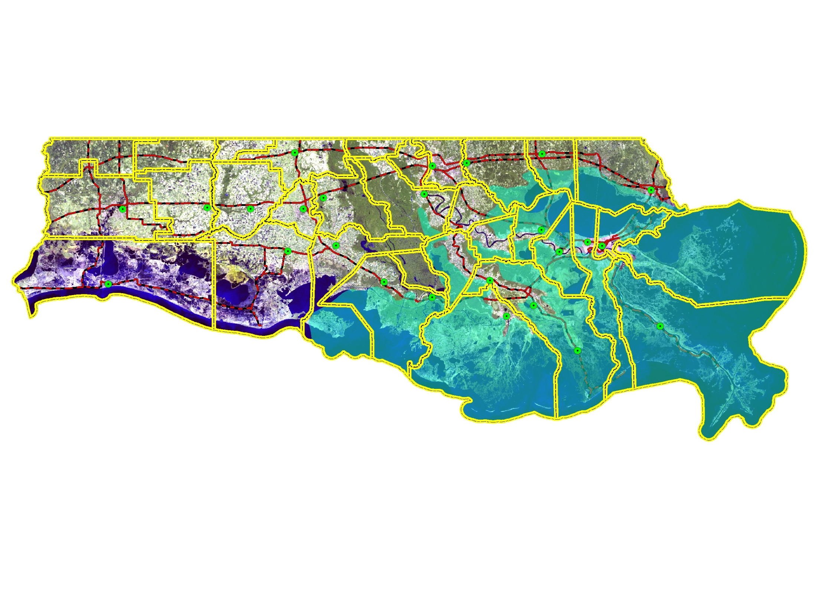
Hurricane Betsy Storm Surge
Beauregard
Allen
Evangeline
Saint
Landry
E.B.R.
Saint
Tammany
W.B.R.
Livingston
Jeff
Davis
Acadia
St
Martin
Tangipahoa
Calcasieu
Iberville
Ascension
St
John
Iberia
Lafayette
St
James
Cameron
St Bernard
Vermilion
Assumption
St Charles
St Mary
Lafourche
Jefferson
Plaquemines
Terrebonne
LEGEND
CITIES
Betsy
1965
PRIMARY ROADS
FLOOD AREA
PARISH BNDRY

Slide 9

Hurricane Carla Storm Surge
Beauregard
Allen
Evangeline
Saint
Landry
E.B.R.
Saint
Tammany
W.B.R.
Livingston
Jeff
Davis
Acadia
St
Martin
Tangipahoa
Calcasieu
Iberville
Ascension
St
John
Iberia
Lafayette
St
James
Cameron
St Bernard
Vermilion
Assumption
St Charles
St Mary
Lafourche
Jefferson
Plaquemines
Terrebonne
LEGEND
CITIES
Carla
1961
Texas Landfall
PRIMARY ROADS
FLOOD AREA
PARISH BNDRY

Slide 10
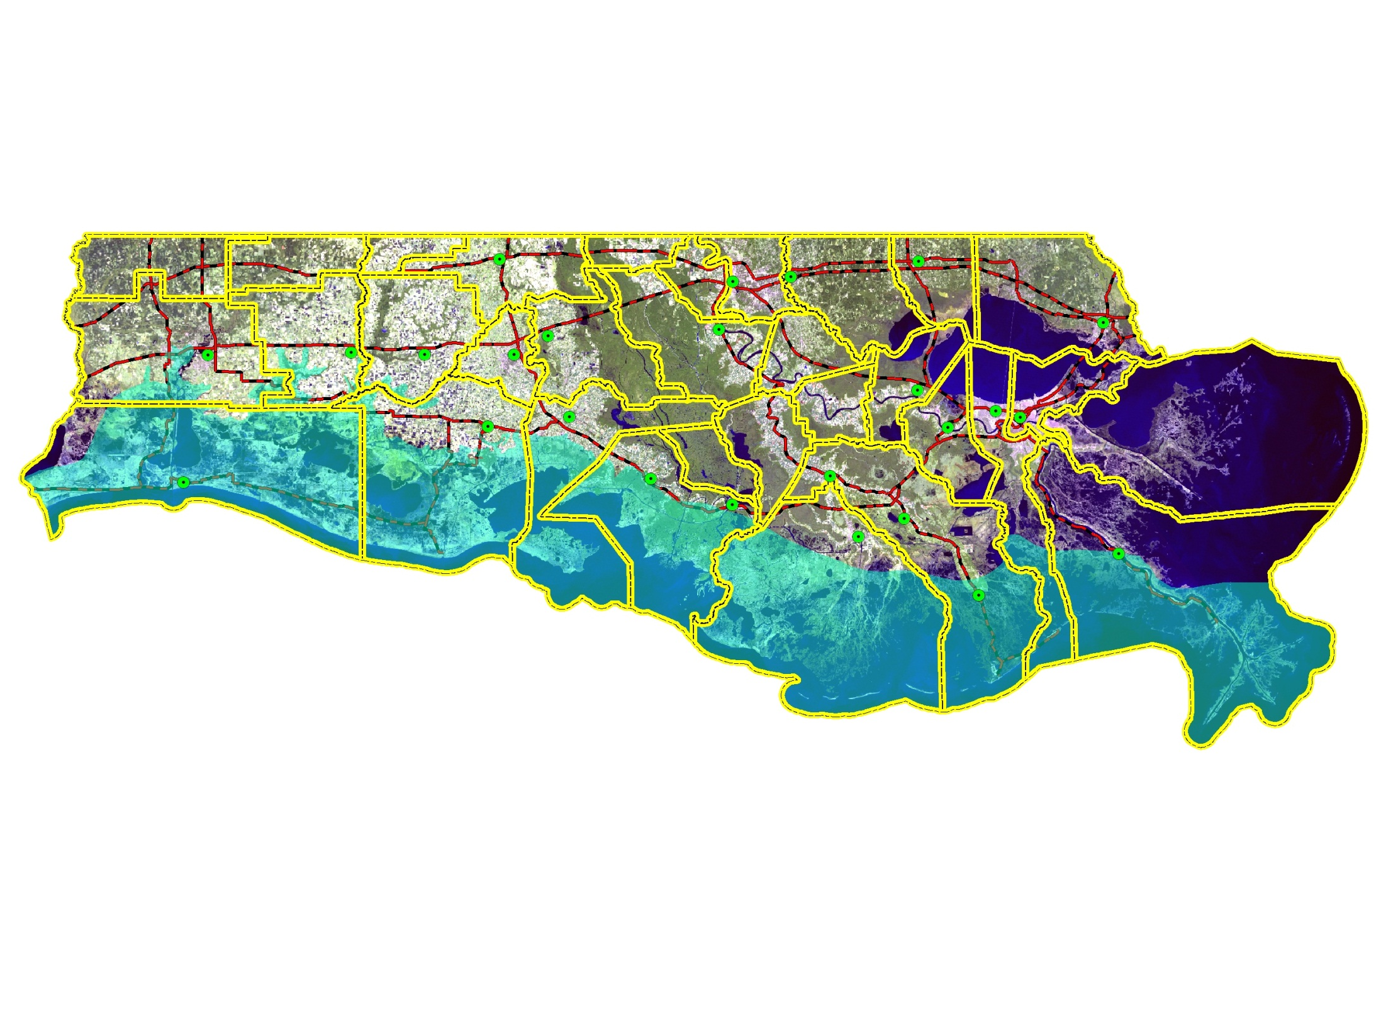
Hurricane Audrey Storm Surge
Beauregard
Allen
Evangeline
Saint
Landry
E.B.R.
Saint
Tammany
W.B.R.
Livingston
Jeff
Davis
Acadia
St
Martin
Tangipahoa
Calcasieu
Iberville
Ascension
St
John
Iberia
Lafayette
St
James
Cameron
St Bernard
Vermilion
Assumption
St Charles
St Mary
Lafourche
Jefferson
Plaquemines
Terrebonne
Audrey
1957
LEGEND
CITIES
PRIMARY ROADS
FLOOD AREA
PARISH BNDRY

Slide 11
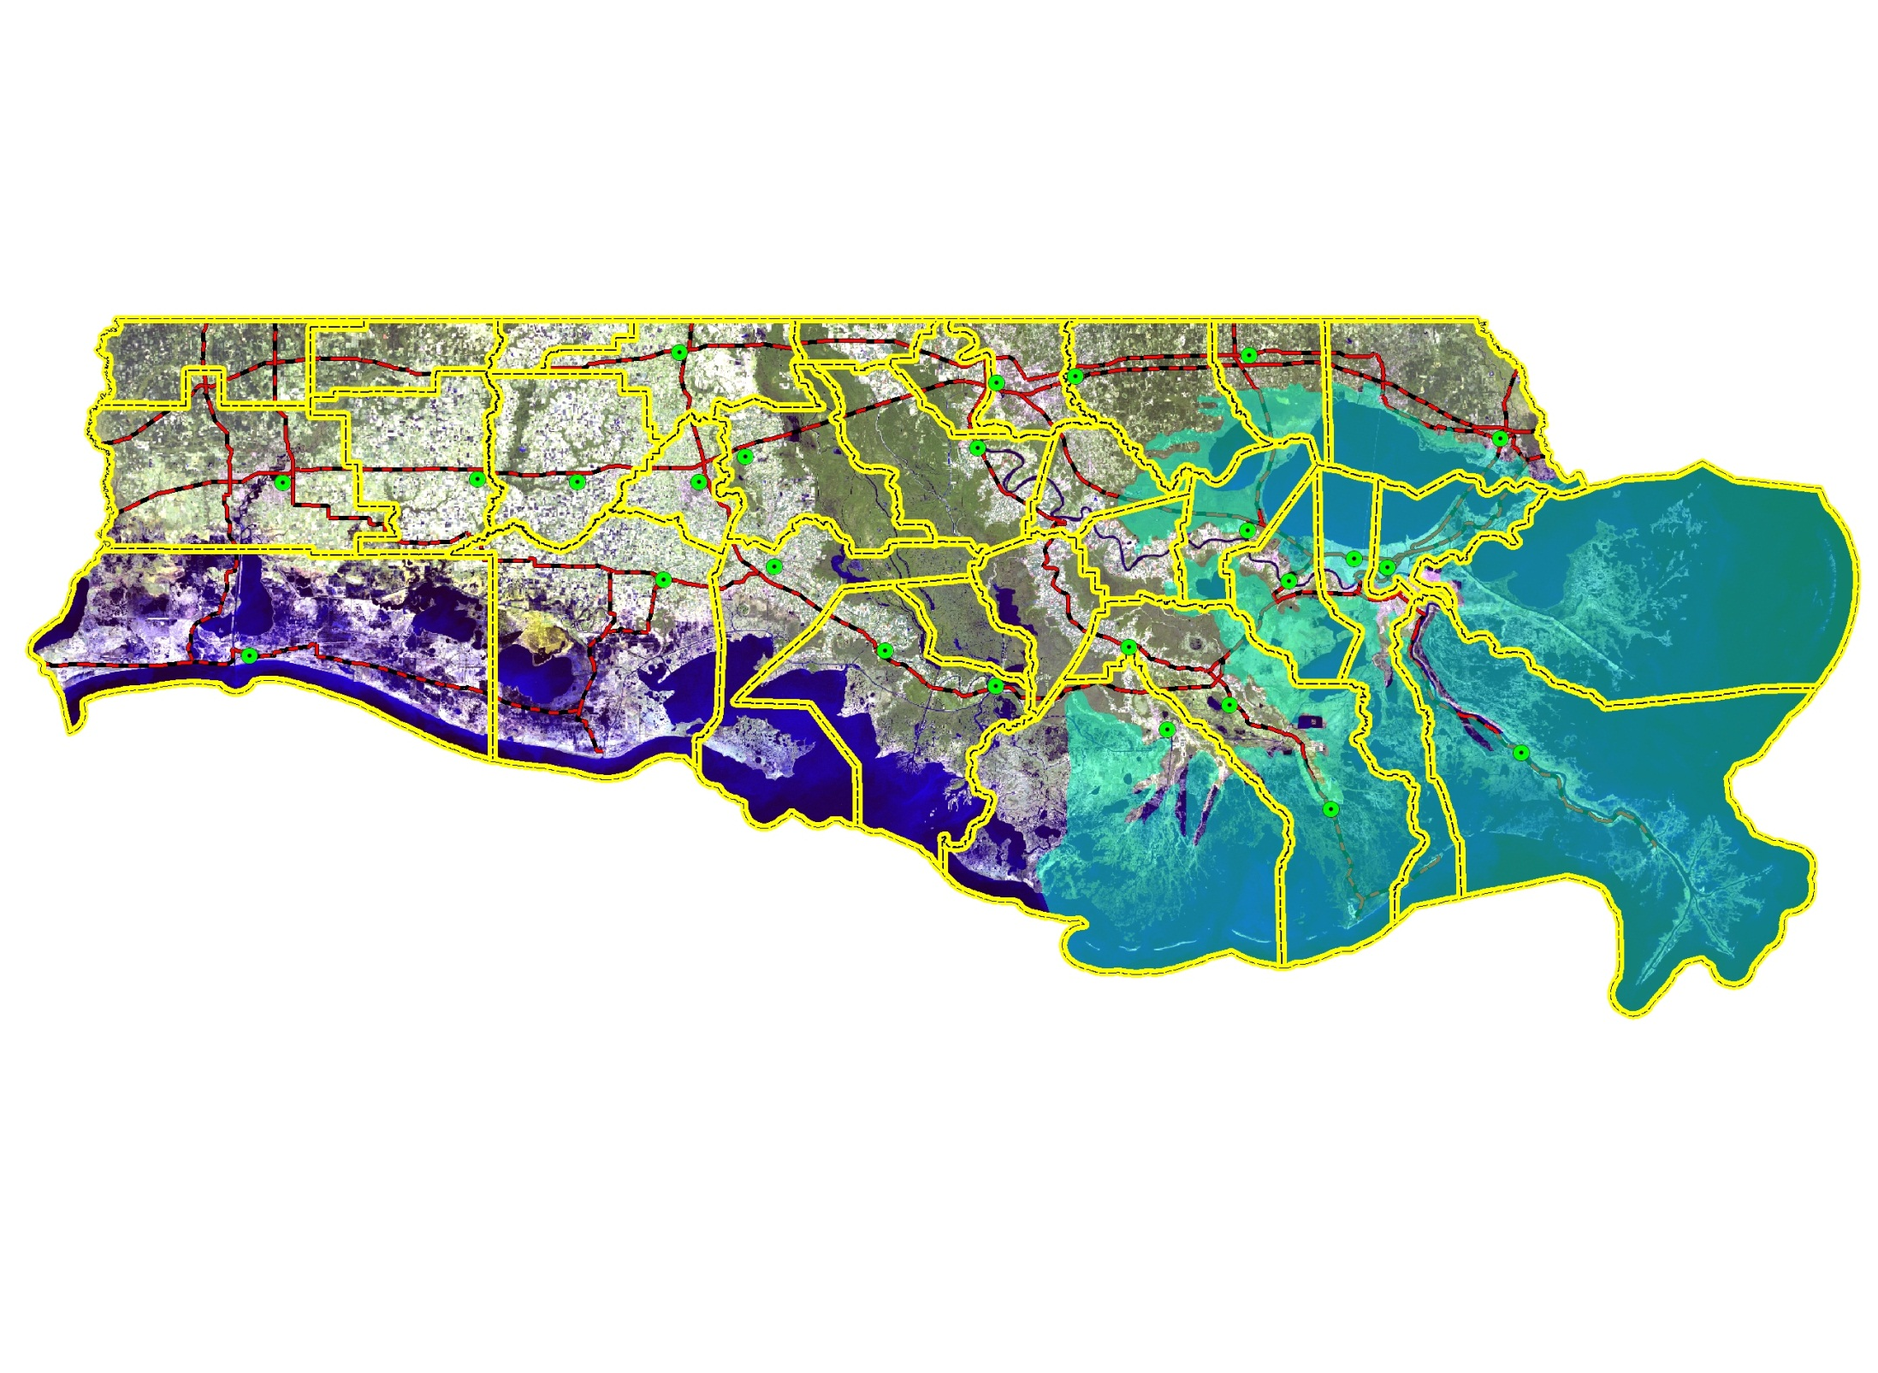
Hurricane Flossy Storm Surge
Beauregard
Allen
Evangeline
Saint
Landry
E.B.R.
Saint
Tammany
W.B.R.
Livingston
Jeff
Davis
Acadia
St
Martin
Tangipahoa
Calcasieu
Iberville
Ascension
St
John
Iberia
Lafayette
St
James
Cameron
St Bernard
Vermilion
Assumption
St Charles
St Mary
Lafourche
Jefferson
Plaquemines
Terrebonne
LEGEND
CITIES
Flossy
1956
PRIMARY ROADS
FLOOD AREA
PARISH BNDRY

Slide 12

August 1940 Hurricane Storm Surge
Beauregard
Allen
Evangeline
Saint
Landry
E.B.R.
Saint
Tammany
W.B.R.
Livingston
Jeff
Davis
Acadia
St
Martin
Tangipahoa
Calcasieu
Iberville
Ascension
St
John
Iberia
Lafayette
St
James
Cameron
St Bernard
Vermilion
Assumption
St Charles
St Mary
Lafourche
Jefferson
Plaquemines
Terrebonne
LEGEND
CITIES
PRIMARY ROADS
FLOOD AREA
PARISH BNDRY

Slide 13

August 1915 Hurricane Storm Surge
Beauregard
Allen
Evangeline
Saint
Landry
E.B.R.
Saint
Tammany
W.B.R.
Livingston
Jeff
Davis
Acadia
St
Martin
Tangipahoa
Calcasieu
Iberville
Ascension
St
John
Iberia
Lafayette
St
James
Cameron
St Bernard
Vermilion
Assumption
St Charles
St Mary
Lafourche
Jefferson
Plaquemines
Terrebonne
LEGEND
CITIES
PRIMARY ROADS
Hurricane of August 1915
Texas Landfall
FLOOD AREA
PARISH BNDRY

Slide 14

Sept. 1915 Hurricane Storm Surge
Beauregard
Allen
Evangeline
Saint
Landry
E.B.R.
Saint
Tammany
W.B.R.
Livingston
Jeff
Davis
Acadia
St
Martin
Tangipahoa
Calcasieu
Iberville
Ascension
St
John
Iberia
Lafayette
St
James
Cameron
St Bernard
Vermilion
Assumption
St Charles
St Mary
Lafourche
Jefferson
Plaquemines
Terrebonne
LEGEND
CITIES
PRIMARY ROADS
FLOOD AREA
PARISH BNDRY

Slide 15
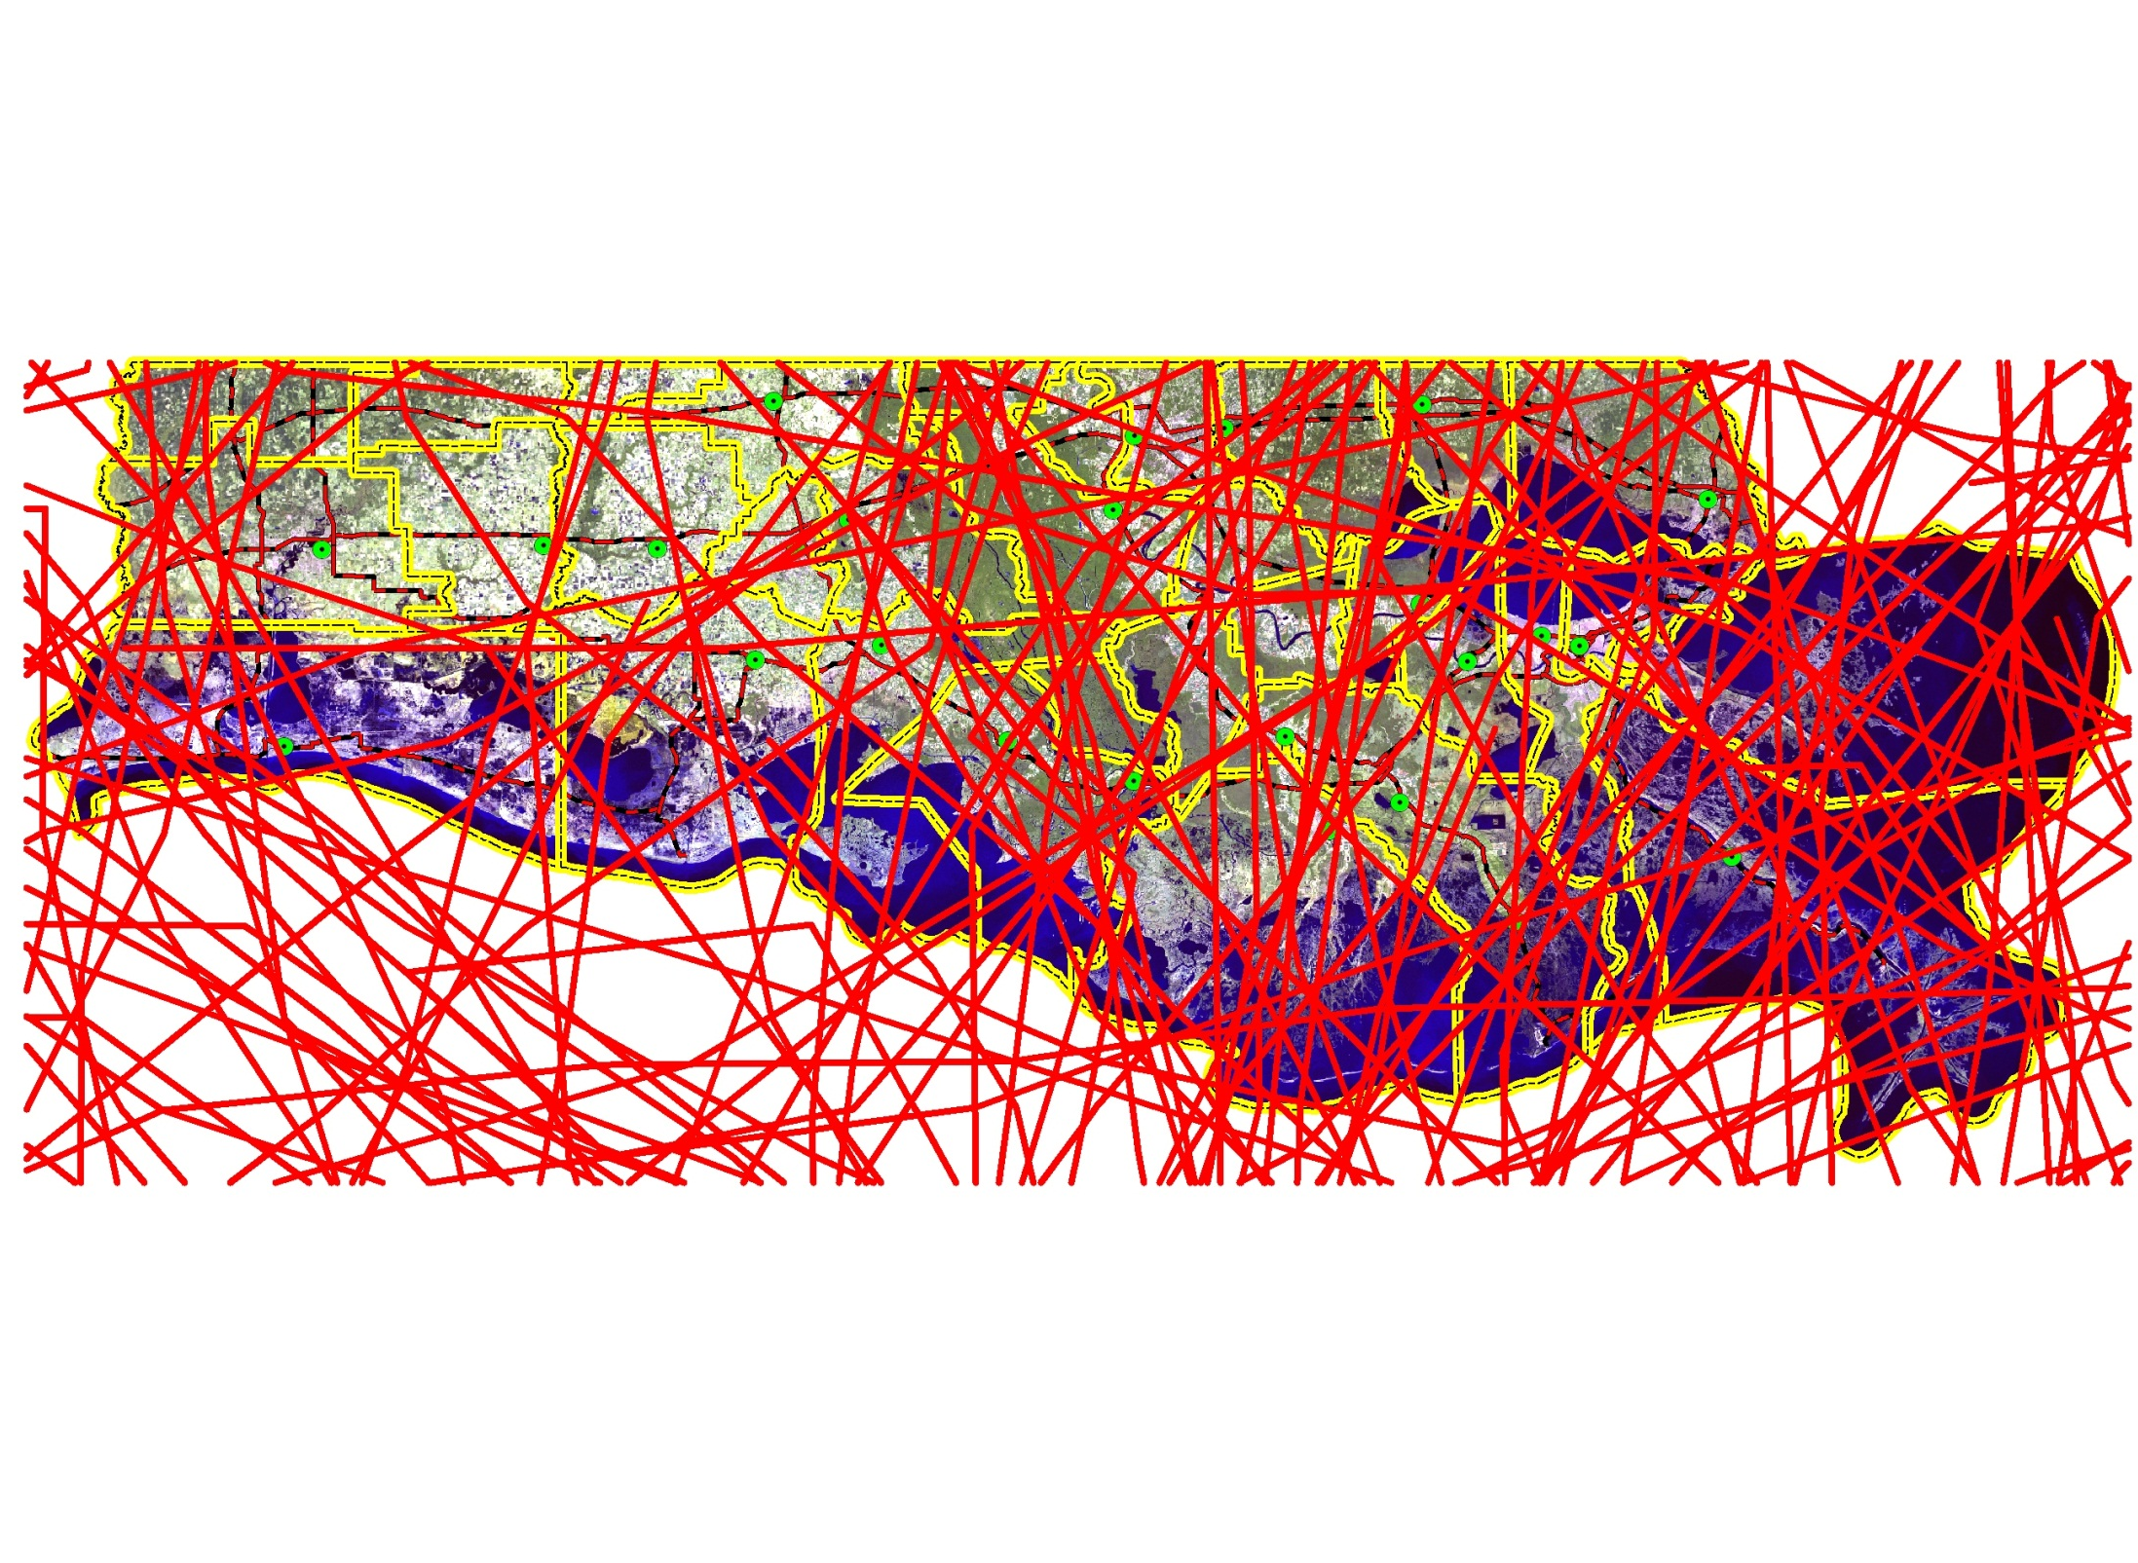
The Louisiana Coast
A Vulnerable Area for Storm Surge
All Atlantic Basin Tropical Systems
National Hurricane Center 1850 - 2008

Slide 16
Storm Surge Myths, Misconceptions, Misunderstanding, and Confusion
“It’s only a Category 2!!!”
“We will evacuate tomorrow morning, there is still plenty of time.” Bolivar Peninsula, Texas, before Ike

Slide 17
Saffir – Simpson Scale
Relates wind speeds to the potential for damage on land
Designed to measure potential wind damage to man-made structures
Category 1 – Winds 74 to 95 mph
Category 2 – Winds 96 to 110 mph
Category 3 – Winds 111 to 130 mph
Category 4 – Winds 131 to 155 mph
Category 5 – Winds exceed 155 mph

Slide 18
Saffir – Simpson Scale FAILURE
Potential Surge
Category 1 – 4 – 5 ft
Category 2 – 6 – 8 ft
Category 3 – 9 – 12 ft
Category 4 – 13 – 18 ft
Category 5 – >18 ft
Charley - Category 4 Surge 6 – 9 ft
Katrina - Category 3 Surge 27+ ft
Ike - Category 2 Surge 15 – 20 ft

Slide 19
Saffir – Simpson Scale
For 2009, the National Hurricane center will be using a “new” version of the the Saffir-Simpson Hurricane Scale
It will be called the Saffir-Simpson Hurricane WIND Scale
  Will assess only wind speed
  All information related to storm surge and flooding will be removed

Slide 20
HURRICANE IKE ADVISORY NUMBER 42
NWS TPC/NATIONAL HURRICANE CENTER, MIAMI, FL
10 AM CDT THUR SEPT 11 2008
(Ike made landfall SEPT 13, 2008 2:00 AM)
COASTAL STORM SURGE FLOODING OF UP TO 20 FEET ABOVE NORMAL TIDE LEVELS...LOCALLY UP TO 20 FEET AT HEAD OF BAYS AND NEARBY RIVERS...WITH LARGE AND DANGEROUS BATTERING WAVES...CAN BE EXPECTED NEAR AND TO THE EAST OF WHERE THE CENTER MAKES LANDFALL.

Slide 21
HURRICANE IKE ADVISORY NUMBER 44
NWS TPC/NATIONAL HURRICANE CENTER, MIAMI, FL
10 PM CDT THUR SEPT 11 2008
(Ike made landfall SEPT 13, 2008 2:00 AM)
THE SURGE EXTENDS A GREATER THAN USUAL DISTANCE FROM THE CENTER DUE TO THE LARGE SIZE OF THE CYCLONE. WATER LEVELS HAVE
ALREADY INCREASED TO 9 TO 12 FEET ABOVE NORMAL ALONG MUCH OF THE NORTHWESTERN GULF COAST.

Slide 22
Communicating the threat from Ike was not so easy
It’s just a Category 2
It’s making landfall well to the west
It’s just weather propaganda
Led to strongly worded warnings:
“Hurricane Ike has the potential to produce a storm surge similar to a Category 4 storm!”

Slide 23
Communicating the threat from Ike was not so easy
It’s just a Category 2
It’s making landfall well to the west
It’s just weather propaganda
Led to strongly worded warnings:
“Neighborhoods that are affected by the storm surge … and possibly entire coastal communities … will be inundated during the period of peak storm tide.”

Slide 24
Communicating the threat from Ike was not so easy
It’s just a Category 2
It’s making landfall well to the west
It’s just weather propaganda
Led to strongly worded warnings:
"Persons not heeding evacuation orders in single-family, one- or two-story homes may face certain death. … Widespread and devastating personal property damage is likely."

Slide 25
Communicating the threat from Ike was not so easy
It’s just a Category 2
It’s making landfall well to the west
It’s just weather propaganda
Led to strongly worded warnings:
In other words,
“LEAVE or DIE”

Slide 26
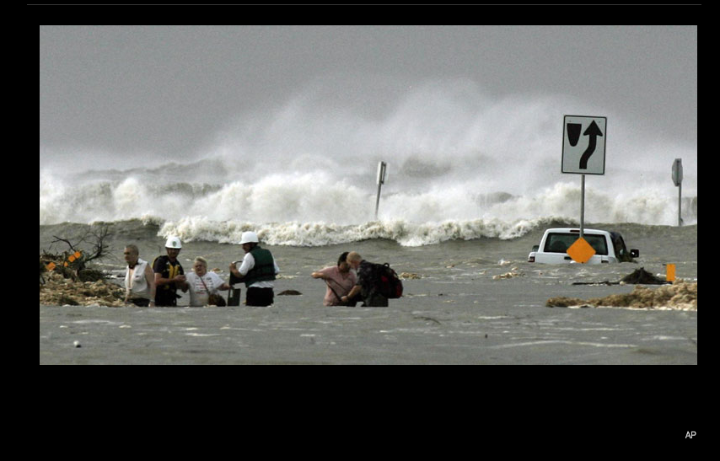
Ike - Friday morning 9/12/2008:
Bolivar - Its too late!
Notes:
26

Slide 27
Saffir – Simpson Scale
While higher wind speeds create the potential for higher storm surges, there IS NOT an ideal relationship between storm category and storm surge
WHY? Many other factors are involved

Slide 28
Factors Impacting Storm Surge
Storm Factors
  Intensity of storm
  Wind speed
  Radius of maximum winds - SIZE
  Atmospheric pressure

Slide 29
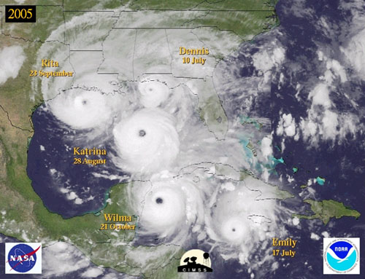
HFW : 40 mi. TSFW: 130 mi.
Camille 1969 HFW : 60 mi. TSFW: 180 mi.
HFW : 70 mi. TSFW: 160 mi.

Slide 30
Storm Surge Myths, Misconceptions, Misunderstanding, and Confusion
“This (house, building) survived Camille, it will survive anything.” Mississippi Gulf Coast resident prior to Katrina
  Camille Syndrome – “It looks like Hurricane Camille killed more people in 2005 than it did in 1969.” (Attributed to Jim Holt of Biloxi, quoted in the Biloxi Sun Herald.)

Slide 31
Betsy 1965 HFW : 90 mi. TSFW: 250 mi.
HFW : 85 mi. TSFW: 205 mi.
HFW : 40 mi. TSFW: 130 mi.
HFW : 105 mi. TSFW: 230 mi.
Gustav 2008 HFW : 70 mi. TSFW: 220 mi.
Ike 2008 HFW : 120 mi. TSFW: 275 mi.
Camille 1969 HFW : 60 mi. TSFW: 180 mi.
Carla 1961 HFW : 125 mi. TSFW: 300 mi.
HFW : 70 mi. TSFW: 160 mi.

Slide 32
Storm Surge Myths, Misconceptions, Misunderstanding, and Confusion
“We didn’t flood for Gustav, why should we worry about Ike?”
“We didn’t flood for Andrew, why should we worry about ???”
Storm Factors
  Forward speed
  Track of the storm

Slide 33
How does this impact storm surge?
Fast moving storms cause high surges along open coast and lower surges in sheltered bays and estuaries.
Slow moving storms usually result in greater flooding inside bays and estuaries, with smaller values along the open coast.
The longer the wind blows over water toward land, the greater the potential for flooding.

Slide 34
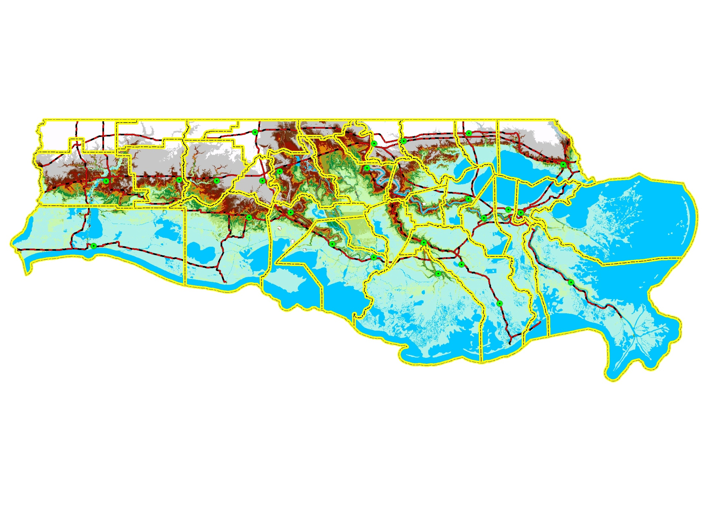
ELEVATION – COASTAL LA. IS LOW
LIDAR SURFACE ELEVATION
Beauregard
Allen
Evangeline
Saint
Landry
E.B.R.
Saint
Tammany
W.B.R.
Livingston
Jeff
Davis
Acadia
St
Martin
Tangipahoa
Calcasieu
Iberville
Ascension
St
John
Iberia
Lafayette
St
James
Cameron
St Bernard
Vermilion
Assumption
St Charles
St Mary
Lafourche
Jefferson
Plaquemines
Terrebonne
Elevation - Feet
< 2
14 - 16
2 - 4
16 - 18
4 - 6
18 - 20
6 - 8
20 - 40
8 - 10
40 - 68
10 - 12
WATER
12 - 14

Slide 35
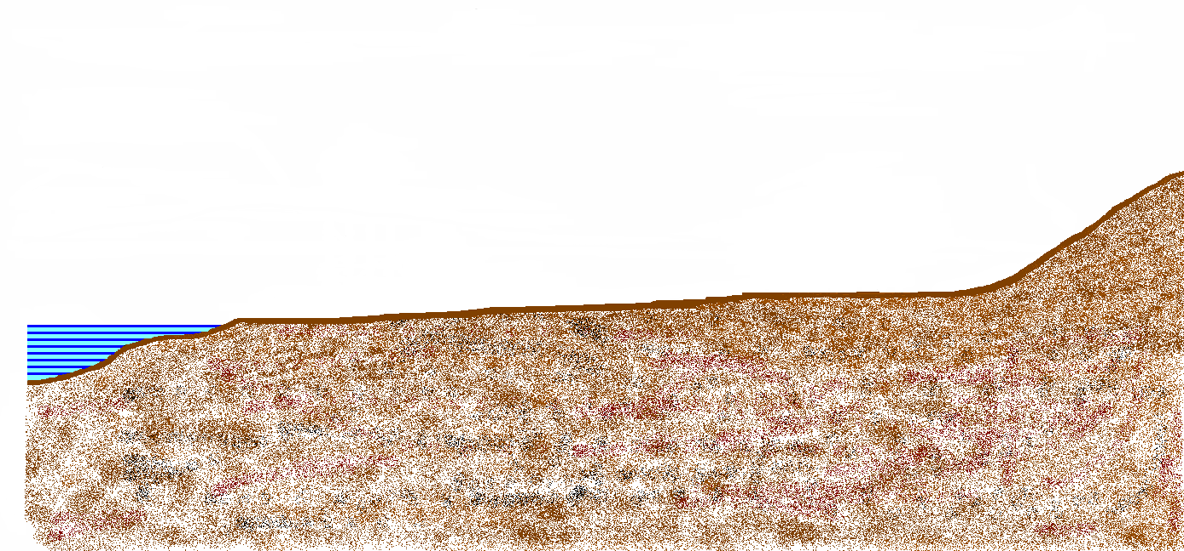
Relative Sea-Level Rise Components
Increasing Sea Level Elevation

Slide 36
Relative Sea-Level Rise Components
Increasing Sea Level Elevation

Slide 37
Relative Sea-Level Rise Components
Increasing Sea Level Elevation

Slide 38
Relative Sea-Level Rise Components
Increasing Sea Level Elevation

Slide 39
Relative Sea-Level Rise Components
Increasing Sea Level Elevation

Slide 40
Relative Sea-Level Rise Components
Increasing Sea Level Elevation

Slide 41
Relative Sea-Level Rise Components
Increasing Sea Level Elevation
Decreasing Land Surface Elevation
+

Slide 42
Relative Sea-Level Rise Components
Increasing Sea Level Elevation
Decreasing Land Surface Elevation
+

Slide 43
Relative Sea-Level Rise Components
Increasing Sea Level Elevation
Decreasing Land Surface Elevation
+

Slide 44
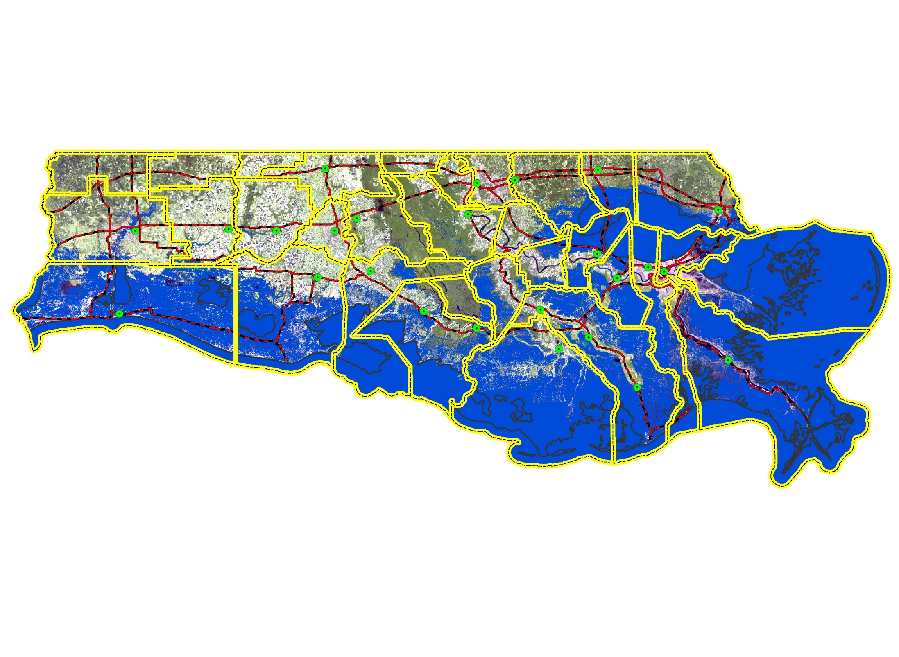
POTENTIAL IMPACTS OF SEA LEVEL RISE
Inundation to 2.0 ft. Elevation
LEGEND
CITIES
PRIMARY ROADS
PARISH BNDRY
WATER

