Slide 1
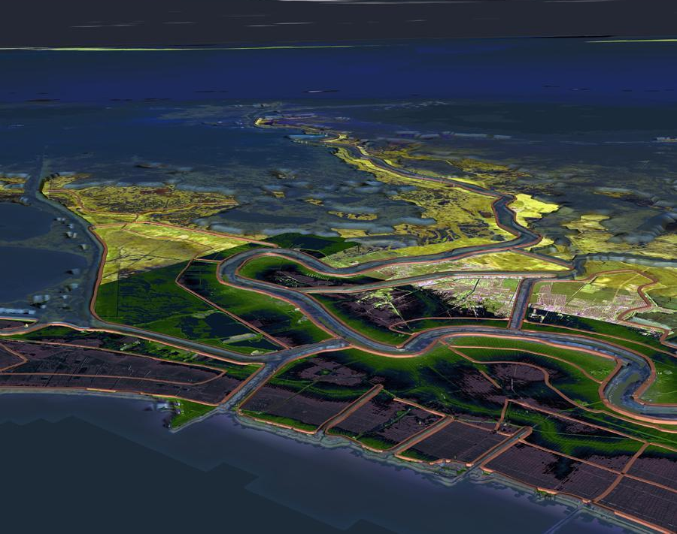
Board of Commissioners of SLFPA-E
vs.
Tennessee Gas Pipeline Co., et.al.
Legal and Geological Evaluaton
Notes:
This image fairly well encompasses the jurisdictional area of the South Louisiana Flood Protection Authority – East. Viewing the City of New Orleans from a perspective several thousand feet above Lake Pontchartrain and looking to the south-southeast the image shows the flood protection levees along the Mississippi River as well as the Intracoastal Waterway, the Industrial Canal, the MRGO, and the outflow canals that drain New Orleans into the Lake. The image also shows the low-lying coastal marshes that extend seaward from the levee systems. It is the contention of the plaintiffs in the subject lawsuit that these marshes have provided protection from storm surge flooding to the area around New Orleans for centuries, and that the same marshes have been destroyed by the activities of the oil and gas industry, specifically by the dredging of access canals. This presentation will examine the assertions of the referenced lawsuit brought by the Board of the Authority against (according to Mark Schelfstein) 92 oil and gas companies.

Slide 2
Bd. of Comm'rs of the S.E. La. Flood Prot. Auth. E. v. Tn. Gas Pipeline Co., LLC., et al., No. 13-6911 (D. Ct. Orleans Parish, La. Jul 24, 2013).
The Coastal “Erosion” Lawsuit

Slide 3
The Parties
Plaintiffs
Southeast Louisiana Flood Protection Authority - East ("the Authority"), individually and as the board governing the Orleans Levee District, the Lake Borgne Basin Levee District, and the East Jefferson Levee District
Defendants
List of energy companies involved in exploration and production over the past 80 years.

Slide 4
The Good Old Days
“Coastal lands have for centuries provided a crucial buffer zone between south Louisiana's communities and the violent wave action and storm surge that tropical storms and hurricanes transmit from the Gulf of Mexico. Coastal lands are a natural protective buffer, without which the levees that protect the cities and towns of south Louisiana are left exposed to unabated destructive forces.”

Slide 5
The Delta after 1932
“This natural protective buffer took 6,000 years to form. Yet, as described below, it has been brought to the brink of destruction over the course of a single human lifetime. Hundreds of thousands of acres of the coastal lands that once protected south Louisiana are now gone as a result of oil and gas industry activities...”

Slide 6
The Legal Claims
This is a third party beneficiary lawsuit.
The landowners have the primary rights to the restoration of the land after production.
The damage to the land increased the cost of hurricane protection to the levee board.
The mechanism of damage
Canals and pipelines destroyed wetlands, which acted as buffers against hurricane storm tide.
Oil extraction caused surface subsidence, which increases the risk of hurricane storm tide.

Slide 7
The Coastal Restoration Demand
“...including, but not limited to, backfilling and revegetating each and every canal dredged by them, used by them, and/or for which they bear responsibility, as well as undertaking all manner of abatement and restoration activities determined to be appropriate, including, but not limited to, wetlands creation, reef creation, land bridge construction, hydrologic restoration, shoreline protection, structural protection, bank stabilization, and ridge restoration...”

Slide 8
Wetlands Lost Since 1932

Slide 9
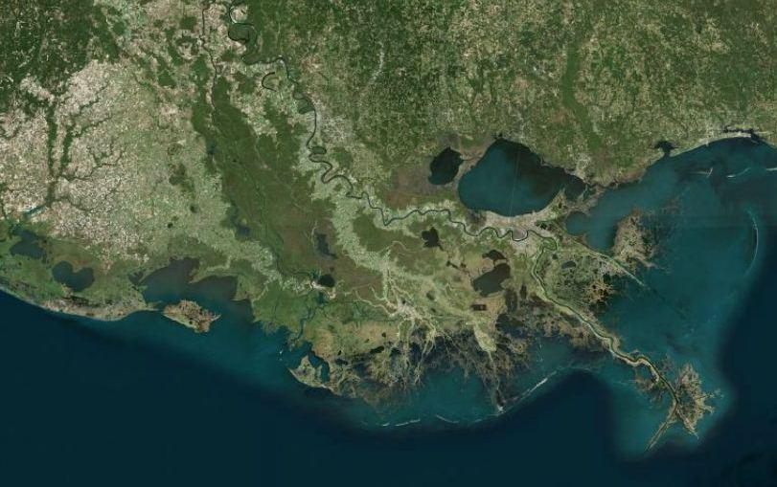
Port Fourchon

Slide 10
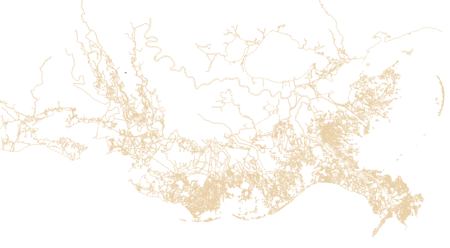
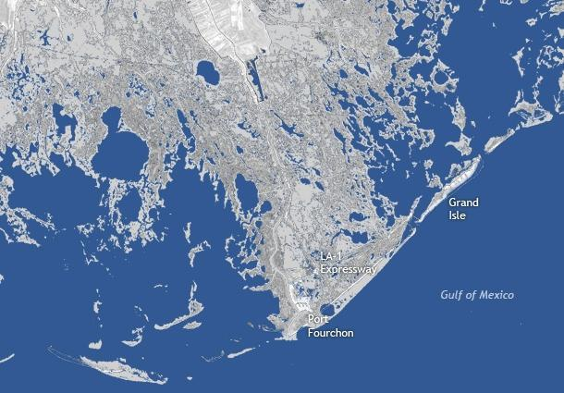
1932
GILL, 2013

Slide 11
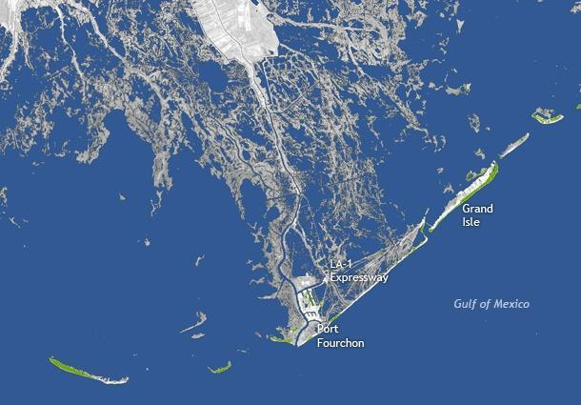
2010
GILL, 2013

Slide 12
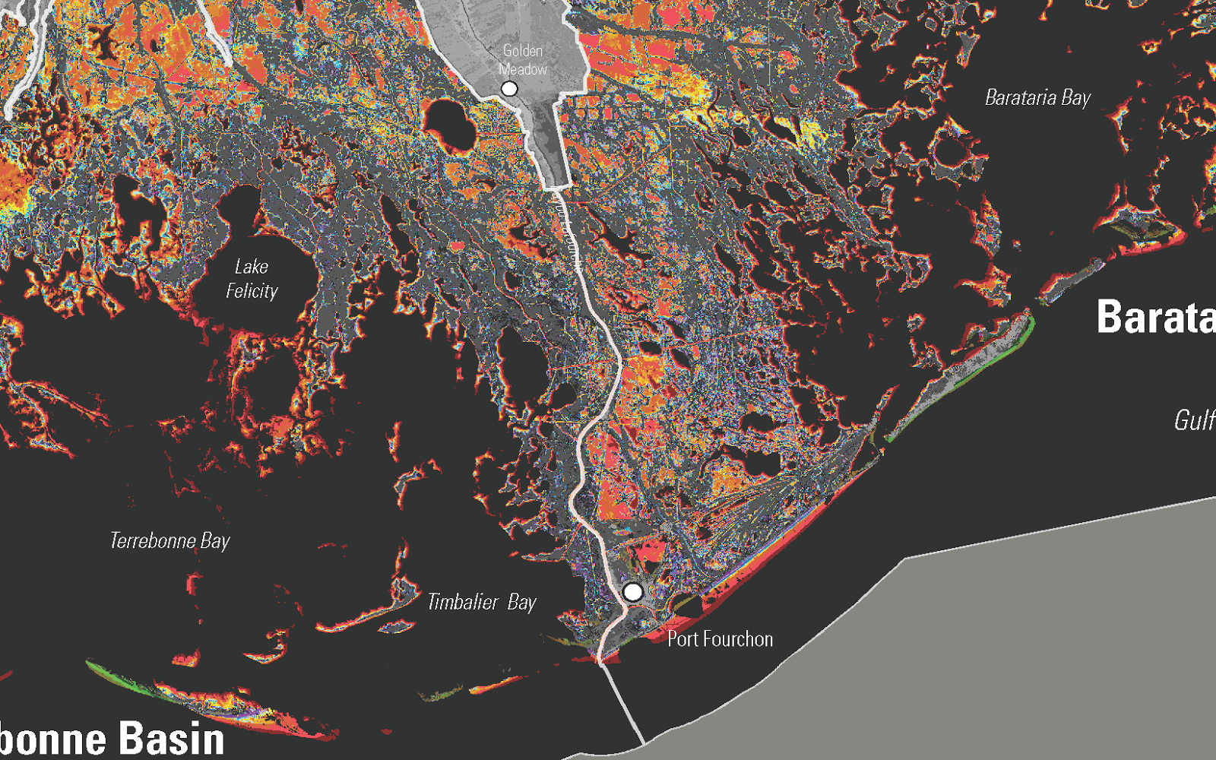
U.S.G.S - Land Area Change in Louisiana 1932-2010
Notes:
A comparison of the two previous slides shows how the USGS Land Area Change Map was constructed. Any areas that were marsh in 1932 and open water in 2010 show up as colored patches on the USGS map. The areas of gray indicate no change. The color codes are by the time interval in which the change occurred. The first two intervals are 24 and 17 years respectively and are colored red. All other intervals are one to two years in length. This explains the concentration of red color.

Slide 13
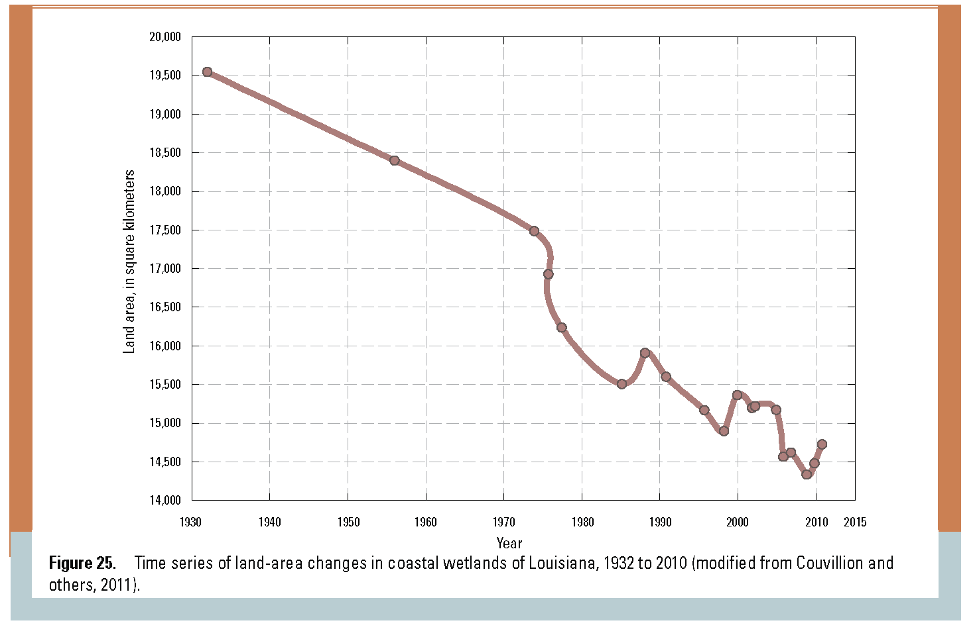
Coastal Land Area Change since 1932
2
Average rate = ~20 mi /yr
1880 sq. mi decrease in wetlands coverage in 78 years
USGS, ALEXANDER, et.al., 2012

Slide 14
Why 1932?
The plaintiffs and their supporters would say that oil exploration began in earnest in the 1930s.
While that is true, the reason that the coastal wetlands loss begin with 1932 is that was the year when aerial photography of the coast began.
The missing information is what happened before 1932.

Slide 15
Determining the Effect of Oil and Gas Production post 1932
This requires determining what other human factors have affected the delta since 1932 and the effect of longer term natural processes.

Slide 16
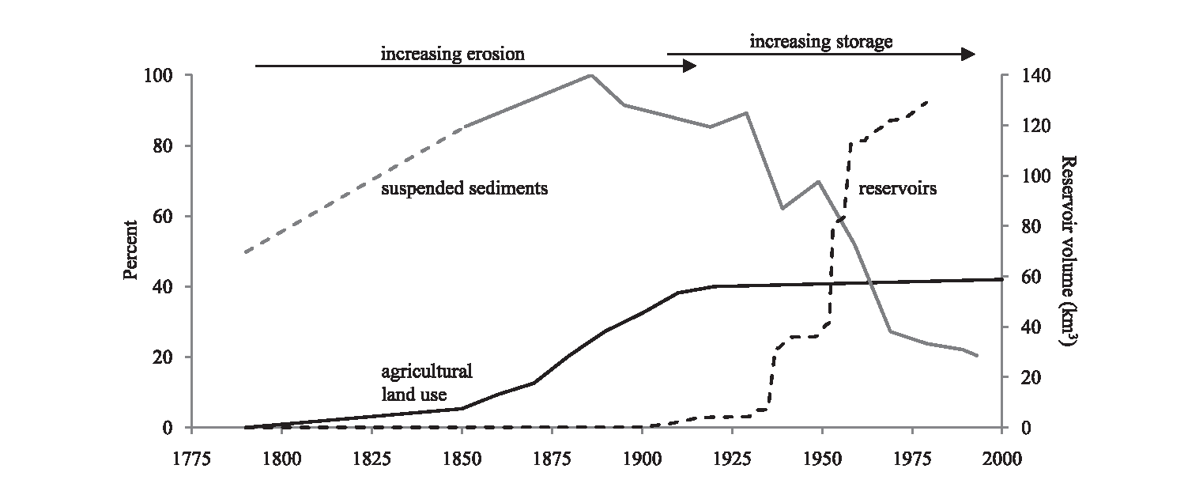
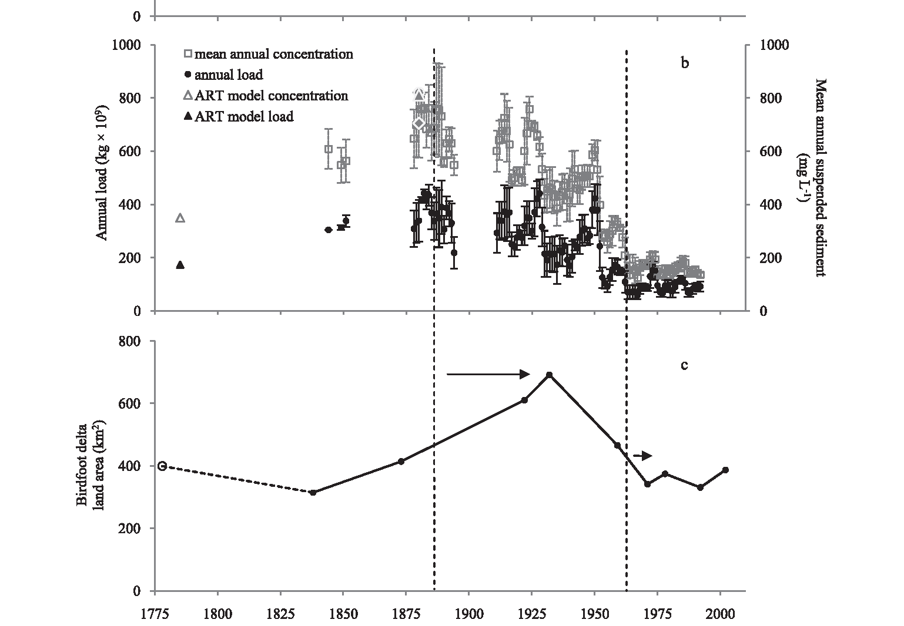
Why 1932 Might Be the Modern Sediment High Point
1932
TWEEL & TURNER, 2012
Notes:
A study by Tweel and Turner in 2012 documented the variation in sediment supply of the Mississippi River since the late 18th century. The decrease in the amount of sediment reaching the delta since the beginning of the 20th century has been well documented, and is due to the construction of locks and dams in the upper reaches of the Mississippi and Ohio Rivers. What is less well know is that this period of decline was preceded by nearly a century of increasing sediment supply in the river due to the rise agricultural land use in the Mississippi Basin. The era of sod-busting dramatically increase the amount of suspended sediment being carried in the river, and it reached a maximum in the early 20th century. Tweel and Turner estimated that land creation in the delta peaked in about 1932.
It turns out that the “baseline of normality” inferred from the 1932 photographs was anything but that. There may have actually been a period of artificially inflated land creation immediately preceding 1932. The natural reaction to this excess of sediment supply being cut off by the construction of the locks and dams would have been a “deflation” of the marsh surface, which could account for a significant proportion of the land loss measure since 1932.

Slide 17
Anthropogenic Changes Since 1932
Sediment in the river peaked in 1932, then declined due to modern farming practices and levees.
Dams have been built, trapping sediment.
Levees have been built, preventing upstream sediment from entering the river and downstream sediment from flooding the delta.

Slide 18
Long Term Natural Processes
The Mississippi Delta from the Holocene to 1932

Slide 19
Why do Plaintiff’s Claim the Wetlands Built over 6000 Years?
This in the end of the Holocene, which began about 12,000 years ago.
The glaciers were melting and sea level was rising until about 6,000 years ago.
The modern Mississippi Delta started 6,000 years ago.

Slide 20
What was here before the Modern Delta?
The ice cap from the last ice age was at the maximum about 20-25,000 years ago.
So much water was tied up in the ice that the sea level was about 120 meters (nearly 400 feet) lower than today.
The Mississippi River was more than 100 miles out into the Gulf of Mexico, in a huge canyon.
What is seen as the delta did not exist.

Slide 21
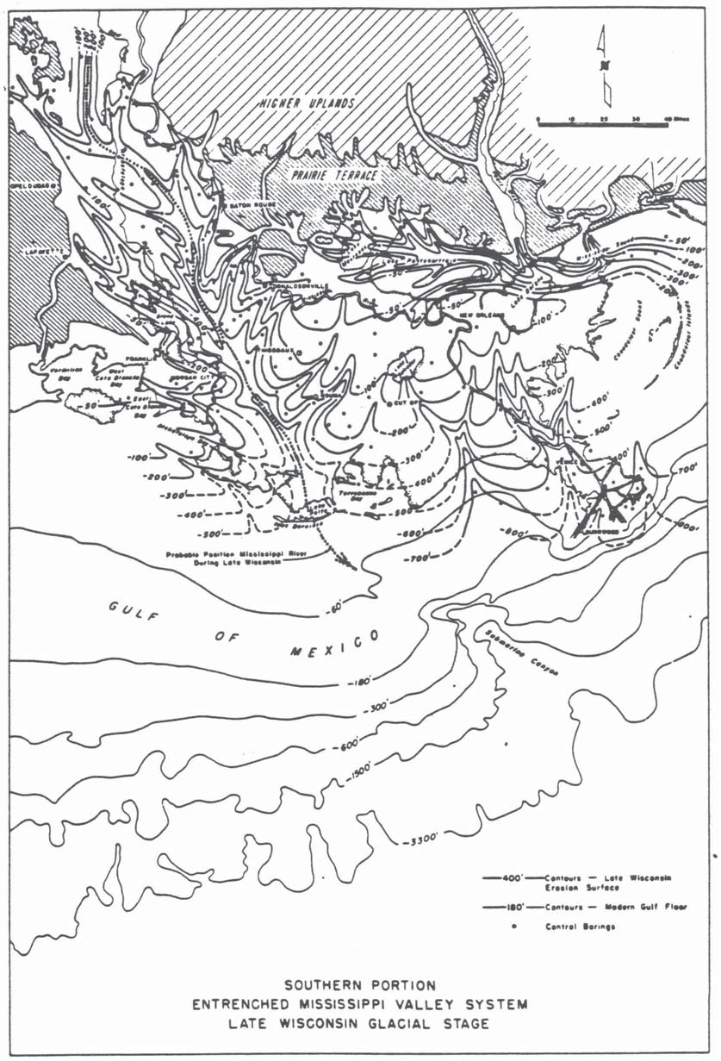
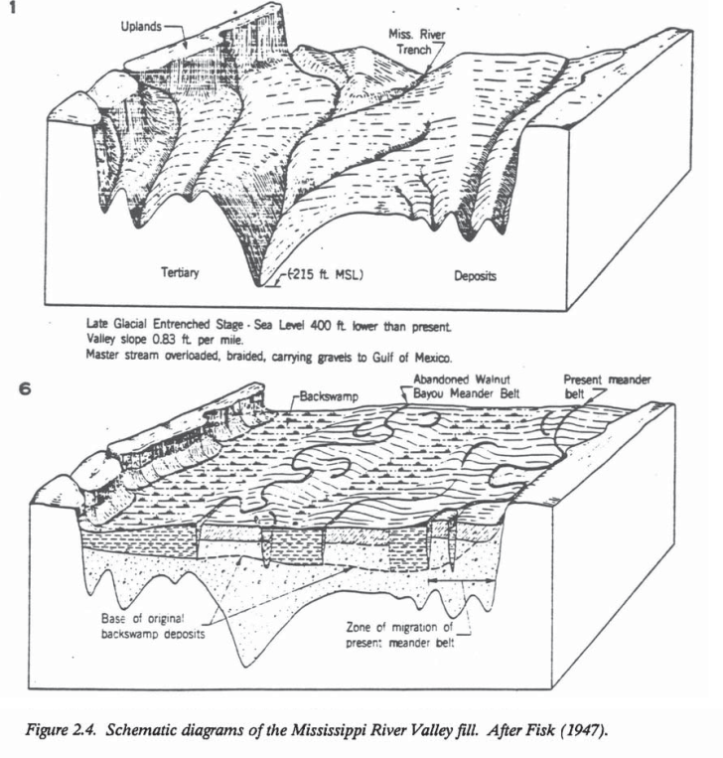
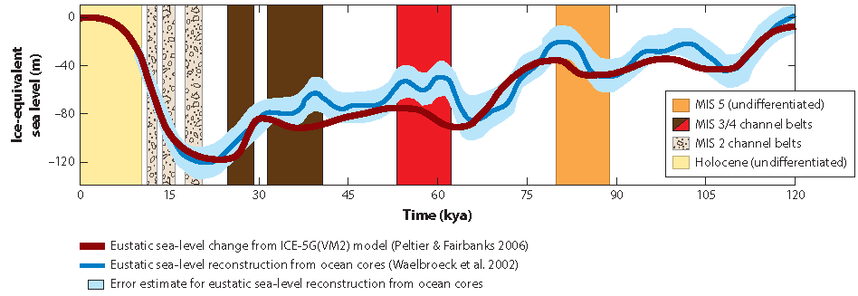
Exposed Continental Shelf During the last Ice Age
Higher Uplands
Pleistocene Terrace
Pleistocene erosional surface
Exposed Shelf
Shelf-edge
Delta
Shoreline
BLUM & ROBERTS, 2011
FISK, 1944

Slide 22
What Happened When the Ice Melted?
The Mississippi was a flooding torrent for thousands of years and carried much more sediment at that time than since.
Despite this mountain of sediment, coastal edge – what we call the delta today – retreated inland more than 100 miles.
Lesson for sea level rise from climate change: sea level rise trumps sediment.

Slide 23
Rising Sea Level
as Ice Cap Melted
Higher Uplands
Braided stream aggradation
Pleistocene Terrace
Holocene delta deposits
BLUM & ROBERTS, 2011
FISK, 1944

Slide 24
Building the Modern Delta
All of the modern river deltas started to build when sea level stabilized about 6,000 years ago.
As long as sea level was rising at a significant rate, the coast line retreats inland because the river cannot build a delta uphill.

Slide 25
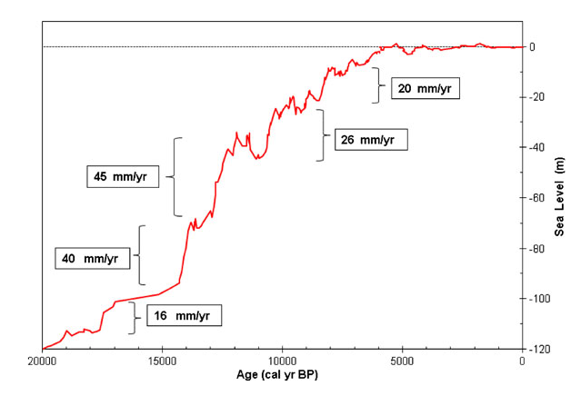
Post-Glacial Maximum Sea Level
Donoghue, Joseph F. “Sea Level History of the Northern Gulf of Mexico Coast and Sea Level Rise Scenarios for the near Future.” Climatic Change 107, no. 1–2 (2011): 17–33.

Slide 26
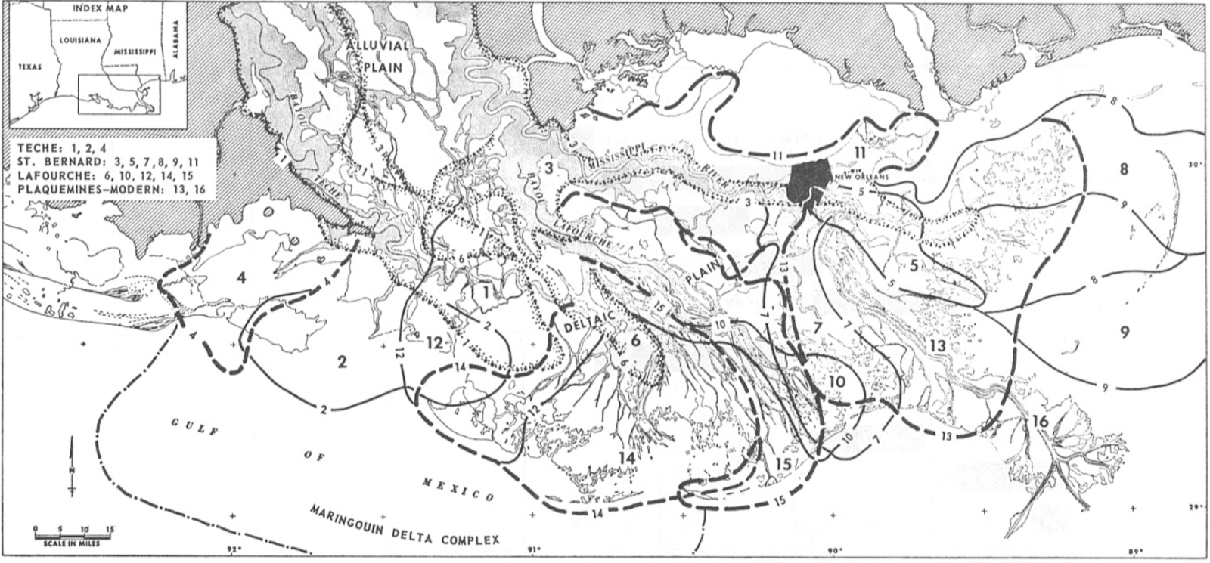
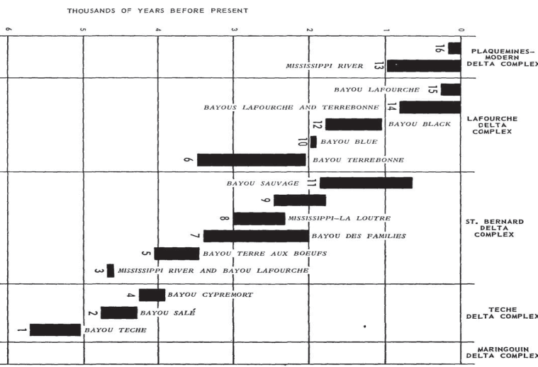
Recent Deltatic Deposits of the Mississippi River:
Their development and chronology – David E. Frazier, 1967
6
5
Thousand Years Before Present
4
3
2
1
0
Notes:
This study by David Frazier in 1967. He used hundreds of cores taken across the coastal plain to interpret and age date as set of sixteen deltas that went into the construction of the wetlands. The graphs shows that each component delta had a distinct live span with a creation, abandonment and eventual subsidence below the surface.

Slide 27
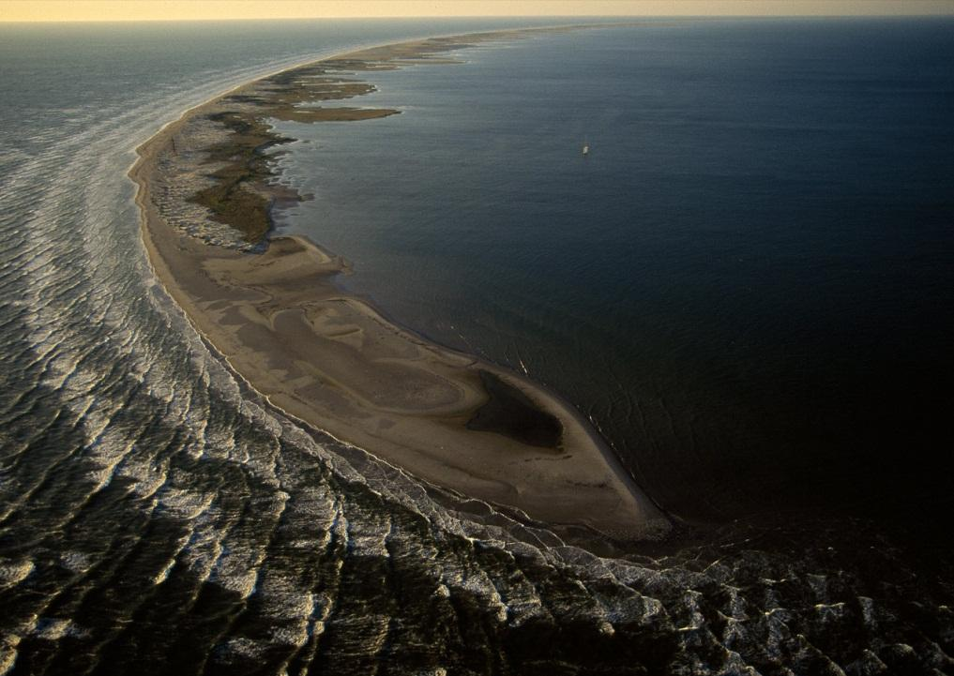
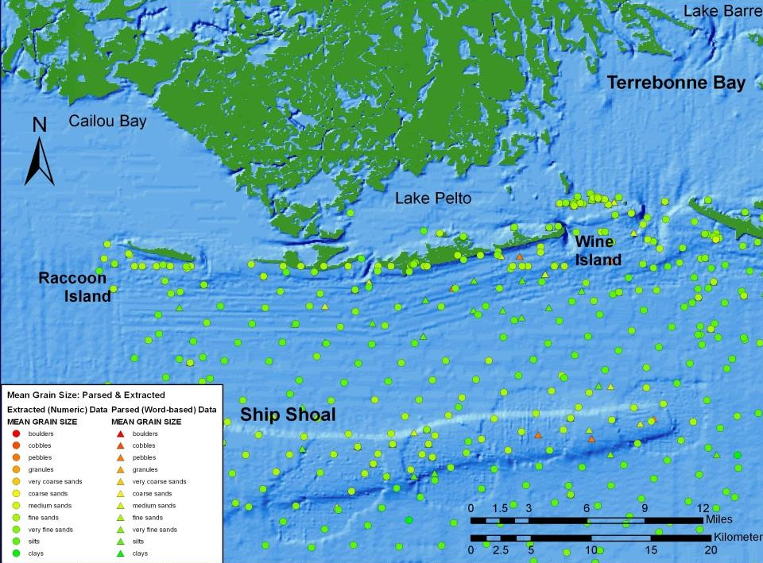
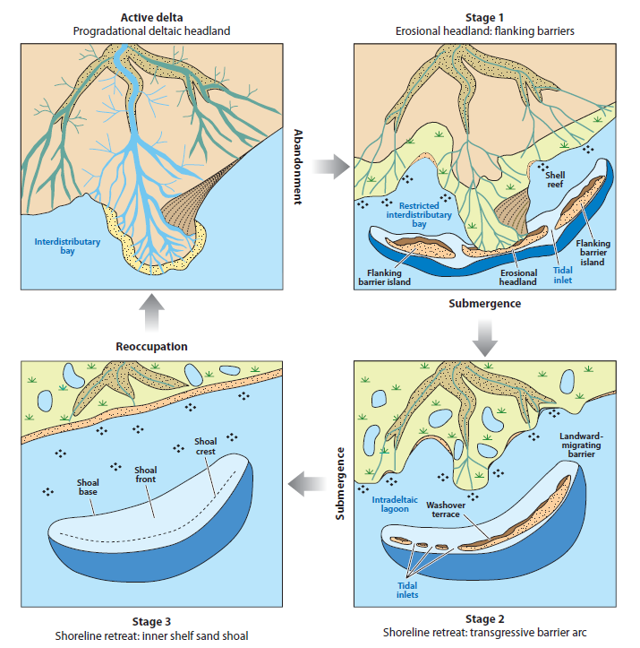
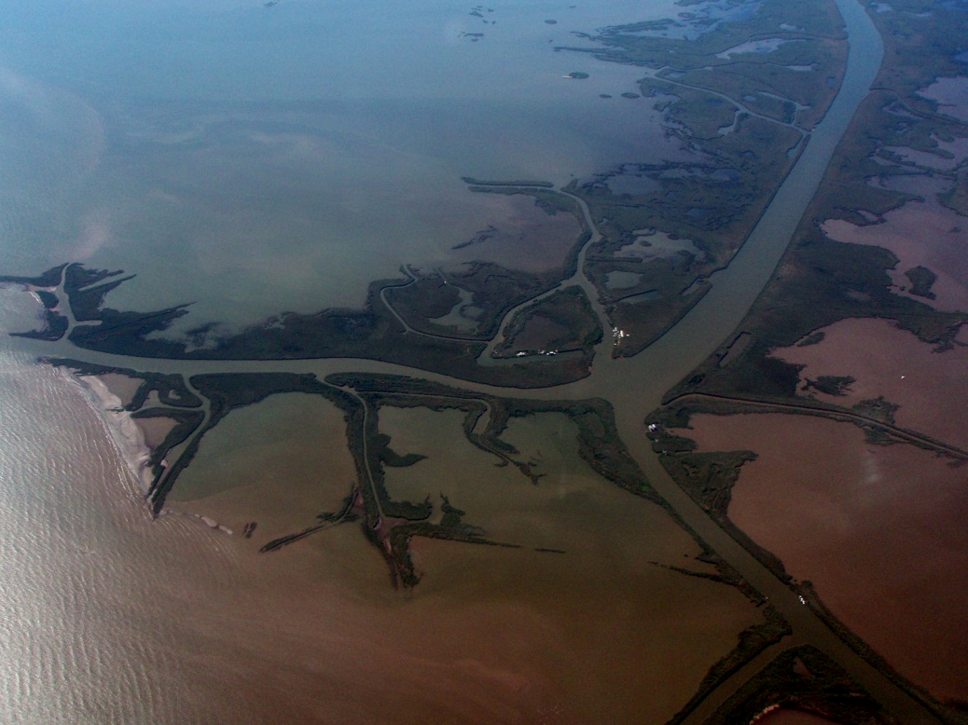
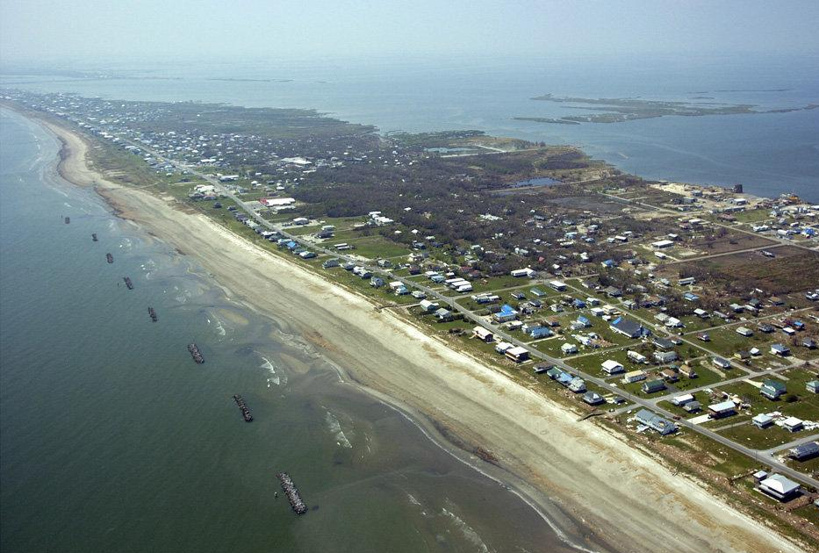
The Delta Cycle
Chandeleur Islands
Ship Shoal
Grand Isle
Mississippi River Delta
Notes:
Blum and Roberts published this diagram of “Delta Cycle”. It is based on previous work by Roberts, James Coleman and Shea Penland. The delta cycle shows that each delta that went into constructing the wetlands had a distinct live cycle from active delta, as represented by the modern birdfoot in which sand bars are deposited at the distributary mouths, to Stage 1 abandonment, represented by Grand Isle, in which those sand bars are pushed up onto the marsh creating an erosional headland with the delta marsh beginning to subside behind the newly formed barrier island, to Stage 2 early submergence, represented by the Chandeleur Islands, in which the marshes behind the barrier island are completely submerged, and the island is rolled toward the coastline, to finally Stage 3 submergence, represented by Ship Shoal, in which the barrier island is completely submerged. Continuation of the cycle is propagated by the reoccupation of the body of open water created by subsidence by a new active delta.

Slide 28
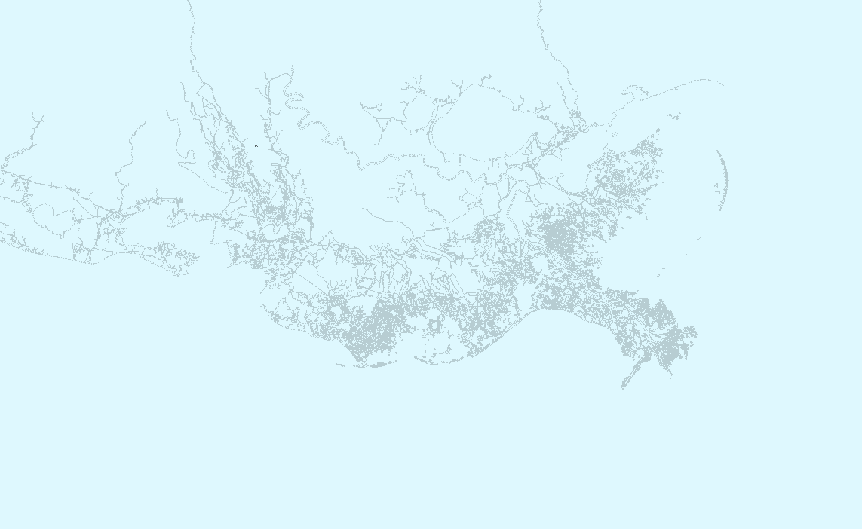
5,500
years before present
Pine Islands
2
0
Trinity Islands
0
1
3
2
Notes:
The following set of eight slides shows the same sequence of time increments previously examined, but this time paying attention to progression of the delta cycle, and where new marsh was being created, and where abandoned deltas were subsiding below the surface. Numbers in the lower right corner show and estimate for number of square miles of new land created and number of square miles of land loss during each time interval.

Slide 29
4,500
years before present
0
2
1
Trinity Shoals
0
1
2
+ 2095
mi
2
- 892
mi
3
2

Slide 30
3,500
years before present
0
0
3
Trinity Shoals
0
0
1
2
+ 4315
mi
2
- 886
mi
3
2

Slide 31
2,500
years before present
0
2
1
Trinity Shoals
0
1
2
1
+ 3306
mi
2
- 2411
mi
Outer Islands
3
2
Notes:
A detailed study of the St Bernard Delta system by Rogers, et.al. from UNO mapped the component delta lobes using cores and sparker profiles. Their configuration of one of the subdeltas is strikingly similar is size and shape to the modern birdfoot delta.

Slide 32
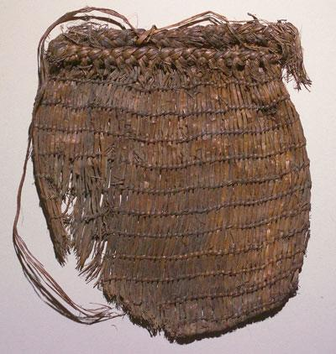
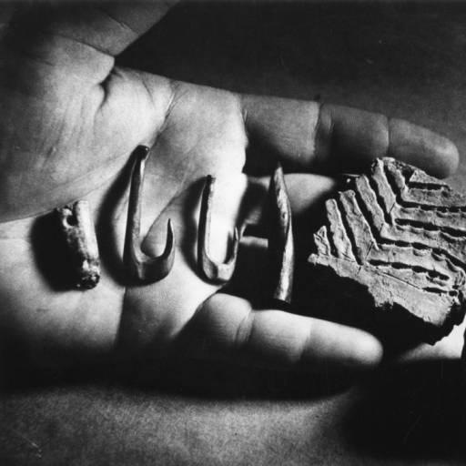
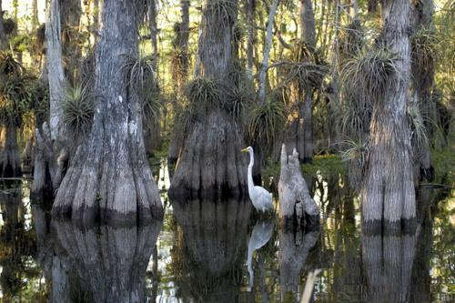
2,500
years before present
Bayou Jasmine Archeological Site
Twinned bag ca. 800 BC
0
LSU TEXTILE MUSEUM
1
2
Trinity Shoals
2
1
+ 3306
mi
2
- 2411
mi
Outer Islands
Notes:
The St. Bernard Delta was very likely inhabited by native people, who’s existence is documented by several archeological sites. The cypress stump found in Frazier’s core documents that this part of the coastal plain was a complex system of cypress swamps and fresh and saltwater marshes.

Slide 33
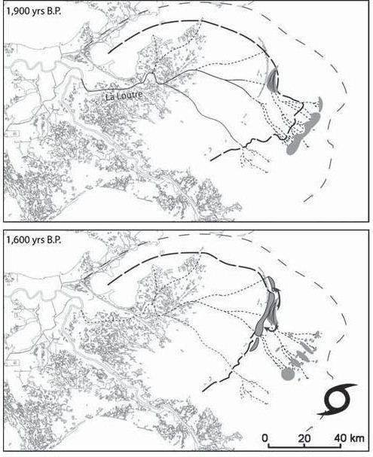
1,500
years before present
2
1
3
0
St Bernard Islands
Trinity Shoals
1
0
0
1
2
Ship Islands
+ 3657
mi
2
- 2349
mi
Outer Shoal
3
2
Notes:
One it was abandoned the St. Bernard Delta began to subside very rapidly. A rough estimate based on the Rogers et.al. study would suggest that the rate of land loss in this delta was consistent with the rate of land loss being measured in the modern birdfoot delta.

Slide 34
500
years before present
Chandeleur Islands
2
0
3
St. Bernard Shoal
0
Trinity Shoals
2
0
1
2
Ship Shoal
+ 2075
mi
2
- 2504
mi
Outer Shoal
3
2
Notes:
By the time that Europeans had landed in the Americas, the rate of land creation and land loss had come into equilibrium. During most of this time period sea level was at a relative standstill. It is logical to assume that without the intervention of humans into the natural patterns of the delta cycle, and the introduction of anthropogenic sea level rise, the coastal plain would have maintained a “no net loss” equilibrium for the foreseeable future in which every acre of wetlands that succumbed to subsidence would be matched by an acre of newly created wetlands at the site of the active delta.

Slide 35
82
years before present (1932)
Chandeleur Islands
2
3
0-1
St. Bernard Shoal
Trinity Shoals
0
Isle Dernier
1
Grand Isle
0
1
2
Ship Shoal
+ 1342
mi
2
- 1082
mi
Outer Shoal
3
2
Notes:
By 1932 the coast of Louisiana had come into the configuration that we recognize as the baseline for assessing change that has occurred since then. It is obvious from this review that 1932 hold no special place in the history of the development of the coast. It was simply a point in time during the continuous evolution of the coastal plain at which a set of photographs were taken.

Slide 36
Land Lost before 1932
2
~10,000
mi
Total estimated submergence prior to 1932
This land was lost without human intervention

Slide 37
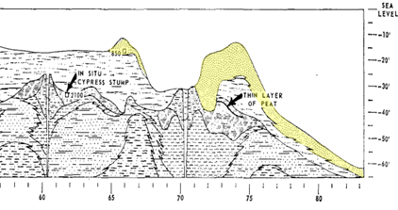
Subsidence and the Delta Cycle
33’/2100 yrs = 0.2 in/yr = 5 mm/yr
Notes:
This cross section extends from the edge of the Ninth Ward across Breton Sound. Delta 5 has subsided almost entirely to a depth of more than 30 feet below sea level. Delta 9 which stretched across Breton Sound has also sunk to depths of up to 30 feet. A detail from Frazier’s section shows that an in situ cypress stump was encountered at 33 feet below sea level and could be age dated to 2100 years old. This gives a more accurate measurement of subsidence rate.

Slide 38
Subsidence Today
The historic sediment load on the delta causes the subsidence that creates the space for the river to deposit the new sediment – the accommodation space.
As we have seen, when the river is not putting sediment in an abandoned part of the delta, the subsidence continues and the abandoned lobe sinks below the water.
This subsidence is drowning the coast.

Slide 39
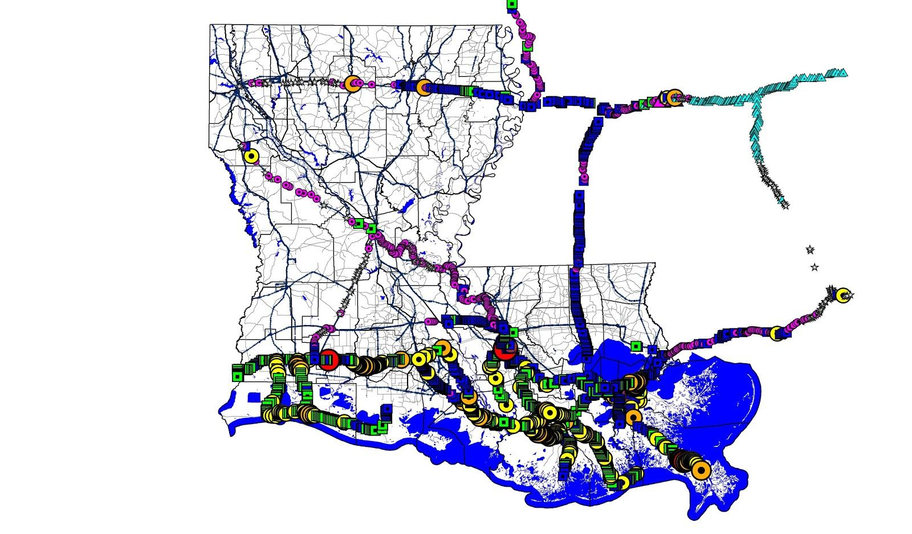
stable
Subsidence and the Sediment Load
uplift
Shinkle and Dokka (2004)
NOAA Tech. Rept. 50
Stars
0 inch/yr
Blue square
-1/3 inch/yr
Green square
-1/2 inch/yr
Load of
Holocene Mississippi
River Delta
Yellow circle
-3/4 inch/yr
Coastal parishes
avg. = ~-1/2 inch/yr
© 2003 Louisiana State University
1960s-1980s

Slide 40
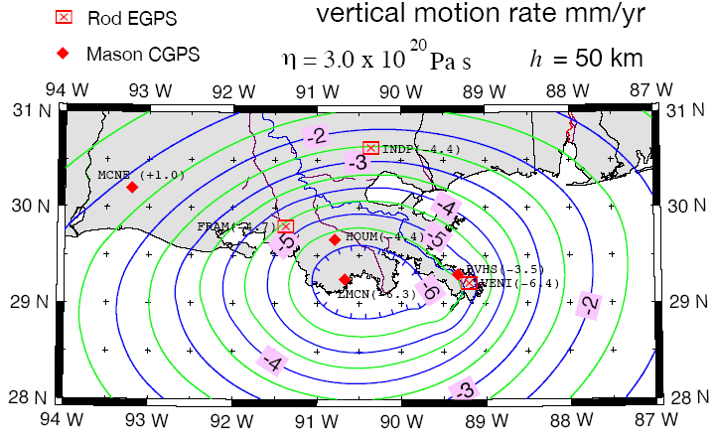
Predicted present-day vertical motions
in mm/yr from delta & ocean loads
Ivins et al (2006)
GULFNet station at
Cocodrie, LA
→sinking 6.3 mm/yr

Slide 41
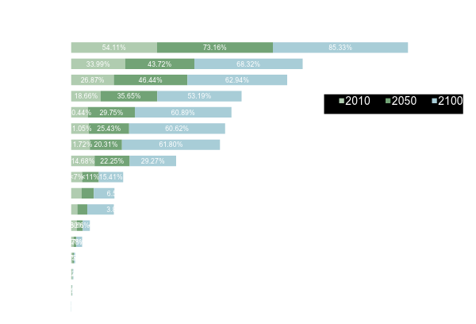

Slide 43
Development of the Coastal Erosion Model
The Standard Accepted Model for Land Loss on which the Lawsuit is Based is fundamentally flawed

Slide 44
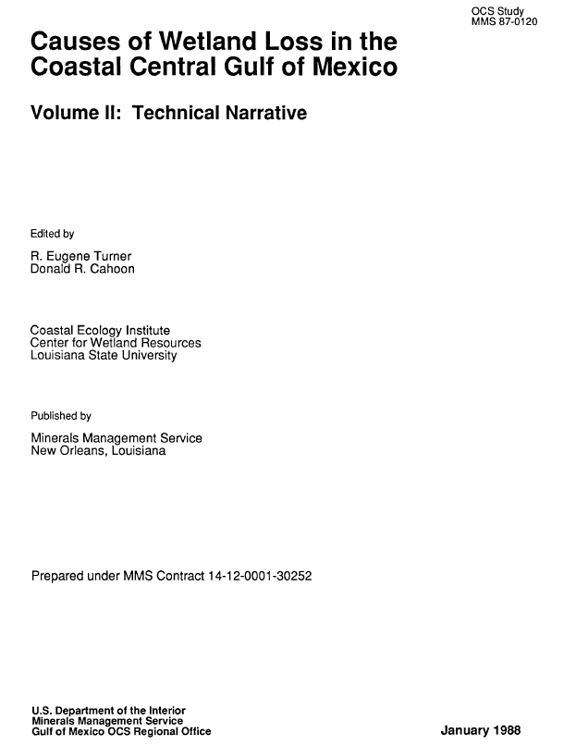
Two Foundational Studies
“Total canal area is estimated to be 10% of the Louisiana coastal region in 1978 and directly accounts for approximately 6.3% of the total wetlands loss from circa 1955 to 1978. However a strong statistical relationship exists between canal density and total wetlands loss indicates that the indirect impacts of canals account for a substantially larger percentage of total wetlands loss.” Page 56
“Total canal area is estimated to be 10% of the Louisiana coastal region in 1978 and directly accounts for approximately 6.3% of the total wetlands loss from circa 1955 to 1978. However a strong statistical relationship exists between canal density and total wetlands loss indicates that the indirect impacts of canals account for a substantially larger percentage of total wetlands loss.” Page 56
Notes:
The most reliable estimates for land loss caused by the direct removal are usually quoted from the early work on the subject independently done by Turner and Penland. Turner led a research team working for the Minerals Management Service and published this document in 1988. They made an estimate of 6.3% of the total wetlands loss being due to direct removal, but insisted on a substantially larger percentage based on a “strong statistical relationship”

Slide 45
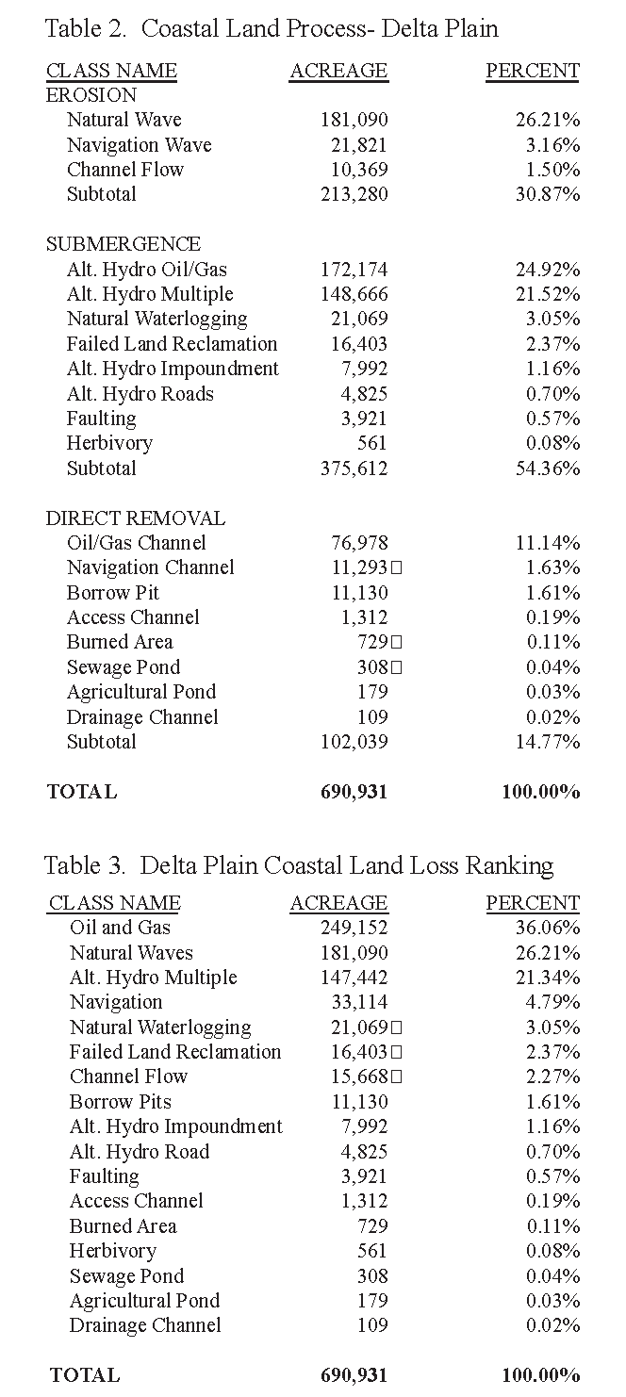
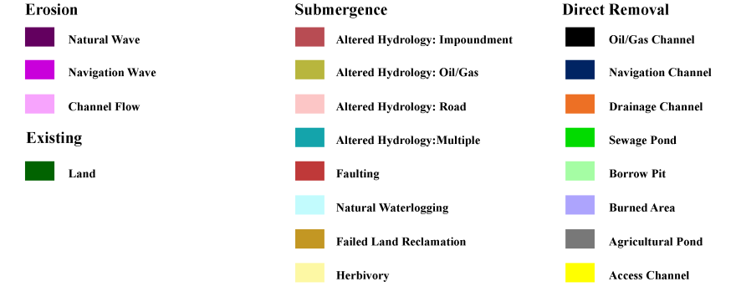
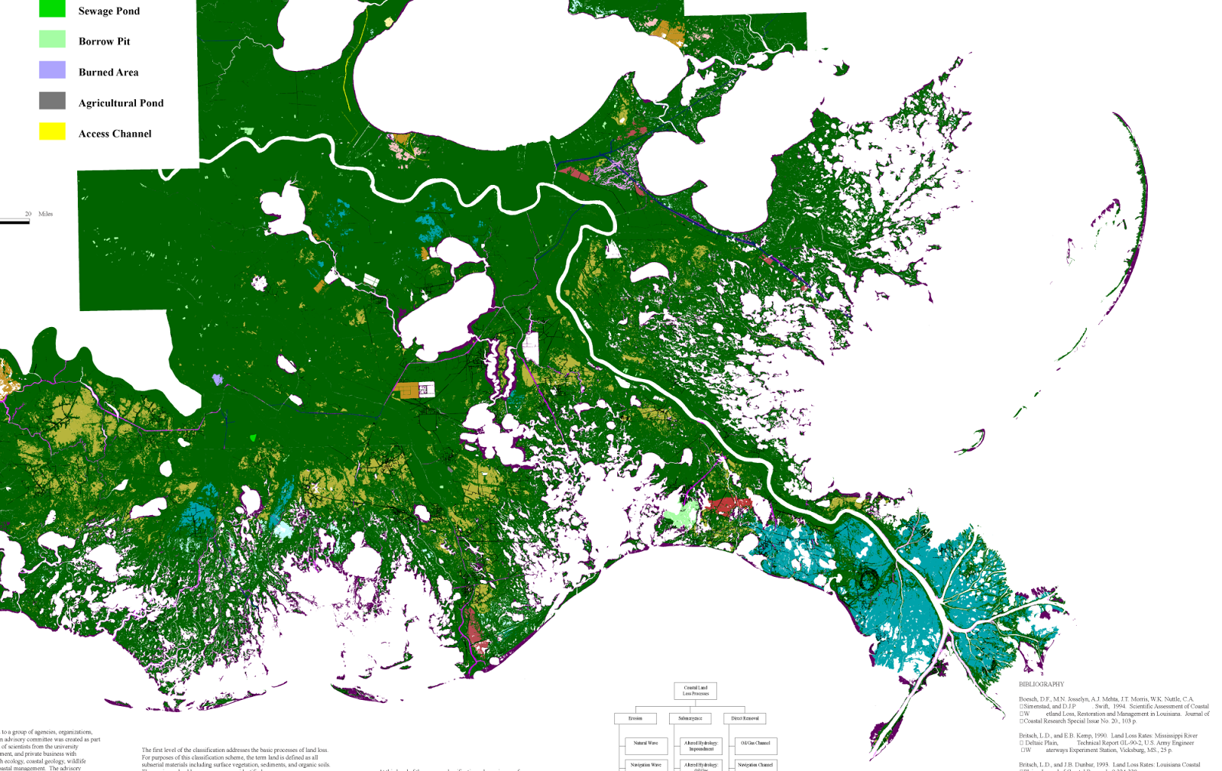
Process Classification of Coastal Land Loss 1932 – 1990
Penland, et. al., 1990
Notes:
Two years later Penland, et.al. made a very similar estimate, and they published their finding in map form. In their estimate direct removal accounted for 11% of the land loss and they attributed an additional 25% to “altered hydrology” caused by the dredged canals. On the map the direct removal is shown as the dark blue and black that define the canals. Their estimate appears to be a little high for oil and gas because they include several navigational canals that were used by oil and gas operators, but that would very likely have been dredged if there were no oil and gas industry in the area.
The dark yellow patches define the areas assigned to land loss indirectly caused by the oil and gas canals. These will be examined in more detail shortly.

Slide 46
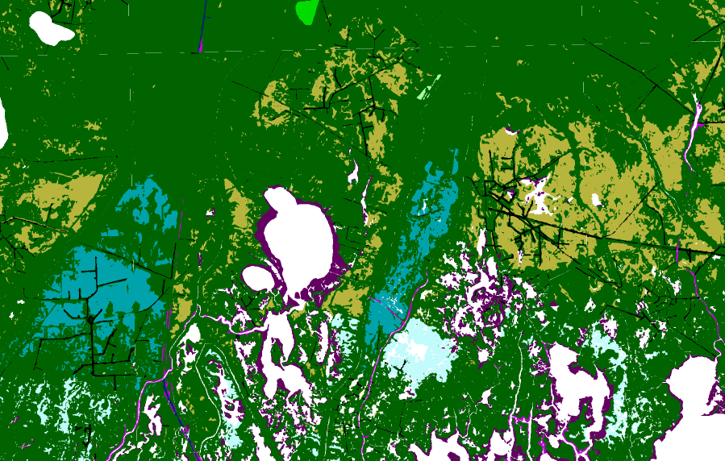
Penland’s Coastal Land Loss 1932 – 1990
Notes:
Penland’s areas of land loss due to altered hydrology and attributed to the oil and gas canals can now be put into context. Some of these areas of land loss are associated with the location of oil field canals, but most are not. The much more obvious relationship is with the downthrow sides of the active surface fault traces.

Slide 47
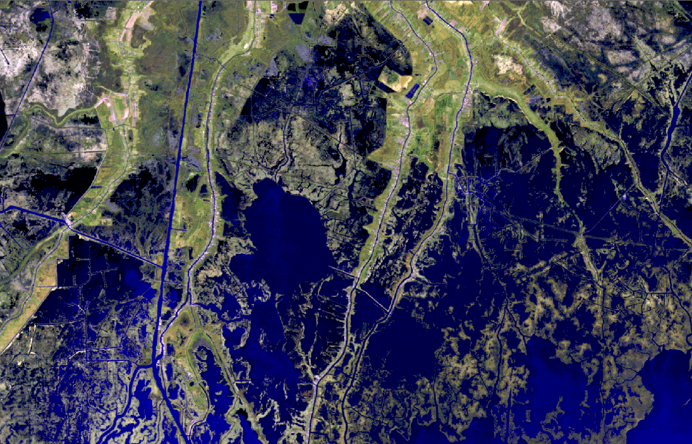
Energy Industry Operations in the Wetlands
Houma Navigational Canal
CHAVIN
MONTEGUT
CHAVIN
Bayou Pointe au Chien
Bayou Dularge
Bayou Jean le Charles
Falgout Canal
LIRETTE
Lake Boudreaux
DULAC
Bayou Terrebonne
BAYOU RAMBIO
LAPEYROUSE
Notes:
The same pattern is clear on the satellite photography for the area. The hot spots of land loss are logically areas of open water.

Slide 48
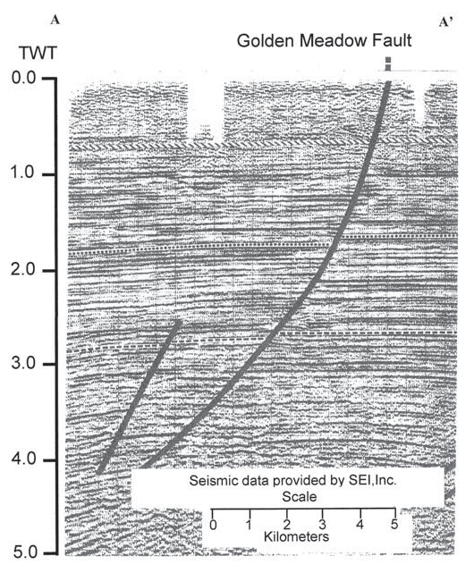
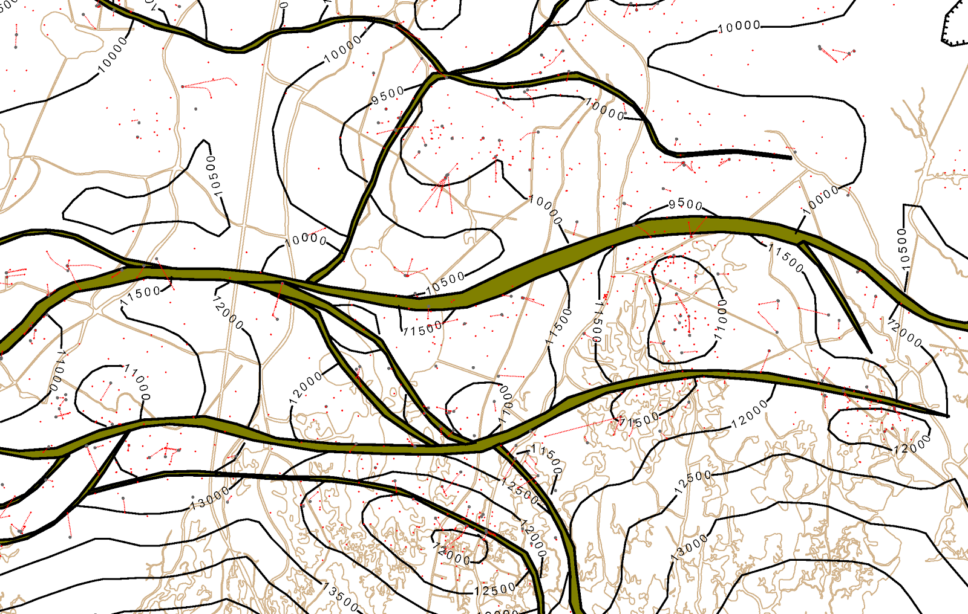
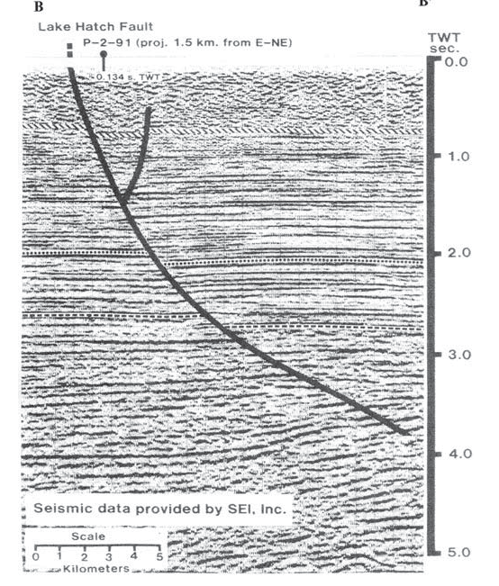
Middle Miocene Fields
A
A’
B
CHAVIN
B
B’
A’
B’
LIRETTE
BAYOU RAMBIO
A
LAPEYROUSE

Slide 49
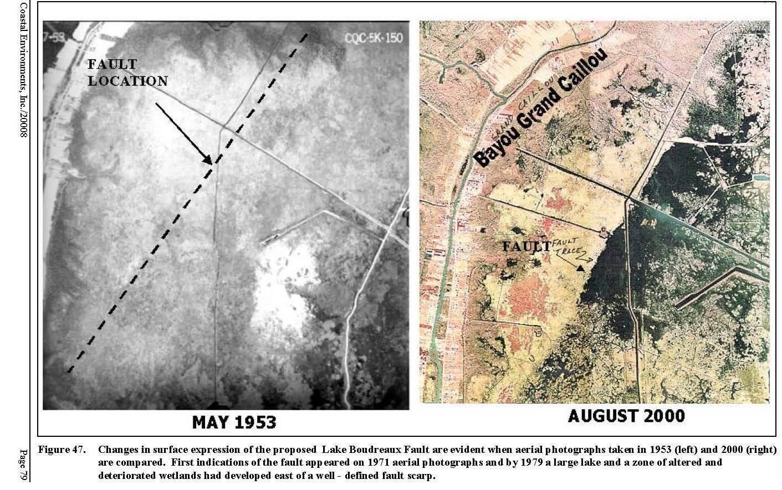
Surface Fault Traces
Notes:
Gagliano examined these same fault systems in his 2003 study. He showed that the altered hydrology is actually due to a rotation of the marsh surface by the movement of the faults. Instead of the commonly stated model of the canals opening up the interior marshes to saltwater intrusion, it is actually the slope of the marsh surface that allows the saltwater to flow into the subsided areas. The juxtaposition of the low areas holding more saline water is what killed the cypress trees. Gagliano also shows in comparative photographs that the area of continuous unbroken marsh in 1953 is bisected by the fault and only the downthrown side is converted to open water.

Slide 50
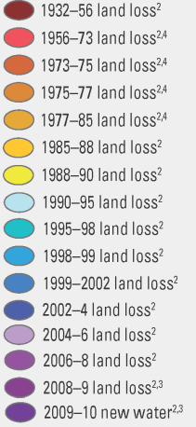
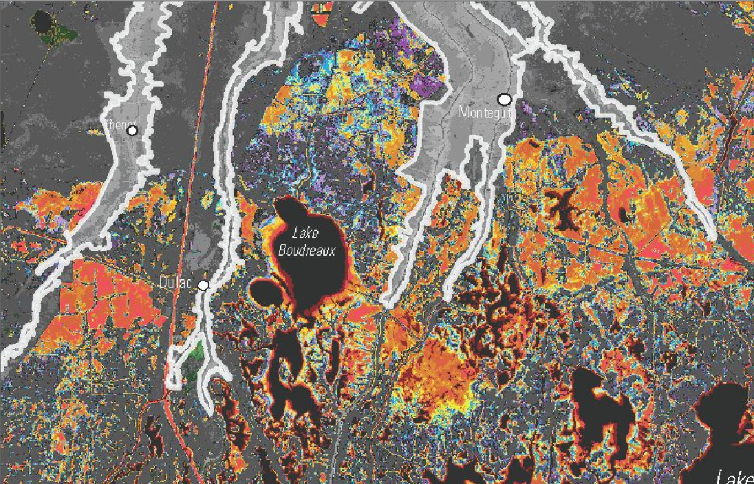
Surface Fault Traces
Notes:
The surface traces of these faults show a clear and repeated relationship with hot spots of land loss in this area. The fault traces form sharp northern boundaries to the hot spots. All of these faults are classic Gulf Coast down-to-the-basin faults meaning that their downthrown sides are to the basinward or south side of the trace. Active subsidence is occurring on the downthrown side of the fault, and the upthrown sides are generally undisturbed marsh that has not experienced land loss since 1932.

Slide 51
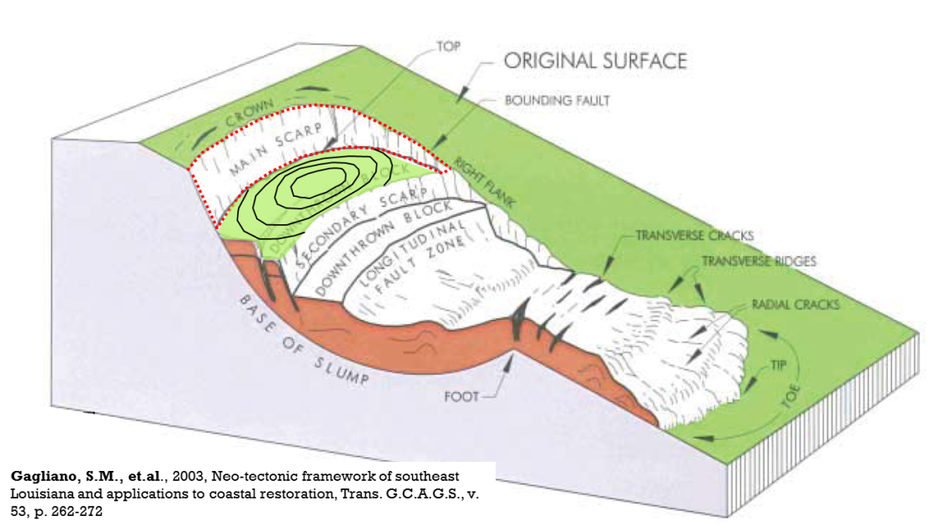
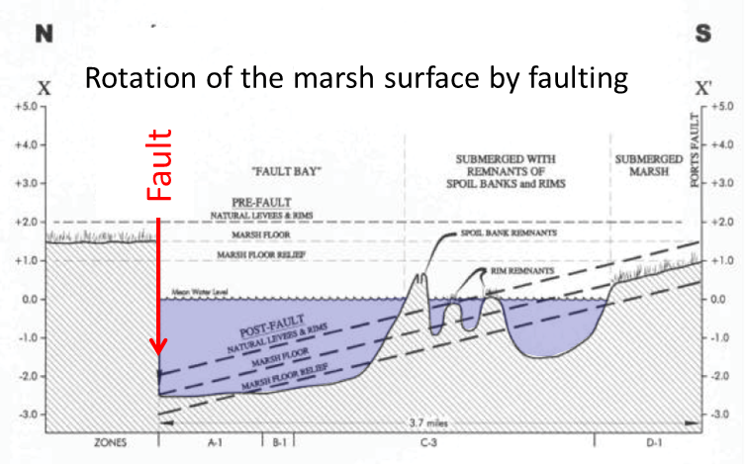
Subsidence Due to Faulting

Slide 52
Marsh Subsidence Due to Faulting
Notes:
Gagliano examined these same fault systems in his 2003 study. He showed that the altered hydrology is actually due to a rotation of the marsh surface by the movement of the faults. Instead of the commonly stated model of the canals opening up the interior marshes to saltwater intrusion, it is actually the slope of the marsh surface that allows the saltwater to flow into the subsided areas. The juxtaposition of the low areas holding more saline water is what killed the cypress trees. Gagliano also shows in comparative photographs that the area of continuous unbroken marsh in 1953 is bisected by the fault and only the downthrown side is converted to open water.

Slide 53
Land Loss Due to Faulting
Notes:
The sequence of inset photographs shows the evolution within the area of the white square since 1971. As can be seen on the land area change map, the upthrown side of the fault shows very little change through the time interval, while the downthrown side is progressively converted to open water by subsidence. Gagliano show various patterns by which fault may subsided the marsh surface. The area around Wonder Lake has a multiple fault signature.
A couple of points of interest on this slide. The yellow line on the photographs is the proposed alignment of the Morganza to the Gulf Levee, and the lower right corner of the white box on the land area change map is the approximate location of Bayou le Jean Charles, which was the subject of a documentary about people being displaced from their village by coastal erosion caused by oil and gas operations.

Slide 54
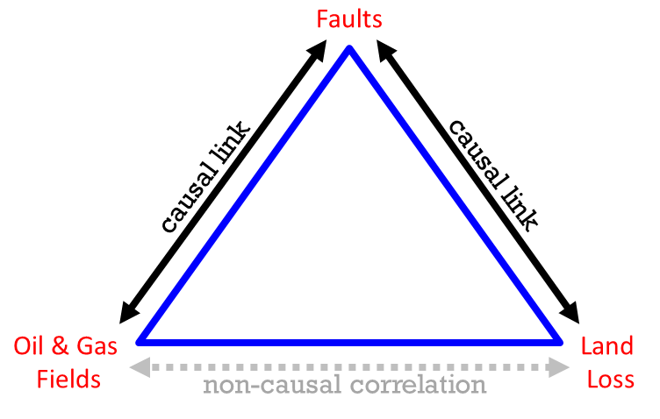
Causal and Non-causal correlations
Notes:
Penland’s areas of land loss due to altered hydrology and attributed to the oil and gas canals can now be put into context. Some of these areas of land loss are associated with the location of oil field canals, but most are not. The much more obvious relationship is with the downthrow sides of the active surface fault traces.

Slide 55
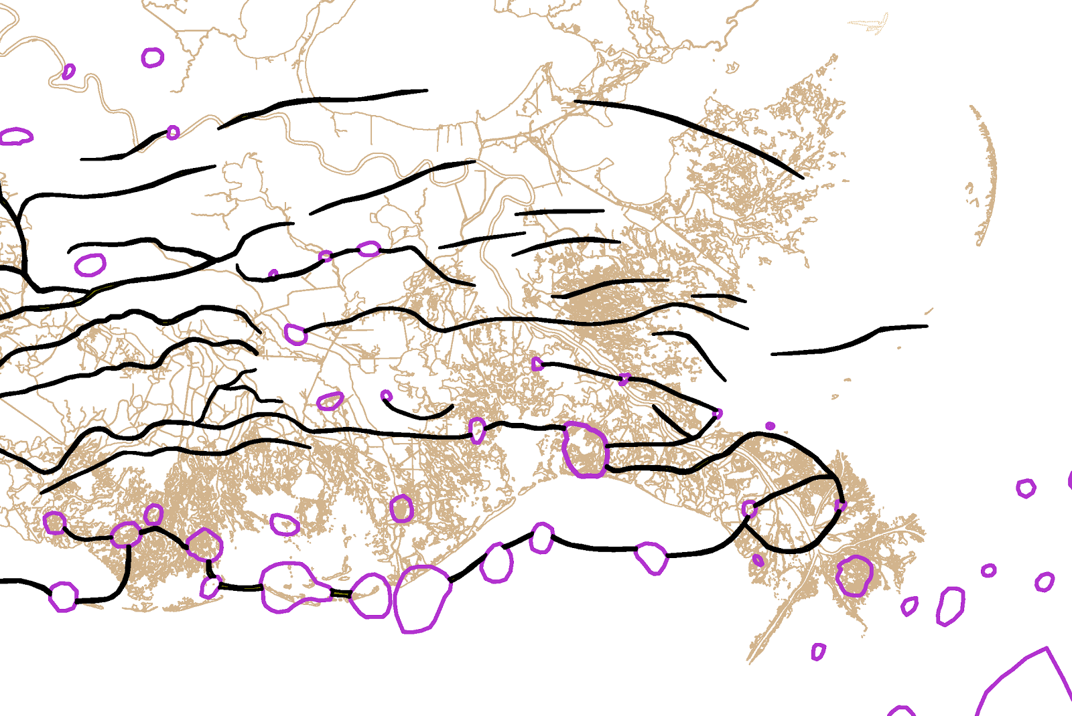
Regional Geology
N
Holocene
S
Pliocene & Pleistocene
Upper Miocene
Pre-Miocene Tertiary
Middle Miocene
Houma Fault
Lafitte Fault
Magnolia Fault
Lake Hatch Fault
Empire Fault
Golden Meadow Fault
Bastian Bay Fault
West Delta Fault
West Bay Fault
The Terrebonne Trough
Notes:
Most of the major fault systems have been mapped in detail, and several of them have been continuously active throughout the history of the basin, and they cut to the surface as shown on the cross section. The surface traces of these shallow cutting faults have also been mapped in some detail as shown by the red dashed lines, but there is much work that can be done to refine the detail of how they cross the marsh.

Slide 56
Land Loss in Southeast Louisiana
Notes:
The effect of the activity of the major fault systems at the surface is apparent on a satellite image of the coastal plain

Slide 57
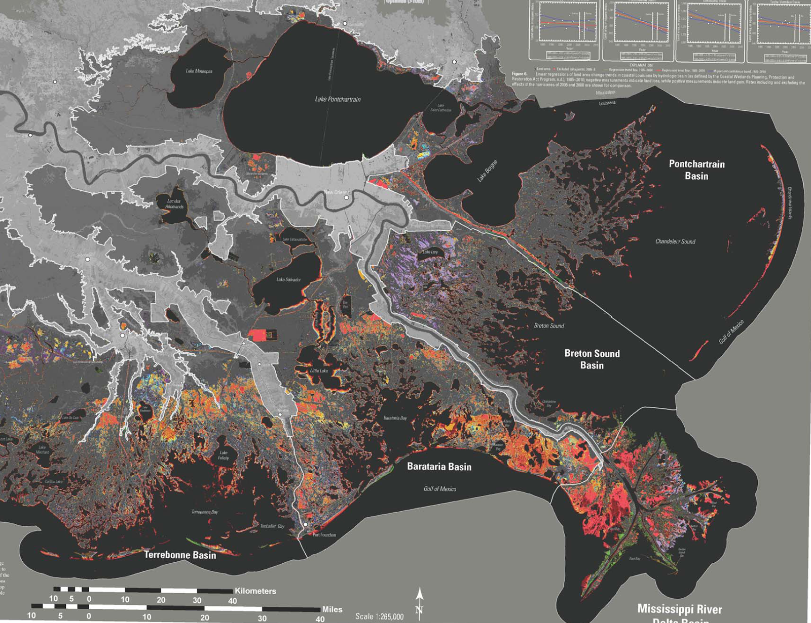
Faults and Land Loss
Notes:
There is also a very clear relationship between the active faults at the surface and the hot spots of land loss. The examination of this area in detail brings that relationship to light.

Slide 58
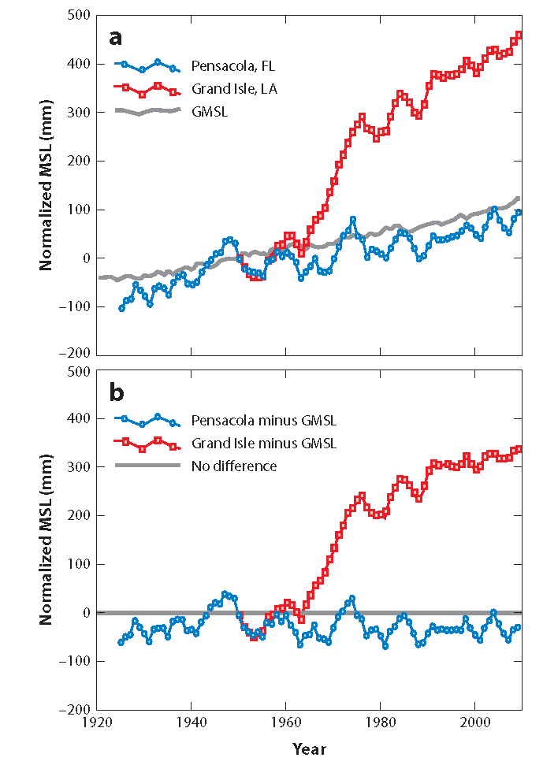
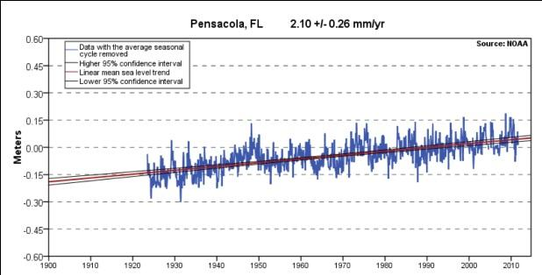
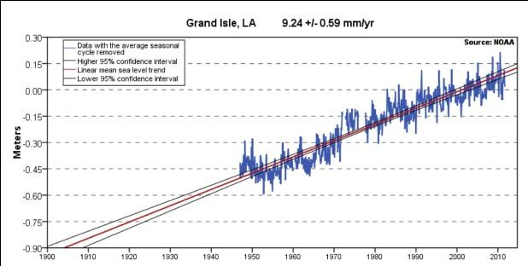
Measuring Subsidence
subsidence

Slide 59
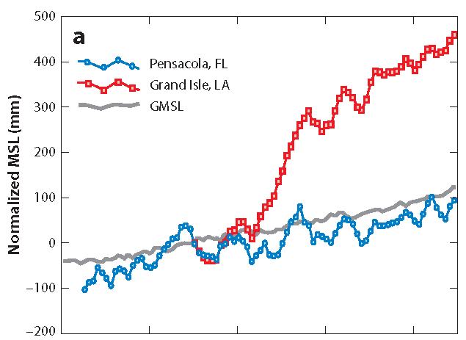
Effects of Subsidence and Sea Level Rise
1932
470 mm = 18.5”
total relative sea
level rise since 1932
subsidence
2010
sea level rise
1932

Slide 60
Subsidence in mm/yr
Dokka, R et.al., 2009, Gulf Coast subsidence, crustal loading, geodesy, and InSAR: Gulf Coast Association of Geological Societies Transactions, v. 59, p. 101-114.
5 mm/yr
6 mm/yr
Fort Proctor

Slide 61
Subsidence in mm/yr
Dokka, R et.al., 2009, Gulf Coast subsidence, crustal loading, geodesy, and InSAR: Gulf Coast Association of Geological Societies Transactions, v. 59, p. 101-114.

Slide 62
Board of Commissioners of SLFPA-E
vs.
Tennessee Gas Pipeline Co., et.al.
Assertions
6,000 Year Steady State Hypothesis
1930’s Represent A Baseline Of Normality
Oilfield Canals Destroyed Wetlands
Oil Extraction Causes Subsidence
Coastal Wetlands Protect Against Storm Surge
Coastal Restoration Is Possible
Notes:
The plaintiffs in the lawsuit make a general claim of wetlands loss having been caused by the extraction of oil and gas, but they offer no details or specific instances.

Slide 63
“Reconnecting the River to the Marsh”
Notes:
Coastal restoration projects have been operational for about 22 years. It can easily be estimated that billions of dollars have been spent on the endeavor. Although every budget of the Coastal Restoration and Protection Authority includes a myriad of types of projects from building bulkhead to beach restoration, there are three principal types of projects that are intended to restore wetlands: freshwater diversions, marsh creation projects, and sediment diversions. Marsh creation projects are generally accepted to be too expensive to ever be implemented to ever create any meaningful amount of new land. The other two are based on the premise of reconnecting the river to the marsh to restore the wetlands. These are all of the major diversions that have been constructed to date, and a review of two of them will serve to evaluate the capabilities of these and all planned diversions.

Slide 64
LACES, KHALIL, 2012
Notes:
The West Bay Sediment Diversion is the only sediment diversion project that has been constructed to date. As opposed to freshwater diversions, which are designed to only skim off a shallow surface component of the river flow, which contains little or no suspended sediment, these diversions are intended to capture a more significant cross section of the river’s flow with a greater chance for sediments to be redirected into the marsh. The West Bay project was intended as a demonstration project for planned future sediment diversions.

Slide 65
West Bay Sediment Diversion
“… it would appear unlikely that large areas of new land would develop in West Bay over a time scale of less than a few decades.”
Kolker, et.al., 2012
West Bay Sediment Diversion
Notes:
What the project demonstrated was very clear. The combination of the drastically reduced sediment supply of the river over the past few decades, and the intentional design of the diversions not to redirect the bed load sediments of the river, make it very unlikely that they will be capable of building any new land. West Bay commenced operations in 2003. Alex Kolker at Tulane did an exhaustive evaluation of the project in 2012, and concluded that “it would appear unlikely that large areas of new land would develop in West Bay over a time scale of less than a few decades”. There is no sound reason to think that any future sediment diversions on the lower Mississippi River will perform any differently unless they are allowed to capture a substantial portion of the bed load sediments of the river, which would very likely render the river to be no longer suitable for navigation.

Slide 66
LACES, KHALIL, 2012
Notes:
The original diversion is the Caenarvon Freshwater diversion. It was constructed in 1992 at the site of the levee breach induced by dynamite in 1927. The stated intention of the diversion was to manage the salinity of the wetlands by slowing the advance of saltwater intrusion that was being blamed for the bulk of the land loss at the time.

Slide 67
USGS Land Area Change 1932 - 2010
Notes:
The location of the Caenarvon Diversion is indicated by the red arrow. There is an immediately obvious relationship between the outflow of this diversion and the concentration of land loss in the Delacroix marsh since 2005.

Slide 68
Caenarvon Freshwater Diversion
“The evidence indicates that diversions not only fail to conserve mature brackish and tidal freshwater marshes, but disrupt plant physiology in ways that endanger individual plant vigor and overall marsh survival.”
Kearney, et.al., 2011
Notes:
As it turns out, there are serious unintended consequences to reconnecting the river to the marsh. The outflow of the Caenarvon feeds directly into saltwater marshes of the Delacroix. The same nutrient-loaded waters of the Mississippi River that are deemed to be causing the dead zone in the Gulf of Mexico every year, have been shown to have an equally detrimental effect on the growth of salt marsh grasses. Several leading scientists including Gene Turner, who is a co-author on the quoted study, have concluded that the excess nutrient load causes a weakening of the root bases of these grasses, and they are easily ripped up during hurricanes. The concentration of land loss, which has been estimated to be over 40 square miles since 2005, is undoubtedly due to Hurricanes Katrina and Rita, but the area of control marsh outlined in yellow, which the eye of Katrina passed directly over was not effected by the storm, because it was not effected by the outflow the Caenarvon.

Slide 69
Relative Sea Level Rise
The Interplay of Subsidence and Sea Level Rise

Slide 70
IPCC Sea Level Projections

Slide 71
The Impact of Sea Level Rise
Without sea level rise, it would be technically, if not politically, possible to increase sediment and slow the delta loss.
This would require removing the levees and dams.
With increasing sea level rise, the coast line will rapidly retreat inland, no matter what is done.

Slide 72
2100 – Minimum Sea Level Rise + Subsidence (subsidence + sea level rise = 1 meter)

Slide 73
Do Wetlands Reduce Flooding?
Mangroves and tsunamis
Tall, dense
Fast pulse, then gone
Fresh and Salt Marsh
Not tall.
Hurricanes have time to flow through the wetlands and equilibrate.
Wave attenuation falls off once the plants are submerged.
Forerunner Surge – Next Slide

Slide 74
Forerunner Surge on Bolivar from Ike
This submerges the marshes before the storm.

Slide 75
Wetlands do not Reduce Flooding in Louisiana
Coastal wetlands have other values, and canals may have done real damage to salt marsh.
But wetlands do not reduce hurricane surge on the Louisiana coast.
Thus, for the purposes of this lawsuit, it does not matter whether canals destroyed the wetlands.
It also means that even if the wetlands could be restored, it would not change flood risk.

Slide 76
What Can The Energy Industry do to be a Better Coastal Citizen?

Slide 77
Back Good Science!
Stop supporting groups like America’s Wetlands and CPRA that deny the effects of subsidence and climate change (sea level rise).
Create a public forum for discussions of accurate coastal science, especially geology and climate change.
Fund research on key points such as the effect of oil production on subsidence.

Slide 78
Admit Your Own Vulnerabilities
“We conservatively estimate that a three-week loss in services from Port Fourchon would lead to:
A loss of $9,994.7 mm in sales at US firms
A loss of $2,890.9 mm in household earning
A loss of 77,400 jobs in the nation”
Notes:
This is a satellite image of the same area as the previous slide from 2010. Switching back and forth shows the changes that have occurred in this area of the coast in 78 years.

Slide 79
Take Climate Change, Sea Level Rise, and Geology Seriously
Start moving critical infrastructure inland out of high risk areas such as Port Fourchon, Houma, and New Orleans.
Encourage employees and suppliers to relocate inland.
This will support retreat and will increase resilience.
It will save money and disruptions in the long term

Slide 80
Get the Rhetoric Right!
False concepts
Erosion, restoration, crumbling into the Gulf, losing the land of our heritage, and reconnecting the river to the marsh.
Correct concepts
The delta cycle, global warming, sea level rise, retreat, subsidence, living in harmony with nature.
The levee board and Parish lawsuits are just the beginning.
As long as people believe in restoration, they will expect the oil industry to pay for it.

Slide 81
The End

