Slide 1
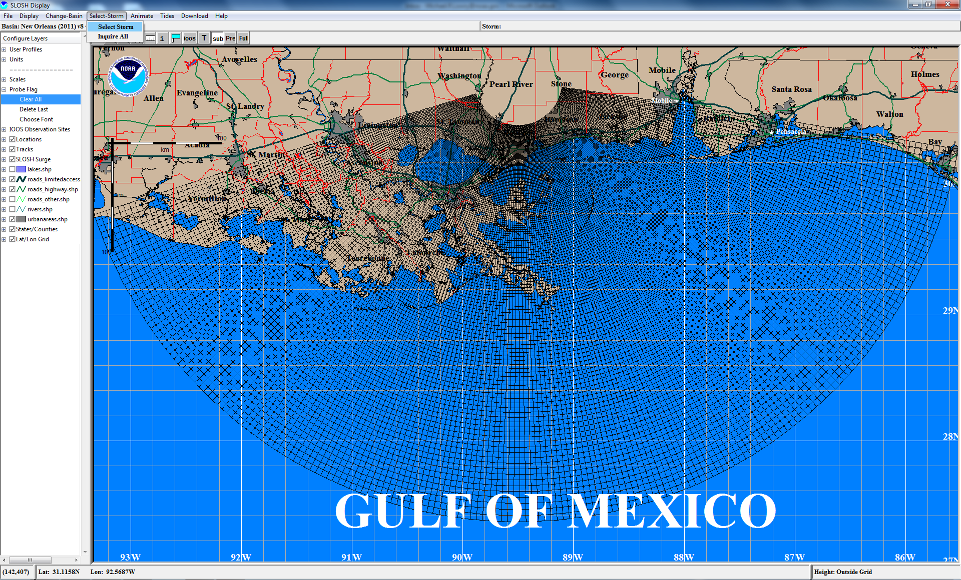
Adding SLOSH Shapefiles to ArcGIS
Select storm composite

Slide 2
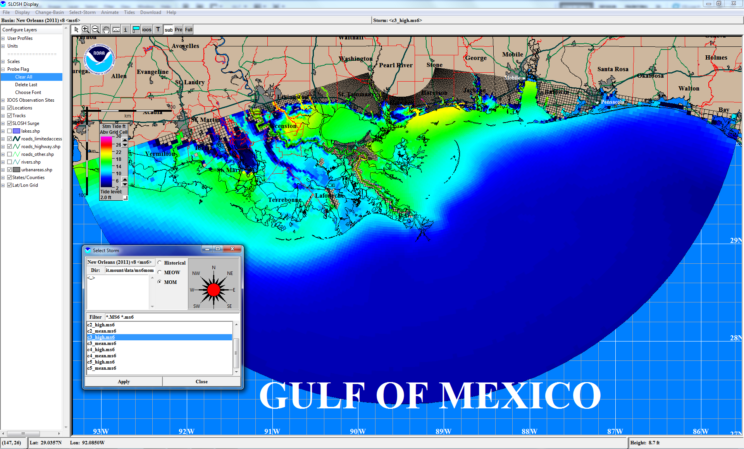
Adding SLOSH Shapefiles to ArcGIS
Apply Historical, MEOW, or
MOM composite

Slide 3
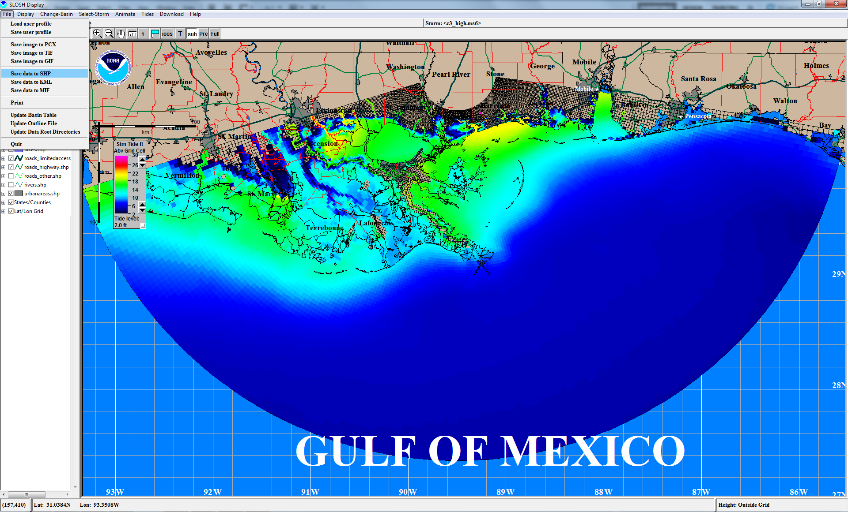
Adding SLOSH Shapefiles to ArcGIS
Save composite data to
shapefile format (SHP)

Slide 4
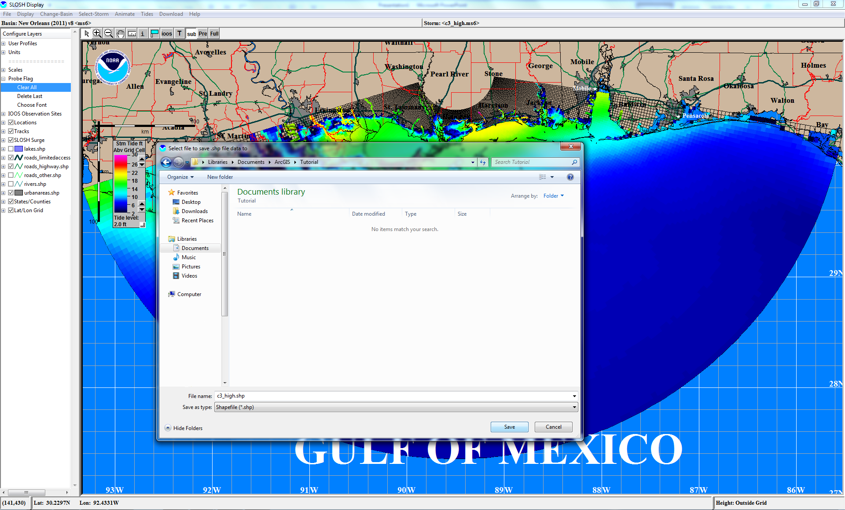
Adding SLOSH Shapefiles to ArcGIS
Specify file name and directory
to which to save composite
shapefile

Slide 5
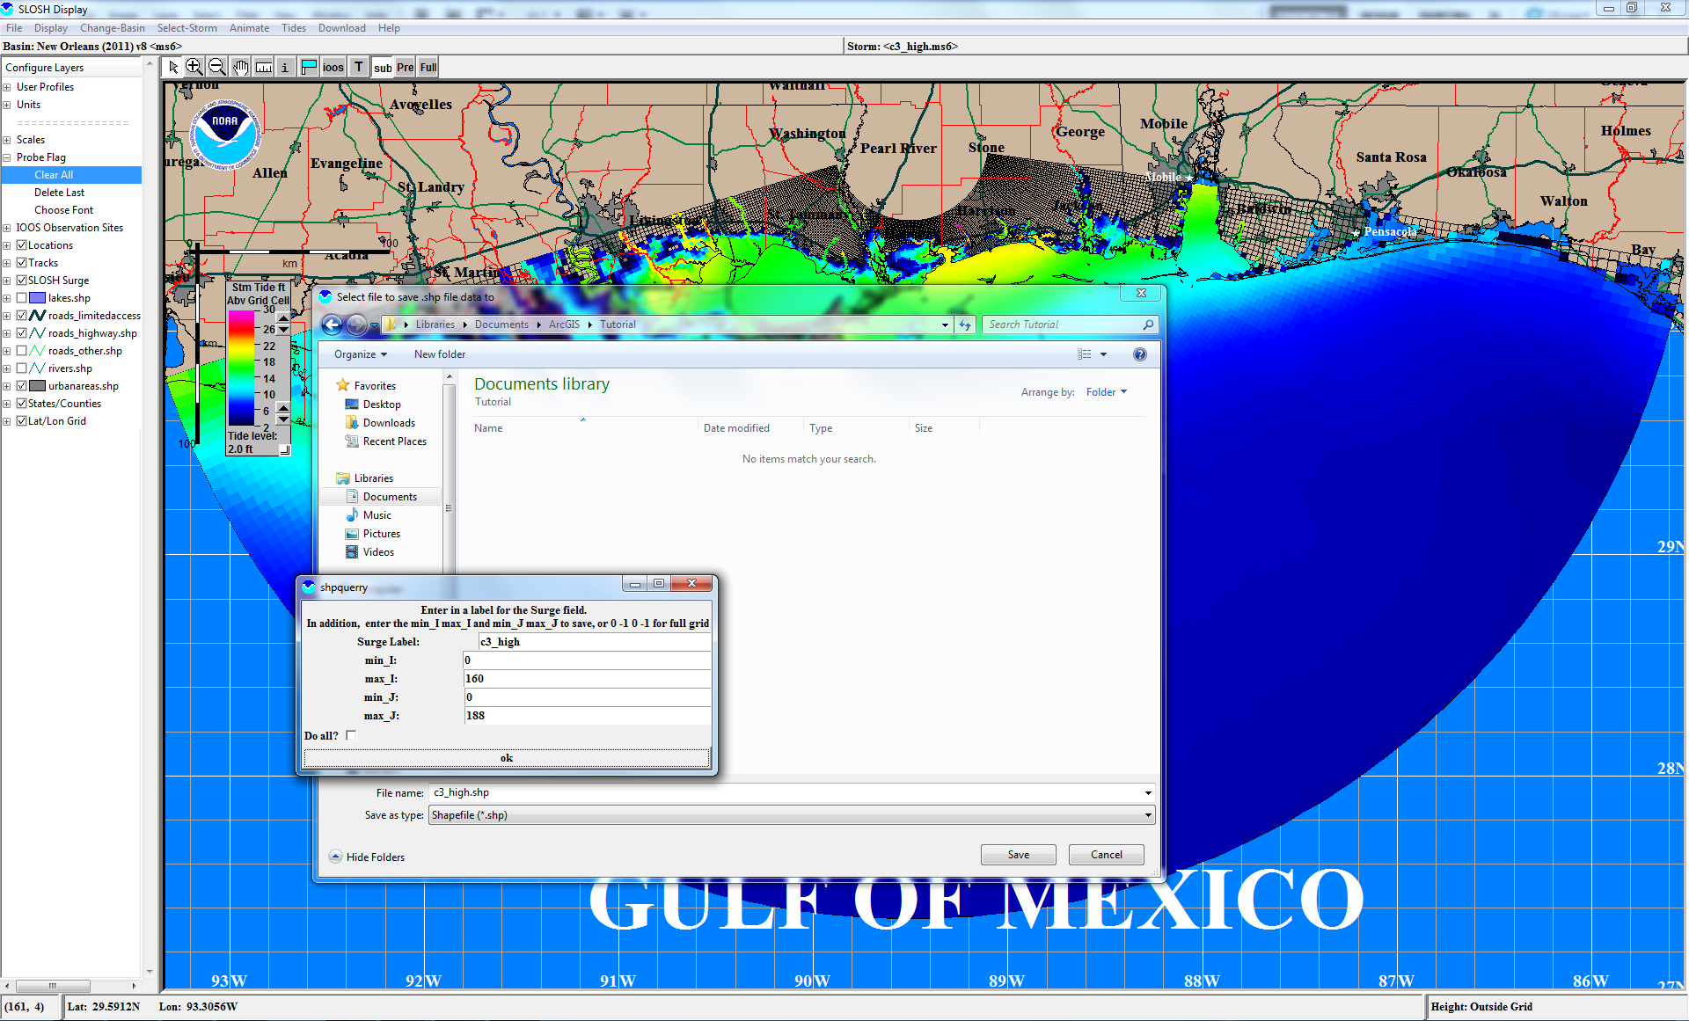
Adding SLOSH Shapefiles to ArcGIS
Click ok to accept the default
grid definition when prompted

Slide 6
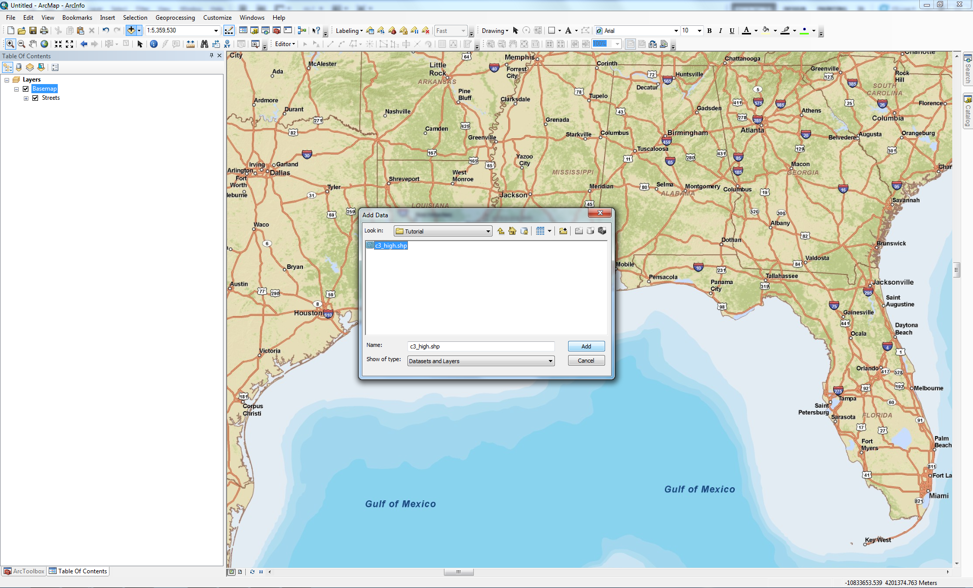
Adding SLOSH Shapefiles to ArcGIS
Open an instance of ArcGIS and click the Add Data button
Navigate to directory to which SLOSH composite shapefile was saved and add shapefile to map document

Slide 7
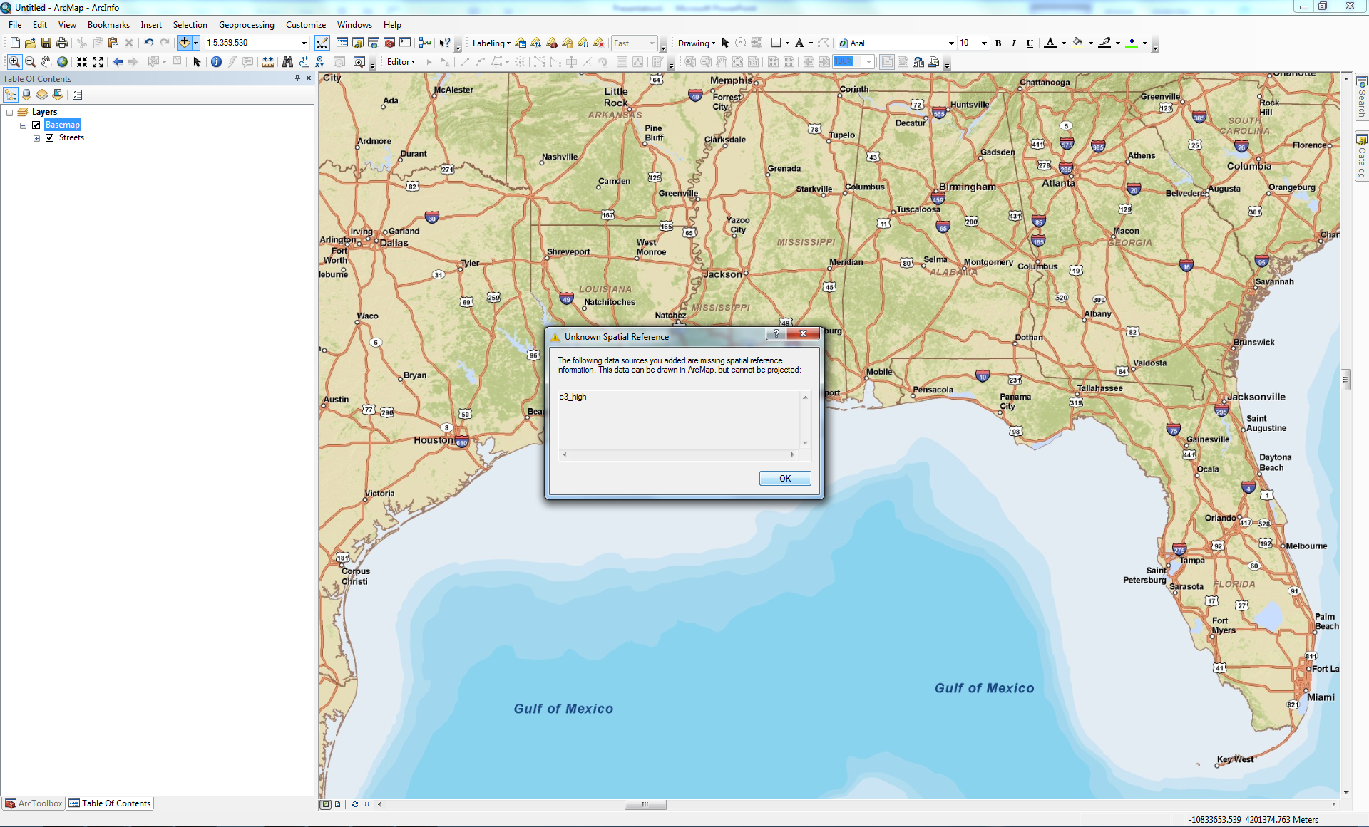
Adding SLOSH Shapefiles to ArcGIS
You will encounter an “Unknown Spatial Reference” warning;
spatial reference of SLOSH shapefile
will be defined in next step

Slide 8
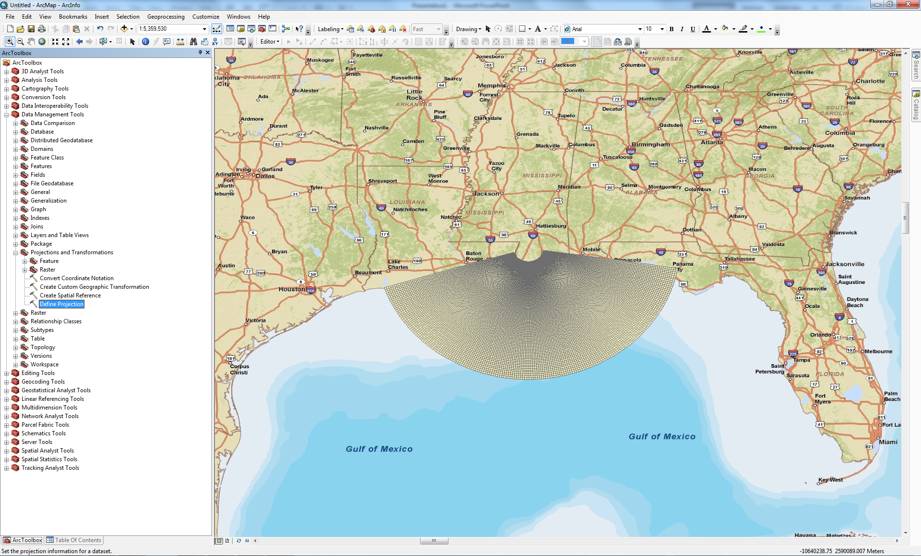
Adding SLOSH Shapefiles to ArcGIS
Open ArcToolbox and navigate to Data Management Tools > Projections and Transformations > Raster > Define Projection
SLOSH grid will appear without
symbology; first you will
define a spatial reference

Slide 9
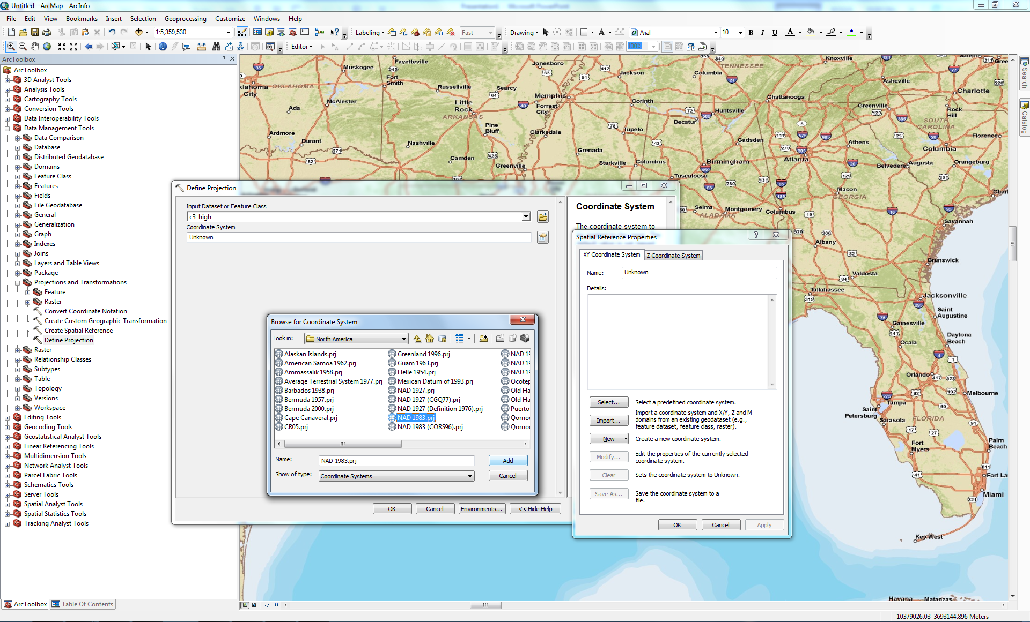
Adding SLOSH Shapefiles to ArcGIS
Click to browse for coordinate system
Click Select… to browse for a coordinate system
Choose NAD 1983 as the horizontal projection (under Geographic Coordinate Systems > North America)

Slide 10
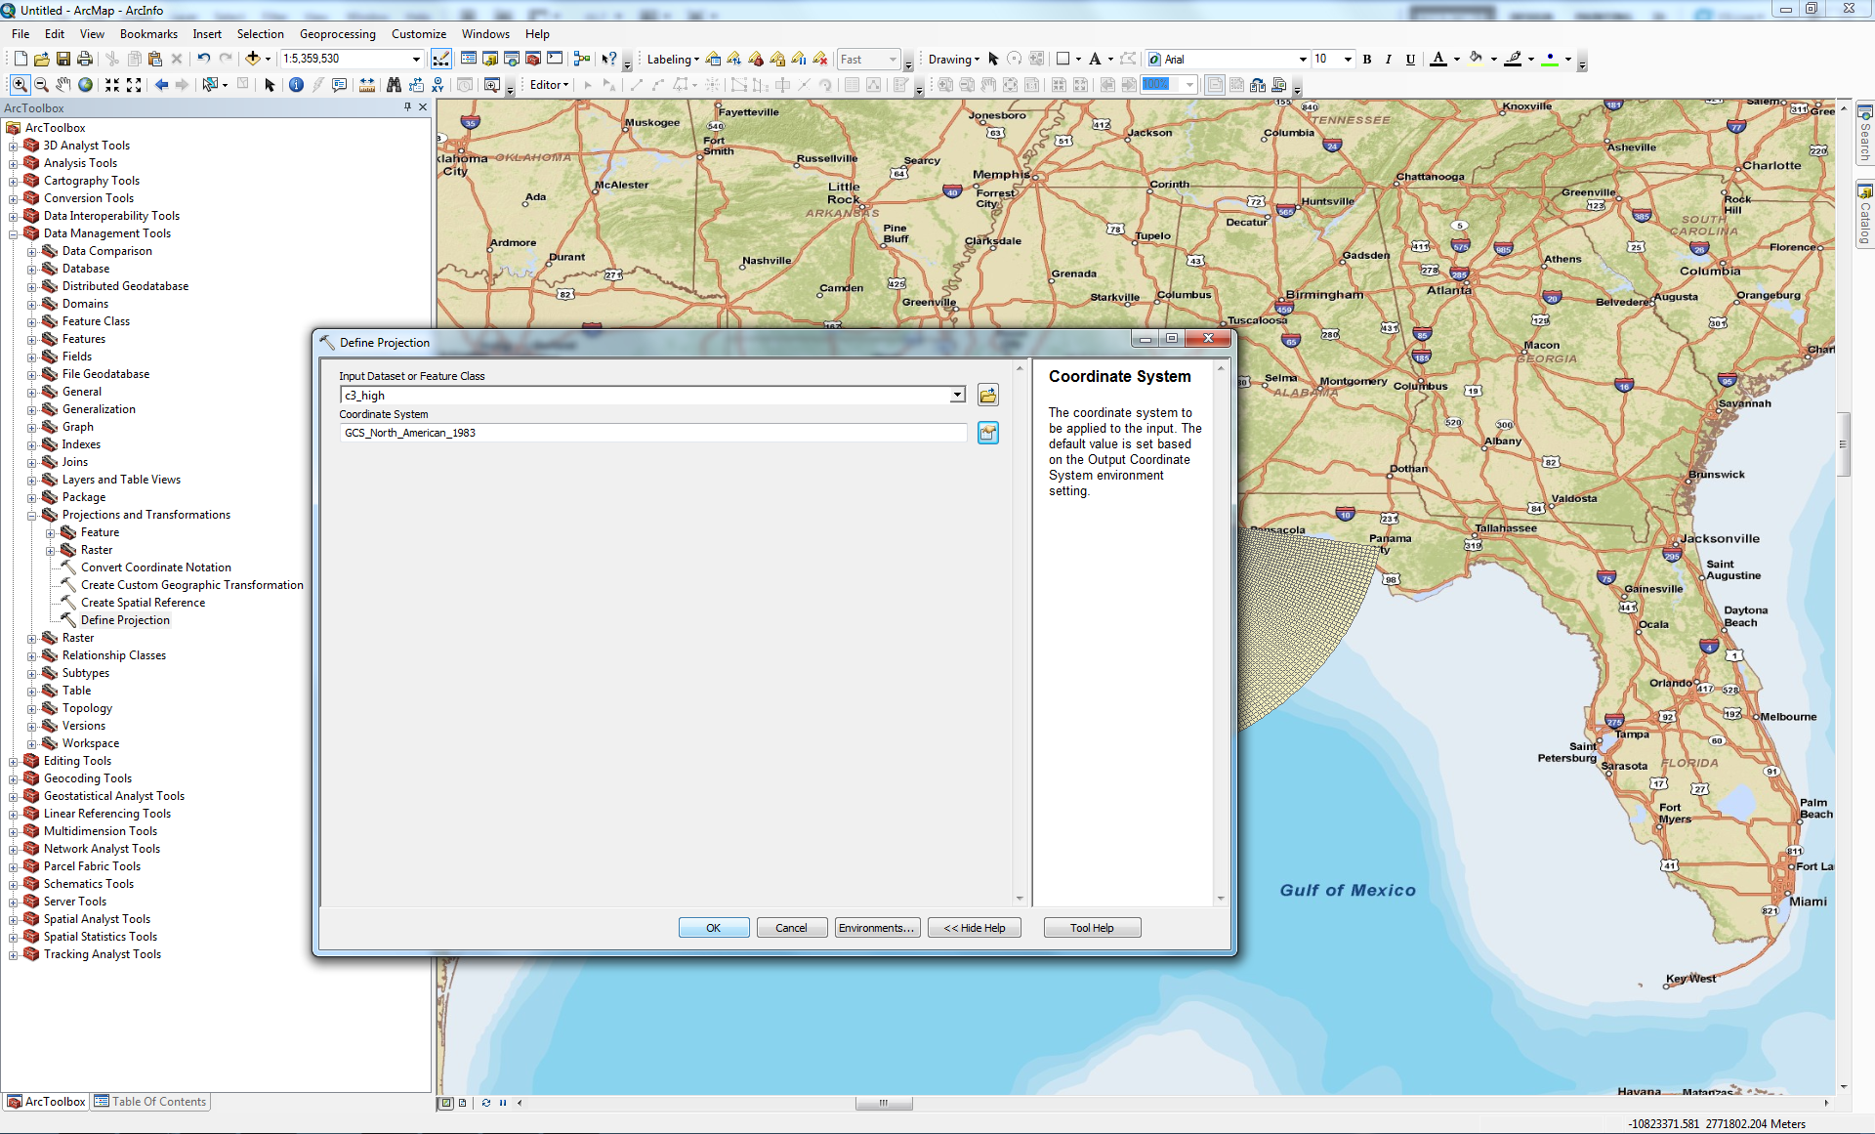
Adding SLOSH Shapefiles to ArcGIS
Click OK once NAD 1983 is selected

Slide 11
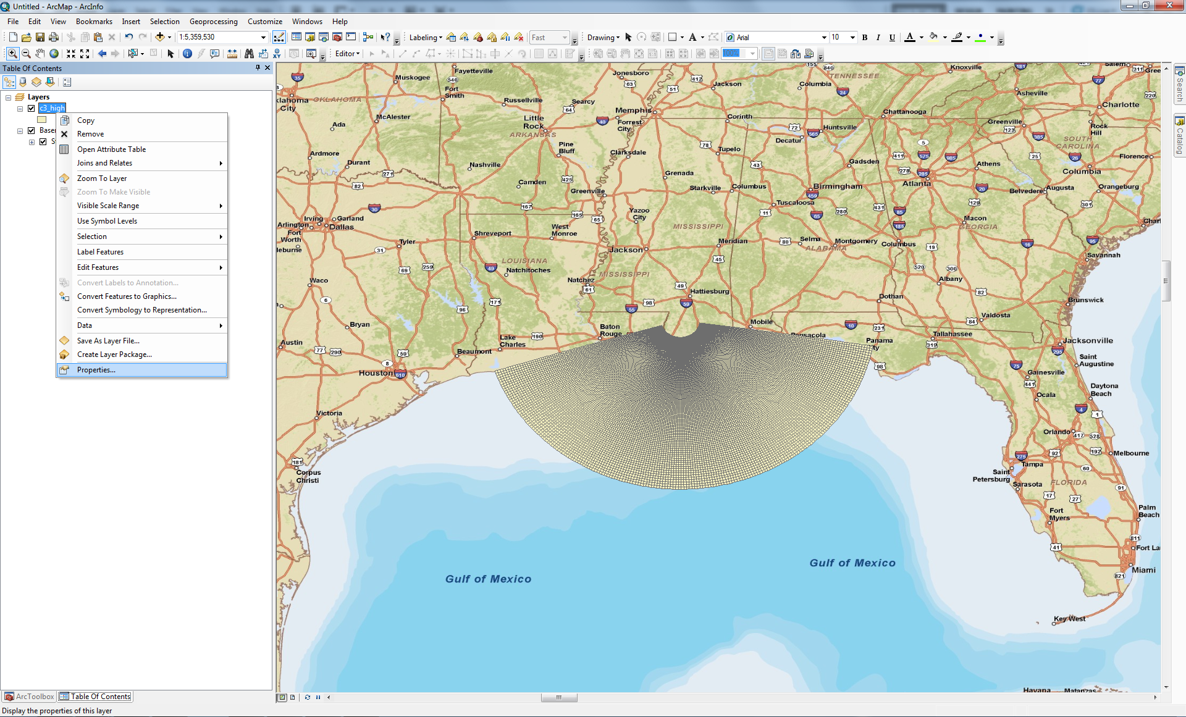
Adding SLOSH Shapefiles to ArcGIS
In order to symbolize the SLOSH composite shapefile, first right-click the
shapefile in the Table of Contents and navigate to Properties

Slide 12
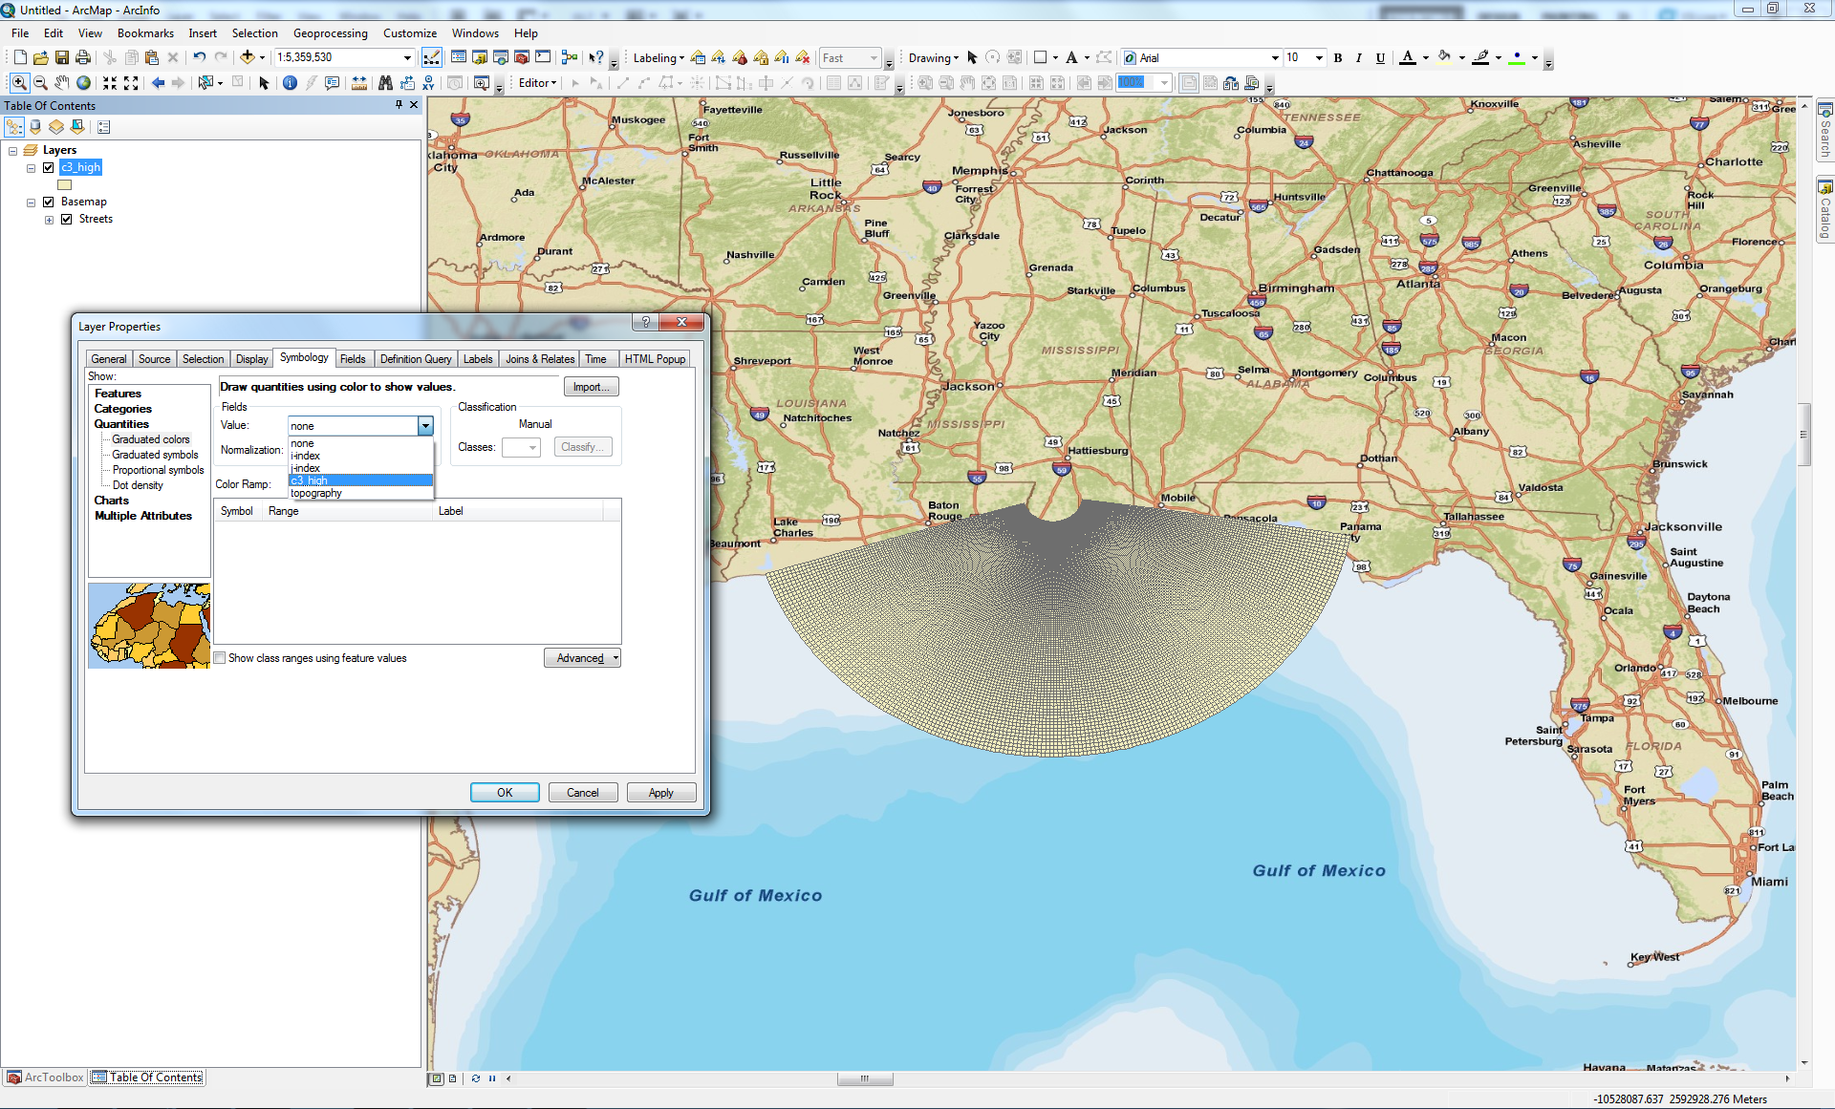
Adding SLOSH Shapefiles to ArcGIS
Click the Symbology tab, choose “Graduated Colors” under “Quantities” on the left-most “Show” frame; select the appropriate SLOSH composite from the “Value” dropdown menu (e.g., c3_high for Cat 3 MOM at high tide)

Slide 13
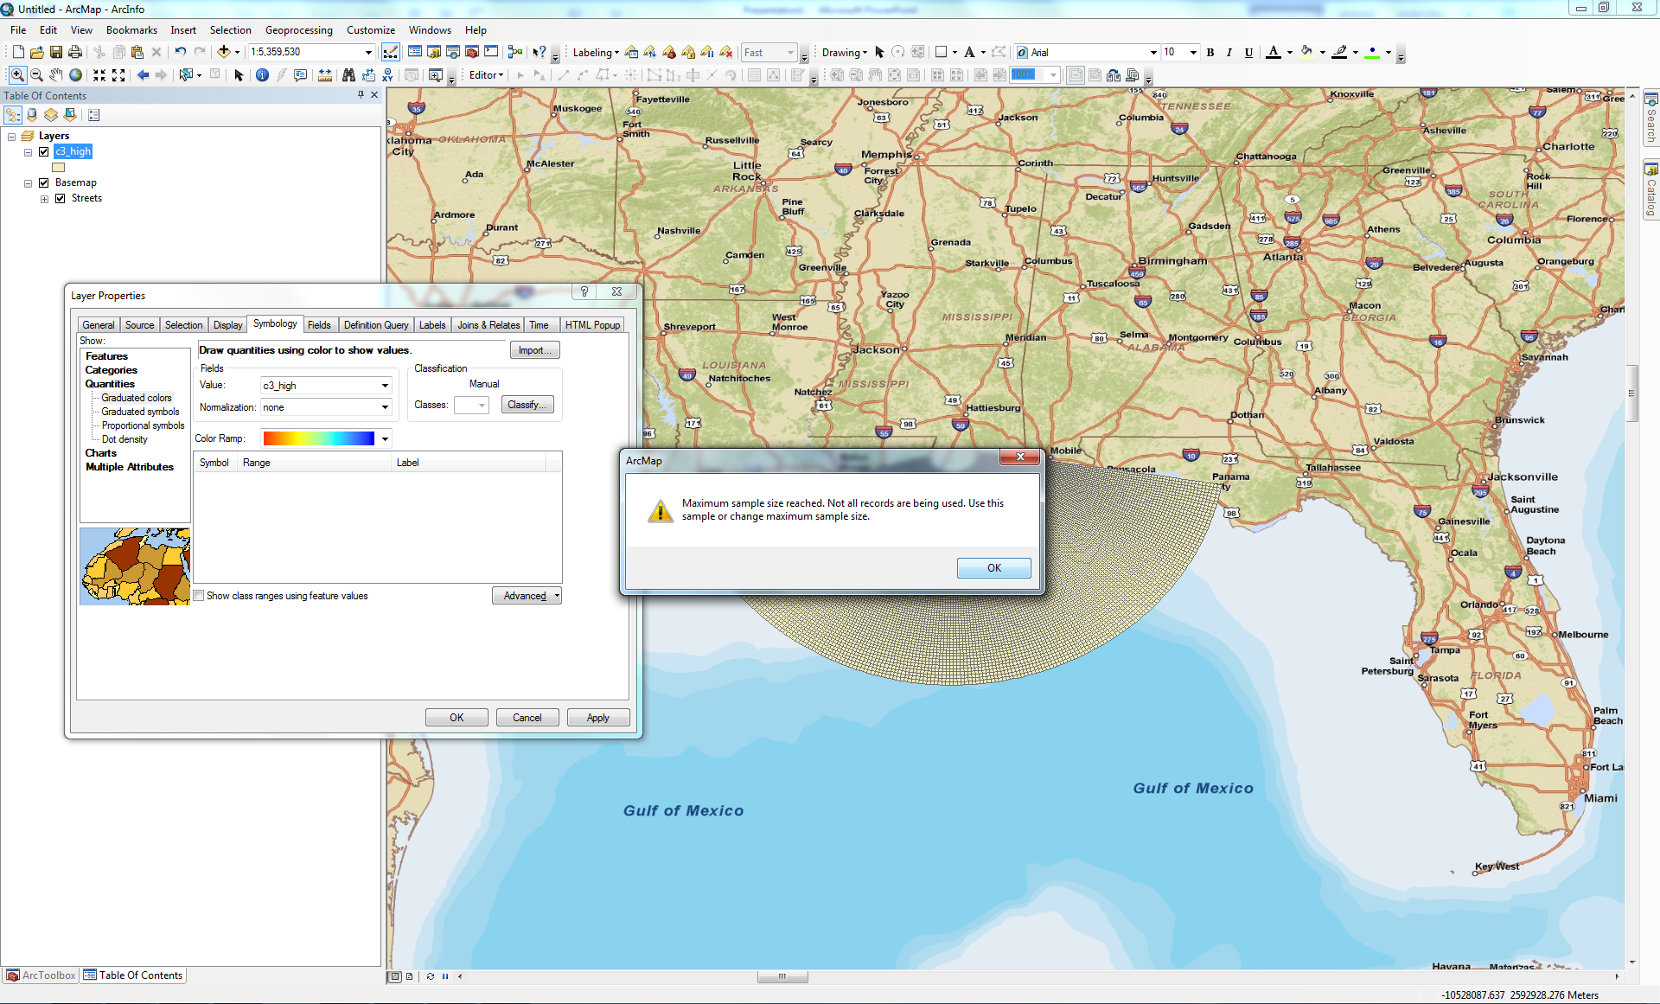
Adding SLOSH Shapefiles to ArcGIS
Click OK if you receive a warning indicating that not all records are being used; you will correct this in the next step

Slide 14
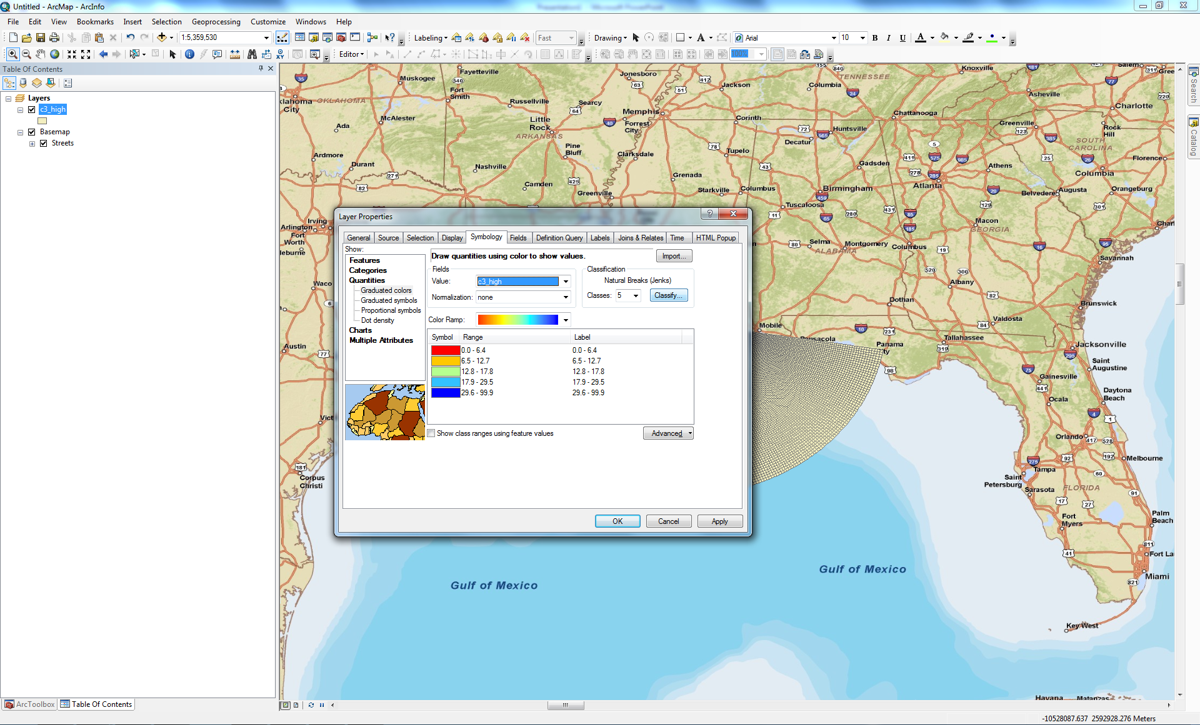
Adding SLOSH Shapefiles to ArcGIS
Click Classify… to open the classification dialog box

Slide 15
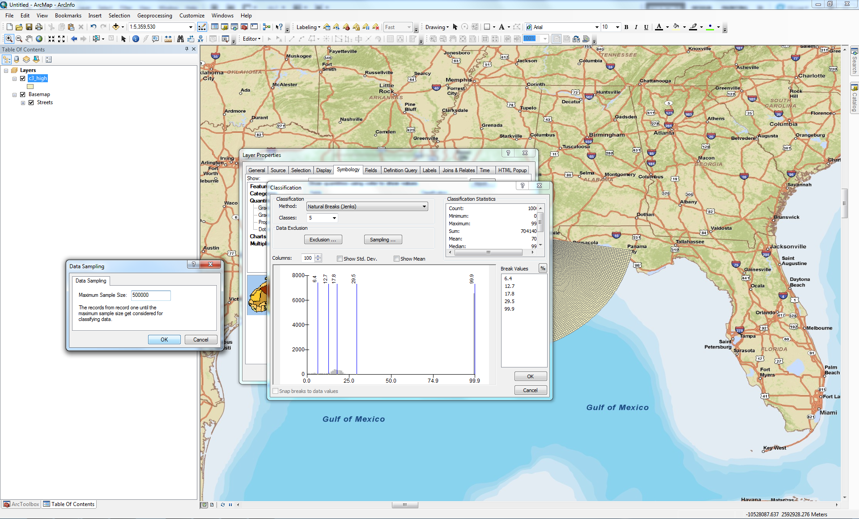
Adding SLOSH Shapefiles to ArcGIS
Click Sampling…
Change the Maximum Sample Size to 500000 (500,000); click OK

Slide 16
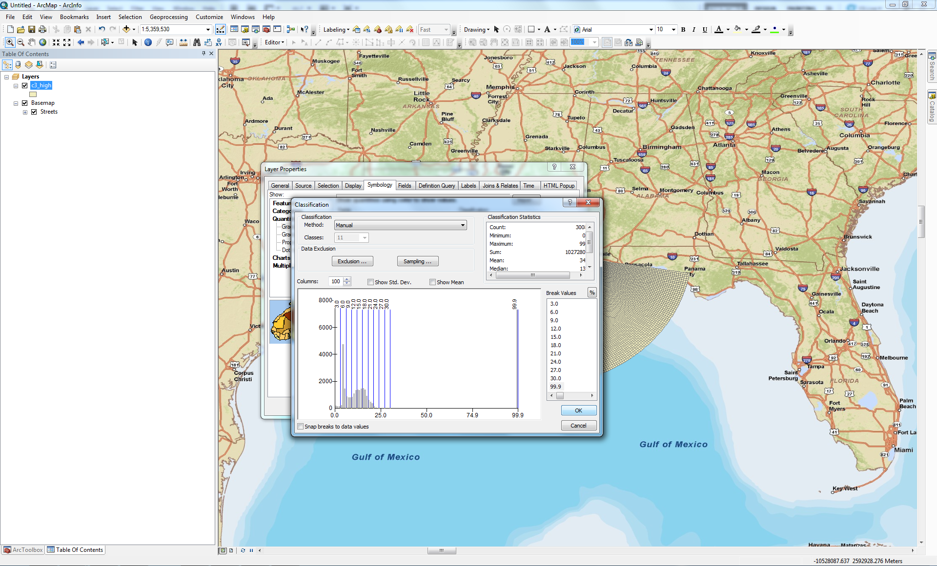
Adding SLOSH Shapefiles to ArcGIS
Adjust classification according to customer requirements; once satisfied, click OK

Slide 17
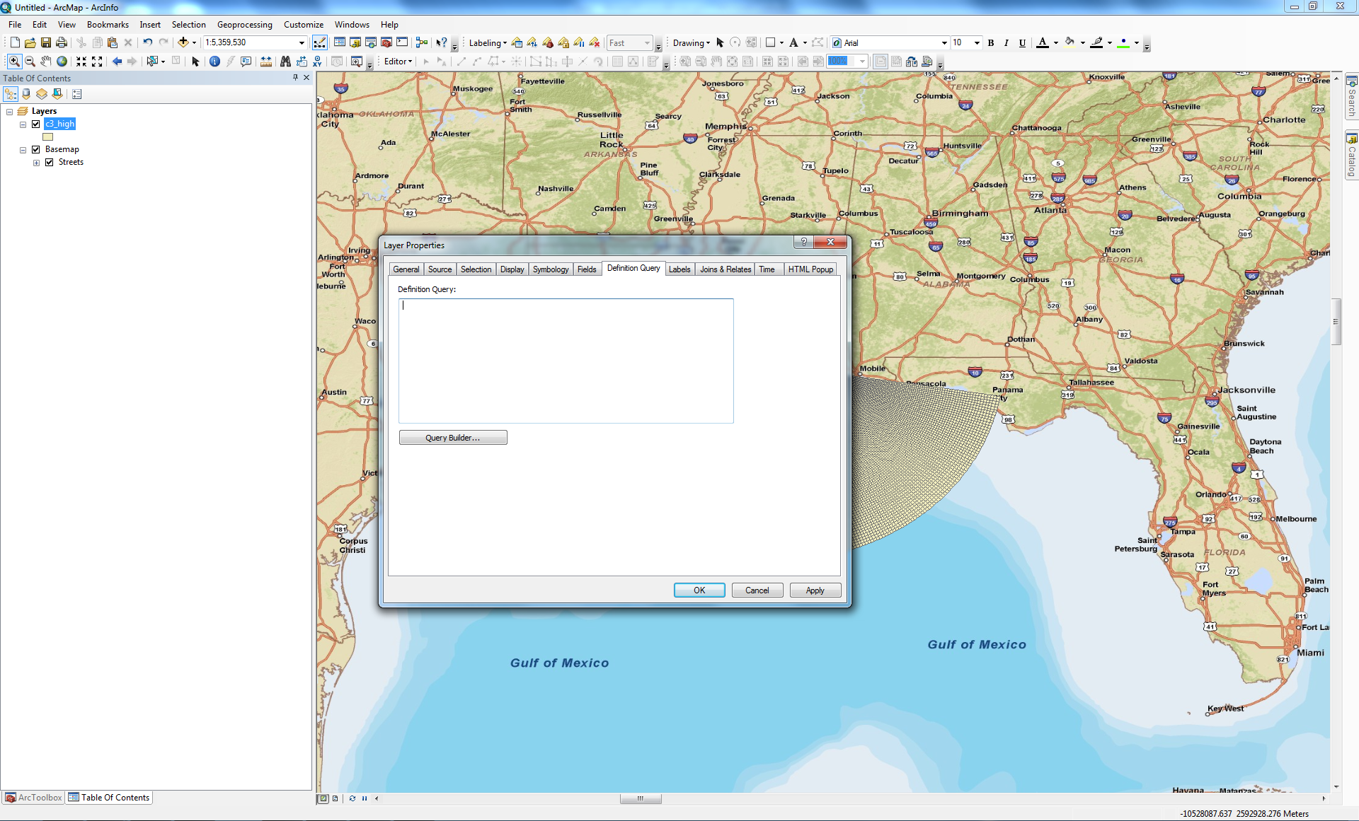
Adding SLOSH Shapefiles to ArcGIS
Click Query Builder… under the “Definition Query” tab

Slide 18
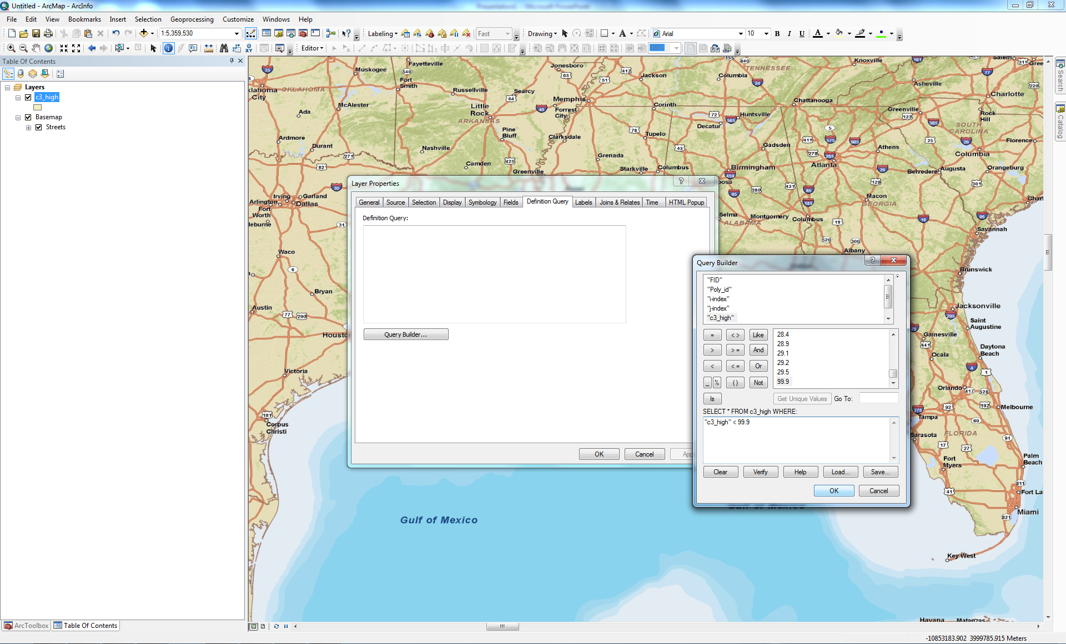
Adding SLOSH Shapefiles to ArcGIS
Create the following query: “c3_high” < 99.9

Slide 19
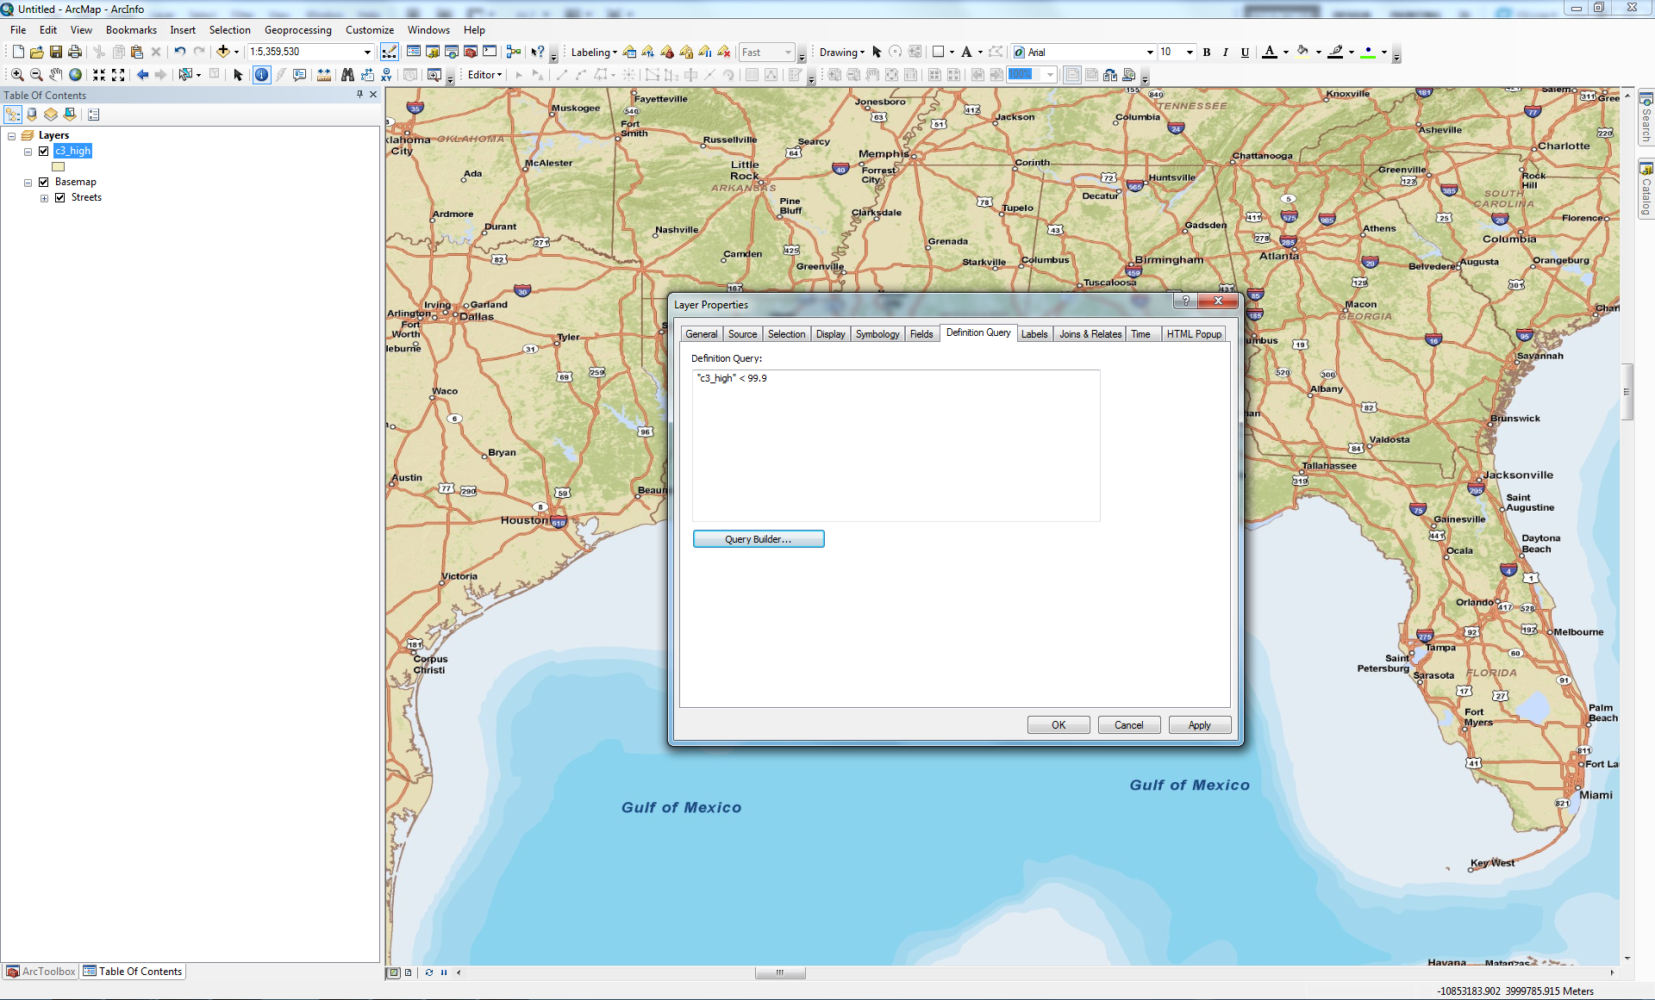
Adding SLOSH Shapefiles to ArcGIS
This definition query will omit dry SLOSH cells from displaying in your map document. The query tells ArcMap to only show those cells with values less than 99.9. If you choose to see all SLOSH cells, leave this definition query empty.

Slide 20
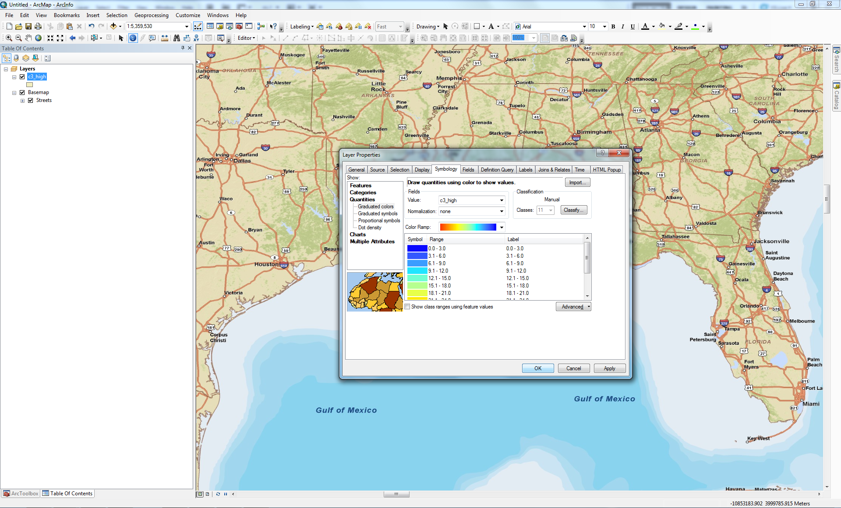
Adding SLOSH Shapefiles to ArcGIS
Navigate to the “Symbology” tab and make any necessary changes to fill, color, classes, etc.

Slide 21
Adding SLOSH Shapefiles to ArcGIS
Navigate to the “Display” tab and change transparency if desired
Click OK upon completion

Slide 22
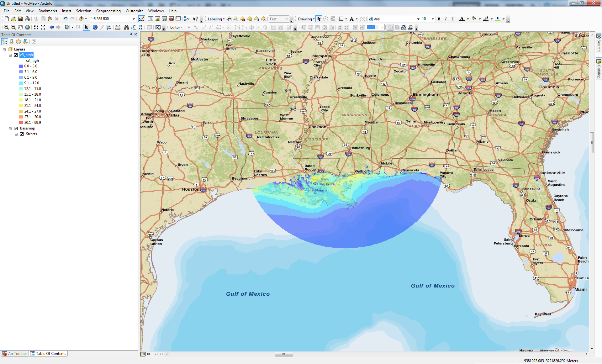
Adding SLOSH Shapefiles to ArcGIS

