Slide 1
Comprehensive Environmental Response Compensation and Liability Act

Slide 2
“Superfund” Popular Name for CERCLA

Slide 3
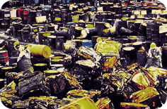
The federal statute for the remediation of past waste disposal practices

Slide 4
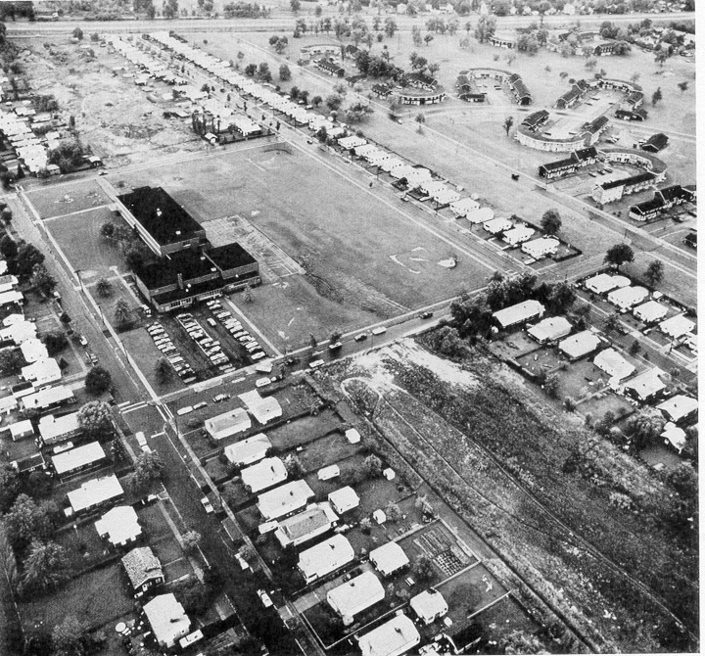
Tragedy of Love Canal

Slide 5
How Many More Love Canals ? The Challenges of Drafting CERCLA
Identifying and prioritizing sites [Response]
Who should perform cleanup [Response]
How clean is clean [Response]
Who should pay [Liability]

Slide 6
Identification & Prioritization of CERCLA Sites

Slide 7
Identifying Old Sites
WHO:
Present owner
Prior owner/operator
Transporter who selected the site
WHAT:
Any unpermitted facility where hazardous waste is or has been treated stored or disposed at any time in the past
ACTION
Notify EPA (starting in 1981) of existence, location, amount & type of waste

Slide 8
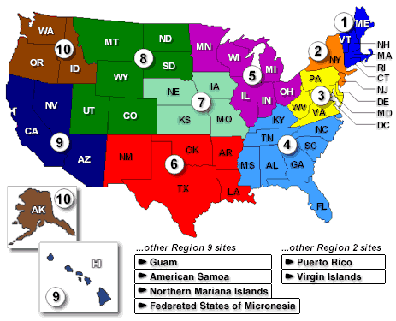
How Many Old Sites ?
EPA has 41,000 reported sites in their inventory (2006)

Slide 9
Prioritization of Old Sites
National Priority List (NPL)
EPA ranks sites
By Hazard
Groundwater
Surface Water
Air

Slide 10
National Priorities List Sites in Louisiana
https://www.epa.gov/superfund/national-priorities-list-npl-sites-state#LA

Slide 11
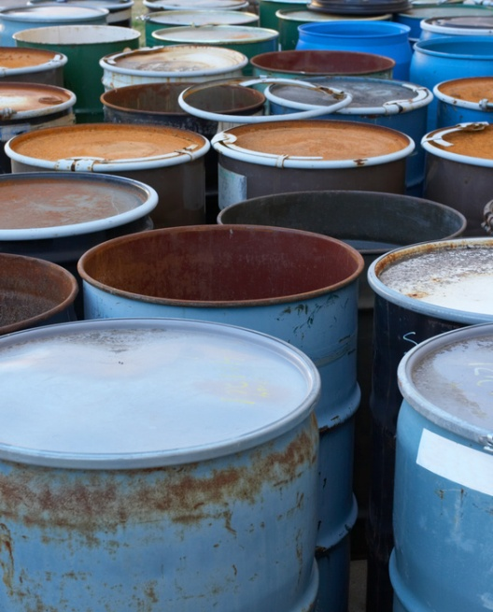
Objective of CERCLA
Reduce and eliminate threats to human health and the environment posed by uncontrolled hazardous waste sites; and
Respond to releases or threatened releases of hazardous substances.

Slide 12
Legal Foundation
Legal foundation for conducting response actions:
Statutes
Executive orders and delegations
Regulations
Policy and guidance
Case law
Site-specific documents

Slide 13
Statutory and Regulatory Framework
Statutes
CERCLA, as amended by:
Superfund Amendments and Reauthorization Act (SARA), 1986
Asset Conservation, Lender Liability, and Deposit Insurance Protection Act (Lender Liability Act), 1996
Superfund Recycling Equity Act of 1999 (SREA or Recycling Amendments)
Small Business Liability Relief and Brownfields Revitalization Act (Brownfields Amendments), 2002
Executive Orders
E.O. 12580 and 13016

Slide 14
Statutory and Regulatory Framework
Regulations
National Oil and Hazardous Substances Pollution Contingency Plan (NCP)
Policy and Guidance
Available on EPA’s website

Slide 15
How Does CERCLA Work?
Section 104(a) - President is authorized to respond to release or threatened release.
Executive orders – President delegates authority to EPA and other federal agencies.

Slide 16
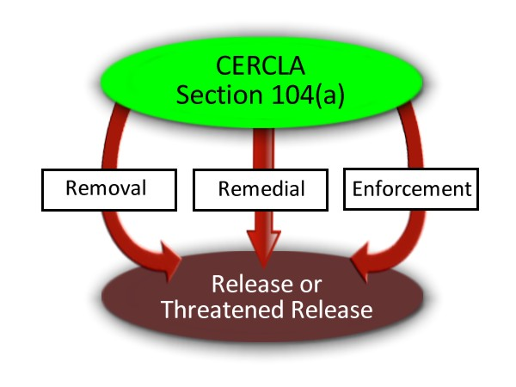
Response Actions
CERCLA defines three kinds of response action:
Removal
Remedial
Enforcement

Slide 17
Overview of CERCLA Enforcement
Objective: Encourage or compel responsible parties to perform removal or remedial work or reimburse EPA for performing it.
Enforcement includes EPA oversight of work performed by responsible parties.

Slide 18
CERCLA Cleanup Triggers For Action
The release or substantial threat of a release of a “hazardous substance” from a facility into the environment
The release or substantial threat of a release of any pollutant or contaminant from a facility into the environment which may present an imminent and substantial danger to the public health or welfare
CERCLA Section 104(a)(1)

Slide 19
CERCLA Trigger Retrospective & Retroactive
Addresses environmental releases from past practices
CAA, CWA & SDWA regulate pollutants before they are released to the environment
Those past practices may have been legal at the time and may have occurred before CERCLA was enacted in 1980

Slide 20
Definition of A Release
CERCLA 101(22)
“any spilling, leaking, pumping, pouring, emitting, emptying, discharging, injecting, escaping, leaching, dumping, or disposing into the environment (including the abandonment or discarding of barrels, containers, and other closed receptacles containing any hazardous substance or pollutant or contaminant)…”

Slide 21
Threatened Release
Not defined in CERLCA
Authority to respond to threatened release contained in National Contingency Plan.

Slide 22
Hazardous Substance
CERCLA 101(14)
Toxic or hazardous substance designated by the Federal Water Pollution Control Act, TSCA, CAA, Sold Waste Disposal Act;
any element, compound, mixture, solution, or substance designated pursuant to section 102 of CERCLA.
About 1200 named substances
Each with a Reportable Quantity (RQ)

Slide 23
Petroleum Exclusion Not a CERCLA Hazardous Substance
Petroleum, including crude oil or any fraction thereof
Excluded from definition of “hazardous substance”
Normal BTX components in gasoline also excluded
Reason why underground storage tanks (UST) are RCRA not CERCLA

Slide 24
Facility
CERCLA 101(9)
The term “facility” means (A) any building, structure, installation, equipment, pipe or pipeline (including any pipe into a sewer or publicly owned treatment works), well, pit, pond, lagoon, impoundment, ditch, landfill, storage container, motor vehicle, rolling stock, or aircraft, or
(B) any site or area where a hazardous substance has been deposited, stored, disposed of, or placed, or otherwise come to be located…

Slide 25
Liability
Liability under CERCLA
More environmental lawyers and consultants are probably involved in Superfund cases than any other single environmental statute.

Slide 26
Liability Under CERCLA
Liability is defined in CERCLA Section 107(a).
A party is liable for response costs when:
There is a release or a threatened release;
Of a hazardous substance;
From a facility into the environment;
Which causes response costs to be incurred; and
The party is included in at least one class of persons described in CERCLA Section 107(a).

Slide 27
Liability Under CERCLA (cont’d)
Four kinds of response cost:
Cost of actions taken by the United States, States, or tribes that are not inconsistent with the NCP;
Cost of actions taken by other parties that are consistent with the NCP;
Cost of natural resource damage restoration; and
Cost of health assessments performed by ATSDR.

Slide 28
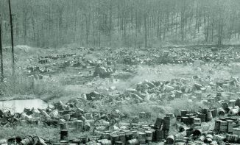
Where Is The Compensation ?
Property Damage (By private lawsuit)

Slide 29
Personal Injury ?

Slide 30
Who is Liable Under CERCLA?
Section 107(a) defines liable parties as:
The current owner and operator of a facility;
Owner or operator of a facility at the time hazardous substances were disposed of;
Person who arranged for disposal or treatment of hazardous substances; and
Person who transported and chose the disposal location of hazardous substances.

Slide 31
CERCLA Liability Retroactive, Strict, Joint and Several
Censored
illegal

Slide 32
Strict Liability
A party is liable even if:
The problems caused by the release of hazardous substances were unforeseeable;
The party’s actions were legal at the time they occurred; and
State-of-the-art waste management practices were used when the materials were disposed of.
Notes:
Liability is strict, meaning parties are liable without regard to fault or motive. “But I didn’t mean to send my drums of methyl-ethyl death to be buried in some guy’s backyard where they contaminated a town’s ground water.” Oh well.
“But we were following the laws at the time when we emptied our solvent tanks on the ground out the back door…” Tough luck.
“But we were doing what everyone else in the industry was doing.” [Shrug]

Slide 33
Retroactive Liability
A party may be liable for actions that took place prior to enactment of CERCLA.
Notes:
Liability is retroactive. So it doesn’t matter if the disposal took place in 1930 prior to the enactment of CERCLA. CERCLA allows us to reach back to whenever the disposal took place and establish liability.

Slide 34
Joint and Several Liability
Any liable party or group of parties may be held liable for all response costs at a site.
Notes:
Liability is also joint and several. Where the harm is not divisible – it cannot be divided – each party is responsible for everything and EPA can choose to collect the entire cost of cleaning up the Site from only one PRP. This only works where the harm is not divisible – otherwise the harm must be apportioned with each party responsible for the harm it caused. Apportioning harm can be really difficult.

Slide 35
Liable For What ?
Response Costs
Incurred by
EPA or Private Party
Consistent with the NCP
In responding to a release or a threatened release of a
Hazardous substance

Slide 36
Liable To Whom?
Federal Government
For EPA led cleanup of the site
Private Parties
Other PRPs that cleaned up the site

Slide 37
What is a Potentially Responsible Party (PRP)?
“PRP” is often used interchangeably with “liable party” or “responsible party.”
PRP must satisfy criteria in CERCLA Section 107(a).
Statutory defenses and exemptions to CERCLA liability.

Slide 38
Statutory Defenses to CERCLA Liability
Section 107(b) provides that a party is not liable if a release was caused solely by an:
Act of God;
Act of war; or
Act or omission of a third party
(“third party defense”).

Slide 39
Third Party Defense
Defined in Section 107(b)(3):
Act or omission performed by someone other than the PRP;
Burden is on PRP to prove it;
PRP had no direct or indirect contractual relationship (defined in Section 101(35)) with the third party;
PRP exercised due care with respect to the hazardous substances; and
PRP took precautions against foreseeable acts or omissions of any such third party.

Slide 40
Statutory Exemptions from CERCLA Liability
Service Station Dealers
CERCLA Section 114(c);
Service station dealers that manage recycled oil;
Cannot be mixed with any other hazardous substances;
Managed in compliance with appropriate regulations or standards.
State and Local Governments
CERCLA Section 107(d);
State and local governments are not liable for costs or damages resulting from an emergency response;
Exception for negligence or misconduct.
Notes:
CERCLA also provides a exemption at Section 114(c) to owners of service stations that manage recycled oil. They are exempt from liability so long as the oil is now mixed with other hazardous substances and they are in compliance with other laws and regulations.
According to Section 107(d), states and local governments are not liable for their actions taken during an emergency response at a facility owned by another person, unless there was negligence or misconduct.

Slide 41
Statutory Exemptions from CERCLA Liability (cont’d)
Secured Creditors
CERCLA Section 101(20)(A) and (E);
Without participating in the management of a facility, holds “indicia of ownership” primarily to protect that person’s security interest in the facility.
Recyclers
Superfund Recycling Equity Act of 1999 (SREA);
CERCLA Section 127;
Exempt certain arrangers and transporters who “arrange for recycling of recyclable materials.”

Slide 42
2002 Brownfield Amendments Landowner Liability Protections
CERCLA Section 101(35)(a)(1) clarified “Innocent Landowner.”
CERCLA Section 107(q) added Contiguous Property Owner (CPO).
CERCLA Sections 101(40) and 107(r) added Bona Fide Prospective Purchaser (BFPP).

Slide 43
Innocent Landowner
Section 101(35) Contractual Relationship
“includes, but is not limited to, land contracts, deeds, easements, leases, or other instruments transferring title or possession, unless the real property on which the facility concerned is located was acquired by the defendant after the disposal or placement of the hazardous substance on, in, or at the facility, and one or more of the circumstances described in clause (i), (ii), or (iii) is also established by the defendant by a preponderance of the evidence…”

Slide 44
Innocent Landowner
At the time the party acquired the facility, the party did not know and had no reason to know of hazardous substances.
Government acquired facility through “involuntary” transfer or acquisition.
Party acquired the facility by inheritance or bequest.

Slide 45
Innocent Landowner
PLUS
Section 107(b)(3) – Third Party Defense;
Provide full cooperation, assistance, and facility access;
Be in compliance with any land use restrictions;
Not impede the effectiveness or integrity of any institutional controls.

Slide 46
Innocent Landowner
101(35)(A)(i) - Did not know and had no reason to know
carry out all appropriate inquiries….into previous ownership and uses of the facility
take reasonable steps to:
stop any continuing release;
prevent any threatened future release; and
prevent or limit any human, environmental, or natural resource exposure to any previously released hazardous substance.

Slide 47
Contiguous Property Owner
CERCLA Section 107(q);
Owner of property contaminated solely by a release from a contiguous property or similarly situated property owned by someone else is not liable if it:
Is not a PRP or affiliated with a PRP;
Did not cause, contribute, or consent to the release of hazardous substances; and
Conducts “all appropriate inquiries” prior to purchase and demonstrates that it did not know or have reason to know of contamination.

Slide 48
Bona Fide Prospective Purchaser
CERCLA Section 101(40);
Current owner is exempt from liability if disposal at the facility occurred prior to purchase, and the current owner:
Purchased the facility after January 11, 2002;
Is not a PRP or affiliated with a PRP;
Conducted all appropriate inquires into previous ownership and uses of the facility;
Took reasonable steps to stop continuing releases and threatened future releases;
Provides cooperation, assistance, and access to EPA; and
Complies with all land use restrictions and institutional controls affecting the property.

Slide 49
Other Statutory Exemptions from CERCLA Liability
Municipal Solid Waste (MSW)
CERCLA Section 107(p);
Conditional exemption for response costs incurred with respect to MSW disposed of at a facility on the NPL.
De Minimus Contributors
CERCLA Section 107(o);
Party contributed < 100 gallons of liquid materials or 200 pounds of solid materials containing hazardous substances.

Slide 50
3. How Clean Is Clean
Clean To Baby-Eating Dirt Level?

Slide 51
How Clean Is Clean
Site by site determination
Guided by ARARs
Applicable, Relevant and Appropriate Requirements
Does every site need to be “baby-dirt eating” clean?

Slide 52
Blueprint For CERCLA Cleanups
National Contingency Plan (“NCP”)

Slide 53
Who Pays

Slide 54
Not The Taxpayer In Theory

Slide 55
Who Pays For Clean Up?
Parties Responsible For the Release
If they Can Be Found
Called Potentially Responsible Party (“PRP”)

Slide 56
If PRP Cannot Be Found So Called “Orphan Sites”
Federal Government Pays For Cleanup
Using a special fund of money
Raised by a tax on chemicals & oil industry
Superfund

Slide 57
Superfund Tax
Tax was ended in 1995, leaving federal cleanup costs to general tax revenue and what can be collected from RPRs.
The proposed Trump budget would further cut taxpayer funds for cleanups.

Slide 58
EPA Enforcement Discretion
Orphan Share
De Minimis Settlements
Ability to Pay

Slide 59
Orphan Share Policy

Slide 60
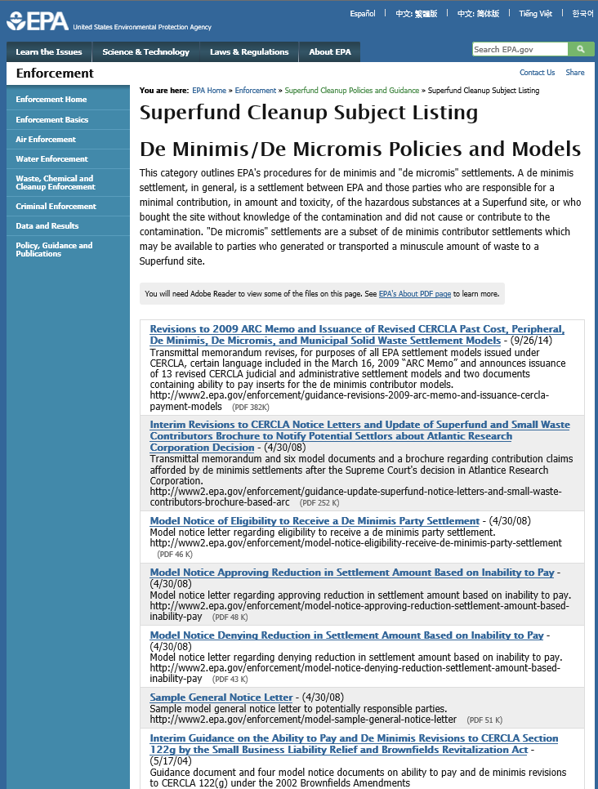
De Minimis Policy

Slide 61
EPA Enforcement Discretion (cont’d)
Owners of residential properties
Unless the residential homeowner’s activities led to a release or threatened release.
Owners of contaminated aquifers
Contamination of property solely as the result of subsurface migration in an aquifer from a source or sources outside the property.

Slide 62
CERCLA Enforcement Process
Where PRP search fits in;
“Enforcement First” policy;
Remedial and removal process timelines.

Slide 63
Settlement and Settlement Tools
Administrative settlements
Orders on consent;
Do not involve courts (except to enforce);
Typically used for removal and Good Samaritans
Judicial settlements
Consent decrees.
Court-approved.

Slide 64
Cost Recovery
Statutory authorities.
Demand letters.
Referrals to DOJ.
Cost documentation.

Slide 65
How About New Sites?

Slide 66
Release Reporting Trigger CERCLA Section 103(a)
Release
Of a Hazardous Substance
Equal to greater than reportable quantity (RQ)
From a vessel or facility
Within a 24-hour period
Into the environment

Slide 67
Report To ?
National Response Center (NRC)

Slide 68
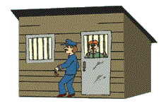
Failure To Report Release
Criminal:
3 years in prison
Fines
Civil
$32,500 per day

Slide 69
Why CERCLA Reporting ?
Identifies
New sites
That potentially warrant
CERCLA
Cleanup
Response or Remediation

Slide 70
Release Reporting
The only “command and control” regulatory provision in CERCLA

Slide 71
Business Entities
as PRPs

Slide 72
Introduction
CERCLA Section 107(a) identifies four classes of liable persons.
Section 101(21) defines a “person” as “an individual, firm, corporation, association, partnership, consortium, joint venture, commercial entity, United States Government, state, municipality, commission, political subdivision of a state, or any interstate body.”

Slide 73
Liability Protections
Shareholders not liable for corporation’s debts.
Shareholders risk only the amount of their investment in the corporation.
Shareholders insulated from liabilities of the corporate enterprise.

Slide 74
Exceptions to Limits on Corporate Liability
Piercing the Corporate Veil
Legal theory used to ignore the separate entity of the corporation and hold individual shareholders individually liable.
Failure to comply with corporate formalities
Co-mingling of corporate assets
Under-capitalized
Used to commit fraudulent or illegal acts

Slide 75
Direct Liability
Direct officer/shareholder liability under certain federal statutes (e.g., operator liability under CERCLA)
Liability of parent for subsidiary - United States v. Best Foods, 524 U.S. 51 (1998)
Parent corporation may have direct liability under CERCLA if it managed, directed, or conducted operations related to pollution.
Involvement must exceed corporate norms.
Presumption that employee of both parent and the subsidiary is acting on behalf of the subsidiary.

Slide 76
Conclusion
Do not assume there is no way around a dead end to corporate liability.
Investigate facts to determine if there is successor liability.
Do not overlook liability of general partners or joint venture partners.

Slide 77
Gathering Information
Notes:
Hi, and welcome to PRP Search Basic Training, Session 3 – Gathering Information.
My name is Cindy Brown, and I have been an Enforcement Officer in Region 6 for more than 10 years. In this session we are going to discuss the wide variety of resources that are available when gathering information about the Site and the potentially responsible parties who may be involved with the Site. My contact information will be available as part of this presentation and I encourage you to call or e-mail me or another member of the National PRP Search Enhancement Team with any questions about this presentation or other Potentially Responsible Party (PRP) Search Activities.
The objectives of information gathering and records management are to develop the site history, compile financial and corporate information, identify PRPs and document liability and viability.

Slide 78
What you Will Learn this Module
Information gathering is not a linear process
Type and size of site may affect your research
Sources of information
Types of information needed
History can play a big role
No 2 Sites are EVER the same
Notes:
It’s not linear in that, the size of the site, the number of times it has changed hands, the information that is readily available (or not) will all contribute to the gathering process.
The objective of this task is to locate and obtain copies of all records pertinent to the site and relevant to the PRP search.
If a site has changed hands many times, its going to make your search more difficult. As it will if the site has had a variety of businesses on the property. Every site is different, that’s what makes this job so interesting.

Slide 79
Questions To Ask before Starting
What information is needed now and what can wait until later?
How far back in time should you search?
What information do you or other EPA employees already have?
What information do other agencies have?
Notes:
Set your priorities to get moving in the right direction. What’s the suspected time frame of when the pollution happened.
Other divisions of your regional office could already be building a file on this site. Possibly the State or Tribe, the Railroad Commission, Bureau of Land Management, ATSDR etc., could have information which could be helpful. You just never know where the information trail is going to lead.
Maybe this is not the 1st time this location has been on our radar. It’s very possible that RCRA already has information on the location.

Slide 80
Site Size and Complexity Impact the Search
Small Sites
Limited number of properties
Limited number of owners
Limited contamination
Notes:
You could be looking at one small piece of property with only a short length of time for it’s pollution history, or a larger site that has changed hands numerous times with a variety of pollutants attributed to various owners throughout the history of the site. I am currently working on a site where the farther down we sampled, the pollutants changed significantly. I was also able to locate some old newspapers showing where a previous owner had been indicted in the 1940’s for dumping arsenic on the property.
This was very different from the contaminant on the surface and it helped us pull in additional PRPs.
Certainly the number of owners, and number of contaminants will effect your search criteria.

Slide 81
Large sites
Large geographic area (mining, sediment, or ground water contamination sites)
Many owners, operators, possibly generators and transporters (sediment, ground water, mining, landfill, waste treatment, or recyclers)
Multiple sources of contamination (sediment, ground water, landfill, or recyclers)
Notes:
In this slide of the Portland Harbor Cleanup, it exemplifies pretty well how complicated one cleanup site can become, with numerous sources of contaminants, numerous owners (previous and current), covering a large geographical area. Plus in this site your cleaning up groundwater, a landfill area, a waste treatment area, so just to get your arms around this type of site will take some time and certainly some strong organizational skills.

Slide 82
What Are You Looking for?
Names associated with site/facility (contact names, former employees)
Current and former owners
Violations
Descriptions of site operations
Mortgages and leases
Customers
Photographs and maps
Notes:
It’s always good to have in mind what type of information you are looking for, and which databases may more readily provide such information. But keep your options open, and just do some good old research. And don’t forget the States often have their own data bases, either through the Environmental Quality Department of the State, or by their online property and assessment records.

Slide 83
Internal Records Review
Search databases for the facility name, street address, or known corporate operator
EPA databases (Primavera, RCRAInfo, ECHO, and SEMS)
Many Superfund sites may have started out in the RCRA corrective action, air, or water programs
Notes:
There are numerous EPA data systems available that can really get you started on gathering information.
Primavera has data sharing capabilities that make it easy to find out if an individual or firm is already in the database, and maybe has been named a PRP at another site. In addition to basic information, of name, address, phone number, on all parties associated with a site, Primavera stores information on site enforcement history. It contains what response actions PRPs have undertaken or committed themselves to perform. You’ll also find information about correspondence issued by the Superfund program, such as 104(e) Information Request letters, General Notice letters and Special Notice letters.
Want to use the website here NO
I would like to warn you though, garbage in/garbage out. It’s up to all of us working in the Enforcement Officers area to put information into Primavera, and keep it up to date and accurate.The information you and your co-workers put into Primavera about PRPs and enforcement actions, will determine how useful the information is at a later date.

Slide 84
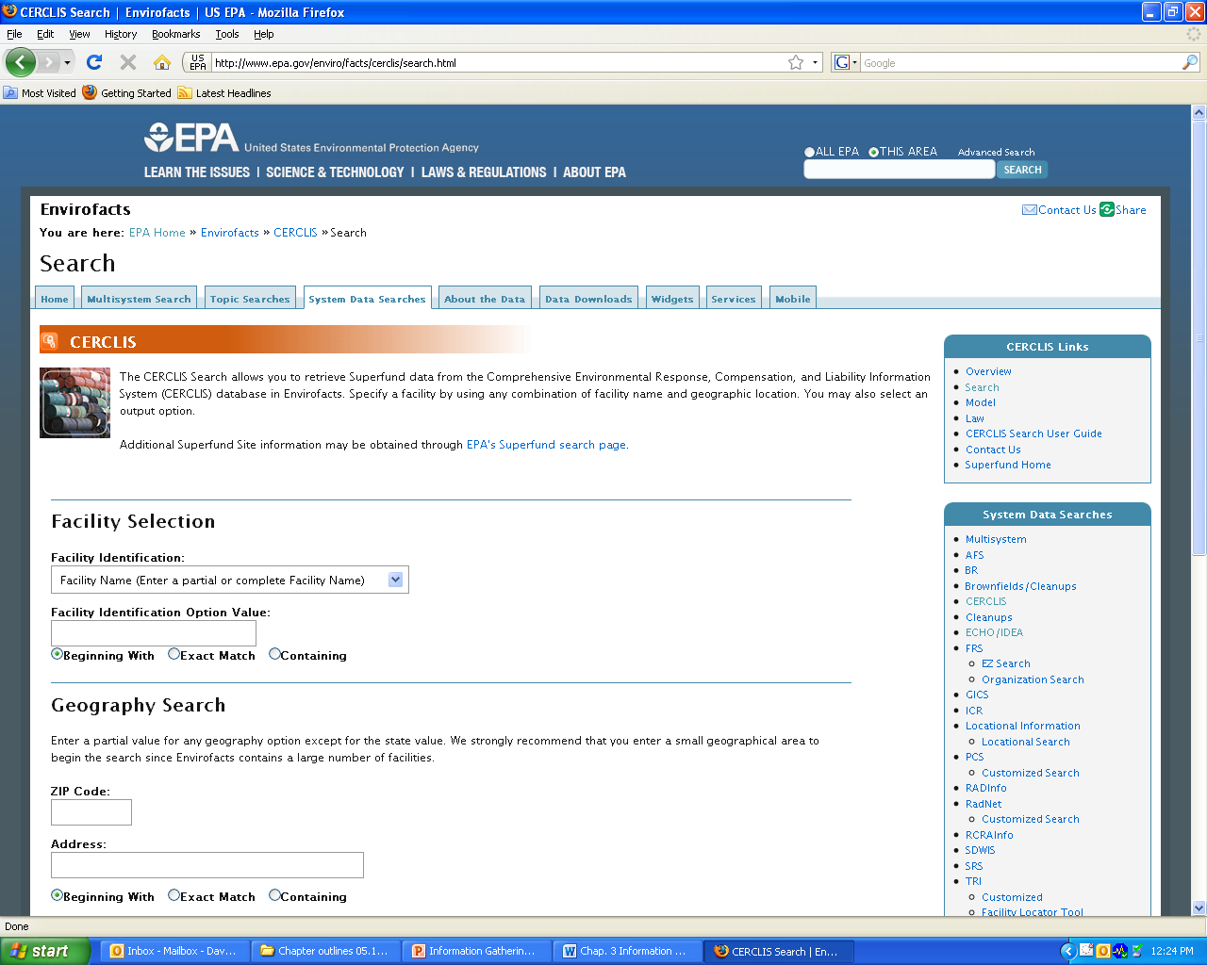
envirofacts
Notes:
Envirofacts is a single point of access to select U.S. EPA environmental data. This website provides access to several EPA databases to provide you with information about environmental activities that may affect air, water, and land anywhere in the United States. With Envirofacts, you can learn more about these environmental activities in a specific area. You can generate maps of environmental information and obtain facility information, including toxic chemical releases, water discharge permit compliance, hazardous waste handling processes, Superfund status, and air emission estimates.

Slide 85
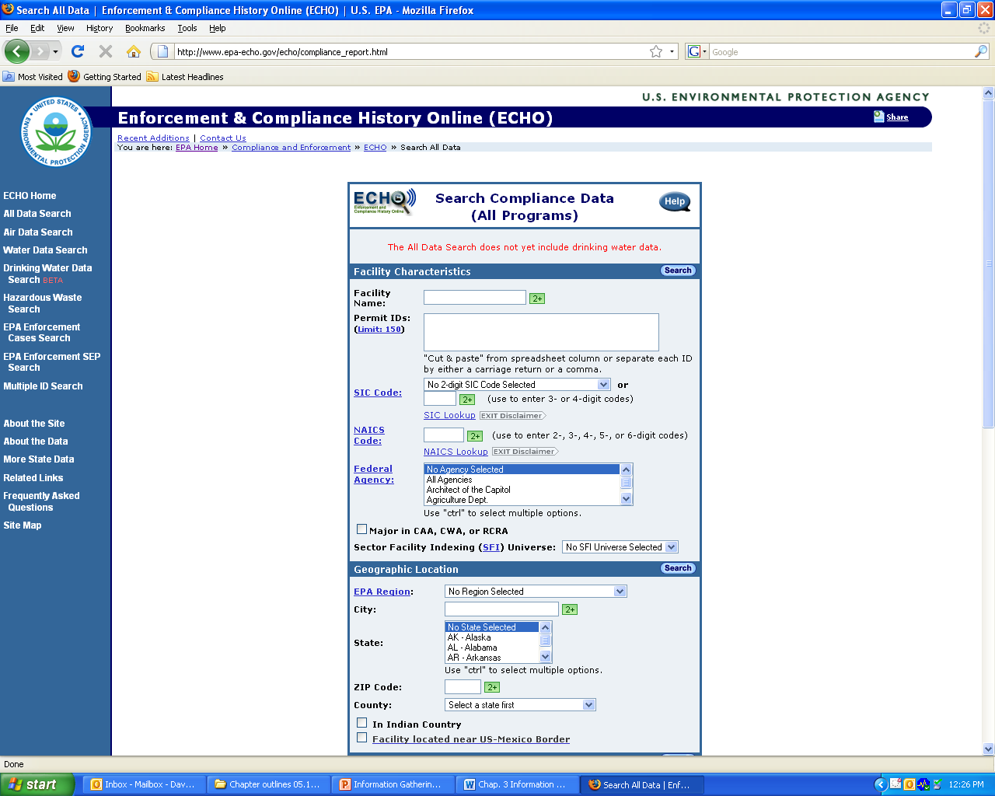
ECHO
Notes:
As mentioned earlier the ECHO system is used primarily by EPA Enforcement to gather information about a facilities compliance history for all programs, TRI, Air, Water, RCRA, etc. It has replaced the OTIS system, which is no longer functioning.
It’s where all of the combined data from EPA’s various databases is stored for the public. You can look up a facility and find violations, see what permitted facilities are in a certain location, find Superfund sites, etc.

Slide 86
TRACS – State of Texas
Notes:
This is an example of a system used by the State of Texas called TRACS. As you can hopefully see, it shows the entity that received the hazardous substances, and what it was that was received and the name of the company that sent the waste. This database of receiving entities, also gives the transporter information, the date received and the quantity of the substance received. etc.
I’m just bringing this up as an example. Many states have similar systems, which can provide you a lot of information especially on sites, where you are dealing with a lot of generators.

Slide 87
Local, State, and Other Federal Agencies as Sources
State enforcement actions, sister federal agency actions, health and fire department reports, local air and water authorities
Environmental investigations and/or permits
Notices of Violation
Complaints
Identify a pattern of non-compliance and hazardous practices
Helps build complete picture of environmental problems
Notes:
These are all good sources of information about a facility and the business that could very well be responsible for the pollution. I recently sent a 104(e) Information Request letter to an entity that I thought was a previous owner. It turns out they were able to prove they were not the previous owner, but were kind enough to provide the contact information for one of the major contributors of a very large site in my region. It was like a gift fell out on the sky onto my desk. All the information that was provided by the non-PRP proved to be exact and extremely helpful. Of course they were very happy to get EPA to turn their focus in another direction.

Slide 88
Invoices
Notes:
This is an example of an invoice from a company (a country club) who shipped used motor oil to an oil recycler. It gives details of what was shipped, from who, and to whom, give generator ID, and depending on the invoice design, it might also provide information on the transporter.
This type of information can be obtained through the 104(e) Information Request letter, or possibly by doing a site visit to review records.
This information can be useful to help build a waste in list for a specific facility.

Slide 89
Hazardous Waste Manifests
Notes:
This is a copy of a Hazardous Waste Manifest, and provides much of the same information as an invoice, and even a little more. It usually gives more information about exactly what was being delivered, it may even have a waste code, depending on how the state has designed their document.
Manifests are very useful to determine who sent what, and to where. They are very good for evidence when you are developing information for your General Notice and Special Notice letters.
It also provides transporter information.

Slide 90
County Records
County Clerk’s Office:
Deeds
Mineral Rights
Outstanding liens and mortgages
County Assessor’s Office:
Real estate tax amounts paid and unpaid
Identify abutting property owners
Provide parcel maps, plat maps
Notes:
From the County Clerk’s Office you’ll be able to get Deed and Title documents, information on Oil and Gas Mineral Rights
As well as information on outstanding liens and mortgages on the property.
The County Assessor’s Office helps in identifying real estate tax amounts paid and unpaid, and by whom. Plus the assessor’s office can help you Identify the owners of abutting property. This may be a good source of information about the PRP, plus the OSC often needs to contact the adjoining property owners.
The County Assessor Office also can provide parcel maps, plat maps, and maps of sub-divisions.

Slide 91
Corporate Information
Sources include the Secretary of State, Department of Revenue, and similar state agencies
Available Information may include corporate officers, percentages of ownership, registered agents, former names, etc.
Company websites
Notes:
There’s a lot of good corporate information available on State’s websites. Much of it is free. Just as this slide explains you can find names and addresses of corporate officers, registered agents. It can point you to previous names the company used, which can lead to possible a bigger net to throw out for your PRP search in the form of a 104(e) Information Request letter.
Some Secretary of State (SOS) websites charge for detailed information by county. So it’s always a good idea to find out if anyone else in your immediate office has accessed the website for the same county or parish. Perhaps the fee has already been paid for the year, and you can access the information under the ID established by the co-worker.
Recently a co-worked had a phone conversation with a PRP who said the company was in dire financial condition. However, when the individual put the Enforcement Officer on hold, there was a recording in the background telling of the companies international holdings and financial strength. After that the argument, didn’t hold water needless to say.

Slide 92
Historical Resources
Polk Directories
Sanborn Maps
Special collections at universities and colleges
Books on subject (use EPA’s library for inter-library loans)
Technical manuals (e.g., Army manuals on NIKE missiles)
Eckhart survey of chemical industry
Historical societies
State manufacturing register
Notes:
These are just some of the various resources that are readily available to EPA employees. You may have a fairly robust library in your regional office, or you may want to resort to the City’s public library or university library. I guess the one take away I want to be sure and emphasis is “think outside the box”. Most likely information about your site is out there, you just might have to dig to find it.
Polk directories have been a business icon for over 140 years and gathers information by State, City, type of business, containing an alphabetical list of business entities.
City directories and manufacturing directories can also provide historical information about what business was in operation at what address.
The Eckhart Survey is a compilation of waste site from the chemical industry. As a result of this responses to this survey, Congress was motivated to pass Superfund legislation (CERCLA) in 1980.

Slide 93
Polk Directories
City Directories where you can search by street name, type of business, and …..
Notes:
This is an example of a Polk Directory. The are city specific and include information regarding listings of businesses that were or are doing business and have an address in that particular city.

Slide 94
Examples of Research Websites
Local historical societies:
Museum of History and Industry in Seattle has nearly 4 million artifacts, photos, and archived files covering the Pacific Northwest
University of Idaho library also has a great website
Notes:
These are just a few examples of special collections. I’m sure your state and local society may be a good place to check.
MOHAI is the museum of History and Industry. The museum includes artifacts related to local businesses and industries, locally designed and invented products, recreational equipment, maritime objects. Again, this is just one example of information that is readily available.

Slide 95
Sanborn Maps
Fire insurance maps showing structures, fire hydrants, wells, construction date, etc.
Started in 1866 and updated about every 10 years
Now provides other digital services
Notes:
This is an example of a Sanborn map. As you can see it provides details of fire hydrants, walls and other construction.
It’s a publisher of historical and current maps of US cities and towns. These maps were initially created to estimate fire insurance risks.
The maps include outlines of each building and outbuilding; the location of windows and doors; street names; etc. .
Today, Sanborn maps are found primarily in the archives and special collections of town halls and public and university libraries, and remain a vital resource for people in many different fields.

Slide 96
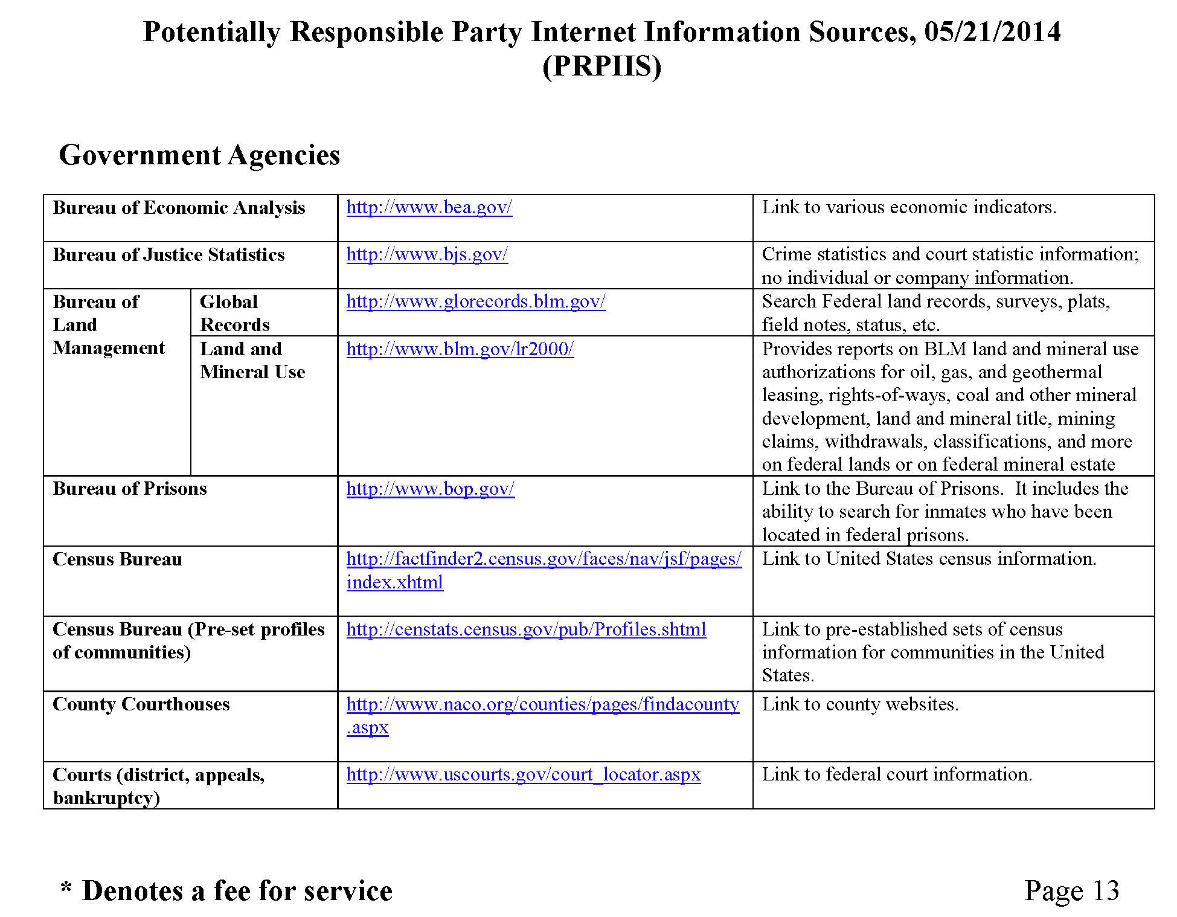
Other Sources
Notes:
This is a collection of websites that could greatly assist in your PRP information gathering. It includes website listings to help you research topics such as security and exchange filings, bankruptcy information, company profiles, corporate financial information, an administrative record data base, a copy of the National Priority Listing, the PRP search manual, Superfund enforcement guidance documents, government agency website addresses, the national criminal justice reference service, etc. It also includes a section on finding people, and the list goes on and on. I strongly recommend that you check out this listing and just at least be familiar with what’s available that you might need for future use.

Slide 97
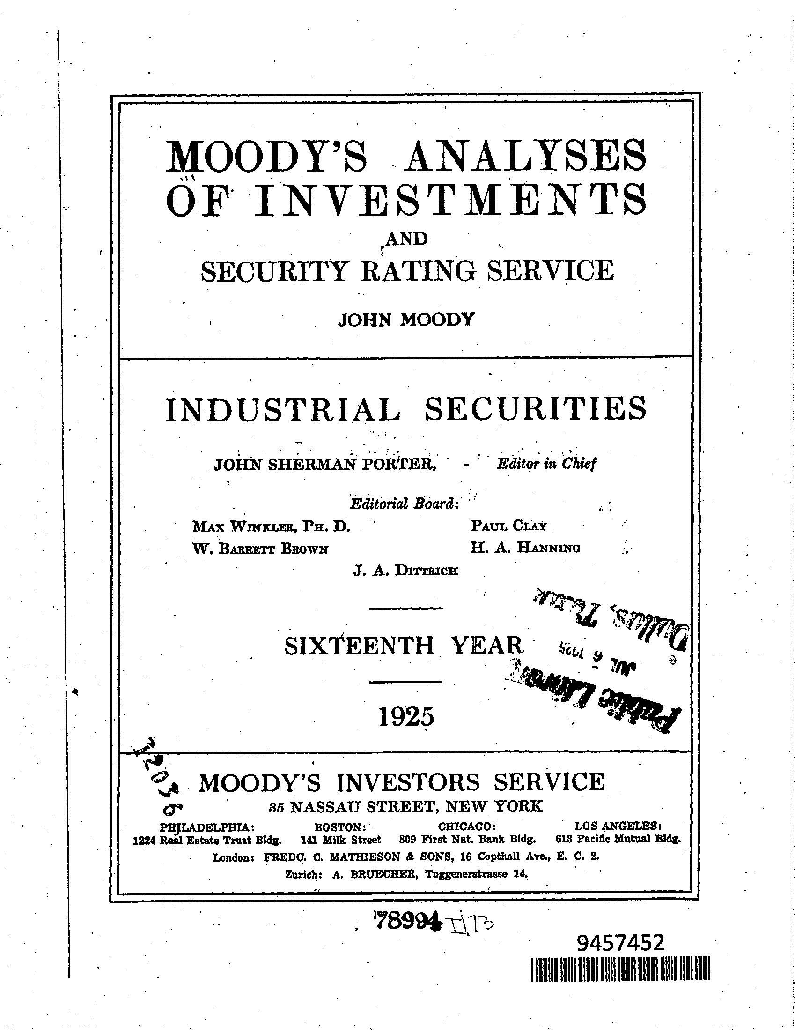
Moody’s Analyses
of
Investments
Notes:
Moody's Investors Service, often referred to as Moody's, is the bond credit rating business of Moody's Corporation, representing the company's traditional line of business and its historical name. Moody's Investors Service provides international financial research on bonds issued by commercial entities. It provides information about the company’s history, board members, stock issuances, etc.

Slide 98
Fee-for-Service Databases
CLEAR
PACER
LexisNexis
These databases allow for “global” searching across the nation
Notes:
There are a number of fee for service databases which can provide detailed information about a company.
CLEAR is an investigative research system that provides information about a person or business from proprietary sources and public records. Hopefully your region has a subscription to use this service.
PACER stands for Public Access to Court Electronic Records, and this is an electronic public access service that allows users to obtain case and docket information online from federal appellate, district, and bankruptcy courts, and the PACER Case Locator. PACER is provided by the Federal Judiciary in keeping with its commitment to providing public access to court information via a centralized service. This also is a Fee for Service database.
LexisNexis Group is a corporation providing computer-assisted legal research as well as business research and risk service solution.

Slide 99
Examples of EPA Source Documents
CERCLA 104(e) Information Request letters
RCRA 3007 Information Request letters
Orders issued to PRPs
Permits issued to PRPs
Confidential Criminal Investigation Division Reports
Inspection reports, sampling data, enforcement actions
Notes:
These documents all represent great ways to obtain information about an entity, and should all be accessible in your office.

Slide 100
Local Government Resources
Fire Department
Police Department
City Hall
Notes:
These local organizations may all have information on an site, based on responses made to the location, or just general knowledge. More than once I have been in local offices trying to obtain information about a specific Superfund Site, when someone working behind the counter says, “Oh my Dad worked there for years,” or something similar. Often these people are more than willing to tell you what the company has left for the City to cleanup.

Slide 101
Potential Federal Sources
Dept of Interior - Maps
Environmental Photographic Interpretation Center -
Maps
Nuclear Regulatory Commission - licenses, permits
U.S. Geological Survey - groundwater data
U.S. Army Corps of Engineers - records at federally owned sites
Occupational Safety and Health Administration - health and safety incident reports
U.S. Coast Guard - incident response reports
Notes:
There’s a lot of information out there from other Federal Agencies. Oftentimes, people in your office, other Enforcement Officers, On-scene Coordinators, or attorneys, have a contact to help get you started.

Slide 102
Sources of Information Commonly in PRP Possession
Information on other PRPs
Hazardous material listings
Shipment manifests
Transporter records
Material Safety Data Sheets (MSDS)
Correspondence
Corporate records
Notes:
You’d be surprised what you can find at the Site location or through a 104(e) Information Request letter. Manifests and customer listings are two of the most fruitful, in my opinion for getting information on additional PRPs.

Slide 103
Organization
Large sites with many PRPs and a large volume of records spanning a number of years may require complex file organization. To choose the best method of organizing documents, the following factors should be considered:
Types of information needed from the documents
Volume of documents
Regional file structure
Capabilities of the organizer
Ease of document retrieval
Long-term tracking needs and capabilities
Potential document security issues
Unique site-specific needs
Nature and number of potential users
Time required to organize documents
Notes:
Organizing records
Does your region require specific file management procedures even on working documents? (filing information using the same format the Records Center requires, for example)
If there are no regional restrictions on working files, organize your records in a way that makes sense to you (e.g., by the agency where you got the documents, document type, company names, individuals associated with site). If you are really good on the computer, you can manage your electronic files the same way.
You need to know the agency record management system regardless and the definition of a record.

