Slide 1
IPCC Fifth Assessment Report
Synthesis Report

Slide 2
The IPCC Synthesis Report
  Integration of three Working Group Reports of the 5th Assessment, 2013-2014
    WG I : The Physical Science Basis
    WGII: Impacts, Adaptation and Vulnerability
    WG III: Mitigation of Climate Change

Slide 3
The IPCC Synthesis Report
  Written by 60 authors from Working Group reports
  Chaired by the IPCC Chair R.K. Pachauri
  Member governments approved the SPM on 1st November 2014 (total membership of IPCC is 195 governments)

Slide 4
Key Messages
  Human influence on the climate system is clear
  The more we disrupt our climate, the more we risk severe, pervasive and irreversible impacts
  We have the means to limit climate change and build a more prosperous, sustainable future
AR5 WGI SPM, AR5 WGII SPM, AR5 WGIII SPM

Slide 5
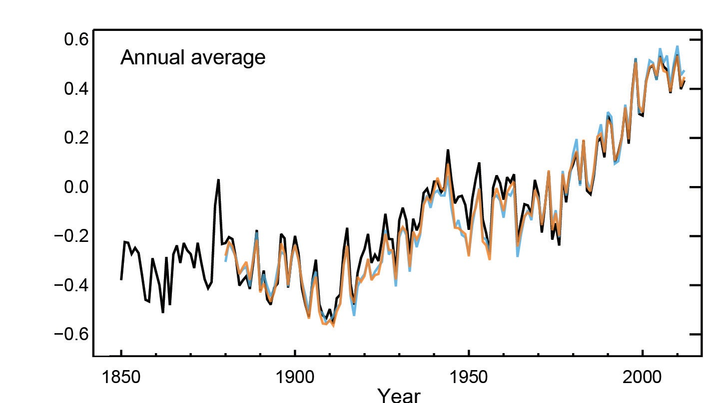
Humans are changing the climate
It is extremely likely that we are the dominant cause of warming since the mid-20th century
Year
Globally averaged combined land and ocean surface temperatures
AR5 WGI SPM

Slide 6
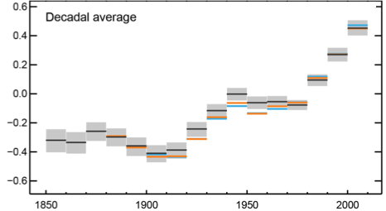
Temperatures continue to rise
Each of the past 3 decades has been successively warmer than the preceding decades since 1850
Year
Globally averaged combined land and ocean surface temperatures
AR5 WGI SPM

Slide 7
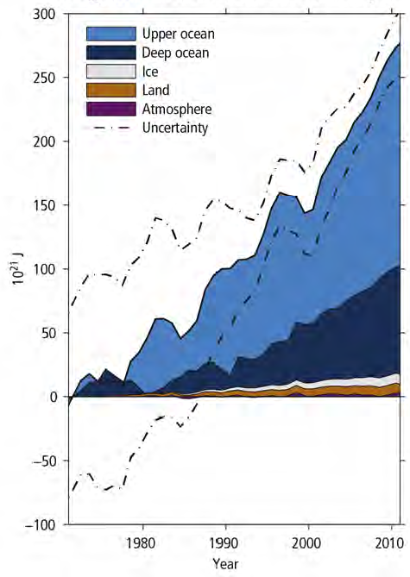
Oceans absorb most of the heat
  More than 90% of the energy accumulating in the climate system between 1971 and 2010 has accumulated in the ocean
  Land temperatures remain at historic highs while ocean temperatures continue to climb
AR5 SYR

Slide 8
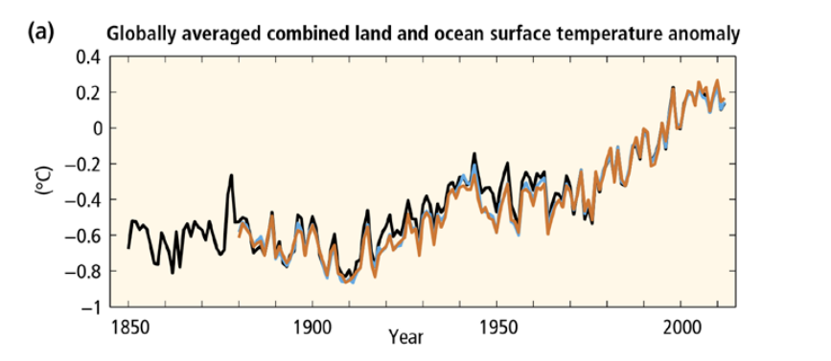
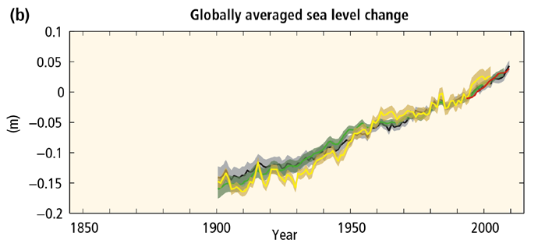
AR5 SYR SPM

Slide 9
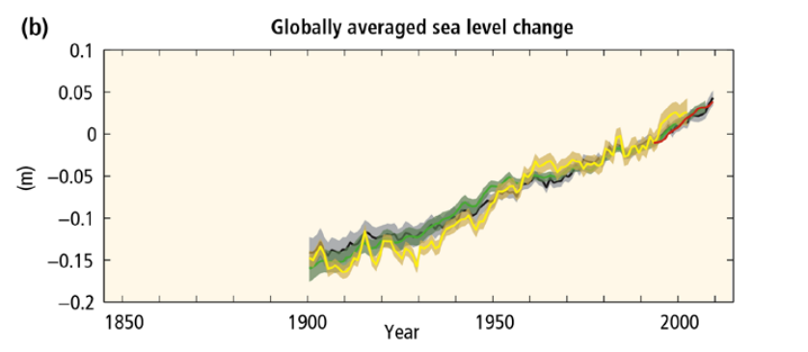
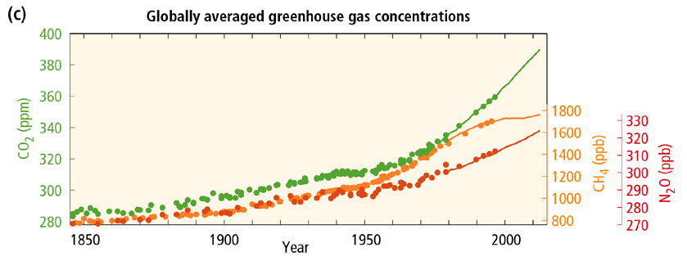
AR5 SYR SPM

Slide 10
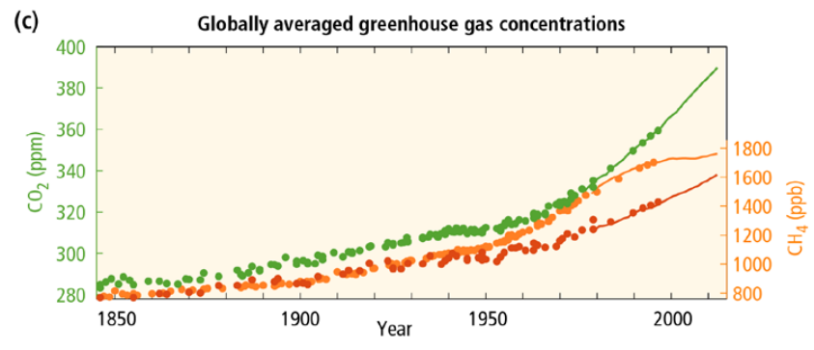
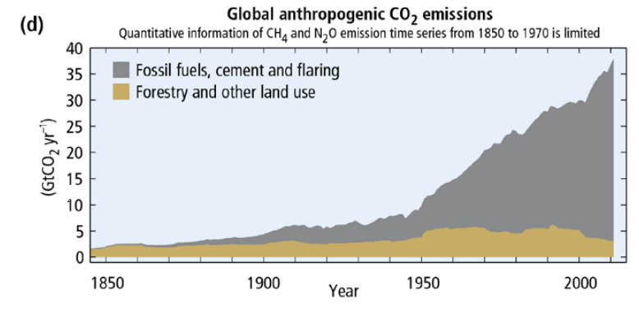
AR5 SYR SPM

Slide 11
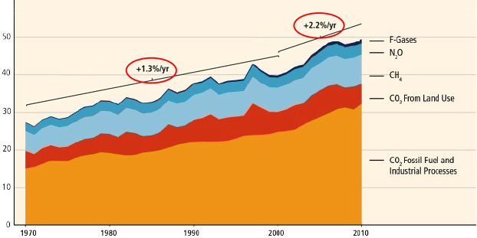
GHG emissions growth between 2000 and 2010 has been larger than in the previous three decades
GHG Emissions [GtCO2 eq/yr]
AR5 WGIII SPM

Slide 12






Sources of emissions
Energy production remains the primary driver of GHG emissions
24%
14%
6.4%
21%
35%
Building
Sector
Agriculture,
forests and
other land uses
Industry
Transport
Energy Sector
2010 GHG emissions
AR5 WGIII SPM

Slide 13
Antropogenic forcings are extremely likely the cause of warming

Slide 14
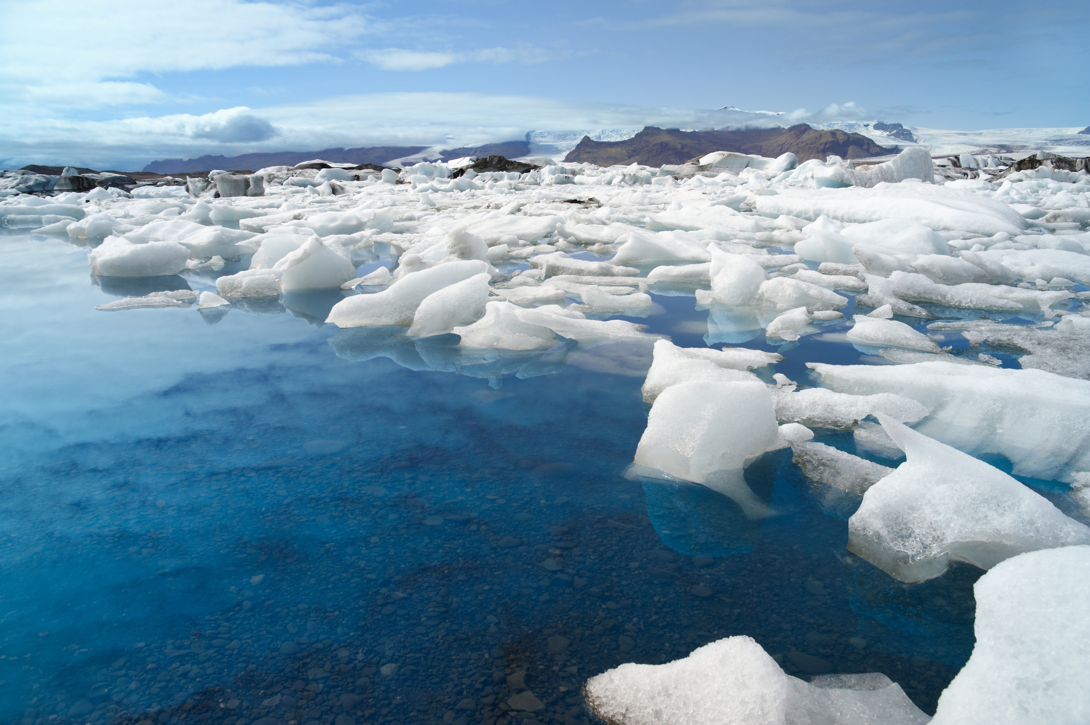
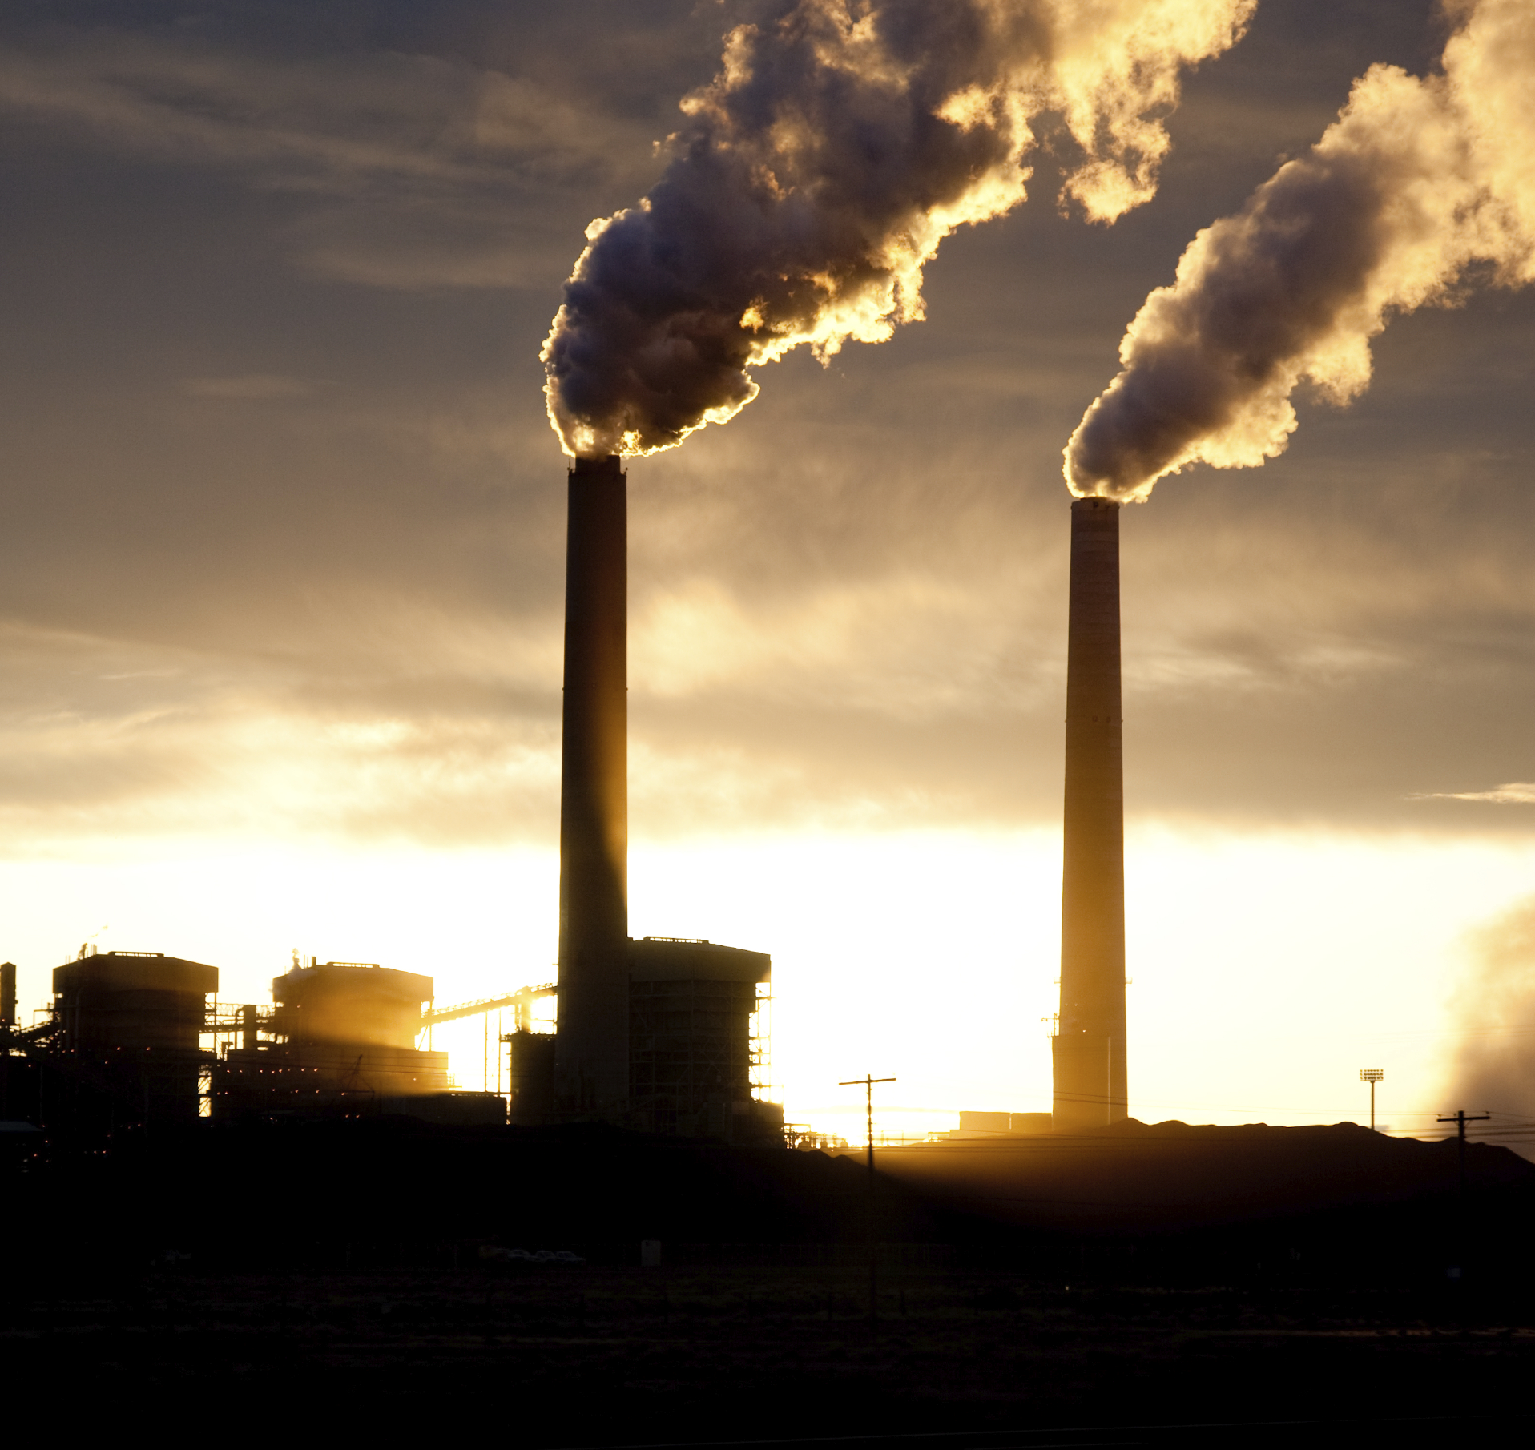
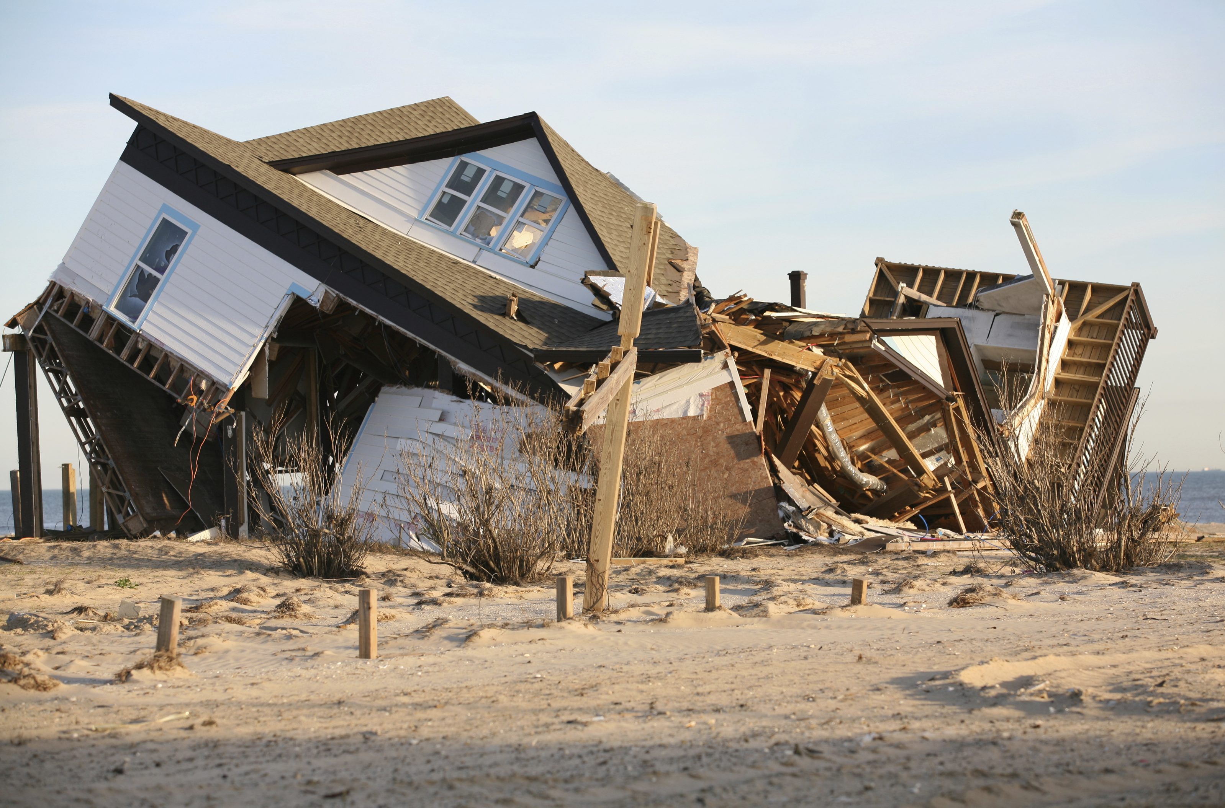
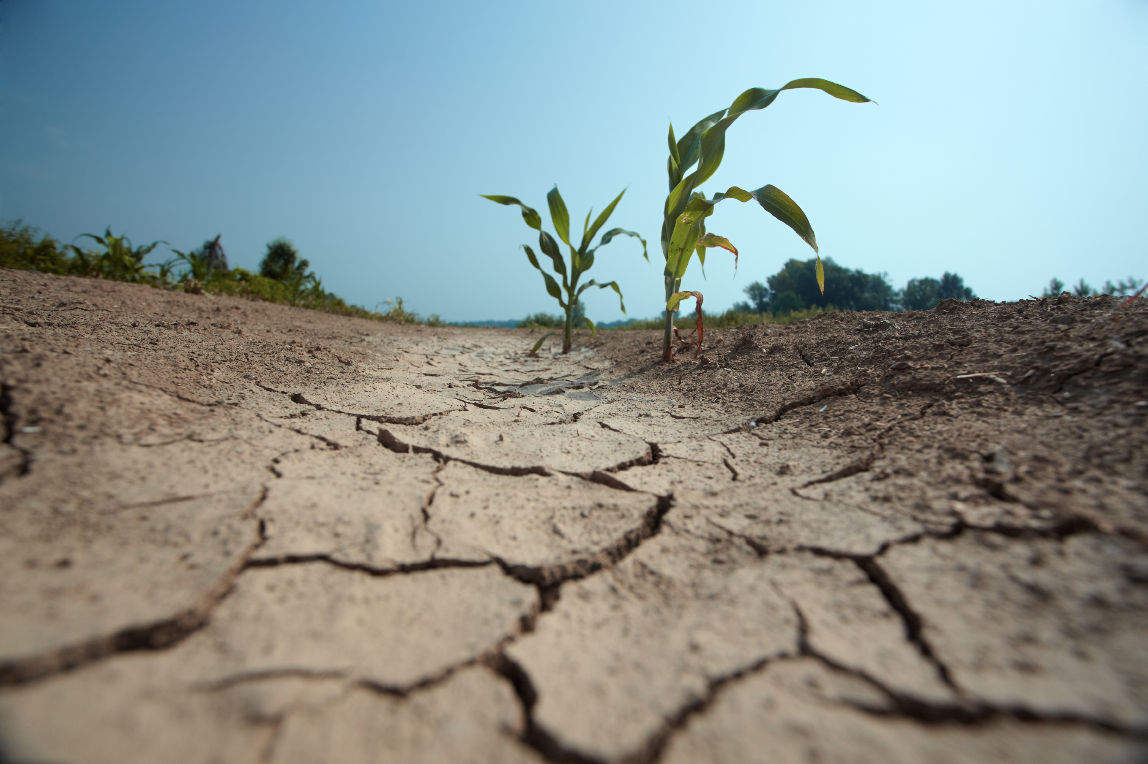
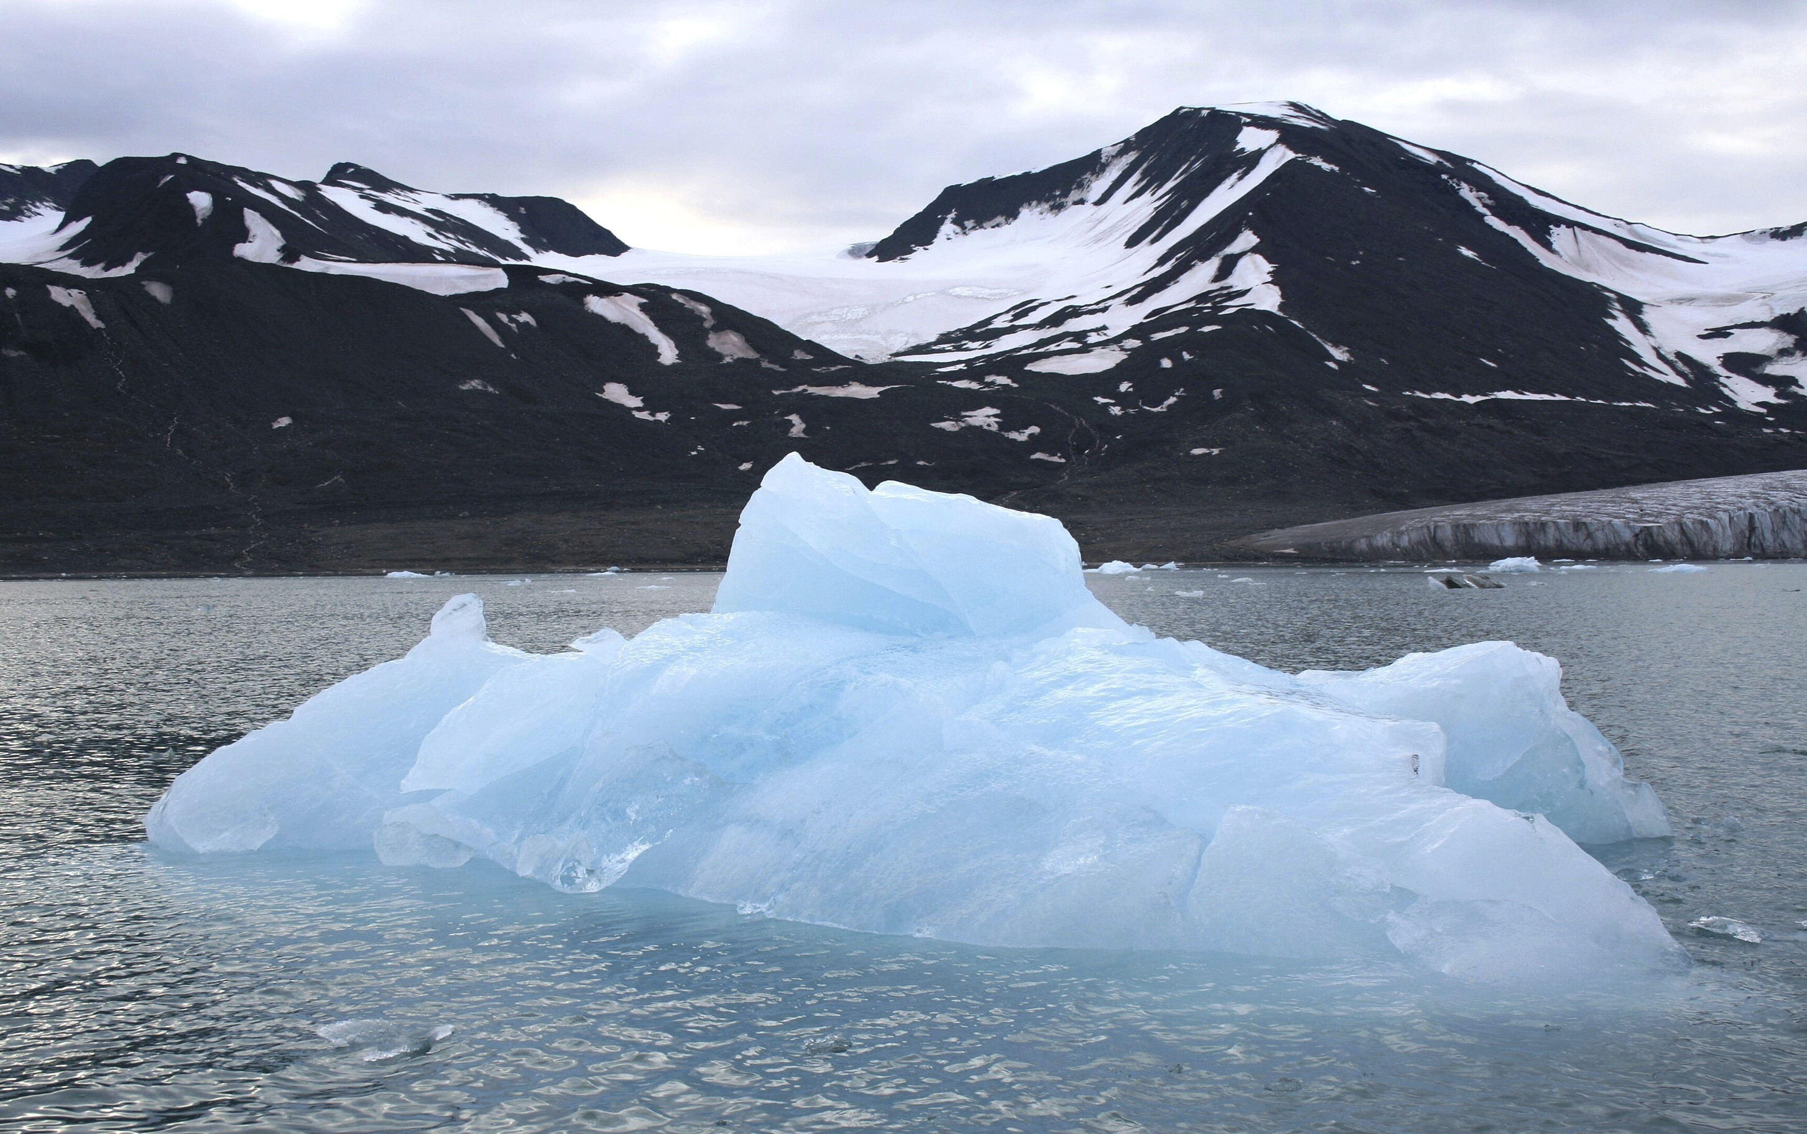
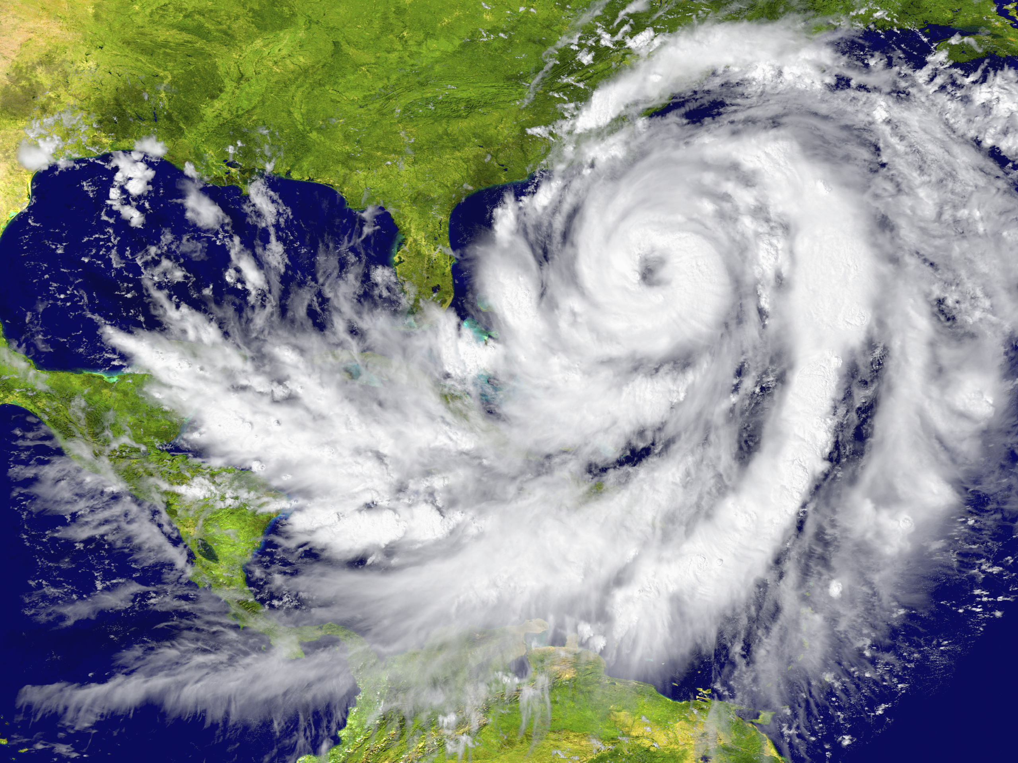
Some of the changes in extreme weather and climate events observed since about 1950 have been linked to human influence
AR5 WGI SPM

Slide 15
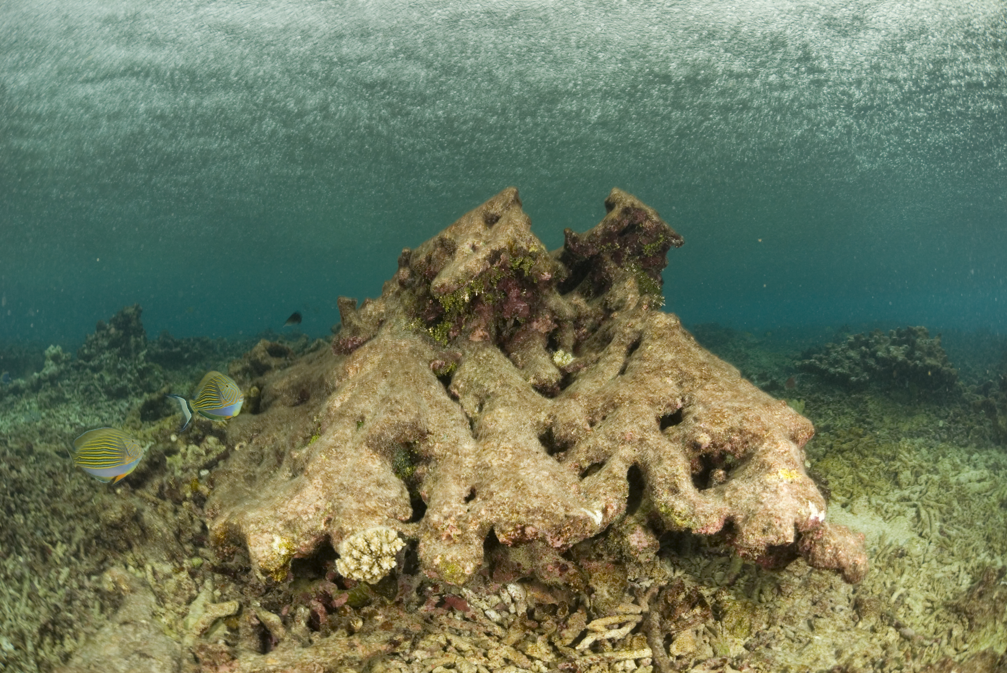
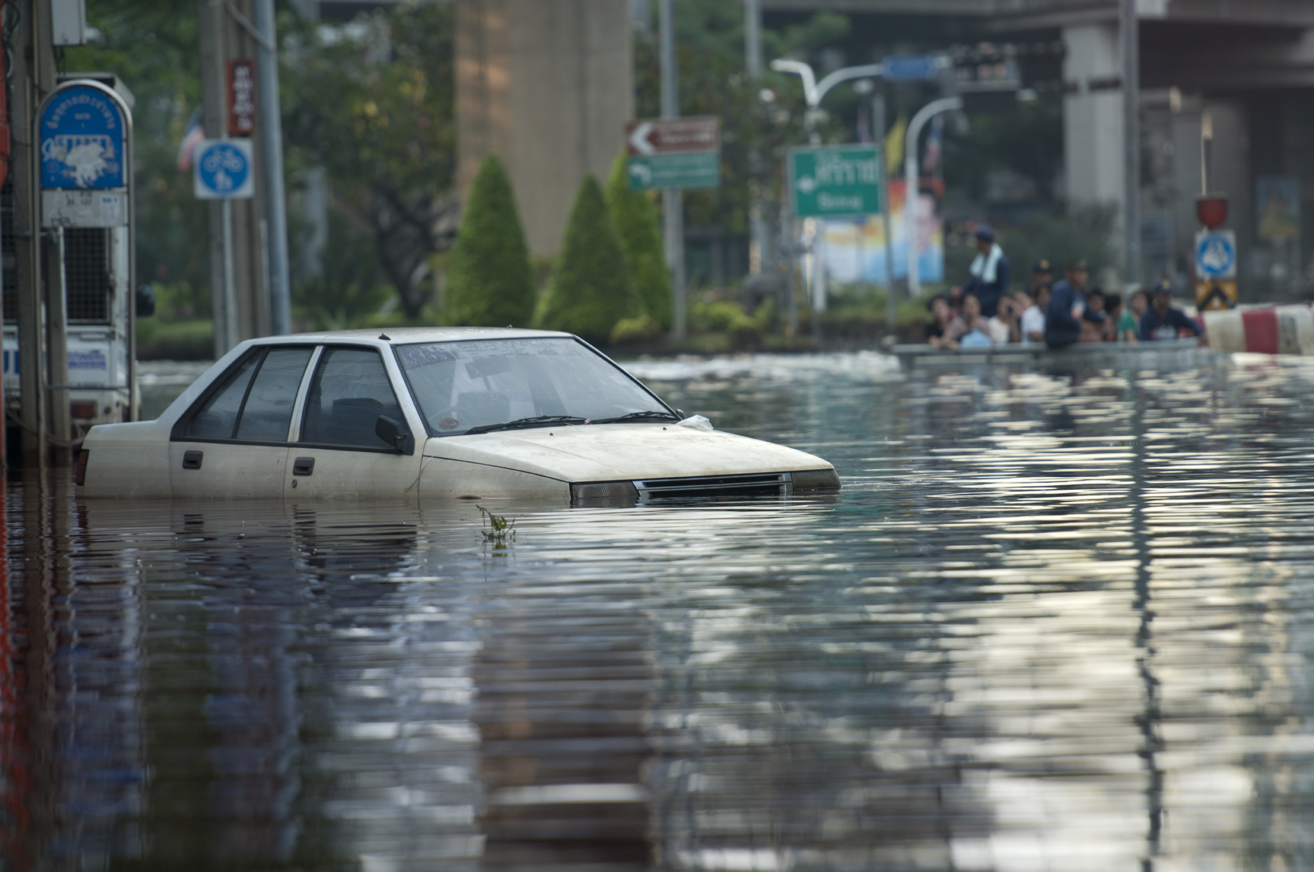
Impacts are already underway
  Tropics to the poles
  On all continents and in the ocean
  Affecting rich and poor countries
AR5 WGII SPM

Slide 16
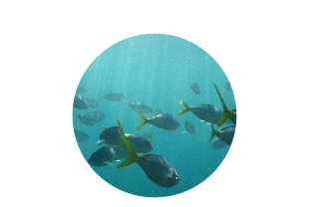

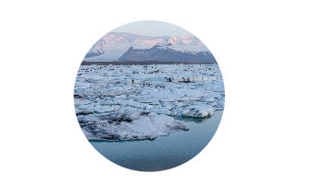

Projected climate changes
Continued emissions of greenhouse gases will cause further warming and changes in the climate system
Oceans will continue to warm during the 21st century
Global mean sea level will continue to rise during the 21st century
It is very likely that the Arctic sea ice cover will continue to shrink and thin as global mean surface temperature rises
Global glacier volume will further decrease
AR5 WGI SPM

Slide 17





Potential Impacts of Climate Change
Food and water shortages
Increased displacement of people
Increased poverty
Coastal flooding
AR5 WGII SPM

Slide 18
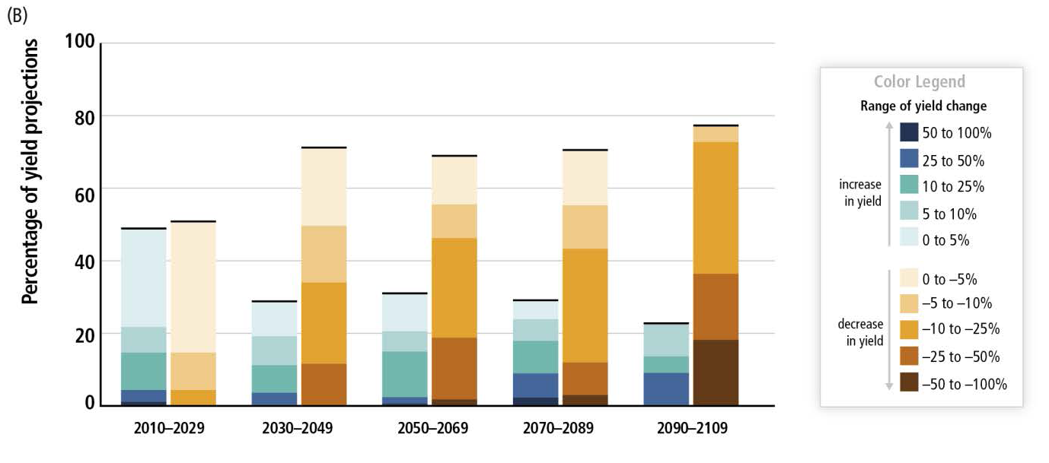
Climate Change Poses Risk for Food Production
Percentage of yield projections
AR5 SYR SPM

Slide 19
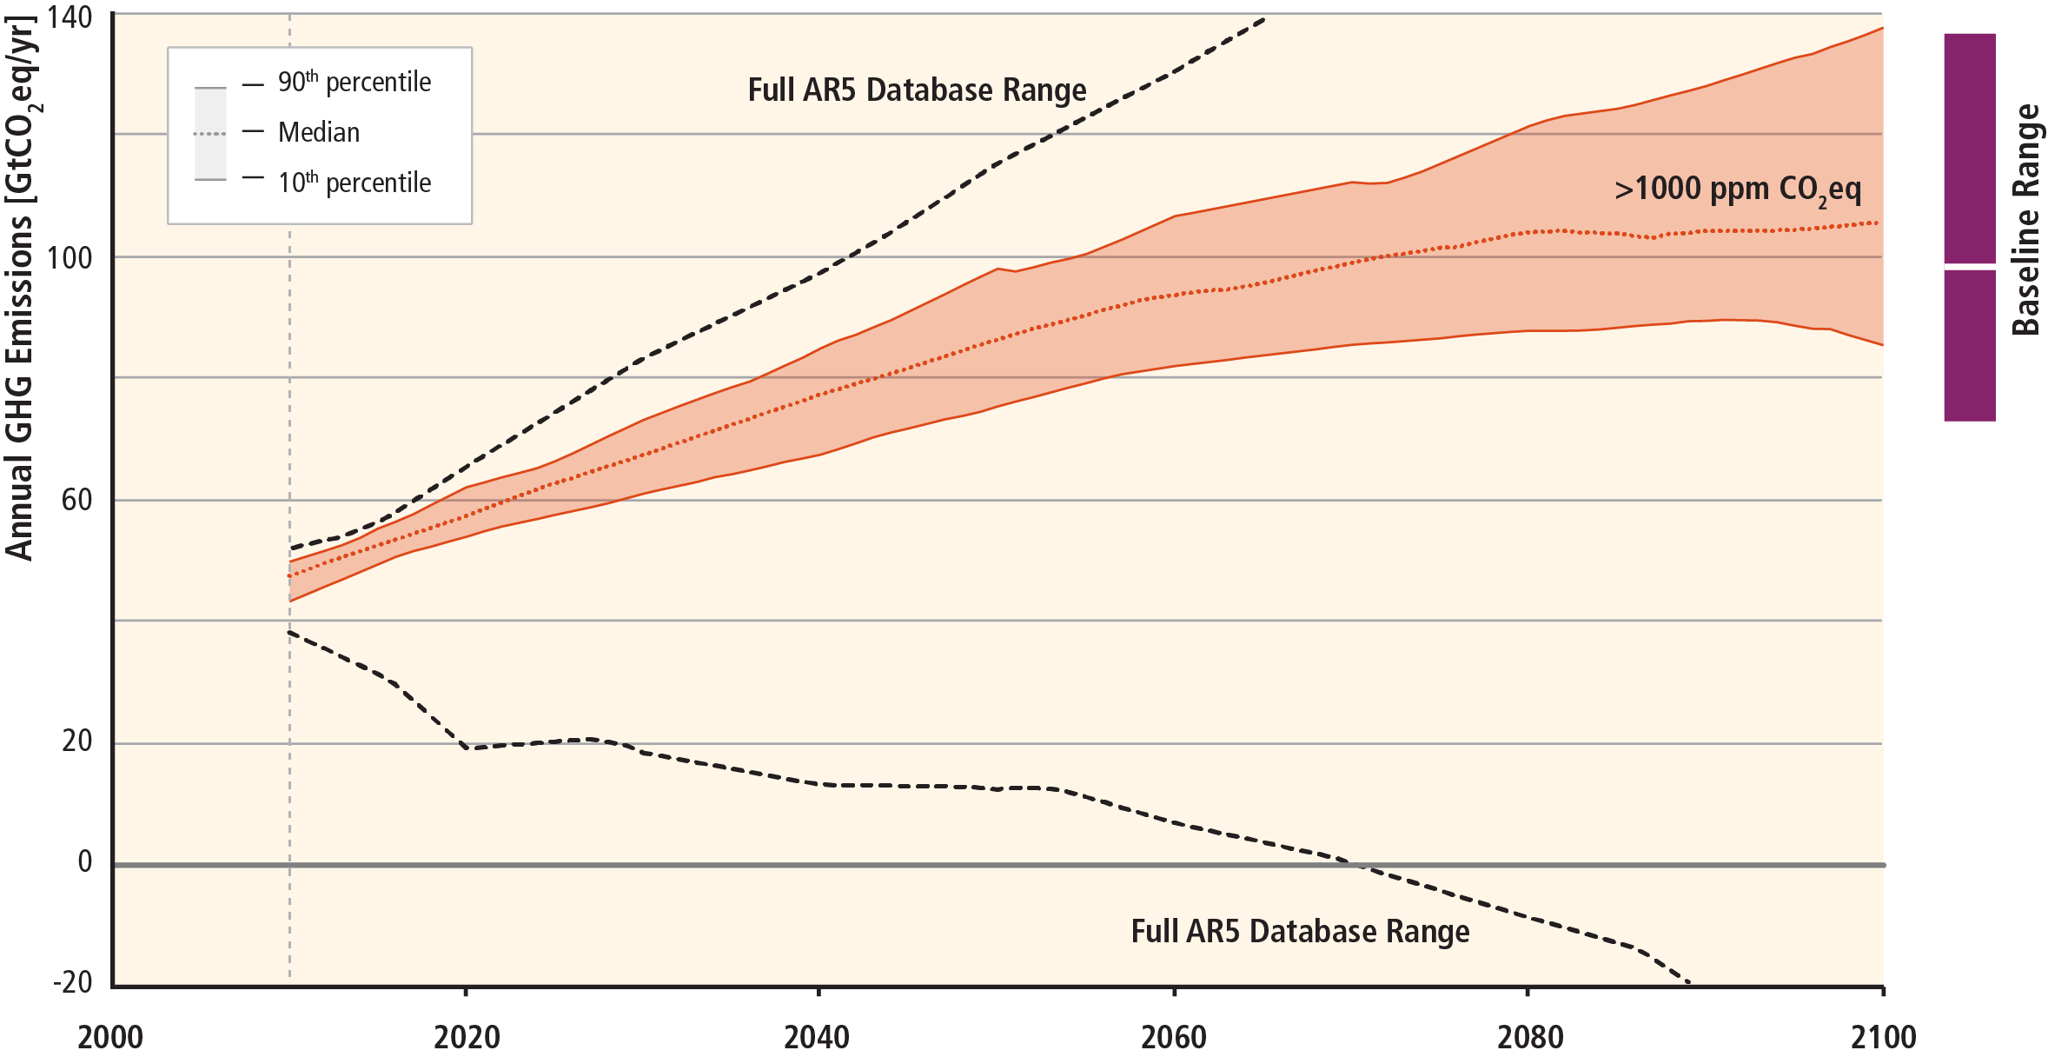
Stabilization of atmospheric concentrations requires moving away from the baseline – regardless of the mitigation goal.
AR5 WGIII SPM
Based on Figure 6.7

Slide 20
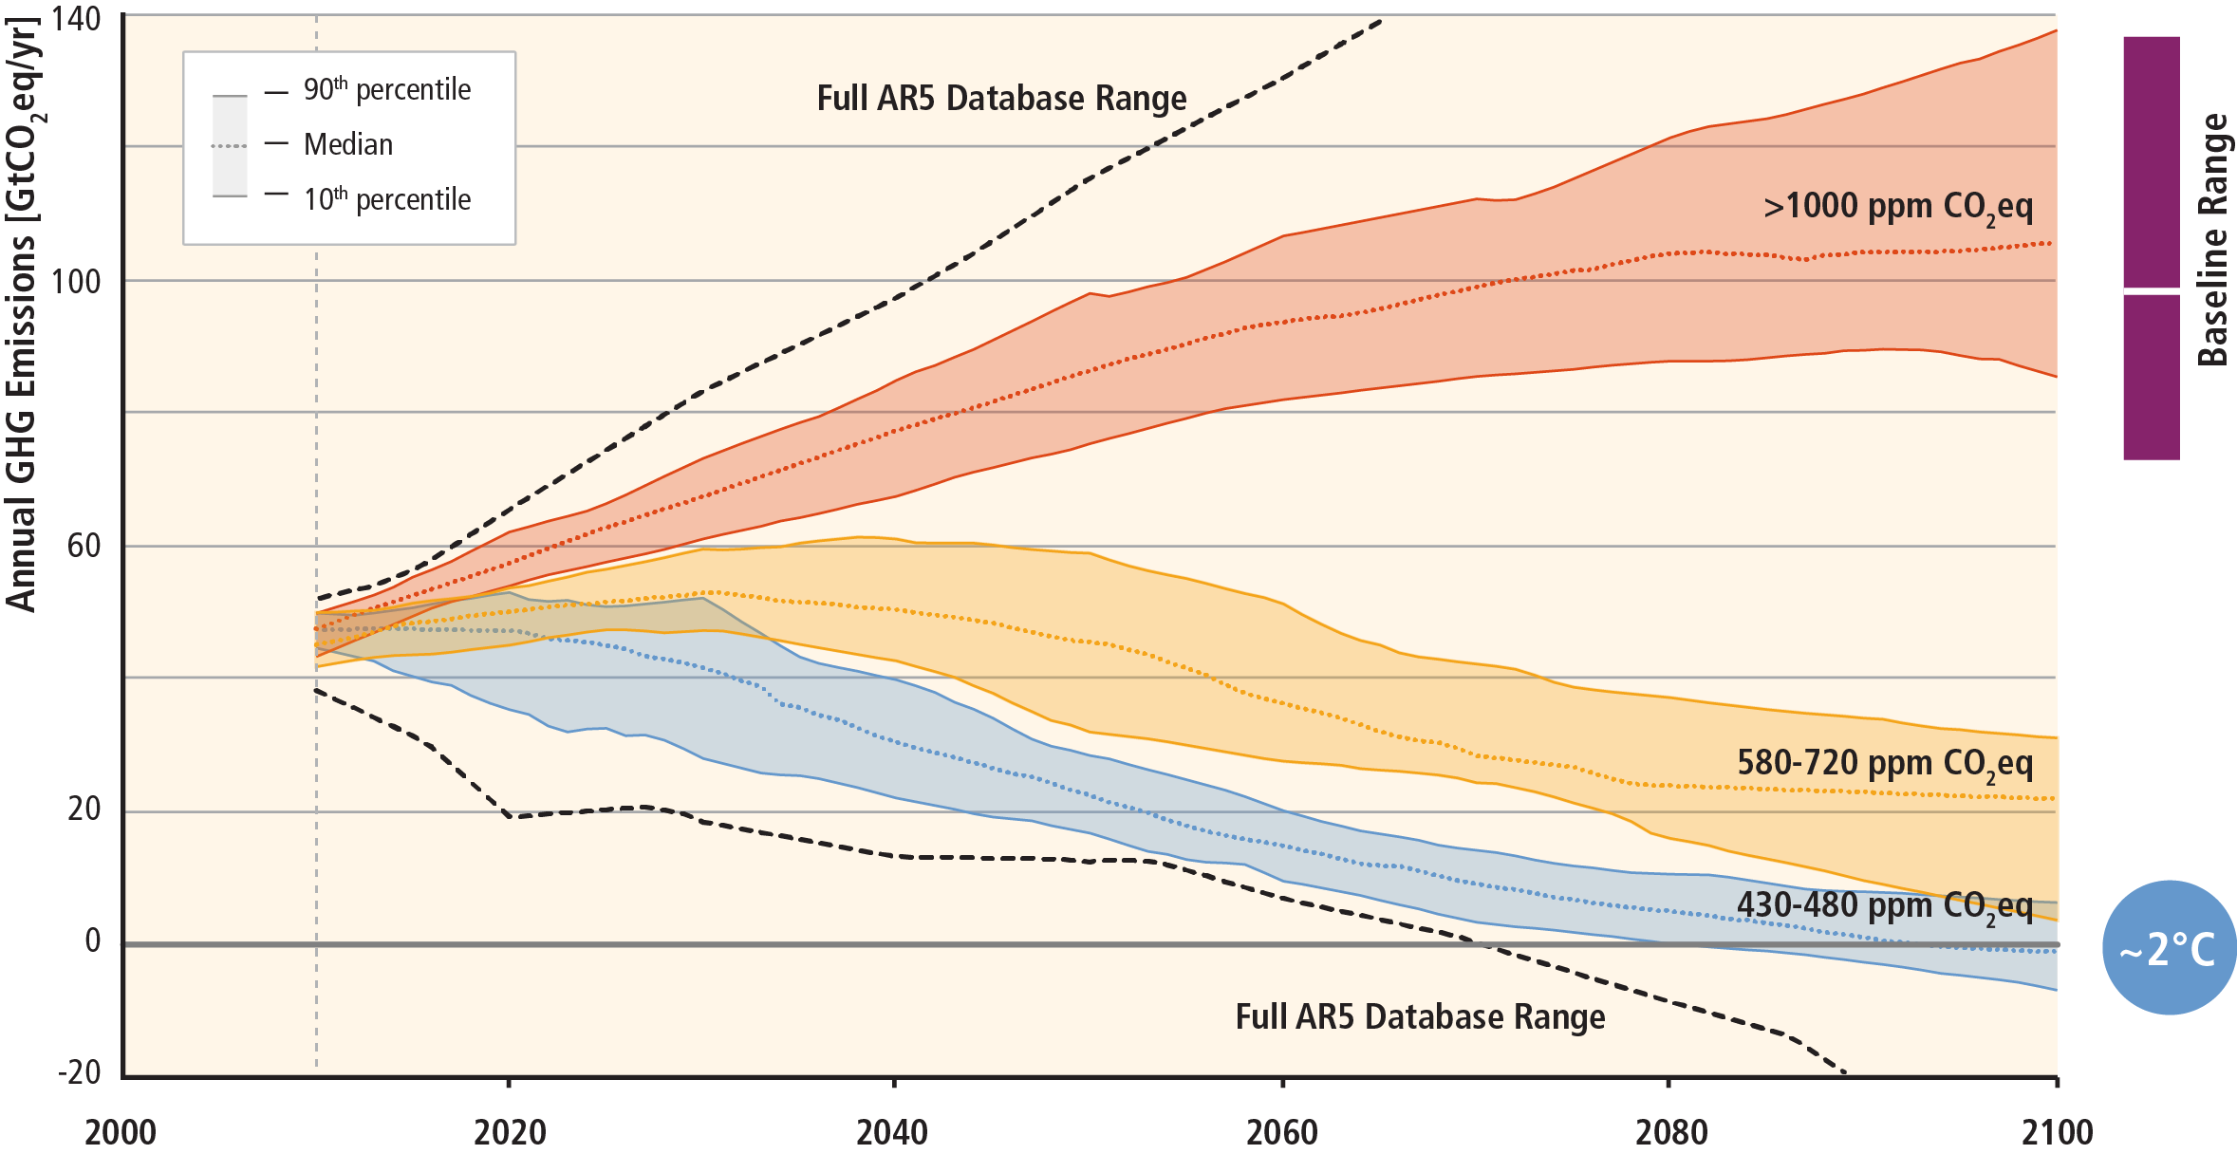
Stabilization of atmospheric concentrations requires moving away from the baseline – regardless of the mitigation goal.
~3°C
Based on Figure 6.7
AR5 WGIII SPM

Slide 21
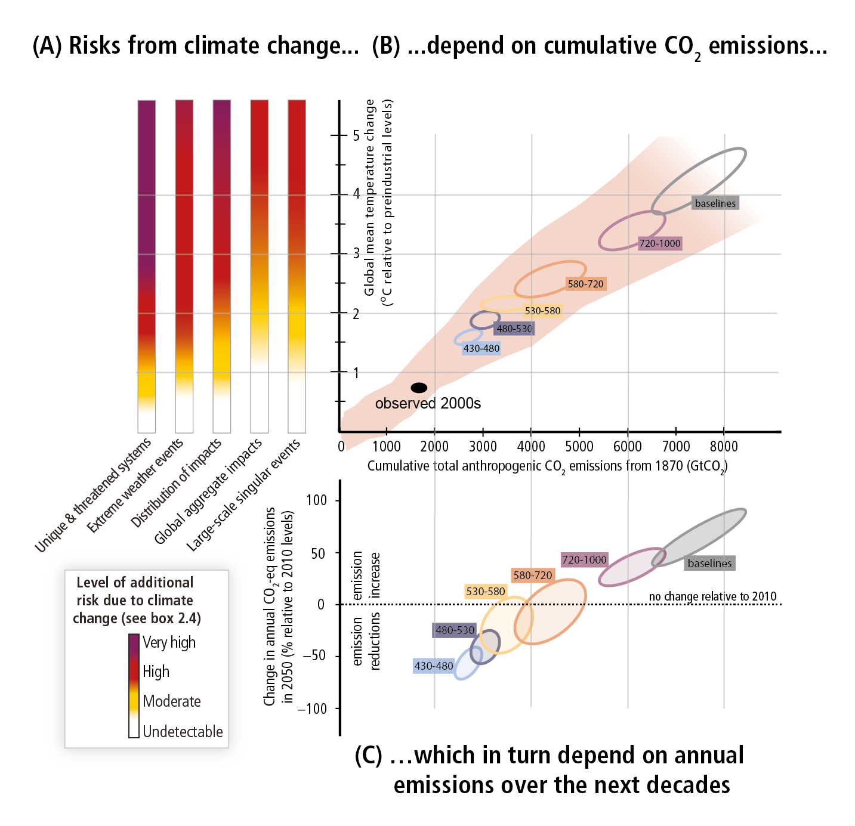
Figure SPM.10,
A reader’s guide
From climate change risks to GHG emissions

Slide 22
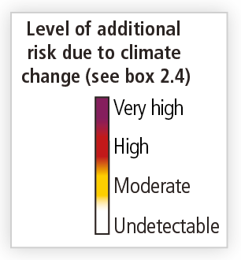
The risks from climate change, assessed by the WGII of the IPCC AR5, and aggregated in five “Reasons for Concerns”
Levels of risk across the Reasons for Concern can be associated with a level of global temperature change.
Here shown for a warming by 2ºC

Slide 23
The link between cumulative CO₂ emissions
and global mean temperature
The pink plume is from WGI complex models.
It includes the uncertainty from non-CO₂ gases and climate and carbon cycle uncertainty, using the likely range

Slide 24
The link between cumulative CO₂ emissions
and global mean temperature
The ellipses show results from the WGIII models, using a simple climate model. It does not include climate and carbon cycle uncertainty, but explores more comprehensively the scenario uncertainty from a range of CO2 and non-CO₂ pathways

Slide 25
Levels of risks can be connected to cumulative CO₂ emission levels, for the average climate response, for high climate sensitivity (lower cumulative emissions), and for low climate sensitivity (higher cumulative emissions)

Slide 26
The link between changes in annual GHG emissions by 2050 and the cumulative CO₂ emissions of the WGIII scenario categories

Slide 27
Levels of risks can now be connected to GHG emission changes by 2050. Added uncertainty arises from action on non-CO₂ gases, timing of pre-2050 action, and ambition of post-2050 action.

Slide 28
The constraint on changes in GHG emissions by 2050 depends on the sensitivity of the climate response.
Here, with large climate sensitivity

Slide 29
The constraint on changes in GHG emissions by 2050 depends on the sensitivity of the climate response.
Here, with low climate sensitivity

Slide 30
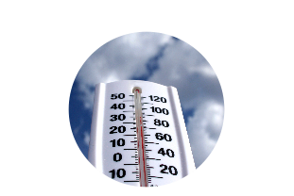
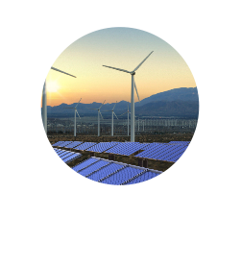
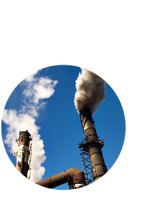

Limiting Temperature Increase to 2˚C
Measures exist to achieve the substantial emissions reductions required to limit likely warming to 2°C (40-70% reduction in GHGs globally by 2050 and near zero GHGs in 2100)
A combination of adaptation and substantial, sustained reductions in greenhouse gas emissions can limit climate change risks
Implementing reductions in greenhouse gas emissions poses substantial technological, economic, social, and institutional challenges
But delaying mitigation will substantially increase the challenges associated with limiting warming to 2°C
AR5 WGI SPM, AR5 WGII SPM,AR5 WGIII SPM

Slide 31




Mitigation Measures
More efficient use of energy
Greater use of low-carbon and no-carbon energy
• Many of these technologies exist today
Improved carbon sinks
• Reduced deforestation and improved forest management and planting of new forests
• Bio-energy with carbon capture and storage
Lifestyle and behavioural changes
AR5 WGIII SPM

Slide 32
Ambitious Mitigation Is Affordable
  Economic growth reduced by ~ 0.06%
  (BAU growth 1.6 - 3%)
  This translates into delayed and not forgone growth
  Estimated cost does not account for the benefits of reduced climate change
  Unmitigated climate change would create increasing risks to economic growth
AR5 WGI SPM, AR5 WGII SPM

Slide 33


The window for action is rapidly closing
65% of our carbon budget compatible with a 2°C goal already used
Amount
Remaining:
Total Carbon
Budget:
¹⁰⁰⁰
^{GtCO2}
Amount Used
1870-2011:
²⁹⁰⁰
^{GtCO2}
¹⁹⁰⁰
^{GtCO2}
AR5 WGI SPM

Slide 34
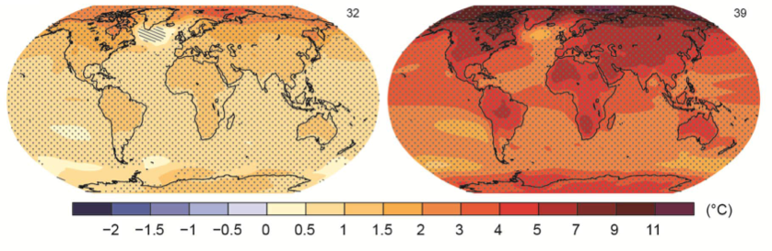
The Choices We Make Will Create Different Outcomes
With substantial mitigation
Without additional mitigation
Change in average surface temperature (1986–2005 to 2081–2100)
AR5 WGI SPM

Slide 35
IPCC Fifth Assessment Report
Synthesis Report

