Slide 1
Chapter 7
State Farm and the Seat Belt Saga

Slide 2
The Seat Belt Saga
We are going to use the adoption of seatbelt standards to look at the evolution of policy and regulations through time.
In more recent times, we have seen this play out in the FCC and recharacterization of the Internet as the FCC regulatory goals change.
Changing regulations have major effects on the society and the economy, which is a factor in the court’s hard look at rulemaking.

Slide 3
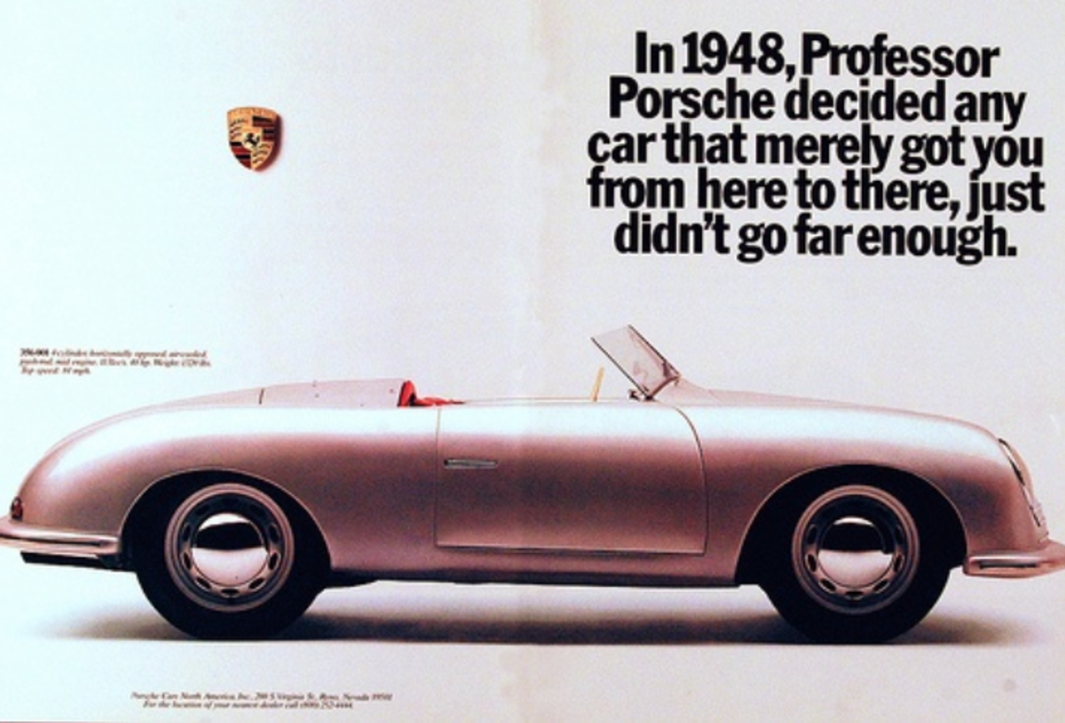
In the Beginning

Slide 7
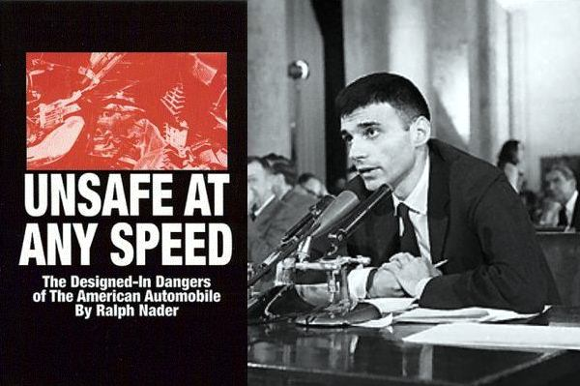
1965

Slide 8
The Statute – Passed in 1966
…15 U. S. C. § 1381, directs the Secretary of Transportation or his delegate to issue motor vehicle safety standards that "shall be practicable, shall meet the need for motor vehicle safety, and shall be stated in objective terms." 15 U. S. C. § 1392(a) (1976 ed., Supp. V). In issuing these standards, the Secretary is directed to consider "relevant available motor vehicle safety data," whether the proposed standard "is reasonable, practicable and appropriate" for the particular type of motor vehicle, and the "extent to which such standards will contribute to carrying out the purposes" of the Act.
[Notice the strong cost/benefit language and the specific reference to safety data. This becomes criminal in State Farm.

Slide 9
The Seat Belt Saga I
Eventually there are more than 60 rulemaking notices related to these standards.
1967 - regulation requiring seat belts.
1972 - realized that people were not wearing the seat belts.
Regulation requiring automatic seat belts or airbags by 1975.

Slide 10
The Seat Belt Saga II
Required cars between 1973 and 1975 to have automatic seat belts or ignition interlocks.
Chrysler v. DOT affirmed the regs.
Industry choose interlocks - why?
1974 - Congress passed a law banning regs requiring interlocks and said that all future regs on passive restraints had to be submitted to Congress for legislative veto.
Chadha does not fix that until 1983.

Slide 11
The Seat Belt Saga III
DOT under Ford withdrew the regs.
DOT under Carter (a few months later) promulgated new passive restraint regs for 1982 and Congress did not veto them.
These required air bags or automatic seatbelts, and assumed that most cars would get air bags.
1979 - Regs were affirmed in Pacific Legal Foundation v. DOT.

Slide 12
The Seat Belt Saga IV
1981 - DOT under Reagan withdrew the regs because the car companies were going to use automatic seat belts that could be disconnected.
The rationale was that drivers would disconnect the seat belts, thus losing their safety benefits.
If they did not have safety benefits, they would fail the cost/benefit analysis required under the statute.
Motor Vehicles Manufacturers Assoc. v State Farm challenged the DOT rule recession.
Plaintiffs argued that DOT had not adequately explained in the rulemaking why the rule was no longer necessary and how this was supported by safety data.

Slide 13
Motor Vehicle Manufacturers v State Farm Mutual Auto, 463 U.S. 29 (1983)
DOT is the real defendant at interest.
State Farm was an intervener.
DOT had previously justified the need for a rule that required automatic (passive) seat belts based on a factual inquiry into how many deaths and injuries they would prevent.

Slide 14
The Question Before the Court
Does the agency have to build the same in-depth record to withdraw a rule as to make a rule?
The government argues that withdrawing a rule is the same as not making a rule.
The courts had ruled that unless there is a Congressional requirement and timetable for making a rule, rulemaking is discretionary.
The agency does not need a rulemaking record to deny a petition for rulemaking, so it argued that it did not need a full rulemaking to withdraw a rule.
We saw in Mass. v. EPA that there the agency may need to provide justifications for denying a petition for rulemaking, but that these need not be a the level of a rulemaking record.

Slide 15
The Standard for Review
We believe that the rescission or modification of an occupant-protection standard is subject to the same test. Section 103(b) of the Act, 15 U. S. C. § 1392(b), states that the procedural and judicial review provisions of the Administrative Procedure Act "shall apply to all orders establishing, amending, or revoking a Federal motor vehicle safety standard," and suggests no difference in the scope of judicial review depending upon the nature of the agency's action.
Accordingly, an agency changing its course by rescinding a rule is obligated to supply a reasoned analysis for the change beyond that which may be required when an agency does not act in the first instance.

Slide 16
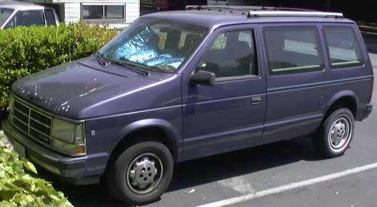
What Else Was Going On: Crashworthiness Regulations
An unintended consequences of crashworthiness regulations was to create the minivan and the light truck (pickup truck) as a replacement for cars.

Slide 17
The Seat Belt Saga V
1984 - DOT promulgated regulations requiring automatic seat belts or airbags in all cars after 1989, unless:
2/3 of the population were covered by state seat belt laws, and;
the laws met certain criteria.
What did some states do?
$5 penalty.
No stop to ticket.
No meaningful seat belt defense to injuries to a person not wearing a seatbelt.
Most State laws did not meet the criteria

Slide 18
The Modern World
By the late 1980s safety becomes a selling point and the market changes.
By 1997 most newer cars had airbags. Shortly after they become universal.
Marketing then turns to how many air bags and other safety features.
Now active safety is the selling point.
Automatic braking and lane assist.
Autonomous cars are also being sold based on safety.

