Slide 1

Chapter 7
Regulatory History of Tobacco

Slide 2
Tobacco Starts in the Americas
Native to Mesoamerica and South America.
  Used 8,000 years ago.
  Cultivated 5,000 years ago.
  Used for religious and medical purposes.
Widely used through the Americas when the Europeans arrived.
Taken back to Europe where it is an instant success.
  No surprise for a mind-altering addictive drug.

Slide 3
Pharmacology of Tobacco
Primary drug effect is from the nicotine.
  Strong nervous system drug used in classic neurophysiology research.
  Great natural bug killer.
Physiologically addictive and habituating.
  You feel bad as your nicotine high fades.
  You need more nicotine to maintain the effect.
  Through time, your body habituates to the nicotine, requiring ever larger doses to stave off withdrawal and maintain the initial nicotine effect.

Slide 4
Health Effects of Tobacco
An oily plant that makes a smoky fire
  Combustion products cause cancer and emphysema.
  Vaping is a huge uncontrolled experiment to find out the long-term effects of nicotine alone.
By the early 17th century problems with breathing and trouble with quitting were described.
1632 - Massachusetts passes first law banning public smoking.

Slide 5
Addiction as a Business Model
Legal addictive drugs become cultural necessities and huge business opportunities.
  Coffee – good for you (within limits).
  There is a reason that Starbucks coffee is heavily caffeinated and comes in big cups.
  Tobacco, alcohol – huge societal costs.
So do illegal addictive drugs.
  Amphetamine (speed), cocaine, opioids (“hard drugs” are now decriminalized in Oregon).
Marijuana?
  Frequently leads to psychological dependence.
  Side-effects are only now becoming known.
  Risks more likely to be like tobacco than opioids, at least for smoked weed.

Slide 6
Tobacco in Colonial US
The colonies were commercial ventures and expected to make money for the investors, as well as be self-sustaining.
No cities of gold in the US.
Tobacco is high value per acre and can be profitable for small farmers.
Compact, high value cargo, so profitable to ship.
Warm weather crop – Mid-Atlantic and South.

Slide 7
The Economics of Tobacco in the US
Becomes a major export, as well as a valuable domestic product.
Standard measures of tobacco used as currency.
A major part of the slave-based economy.
Post-slavery, mostly grown by small farmers because it is labor intensive to grow and cure.
Primary revenue from product sales.
States get significant income from tobacco taxes.

Slide 8
Tobacco Tax Regulation
Britain taxed colonial tobacco.
States and localities have always taxed tobacco.
The federal government has taxed it since the Civil War.
Tax collection requires tracking product and controlling smuggling of untaxed product.
The Treasury Department, then the Bureau of Alcohol, Tobacco, Firearms regulated tobacco taxes.
  Shifted to the Alcohol and Tobacco Tax and Trade Bureau in 2003, as part of the Homeland Security Bill.

Slide 9
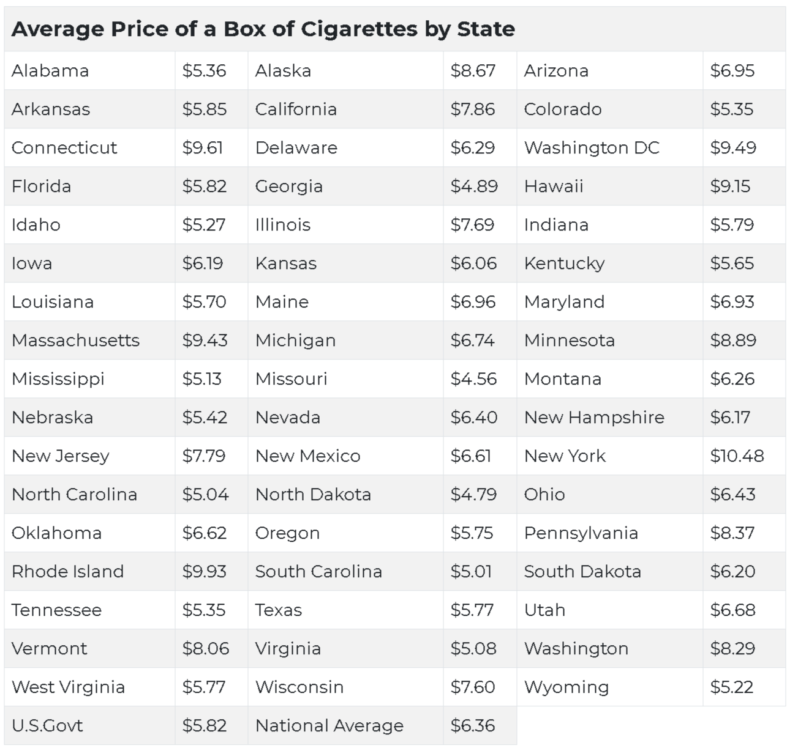

Slide 10
Tobacco Use Regulation
States begin to pass age limits on smoking in the 1880s, shortly after technology lowers the price of cigarettes.
States enact additional restrictions on smoking, even banning cigarette sales entirely.
Tobacco lobbying pushes back and persuades the federal government to encourage tobacco use by soldiers and support tobacco exports.
No federal health regulations on tobacco use prior to 1996.

Slide 11
The Federal Government Encouraged Tobacco Consumption and Export until 1964

Slide 12
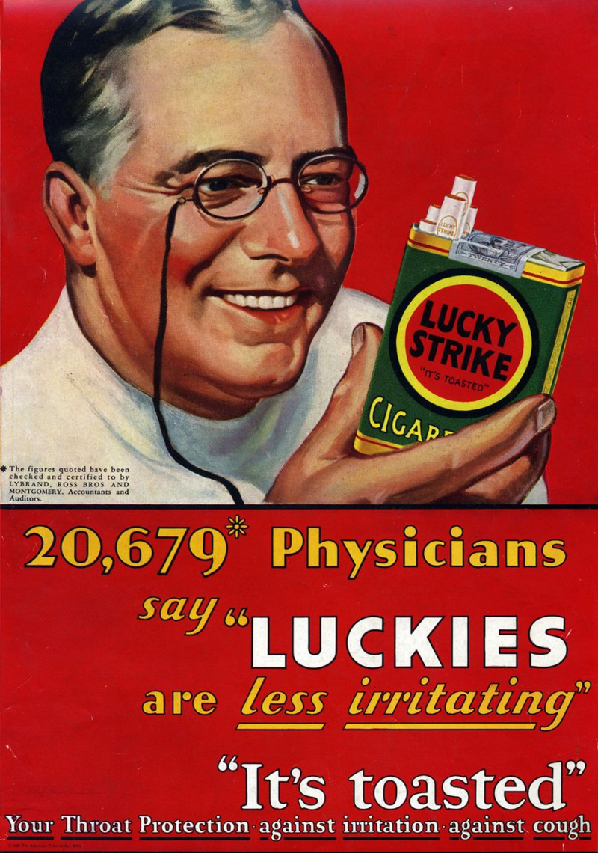
Cigarette Ad from the 1930s

Slide 13
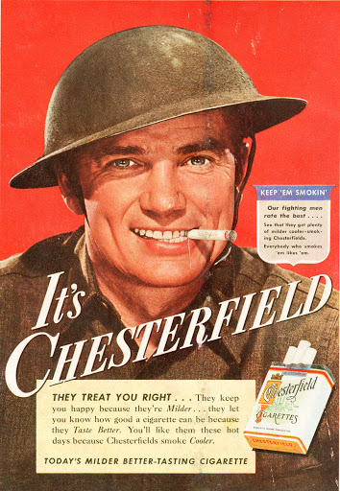
Cigarette Ad from WWII

Slide 14
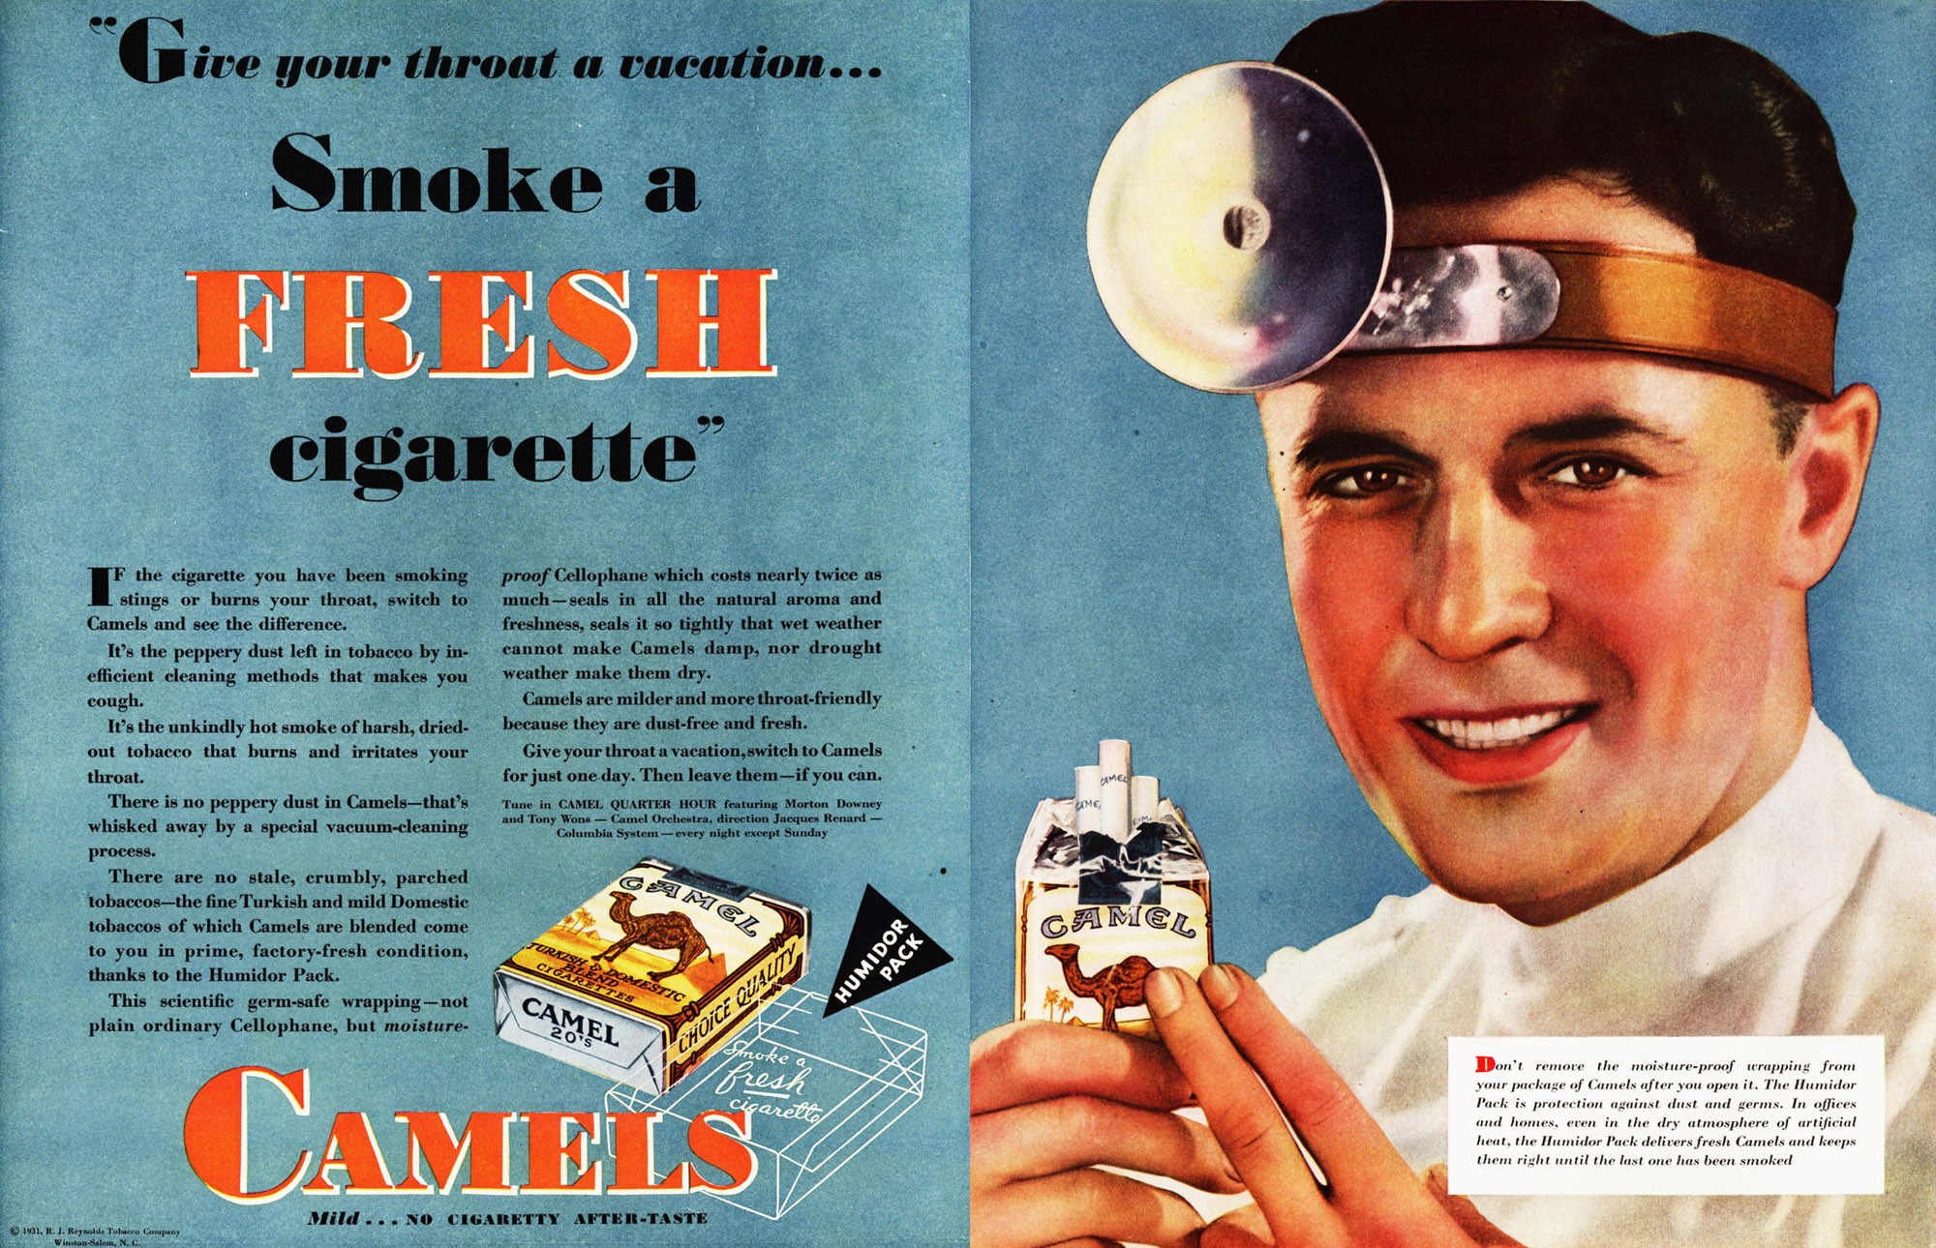
Cigarette Ad from the 1950s

Slide 15
The Surgeon General’s Report - 1964
First official notice of risks of tobacco.
Began a long-term decline in smoking.
  With some exceptions, smoking moves from the wealthy and middle class to the poor and poorly educated.
  A major factor, along with alcohol and obesity, in the higher morbidity and mortality, including cancer, in disadvantaged groups.
Smoking rate may have plateaued after the tobacco settlement.
  States make more money if kids smoke.

Slide 16
Federal Cigarette Labeling and Advertising Act - 1965/1969
Restatement 2nd of Torts was 1965.
  Included 402a and 402b – products liability.
  Also Comment k – safe harbor for unavoidably unsafe products.
Required hazard labeling on cigarettes
  Prevented additional state requirements such as tort recoveries for failure to warn.
Banned cigarette advertising in electronic media regulated by the FCC.

Slide 17
Other National Legal Events
Sale of tobacco limited to adults.
Cigarette vending machines banned in 1990 in places where minors could use them.
The tobacco litigation settlement – 1998
  The tobacco industry agreed to voluntarily limit some marketing.
  There is a settlement with the states, paid out over years, with higher payments if more minors smoke.
This prompts the regulation of tobacco by the FDA at issue in this case.
After Brown & Williamson, Congress gave the FDA limited authority over tobacco.

