Slide 1
Executive Order and Statutory Requirements for Reviewing Rulemaking

Slide 2
Why Have Executive Branch Review of Rulemaking?
The President sets policy and acts through agencies.
The regulatory review system run through OMB and OIRA is used to coordinate agency rulemaking, which is the primary way agencies establish policies and implement statutes.
The second concern is that the agencies base regulations on good science and that the benefits of regulation outweigh its costs.
Regulatory review assures that agencies properly assess the benefits and costs of new rules.
Regulatory review also assures coordination of regulations across agencies.

Slide 3
The Cumulative Effect Problem – A Workplace Example
EEOC deals with discrimination and disability accommodations.
IRS deals with pension plans and employee pay and taxing.
OSHA deals with worker safety.
Other agencies deal issues depending on the nature of the workplace.
Each agency is driven by its enabling statute to carry out its individual mandates.
What is the overall impact on the business?
Do the regulations create conflicting incentives or even conflicting obligations?
Do rules to protect workers create incentives to automate and thus cost jobs?
Justice Breyer calls this the tunnel vision problem – each agency see a new rule as having a limited effect on the regulated parties, but missing the cumulative effect of regulations.

Slide 4
Coordination of Agencies – Mission Conflicts
The Department of Agriculture
Mission is to help farmers
Regulates chicken processing to keep chicken cheap and fast to process.
Sanitation comes second, so the chickens are often contaminated with feces.
May be washed in chlorine water as a disinfectant, which makes them unattractive as exports to other countries.
FDA
Charged with keeping packaged food safe to eat.
Requires chicken to be labeled to warn consumers that it is likely contaminated by dangerous bacteria.
OSHA
Charged with worker safety.
Tries to deal with the worker injuries from high-speed chicken processing.

Slide 5
Internal Agency Policy and Statutory Conflicts
EPA regulates drinking water safety.
Drinking water sanitation is critical to prevent water borne illnesses caused by bacteria and other infectious agents in water.
Chlorine is added to drinking water to kill infectious agents in the water and the chlorine residual prevents contamination as the water passed through the distribution system.
Chlorination is cheap, reliable, and effective.
Chlorination can create trace levels of potentially carcinogenic compounds in the water as it reacts with organic material in the water.
By statute and policy, the EPA wants to reduce carcinogens in drinking water.
Should the EPA care more about carcinogens and ban the use of chlorination to treat drinking water?
The risk is very low.
Alternative methods are more expensive and less reliable.
Waterborne disease outbreaks can be widespread and deadly, especially to children.

Slide 6
Presidential Oversight of Rulemaking through Executive Orders
Starting with the Nixon administration, presidents have used executive orders to set standards to guide agency rulemaking.
These EOs do not affect the agency’s legal authority.
The EOs set procedural requirements for how the rules are made and what factors have to be considered when making a rule.
These cannot conflict with statutory requirements.
For example, if a statute says that the agency cannot use benefit cost analysis when setting regulatory standards, then an EO requirement that all rules use BC analysis would not apply.
The EO review process is carried out through the OMB and its review arm, the OIRA.

Slide 7
Issues Raised by EO Regulatory Review
While there is no specific law on point, EOs traditionally do not bind independent agencies.
OIRA can make recommendations to independent agencies
Independent agencies can voluntarily comply with the review process.
There is no judicial review of EO-driven regulatory review.
Regulatory review EOs do not change legal rights or otherwise trigger standing for judicial review.
Since EO regulatory review deals with internal agency procedures, there is very limited access to EO documents through the Freedom of Information Act.
Presidents can and do use regulatory review to block or delay rules.
We are first going to look at the EO driven regulatory review process, then we will look at the statutory review requirements which apply to all agencies.

Slide 8
OMB - Office of Management and Budget

Slide 9
OIRA - Office of Information and Regulatory Affairs

Slide 10
Regulatory Agenda
The regulatory agenda is “an inventory of all regulations under development or review” by that agency.
The “regulatory plan” identifies “the most important significant regulatory actions” that the agency plans to take in the next year or so.
The regulatory agenda (with its regulatory plan) goes to the Office of Information and Regulatory Affairs (OIRA)
OIRA circulates it to other agencies and conducts its own review for conflicts
OIRA also has meetings with the agency and Vice President to coordinate agency action.
Each agency designates a “Regulatory Policy Officer” (“RPO”).
The RPO reports to the head of the agency and must be involved “at each stage of the regulatory process to foster the development of effective, innovative, and least burdensome regulations and to further the principles [for regulation].”

Slide 11
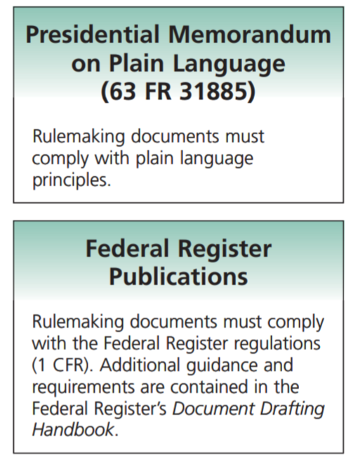

Slide 13
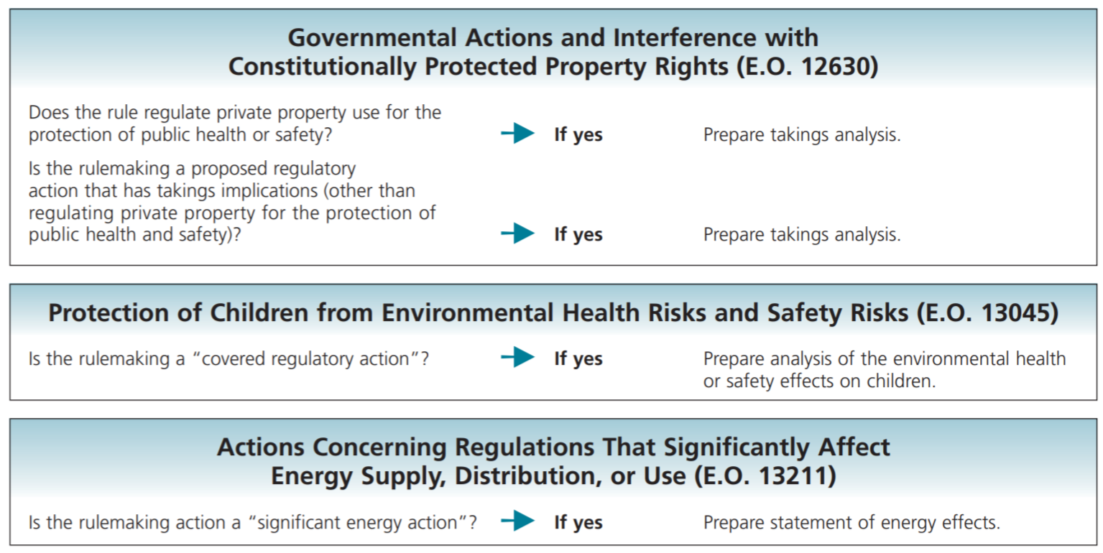

Slide 14
Executive Order 12866 - The Regulatory Philosophy
Federal agencies should promulgate only such regulations as are
required by law,
are necessary to interpret the law,
or are made necessary by compelling public need, such as material failures of private markets to protect or improve the health and safety of the public, the environment, or the well-being of the American people.
In deciding whether and how to regulate, agencies should assess all costs and benefits of available regulatory alternatives, including the alternative of not regulating.

Slide 15
Where does the Court Stand on Requiring CBA? (Not in the book.)
The enabling act is controlling, in theory.
In AFL-CIO v. API, 448 U.S. 607 (1980), the court found that OSHA enabling act required CBA on standards for benzene exposure.
In American Textile Mfrs. Institute v. Donovan, 452 U.S. 490 (1981), the court found that OSHA did not have to do CBA because it was not required by the statute.
Can the agency do CBA even if not required to?
Yes, unless the statute directs it NOT to do CPA.
The Delaney Clause is a statute that tells the FDA to not allow cancer causing substances in food. It does not allow the FDA to do a CBA analysis.
The courts increasingly impose something that looks like CBA during hard look review of the record, even if the statute is silent.

Slide 16
OIRA Review of Significant Regulatory Actions
Significant regulatory actions are proposed regulations:
(1) that have a major effect on the economy; the environment; public health; state, local, or tribal governments; communities; or existing federal programs;
(2) that conflict with other agency actions; or
(3) that raise novel legal issues or policy issues.
OIRA considers whether the planned regulation:
complies with the applicable law, the President’s priorities, and the principles for regulation.
conflicts with the actions or planned actions of any other agency.
OIRA sends the written results of this review back to the agency and involves the president if it cannot resolve problems

Slide 17
CBA under 12866
Costs and benefits shall be understood to include both quantifiable measures (to the fullest extent that these can be usefully estimated) and qualitative measures of costs and benefits that are difficult to quantify, but nevertheless essential to consider.
Further, in choosing among alternative regulatory approaches, agencies should select those approaches that maximize net benefits (including potential economic, environmental, public health and safety, and other advantages; distributive impacts; and equity), unless a statute requires another regulatory approach.
Pretty simple? ☺

Slide 18
What the Agency Must Provide OIRA
Benefits An assessment, including the underlying analysis, of benefits anticipated from the regulatory action (such as, but not limited to, the promotion of the efficient functioning of the economy and private markets, the enhancement of health and safety, the protection of the natural environment, and the elimination or reduction of discrimination or bias) together with, to the extent feasible, a quantification of those benefits;
Costs An assessment, including the underlying analysis, of costs anticipated from the regulatory action (such as, but not limited to, the direct cost both to the government in administering the regulation and to businesses and others in complying with the regulation, and any adverse effects on the efficient functioning of the economy, private markets (including productivity, employment, and competitiveness), health, safety, and the natural environment), together with, to the extent feasible, a quantification of those costs;
Alternatives An assessment, including the underlying analysis, of costs and benefits of potentially effective and reasonably feasible alternatives to the planned regulation, identified by the agencies or the public (including improving the current regulation and reasonably viable nonregulatory actions), and an explanation why the planned regulatory action is preferable to the identified potential alternatives.

Slide 19
How do these CBA and Review Requirements Affect Agencies?
What are the effects on the agency?
Fewer rules?
Better documented rules?
Less regulation?
More danger to the public?
Less harm to the economy?
Who benefits? Who loses?
CBA raises social justice issues
The benefits may be lower than the costs because the rule protects a low-income population whose property and jobs are worth less in the economic analysis than a more affluent community.

Slide 20
Should Small Businesses Get a Break?
Why do many regulations exempt small business?
What is our mythology of small business?
They provide new jobs, but most do not last.
Most are for owners of the business.
If you are an employee of a small business, do you want it exempted from OSHA?
If you are a consumer, do you want small businesses exempted from consumer safety regulations?
Small business slip through the cracks of federal safety regulation.

Slide 21
Statutory Review Requirements
These apply to all agencies, including independent agencies.
Statutory review requirements are subject to judicial review.
If the agency does not comply with a statutory requirement, it is grounds for the court to remand the rule back to the agency to be repromulgated once the statutory requirements have been met.
While OIRA cannot stop an independent agency from promulgating a rule that does not meet the necessary statutory requirement, an independent agency would be expected to follow the recommendation to save having to renotice the rule after the comments pointed out the problem.
NEPA is included as a regulatory review statute because it applies to rules. NEPA also applies more generally across federal actions.
The Paperwork Reduction Act also applies outside of rulemaking whenever the government wants to promulgate a form to collect information from the public.

Slide 23
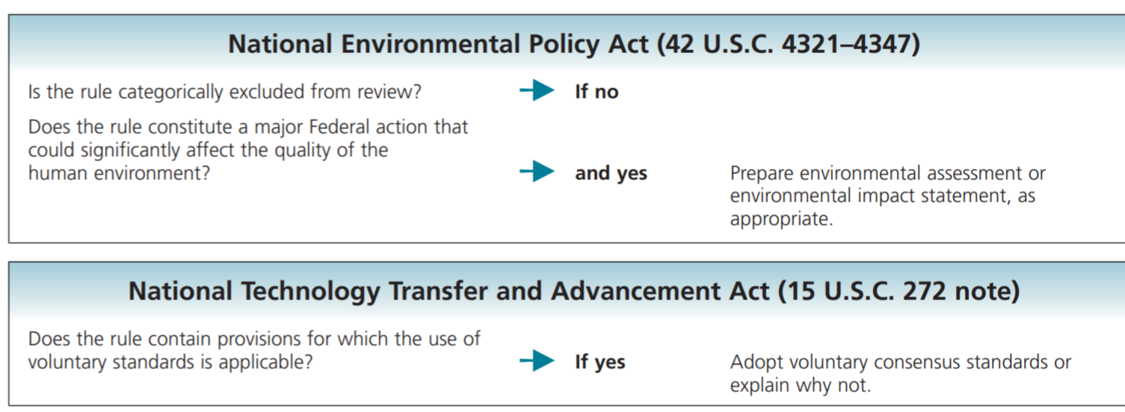
Information Quality Act
Requires OMB to adopt guidelines ensuring and maximizing the quality, objectivity, utility, and integrity of information (including statistical information) disseminated by Federal agencies.
These apply to all agencies.

