Slide 1
Theories of Regulation and Critiques of Regulatory Policy

Slide 2
Regulatory Successes
Public health - Life expectancy from 25 to nearly 80.
Food and drug safety - compared to 1900
Environmental regulation
Workplace safety
Civil rights
Banking
Lots of moral hazard problems, which blew up in 2008
No one lost insured deposits
Lots of folks lost retirement savings that were in the market and shadow banks.

Slide 3
Criminal Law as Regulation
Moral/natural law standards for crimes
Traditional crimes such as murder
Politically driven criminal law and penalties
Driven by political winds and stories in the news.
Usually about increasing penalties and criminalizing something that is already illegal.
Criminal law is almost never rationally evaluated as to effectiveness or cost.

Slide 4
Economic Theories of Regulation

Slide 5
Internalization of Costs
The market cannot work efficiently if businesses can escape the full costs of their activities.
Dumping untreated waste into a river lowers the cost of doing business by the cost of treating the waste.
This cost is shifted to the public and downstream water users.
If a business has to internalize all the costs, it will have an incentive to be more efficient.

Slide 6
Correction of Informational and Bargaining Asymmetries.
Market regulation can only work if the buyers products and services have:
Adequate information;
The ability to evaluate that information; and
Bargaining power.
FDA
Department of Agriculture
Regulation of professional practice

Slide 7
Optimization and Protection of the State
Protection of the state itself
National security
Protection of the populace so they can be more effective participants in the state.
Free public education
Public health
Social welfare as necessary for social stability and an optimal workforce.

Slide 8
The Costs in Cost Benefit Analysis
There is general agreement that the benefit of regulation should outweigh the costs.
Costs to the regulated party are generally easy to determine.
They are incurred upfront.
They are usually already monetized.
They are generally incurred by the regulated party.

Slide 9
The Benefits
Benefits are usually incurred by the public in general, or by specific subsets, but generally not by the regulated party.
Benefits are usually incurred over a long period of time.
Benefits are generally not directly monetized.

Slide 10
Avoidance of public costs as a benefit
Many regulatory schemes, especially those involving public health, the benefits of the regulation are usually expressed in terms of foregone costs.
Costs of medical care for avoided illnesses.
Avoidance of lost days at work.
Costs of premature death to the individual in the economy.

Slide 11
The costs of aesthetic injuries
The most difficult costs to monetize are those from aesthetic injuries.
How do you value the loss of national parkland?
The value of the integral views in the Regulators?
The ability to swim and fish in public waters?
You can survey people and ask them what they pay to preserve these benefits, but this is not a very effective methodology.

Slide 12
The problem of statistical injuries

Slide 13
Early regulatory benefits were clear.
Removing sewage from rivers
Eliminating dangerous building conditions
Eliminating clear physical hazards in the workplace
Preventing food from being contaminated with dangerous chemicals and bacteria

Slide 14
Statistical lives and health
Most modern health and safety regulations depend on long-term statistical analysis to show benefits.
These benefits can be large, but they are always invisible in the individual case.
This is especially true when the benefit is the prevention of harm.

Slide 15
The public perception of risk
The public, and most politicians, are unable to properly evaluate statistical risk.
They are overly frightened of low-level risks:
Toxic exposures
Low-frequency incidents
They are not properly appreciative of long-term cumulative risk.
Smoking – until fairly recently.
Climate change.

Slide 16
Hard questions in assigning costs
How much should we spend to save a life?
Why does Congress refuse to put a price on human life?
Why does this make CBA irrational?
How much to prevent injury?
How do we value injury and disability?
What about regulation of “dangerous” personal behavior?
What is the CBA for US drug policy?
Smoking?

Slide 17
What is PBA?
Political benefit analysis
Why does it usually trump CBA?

Slide 18
PBA and Small Businesses
Why do most regulations exempt small business?
What is our mythology of small business?
They provide new jobs, but most do not last
Most are for owners of the business
If you are an employee of a small business, do you want it exempted from OSHA?
If you are a consumer, do you want small business exempted from regulation?

Slide 19
The Cumulative Effect Problem of Regulations
Each rule is seen without reference to all the other regulations
Thus each new safety rule may be cost effective, but the aggregate is not.
Justice Breyer calls this the tunnel vision problem.
This is a major rationale for OIRA

Slide 20
Where does CBA fail?
What if the costs and benefits do not fall on the same group?
Why does HHS and the state continue to favor high tech medicine over primary care?
What is the disconnect between the costs and the benefits?
Does good health even save the country money?
Think about Social Security, Medicare, and pensions.
What are the economics of death?
What might a CBA analysis say?

Slide 21
Should we do CBA at All?
Why not prevent all possible risks?
Precautionary principle
Does the US concern with risks affect our cost of business production?
When can preventing one risk cause another?
Levees
Smaller, lighter cars
Guns for personal protection at home

Slide 22
How Do We Make Political Choices?
Response to a crisis
Can work for specific narrow issues - FDA
Tends to not consider unintended consequences
Driven by lobbyists
Works best for lobbyists when it is not publically vetted
Think tax code
Cost-Benefit analysis by legislators
Almost never based on actual data

Slide 23
Could We Spend the Money More Wisely?
What type of risks do we spend the most on with the least return?
Asbestos abatement of stable asbestos in buildings
Superfund risks
Low frequency specific toxic exposures in general
Is there an LA cancer corridor?
What major risks get the least attention?
Smoking cessation?
Immunizations?
Primary care?

Slide 24
Non-Agency Regulation: Tort and Compensation Law
How is tort law a regulatory process?
Is it a democratic process?
What is the public input?
Who protects the public's interest in tort cases?
What are the standards for scientific decisionmaking?
Breast implant litigation?
Erin Brockovich and toxic hazards?
Roundup?
What are the standards for CBA in tort cases?
What if later evidence shows that the verdict or settlement was wrong?

Slide 25
Regulatory Dilemmas

Slide 26
FDA
What are the tradeoffs in FDA regulation?
Safety/Effectiveness
Should cost be part of the equation?
Why are consumers in a poor position to judge drugs?
Background Information?
Timeframe of action?
Comparative effectiveness?
What is drug lag?
Why not let the market sort it out?
What is the market mechanism - think Vioxx

Slide 27
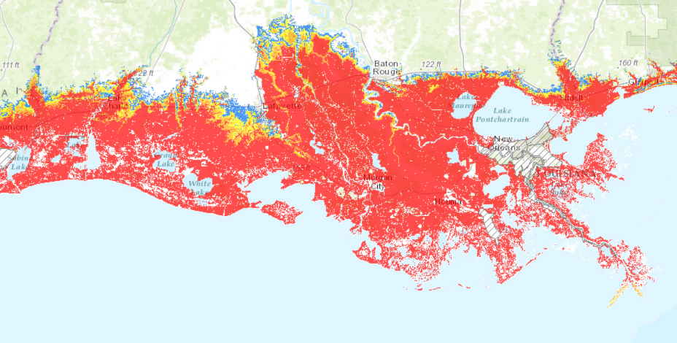

Slide 28
CBA - Federal Flood Insurance
Why did the feds get into flood insurance?
What should the private market failure have told us?
How is flood insurance different from medical insurance?
What are the political pressures on the feds?
Do local communities really want accurate flood maps?
Do people really want accurate storm probability predictions?
Can the feds charge accurate premiums?
What have been the unintended consequences of the program?

