Slide 1
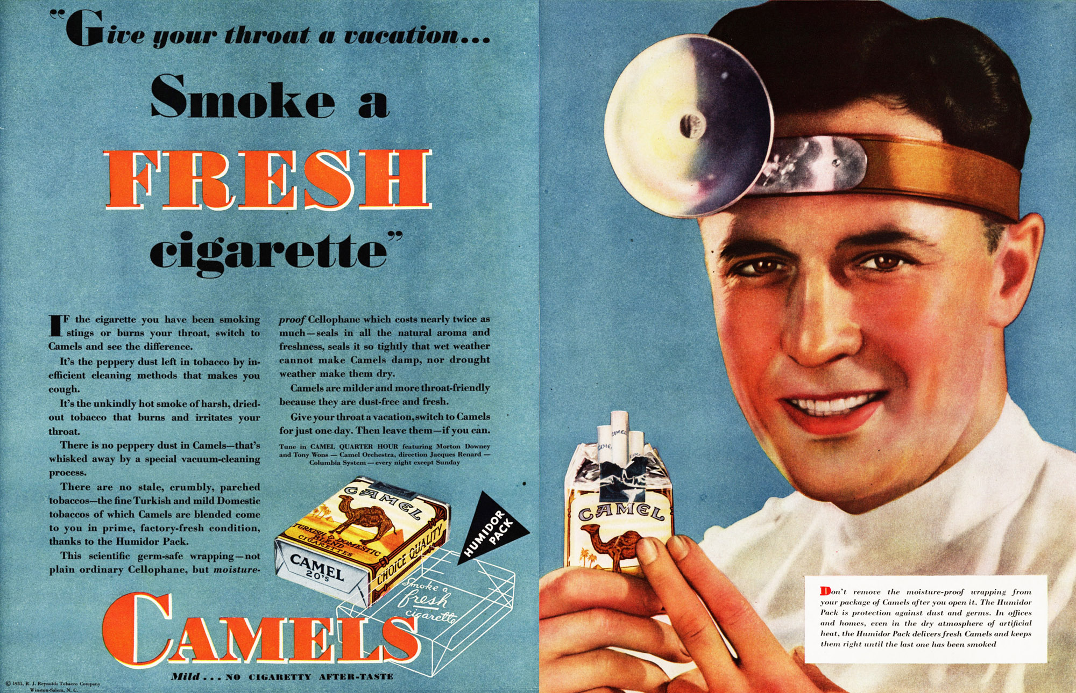
Changing Smoking Habits

Slide 2
Politics of Tobacco Regulation
FDA v. Brown & Williamson Tobacco Corp., 529 U.S. 120 (U.S. 2000)

Slide 3
Pharmacology of Tobacco
Primary drug effect is nicotine
Strong nervous system drug using in classic neurophysiology research
Great natural bug killer
An oily plant that makes a smoky fire
Tars from combustion cause cancer and emphysema
Is marijuana safer?

Slide 4
Public Health Impact of Tobacco
#1 preventable cause of illness
#1 problem is heart disease
6 out of 7 smokers do not live to get lung cancer
Heart attack data on secondary smoking
Emphysema is the big lung issue - nasty way to live, then you die
Poorly understood genetic factors affect individual risk.
Less risk for smokers in Japan – could diet matter?

Slide 5
Second Hand Smoke
Children of smokers
More respiratory problems
More likely to smoke
Workplaces and homes
Reduction in heart attacks after smoking bans
This was unexpected – significant and quick decline after bans

Slide 6
In Defense of Tobacco
Tobacco will reduce life-time health care costs if you smoke enough
Ideally you will also eat a lot of burgers while sitting on the couch watching TV
Limits retirement costs
Saves Medicare and Social Security
Great for private pension plans as well
Also improves job opportunities for young, cheaper workers

Slide 7
Problems in Stopping Smoking
“Giving up smoking is the easiest thing in the world. I know because I've done it thousands of times.”
― Mark Twain
Easier to quit heroin
Why?
What about Starbucks?

Slide 8
The Surgeon General’s Report - 1964
First official notice of risks of tobacco
Began a long term decline in smoking
With some exceptions, smoking moves from the wealthy and middle class to the poor and poorly educated.
May have plateaued after the tobacco settlement
States make more money if kids smoke.

Slide 9
Reducing Smoking
The price
Taxing the poor?
Smoking limitations
Reduce the amount smoked
Even LA banned indoor smoking
Insurance surcharges?
This is now being done
Why not ban tobacco, as we did with heroin?

Slide 10
E-Cigarettes and Vaping
Advantages
No smoke with tars, etc.
No second hand smoke
Questions
Is this a way to stop smoking or a way to inject nicotine?
Long term consequences of nicotine without tobacco are unknown

Slide 11
Regulatory History of Tobacco

Slide 12
Economic History of Tobacco
What was the role of tobacco in the colonial period?
What are the economics of tobacco?
Why has CVS banned tobacco?
What is the primary role of the Bureau of Alcohol Firearms and Tobacco?
What happened when Canada raised tobacco taxes?

Slide 13
Federal Cigarette Labeling and Advertising Act - 1965/1969
Required hazard labeling on cigarettes
Banned cigarette advertising in electronic media regulated by the FCC
Why not ban it everywhere?
Prevented additional state requirements
Which requirements were they worried about?
What happened in torts in 1965?
What about non-tort concerns?

Slide 14
History of the FDA

Slide 16
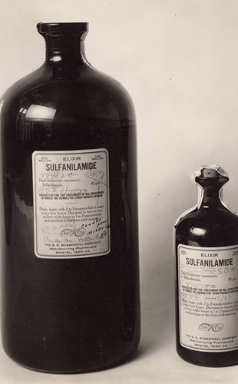
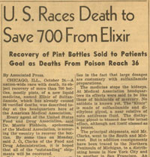

Slide 17
FDA v. Brown & Williamson Tobacco Corp., 529 U.S. 120 (U.S. 2000)
What had the FDA said about tobacco regulation over the past 50 years?
Which group of smokers did the regulation target?
Why this group?
How did the regulation attempt to reduce smoking in this group?
What was the tobacco companies attack on this regulation?

Slide 18
FDA Jurisdiction
Based on interstate sale of the drug/device
Not the broad definition of interstate commerce used in civil rights cases
Only regulates manufacturing, interstate sale, and promotion.
No authority over how drugs are prescribed and used
Unless the state regulates you, you can make and sell a drug within a state and not be under FDA regulation

Slide 19
Shared Jurisdiction
BAFT – Bureau of alcohol, tobacco, and firearms
Merchants of death
BATF deals with tax issues of tobacco
DEA – Drug Enforcement Agency
Federal limits on the prescribing and use of drugs through the Controlled Substances Act
Criminal and civil law, but managed as criminal law, not administrative law.

Slide 20
Definition of Drugs
The Act defines "drug" to include "articles (other than food) intended to affect the structure or any function of the body." 21 U. S. C. §321(g)(1)(C).

Slide 21
Definition of Devices
It defines "device," in part, as "an instrument, apparatus, implement, machine, contrivance, ... or other similar or related article, including any component, part, or accessory, which is ... intended to affect the structure or any function of the body." §321(h).

Slide 22
Definition of Combination Products
The Act also grants the FDA the authority to regulate so-called "combination products," which "constitute a combination of a drug, device, or biologic product." §353(g)(1). The FDA has construed this provision as giving it the discretion to regulate combination products as drugs, as devices, or as both. See 61 Fed. Reg. 44400 (1996).

Slide 23
Tobacco as a Combination Product
What is the purpose of a cigarette?
Is it purely a drug delivery system?
How else can you deliver nicotine?
Why might you want to deliver nicotine without smoking?
How do e-cigarettes fit into this scheme?

Slide 24
Enforcement Tools: Adulteration and Misbranding
The Act prohibits "[t]he introduction or delivery for introduction into interstate commerce of any food, drug, device, or cosmetic that is adultered or misbranded." 21 U. S. C. §331(a)
§352(j) deems a drug or device misbranded "[i]f it is dangerous to health when used in the dosage or manner, or with the frequency or duration prescribed, recommended, or suggested in the labeling thereof."
Drugs must be proven safe and effective

Slide 25
Enforcement Tools: Labeling
Second, a drug or device is misbranded under the Act "[u]nless its labeling bears ... adequate directions for use ... in such manner and form, as are necessary for the protection of users," except where such directions are "not necessary for the protection of the public health." §352(f)(1).
Mislabeling is a major enforcement tool
Difference between prescription and over the counter (OTC) drugs.

Slide 26
Chevron - Step One
Does tobacco fall under the statute?
Is it specifically named?
Is it specifically prohibited?
Why is there a question of ambiguity in what the statute means?
Is tobacco sold for its effects on the body?

Slide 27
Chevron – Step Two
What was congressional intent?
What about in the 30s, when the modern drug provisions were passed?
The 1950s when they were expanded?
What is the evidence that congress did not intend for the FDA to regulation tobacco in modern times?
Alternative regulatory schemes and agencies?
Renewed and expanded the FDA Act without addressing tobacco, despite efforts to add tobacco to the Act

Slide 28
Does the FDA Model fit Tobacco?
Does tobacco fit within the definition of a drug?
Is tobacco safe and effective for any use?
Is it possible to label tobacco so it can be used safely?
What would be the effect of applying the safe and effective test to tobacco?
Thus, the Act generally requires the FDA to prevent the marketing of any drug or device where the "potential for inflicting death or physical injury is not offset by the possibility of therapeutic benefit."

Slide 29
Regulating, not Banning Tobacco
How does the FDA argue that it does not have to show that tobacco is safe and effective?
What are the arguments against banning tobacco?
How can regulation make tobacco safer, if not safe?
Is safer OK under the “safe for the intended use” test?
How is tobacco different from chemotherapy drugs?

Slide 30
United States Supreme Court Opinion
“Reading the FDCA as a whole, as well as in conjunction with Congress' subsequent tobacco-specific legislation, it is plain that Congress has not given the FDA the authority that it seeks to exercise here. For these reasons, the judgment of the Court of Appeals for the Fourth Circuit is affirmed.”
Does this now relate back and change Step 1, i.e., is this the Chevron Step 0 three step?

Slide 31
The Politics
The majority (including Scalia) said this was evidence that Congress did not intend for the FDA to regulate tobacco, and that such intent trumped Chevron
Minority (Breyer) said just look at the law
Politics trumps principle (which is probably right in this case)
Congress later gave the FDA some authority over tobacco.

