Slide 1
United Nations Framework Convention on Climate Change
Cop 21
Venue: Paris, France

Slide 2
Participation Statistics
 | State/Organizations | Participants
Parties | 186 | 6291
Observer States | 2 (Palestine and Holy See) | 5
UN Secretariat units and bodies | 30 | 245
Specialized agencies and related organizations | 19 | 197
Intergovernmental organizations | 53 | 439
Non-governmental organizations | 624 | 3104
Media | 434 | 904
Total |  | 11185

Slide 3
Important Points in the Agreement
Differentiation
Long-Term Goal
Mitigation
Carbon Markets
Transparency and Support
Finance
Adaptation
Loss and Damage

Slide 4
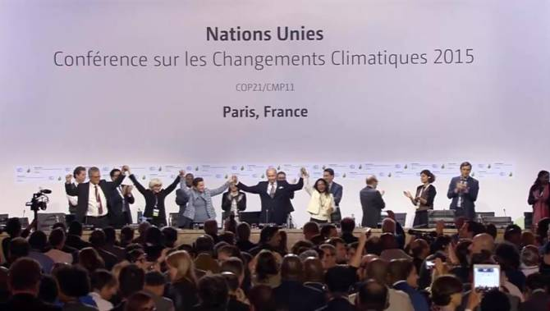

Slide 5
Differentiation
The agreement includes references to developed and developing countries, stating in several places that the former should take the lead.
Many provisions establish common commitments while allowing flexibility to accommodate different national capacities and circumstances - either through self-differentiation, as implicit in the concept of nationally determined contributions, or through more detailed operational rules still to be developed.

Slide 6
Long-Term Goal
The agreement reaffirms the goal of keeping average warming below 2 degrees Celsius, while also urging parties to “pursue efforts” to limit it to 1.5 degrees, a top priority for developing countries highly vulnerable to climate impacts.

Slide 7
Mitigation
With respect to countries’ individual mitigation efforts, the agreement prescribes a set of binding procedural commitments:
To “prepare, communicate and maintain” a NDC (Nationally Determined Contributions)
To provide information necessary for clarity and transparency; and to communicate a new NDC every five years.
It also sets the expectation that each successive NDC will “represent a progression” beyond the previous one and reflect a party’s “highest possible ambition.”
Developed countries “should” undertake absolute economy-wide reduction targets, while developing countries “are encouraged” to move toward economy-wide targets over time. In addition, developing countries are to receive support to implement their commitments.

Slide 8
Carbon Markets
While avoiding any direct reference to the use of market based approaches – a concession to a handful of countries that oppose them – the agreement recognizes that parties may use “internationally transferred mitigation outcomes” to implement their NDCs.
It requires that parties engaging in such transfers ensure the “avoidance of double counting,” consistent with accounting guidelines for NDCs to be developed.

Slide 9
Transparency and Support
All countries are required to submit emissions inventories and the “information necessary to track progress made in implementing and achieving” their NDCs.
The COP decision says that, with the exception of least developed and small island countries, these reports are to be submitted at least every two years.
In addition, developed countries “shall” report on support provided; developing countries “should” report on support received; and all “should” report on their adaptation efforts.

Slide 10
Finance
The agreement commits developed countries to provide finance for mitigation and adaptation in developing countries (“in continuation of their existing obligations under the Convention,” a stipulation sought by the United States so the agreement would not create new binding financial commitments requiring congressional approval).
“Other” parties are “encouraged” to provide such support “voluntarily.” The COP decision extends the $100 billion-a-year goal through 2025, and beyond that, says only that by 2025 the COP will set a “new collective quantified goal from a floor of” $100 billion a year.

Slide 11
Finance
Biennially, developed countries should report the status of their help to developing countries in terms of climate finance, and mitigation and adaption.
Global stocktake should collect the information regarding the dealings of climate finance.
The report submitted by developed countries should be transparent and consistent.
In the context of national climate strategies and plans of least developed or developing countries, The Financial Mechanism of the Convention should aim to ensure easy approval procedures and ready support.

Slide 12
Adaptation
Establishing a global goal of “enhancing adaptive capacity, strengthening resilience and reducing vulnerability to climate change;”
Requiring all parties, “as appropriate,” to plan and implement adaptation efforts;
Committing enhanced adaptation support for developing countries; including a review of adaptation progress, and of the adequacy and effectiveness of adaptation support, in the global stocktake to be undertaken every five years.

Slide 13
Loss and Damage
The mechanism, established as an interim body at COP 19, is charged with developing approaches to help vulnerable countries cope with unavoidable impacts, including extreme weather events and slow-onset events such as sea-level rise.
At the insistence of developed countries, led by the United States, the accompanying COP decision specifies that the loss and damage provision “does not involve or provide a basis for any liability or compensation.”

Slide 14
Civil Society Responses regarding the Paris Agreement

Slide 15
Oxfam International
“Developed countries agreed to extend the 100bn goal through to 2025, after which a new goal will be set for post-2025 finance mobilization, with 100bn as a floor. It remains unclear if this will be a vague goal that no one can be held accountable to or if it strengthens provisions specifically related to financial support from public sources.
Paris has not established an adaptation climate finance target for either pre or post 2020 (either quantitative or qualitatively). Such targets will need to be discussed at COP22 in Morocco.
Paris has been a landmark agreement, but it won’t be the last.”

Slide 16
WWF
“ More immediate steps are needed for the said ambitious action to fight the climate change.
Lou Leonard, vice president, climate change says ‘This is a pivotal moment where nations stepped across political fault lines to collectively face down climate change. For decades, we have heard that large developing nations don’t care about climate change and aren’t acting fast enough. The climate talks in Paris showed us that this false narrative now belongs in the dustbin of history.’

Slide 17
Friends of the Earth
“Despite the very favourable reception given by some, Friends of the Earth International believes that the Paris Agreement fails to deliver climate justice.
It is a weak agreement where rich countries do not do their fair shares of emissions cuts, or provide their fair share of finance for energy transformation and adaptation for developing countries.
There are almost no hard numbers or goals within the text to ensure ambitious action on climate change. The part of the text that may have offered redress for vulnerable communities who have suffered irreparable impacts of climate change has been weakened so as to render it ineffective.”

Slide 18
Climate Justice Campaign
“As a first step in implementing the agreement, the UN will host a high-level signing ceremony by world leaders on April 22 next year, followed by a summit meeting of government, business and civil society leaders on May 5-6.
But what was left unsaid was one of the key challenges in fighting climate change: how soon will the international community, and specifically the world’s rich nations and the private sector, succeed in raising the estimated 100 billion dollars per year needed by 2020?”

Slide 19
Think Tanks’ Responses to The Paris Agreement

Slide 20
HEINRICH BOLL STIFTUNG (HBS)
“Judged against low expectations and the collective trauma of Copenhagen 2009, the acceptance of the global and legally binding Paris Agreement on Saturday, 12th of December, at 19:26 h, is a historical moment. It achieves a goal long believed unattainable on the long road from Bali (2007) via Durban (2011). It sends a powerful signal that global agreement on such a painful structural transformation is possible.
Yet, no government seemed to be willing or able to agree on the specifics. Judged against the enormity of the challenge and the needs and pressure from people on the ground demanding a global deal anchored in climate justice, the Paris Agreement can only be called a disappointment. The gavel in Paris has fallen to seal the deal. But citizens around the world have yet to find out whether the Paris Agreement can be the springboard for lasting policy changes on the ground or whether it will wrap a glorified green veil around the continued inaction of our political leaders.

Slide 21
Brookings
“A sense of measured optimism and achievement emerged from the Paris climate conference. Diplomats, environmentalists, researchers, and other observers mostly felt relieved after years of discussions toward a new international agreement on climate change. Multilateralism had proven it might be up to the task of addressing climate change. But it’s a very mixed picture, and many of us are still trying to weigh the strengths and weaknesses of the agreement, the structure for global action it has established, and the momentum around climate action it created. As George Monbiot put it in the Guardian: “By comparison to what it could have been, it’s a miracle. By comparison to what it should have been, it’s a disaster.”

Slide 22
Oxford Climate Policy (OCP)
“As regards institutional arrangements and public sector finance, the Paris outcome is clearly weaker than that of Cancun – although, in fairness, there was never any serious expectation that there would be a new fund in the Paris finance package. However, the absence of any figure for public sector funding in the Paris outcome is a genuine step backwards, at least from a recipient perspective.
We must be humble and discard the emperor’s new clothes (or, in this case, ‘haute couture’) by admitting that the Paris finance outcome was (lamentably) weak and we should try and look for ways to genuinely enhance the predictability of public sector contributions to international climate finance.

Slide 23
Structural View

Slide 24
AGREEMENT FOR
CLIMATE TRANSFORMATION

Slide 25
ACT 2015 Partners:
ACT 2015 is supported by:

Slide 26
PARIS AGREEMENT’S SEVEN CORE FUNCTIONS
Send a clear signal that the low-carbon economy is inevitable
Connect the global agreement to the “real economy” and “real people”
Provide transparency and accountability
Accelerate investment in low-carbon, climate resilient economies
Build a basis for climate action that demonstrates fairness
Ensure the vulnerable have the capacity to build resilience and adapt
Link to science with a sense of urgency
Image: NASA

Slide 27
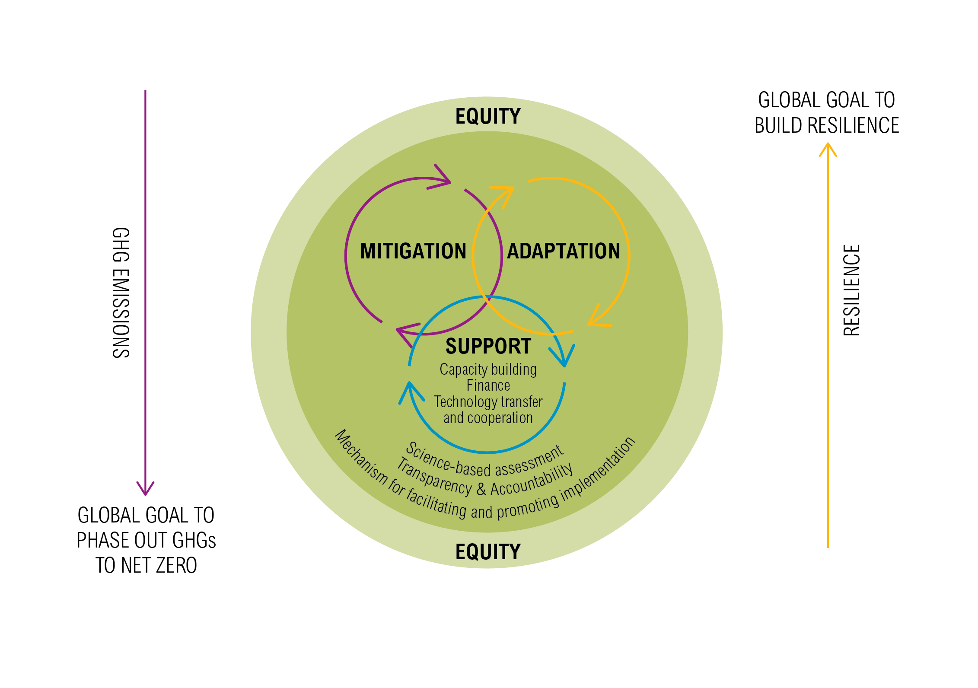
GLOBAL AGREEMENT
The package: binding Agreement + decisions + political declaration

Slide 28
CHOICES ON EQUITY
Then how to address equity?
Formal process with set criteria?
Equity framework
Yes
No
Provision of support for developing countries
Special LDCs/SIDS treatment
Balance
(3 cycles + L&D)
Types of commitments, robustness and type of information based on capability

Slide 29
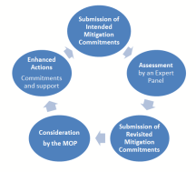
ELEMENTS OF MITIGATION (1)
Parties shall prepare, regularly update, and implement mitigation commitments
The ambition of all Parties’ mitigation commitments shall be raised in a continuous mitigation cycle every five years, informed by and informing the adaptation cycle and the support cycle
Developing countries, including, in particular, least developed countries and small island developing States, shall be eligible for support
Least developed countries and small island developing States shall have particular flexibility

Slide 30
ELEMENTS OF MITIGATION (2)
Each Party may at any time submit mitigation commitments that are additional
An independent expert panel is established to undertake individual and global assessments, which will be considered by the MOP
Competent IO and NGOs, and sub-national authorities are encouraged to provide input
Market and non-market mechanisms and new economic mechanism(s) allow for cooperation between Parties

Slide 31
CHOICES ON MITIGATION
Setting commitments?
How to close the gap?
What’s the long term goal of the cycle?
Internationally
negotiated
Nationally determined
Long-term goal
Emission reduction target
No roll-back + strengthen
Common accounting
Phase out all greenhouse gas emissions to net zero
Ex ante assessment
Global decarbonization
5 year cycle

Slide 32
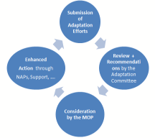
ELEMENTS OF ADAPTATION (1)
Shall prepare, regularly update and implement adaptation efforts statements
The adaptation effort shall be enhanced, communicated and updated in a continuous adaptation cycle, informed by the mitigation cycle and the support cycle
The MOP shall consider, every five years, ways to enhance adaption action
The Adaptation Committee shall, upon submission of the adaptation efforts statements, every five years, undertake a review and submit a report

Slide 33
ELEMENTS OF ADAPTATION (2)
Shall aim to ensure the allocation of public finance is balanced (equal allocation)
Developing countries, including, in particular, least developed countries and small island developing States, shall be eligible for support
Relevant international organizations and expert bodies outside the Convention are encouraged to cooperate and invited to report regularly on their actions and activities to achieve the long-term adaptation goal

Slide 34
CHOICES ON ADAPTATION
Further Enhancement
Goal or No Goal?
Goal?
Political Parity
Quantitative
Qualitative
5-year cycle
MRV
(or M & E)
Effort statement
Adaptation committee role
50-50 finance split
NAPs undertaken for different temperature scenarios

Slide 35
CHOICES ON LOSS & DAMAGE
Is Loss & Damage in the Agreement?
What is the vehicle?
What are the functions?
Goal or No Goal?
Goal or No Goal?
Extend the WIM beyond 2016
Accelerate work under the WIM
YES
NO
Compensation regime
Additional research and scoping studies or pilots
Specific requirements

Slide 36
ELEMENTS OF ADDITIONAL COOPERATIVE ACTION
Parties may prepare, communicate and implement joint agreements to cooperate on actions that represent a progression
These supplementary actions may include non-state actors
Parties may work with other international organizations in pursuit of cooperative action
Guidelines for recognition and contributions by subnational and non-State actors

Slide 37
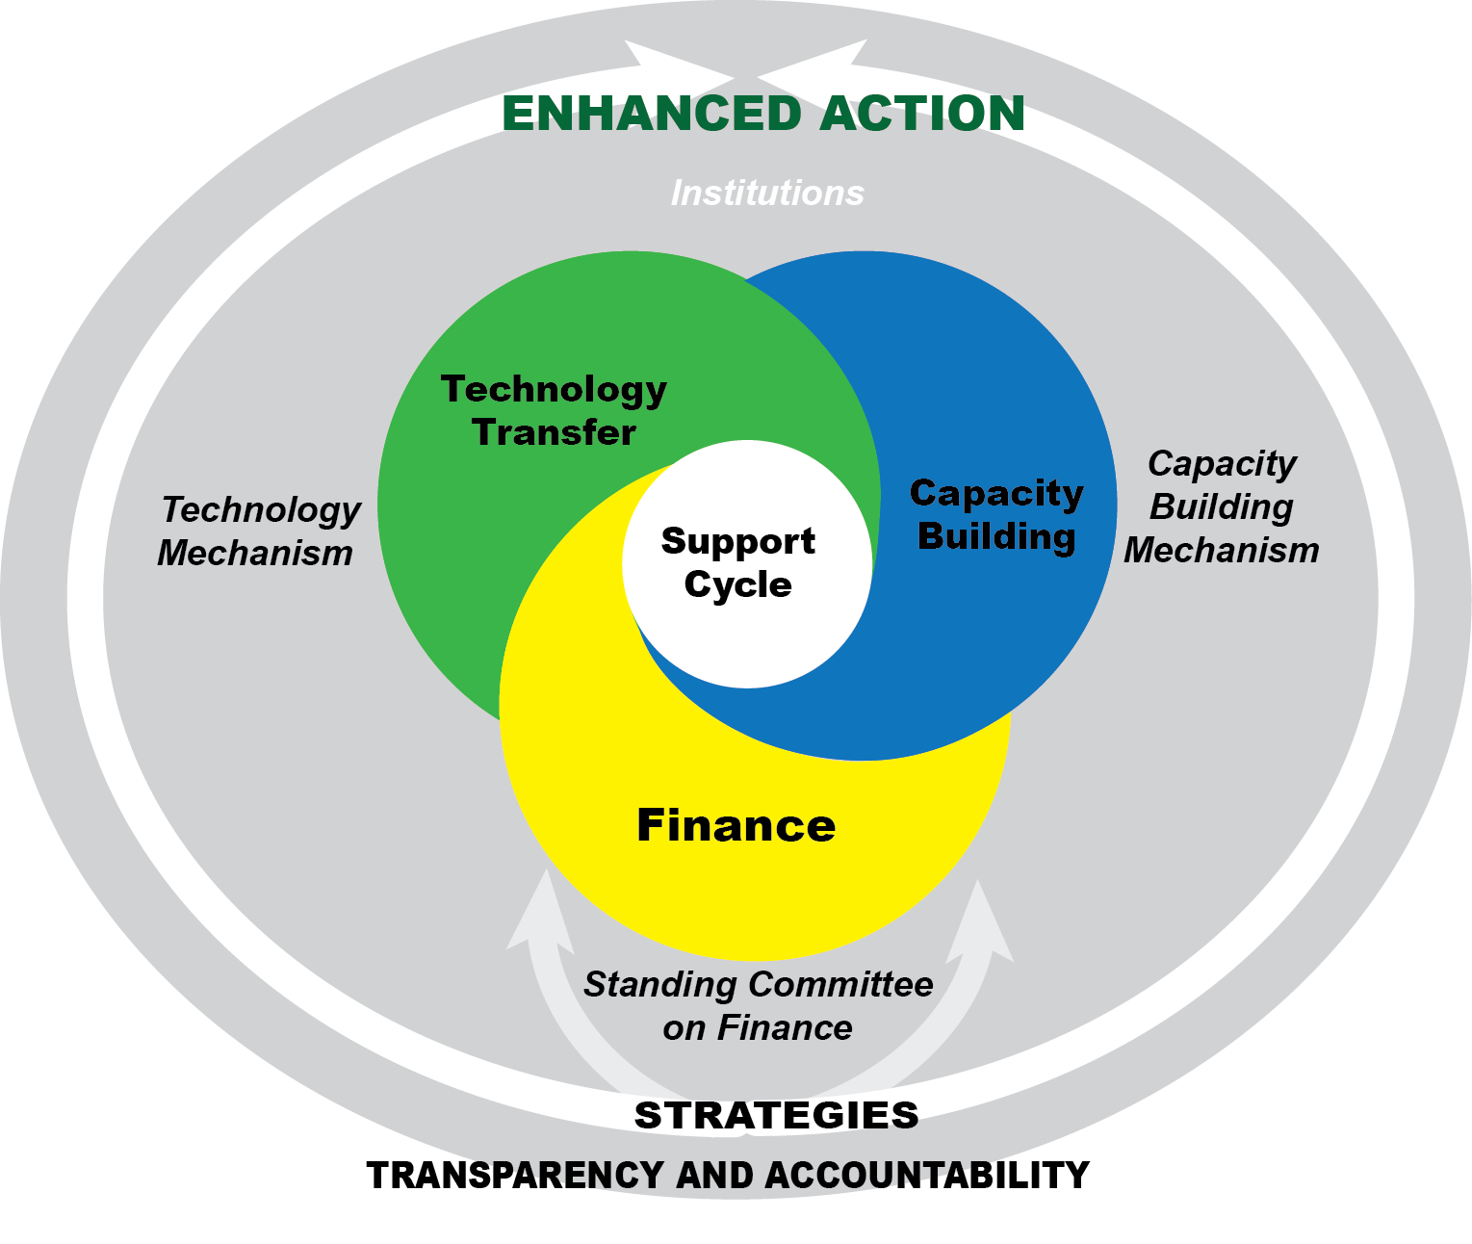
SUPPORT CYCLE
Review and Consideration by the MOP
Finance Strategies
Synthesis of Finance Strategies by SCF
Enhanced Action e.g. scaled up finance.
Inputs:
National reports
Biennial assessments
Reports by financial Institutions
Equity Framework
GOAL: Support mitigation and adaptation goals and shift the agenda

Slide 38
ELEMENTS OF FINANCE (1)
Parties shall shift and scale-up investments for low carbon and climate-resilient development
Developed country Parties shall make financial contributions and mobilize finance at an increasing scale from a floor
Other Parties, regularly determined by the MOP, shall also provide financial contributions
Parties shall improve national policy and institutional frameworks for climate finance

Slide 39
ELEMENTS OF FINANCE (2)
Every five years, until the LTGs are met, the provision of climate finance shall be scaled up as part of a continuous support cycle
Each Party shall prepare and submit finance strategies
Standing Committee on Finance shall prepare and provide, for the MOP a synthesis and aggregate analysis of the strategies
Parties shall work with and through national and international financial institutions in order to align investment decisions and policies w the LTGs

Slide 40
CHOICES ON FINANCE
Numbers in the Agreement?
Credible pathway
in the Agreement
Support Cycle
5 yr cycles
Yes
Finance Cycle
No
Finance strategies
Capacity building mechanism
Standing committee
Technology development and transfer
More MRV
Alignment of
IFIs with climate
objectives
Replenishment of the GCF
More Parties contribute in the future

Slide 41
only developed countries
CHOICES ON TECHNOLOGY
Should we create a new TT mechanism?
How do we enhance existing technology transfer?
YES
Set goals for all Parties in the Agreement
Create specific commitments for developed country Parties
NO
What kind of goal?
Increase diffusion of climate technologies
Enhance national enabling environments
What kind of goal?
Increase public funding for R&D
How to spend the funding?

Slide 42
CHOICES ON CAPACITY BUILDING
Should we create a new CB mechanism?
What should be its focus or function?
YES
Enhance institutional and legal framework
Adequate and dedicated financial support
Monitoring and review of efforts and support
Provide advice and guidance
NO
How to spend the funding?

Slide 43
COMMONALITIES AND DIFFERENCES BETWEEN THE CYCLES
 | What is common | What is different
 |  | Mitigation | Adaptation | Finance/Support
5-year cycle | Submissions every 5 years | Mitigation iNDCs/ Commitments | Adaptation Efforts Statements | Finance strategies (to include pathways and investment plans)
Assessment Process | MRV framework + additional Review or Assessment + Consideration by the MOP | Ex-ante assessment by Expert Panel | Review and recommendations by Adaptation Committee | Synthesis assessment by SCF Consideration by the MOP in conjunction with technology & CB
Reporting | National Communications every 4 years | National reports every 2 years | NAPs, NAPAs (no frequency) | National reports every 2 years

Slide 44
ELEMENTS OF TRANSPARENCY AND ACCOUNTABILITY (1)
All Parties shall work towards improving transparency in a continuous and sustained manner over time, taking into account national capabilities and circumstances. No less than existing rules, methodologies and guidelines.
Every two years each Party submits a national report including progress on implementation on mitigation and support
More comprehensive report every four years, that includes information on adaptation efforts and plans
Two-phased assessment
Technical evaluation of individual reports
Multilateral appraisal based on the output of the technical evaluation

Slide 45
ELEMENTS OF TRANSPARENCY AND ACCOUNTABILITY (2)
Common Guidelines to be elaborated:
Common global accounting framework that includes the land use sector and transferable emission units
Common methodologies for risk, vulnerability assessments
Common methodologies for tracking and reporting on financial flows

Slide 46
CHOICES ON TRANSPARENCY AND ACCOUNTABILITY
Is the existing system sufficient?
How do you improve the system?
YES
NO
Same reporting obligations for all countries now
Adjust existing reporting obligations based on capabilities/ circumstances
All countries improve, but responsibilities and capabilities vary
Enhanced MRV of actions and support
How do you support developing countries?
Lower their requirements
Provide financial and technical support

Slide 47
MECHANISM FOR FACILITATING AND PROMOTING IMPLEMENTATION
A mechanism to facilitate and promote implementation, including an implementation committee is established
Non-adversarial and facilitative and shall aim at facilitating and promoting compliance
Procedure triggered by Parties or through assessment process
Shall be able to issue its finding independently & have effective measures available
The MOP, at its first session, shall adopt further modalities and procedures

Slide 48
ELEMENTS OF LEGAL FORM
The package: Binding Agreement + decisions + political declaration
Within the Binding Agreement:
Binding conduct linked to result (implementation of commitments), binding procedures (MRV)
Tools for Robustness/Accountability:
Transparency and Accountability Framework
Compliance (facilitative mechanism)

Slide 49
only developed countries
CHOICES ON LEGAL FORM: ADAPTATION
Is the Agreement itself legally binding?
Provisions within the Agreement?
YES
Legally binding performance e.g. shall achieve
Legally binding conduct e.g. ‘shall implement’
Legally binding procedures e.g. shall maintain, review, update
NO
Where are the mitigation commitments located?
Where are the adaptation effort statements located?
Shall be publicly recorded as decided by the COP
What kind of goal?
In an annex inside the Agreement
In a registry
How to spend the funding?

Slide 50
only developed countries
CHOICES ON LEGAL FORM: MITIGATION
Is the Agreement itself legally binding?
Provisions within the Agreement?
YES
Legally binding conduct linked to result e.g. ‘shall implement’
Legally binding performance e.g. shall achieve
Legally binding procedures e.g. shall maintain, review, update
NO
Where are the mitigation commitments located?
Inscribed in a list kept by the Secretariat alongside the Agreement – defined procedures for change
Where are the mitigation contributions/commitments located?
What kind of goal?
In an annex inside the Agreement
In a schedule
How to spend the funding?
Notes:
In conclusion:
Through our proposal, we are combining the bindingness of conduct and bindingness of result by:
- Having countries bound to implement their mitigation commitments with a view to induce policy change - (bindingness of conduct)
- Providing a clear direction (Long term goals), benchmark for the compliance assessment (ex post MRV and Implementation mechanism) and the link to the result/commitments – (result)

Slide 51
THANK YOU !
ACT 2015 Partners:
ACT 2015 is supported by:

Slide 52
Specific provisions

Slide 53
Section | Provisions
General | Preamble, Article 1 – definitions, Art.2 – the Agreement’s purpose and Art.3 – NDCs
Main substantive elements and commitments | Art.4 – mitigation
 | Art.5 – greenhouse gas sinks and reservoirs and REDD+
 | Art.6 – cooperative approaches
 | Art.7 – adaptation
 | Art.8 – loss and damage
 | Art.9 – finance
 | Art.10 – technology development and transfer
 | Art.11 – capacity –building
 | Art.12 – climate change awareness and education
Reporting, review and compliance | Art.13 – transparency, Art.14 – global stocktake and Art.15 – facilitating implementation and compliance
Institutional arrangements | Art.16 – CMA, Art.17 – secretariat, Art.18 – SBI and SBSTA, Art.19 – other bodies and institutional arrangements to serve the Agreement
Final articles | Art.20 – signature and ratification, Art.21 – entry into force, Art.22 – amendments, Art.23 – annexes, Art.24 – dispute settlement, Art.25 – voting, Art.26 – depository, Art.27 – reservations, Art.28 – withdrawal and Art.29 – languages

Slide 54
General
Preamble: sustainable development, food production, quality jobs, human rights, Mother Earth, “climate justice”, public participation, all levels of government, lifestyles and consumption etc.
Definitions & purpose (Arts 1 & 2): developed, developing country and other Parties; long term temperature goal
Nationally determined contributions in general (Art.3)
Notes:
No longer perceived as environmental problem, cross cutting, various interests feeding into agreement

Slide 55
Mitigation
Shall submit increasingly ambitious NDCs every 5 years that are recoded in a public registry (process)
Shall pursue measures with the aim of achieving NDC objectives; ‘bindingness’ of NDCs
Shall provide additional information (Art.4.8); account (Art.4.13); and provide national inventory and progress reports (Art.13.7) at least biennial (decision para.90)
Support for developing country Parties (Art.4.5) but not a precondition
Does not address bunker fuels; forum on the Impact of the Implementation of response measures will serve the Agreement (decision, para.33); CMA to consider common timeframes (Art.4.10); Review of INDCs with 2025/30 timeframes (paras.23 & 24)
Notes:
Process, substantive obligation? – good faith,

Slide 56
Mitigation contd.
Gas sinks/reservoirs and REDD+ (Art.5)
Conserve and manage emission sinks and reservoirs (Art.4.1 d Convention)
Reduce emissions from deforestation and forest degradation in developing countries through existing REDD+ framework
No new mechanism (for payments for ecosystem services)
“non-carbon benefits” = social and environmental safeguards?
Voluntary cooperation (Art.6)
Cooperative approaches to transfer mitigation outcomes
Mechanism to mitigate GHG emissions and support sustainable development (CDM+)
Framework for non-market mechanisms
Notes:
Law firms’ interest – rules and modalities to be developed by CMA

Slide 57
Adaptation (Art.7)
Global goal to enhance adaptive capacity, strengthen resilience and reduce vulnerability (7.1)
Mitigation reduces adaptation efforts (7.4)
Shall, as appropriate, engage in adaptation planning processes and the implementation of actions (7.9)
Should, as appropriate, submit and periodically update an adaptation communication on needs, plans and actions (7.10) as part of e.g. NAPs, NDCs or national communications (7.11).
Adaptation communications will be housed in a public registry (7.12).
Adaptation Committee and the Least Developed Countries Expert Group will jointly develop recommendations (decision, para.41) on modalities to recognise adaption efforts by developing countries - to be adopted @ CMA 1 (Art.7.3)

Slide 58
Loss & damage (Art.8)
Warsaw International Mechanism on loss and damage
Outside support, transparency, stocktake, review and compliance
Task force on displacement related to the adverse impacts of climate change (decision, para.49)
“Agrees that Article 8 does not involve or provide a basis for any liability or compensation” (para.51)
State responsibility under public international law
Notes:
Legal principles in negotiations

Slide 59
Finance (Art.9)
Developed countries shall provide financial resources in continuation of existing obligations (Art.9.1) as part of a global effort from a wide variety of sources and through a variety of actions (9.3)
No burden sharing agreement or other binding arrangements
Biennially communicate indicative quantitative and qualitative information (9.5) and further information on the support actually provided and mobilized (9.7)
Financial Mechanism of the Convention, including its operating entities – GEF and GCF – will serve as the financial mechanism of the Agreement (9.8)
Developed countries intend to continue their collective mobilization goal through 2025 (USD 100 billion/year from 2020); CMA will set a new collective quantified goal before 2025 from a floor of USD 100 billion/year (para.53)
Notes:
LRI impact

Slide 60
Capacity building (Art.11)
Technology (Art.10)
Technology framework to guide existing mechanism (Technology Executive Committee and Climate Technology Centre and Network)
Does not address intellectual property rights
Enhance capacity of developing countries to take effective action on mitigation, adaptation, technology development, access to finance, education and reporting
Developing institutional arrangements to be adopted @ CMA 1 (11.5)
Education & awareness raising (Art.12)
Notes:
LRI impact institutional arrangements to support capacity building

Slide 61
Transparency (Art.13)
Parties shall report on mitigation effort (13.7)
Parties should report on climate impacts and adaptation (13.8)
Developed country Parties shall report on financial, tech transfer and capacity building support; other Parties should (13.9)
Developing country Parties should report on needs and support received (13.10)
Technical expert review on mitigation and support, implementation and achievement of NDCs (13.11 & 12)
Multilateral consideration of progress on finance (13. 11)
Support for developing countries and (13.14 & 15) and Capacity Building Initiative for Transparency (decision, para.84)
Notes:
All facilitative, flexible, non-intrusive, respectful

Slide 62
Stocktake (Art.14)
Global stocktake on mitigation, adaptation and means of implementation (finance 9.6, technology transfer 10.6, no corresponding reference in capacity building)
Implementation of Agreement # implementation of NDCs
Collective progress # individual assessments, but transparency framework to inform global stocktake (Art.13.5 & 6)
Sources for global stocktake to be identified – e.g. overall effect of NDCs communicated, IPCC report (decision, para.99)
Notes:
Battle ground, parties pulled into different directions

Slide 63
Compliance (Art.15)
Mechanism to facilitate implementation and compliance established
Committee of 12 experts (decision, para.102)
Modalities and procedures to be adopted @ CMA 1
No triggers for involvement

Slide 64
Institutional arrangements (Arts 16-19)
COP serving as the meeting of Parties to this Agreement (CMA)
Convention secretariat (Art.17)
Subsidiary bodies for scientific and technological advice (SBSTA) and implementation (SBI)
Other bodies or institutional arrangements (Art.19)

Slide 65
Final articles (Arts 20-29)
Paris Agreement open for signature at UN Headquarters, New York from 22 April 2016 to 21 April 2017 (Art.20.1)
High-level signature ceremony on 22 April 2016 (decision, para.3)
Entry into force when 55 Parties to the Convention representing 55% of global GHG (Art.21) deposit instrument of ratification, acceptance etc.
Convention provisions on amendments, annexes and dispute settlement apply “mutatis mutandis”
No reference to the multilateral consultative process on implementation of the Convention (Convention, Art.13)
Withdrawal (Art.28)
Provisional application (Decision, para.5)

Slide 66
General
International (formally binding) treaty building on Copenhagen Accord
Focuses on mitigation and also addresses other areas
COP decision language with some uncertainties
Framework/skeleton agreement
Ad-hoc Working Group on Paris Agreement
Role of the US
NDC implementation => domestic legislation

