Slide 1
Chapter 3
Presidential National Security Powers
More accurately, the Conflict between Congressional and Presidential National Security Powers

Slide 2
Learning Objectives for Part 1
Congressional national security powers are limited, i.e., enumerated, but they are broad and subject to broad interpretation.
  Congressional powers, because of the Commerce Clause and other sources of domestic power, are strongest inside the US.
Presidential powers are open-ended, but vague.
  Because of the limits of the operation of the Constitution, the presidential powers are strongest outside of the US.
  The court has traditionally upheld long exercised powers even if they are not clearly rooted in the Constitution. (Going First)
The Constitutional provisions are sufficiently vague that the Court could rule either way on the key cases.
What you need to recognize is how to argue both sides of question involved a conflict between the president and congress over national security powers.

Slide 3

The Origin of Foreign Affairs Powers
(From Curtis Wright)
Colonial Period
  Foreign Powers rested with England
  Colonies controlled domestic governance to a great extent
At the moment of Independence
  All powers held by the states as independent sovereigns
Articles of Confederate
  States individually held domestic powers
  Foreign Powers were held jointly through the Confederation

Slide 4

The Constitution
Federal Law is preeminent over state law in areas provided for by the Constitution.
State domestic powers not specifically assigned to the federal government are retained by the states.
  Commerce clause is the major vehicle for Congress to assert authority over what are traditionally state matters.
Foreign Powers are federal
  Relations with other nations
  National security (insurrections, foreign attacks, etc.)
  Pandemics?

Slide 5
Article I – Congressional National Security Powers (Edited)
All legislative Powers herein granted shall be vested in a Congress of the United States…
To regulate Commerce with foreign Nations, and among the several States, and with the Indian Tribes;
To establish an uniform Rule of Naturalization, and uniform Laws on the subject of Bankruptcies throughout the United States;
To define and punish Piracies and Felonies committed on the high Seas, and Offences against the Law of Nations;
To declare War, grant Letters of Marque and Reprisal, and make Rules concerning Captures on Land and Water;
To raise and support Armies, but no Appropriation of Money to that Use shall be for a longer Term than two Years;
To provide and maintain a Navy;
To make Rules for the Government and Regulation of the land and naval Forces;
To provide for calling forth the Militia to execute the Laws of the Union, suppress Insurrections and repel Invasions;
To provide for organizing, arming, and disciplining, the Militia, and for governing such Part of them as may be employed in the Service of the United States, reserving to the States respectively, the Appointment of the Officers, and the Authority of training the Militia according to the discipline prescribed by Congress;

Slide 6
Article II – Presidential Powers National Security Powers (edited)
Section 1
  The executive Power shall be vested in a President of the United States of America.
Section 2
  The President shall be Commander in Chief of the Army and Navy of the United States, and of the Militia of the several States, when called into the actual Service of the United States; …
  He shall have Power, by and with the Advice and Consent of the Senate, to make Treaties, provided two thirds of the Senators present concur; and he shall nominate, and by and with the Advice and Consent of the Senate, shall appoint Ambassadors, other public Ministers and Consuls …
  [while not provided for in the Constitution, the courts have recognized the right of the president to make executive agreements with foreign powers without the involvement of the Senate]
Article 3
  shall Commission all the Officers of the United States.
Article 4
  Removal

Slide 7

Is the Presidential Power Expansive or Limited?
“[The President is] a steward of the people bound actively and affirmatively to do all he could for the people. [It is] not only his right but his duty to do anything that the needs of the Nation demand, unless such action [is] forbidden by the Constitution or by the law.” (Theodore Roosevelt)
“[t]he true view of the Executive function is : : : that the President can exercise no power which cannot be fairly and reasonably traced to some specific grant of power or justly implied and included within such express grant as proper and necessary to its exercise.” (Chief Justice William H. Taft)

Slide 8
Youngstown Review
You read this in Constitutional Law and we are not going to reread it here.

Slide 9
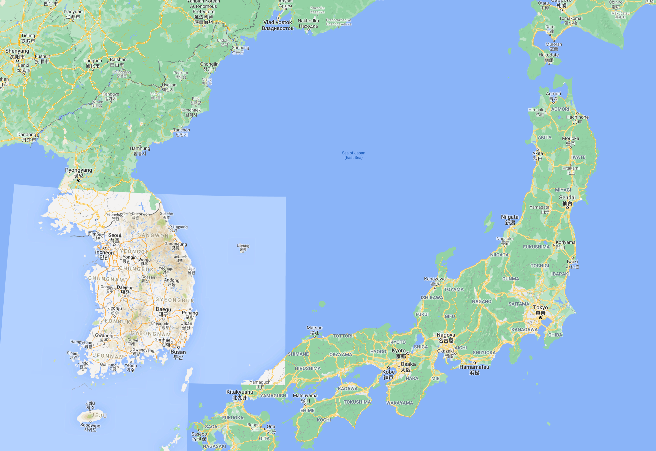
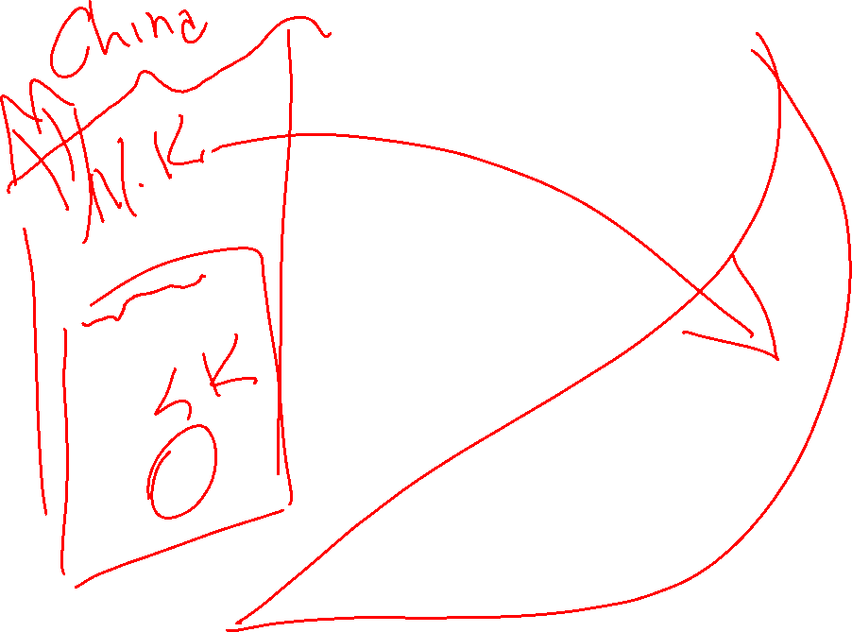
South Korea is important on its own and as buffer between North Korea (China) and Japan. In 1949, North Korea was very much a client state of China. The Korean War was also a war with China.
North Korea became an independent, isolated country in the years after the war.

Slide 10
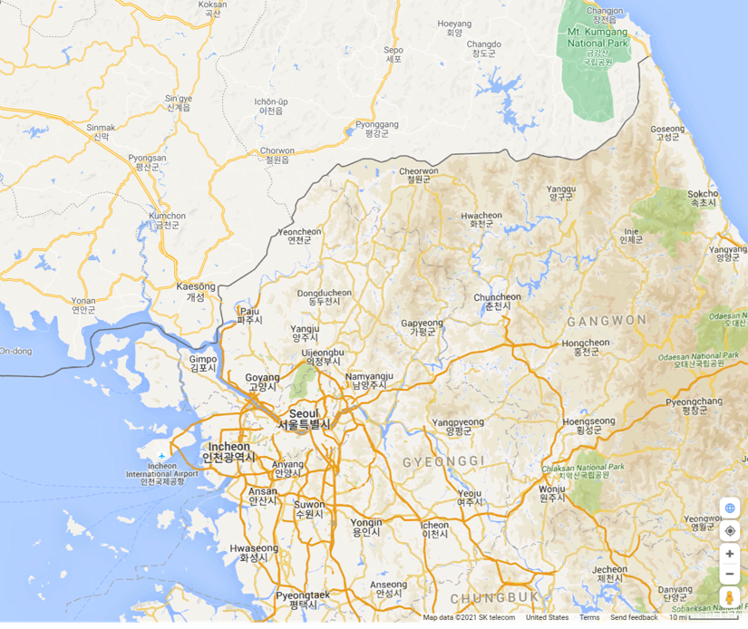













North Korea has a huge strategic advantage because South Korea’s capital and major city is only 35 miles from the border.

Slide 11

The Korean War
UN police action, no declaration of war
The role of the US
  A lot of US troops
  Very unpopular in the US
  36,000 US soldiers killed
  No peace treaty
  US Troops remain in North Korea
10-15% of North Koreans killed
  The North Korea founding myth is the heroic resistance against the United States and that the country must always be on war footing because the US will be back.
  The privations in the county are blamed on the US.
  The government has always completely controlled media and every home must listen to the propaganda channel.
  It is 1984.

Slide 12

The 1952 Steel Strike
The Steel Workers Union votes to strike industry wide in 1952.
There are wage and price controls in place because of the war.
The companies are reluctant to settle and agree to higher wages because they might not be able to pass on the price increases.
There is talk of a lockout.
Truman uses an Executive order to seize the steel mills.
  He is forcing the owners to keep operating the mills and blocking the strike.
Owners seek an injunction in Youngstown
Key political fact – it was known that the owners had been stockpiling steel so there was no short-term threat to the war effort if the mills closed.

Slide 13

The Question in Youngstown
Did the Labor Relations Act ban the president from using an EO to seize the mills?
  Was he limited to ordering a cooling off period under the Act?
  Biden used this in 2022 to avert a railroad strike.
If the Act controlled, could the president overrule it under his intrinsic national security powers?
  There were was no relevant Congressional grant of emergency power to the president.

Slide 14

The Ruling in Youngstown
Some justices thought there was an intrinsic national security power to seize the mills.
Douglas thought it was a taking and could only be authorized if Congress was willing to pay.
The majority thought that the Labor Relations Act controlled, and the president was limited to remedies in the Act.
  There was language that indicated that some justices might have decided differently if they had been convinced there was a real threat.

Slide 15

Youngstown Principles for Presidential National Security Powers
Political Lesson
1) Direct authorization by Congress
  Greatest presidential power
  Still subject to constitutional limitations
2) Congress is silent
  More limited presidential power
  Must be found in the constitution or traditional law of nations
3) Acting against specific statutes
  Most limited presidential power
  Must be based on a constitutional argument, such as commander in chief power.
  Implies that the statute may be unconstitutional to the extent that it liits the president’s power.

Slide 16
US v Curtis-Wright, 299 US 304 (1936)

Slide 17

The Nondelegation Doctrine - History
“That Congress cannot delegate legislative power to the President is a principle universally recognized as vital to the integrity and maintenance of the system of government ordained by the Constitution.” Field v. Clark, 143 U.S. 649, 692 (1892).
  There is a parallel principle for judicial power.
Not an issue until the mid-1930s, during the New Deal.
  A conservative court used it in two cases to try to stop the New Deal agencies that Congress had authorized under the Commerce Clause.
  Roosevelt threatened to pack the Court and the public was on his side.
The Court abandoned the doctrine for the Intelligible Principle test:
  Does the statute provide enough information for the court to evaluate the agency’s actions?
  If not, the agency does not have the power to act.
  This is different from nondelegation, which would hold the law unconstitutional.

Slide 18

The Nondelegation Doctrine Today
The Court has not used the nondelegation doctrine since the 1930s.
A few conservative members of the court, lead by Thomas, want to bring it back so the Court can limit Congressionally created regulatory agencies.
  This is part of the current power grab by the Court to allow the Justices greater ability to set public policy and limit the powers of Congress and the President.
The modern version is the Major Questions Doctrine (MQD)
  The court decides, with no standards, that an agency action is so important that the law must be amended to specifically allow the agency’s action.
  Since this is almost always politically impossible, it gives the Court veto power over agency actions that are otherwise consistent with statute under traditional judicial review standards.
  In summer 2022, the Court used the MQD to dramatically limited the EPA’s power to regulated greenhouse gases.

Slide 19
US v Curtis-Wright, 299 US 304 (1936)
The defendants want the congressional delegation of power declared unconstitutional to defeat their criminal prosecution for selling prohibited arms to Bolivia, in violation of a Presidential order.
This case has major limits as precedent today.
  Chadha found the power to make law by joint resolution unconstitutional except in the case where it is authorized by the Constitution.
  Today Congress would need to pass this as a law.
  Once the Court abandoned the nondelegation doctrine, it is clear that Congress could grant the president this power but would have to do with a law.
We are reading this for limited purpose of learning the principle that some national security powers are inherent to the Presidency and do not need to be specifically delegated by Congress or enumerated in the Constitution.

Slide 20

The Monroe Doctrine
President James Monroe’s 1823 annual message to Congress contained the Monroe Doctrine, which warned European powers not to interfere in the affairs of the Western Hemisphere.
It was used to provide support to Mexico in 1865 in its revolt against French rule.
It was used on numerous occasions to send troops into Central and South America.
It was referred to in the 1962 Cuban missile crisis.

Slide 21

The Joint Resolution
Resolved by the Senate and House of Representatives of the United States of America in Congress assembled, That if the President finds
  that the prohibition of the sale of arms and munitions of war in the United States to those countries now engaged in armed conflict in the Chaco may contribute to the reestablishment of peace between those countries, and
  if after consultation with the governments of other American Republics and with their cooperation, as well as that of such other governments as he may deem necessary,
  he makes proclamation to that effect,
  it shall be unlawful to sell, except under such limitations and exceptions as the President prescribes, any arms or munitions of war in any place in the United States to the countries now engaged in that armed conflict, or to any person, company, or association acting in the interest of either country, until otherwise ordered by the President or by Congress.
Sec. 2. Whoever sells any arms or munitions of war in violation of section 1 shall, on conviction, be punished by a fine not exceeding $10,000 or by imprisonment not exceeding two years, or both.

Slide 22
The Presidential Declaration
Now, therefore, I, Franklin D. Roosevelt, President of the United States of America, acting under and by virtue of the authority conferred in me by the said joint resolution of Congress, do hereby declare and proclaim that
I have found that the prohibition of the sale of arms and munitions of war in the United States to those countries now engaged in armed conflict in the Chaco may contribute to the reestablishment of peace between those countries, and that
I have consulted with the governments of other American Republics and have been assured of the cooperation of such governments as I have deemed necessary as contemplated by the said joint resolution; and
I do hereby admonish all citizens of the United States and every person to abstain from every violation of the provisions of the Joint Resolution above set forth, hereby made applicable to Bolivia and Paraguay, and
I do hereby warn them that all violations of such provisions will be rigorously prosecuted.

Slide 23

The Court’s Question
“In other words, assuming (but not deciding) that the challenged delegation, if it were confined to internal affairs, would be invalid, may it nevertheless be sustained on the ground that its exclusive aim is to afford a remedy for a hurtful condition within foreign territory?”
The Court then looks for the basis of this power – if it is already the President’s power, then Congress need not delegate it to him, and the court does have to answer whether foreign affairs are subject to the nondelegation doctrine.

Slide 24
The Senate Report of 1816
"The President is the constitutional representative of the United States with regard to foreign nations. He manages our concerns with foreign nations and must necessarily be most competent to determine when, how, and upon what subjects negotiation may be urged with the greatest prospect of success. For his conduct he is responsible to the Constitution. The committee consider this responsibility the surest pledge for the faithful discharge of his duty. They think the interference of the Senate in the direction of foreign negotiations calculated to diminish that responsibility and thereby to impair the best security for the national safety.
Why is an 1816 report persuasive?

Slide 25

What did Marshall Say?
The treaty, which is a law, enjoins the performance of a particular object. The person who is to perform this object [the President] is marked out by the Constitution, since the person is named who conducts the foreign intercourse, and is to take care that the laws be faithfully executed. The means by which it is to be performed, the force of the nation, are in the hands of this person. : : : Congress, unquestionably, may prescribe the mode, and Congress may devolve on others the whole execution of the contract; but, till this be done, it seems the duty of the Executive department to execute the contract by any means it possesses.
This was shortened to: “The President is the sole organ of the nation in its external relations, and its sole representative with foreign nations.”

Slide 26
Constitutional Allocation of Powers
In this court's analysis, who held the domestic powers under the Articles of Confederation (between the Declaration of Independence and the signing of the Constitution)?
The court finds that the foreign powers were held jointly during this period.
  Why does the court conclude this?
  Is this based on a jurisprudential analysis of the Articles of Confederation or on practical considerations of state craft?
What does this mean for the transfer of powers in the Constitution?
  Could the states have chosen to retain the foreign powers under this analysis?

Slide 27
The Nature of Foreign and Domestic Powers
The Court presumes that there is a fundamental difference in the types of powers the president needs for foreign and domestic powers
  Clearly military actions and threats are different.
  What about trade and commercial issues?
  What about immigration and other human rights issues?
Are domestic problems really just domestic, or do many have international implications?

Slide 28

Going First
Article II grants few specific powers to the president, but the Court has been willing to find intrinsic national security powers.
The Court has also been willing to find that long and accepted use of executive power strengthens the argument that it is intrinsic.
This creates the idea that the President can take power by acting ahead of Congress.
We will discuss in later chapters how Congress can take back powers the President has claimed by going first.

Slide 29
Stopped here – Day 3

Slide 30
Iranian Hostage Crisis – Dames & Moore
Is the President “going first”, or using statutory authority?
Does it matter, if the court finds the action is within the President’s constitutional powers?

Slide 31
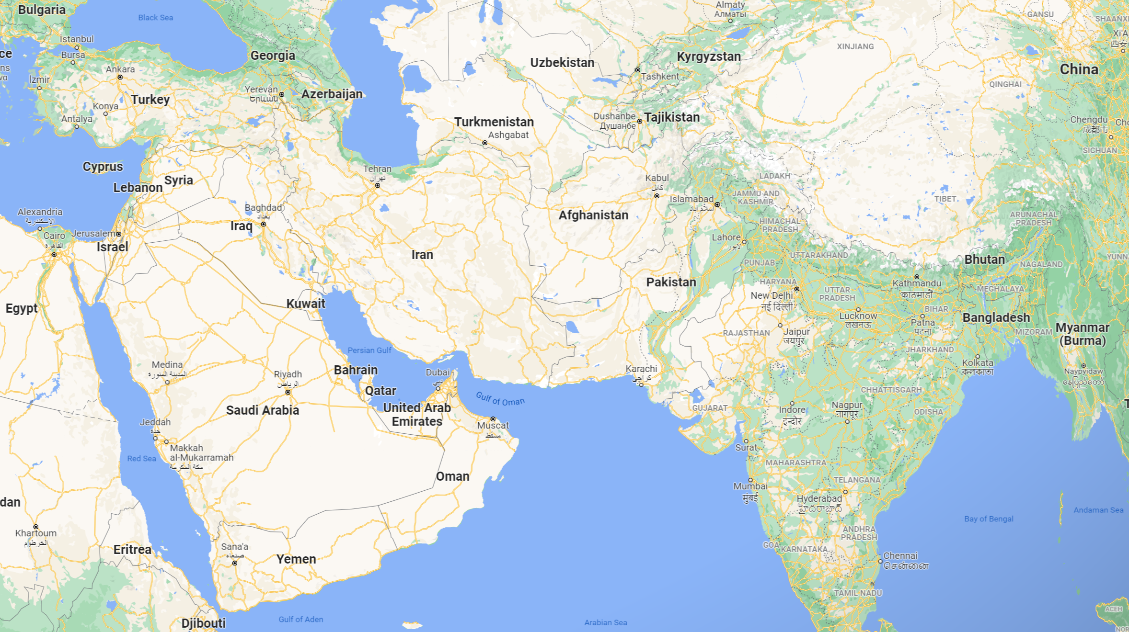
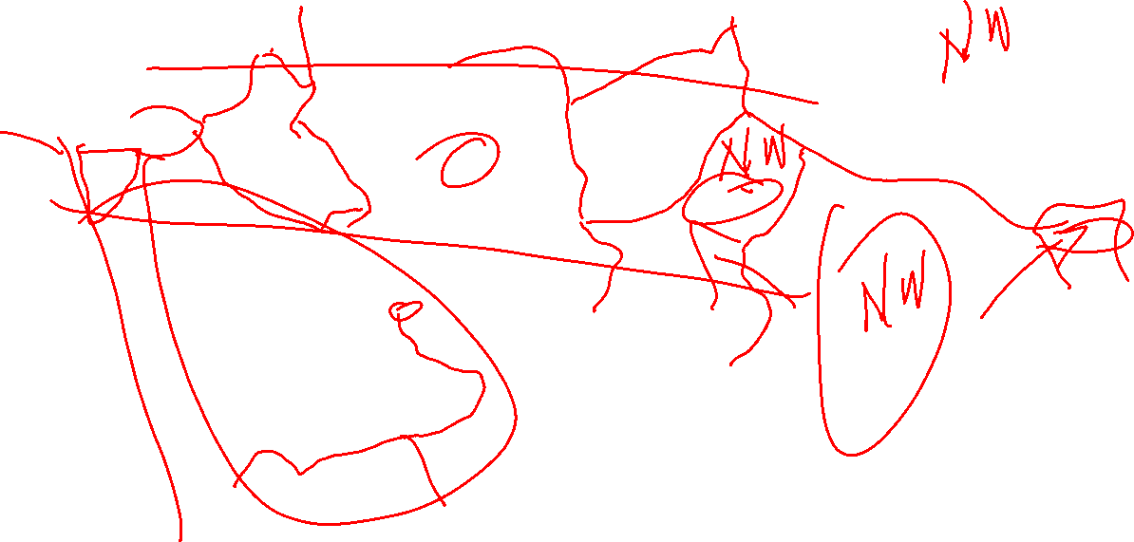

Slide 32

Background
1953 – CIA helps engineer a coup that overthrows the Premier of Iran and installs the pro-west and pro-oil company Shah.
In the late 1970s, the resistance (mostly religious leaders) use high tech (Sony Walkman cassette tape players) to trigger a popular rebellion and displace the Shah.
In 1979, President Carter, against the advice of foreign policy experts, allows the Shah to enter the US for medical treatment.
Iranian “students” then took 52 American diplomatic personnel hostage after seizing the U.S. embassy in Tehran. (The dramatic escape of a few with the help of the Canadian Embassy and a CIA agent is recounted in the movie Argo.)
Carter stays in the White House and limits campaigning because of the hostages.
  This destroys Carter’s ability to fight for reelection and assures the Reagan presidency.
The hostages are not released until Reagan is sworn in.
This fueled speculation that Reagan operatives persuaded the Iranians to not make a deal until after the election.
The counter speculation is that they were released because the Iranians were afraid of Reagan.

Slide 33

Legal Response
President Carter responded by declaring a national emergency and issuing an executive order blocking the removal or transfer of Iranian assets, and nullifying attachments of those assets in suits against Iran.
  Why limit attachments?
More than a year later, the United States and Iran reached an agreement (the Algiers Accords) for release of the hostages in return for the termination of legal proceedings against Iran in U.S. courts, the nullification of all attachments and judgments therein, and the remission of all claims to binding international arbitration, among other provisions.
Iran gets its money and all legal claims, including those not related to the hostage taking, are liquidated.

Slide 34

Can the US Seize Russian Assets in US Banks?
50 U.S.C. §1702(c), authorizing the President, “when the United States is engaged in armed hostilities or has been attacked by a foreign country or foreign nationals,” to
  confiscate any property, subject to the jurisdiction of the United States, of any foreign person, foreign organization, or foreign country that he determines has planned, authorized, aided, or engaged in such hostilities or attacks against the United States; and all right, title, and interest in any property so confiscated shall vest, when, as, and upon the terms directed by the President, in such agency or person as the President may designate . . . [and be] liquidated, sold, or otherwise dealt with . . . .
Despite the authority of this statute, seizing foreign bank assets would undermine the role of the US as the global banking center and reduce our ability to control currency flows and impose sanctions.

Slide 35

Dames & Moore v. Regan, 453 US 654 (1981)
Plaintiff had a claim based on a contract dispute.
  It contests the claims liquidation part of the hostage accords, arguing that it exceeds the president’s powers.
What is the policy argument for a presidential power to liquidate claims?
  How can private claims interfere with foreign policy?
  What would be the impact in this case?

Slide 36

International Emergency Economic Powers Act (IEEPA)
(The Trump administration tried to use this to shutdown TicToc and WeChat.)

Slide 37

Triggering IEEPA
Title 50 U.S.C. §1701(a) (1976 ed., Supp. III) states that the President’s authority under the Act “may be exercised to
  deal with any unusual and extraordinary threat,
  which has its source in whole or substantial part outside the United States,
  to the national security, foreign policy, or economy of the United States,
  if the President declares a national emergency with respect to such threat.”

Slide 38
Powers under IEEPA (in 1980)
Title 50 U.S.C. §1702(a)(1)(B) (1976 ed., Supp. III) empowers the President to investigate, regulate, direct and compel, nullify, void, prevent or prohibit, any acquisition, holding, withholding, use, transfer, withdrawal, transportation, importation or exportation of, or dealing in, or exercising any right, power, or privilege with respect to, or transactions involving, any property in which any foreign country or a national thereof has any interest.

Slide 39

The Legal Issue
The court finds that IEEPA and the Hostage Act provide a basis for preventing attachments to Iranian assets
The court does not see them as granting the president the right to dissolve the claims themselves, which are rights in US courts.
  The president has control over the attempt to seize property in which any foreign country or a national thereof has any interest to pay the claim.
A legal cause of action, to the extent that it is a property right, is owned by the plaintiff, not the defendant.
  Even if a cause of action is a property right, it is not a taking for the legislature to abolish the cause of action, absent a Constitutional basis for the action.
If IEEPA does not give the president the right to abolish these claims, is there other statutory authority?

Slide 40

Has Congress Approved These Type of Agreements?
International Claims Settlement Act of 1949, 22 U.S.C. §1621 et seq. (1976 ed. and Supp. IV).
The Act had two purposes:
  (1) to allocate to United States nationals funds received in the course of an executive claims settlement with Yugoslavia, and
  (2) to provide a procedure whereby funds resulting from future settlements could be distributed.
To achieve these ends Congress created the International Claims Commission, now the Foreign Claims Settlement Commission, and gave it jurisdiction to make final and binding decisions with respect to claims by United States nationals against settlement funds.
By creating a procedure to implement future settlement agreements, Congress placed its stamp of approval on such agreements. Indeed, the legislative history of the Act observed that the United States was seeking settlements with countries other than Yugoslavia and that the bill contemplated settlements of a similar nature in the future.

Slide 41

Previous Settlements
prior cases of this Court have also recognized that the President does have some measure of power to enter into executive agreements without obtaining the advice and consent of the Senate.
United States v. Pink, 315 U.S. 203 (1942), upheld the validity of the Litvinov Assignment, which was part of an Executive Agreement whereby the Soviet Union assigned to the United States amounts owed to it by American nationals so that outstanding claims of other American nationals could be paid.
The Court explained that the resolution of such claims was integrally connected with normalizing United States’ relations with a foreign state: Power to remove such obstacles to full recognition as settlement of claims of our nationals : : : certainly is a modest implied power of the President. : : :No such obstacle can be placed in the way of rehabilitation of relations between this country and another nation, unless the historic conception of the powers and responsibilities : : : is to be drastically revised. Id. at 229-230. : : :

Slide 42
Congressional Ratification
Though Congress has held hearings on the Iranian Agreement itself, Congress has not enacted legislation, or even passed a resolution, indicating its displeasure with the Agreement. Quite the contrary, the relevant Senate Committee has stated that the establishment of the Tribunal is “of vital importance to the United States.” S. Rep. No. 97-71, p. 5 (1981).13 We are thus clearly not confronted with a situation in which Congress has in some way resisted the exercise of Presidential authority.

Slide 43

The Lesson of Dames & Moore?
If there is some congressional authorization, even if not directly on the point; and
There are past examples of the similar actions that have been approved by the Courts; and
Congress has ratified by the action by looking into it and not disapproving,
The President can act, even to the extent of dissolving US citizen’s court claims without specific authorization.
Not mentioned – also without takings liability.

Slide 44
Zivotofsky ex rel. Zivotofsky v. Kerry (Zivotofsky II), 135 S. Ct. 2076 (2015)
When there is a conflict between the President and Congress. (Youngstown 3)

Slide 45

Zivotofsky ex rel. Zivotofsky v. Kerry (Zivotofsky II), 135 S. Ct. 2076 (2015)
What is the Jerusalem problem?
What does plaintiff want?
  He was born in Jerusalem and wants Israel as his country of birth on this passport.
What are legal questions for the court?
  First, it must determine whether the President has the exclusive power to grant formal recognition to a foreign sovereign.
  Second, if he has that power, the Court must determine whether Congress can command the President and his Secretary of State to issue a formal statement that contradicts the earlier recognition.

Slide 46
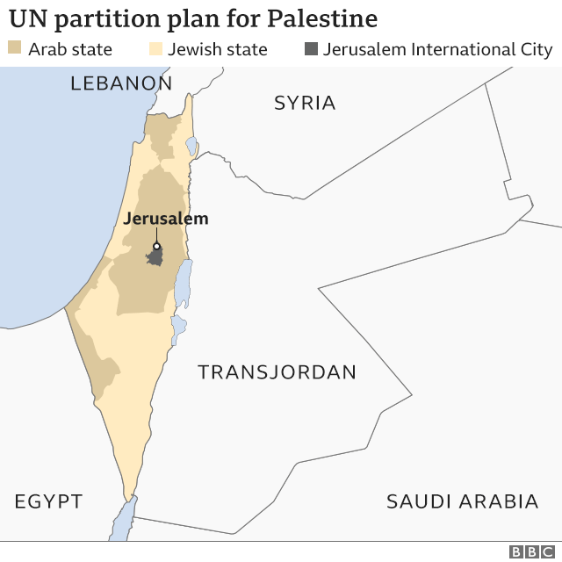


Slide 47
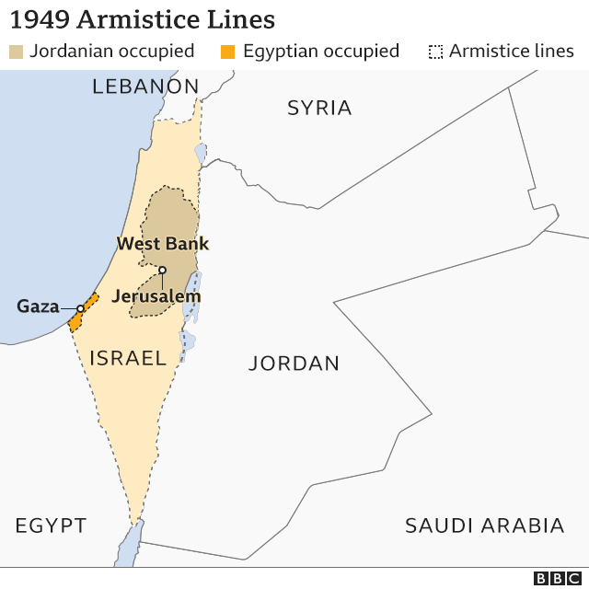


Slide 48
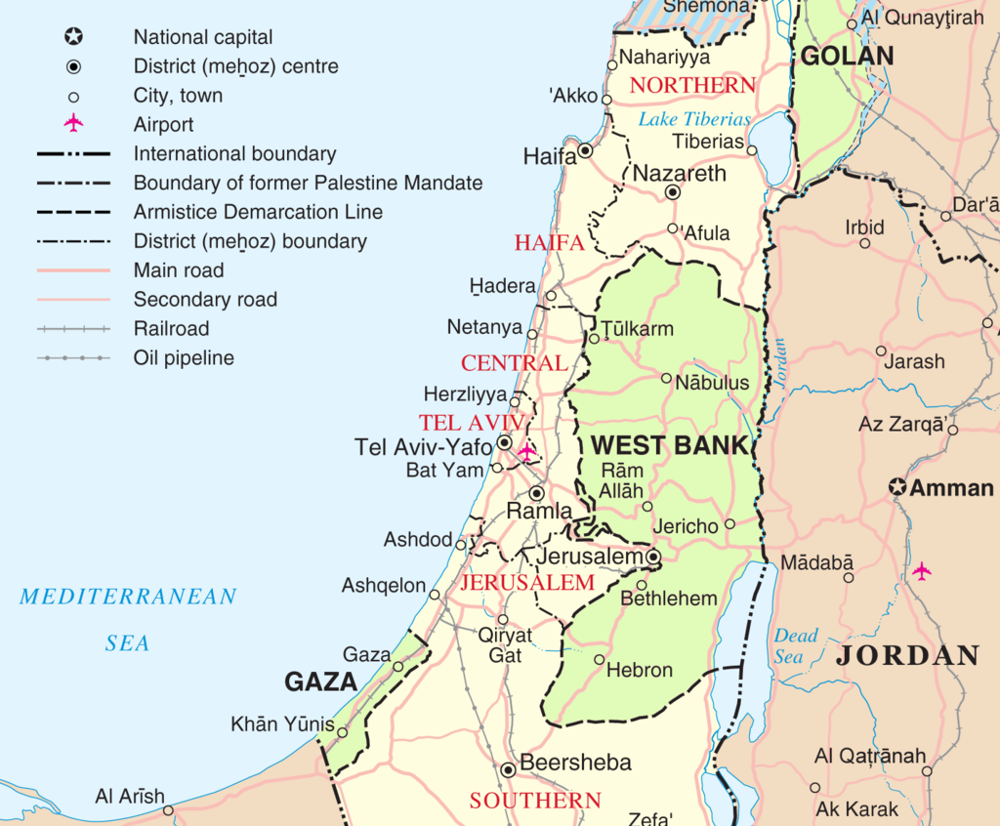


Slide 49

What did Congress do in 1995 about Jerusalem?
Congress passed the Jerusalem Embassy Act of 1995, Pub. L. No. 104-45, 109 Stat. 398 (1995), without the President’s signature, purporting to recognize Jerusalem as the capital of the State of Israel.
  When he signed the Act into law, President George W. Bush issued a statement declaring his position that §214 would, “if construed as mandatory rather than advisory, impermissibly interfere with the President’s constitutional authority to formulate the position of the United States, speak for the Nation in international affairs, and determine the terms on which recognition is given to foreign states.” Statement on Signing the Foreign Relations Authorization Act, Fiscal Year 2003,
How was the President able to avoid recognizing Jerusalem as the capital of Israel in the past?
  It allowed the President to waive application of the law every six months on “national security” grounds

Slide 50
What about People Born in Jerusalem?
Prior to the Trump policy change in 2017 recognizing Jerusalem as part of Israel, how did the state department deal with the problem of people born in Jerusalem?
  Put the city of birth on their passport, but not the state.
What did the statute allow people born in Jerusalem to request?
  Listing their birthplace as Israel.

Slide 51

What Constitutional Clause did the President Invoke in Contesting this Statute?
The Reception Clause, which directs that the President “shall receive Ambassadors and other public Ministers.” Art. II, §3.
  Does it specifically answer the question?
Why does the court say it is an important foreign power to control the recognition of foreign nations?
What legal consequences flow from recognition?
What does the court say about stability of foreign policy set by the president versus Congress?
  How did this shift since the case was decided in 1981?

Slide 52

Which of Jackson’s categories does this fit in?
3 – refusing to carry out the will of congress.
What does the president have to show to win in a Jackson 3 conflict?
  That the congressional direction was unconstitutional.
How did the majority link this to the Reception Clause?
  It forces the State to recognize Jerusalem as being in Israel, thus recognizing the annexation of the conquered territories.
  Thus, an unconstitutional limitation on the President’s power to recognize foreign governments.
How does the dissent limit this?
  Just listing something on a passport has no broader legal significance, thus it does not unconstitutionally interfere with executive power.
  This is correct as to formal legal effect but ignores the diplomatic effect.

Slide 53
B. THE COMMANDER IN CHIEF’S WAR POWERS

Slide 54

What is Jus Belli?
Traditional international law of war
Mostly about shipping and trade during wars
Nations agreed to it because of the mutual benefit of being able to conduct shipping with non-warring parties during wars
Key international law principle
  As we will discuss later, there is no enforcement mechanism for international law.
  Nations accept it because of mutual benefits or coercion by other nations.

Slide 55

The Law of Prize and Capture at the Time of the Prize Cases
Jus belli recognizes the prize and capture and rewards for recapture
It does not specify the workings of the finance – that is left to the countries.
It also recognizes that the ships owner must be reimbursed if the ship is mistakenly sold as a prize.
Letters of marque and reprisal allowed private ships to seize and sell ships of the enemies of the country that issues them.
  Essentially creates a privately funded navy or pirate fleet, depending on your perspective.

Slide 56
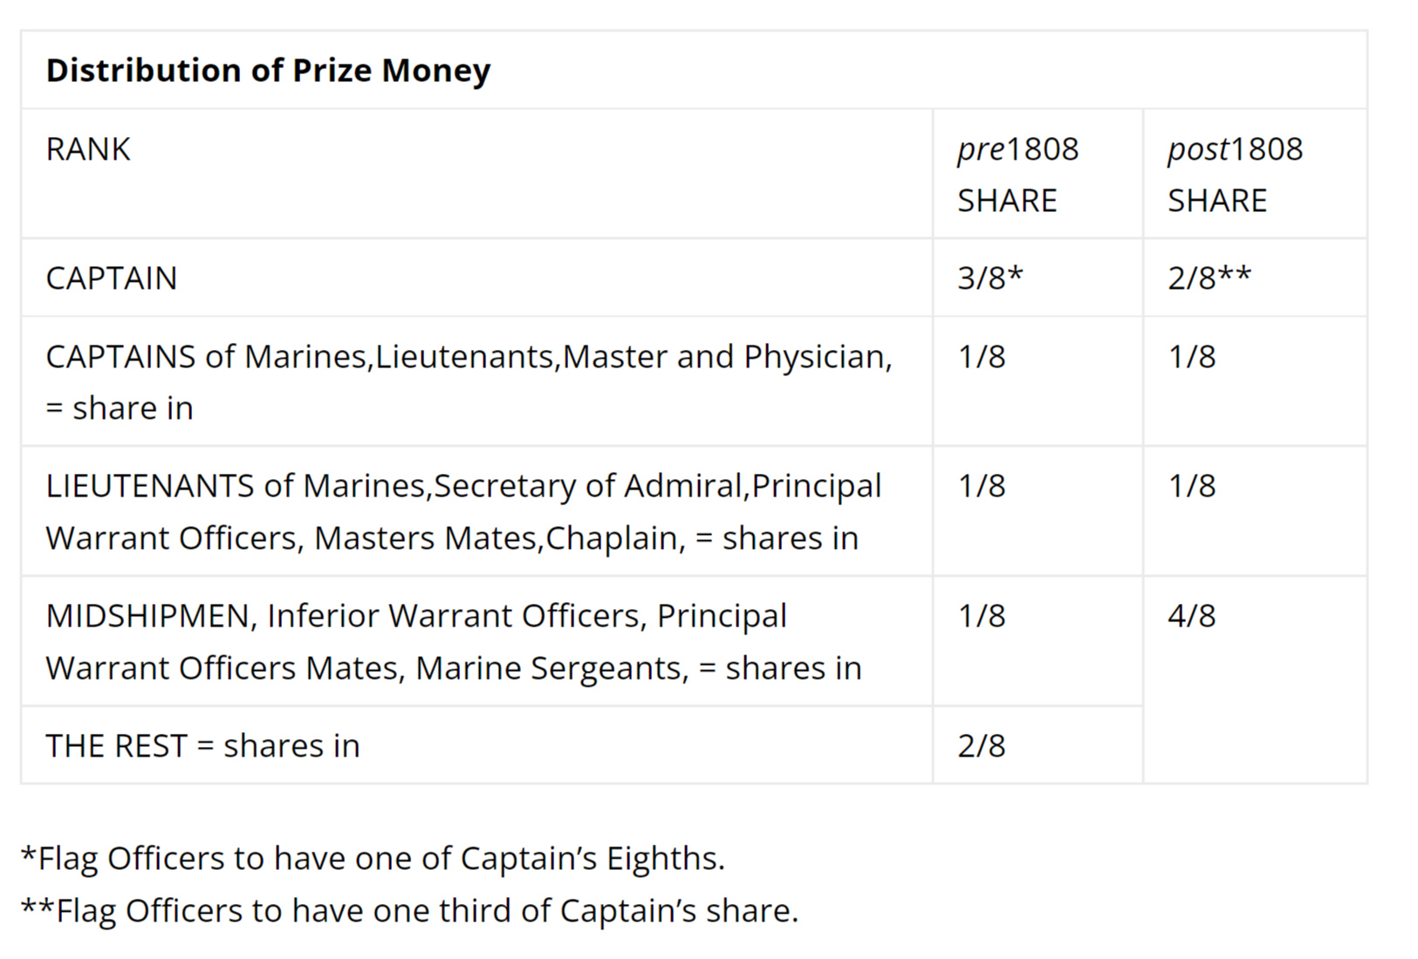


Slide 57

Capture of the Spanish treasure ship Hermione
One of the most remarkable instances of prize distribution followed the capture in 1762 of the Spanish treasure ship Hermione by the frigates Active and Favourite. She was condemned in prize for £519,705, and each of the two captains received £65,000, every lieutenant £13,000 and every seaman in the two ships £485. There were other captures as rich as this, but in most cases the numbers entitled to share in the distribution were considerably greater than the crews of two frigates, and thus the individual shares were proportionally smaller.”
£500 pounds in 1762 = £131,522.87 pounds today

Slide 58

The Prize Cases, 67 U.S. (2 Black) 635 (1863)
What precipitated this case?
  Ships were seized and sold for prizes under Lincoln’s blockade order after Fort Sumter was fired on.
What is the plaintiff trying to get in this case?
  The value of the ships and cargo
Who must pay the damages if the plaintiffs prevail?
  The captain of the ship.

Slide 59
What is Plaintiffs’ Legal Argument?
Plaintiffs argue that only Congress can declare war, and that jus belli requires that there be a war before a blockade and seizure orders can be legally issued.
Since Congress did not declare war, Lincoln’s order was not valid and thus there was no legal authority to seize the ships.
Why didn't the president go to Congress for a declaration of war?
  Congress was out of session, and it took weeks to reconvene.

Slide 60

What does Jus Belli Require?
A war
Formal or perfect war
  Declared by both sides so everyone knows who is at war
Informal or imperfect war
  The walks like a war, sounds like a war test
Jus belli has always recognized that people start wars without formal declarations, and that requiring a formal declaration to trigger the law of war would create legal uncertainty.

Slide 61

Issues before the Court
Can the president legally use troops without a declaration of war?
Is a declaration of war necessary to meet the terms of jus belli?

Slide 62

Is there a statutory provision recognizing that the president might need to respond to attack without Congressional action?
But by the Acts of Congress of February 28th, 1795, and 3d of March, 1807, he is authorized to call out the militia and use the military and naval forces of the United States in case of invasion by foreign nations, and to suppress insurrection against the government of a State or of the United States.
Is the firing on Fort Sumter an insurrection?
Would this authorize the blockade?

Slide 63

Does jus belli require a declaration of war or other legal authorization?
And whether the hostile party be a foreign invader, or States organized in rebellion, it is none the less a war, although the declaration of it be “unilateral.”
Lord Stowell (1 Dodson, 247) observes, “It is not the less a war on that account, for war may exist without a declaration on either side. It is so laid down by the best writers on the law of nations. A declaration of war by one country only, is not a mere challenge to be accepted or refused at pleasure by the other.”

Slide 64

Ratification
Did Congress authorize the action once they were back in session?
How does the majority treat this ratification?
Does the majority say that this authorization was necessary for the president's actions to be legal?
Ratification, explicit and implicit (through funding authorizations), will be explored later in the course.

Slide 65
The Dissent
[C]onsequently, : : : the President had no power to set on foot a blockade under the law of nations, and : : : the capture of the vessel and cargo in this case, and in all cases before us in which the capture occurred before the 13th of July, 1861 [the date on which Congress first authorized a naval blockade of the Confederacy], for breach of blockade, or as enemies’ property, are illegal and void, and : : : the decrees of condemnation should be reversed and the vessel and cargo restored.
Where would this leave the President when Congress was out of session?

Slide 66

Can the Defensive War Power Be Abused?
Abraham Lincoln offered this warning about the President's invocation of his "repel attack" authority to fight the undeclared Mexican War of 1846:
“Allow the President to invade a neighboring nation, whenever he shall deem it necessary to repel an invasion and you allow him to do so, whenever he may choose to say he deems it necessary for such purpose, and you allow him to make war at pleasure. Study to see if you can fix any limit to his power in this respect, after you have given him so much as you propose.”

Slide 67

Note 3 - Repealing Invasions
Martin v. Mott - 1813
Congress passes a law saying the president can repel invasions and deal with insurrections.
What does the Court say about who gets to decide if there is an invasion?
  the Court found the President to be “the sole and exclusive judge whether the exigency has arisen” that would justify invocation of the statute, and it implied the unsuitability of such a determination for judicial review. “Whenever a statute gives a discretionary power to any person, to be exercised by him upon his own opinion of certain facts,” the Court explained, “it is a sound rule of construction, that the statute constitutes him the sole and exclusive judge of the existence of those facts.”
This is a recurring problem – Congressional grants of national security power contingent on undefined circumstances. The court always defers to the president in these cases because there is no standard to review the actions.
The court is less deferential if the grant is for domestic powers.

Slide 68
Customary War Power
Unilateral Presidential Uses of Military Power

Slide 69

What did Hamilton and Madison Think about Limiting the President’s War Powers?
Alexander Hamilton wrote in The Federalist No. 23 that it was undesirable to impose “constitutional shackles” on “the power to which the care of [the safety of the nation] is committed,” because “it is impossible to foresee or define the extent and variety of national exigencies, or the correspondent extent and variety of means that may be necessary to satisfy them.”
James Madison also noted in The Federalist No. 41 that [t]he means of security can only be regulated by the means and the danger of attack. They will, in fact, be ever determined by these rules and no others. It is in vain to oppose constitutional barriers to the impulse of self-preservation. It is worse than in vain; because it places in the Constitution itself necessary usurpations of power; every precedent of which is a germ of unnecessary and multiplied repetitions.

Slide 70
May the President use armed force whenever he thinks it necessary to protect national security?
The Legal Adviser to the State Department inferred from 125 prior congressionally unauthorized uses of armed force abroad that the President has the “power to deploy American forces abroad and commit them to military operations when [he] deems such action necessary to maintain the security and defense of the United States.”

Slide 71
The Split of Scholarly Opinion on the Presidential War Power
No contemporaneous congressional interpretation attributes a power of initiating war to the President. The early Presidents, and indeed everyone in the country until the year 1950, denied that the President possessed such a power. There is no sustained body of usage to support such a claim.
To my mind, this historical development of our institutions has settled the legitimacy of ‘‘inherent’’ presidential power to commit the armed forces to hostilities. A practice so deeply embedded in our governmental structure should be treated as decisive of the constitutional issue.

Slide 72
Why should we care about theories of war powers?
If Professor Monaghan’s theory is that exercise of the war power is negotiated between the branches, what is the point of studying legal limits on war powers?
Is what the political branches negotiate not then constitutional per se, and does the President not hold all the cards in the negotiations?
How do constitutional claims, international law doctrines, and past military precedents fit into the next negotiation?

Slide 73
Stopped here Day 4

Slide 74

Little v. Barreme, 6 U.S. (2 Cranch) 170 (1804)
This is a prize case, with the Captain being sued for illegally seizing a ship
What did the statute provide?
  The 5th section of this act authorizes the President of the United States, to instruct the commanders of armed vessels, “to stop and examine any ship or vessel of the United States on the high sea, which there may be reason to suspect to be engaged in any traffic or commerce contrary to the true tenor of the act, and if upon examination it should appear that such ship or vessel is bound or sailing to any port or place within the territory of the French republic or her dependencies, it is rendered lawful to seize such vessel, and send her into the United States for adjudication.”
Was this ship bound for France?

Slide 75

Why did the Captain Include Ships from France?
This was part of the transmittal order
A proper discharge of the important duties enjoined on you, arising out of this act, will require the exercise of a sound and an impartial judgment. You are not only to do all that in you lies, to prevent all intercourse, whether direct or circuitous, between the ports of the United States and those of France or her dependencies, where the vessels are apparently as well as really American, and protected by American papers only, but you are to be vigilant that vessels or cargoes really American, but covered by Danish or other foreign papers, and bound to or from French ports, do not escape you.

Slide 76

The Legal Issues
What legal theory did the ship's owners use to sue the Captain?
Had there not been a law, would this have been within the president's powers?
What is the effect of the law in this courts' view?
  Nor did they give the Commander in Chief any constitutional right to ignore the terms of a congressional authorization for the use of force. When Congress gives the President the authority to conduct war, he or she must conduct it within that authority, just as the President must follow any law that is constitutionally made.
Stay tuned for the War Powers Resolution

Slide 77

The Mexican War: Fleming v Page
President orders seizure of a Mexican port
  Remember the Halls of Montezuma in the Marine Hymn?
What is the president's legal role in directing the seizure?
  Military commander or policy maker?
Does the president's seizure of the port make it US territory?
  Only Congress can authorize addition of territory to the US.

Slide 78

OLC on Congressional Limitations on Torture from the Torture Memos
Congress can no more interfere with the President’s conduct of the interrogation of enemy combatants than it can dictate strategic or tactical decisions on the battlefield. Just as statutes that order the President to conduct warfare in a certain manner or for specific goals would be unconstitutional, so too are laws that seek to prevent the President from gaining the intelligence he believes necessary to prevent attacks upon the United States. (Bybee)

Slide 79

9/11 and War
Who is the enemy in the War on Terror?
What does War on Terror mean in the context of formal and informal war?
  Does it satisfy the international law standard that states understand who is at war and who is not?
  Can it ever be ended?
  Why is this legally significant?
What does it mean to a prisoner in this sort of war?

Slide 80
The President’s Domestic Emergency Powers
I am going to deviate from the chapter because I do not think it captures the current jurisprudence and practicalities of the President’s Emergency Powers.

Slide 81

Emergency Powers in the Constitution
Suspension Clause provides that “the privilege of the writ of habeas corpus shall not be suspended, unless when in cases of rebellion or invasion the public safety may require it.” U.S. Const., art. I,
  This has been severely limited by the Supreme Court as long as the court are open or available.
The Calling Forth Clause authorizes Congress to “provide for calling forth the militia to execute the laws of the Union, suppress insurrections and repel invasions.” Id. art. I, §8, cl. 15
  Not clear that this is necessary.
Article I, §10, cl. 3 provides that a state may not engage in war “unless actually invaded, or in such imminent danger as will not admit of delay.”
  Not likely relevant in the modern US.
Article IV, §4, provides that the United States shall protect a state against “domestic Violence” “on Application of [its] Legislature, or of the Executive (when the Legislature cannot be convened).”

Slide 82

The Historic View of Emergency Powers
Emergency does not create power. Emergency does not increase granted power or remove or diminish the restrictions imposed upon power granted or reserved. The Constitution was adopted in a period of grave emergency. Its grants of power to the Federal Government and its limitations of the powers of the States were determined in the light of emergency and they were not altered by emergency. What power was thus granted and what limitations were thus imposed are questions which have always been, and always will be, the subject of close examination under our constitutional system.
Home Building & Loan Assn. v. Blaisdell, 290 U.S. 398, 425-426 (1934)

Slide 83

Rethinking the President’s Domestic Emergency Powers in the Modern Legal Landscape
The question has shifted from the inherent or constitutionally granted powers mostly focused on in the chapter to compliance with Congressionally granted emergency powers.
The expansion of the statutory framework for presidential domestic powers of all types begins with the New Deal, accelerates with WWII, and continues to this day.
The New Deal view of the Congressional power and duty to improve the life of Americans continues through the Nixon presidency.
Reagan ends this with his rhetoric that government is the problem.

Slide 84

National Emergencies Act - 1976
1976 – The Church Committee
Uncovers massive violations of the law by the CIA and the FBI, and the misuse of emergency powers left over from the Civil War by the Nixon administration to support the bombing in Cambodia.
The National Emergencies Act is passed to clear the books of all open emergency declarations and to clarify the process for declaring an emergency.
It does not grant any emergency powers or funds to pay for emergency actions.
It specifies how the president can trigger existing statutorily granted emergency powers and provisions for reprogramming funds.

Slide 85

The Declaration
§ 1621. Declaration of national emergency by President; publication in Federal Register; effect on other laws; superseding legislation
  (a) With respect to Acts of Congress authorizing the exercise, during the period of a national emergency, of any special or extraordinary power, the President is authorized to declare such national emergency. Such proclamation shall immediately be transmitted to the Congress and published in the Federal Register.
Notice – no definition of an emergency

Slide 86
What Must Be in the Declaration
§ 1631. Declaration of national emergency by Executive order; authority; publication in Federal Register; transmittal to Congress
When the President declares a national emergency, no powers or authorities made available by statute for use in the event of an emergency shall be exercised unless and until the President specifies the provisions of law under which he proposes that he, or other officers will act.
Such specification may be made either in the declaration of a national emergency, or by one or more contemporaneous or subsequent Executive orders published in the Federal Register and transmitted to the Congress.

Slide 87

Termination of the Emergency
(d) Automatic termination of national emergency; continuation notice from President to Congress; publication in Federal Register
Any national emergency declared by the President in accordance with this subchapter, and not otherwise previously terminated, shall terminate on the anniversary of the declaration of that emergency if, within the ninety-day period prior to each anniversary date, the President does not publish in the Federal Register and transmit to the Congress a notice stating that such emergency is to continue in effect after such anniversary
(The 1976 Act included a provision for Congress to terminate an emergency by unilateral action, which became unconstitutional after Chadha.)

Slide 88
How Can Congress Terminate Emergencies
Congress must pass a law (joint resolution) and get it signed by the President.
  Congress passed a joint resolution ending the border wall emergency, but the president vetoed it.
The president can continue an emergency indefinitely if there are not enough votes in Congress to override the veto or to impeach and remove him.

Slide 89

The Judicial Review Problem
The statutory language:
  With respect to Acts of Congress authorizing the exercise, during the period of a national emergency, of any special or extraordinary power, the President is authorized to declare such national emergency.
Do you see any standards for the court to use to determine to evaluate the existence of a real emergency?
Why doesn’t this fail the Intelligible Principle test if there is no way for the court to properly review the declaration?
  The declaration does not give the president any power to act, it only triggers existing statutes.
  Those statutes would have to pass the Intelligible Principle or the new Major Questions test.
  The OSHA emergency powers statute failed the MQD for mandatory COVID testing of workers.

Slide 90

The Growth of Statutory Limits on Agency Actions
In the post-Reagan world, Congress and state legislatures have pulled back from broad grants of agency powers (the powers that a President or Governor can use) to narrower grants of specific authority.
  The states have been most aggressive at this, driven by model legislation from ALEC (American Legislative Exchange Council), an antiregulatory/antitax thinktank.
The problem with limiting agency power and requiring specific statutory authorization for action is that makes it very difficult to respond to emergencies.
  States responded by passing expansive emergency powers laws that concentrate power in the governor.
  Some state legislatures, such as in Louisiana, then tried to limit these powers during COVID.

Slide 91

The Growth of Emergency/Contingent Powers
The major driver of statutes providing emergency powers and funding are natural disasters.
  Hurricanes
  Floods
  Forest Fires
  Pandemics and bioterrorism (post SARS1 and the anthrax attacks in the early 2000s)
Once the president issues the emergency declaration, usually at the request of a state governor, the relevant emergency powers are triggered.

Slide 92

What Does a Federal Hurricane Emergency Declaration Trigger?
FEMA and the Stafford Act are the major vehicle for hurricane, flood, and fire relief.
  Once triggered by a presidential declaration, usually at the request of a state governor, money is immediately available (without needing congressional appropriation) for emergency relief, housing, and repairs.
Effects on other laws
  The small business administration has emergency provisions to allow interest free loan for rebuilding.
  Medical licensing laws may be waived to allow out of state providers to work in the disaster zone.
  Many other provisions are triggered that affect federal programs and benefits.

Slide 93
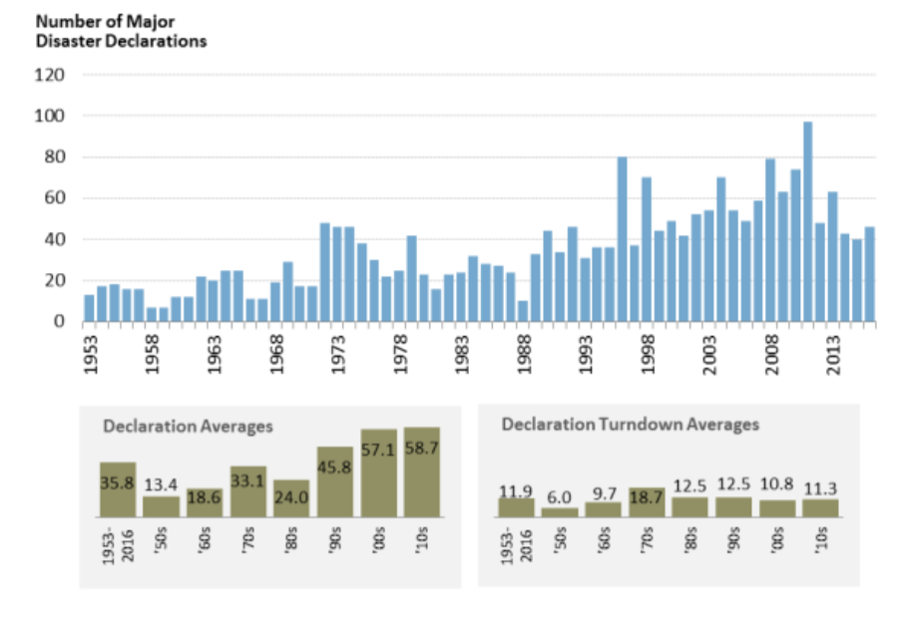

Disaster Declarations Through Time

Slide 94

Emergency Powers Become Long-Term
Natural disaster declarations can be renewed for years.
Federal relief provided under emergency powers granted after Hurricane Katrina is still not finished for New Orleans
This is very different from the traditional notion of emergency as contemplated by the Courts in the old cases.

Slide 95

Today’s Limitations on Emergency Powers
The courts will not review the validity of the Declaration because there is no standard for review.
The court will review whether the President is complying with the statutes that are triggered by the Declaration and their spending provisions.
In some cases, the current Supreme Court is short-circuiting the review process by using the shadow docket and other procedural short-cuts to rule on issues that have not been fully developed in the lower courts or briefed and argued at the Supreme Court.

Slide 96

Proposals for Congressional Reform
Presidential Proclamation No. 9844, Declaring a National Emergency Concerning the Southern Border of the United States
  Most of the factual assertions in the declaration were not emergent conditions and many were inaccurate.
  But without a standard of review, the Court did not review these claims.
  There were also attacks based on whether Congress intended the statutes triggered by the Declaration to be used for the building a border fence which Congress had specifically rejected.
These are purely statutory problems which Congress can fix if it can get the votes. They do not raise Constitutional issues.

Slide 97
The President’s Power and the Debt Crisis
Go to the resource stories
The debt limit catch-22: Will Congress hand Biden its power of the purse?
Biden Can Raise the Debt Ceiling Without Congress

