Slide 1
Cyber Operations
Chapter 14

Slide 2

Cyberspace Defined
Ubiquitous, overlapping domains
“A global domain within the information environment consisting of the interdependent network of information technology infrastructures, including the internet, telecommunications networks, computer systems, and embedded processors and controllers …”
“… common usage of the term also refers to the virtual environment of information and interactions between people.”
  National Security Presidential Directive 54/Homeland Security Presidential Directive 23 (NSPD-54/HSPD-23)

Slide 3
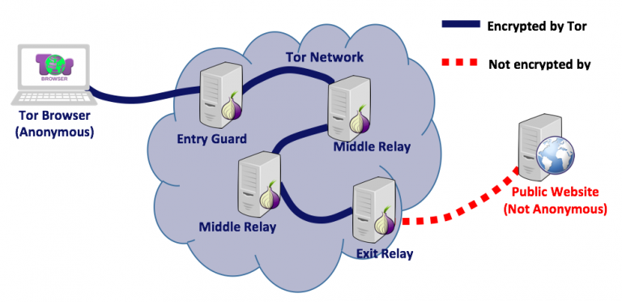
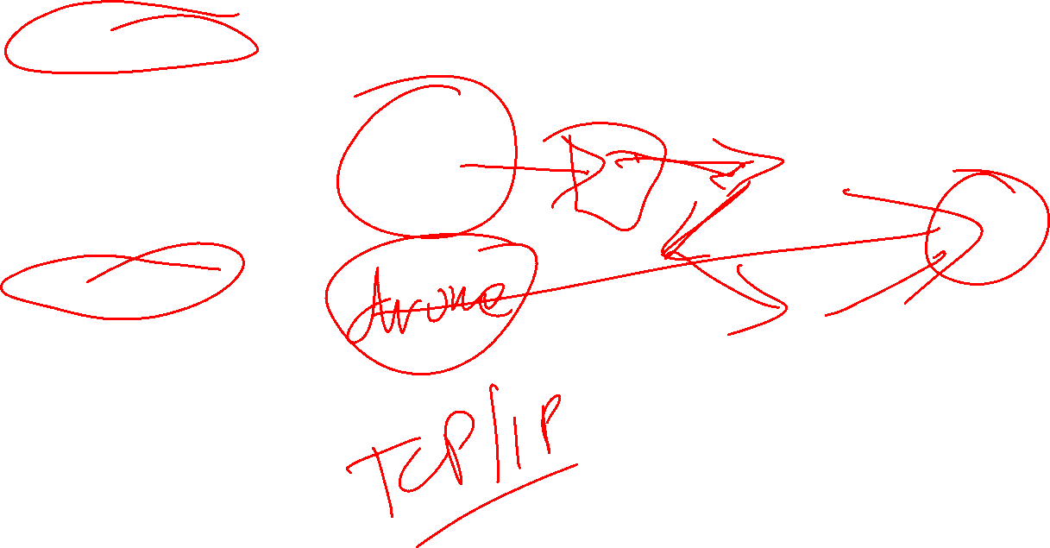
The Dark Web
Same hardware as the rest of the WWW
The pages looks the same.
Different protocol for addressing and requesting pages so the pages are invisible to Google and to the usual browsers.
Identify is protected by layers of intermediate servers run by volunteers.
Onion routing and the Tor Browser

Slide 4
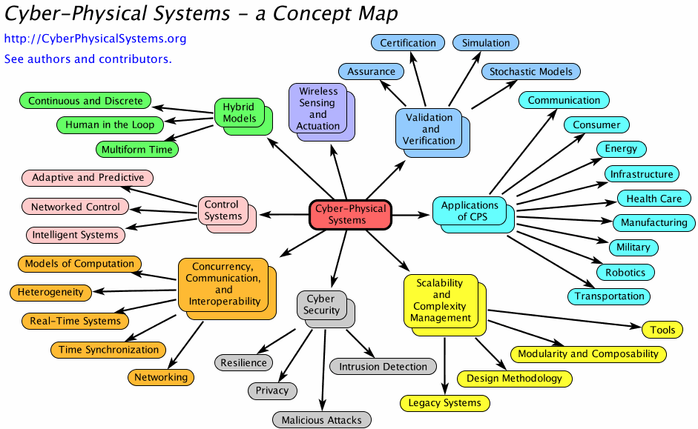

Cyber Physical Systems
Brian Connett, LCDR, USN, US NAVAL ACADEMY

Slide 5

National Security vs. Crime?
Information war/cyber war is an escalated state of cyber conflict between or among states in which cyber attacks are carried out by state actors against cyber infrastructure as part of a military campaign
  Declared: that is formally declared by an authority of one of the parties.
  De Facto: with the absence of a declaration.
Cyber conflict: is a tense situation between or among nation-states or organized groups where unwelcome cyber attacks result in retaliation.
Cyber attack: is an offensive use of a cyber weapon intended to harm a designated target.
Cyber infrastructure: is the aggregation of people, processes and systems that constitute cyberspace.

Slide 6

The History of Cybercrime/Cyberwar
November 16, 2022 - by Arctic Wolf
Technically, the first cyber attack happened in France well before the internet was even invented, in 1834. Attackers stole financial market information by accessing the French telegraph system. From that moment on, cybercrime has grown exponentially, marked by an intriguing evolution of tactics, techniques, and procedures — all implemented for malicious gain.
Still, cybercrime didn’t really find its footing until the mid-point of the 20th century. Spurred on by the digital revolution, cybercriminals became early adopters of technology, using their head start and their smarts to engineer new, devious ways to part people and organizations from their data and dollars.
If there was a Cybercrime Hall of Infamy, its halls would be lined with the names and faces of these noted attackers whose “groundbreaking” work caught both the eye of federal investigators and the envy of fellow hackers.

Slide 7

1962
The modern history of cybercrime began when Allen Scherr launched a cyber attack against the MIT computer networks, stealing passwords from their database via punch card.

Slide 8
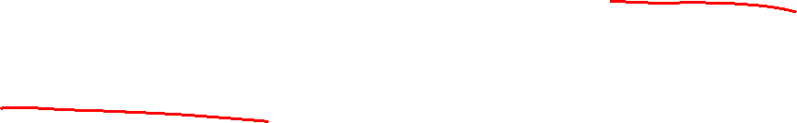
1971
The first computer virus was created for research purposes by Bob Thomas at BBN technologies. Referred to as the Creeper Virus, the self-replicating program was detected on the ARPANET in 1971 and foretold the potential of future viruses to cause significant damage to computer systems.

Slide 9

1981
Ian Murphy became the first person ever to be convicted for committing a cybercrime after successfully hacking into AT&T’s internal systems and changing their computers’ clocks, causing havoc.

Slide 10
1988
The first major cyber attack on the internet came courtesy of Cornell grad student Robert Morris. The “Morris Worm” struck in the year before the World Wide Web debuted, back when the internet was primarily the domain of academic researchers. It infected computer systems at Stanford, Princeton, Johns Hopkins, NASA, Lawrence Livermore Labs, and UC Berkeley, among other institutions.

Slide 11

1994
Datastream Cowboy and Kuji — a 16-year-old British schoolboy and his accomplice — used a “password sniffer” program to launch a series of attacks that crippled the Air Force’s Rome Laboratory, while stealing research data used as attack instructions for warplanes in battle.

Slide 12

1995
Vladimir Levin was the first known hacker to attempt to rob a bank — and a very big bank at that. He hacked into Citibank’s network and conducted an abundance of fraudulent transactions. All told, he transferred more than 10 million dollars into various bank accounts worldwide.

Slide 13

1995
Kevin Mitnick — one of history’s most notorious hackers — became the first person to penetrate large networks by manipulating people and using insiders to get the codes to access Motorola and Nokia, among others.

Slide 14
1998
Max Butler, a security consultant for the FBI among others, hacked into U.S. government websites under false pretenses. The U.S Air Force alerted officials to his misdeeds, and he received an 18-month sentence. Later, for another illicit foray, he was sentenced to 13 years, a record for a hacker.

Slide 15
1999
Computer viruses were relatively unknown by the general public until the Melissa Virus struck in March 1999 and affected users across the internet, corrupting their Microsoft document files and causing an estimated $80 million in damages.

Slide 16
The New Millenium: Cybercrime Ramps Up
The first decade of the new millennium saw more sophisticated attacks and an abundance of advanced persistent threat actors (APTs), most of which were sponsored by nation-states. The evolution of cybercrime meant new viruses and worms, which caused significant damage to critical sectors of the global, digital economy.
By decade’s end, cybersecurity was a concern to computer users everywhere, but especially to government agencies and large corporations who had the most at stake. Here’s the most notable cybercrimes of the decade:

Slide 17
2000
A 15-year-old hacker named Michael Calse — who went by the online handle “Mafiaboy” — launched a series of distributed denial of service (DDoS) attacks on some of the largest commercial websites in the world, sites like Amazon, Yahoo, CNN, and eBay. The attack brought the sites down for hours in some cases and cost these businesses untold millions.

Slide 18
2005
A security breach at a U.S. retailer led to the data leak of 1.4 million HSBC Bank MasterCard users.

Slide 19
2008
In one of the largest breaches ever, Heartland Payment systems were attacked using a combination SQL injection, password sniffers, and malware, compromising the data of 134 million users.

Slide 20
2010s: An Explosion of Cyber Attacks
The past ten years have seen an explosion in cybercrime, turning what was once a cottage industry into big business. Attackers developed new malicious programs and techniques, which increased both the cybercrime rate and the number of attacks per day. Trillions of dollars were lost.
Cybercrime wasn’t the only industry that saw huge growth. Organizations began employing more cybersecurity professionals to counter the risk of cyber threats as the sense of assumed digital security dissipated. And, due to the demand for constant data security, a new field emerged known as ethical hacking, whose sole purpose is to discover vulnerabilities prior to malicious exploitation.
The evolution and increased sophistication of different types of cyber threats and how they’re leveraged in attacks puts organizations in precarious positions when it comes to defending against them. Here are the most damaging attacks from this most damaging decade:

Slide 21

2010
The Stuxnet worm — called the world’s first “digital weapon” — attacked nuclear plants in Iran, sabotaging the country’s uranium enrichment facilities.

Slide 22
2010
The Zeus Trojan virus was distributed around the world via email in an attack targeting financial services organizations. The 100-plus-person crime ring, based largely in the U.S., managed to steal more than $70 million from American banks.

Slide 23
2010
In a notorious nation-state attack, Operation Aurora was launched by Chinese military hackers on more than 20 leading technology companies. The public was first made aware of the attacks when Google notified the public that its intellectual property had been seized in the attack.

Slide 24
2011
Sony Corporation announced In April that, over the course of a few days, hackers stole information from 77 million users of its PlayStation Network. This included gamers’ usernames and passwords, their birthdates, answers to security questions, and more. It took 23 days to recover the system and remediate the threat.

Slide 25

2013
In perhaps the largest high-profile data leak of all time, whistleblower Edward Snowden revealed sensitive information stolen from several foreign governments with spyware software as part of the National Security Agency’s PRISM surveillance program.

Slide 26
2013
Over 110 million Target customers had their credit card records stolen in a phishing attack. The scheme involved a malware-laden email to the company’s HVAC subcontractor, allowing the cybercriminals to gain access credentials to the data.

Slide 27
2013
A researcher discovered that Finnish telecommunications Nokia was essentially conducting man-in-the-middle attacks on its smart phone users by sending HTTPs traffic through its servers and decrypting data. The company said it did so to help compress data and keep rates and charges reduced.

Slide 28
2015
The first strains of SamSam ransomware appeared, which by 2018 had earned its creator nearly $6 million. Among its highest-profile “hostage-taking” strikes were the City of Atlanta and the Colorado Department of Transportation.

Slide 29
2015
A successful spear-phishing attack against high-value Defense Department targets with customized emails led to a data breach of information for 4,000 military and civilian personnel who worked for the Joint Chiefs of Staff. The attack forced the Pentagon to shut down its email system.

Slide 30
2016
TeleCrypt ransomware appeared and targeted gamers, who downloaded it while playing games online. Luckily, a free decrypt tool was quickly created by researchers at Malwarebytes.

Slide 31
2016
The Austrian Aerospace firm, FACC AG, was defrauded of 50 million Euros in a spear-phishing scheme that tricked a finance employee to transfer the money into bank accounts controlled by the cybercriminals. As a result, the company’s CEO was fired.

Slide 32

2017
Perhaps the most insidious of all ransomware strains, WannaCry, managed to affect more than 200,000 Windows computers in 150 countries. It was especially dangerous — and deadly — as the UK’s National Health Service Hospitals were among the most devastated. It is widely assumed hackers in North Korea were behind the attack.

Slide 33

2017
Just a month later, piggybacking on the success of WannaCry was NotPetya, an updated version of the earlier ransomware strain. It took out organizations from shipping giant Maersk to multinational pharmaceutical manufacturer Merck.

Slide 34
2017
A Lithuanian cybercriminal posed as an Asian manufacturer to deceive Google and Facebook employees into wiring over $100 million to untraceable offshore bank accounts. The swindle occurred over the course of two years before his capture. For their part, Google claimed to have recouped the funds it had lost.

Slide 35
2018
In the biggest DDoS inundation to date, GitHub — a popular developer platform — experienced traffic of 1.3 terabytes per second, which halted all operations on its server. GitHub had security measures in place, far more than most organizations, but was simply overwhelmed by the sheer size of the attack.

Slide 36

2018
Perhaps the most noteworthy of all cryptojacking attacks was Coinhive, a popular cryptocurrency mining service that, for a time, was considered by leading security firms as the top malicious threat to web users. Its computer code could be used on hacked websites to steal the processing power of that site’s visitors’ devices. For 15 long months, cybercriminals used the malicious program to infect millions of devices.

Slide 37
2019
Capital One fell victim to one of the largest data breaches in banking history when over 100 million credit card applications were accessed and thousands of Social Security and bank account numbers were taken. Capital One spent around $150M mitigating damages.

Slide 38
2020
Neiman Marcus notified 4.6 million customers that a hacker had compromised online accounts in May 2020, gaining access to personal data such as usernames and passwords, customer names, contact information, credit card numbers, as well as expiration dates and virtual card numbers.

Slide 39

2020
Russian cyberattacks on U.S. governmental institutions have been on the rise and, in one of the most catastrophic data breaches during all of 2020, foreign intelligence operatives took advantage of a compromised SolarWinds program and invaded an estimated 18,000 private and government-affiliated networks. These data breaches granted attackers access to an abundance of identifiable information, including financial information, source code, passwords, and usernames.

Slide 40

2021
In early May, a suspected Russian hacking group took Colonial Pipeline offline for more than three days in an attack that made “ransomware” a household word. As Colonial provides 45% of the East Coast’s supply of gasoline, diesel fuel, and jet fuel, this was a major blow. Gas prices spiked across the country, some gas stations ran out of fuel, over-the-road deliveries were delayed, and there were even reports of gasoline hoarding.

Slide 41
2021
The infamous REvil collective hit Florida-based software provider Kaseya with a ransomware attack, demanding $70 million in bitcoin. This attack impacted businesses across five continents — including shutting down public schools in New Zealand, closing a major grocery chain in Sweden, and disrupting operations for hundreds of businesses across the U.S.

Slide 42
2021
The year closed out with the revelation of a zero-day threat that created massive waves in the cybersecurity industry, when security researchers published a proof-of-concept critical exploit for a remote code execution vulnerability in Log4j, a Java logging library used in a significant number of internet applications.
In the weeks following, businesses worldwide worked frantically to identify and mitigate the impact of the exploit, while security pros and experts released patches and scanning tools, and guided organizations on how to best protect themselves from attack.

Slide 43
2022
In one of the more frightening displays of cybercriminals’ willingness to endanger the lives and livelihoods of strangers, the agency that administers social security for Costa Rica was shut down by a late May ransomware attack, an attack which spread to other offices in the country and caused a state of emergency.

Slide 44

2022
A mid-September hack yielded a striking amount of material from a titan of the gaming industry. The hotly anticipated release of Rockstar Games’ Grand Theft Auto 6 was thrown into disarray when a hacker known as “teapotuberhacker” breached Rockstar’s internal Slack channel and purloined 90 videos of work-in-progress gameplay. But this hacker wasn’t done.
In an extremely similar Slack attack, teapotuberhacker lived up to their screen name on September 14 when they, well, hacked Uber. The international ride-share company was breached even more deeply than Rockstar, with the hacker gaining “pretty much full access to Uber,” including email systems, internal communications, cloud storage, and code repositories.

Slide 45
Types of Attackers

Slide 46
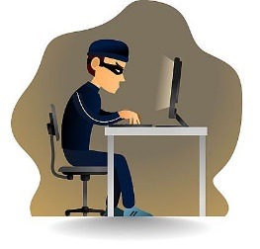
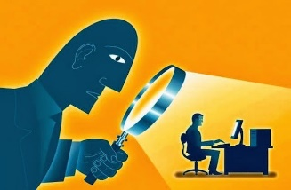

Crackers
System Administrators
Some scripts are useful
to protect networks…
Get info from hacker
bulletin boards
Cracker:
Computer-savvy
programmer creates
attack software
Dark Web
For Sale:
Credit Cards
Medical Insurance
Identification
Malware
Script Kiddies:
Know how to
execute programs
Criminals:
Create & sell botnets -> spam
Sell credit card numbers,…
Nation States:
Cyber-warfare, spying, extortion, DDOS
Crimeware or
Attack Kit=$1K-2K
1 M Email addresses = $8
10,000 PCs = $1000

Slide 47

Other Hackers/Crackers:
Nation-States
  Accused: Russia, North Korea, China, France, South Korea, Germany, Israel, India, Pakistan, US.
Cyberterrorists
Corporations
Activists
Criminals
Hobbyists

Slide 48
Types of Attacks

Slide 49



Social Engineering
I need a password reset. What is the passwd set to?
Email:
ABC Bank has
noticed a
problem with
your account…
This is John, the System Admin. What is your password?
I have come to repair your machine…
What ethnicity are you? Your mother’s maiden name?
and have some software patches
Notes:
Always be sure who you’re talking to before you give out information

Slide 50
Phishing =
Fake Email
ABC BANK
Your bank account password is about to expire.
Please login…
Spearfishing
John:
Could you send Automated Services $1200?
Joe (CEO)
The bank has found
problems with your
account.
Please contact …”
Notes:
“Greetings to good sir in USA. I am here wishing to offer you a good bargain in exchange for your help. You understand, I must now leave my home country of Nigeria where I have the ten million Euros in the bank, but I need a new place where to transfer it so when I reach my new home I can still feed my children. If you would please to offer me your bank number and information I will immediately send to you one million of the Euros…”

Slide 51
Social Engineering
Phishing
Gain Foothold
Malware>67%
Pretexting
Dialogue
Technique:
Financial 59%
Spying 41%
Techniques:
Goals:
Obtain info, influence
Malware 10%
CEO impersonation
Goals:
Financial: 95%
Human resources: W2 info->fraudulent tax returns
Finance: transfer $
93% of Breaches
Prominent technique: email 96%
  Malicious attachment
  Link to pharming website
78% do not click a single phish all year;
4% phish acceptance rate
Verizon 2018 Data Breach Investigations Report

Slide 52
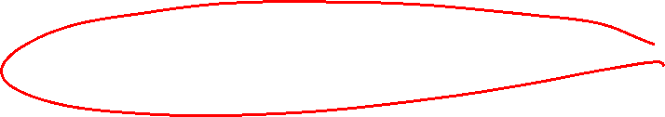
Man-in-the-middle attack
Man-in-the-middle (MitM) attacks, also known as eavesdropping attacks, occur when attackers insert themselves into a two-party transaction. Once the attackers interrupt the traffic, they can filter and steal data.
Two common points of entry for MitM attacks:
  1. On unsecure public Wi-Fi, attackers can insert themselves between a visitor’s device and the network. Without knowing, the visitor passes all information through the attacker.
  2. Once malware has breached a device, an attacker can install software to process all of the victim’s information.

Slide 53

Pharming = Fake web pages
Pharming:
A fake web page may lead to a real web page
The fake web page looks like the real thing
  Extracts account information
www.abc.com
www.abcBank.com
Login
Passwd
Welcome
To ABC
Bank

Slide 54

Drive-By Download
Games:
Vampires and Wolfmen
Planet of the Apes
Dungeons and Dragons
A web site exploits a vulnerability in the visitor’s browser when the site is viewed

Slide 55

Malware
Malware is a term used to describe malicious software, including spyware, ransomware, viruses, and worms. Malware breaches a network through a vulnerability, typically when a user clicks a dangerous link or email attachment that then installs risky software. Once inside the system, malware can do the following:
  Blocks access to key components of the network (ransomware)
  Installs malware or additional harmful software
  Covertly obtains information by transmitting data from the hard drive (spyware)
  Disrupts certain components and renders the system inoperable

Slide 56

The Network Effect
Everyone knows the term computer virus.
Virus spread through networks as they spread through populations.
Most desktops globally run Windows – sorry Apple – or are served by Windows services.
Microsoft patches windows to cure Zero-day exploits – newly discovered flaws that allow network attacks.
Very few large organizations and end users maintain the latest version of fully maintained Windows products and the latest patches.
  Every out of data machine is like an unvaccinated person.
  When you get enough of them, you can have a computer virus pandemic like NotPetya.

Slide 57

Botnets – Zombie Computers
Some malware only uses the computer as a network node for a botnet.
  The measurable effect may be a slight reduction in performance.
  The controlling computer uses the botnet for attacks on other computers.
  You can rent botnets with tens of thousands of computers.
Botnets are linked by coded messages.
  Coordination by time and target, not need for direct communication at the time of the attack.
  Some have kill codes to disable the botnet.
  Others you have to get the transmitting machine.

Slide 58
Stopped here

Slide 59
Denial-of-service attack
A denial-of-service attack floods systems, servers, or networks with traffic to exhaust resources and bandwidth. As a result, the system is unable to fulfill legitimate requests.
Attackers can also use multiple compromised devices (botnet) to launch this attack. This is known as a distributed-denial-of-service (DDoS) attack.
  These are an attribution nightmare.
Just temporary disruption, no theft of information or damage to the system.
  Can be used for ransomware on commercial sites.

Slide 60
Zero-day exploit
A zero-day exploit hits after a network vulnerability is discovered but before a patch or solution is implemented. Attackers target the disclosed vulnerability during this window of time.
The most dangerous hacks may use multiple zero-day exploits.
Zero-day vulnerability threat detection requires constant awareness. Major software vendors have high bounties for zero-day exploits as they try to outbid the dark web.
Most military and government software is the same COTS (commercial off the shelf) software that you use.
  Microsoft Update Tuesday
Should the NSA horde zero-day exploits it finds or tell the vendors so they can be fixed?
  What is the risk of sitting on them?

Slide 61
Supply Chain Breach - New
The most dangerous hacks because they take advantage of the complexity of the supply chain and hegemony of the major providers.
Get the malware into the update stream for a major product or the OS.
Software vendors often use contractors to do updates.
Hack the contractor and get the malware into original update package and it automatically gets into every updated computer because the computers trust the update source.
Solarwinds is an update company that got hacked and then infected tens of thousands of networks, including major government networks.
  It is still likely in some of the systems and we do not know what it can do.

Slide 62
Advanced Persistent Threat
Advanced: Combination of custom & common malware
  Target: Business or Gov’t data/operation
Persistent: Extended period attack until target is compromised – often data is mined until the attack is detected.
Threat: Organized, capable, well-funded attacker
  Source: Gov’t or criminal enterprise.
The most dangerous are code that is embedded in the systems and evades detection so the compromise lasts.
  Solarwinds is the most successful that we know of.
  It was both widespread and persistent.

Slide 63
Examples of National Security Attacks

Slide 64
Estonia, 2007
DDOS attacks came from 178 countries, including large botnets
Attacker could not be definitively attributed to a nation-state
CERT-EE and NATO classified it as a “cyber riot”
Did not trigger NATO Art. 5, requiring “armed attack”
Ultimately characterized as “patriotic hacking”
Estonian government chose to treat it as cyber crime
Attempted to use MLAT (Mutual Legal Assistance Treaty) and letters rogatory but Russia refused to cooperate.

Slide 65
Stuxnet 2010
Written to subvert SCADA for Siemens centrifuge programmable logic controllers (PLCs)
  Damaged Uranium-enrichment centrifuges in Iran
  Spun too fast – crashed physically
60% of Stuxnet infections were in Iran
Speculations that US & Israel wrote Stuxnet Worm
  No direct proof
  Circumstantial evidence includes codes and dates that might be related to Israel
  Documents supporting view that US involved were released by Edward Snowden in July 2013

Slide 66

Ukraine 2015
Volz, D. (2016-02-25). “U.S. government concludes cyber attack caused Ukraine power outage.” Reuters < http://tinyurl.com/hsf47hl >
2015-12-23
  225,000 people affected
  1st known successful cyberattack on a grid
  Likely from Russian Sandworm group
Installed malware that switched breakers off
DoS on customer-service phones
  Prevented real customers from reporting outages

Slide 67
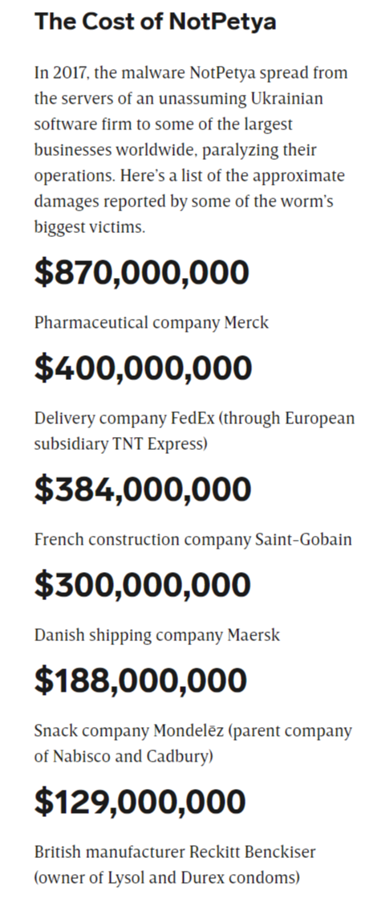

NotPetya
Russian cyberattack on Ukraine.
No attempt by the Russians to contain the damage.
Spread to global companies doing business in Ukraine.
Caused massive financial loss from the cost of rebuilding computer networks and lost business during the weeks to months of disrupted business.
The Trump White House took no action and imposed no sanctions, sending a strong message to Russia that anything cyber is OK.

Slide 68

The Ukraine War
Russia has been using cyber attacks against Ukraine infrastructure
These have not been very successful
  NATO cyber operations have helped counter the attacks.
  Private hackers have also helped in defense and counter attacks against Russia
Ukraine forces and civilians have weaponized social media against the Russian forces
  It is used to communicate Russia troop movements and positions to Ukraine forces.
  It is used to coordinate Ukraine partisan resistance.

Slide 69

China
People’s Republic of China is the major state actor
  Technologically sophisticated.
  People’s Liberation Army doctrine explicitly includes information warfare.
  Widespread evidence of massive probes and attacks originating from China through state sponsorship.
  Formal training for cadres.
Full spectrum
  Classic national security
  Massive industrial espionage to steal IP
  Disinformation
The most significant player in cyberoperations against the US.

Slide 70
Cyberwar and the Laws of War

Slide 71

The Economics of Asymmetric Warfare
Basic terrorism strategy for kinetic attacks.
Defense more expensive than attack.
Probability of at least 1 weakness
  Increases as number of potential attack points grows
P(system breach) = 1 – (1 - p)^{n} where
  p = probability of unit failure &
  n = number of independent possible breach points or
P = 1 – Π(1 - p_{i}) where
  Π is multiplication
  p_{i} = probability of failure of unit I
Bottom line – big, complex countries have more to lose and thus defend

Slide 72
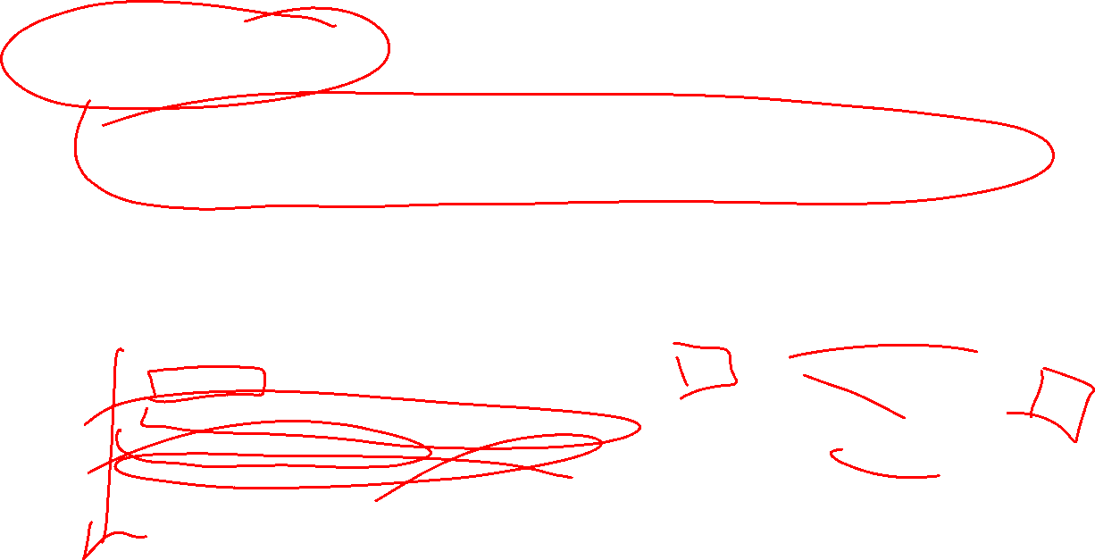
Attribution
Remember - TCP/IP that defines the Internet was developed by nerds who wanted a universal system with no checks on who could use it.
  Technology can obfuscate attribution - e.g., spoofing, anonymizers, etc.
If nations can act anonymously, accepted rules of behavior can be largely ignored.
  Same issue with traditional terrorist groups and the fights over who is a state sponsor of terrorism.
Levels of attribution
  IP address
  Computer associated with that IP address
  Controlling computer
  Person behind the controlling computer
  Sponsor of the person (nation-state, terrorist org, criminal org, etc.)

Slide 73

Attribution: Legal Issues
Laws slow the attribution process
  Attribution outside victim state generally requires foreign state/international cooperation.
International discovery is complicated.
  Letters rogatory
  Mutual Legal Assistance Treaties (w/ 64 of 193 countries)
  24/7 POCs under Cyber Crime Convention (~30 countries)
  Data retention (EU law)
  Data preservation (US law, 2703(f) order)

Slide 74

Are Cyberattacks Covered by the UN Charter?
Article 2(4)
  “Threat or use of force against the territorial integrity or political independence of any state”?
Article 39
  “Threat to the peace, breach of the peace, or act of aggression” permitting Security Council action?
Article 41
  “Armed force” permitting Security Council action?
Article 51
  “Armed attack” permitting self-defense?

Slide 75

Department of Defense
Law of War Manual

Slide 76

16.2.1 Application of Specific Law of War Rules to Cyber Operations.
Specific law of war rules may be applicable to cyber operations, even though these rules were developed long before cyber operations were possible.
The law of war affirmatively anticipates technological innovation and contemplates that its existing rules will apply to such innovation, including cyber operations. Law of war rules may apply to new technologies because the rules often are not framed in terms of specific technological means. For example, the rules on conducting attacks do not depend on what type of weapon is used to conduct the attack. Thus, cyber operations may be subject to a variety of law of war rules depending on the rule and the nature of the cyber operation. For example, if the physical consequences of a cyber attack constitute the kind of physical damage that would be caused by dropping a bomb or firing a missile, that cyber attack would equally be subject to the same rules that apply to attacks using bombs or missiles. . . .

Slide 77
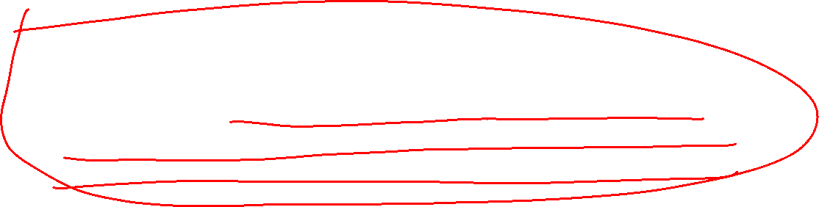
16.2.2 Application of Law of War Principles as a General Guide to Cyber Operations.
When no specific rule applies, the principles of the law of war form the general guide for conduct during war, including conduct during cyber operations. For example, under the principle of humanity, suffering, injury, or destruction unnecessary to accomplish a legitimate military purpose must be avoided in cyber operations. . . .
[The key principle]

Slide 78
16.3 CYBER OPERATIONS AND JUS AD BELLUM

Slide 79
16.3.1 Prohibition on Cyber Operations That Constitute Illegal Uses of Force Under Article 2(4) of the Charter of the United Nations.
. . . Cyber operations may in certain circumstances constitute uses of force within the meaning of Article 2(4) of the Charter of the United Nations and customary international law. For example, if cyber operations cause effects that, if caused by traditional physical means, would be regarded as a use of force under jus ad bellum, then such cyber operations would likely also be regarded as a use of force. Such operations may include cyber operations that: (1) trigger a nuclear plant meltdown; (2) open a dam above a populated area, causing destruction; or (3) disable air traffic control services, resulting in airplane crashes. Similarly, cyber operations that cripple a military’s logistics systems, and thus its ability to conduct and sustain military operations, might also be considered a use of force under jus ad bellum. Other factors, besides the effects of the cyber operation, may also be relevant to whether the cyber operation constitutes a use of force under jus ad bellum.22 . . .

Slide 80

16.3.2 Peacetime Intelligence and Counterintelligence Activities
. . . [T]he question of the legality of peacetime intelligence and counterintelligence activities must be considered on a case-by-case basis. Generally, to the extent that cyber operations resemble traditional intelligence and counter-intelligence activities, such as unauthorized intrusions into computer networks solely to acquire information, then such cyber operations would likely be treated similarly under international law. The United States conducts such activities via cyberspace, and such operations are governed by long-standing and well-established considerations, including the possibility that those operations could be interpreted as a hostile act.

Slide 81
16.3.3 Responding to Hostile or Malicious Cyber Operations.
A State’s inherent right of self-defense, recognized in Article 51 of the Charter of the United Nations, may be triggered by cyber operations that amount to an armed attack or imminent threat thereof. As a matter of national policy, the United States has expressed the view that when warranted, it will respond to hostile acts in cyberspace as it would to any other threat to the country.
Measures taken in the exercise of the right of national self-defense in response to an armed attack must be reported immediately to the U.N. Security Council in accordance with Article 51 of the Charter of the United Nations.

Slide 82
16.3.3.1 Use of Force Versus Armed Attack.
The United States has long taken the position that the inherent right of self-defense potentially applies against any illegal use of force. Thus, any cyber operation that constitutes an illegal use of force against a State potentially gives rise to a right to take necessary and proportionate action in self-defense.

Slide 83
16.3.3.2 No Legal Requirement for a Cyber Response to a Cyber Attack.
There is no legal requirement that the response in self-defense to a cyber armed attack take the form of a cyber action, as long as the response meets the requirements of necessity and proportionality.

Slide 84

16.3.3.3 Responses to Hostile or Malicious Cyber Acts That Do Not Constitute Uses of Force.
Although cyber operations that do not constitute uses of force under jus ad bellum would not permit injured States to use force in self-defense, those injured States may be justified in taking necessary and appropriate actions in response that do not constitute a use of force. Such actions might include, for example, a diplomatic protest, an economic embargo, or other acts of retorsion [retaliation or reprisal by one state identical or similar to an act by an offending state, such as high tariffs or discriminating duties]. .

Slide 85
16.3.3.4 Attribution and Self-Defense Against Cyber Operations.
Attribution may pose a difficult factual question in responding to hostile or malicious cyber operations because adversaries may be able to hide or disguise their activities or identities in cyberspace more easily than in the case of other types of operations.
A State’s right to take necessary and proportionate action in self-defense in response to an armed attack originating through cyberspace applies whether the attack is attributed to another State or to a non-State actor.

Slide 86
16.3.3.5 Authorities Under U.S. Law to Respond to Hostile Cyber Acts.
Decisions about whether to invoke a State’s inherent right of self-defense would be made at the national level because they involve the State’s rights and responsibilities under international law. For example, in the United States, such decisions would generally be made by the President.
The Standing Rules of Engagement for U.S. forces have addressed the authority of the U.S. armed forces to take action in self-defense in response to hostile acts or hostile intent, including such acts perpetrated in or through cyberspace.

Slide 87
16.4 CYBER OPERATIONS AND THE LAW OF NEUTRALITY
. . . [U]nder the law of neutrality, belligerent States are bound to respect the sovereign rights of neutral States. Because of the interconnected nature of cyberspace, cyber operations targeting networked information infrastructures in one State may create effects in another State that is not a party to the armed conflict.

Slide 88
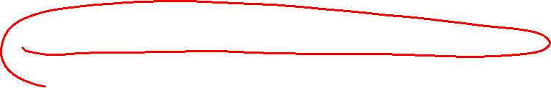
16.4.1 Cyber Operations That Use Communications Infrastructure in Neutral States.
[This is inherent in the structure of the Internet.]
. . . The use of communications infrastructure in neutral States may be implicated under the general rule that neutral territory may not serve as a base of operations for one belligerent against another. In particular, belligerent States are prohibited from erecting on the territory of a neutral State any apparatus for the purpose of communicating with belligerent forces on land or sea, or from using any installation of this kind established by them before the armed conflict on the territory of a neutral State for purely military purposes, and which has not been opened for the service of public messages.
However, merely relaying information through neutral communications infrastructure (provided that the facilities are made available impartially) generally would not constitute a violation of the law of neutrality that belligerent States would have an obligation to refrain from and that a neutral State would have an obligation to prevent. . . .

Slide 89
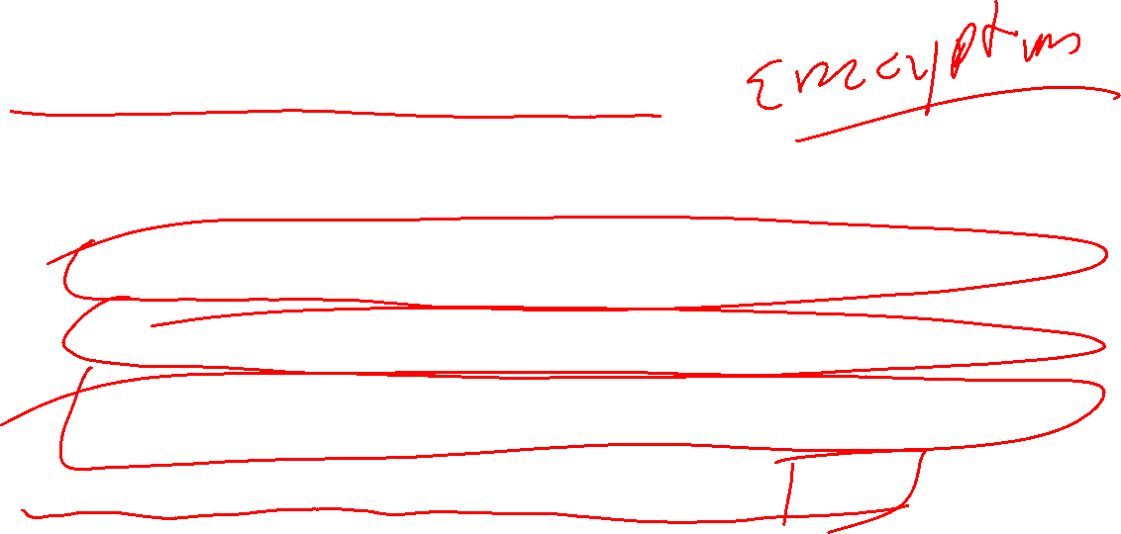
Domestic Cyber Operations
Congress has not been successful in passing a comprehensive cybersecurity bill.
  Industry opposition because of concerns about government intrusion into private networks.
  Civil libertarian opposition because of pressure to put backdoors in networks and encryption schemes.
  Both are also concerned that the government cannot get information away from hackers and thus do not want any special access or control by government agencies.
Cybersecurity and Infrastructure Security Agency (CISA)
  Deals with hacks, ransomware, and other non-espionage cyber attacks.
  Currently working on rules for reporting and responding to attacks.

Slide 90

Social Media, New Media, and the Information War
The Section 230 of the 1996 Communications Decency Act case before the SC deals with whether social media provided material support to terrorists through their algorithmic delivery of Isis posts.
  5 Justices could end the internet as we know it.
Where does disinformation fit into the law of war?
  Russian meddling with US elections.
What data is available through social media?
How can it be used for disinformation?
What are other social media, smart phone, etc. issues?

