Slide 1
Chapter 19 – Covert Actions

Slide 2
Learning Objectives
Covert actions are foreign actions, unconstrainted by the Constitution or domestic law.
Historically, Congress did not constrain covert actions.
The Intelligence Authorization Act of 1991 requires reporting covert actions to congress, limiting plausible deniability.
Enforcement of Congressional limitations is still limited.
The CIA is tasked with covert actions, but the military is also used.
Work was increasingly pushed to private contractors, which are outside of the government and military command and control structure.
Standing and extraterritoriality makes it difficulty for individuals and NGOs to challenge covert actions in court.

Slide 3
CURTAILING PRIVATE MILITARY ACTIONS

Slide 4
Neutrality Act of 1794
Whoever, within the United States, knowingly begins or sets on foot or provides or prepares a means for or furnishes the money for, or takes part in, any military or naval expedition or enterprise to be carried on from thence against the territory or dominion of any foreign prince or state, or of any colony, district, or people with whom the United States is at peace, shall be fined under this title or imprisoned not more than three years, or both.

Slide 5
Jefferson on the Neutrality Act
If one citizen has a right to go to war of his own authority, every citizen has the same. If every citizen has that right, then the nation (which is composed of all its citizens) has a right to go to war, by the authority of its individual citizens. But this is not true either on the general principles of society, or by our Constitution, which gives that power to Congress alone and not to the citizens individually. (not in the book)

Slide 6

US v. Terrell, 731 F.Supp 473 (1989)
Prosecution based on the Neutrality Act, for shipping arms to the Contras.
The court dismissed an argument that United States was “at peace” with Nicaragua within the meaning of the Act as “absurd,” given the “unceasing efforts of the executive branch to support the Contra cause”
Does this mean that the Act never applies to US backed private armies because they end the peace?

Slide 7

Logan Act - 18 U.S. Code § 953. (1799)
Any citizen of the United States, wherever he may be, who, without authority of the United States, directly or indirectly commences or carries on any correspondence or intercourse with any foreign government or any officer or agent thereof, with intent to influence the measures or conduct of any foreign government or of any officer or agent thereof, in relation to any disputes or controversies with the United States, or to defeat the measures of the United States, shall be fined under this title or imprisoned not more than three years, or both. …

Slide 8
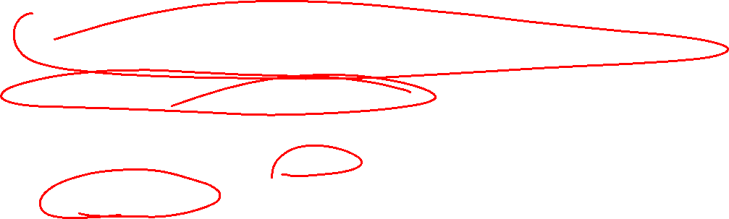
The History of the Logan Act
Could this have been used against Jane Fonda in the Vietnam War?
The 47 Senators who wrote to Iran warning it not to make a deal with Obama?
Most international lobbying firms?
Has the law been enforced?
  Last indictment was 1803!
  Desuetude – the implicit repeal of criminal laws through disuse.
What are the 1st amendment issues under modern Supreme Court precedent?

Slide 9
AUTHORITY FOR EARLY CIA COVERT OPERATIONS

Slide 10
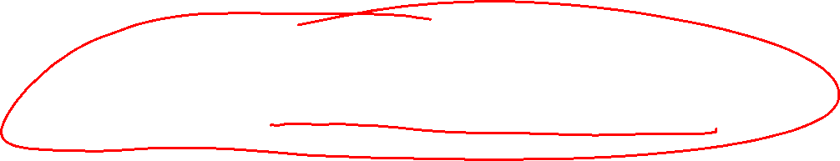
National Security Act of 1947
‘‘perform such other functions and duties related to intelligence affecting the national security as the President or the Director of National Intelligence may direct,’’
  50 U.S.C. §403-4a(d)(4)

Slide 11
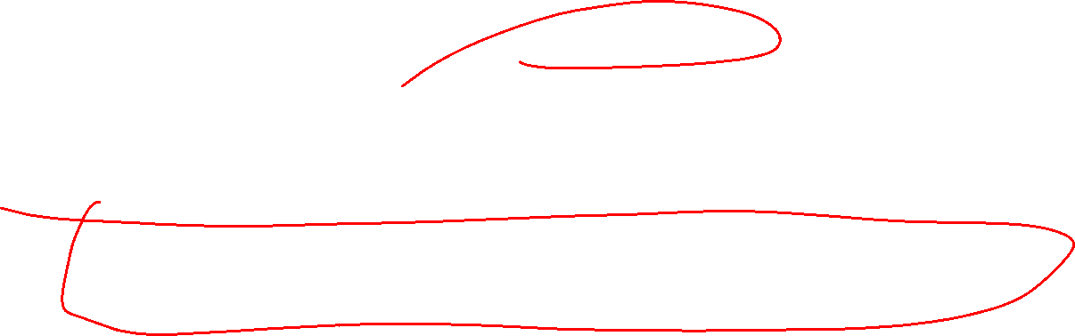
Why is it Hard to Know What Covert Action Meant in 1947?
Finally, the contemporary term ‘‘covert action’’ had no clearly understood forebear in 1947. While the terms ‘‘operational activities,’’ ‘‘special operations,’’ and ‘‘direct activities’’ were all used, they were employed to refer to secret collection of intelligence as well as to covert action.
Why might the formal congressional record not be an accurate picture of whether congress intended for the CIA to carry out cover actions?
  They wanted to keep it secret

Slide 12
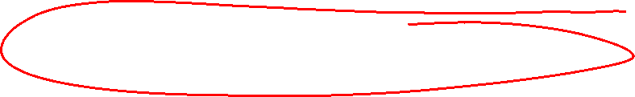
What did the CIA General Counsel Say in 1947?
Taken out of context and without knowledge of its history, these Sections could bear almost unlimited interpretation, provided that the services performed could be shown to be of benefit to an intelligence agency or related to national intelligence. …
In our opinion, however, either activity would be an unwarranted extension of the functions authorized in Sections [§3036d(4)]. This is based on our understanding of the intent of Congress at the time these provisions were enacted.
What else would the Counsel say in public?

Slide 13

Annex NSC-4[/]A, Adopted by the NSC at its First Meeting
NSC-4[/]A, which empowered the Secretary of State to coordinate information activities designed to counter communism. A top secret annex took cognizance of the ‘‘vicious psychological efforts of the USSR, its satellite countries, and Communist groups to discredit and defeat the activities of the U.S. and other Western powers.’’ The NSC determined that ‘‘in the interests of world peace and U.S. national security the foreign information activities of the U.S. government must be supplemented by covert psychological operations”

Slide 14

NSC-10/2, Which Superseded NSC-4[/]A
The CIA was authorized to undertake economic warfare, sabotage, subversion against hostile states (including assistance to guerrilla and refugee liberation groups), and support of indigenous anti-communist elements in threatened countries. . . .

Slide 15
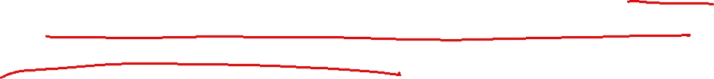
Office of Special Projects (OSP)
[U]nder the authority of 50 U.S.C. §[403-4a(d)(4)], the NSC ordered the establishment in CIA of the Office of Special Projects (OSP), to conduct covert action. The Chief of OSP was to receive policy guidance from the Secretary of State and the Secretary of Defense. OSP (later, OPC) [Office of Policy Coordination] was to operate independently of all components of the CIA to the maximum degree consistent with efficiency.

Slide 16

Expanding Covert Actions during the Cold War – From a 1954 Report
It is now clear that we are facing an implacable enemy whose avowed objective is world domination by whatever means and at whatever cost. There are no rules in such a game. Hitherto acceptable norms of human conduct do not apply. If the U.S. is to survive, longstanding American concepts of ''fair play'' must be reconsidered. We must develop effective espionage and counterespionage services and must learn to subvert, sabotage, and destroy our enemies by more clever, more sophisticated, and more effective methods than those used against us. It may become necessary that the American people be made acquainted with, understand and support this fundamentally repugnant philosophy. [Quoted in Church Comm. Rep., supra p. 478, bk. I, at 50.]

Slide 17
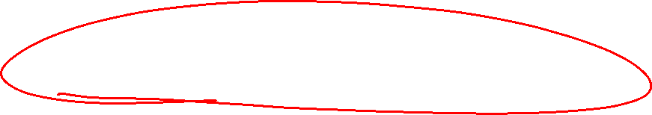
Covert Actions in Cuba

Slide 18
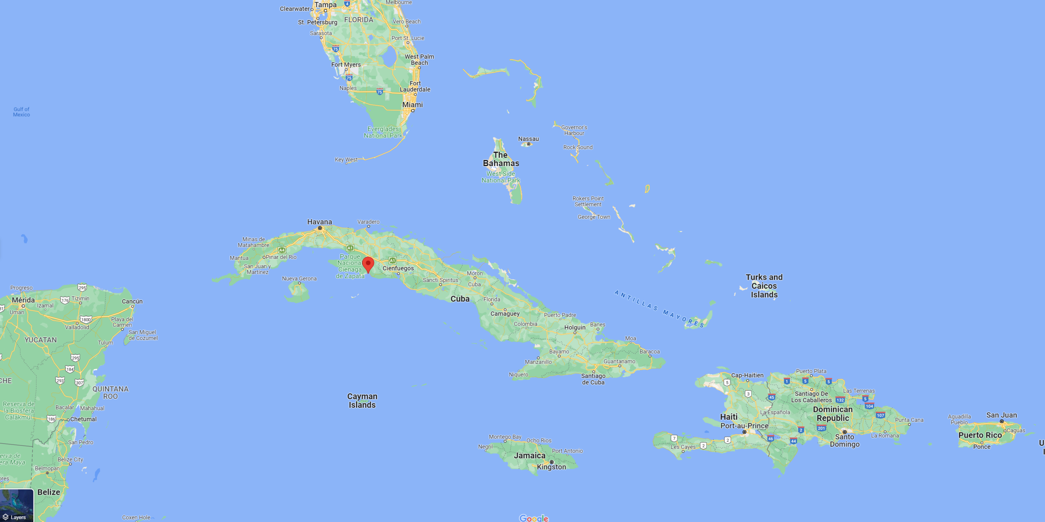
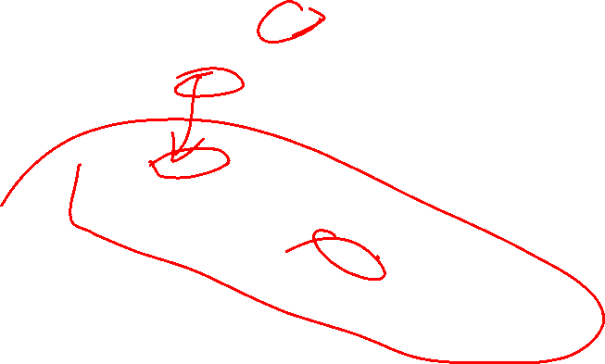

Slide 19
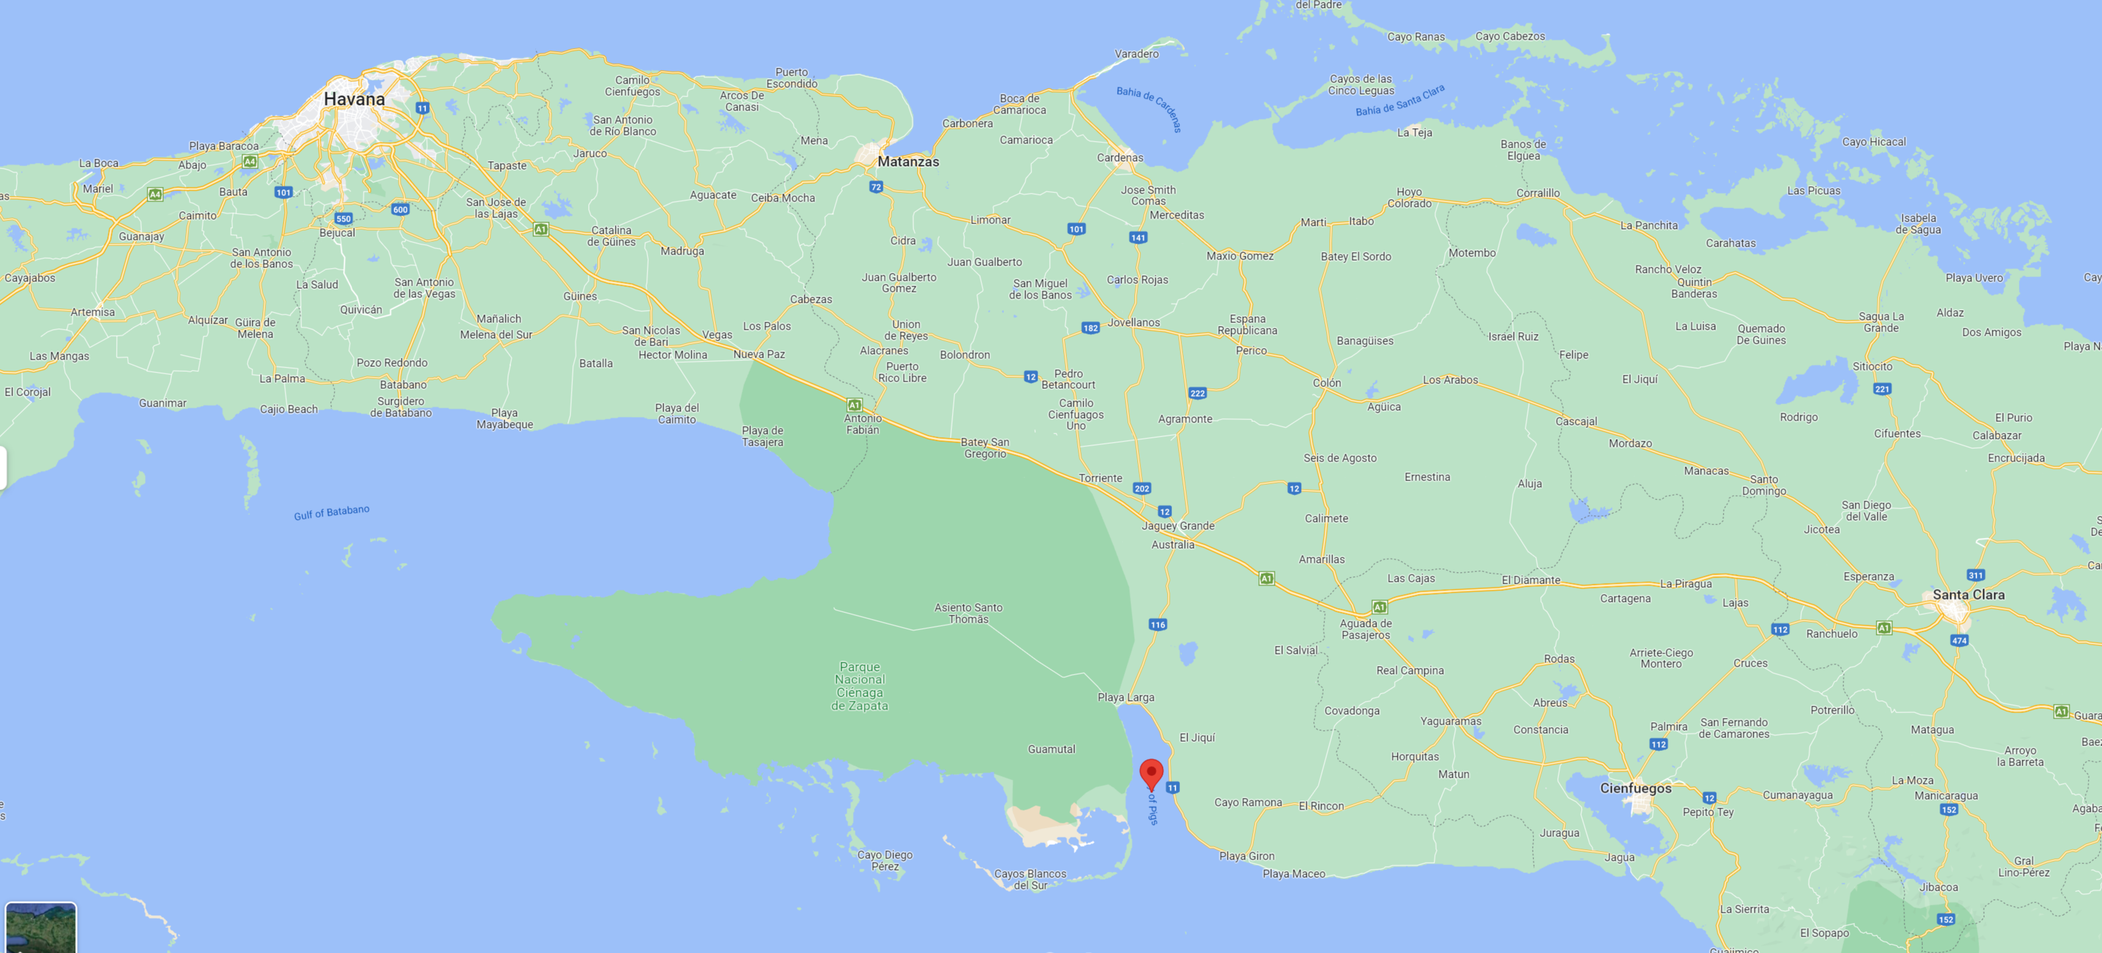
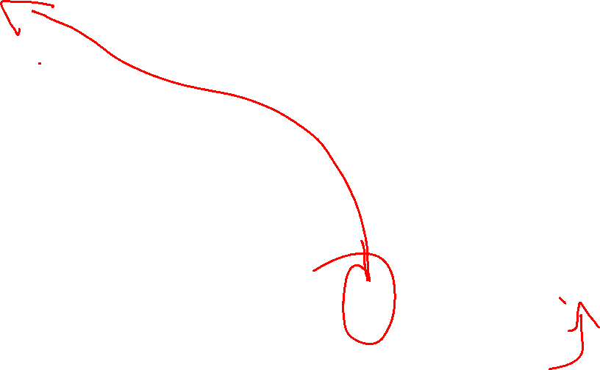

Slide 20
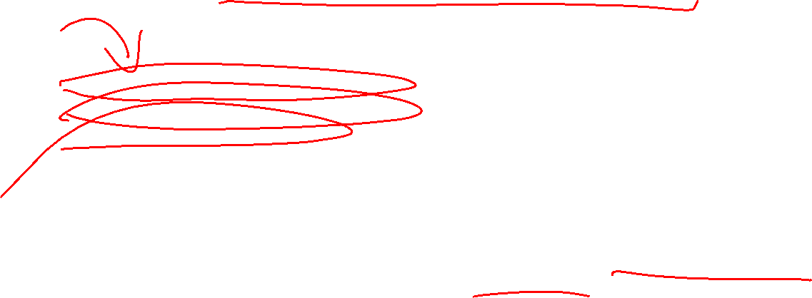
The Bay of Pigs (April 1961)
Richard M. Nixon proposed it
Dwight D. Eisenhower planned it
Robert F. Kennedy championed it
John F. Kennedy approved it
The CIA carried it out
1,197 invaders were captured
200 of them had been soldiers in Batista's army (14 of those were wanted for murder in Cuba)
One CIA soldier fired the first shot
A volunteer teacher was the first Cuban casualty
4 American pilots and over 100 Cuban invaders were killed in battle
1,400 Cuban invaders felt betrayed by their sponsor
One U.S. president was embarrassed in front of the world
Leads to Cuban missile crisis, October 1962.
  Last major threat of nuclear war??
CIA Motto - “Killing Castro for Fifty Years”
Did it get Kennedy assassinated?

Slide 21

Bay of Pigs – Legal Issues
Why Cuban nationals and not US soldiers?
What about using aircraft painted to look like Cuban air force planes to bomb Cuban airports?
Was this a United Nations issue?
  What does that not matter?
One of the major newspapers had the information before the invasion but sat on it at the government’s request.
  Kennedy later quipped that he would have been better off if they had printed it and stopped the invasion.

Slide 22

Outsourcing War: The Secret War in Laos
1962 Geneva agreements “neutralized” Laos and required all “foreign military personnel” to leave the country.
Director of Central Intelligence (DCI) William Colby organized L’Armée Clandestine.
Tens of thousands of Hmong and other tribesmen were recruited for the CIA’s private army. 20,000 were U.S.-paid “volunteers” Thai army
By 1969 the private Air America fleet had 29 helicopters, 20 light planes, and 19 medium transport planes.
  What else might Air American be transporting to pay the bills?
The U.S. Air Force role grew to 100 fighter-bombers and supporting gunships.
Did not become public or known to Congress until 1969, as it was winding down.

Slide 23
Congressional Oversight

Slide 24
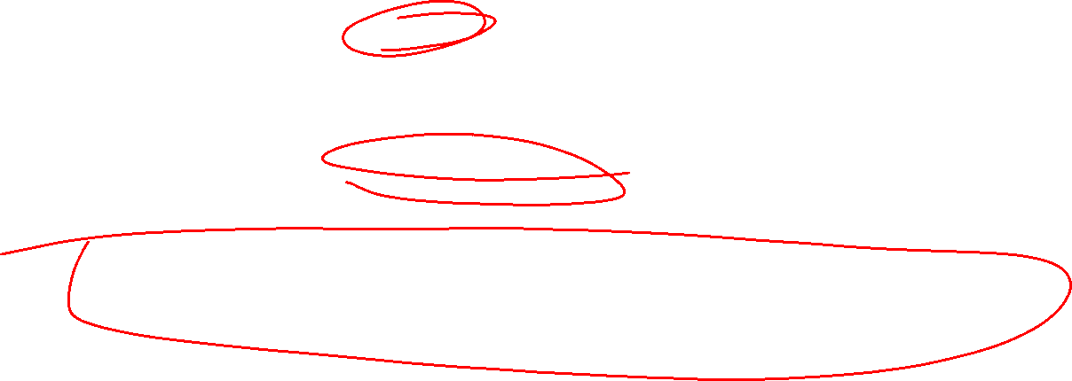
1947 Through Vietnam
Archetypical “good old boy” organization.
Ivy league universities and old money networks.
Cozy personal relationships with influential congressional members.
Mostly based on “plausible deniability”
  Don’t ask, we won’t tell
This extended to not questioning the many CIA failures, especially in the USSR, China, and Cuba.

Slide 25
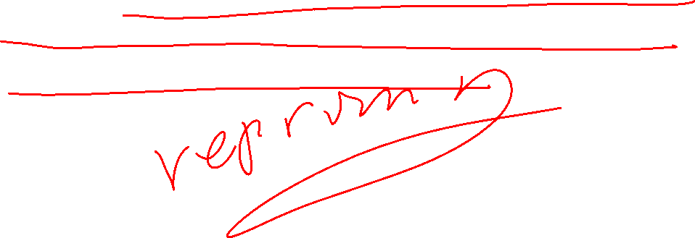
The CIA Budget – Exemption from Rules on Using Public Funds
The 1949 Central Intelligence Agency Act grants expansive authority to the CIA concerning the transfer and use of public funds. The Act states that sums made available to the CIA “may be expended without regard to the provisions of law and regulations relating to the expenditure of Government funds.”

Slide 26
The CIA Budget – Transfer from Other Agencies by OMB
Moreover, instead of direct appropriations to the CIA, the 1949 Act authorizes the Agency to transfer to and receive from other government agencies “such sums as may be approved” by the Office of Management and Budget (OMB) for any of the functions or activities authorized by the National Security Act of 1947. Other agencies are also permitted to transfer or receive from the CIA such sums “without regard to any provisions of law limiting or prohibiting transfers between appropriations.”
Thus, funds for the intelligence community are first concealed in various inflated appropriation bills and then secretly transferred by OMB to the intelligence agencies after the bills are enacted.

Slide 27
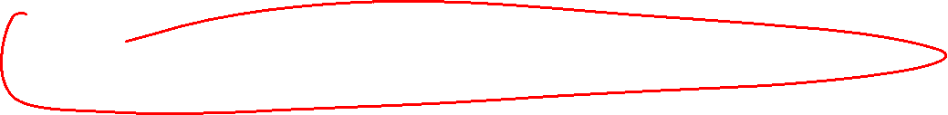
United States v. Richardson, 418 U.S. 166 (1974)
The Statement and Account Clause
  ‘No Money shall be drawn from the Treasury, but in Consequence of Appropriations made by Law; and a regular Statement and Account of the Receipts and Expenditures of all public Money shall be published from time to time.’
Richardson asked the Treasury Department to give an accounting of the money spent by the CIA. He then sued, asking for an accounting.
The lower court found that Richardson had standing to request an accounting.

Slide 28
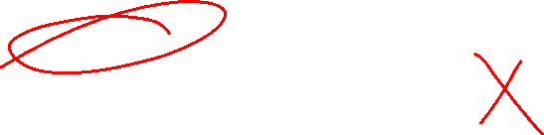
The Taxpayer Standing Problem
Taxpayers can get standing if the government is spending money unconstitutionally – Flast.
  This was pretty much limited to establishment clause cases, and I would not bet on those precedents today.
Taxpayers cannot get standing to complain about government policy.

Slide 29
Richardson at the United States Supreme Court
The court found that he did not have standing because he was not complaining of unconstitutional spending.
As dicta: it is clear that Congress has plenary power to exact any reporting and accounting it considers appropriate in the public interest. It is therefore open to serious question whether the Framers of the Constitution ever imagined that general directives to the Congress or the Executive would be subject to enforcement by an individual citizen. …historical analysis of the genesis of cl. 7 suggests that it was intended to permit some degree of secrecy of governmental operations.

Slide 30
CIA Activities in Chile
At the direction of the White House and interagency policy coordination committees, CIA undertook : : : sustained propaganda efforts, including financial support for major news media, against Allende and other Marxists.
President Nixon instructed Helms and the CIA not to inform the 40 Committee (then the executive decision-making body on covert operations), the State or Defense Departments, or the ambassador in Santiago. Staff of the S. Select Comm. to Study Governmental Operations with Respect to Intelligence Activities,
Support for Coup in 1970.
Awareness of Coup Plotting in 1973. Because CIA did not discourage the takeover and had sought to instigate a coup in 1970—probably appeared to condone it.

Slide 31
What was the Effect on Congress?
CIA covert actions in Chile during the 1960s and early 1970s, designed to discredit left-leaning political leaders and to prevent them from assuming power, along with Watergate and the Southeast Asia war, all served to focus public attention on the CIA and crystalize congressional determination to investigate intelligence abuses.
This leads to the War Powers Resolution and the Hughes Ryan Amendment, discussed in a previous chapter.
For this discussion, the key is that both impose a reporting requirement on the President for sending in troops and for covert actions by the CIA that go beyond intelligence gathering.

Slide 32
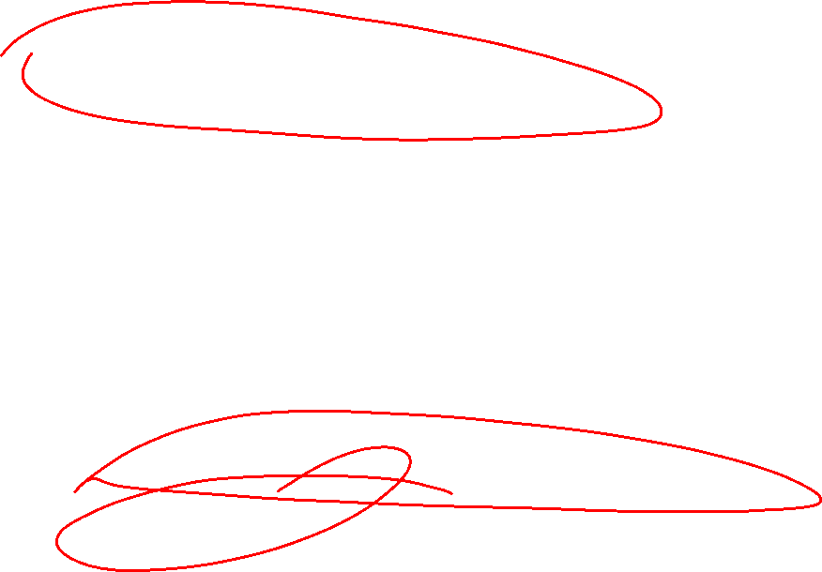
‘‘Plausible Deniability’’
How can plausible deniability let subordinates hijack policy?
How does the Hughes-Ryan Amendment try to end plausible deniability, as well as don’t ask, don’t tell for Congressional oversight?
  What does this tell us about question of whether CIA is authorized to carry out covert actions?
The core problem is the limited the recourse if the president does not comply with this law.
  Cut off funding, which can be politically difficult
  Impeach the president.

Slide 33
Iran-Contra

Slide 34
Hostage taking in Lebanon Starts the Story
The US Embassy Hostages in Iran as Backdrop
  Carter negotiated the release of the hostages, with part of the deal being the basis for Dames v. Moore, which we discussed in an earlier chapter.
  Reagan saw the hostages as fatally weakening the Carter presidency.
US hostages, along those from other countries, were taken in Lebanon early in Reagan’s presidency.
  This upset Reagan personally and was bad political publicity.
Other countries were negotiating deals to ransom their hostages, but Reagan took a no-negotiating with terrorist's position.

Slide 35
Iran and Iraq
The CIA helped install the Shah of Iran and he was a close ally of the US
The US had a long and mostly hostile relationship with Iraq prior to 1980, driven by Cold War politics.
After the fall of the Shah and ensuing turmoil, Iraq invaded Iran in 1980, leading to a long, bloody war.
The enemy of our enemy is our friend.
  At this point, Iraq and Saddam Hussein became great friends of the US, and the US poured arms and support into Iraq.
  About the same time the Soviet Union invades Afghanistan, starting a long process of the US effectively creating and arming what becomes the Taliban to fight the Soviets.

Slide 36

Nicaragua
US Marines stabilize US friendly government from 1912-1933.
  Opposed by rebel leader, Augusto C. Sandino
In 1933, Sandino is part of a three-way government with Somoza
Somoza kills Sandino and his Somoza’s family rules until forced out by Sandinista rebels in 1979
US opposes Sandinistas, supporting Contra rebels, even after Sandinistas are elected in 1984
Sandinistas lose elections in 1990 and are out of power until they win again in 2006.
They have been in power since 2007 and have become a tyrannical government.

Slide 37
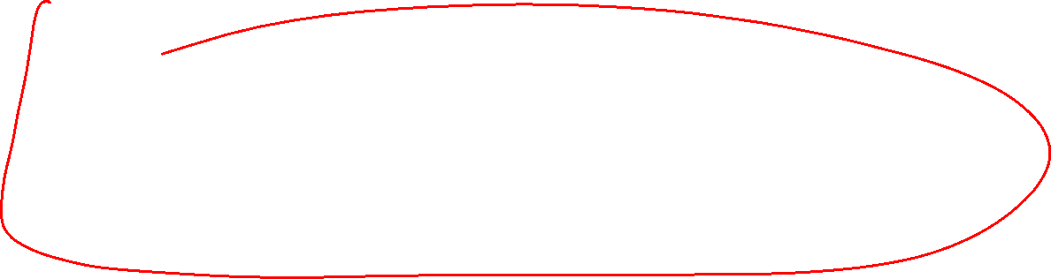
Congressional Politics and Nicaragua
This is a few years after the Church Committee has documented a long history of abuses by the CIA, including involvement in coups and assassinations in South and Central America.
Nicaragua has deposed a long-time dictator and installed an elected government, if hostile to the US.

Slide 38
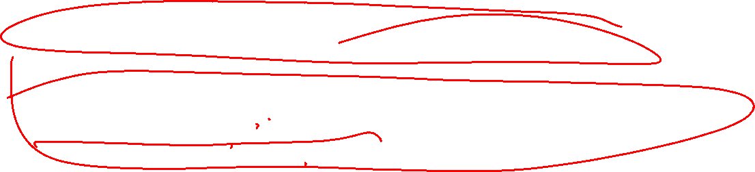
The Contra Finding
What finding did Regan make on 1 Dec 1981 and convey to the Congressional intelligence committees?
  authorized the CIA to ‘‘[s]upport and conduct . . . paramilitary operations against the Cuban presence and Cuban Sandinista support infrastructure in Nicaragua and elsewhere in Central America.’’
[The Soviet Union was still supporting Cuba at this point]
What was the stated purpose of this finding?
  ...interdiction of arms shipments from Nicaragua to the leftist insurgents in El Salvador...
  [this was not well-supported]

Slide 39

Mining the Harbor of Managua, Nicaragua
Ignoring the Hughes-Ryan amendment, the CIA mines the harbor on Managua without the President notifying Congress.
This hits the news, leading to the Boland Amendment.
This also spawned the ICC case we read in an earlier chapter.

Slide 40
The Boland Amendment
[This is in the budget bill, and Regan was unwilling to shutdown the government over the Amendment.]
No appropriations or funds made available pursuant to this [authorization bill] to the Central Intelligence Agency, the Department of Defense, or any other agency or entity of the United States involved in intelligence activities may be obligated or expended for the purpose or which would have the effect of supporting, directly or indirectly, military or paramilitary operations in Nicaragua by any nation, group, organization, movement, or individual. [Pub. L. No. 98-473, §8066(a), 98 Stat. 1837, 1935 (1984).]

Slide 41
Iran as Intermediary with the Hostage Takers
Official policy is no negotiating with terrorists and no ransom.
It was OK to have a third-party country try to influence the hostage takers.
  If that includes money, just don’t tell us.
Iran is a position to be the intermediary, but it is our enemy, and we are supporting Iraq in its war against Iran.
What to do?

Slide 42
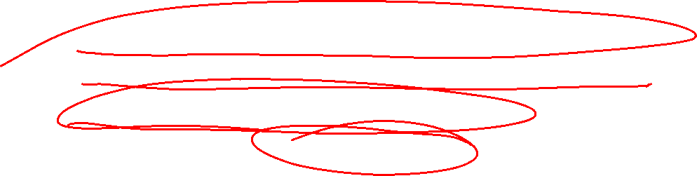
The Arms Deal
At first the US does not want to sell arms directly to Iran, so Israel is brought in as a broker.
  Israel wants to improve its relationship with the US.
Arms are transferred to Israel, who sells them to Iran.
Later the US sells arms directly to Iran.
  These go to “Iranian moderates”

Slide 43
Linking in the Contras
The Boland Amendment blocks the use of Congressional funds to support the Contras or to support the US forces supporting the Contras.
The arms deal with Iran is generating cash outside congressional appropriations, so why not use it to support the Contras?
  It was generally assumed that the Constitution does not allow the president to use funds outside of appropriations unless authorized by Congress.

Slide 44

Arms Export Control Act
What does the AECA require before foreign arms sales?
  the transfer ‘‘will strengthen the security of the United States and promote world peace,’’ and unless the transferee agrees in writing not to further transfer the items without obtaining the consent of the President.
  Reagan only gave oral approval and did not notify Congress
The AECA forbids transfer to states involved with international terrorism, such as Iran, unless the President makes a specific finding that the sale is necessary for national security and notifies Congress.
  This finding was not shared with Congress.

Slide 45

Interpreting Boland
The ambiguities
  First, does the language ‘‘any other agency or entity’’ cover only agencies traditionally involved in intelligence operations, or does it also apply to any entity that is actually so involved?
  Second, does ‘‘involved’’ encompass indirect support?
  Third, does the phrase ‘‘no funds available’’ apply only to the then-current DOD appropriation or to all government funds?
The core problem is the Appropriations Clause, as we discussed in a previous chapter.

Slide 46
Dealing with the Boland Amendment
What are the arguments that the Boland Amendment is unconstitutional?
Does this affect the Appropriations Clause problem?
  Before the arms for hostages deal, the administration was seeking donations from wealthy individuals and other countries to fund the Contras.
  Secretary of State Schultz reported to the President that the White House Chief of Staff believed that it would be an impeachable offense to funnel third-party money to the Contras.
Had this just been a fight over misappropriated government money, it would have, at best, resulted in an injunction as with the fight over the border fence funding.

Slide 47
The Iran-Contra Affair in the Courts

Slide 48
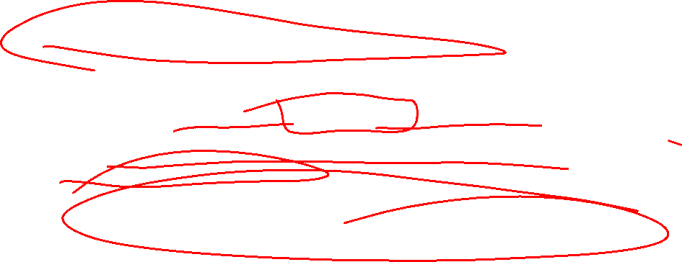
The Independent Counsel
The attorney general (Meese) requested an independent counsel
Judge Lawrence Walsh was appointed
Became a huge project
Indicted Poindexter, Oliver North, Secord, and Hakim
  Conspiracy to violate the Boland Amendment
  Obstruction of justice
  Money crimes related to improper expenditures

Slide 49
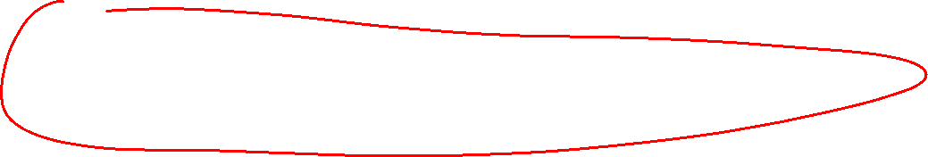
Problems with the Prosecutions
Complicated because the defendants had been granted immunity by Congress so they would testify before congressional committees.
  Did Congress intend to stop the prosecution by granting immunity?
  Is it better to have the hearing or a conviction?
The White House refused to turn over classified documents requested by North's attorneys, resulting in the dismissal of most of the money crimes.

Slide 50
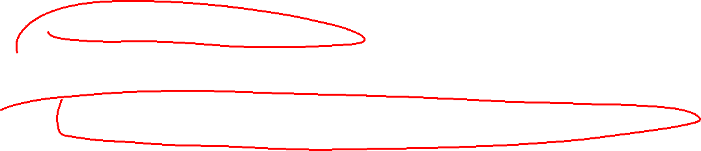
The President's Involvement
What did Reagan say about what he knew and authorized?
  That he did not remember.
  Why did this defuse the impeachment issue?
What was later support for this position?
  His Alzheimer's Disease was publicly disclosed after he left the White House.
If there are no presidential findings, where does this leave the legal status of these activities, even if they might have been legal with presidential findings?
  This does not affect the Appropriations Clause issue and the criminal activities around arms transfers.

Slide 51
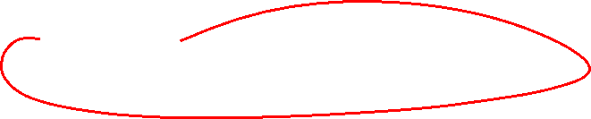
The Outcomes
North and Poindexter were convicted
  The convictions were thrown out on appeal because they depended in part on immunized testimony
  The independent counsel did not re-prosecute, finding it impossible to prove the case without running into immunity.
McFarlane pleaded guilty to misdemeanor charges of withholding information from Congress. He was pardoned by Bush I.
Casper Weinberger was pardoned, foreclosing trial.
Six were pardoned, 5 after convictions.

Slide 52
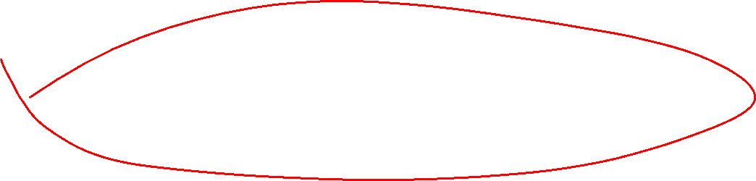
Intelligence Authorization Act of 1991
Replaces the Hughes-Ryan Amendment

Slide 53
§3091. GENERAL CONGRESSIONAL OVERSIGHT PROVISIONS
(a)(1) The President shall ensure that the congressional intelligence committees are kept fully and currently informed of the intelligence activities of the United States, including any significant anticipated intelligence activity as required by this subchapter.
(2) Nothing in this subchapter shall be construed as requiring the approval of the congressional intelligence committees as a condition precedent to the initiation of any significant anticipated intelligence activity.

Slide 54

(b) The President shall ensure that any illegal intelligence activity is reported promptly to the intelligence committees, as well as any corrective action that has been taken or is planned in connection with such illegal activity. …
(e) Nothing in this chapter shall be construed as authority to withhold information from the congressional intelligence committees on the grounds that providing the information to the congressional intelligence committees would constitute the unauthorized disclosure of classified information or information relating to intelligence sources and methods.
(f) As used in this section, the term “intelligence activities” includes covert actions as defined in section 3093(e) of this title, and includes financial intelligence activities.

Slide 55

3092. REPORTING OF INTELLIGENCE ACTIVITIES OTHER THAN COVERT ACTIONS
(a) To the extent consistent with due regard for the protection from unauthorized disclosure of classified information relating to sensitive intelligence sources and methods or other exceptionally sensitive matters, the Director of National Intelligence and the heads of all departments, agencies, and other entities of the United States Government involved in intelligence activities shall—

Slide 56
  (1) keep the congressional intelligence committees fully and currently informed of all intelligence activities, other than a covert action (as defined in section 3093(e) of this title), which are the responsibility of, are engaged in by, or are carried out for or on behalf of, any department, agency, or entity of the United States Government, including any significant anticipated intelligence activity and any significant intelligence failure; and
  (2) furnish the congressional intelligence committees any information or material concerning intelligence activities (including the legal basis under which the intelligence activity is being or was conducted), other than covert actions, which is within their custody or control, and which is requested by either of the congressional intelligence committees in order to carry out its authorized responsibilities. . . .

Slide 57
§3093. PRESIDENTIAL APPROVAL AND REPORTING OF COVERT ACTIONS
(a) The President may not authorize the conduct of a covert action by departments, agencies, or entities of the United States Government unless the President determines such an action is necessary to support identifiable foreign policy objectives of the United States and is important to the national security of the United States, which determination shall be set forth in a finding that shall meet each of the following conditions:
  (1) Each finding shall be in writing, unless immediate action by the United States is required and time does not permit the preparation of a written finding, in which case a written record of the President’s decision shall be contemporaneously made and shall be reduced to a written finding as soon as possible but in no event more than 48 hours after the decision is made.
  (2) Except as permitted by paragraph (1), a finding may not authorize or sanction a covert action, or any aspect of any such action, which already has occurred.

Slide 58
§3093. PRESIDENTIAL APPROVAL AND REPORTING OF COVERT ACTIONS - continued
  (3) Each finding shall specify each department, agency, or entity of the United States Government authorized to fund or otherwise participate in any significant way in such action.
  Any employee, contractor, or contract agent of a department, agency, or entity of the United States Government other than the Central Intelligence Agency directed to participate in any way in a covert action shall be subject either to the policies and regulations of the Central Intelligence Agency, or to written policies or regulations adopted by such department, agency, or entity, to govern such participation.
  (4) Each finding shall specify whether it is contemplated that any third party which is not an element of, or a contractor or contract agent of, the United States Government, or is not otherwise subject to United States Government policies and regulations, will be used to fund or otherwise participate in any significant way in the covert action concerned, or be used to undertake the covert action concerned on behalf of the United States.
  (5) A finding may not authorize any action that would violate the Constitution or any statute of the United States.

Slide 59
§3093. PRESIDENTIAL APPROVAL AND REPORTING OF COVERT ACTIONS - continued
(b) To the extent consistent with due regard for the protection from unauthorized disclosure of classified information relating to sensitive intelligence sources and methods or other exceptionally sensitive matters, the Director of National Intelligence and the heads of all departments, agencies, and entities of the United States Government involved in a covert action—
  (1) shall keep the congressional intelligence committees fully and currently informed of all covert actions which are the responsibility of, are engaged in by, or are carried out for or on behalf of, any department, agency, or entity of the United States Government, including significant failures; and

Slide 60
§3093. PRESIDENTIAL APPROVAL AND REPORTING OF COVERT ACTIONS - continued
  (2) shall furnish to the congressional intelligence committees any information or material concerning covert actions (including the legal basis under which the covert action is being or was conducted) which is in the possession, custody, or control of any department, agency, or entity of the United States Government and which is requested by either of the congressional intelligence committees in order to carry out its authorized responsibilities.
(c)(1) The President shall ensure that any finding approved pursuant to subsection (a) shall be reported in writing to the congressional intelligence committees as soon as possible after such approval and before the initiation of the covert action authorized by the finding, except as otherwise provided in paragraph (2) and paragraph (3).
(2) If the President determines that it is essential to limit access to the finding to meet extraordinary circumstances affecting vital interests of the United States, the finding may be reported to the chairmen and ranking minority members of the congressional intelligence committees, the Speaker and minority leader of the House of Representatives, the majority and minority leaders of the Senate, and such other member or members of the congressional leadership as may be included by the President.
  [Gang of 8]

Slide 61
§3093. PRESIDENTIAL APPROVAL AND REPORTING OF COVERT ACTIONS - continued
(3) Whenever a finding is not reported pursuant to paragraph (1) or (2) of this [sub]section, the President shall fully inform the congressional intelligence committees in a timely fashion and shall provide a statement of the reasons for not giving prior notice.
(4) In a case under paragraph (1), (2), or (3), a copy of the finding, signed by the President, shall be provided to the chairman of each congressional intelligence committee.
(5)(A) When access to a finding, or a notification provided under subsection (d)(1), is limited to the Members of Congress specified in paragraph (2), a written statement of the reasons for limiting such access shall also be provided.
(B) Not later than 180 days after a statement of reasons is submitted in accordance with subparagraph (A) or this subparagraph, the President shall ensure that—
(i) all members of the congressional intelligence committees are provided access to the finding or notification; or
(ii) a statement of reasons that it is essential to continue to limit access to such finding or such notification to meet extraordinary circumstances affecting vital interests of the United States is submitted to the Members of Congress specified in paragraph (2).

Slide 62
§3093. PRESIDENTIAL APPROVAL AND REPORTING OF COVERT ACTIONS - continued
(d)(1) The President shall ensure that the congressional intelligence committees, or, if applicable, the Members of Congress specified in subsection (c)(2) [of this section,] are notified in writing of any significant change in a previously approved covert action, or any significant undertaking pursuant to a previously approved finding, in the same manner as findings are reported pursuant to subsection (c) of this section.
(2) In determining whether an activity constitutes a significant undertaking for purposes of paragraph (1), the President shall consider whether the activity—
  (A) involves significant risk of loss of life;
  (B) requires an expansion of existing authorities, including authorities relating to research, development, or operations;
  (C) results in the expenditure of significant funds or other resources;
  (D) requires notification under section 3094 of this title;
  (E) gives rise to a significant risk of disclosing intelligence sources or methods; or
  (F) presents a reasonably foreseeable risk of serious damage to the diplomatic relations of the United States if such activity were disclosed without authorization.

Slide 63
(Definition of Covert Action)§3093. PRESIDENTIAL APPROVAL AND REPORTING OF COVERT ACTIONS
(e) As used in this subchapter, the term “covert action” means an activity or activities of the United States Government to influence political, economic, or military conditions abroad, where it is intended that the role of the United States Government will not be apparent or acknowledged publicly, but does not include—
  (1) activities the primary purpose of which is to acquire intelligence, traditional counterintelligence activities, traditional activities to improve or maintain the operational security of United States Government programs, or administrative activities;
  (2) traditional diplomatic or military activities or routine support to such activities;
  (3) traditional law enforcement activities conducted by United States Government law enforcement agencies or routine support to such activities; or
  (4) activities to provide routine support to the overt activities (other than activities described in paragraph (1), (2), or (3)) of other United States Government agencies abroad.
(f) No covert action may be conducted which is intended to influence United States political processes, public opinion, policies, or media. …
(h) For each type of activity undertaken as part of a covert action, the President shall establish in writing a plan to respond to the unauthorized public disclosure of that type of activity.
Exclusions

Slide 64
§3094. FUNDING OF INTELLIGENCE ACTIVITIES . . .
(c) No funds appropriated for, or otherwise available to, any department, agency, or entity of the United States Government may be expended, or may be directed to be expended, for any covert action, as defined in section 3093(e), unless and until a Presidential finding required by subsection (a) of section 3093 has been signed or otherwise issued in accordance with that subsection.
(d)(1) Except as otherwise specifically provided by law, funds available to an intelligence agency that are not appropriated funds may be obligated or expended for an intelligence or intelligence-related activity only if those funds are used for activities reported to the appropriate congressional committees pursuant to procedures which identify—
  (A) the types of activities for which non-appropriated funds may be expended; and
  (B) the circumstances under which an activity must be reported as a significant anticipated intelligence activity before such funds can be expended.

Slide 65

Gang of Eight
If the President determines that it is “essential” to limit access to a covert action finding in order to “meet extraordinary circumstances affecting vital interests of the United States,” he may limit the notification of such a finding to the chairs and ranking minority members of the House and Senate intelligence committees, the Speaker and minority leader of the House of Representatives, and the majority and minority leaders of the Senate. These Members are colloquially known as the Gang of Eight.

Slide 66

Presidential Signing Statement
President George Bush I
  Several provisions in the Act requiring the disclosure of certain information to the Congress raise constitutional concerns. These provisions cannot be construed to detract from the President’s constitutional authority to withhold information the disclosure of which could significantly impair foreign relations, the national security, the deliberative processes of the Executive, or the performance of the Executive’s constitutional duties.

Slide 67
The Effect of Reporting to the Gang of Eight
Can the President report an action to the Gang of Eight, then publicly deny it?
What are the implications if a member of the Gang of Eight publicly calls the president out?
  Is this a rationale for not telling them?
What if the president notifies them of something that might be illegal, like torture?
  Are they approving it by not taking action?
  Feinstein did nothing about the report that detainees were being tortured, then tried to deny knowing about it.
We are still left with the enforcement problem if the president ignores the reporting requirements.

Slide 68

SPECIAL MILITARY OPERATIONS
[Who gets to do covert actions?]
No agency except the Central Intelligence Agency (or the Armed Forces of the United States in time of war declared by the Congress or during any period covered by a report from the President to the Congress consistent with the War Powers Resolution, Public Law 93-148) may conduct any covert action activity unless the President determines that another agency is more likely to achieve a particular objective.
Is this really a limit?

Slide 69

Problems Raised Special Military Actions by the Military
Military personnel are always covered by the uniform code of military justice
  the president cannot waive the coverage of the uniform code of military justice
Military personnel are subject to the chain of command, which can limit plausible deniability.
Military personnel caught carrying out covert operations in foreign countries are hard to disown by the government.
Military personnel out of uniform may lose Geneva Convention protection and can be treated as spies and saboteurs.

Slide 70

Paramilitary Forces
Nonmilitary, such as CIA
  Not subject to military chain of command
  Not subject to UCMJ
Usually also work with contractors and dirty assets
  Air America in Laos
Are still agents of the US under International law
  For what that is worth.
Do not get combatant status and can be tried as criminals or spies.

Slide 71
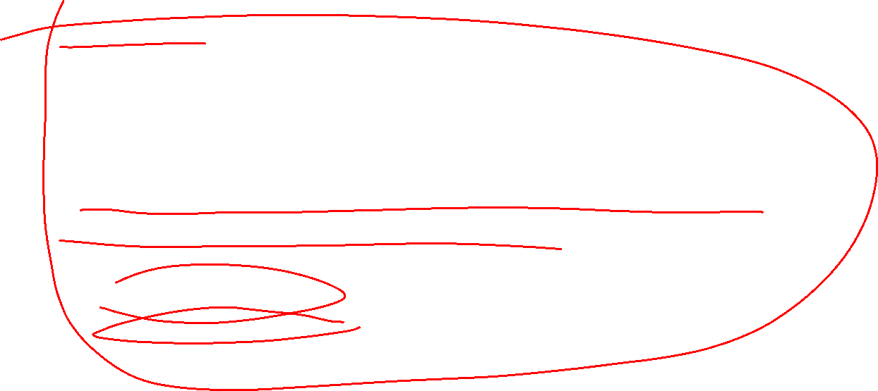
Dirty Assets
Is a foreign government employee working as a spy for the US a dirty asset?
What about working with international criminal organizations?
Why must intelligence agencies deal with dirty assets?
What are the accountability issues?
What are the risks?
  Double agents?
  Disinformation?
  Assassination?

Slide 72

Private Contractors
Brown and Root – Vietnam war
Bechtel – mostly engineering
Blackwater, rebranded as Xe Services and now Academi.
Limited accountability when on foreign shores
Bad for military morale
  Not subject to military control
  Paid much more than soldiers

Slide 73

Case Study: Nisour Square
Although Blackwater claimed that the convoy was ambushed and that its employees fired in self-defense, Iraqi and U.S. investigations found that at least 14 of the 17 deaths in Nisour Square that day were without cause. Nevertheless, the United States allowed Blackwater to continue operating in Iraq until January 2009, when a new U.S.-Iraq Status of Forces Agreement took effect.
In 2014, four Blackwater contractors were convicted of murder, manslaughter, and weapons violations. A fifth pleaded guilty to manslaughter. A civil action brought by six Nisour Square victims was settled in 2012 for an unannounced sum.
President Trump pardoned the four who were convicted.

Slide 74

What are Legitimate Roles for Contractors?
Congress has forbidden the use of contractors to perform “inherently governmental functions.”
  But with no limiting definition of inherently government function.
The U.S. government has exclusive responsibility for discretionary decisions concerning the appropriate, measured use of combat power. : : : Since combat operations authorized by the U.S. government entail the exercise of sovereign Government authority and involve substantial discretion—i.e., can significantly affect the life, liberty, or property of private persons or international relations—they are IG [inherently governmental]. : : : [U.S. Dep’t of Defense, DOD Instr. 1100.22, Policy and Procedures for Determining Workforce Mix 18 (Apr. 12, 2010).]
How about peace keeping after a military intervention, interrogation, and torture?

Slide 75

Legal Accountability for Contractors
Can be tried for violations of US by the DOJ.
Hard to sue them in the US for actions on foreign soil against foreign nationals.
Do not get prisoner of war protections and may be tried as criminals in the country they operate in.
  The US may not extradite them if they escape to the US.
Easy to cross the line to a criminal gang.

