Slide 1
What is Important to Remember?
The text, especially in the notes, gets deeply into the weeds with hypotheticals and special cases without well developed law.
This is meant to help you think about how to analyze these problems.
You do not need to memorize any of the detailed note materials.
For example, you should know the basics of NSLs and constitutional problem they posed before being amended.
You should know the basic difference between Section 215 collection and 702 collection, but you do not to know all the nuanced discussion of 215 or its history.

Slide 2
Chapter 24
THE COLLECTION AND USE OF THIRD-PARTY RECORDS

Slide 3
National Security Letters
A scary administrative subpoena for national security investigations.

Slide 5

National Security Letter – what does it cover
Duty to provide.—A wire or electronic communication service provider shall comply with a request for subscriber information and toll billing records information, or electronic communication transactional records in its custody or possession made by the Director of the Federal Bureau of Investigation under subsection (b) of this section.
(not the content of email, just metadata and business records.)

Slide 6

Who issues a NSL?
(b) Required certification.—The Director of the Federal Bureau of Investigation, or his designee in a position not lower than Deputy Assistant Director at Bureau headquarters or a Special Agent in Charge in a Bureau field office designate’d by the Director, may—

Slide 7

What does the Director have to Certify?
(1) … if the Director (or his designee) certifies in writing to the wire or electronic communication service provider to which the request is made that the name, address, length of service, and toll billing records sought are relevant to an authorized investigation to protect against international terrorism or clandestine intelligence activities,

Slide 8

Limitation of the purpose of an investigation
provided that such an investigation of a United States person is not conducted solely on the basis of activities protected by the first amendment to the Constitution of the United States. . . .

Slide 9

Limitations on disclosure by the recipient
(c) Prohibition of certain disclosure.—No wire or electronic communication service provider, or officer, employee, or agent thereof, shall disclose to any person that the Federal Bureau of Investigation has sought or obtained access to information or records under this section. . . .
Does this apply to the entity's lawyer?
Does that raise constitutional issues?

Slide 10
Doe v. Ashcroft (Doe I), 334 F. Supp. 2d 471 (2004)

Slide 11


Slide 12

Facts
Doe is an ISP, one of whose clients is the NYC ACLU.
  Which might have been a target – Doe still cannot say what the NSL asked for.
Doe receives an NSL asking for the statutorily defined account information.
Doe was to provide the requested records directly to an agent and not email them.
Doe did not comply and violated the NSL by calling the ACLU.

Slide 13

Alternative to NSL: Administrative Subpoenas
Remember – these do not require court approval.
Courts will enforce the subpoena as long as:
  (1) the agency’s investigation is being conducted pursuant to a legitimate purpose,
  (2) the inquiry is relevant to that purpose,
  (3) the information is not already within the agency’s possession, and
  (4) the proper procedures have been followed.
You can either go to court when you get the subpoena, or you can wait for the agency to go to court to enforce the subpoena.
  Before you contest the subpoena, be sure you do not have a duty to comply because you are in a regulated industry.

Slide 14

Alternative to NSL: Criminal Subpoenas
Does a judge have to make probable cause determinations before a criminal subpoena is issued?
  How do you get judicial review?
Why are the standards different from search warrants?
  How is the execution of the orders different?
  Why does this allow a different path for judicial review?

Slide 15

National Security Letters As Intimidation
[The court found] that hundreds of NSL requests were made during that period (2001 through January 2003). Because §2709 has been available to the FBI since 1986 (and its financial records counterpart in RFPA since 1978), the Court concludes that there must have been hundreds more NSLs issued in that long time span. The evidence suggests that, until now, none of those NSLs was ever challenged in any court. . . .

Slide 16

What is the implication of no one other than does challenging an NSL?
. . . The Court thus concludes that in practice NSLs are essentially unreviewable because, as explained, given the language and tone of the statute as carried into the NSL by the FBI, the recipient would consider himself, in virtually every case, obliged to comply, with no other option but to immediately obey and stay quiet.

Slide 17

Is §2709(c) a Prior Restraint?
First, axiomatically the categorical non-disclosure mandate embodied in §2709(c) functions as prior restraint because of the straightforward observation that it prohibits speech before the speech occurs. As the Supreme Court articulated the threshold inquiry: ‘‘The relevant question is whether the challenged regulation authorizes suppression of speech in advance of its expression.’’
There is a long discussion of the 1st Amendment restrictions on prior restraint of speech. You are not responsible for this material. We will revisit prior restraint in later chapters.

Slide 18
Fixing §2709(c)
The court found that it was unconstitutional to imply that a recipient of a national security letter cannot contact his or her lawyer.
These provisions were changed in a revision of the Patriot Act, mooting this case.
It is constitutional to prevent a recipient from talking to the public and reporters, so Doe is still very limited in what he can say about this case.

Slide 19
The Current Status of National Security Letters
Post 9/11 amendments have clarified national security letter law and provided substantial authority for national security letters.
See chart on p. 725.

Slide 20

Carpenter
There is a brief section of Carpenter that reviews our previous discussion that Carpenter does not intend to change general third party doctrine.
It does not change the availability of TP records with a subpoena.
Carpenter only affects records in which a person has a reasonable expectation of privacy.

Slide 21

Bulk Data Collection
This section deals with bulk data collected under Section 215 of FISA. Chapter 22 dealt with bulk data collected with a FISA warrant under 702.

Slide 22
ACLU v. Clapper, 785 F.3d 787 (2015)
This case does not reach the Constitutional issue of whether bulk collection is fundamentally different from the usual 3rd party exception from the warrant requirement.
It focuses on the use of a FISA warrant for bulk collection.
(215 is amended in 2015, likely because of the Snowden’s revelations. This case deals with the old version.)

Slide 23

What is Bulk Data in ACLU v. Clapper?
Unlike what is gleaned from the more traditional investigative practice of wiretapping, telephone metadata do not include the voice content of telephone conversations. Rather, they include details about telephone calls, including, for example, the length of a call, the phone number from which the call was made, and the phone number called. Metadata can also reveal the user or device making or receiving a call through unique “identity numbers” associated with the equipment (although the government maintains that the information collected does not include information about the identities or names of individuals), and provide information about the routing of a call through the telephone network, which can sometimes (although not always) convey information about a caller’s general location.

Slide 24

Section 215
§215 allows the Director of the FBI or his designee to make an application for an order requiring the production of any tangible things (including books, records, papers, documents, and other items) for an investigation to obtain foreign intelligence information not concerning a United States person or to protect against international terrorism or clandestine intelligence activities.

Slide 25

The Order
The order was classified and remained secret until leaked by Edward Snowden.
The order directed Verizon Business Network Services, Inc. (“Verizon”), a telephone company, to produce to the NSA “on an ongoing daily basis…all call detail records or ‘telephony metadata’ created by Verizon for communications (I) between the United States and abroad; or (ii) wholly within the United States, including local telephone calls.”

Slide 26

The Database
The NSA put all of the data into a database for later searching.
The data could be searched with specific identifiers, called seeds.
A seed, followed through several hops, could generate thousands of call detail records (CDRs).

Slide 27
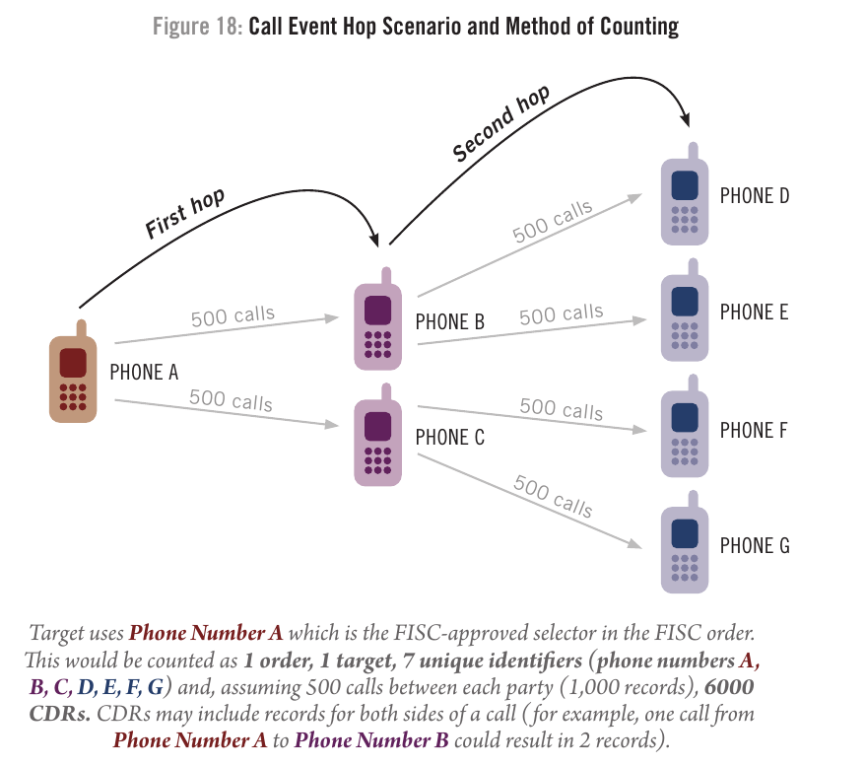

Call Event Hop Scenario and Method of Counting

Slide 28

The Legal Problem
50 U.S.C. §1861(a)(1). In its current form, the provision requires such an application to include a statement of facts showing that there are reasonable grounds to believe that the tangible things sought are relevant to an authorized investigation (other than a threat assessment) conducted in accordance with subsection (a)(2) of this section to obtain foreign intelligence information not concerning a United States person or to protect against international terrorism or clandestine intelligence activities

Slide 29
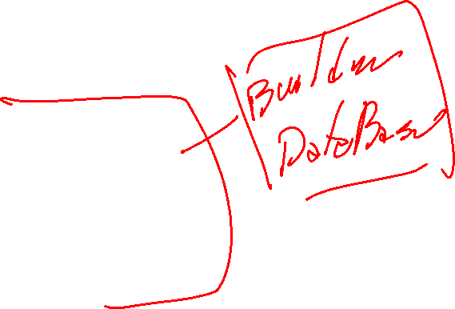
What are the Criteria for a Threat Assessment?
“After all, when conducting a threat assessment, FBI agents must have both a reason to conduct the inquiry and an articulable connection between the particular inquiry being made and the information being sought. The telephone metadata program, by contrast, seeks to compile data in advance of the need to conduct any inquiry (or even to examine the data), and is based on no evidence of any current connection between the data being sought and any existing inquiry.”

Slide 30

Rejecting the Order
The court found that Section 215 required some link to a defined investigation before the FISC could order collection.
Since the nature of bulk collection is to build a database for future searches, it cannot satisfy this requirement.
Interestingly, without Snowden’s leak, this program might still be going on.

Slide 31
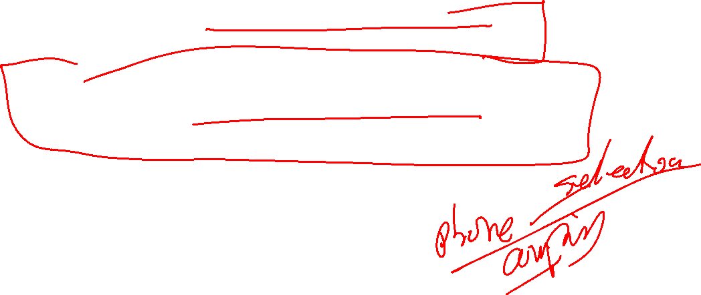
Tweaks
Obama limited search to three hops, but this didn’t solve the 215 question about relevance.
Congress amended the law to require that the phone companies hold the data, not the agency.
  This solves the collection problem.
Agencies then get a warrant to do targeted searches in the company data.

Slide 32

Current Status of the Program
The carriers holding the data has not worked out well.
The program has been suspended because of problems with carrier data.
Investigations of the program show that it has turned out very few leads.
Carpenter puts the constitutional basis in question.
Whatsapp and its ilk make the program irrelevant.
Section 215 sunsetted in 2020 and has not been renewed.

Slide 33

Access to Certain Business Records for Foreign Intelligence and International Terrorism Investigations 50 U.S.C. §1861 (2018)
A limited version of 215
This requires a more specific showing and provides more limits on collection.
The next question is whether Section 215 will be renewed.

Slide 34
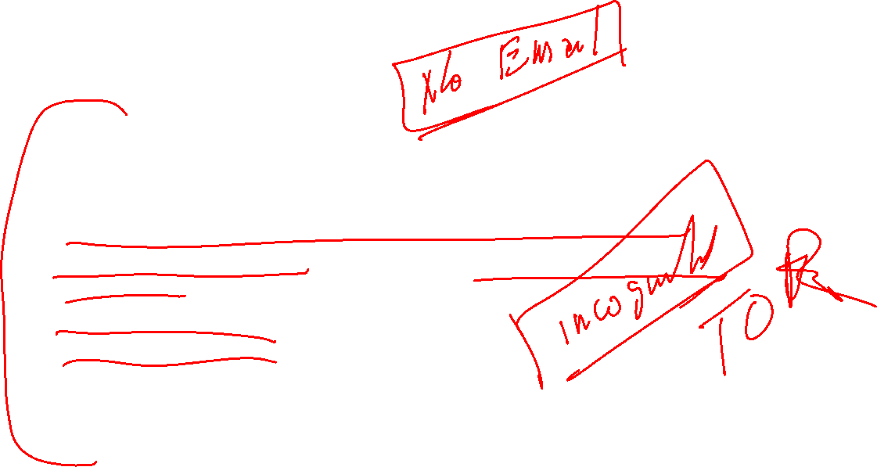
Data Mining
All of those records that are still considered classic third-party records and thus are available without a warrant.
Financial records, including credit card records
Store checkout records, including pharmacy checkout record.
Google searches
Social media data
What else can you think of?
What questions are posed by government access and searching of these records?

