Slide 1
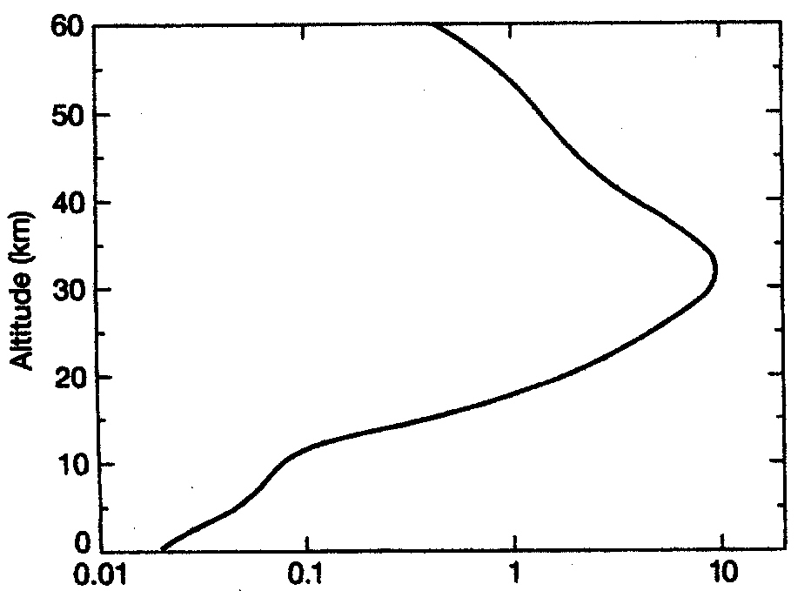
WHERE IS THE OZONE LAYER?
SGC
Fig. 3-11
Stratosphere
Ozone Concentration (ppm)
☺

Slide 2
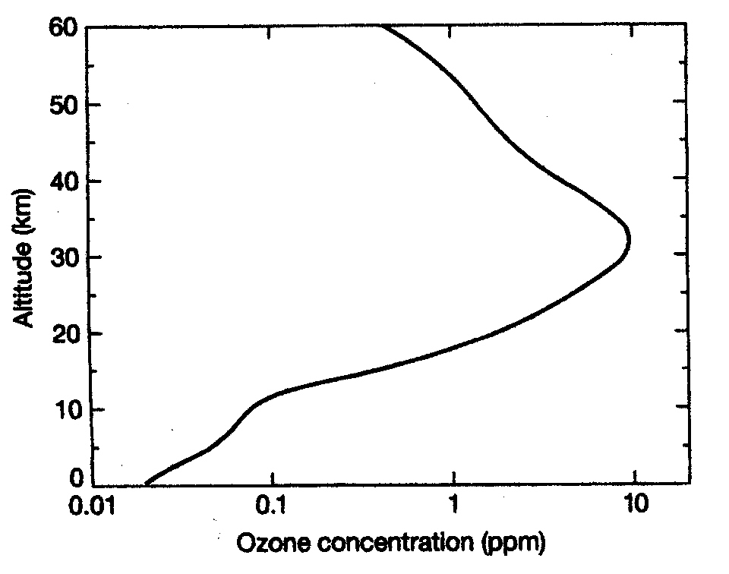
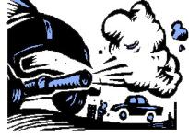
OZONE: Sources
Ozone is produced naturally in photochemical reactions in the stratospheric ozone layer --“good ozone” -- is decreasing!
However, ozone has increased in troposphere due to photochemical smog reactions -- “bad ozone”
review

Slide 3
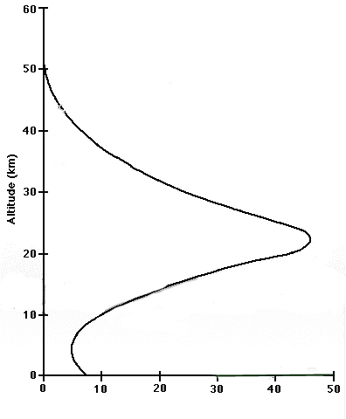
Here’s a different version of the figure ➔
Shows 2 peaks, a major peak in O₃ density in the stratosphere, a smaller secondary peak in the lower troposphere
Ozone Density
(10¹⁷ molecules / m³⁾
p 76

Slide 4
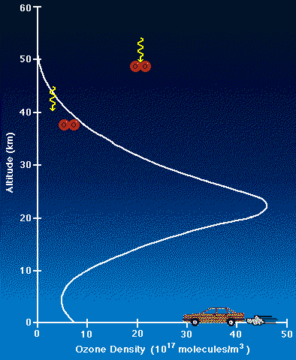
First we’ll focus on the “GOOD” ozone located
in the STRATOSPHERE (the ozone that is being depleted leading to an ozone “hole”)
Bulk of ozone produced
at ~ 25 km & drifts downward
22 km altitude peak ➔
Another lesser peak at ground level
☺

Slide 5
THE OZONE LAYER IN THE STRATOSPHERE --
WHY IT'S THERE
Due to: the natural
“Chapman Mechanism”
(a series of photochemical reactions)

Slide 6
THE CHAPMAN MECHANISM
(first proposed in 1930s)
ozone is continuously produced and destroyed
through PHOTOCHEMICAL REACTIONS in the stratosphere
involves oxygen (O₂), molecular oxygen (O), photons of UV radiation, and OZONE (O₃).
Key Concept

Slide 7

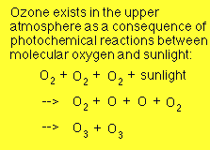
The Chapman Mechanism
O
O
O
O
O
O
+
+
O
O
O
O
O
O
O
O

Slide 8
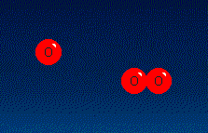
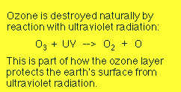

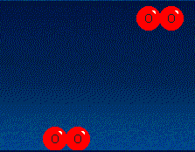
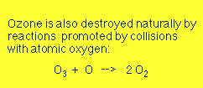
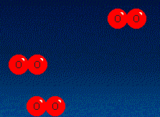

O
O
O
O
O
O
O
O
O
O
O
O
O
O

Slide 9
In theory:
a balance of ozone is established over time
> prevents much of the harmful UV radiation from reaching the earth's surface.
Leads to an “Equilibrium” or “Steady State”
Key Concept

Slide 10
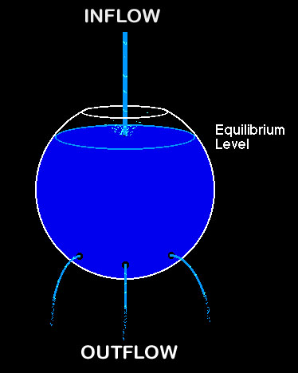
STEADY STATE =
a condition in which the STATE of a system component
(e.g. reservoir)
is CONSTANT
over time.

Slide 11

Steady state can be achieved
in a reservoir:
if there are no inflows or outflows, or
if the rate of inflow = the rate of outflow.
Any imbalance in these rates leads to a change in the level of the reservoir.

Slide 12
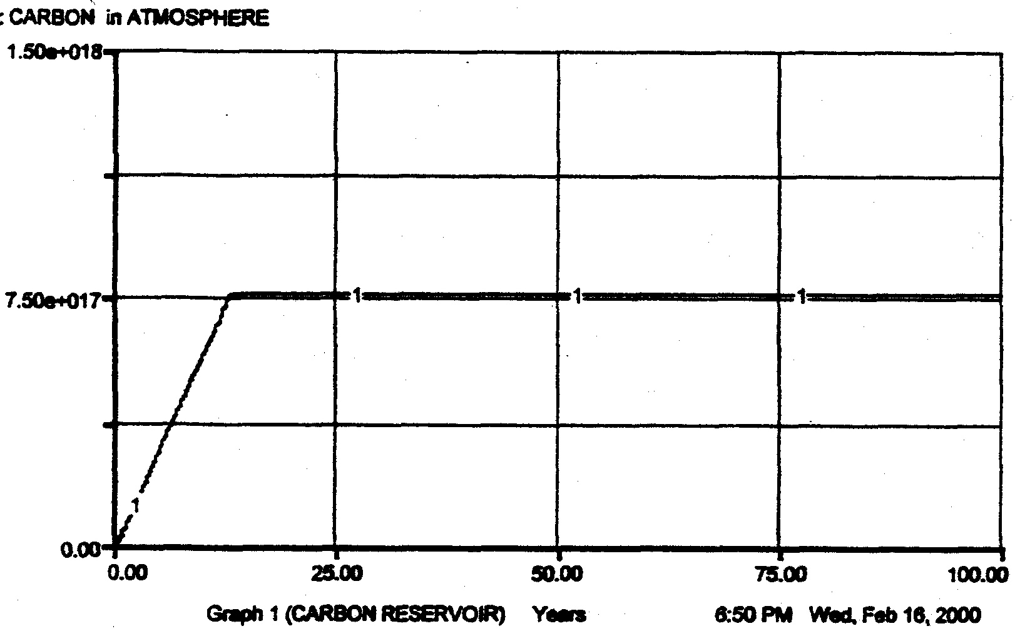
FLOW DIAGRAM
OF A STEADY STATE
Reservoir
of
STRATOSPHERIC
OZONE
Inflow
Ozone being formed via natural Chapman mechanism
Outflow
Ozone being destroyed via natural Chapman mechanism
Stratospheric ozone under steady state natural conditions
After an initial period of adjustment
a steady state is reached ➔ as a horizontal line
Ozone reservoir
☺

Slide 13
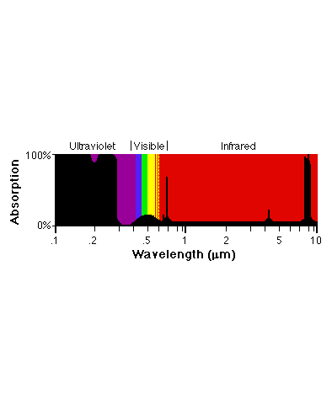
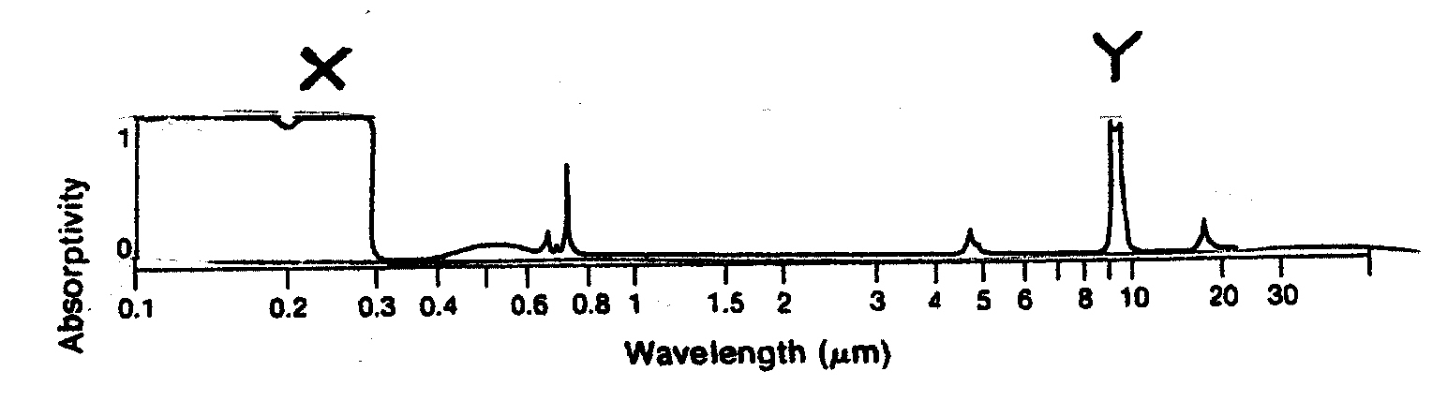
Review:
Why stratospheric ozone is “Good”:
Ozone has the property of being a very strong absorber of ultraviolet radiation ➔ nearly total absorption of wavelengths less than 0.3 m
Black areas = radiation absorbed
⬅ remember this figure?

Slide 14
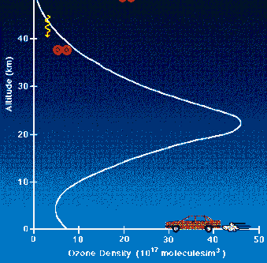

What about the “BAD” ozone
located in the troposphere?
Ozone has increased in troposphere due to photochemical smog reactions ➔ “bad ozone”
☺

Slide 15
HEALTH AND ENVIRONMENTAL EFFECTS OF GROUND-LEVEL OZONE
Why are We Concerned
about Ground-Level Ozone?
➔ Ozone is the prime ingredient
of smog in our cities and
other areas of the country.
http://www.epa.gov/ttn/oarpg/naaqsfin/o3health.html
☺

Slide 16
➔ When inhaled, even at very low levels, ozone can:
  cause acute respiratory problems
  aggravate asthma
  cause significant temporary decreases
  in lung capacity
  cause inflammation of lung tissue
  lead to hospital admissions &
  emergency room visits
  impair the body's immune system defenses
http://www.epa.gov/ttn/oarpg/naaqsfin/o3health.html
☺

Slide 17
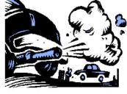
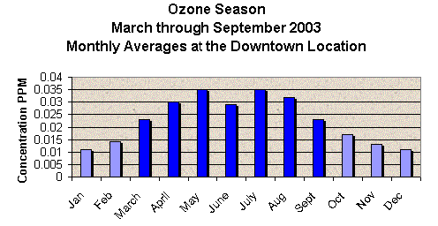
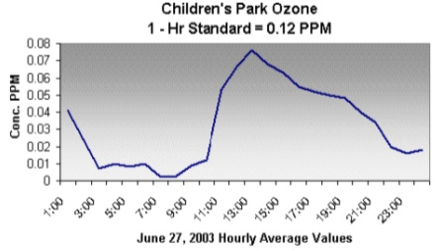

“BAD” OZONE
Ground-level ozone is a form of pollution
created when:
nitrogen oxides in auto emissions
+ hydrocarbons from plant matter
+ solvents and gasoline fumes
. . . . mix and bake in stagnant heat and sunlight!
Tucson data
http://www.airinfonow.org/html/ozoneMC.html
☺

Slide 18
ANOTHER LINK TO EVERYDAY LIFE:
SUN SAFETY!

Slide 19

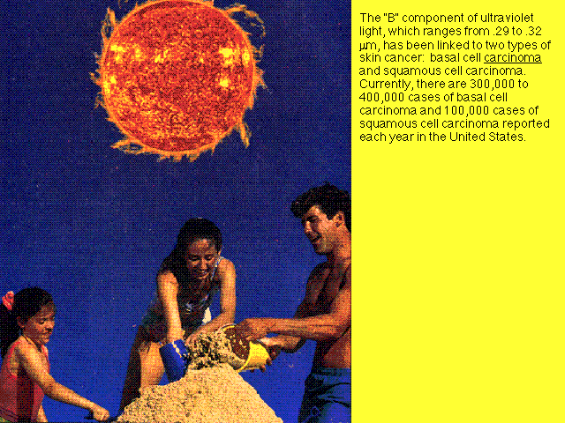
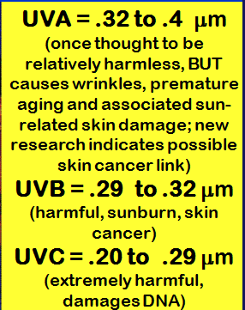
UVB
UVC
UVA
Turn to p 75

Slide 20
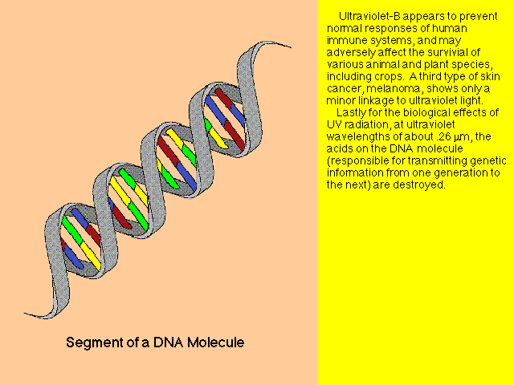
UV-C wavelengths are the most harmful

Slide 21
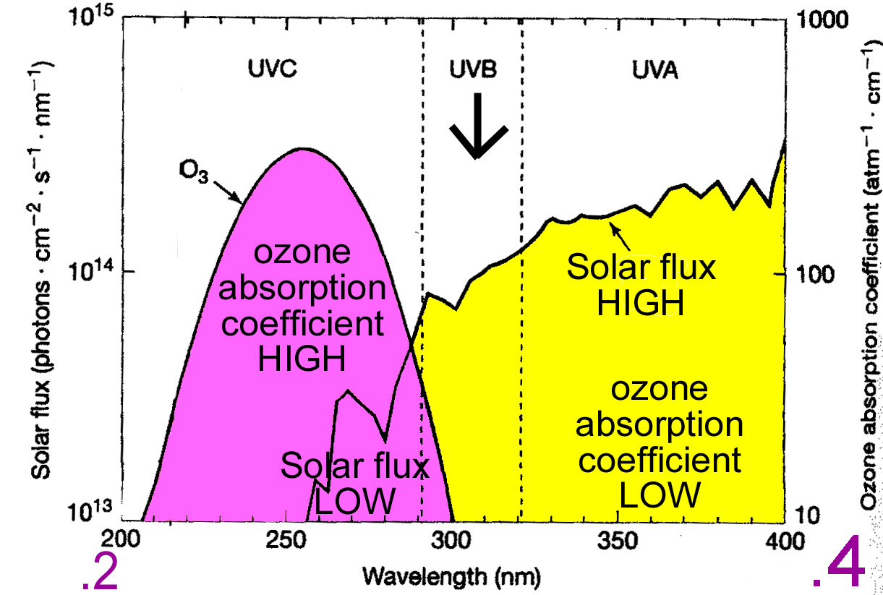
OZONE absorbs harmful UVC & most harmful UVB

Slide 22
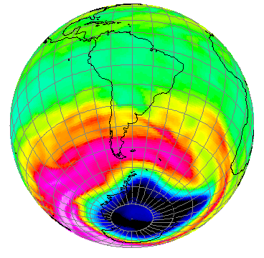
NEXT:
THE DESTRUCTION OF STRATOSPHERIC OZONE

Slide 23

The Chapman Mechansim “balance”
is being disrupted by the introduction of CFC's and other similar gases into the stratosphere:
Stratospheric ozone under steady state natural conditions
Ozone reservoir
> CFCs are photo-dissociated into
FREE CHLORINE ATOMS (Cl) and other molecular fragments by UV rays
> Chlorine (and other gases such as Nitric oxide, NO) act as catalysts in ozone loss reactions
Key Concept

Slide 24
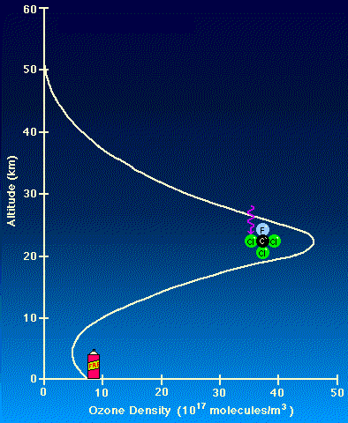
CFC compounds
Chlorofluorocarbons
are unreactive at Earth’s surface,
but if they get into the stratosphere, they can be broken down by high energy UV radiation ➔ leads to release of highly reactive CHLORINE atoms (Cl)
Threat to stratospheric ozone of CHLORINE was recognized in mid-1970s
(in CFCs, or “FREON”)
☺

Slide 25
CATALYST =
A compound that increases the rate of a chemical reaction and is itself unchanged by the reaction
Through chemical reactions:
the chlorine removes ozone from the stratosphere
and also frees more chlorine atoms to begin the process all over again
Key Concept

Slide 26
CFC’s & the CHLORINE CATALYST
A single chlorine atom may destroy hundreds of thousands of ozone molecules during its residence in the stratosphere!
This chemical theory of ozone destruction by CFC’s was first proposed in 1974 – but no observations existed!
(Atmospheric chemists Crutzen, Molina, Rowland
were later given Nobel prize for this theory)
Key Concept

Slide 27
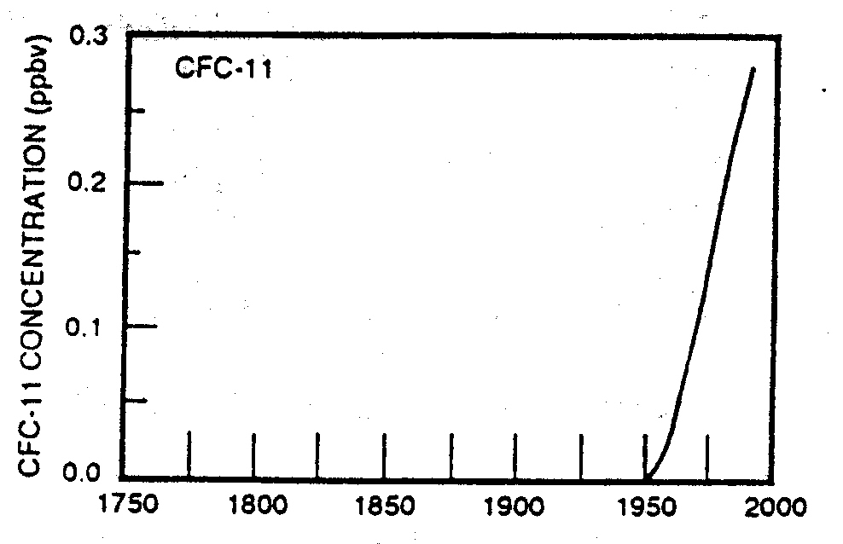

CFCs: Trends
Human-made -- didn’t exist before 1950!

Slide 28
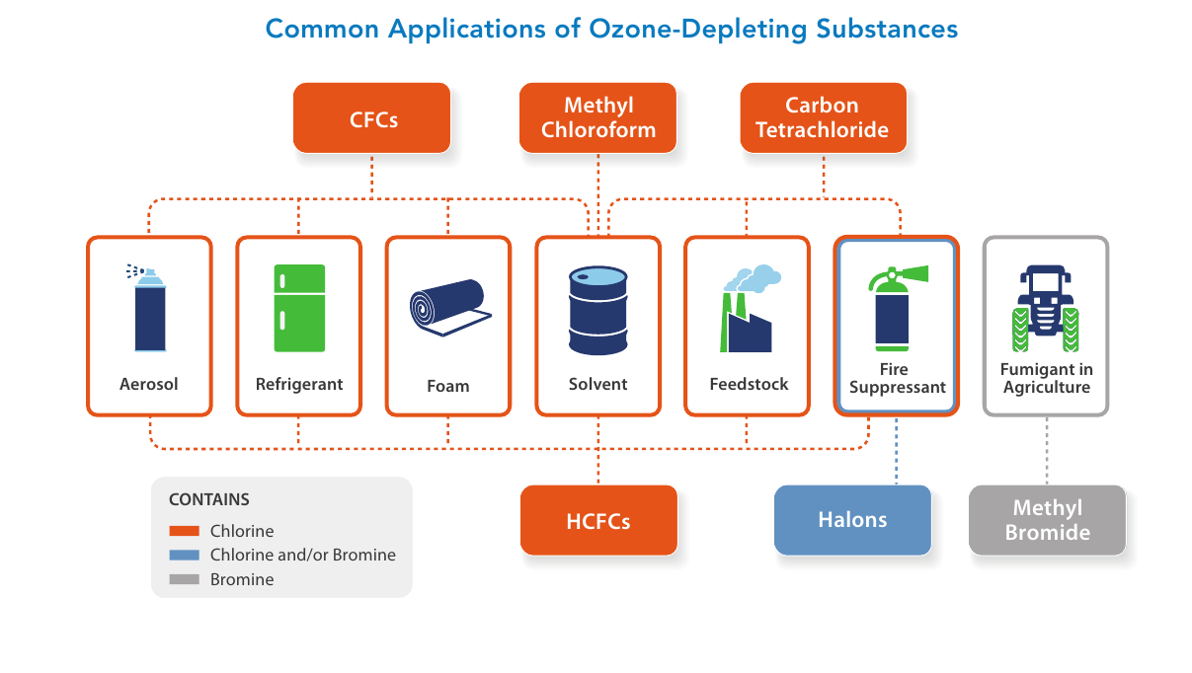

Slide 29
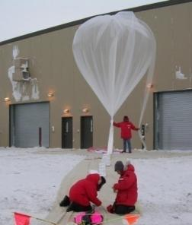
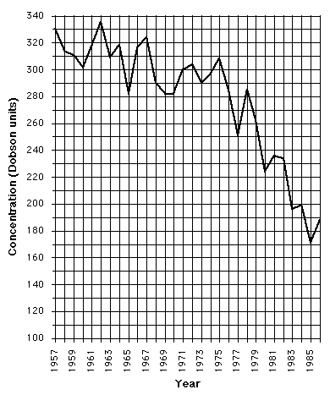
DISCOVERY OF THE OZONE HOLE:
“A Misadventure of Science?”
CHAPTER 1
Ground-based ozone measurements since 1956. (British survey team)
They observed a new trend of decreasing ozone concentrations beginning in 1977
Didn’t believe their measurements & delayed publication for several years while rechecking data & instruments.
Finally published in 1985;
greeted with skepticism!
☺

Slide 30
Declining OZONE CONCENTRATIONS (in Dobson units)
1957-1986
Early data from ground measurements of British survey team
(over Antarctica)
☺

Slide 31


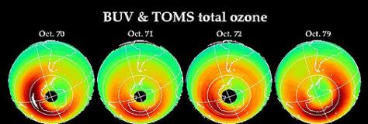
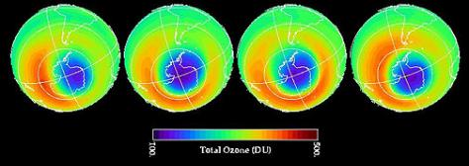
DISCOVERY OF
THE OZONE HOLE (cont.)
Meanwhile, satellites had been launched to observe ozone from above via the TOMS instrument on the satellite
1970
1971
1972
1979
TOMS detected the developing hole, but the anomalously low readings were rejected as “noise” by the computer program set up to process the data !!
1992
1993
1994
1996
☺
Total Ozone in October (DU)

Slide 32
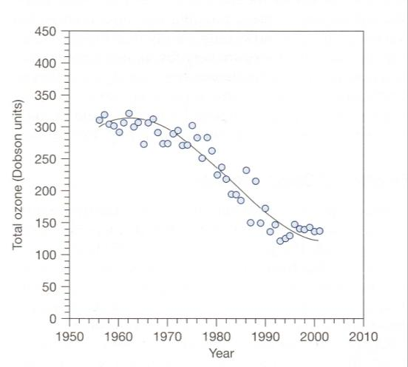
RATE OF OZONE DEPLETION
in DOBSON UNITS (DU)
When did the Hole begin forming?
Hole generally
defined as
< 290 DU
Sketch in the 290 DU threshold line:
~ 1969 to 1970
p 77

Slide 33
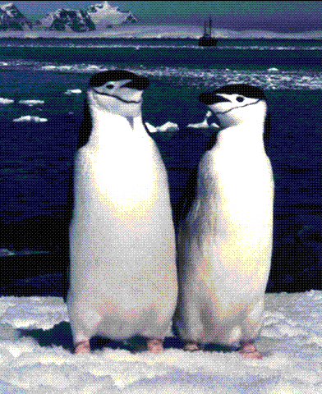
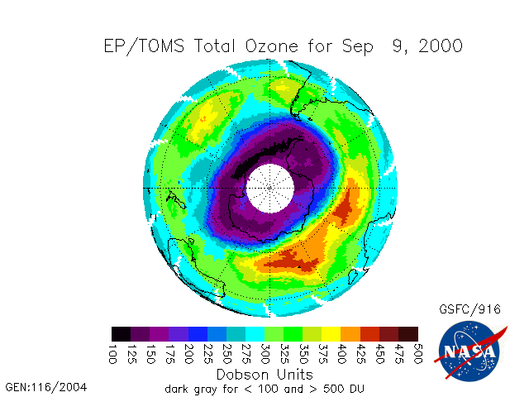
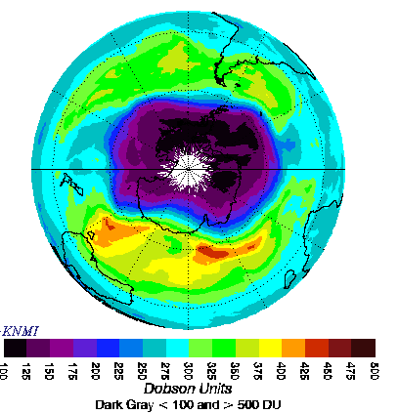
Sep 9, 2000
Sep 24, 2006
The area of 29 million square kilometers (11.4 million square miles) on September 24, 2006 tied the largest value (on September 9, 2000)
Here are some inhabitants with strong cause for concern about the Ozone Hole!
But what about the rest of us?
☺

Slide 34
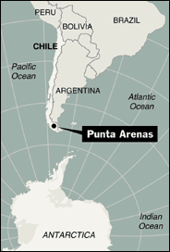
HOLE IN OZONE LAYER EXPOSED A CITY
THE ASSOCIATED PRESS 10-6-00
WELLINGTON, New Zealand –
“The hole in the ozone layer over Antarctica stretched over a Chilean city when it ballooned to a record size last month, the first time it has reached a population center, scientists said yesterday. . . .
In an Upside-Down World, Sunshine Is Shunned
(New York Times 12-27-2002)
☺

Slide 35
“Previously, the hole had only opened over Antarctica and the surrounding ocean.
“Citing data from NASA, atmospheric research scientist Stephen Wood said the hole covered 11.4 million square miles - an area more than three times the size of the United States - on Sept. 9 and 10.
☺

Slide 36

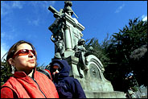
“For those two days, the hole extended over Punta Arenas, a southern Chilean city of about 120,000 people, exposing residents to very high levels of ultraviolet radiation.
“ . . . findings showed a city being exposed to the ozone hole for the first time.”
A "solar stoplight" in Punta Arenas announces an orange alert, the second highest of four levels, and warns people to limit their exposure to the sun between noon and 3 p.m. to a maximum of 21 minutes.
a woman and her child are bundled up against the sun
☺

Slide 37
What about other parts
of the globe?
> Decreases have been observed in
nearly all latitude zones:
(1.1 - 9% in S.H. & 1.1 - 3.7% in N.H.)
> Mid-latitude ozone has been decreasing by ~ 4% per decade in both hemispheres, whereas tropical ozone has remained more or less constant.
http://www.theozonehole.com/arcticozone.htm
Key Concept

Slide 38
Arctic ozone depletion also takes place!
There are concerns that an “Arctic Ozone Hole” may develop that is similar to the severe Antarctic Hole
“An Arctic Ozone Hole, if similar in size to the Antarctic Ozone Hole, could expose over 700+ million people, wildlife and plants to dangerous UV ray levels.
The likely hood of this happening seems inevitable based on the deterioration of ozone layer caused by the effects of global warming on the upper atmosphere.”
http://www.theozonehole.com/arcticozone.htm
☺

Slide 39
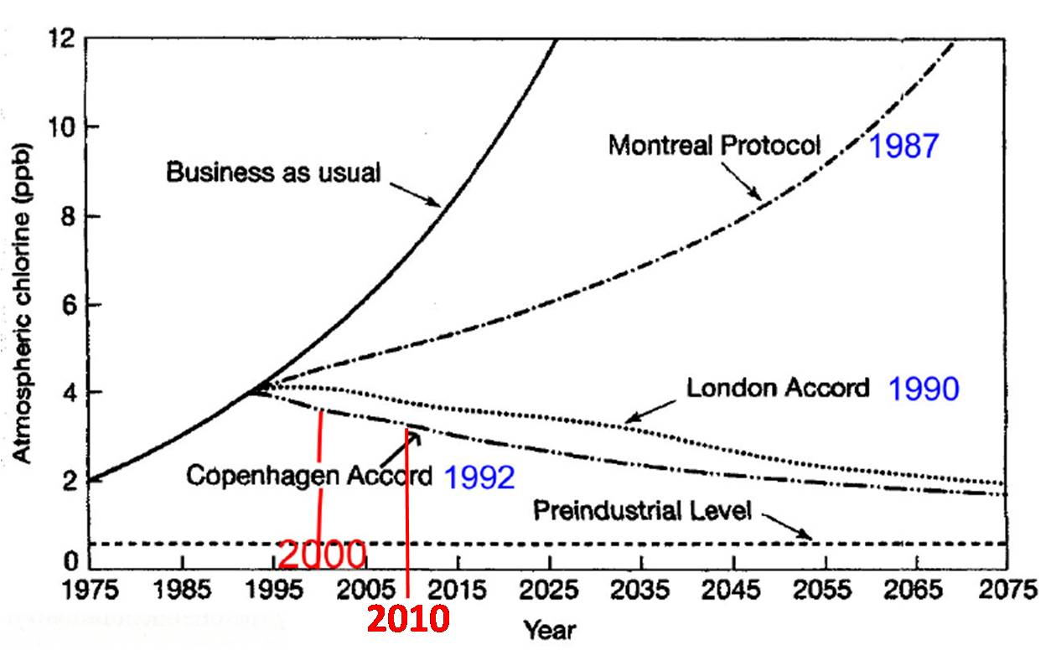
Very long residence time of CFCs!
p 78

Slide 40
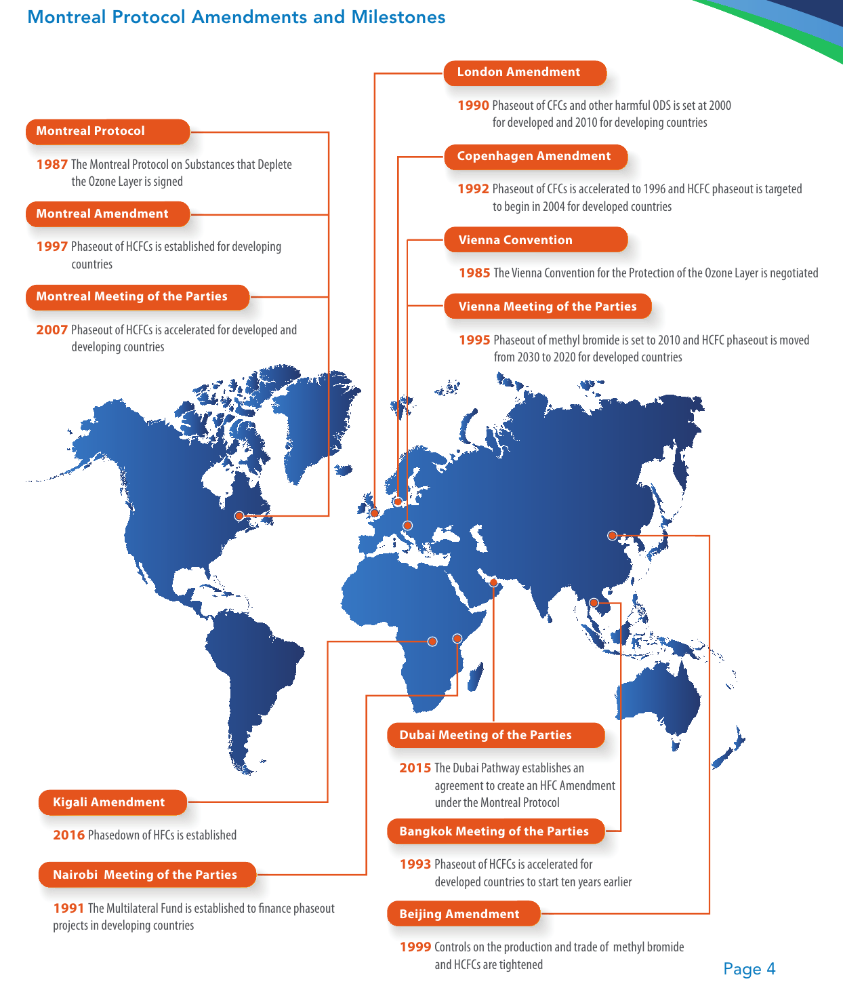

Slide 41
