Slide 1
Introduction to Rulemaking for Climate Law Students

Slide 2
Why Does Congress Leave Legislation to Agencies?

Slide 3
Agency Expertise
Congress does not have the technical expertise to provide regulatory details in many regulatory areas.
Clean Air Act.
Clean Water Act.
FDA.
Congress sets the policy and delegates the details to the agency.

Slide 4
Adapting to Changing Circumstances
Legislation can be cumbersome and time consuming to pass and to amend.
Agencies need flexibility to deal with changing circumstances such as the emergence of COVID-19.
As we will see, enhanced judicial review of rulemaking has limited the much of the original flexibility of rulemaking.

Slide 5
Dodging Politically Sensitive Issues
Congress does not like to legislate on, or cannot reach agreement on, difficult political questions and will often pass these to agencies.
FERC – do you want reliable power or cheap power?
FDA – lots of drugs or safe drugs?
EPA – Can the EPA regulate GHGs?
The lack of legislative direction means that there can be huge policy swings as administrations change.

Slide 6
Controlling the Power to Make Rules
Congress must give agencies the power to make rules.
If the enabling legislation (the legislation creating an agency) is silent, the agency cannot make rules.
The delegation may be broad, allowing the agency great discretion, or very narrow.
Broad discretion: CAA – what is a pollutant?
Narrow discretion: ADA – what is disability?

Slide 7
Benefits of Rulemaking in the Absence of Detailed Legislation

Slide 8
Uniformity
Rules set up a general framework that treats all parties uniformly
Because of the notice process, rules are the fairest way to make big regulatory changes
If the agency is not bound by rules, it can change enforcement policy from case to case.
Judges are less deferential to agency actions that are not based on rules, leading to less predictable results on judicial review.

Slide 9
Adoption of National Standards
National standards can be adopted through agency rules, harmonizing practice across jurisdictions.
Building codes.
CDC guidelines on food sanitation and immunizations.
Drinking water treatment standards.
By incorporating an external standard, the standard can be updated without changing the rule.

Slide 10
Agency Efficiency
Clear rules reduce the need for individual assistance to regulated parties.
If a standard is established by rule, it cannot be attacked during an enforcement proceeding or subsequent judicial review.
Safe temperatures for food handling.
In disability cases, rules can be used to establish what constitutes a disability, rather using case by case determinations.

Slide 11
United States v. Storer Broadcasting Co., 351 U.S. 192 (1956)
The FCC is concerned that concentrated ownership of TV stations is not in the public interest.
Licensing is an adjudication, i.e., the applicant is entitled to a hearing if his license is turned down.
Absent a rule, the number of stations that constitute concentrated ownership would have to be determined in each adjudication.
The FCC issues a rule that no one can own more than five stations.
Does an applicant with 5 stations asking for an additional station license get a hearing when it is turned down based on the rule?

Slide 12
Agency Oversight
Rules are also binding on the agency, so rules reduce the discretion of agency enforcement officers across the country.
Some agency enforcement is done through adjudications with ALJs (administrative law judges).
The agency cannot tell them how to decide cases.
Rules reduce their discretion and scope of review.
This especially important at the state level, where the ALJs are often outside of the agencies.
This is critical since, like court decisions, adjudications can set policy by precedent.

Slide 13
Rulemaking Ossification
The courts and legislatures have increased the burden on rulemaking, especially in states.
Rulemaking has gotten so complex and time consuming it has lost some of its value
Complicated by regulatory conflict and incompetent agency practice.
We will look at this in detail when we look at judicial review of rulemaking in later chapters.
Rulemaking can go on for years, with additional years of litigation before the rule goes into effect or is sent back to the agency for a do-over.

Slide 14
Downsides of Rulemaking
Adjudications are useful when you are not sure what the rule should be and need more info and a chance to experiment.
Rulemaking is now so slow that putting policy into rules makes it difficult to deal with changing circumstances.
Agencies can promulgate rules that Congress would not pass.
EPA – GHG regulations.
Immigration restrictions.

Slide 15
Must the Agency Make Rules?
If the agency has the power to make rules, it has discretion on what rules to make and when to make them.
The legislature can put provisions in the agency legislation requiring that certain rules be made, and the timeframe for making them.
The Clean Air Act required rulemaking to flesh out detailed technical standards through rulemaking.
Unless there is a legislative directive, it is difficult to get the courts to force an agency to make rules.

Slide 16
The Procedures for Notice-and-Comment Rulemaking
These are set by statute (APA or enabling act). Unlike adjudications, where the Constitution sets the basic procedural requirements, there are no Constitutional requirements for rulemaking.

Slide 17
§ 553. Publishing the Rule
(b) General notice of proposed rule making shall be published in the Federal Register, unless persons subject thereto are named and either personally served or otherwise have actual notice thereof in accordance with law. The notice shall include -
(1) a statement of the time, place, and nature of public rule making proceedings;
(2) reference to the legal authority under which the rule is proposed; and
(3) either the terms or substance of the proposed rule or a description of the subjects and issues involved.

Slide 18
§ 553. Public Comments
(c) After notice required by this section, the agency shall give interested persons an opportunity to participate in the rule making through submission of written data, views, or arguments with or without opportunity for oral presentation.
After consideration of the relevant matter presented, the agency shall incorporate in the rules adopted a concise general statement of their basis and purpose.
When rules are required by statute to be made on the record after opportunity for an agency hearing, sections 556 and 557 of this title apply instead of this subsection.

Slide 19
§ 553. Effective Date
(d) The required publication or service of a substantive rule shall be made not less than 30 days before its effective date, except -
(1) a substantive rule which grants or recognizes an exemption or relieves a restriction;
(2) interpretative rules and statements of policy; or
(3) as otherwise provided by the agency for good cause found and published with the rule.

Slide 20
Steps in Federal Notice and Comment Rulemaking

Slide 21
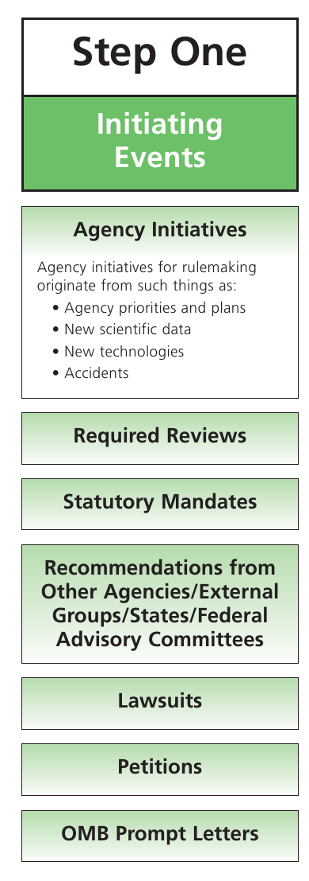

Slide 22
What is the President's Role in Rulemaking?
(Not independent agencies.)
Controls and supervises executive branch decisionmaking.
Traditionally done through by OIRA/OMB.
Can also pressure agency heads directly.
When should the president's contacts be documented in the published record?
If the statute requires that they be docketed.
If the rule is based on factual information that comes from such a meeting.

Slide 24
Negotiated Rulemaking
In negotiated rulemaking the agency works with representatives of groups who will be affected by the rule (stakeholders) to identify problems and potential solutions before the agency promulgates a rule.
The agency will then use what it learns to write the rule that then then goes through the usual notice and comment process.
Environmental rulemaking often has politically powerful parties on both sides of the issue. If the agency can find common ground among the groups, that will reduce the legal challenges to the final rule.
The agency has to be mindful of social justice issues and assure that disadvantaged groups have the resources to participate in the process.
This sometimes means funding their participation.
Assume you are regulating wood stoves.
Environmental groups which want strict regulations will have the funding to participate, as will the wood stove manufacturers.
Persons who heat with wood because they are poor probably will not be able to participate.
They will be injured if environmentalists and the manufacturers agree on new regs that make stoves much more expensive.

Slide 25
Negotiated Rulemaking and Notice and Comment
The negotiation happens before the rule is proposed in the FR.
The standards for publication and notice are the same as for all other notice and comment rules.
This solves any ex parte contacts problem because the rule must be fully justified by its published record.
Interested parties can still comment.

Slide 26
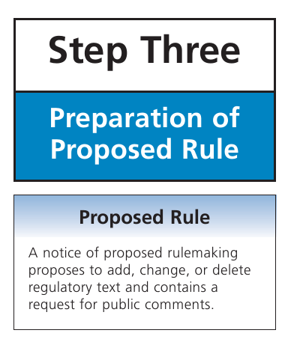

Slide 27
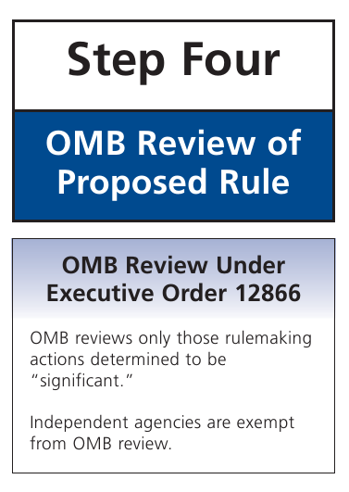

Slide 29
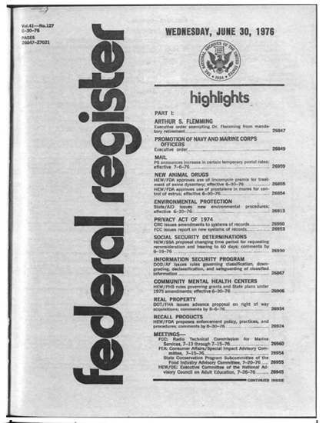
Federal Register - The Paper Version

Slide 30
Federal Register

Slide 31
What Technical and Scientific Information Must Be in the Notice?
Portland Cement v. Ruckelshaus, 486 F2d 375 (1973)
The agency must disclose the factual basis for the proposed rule, if it relied on scientific studies or other collections of information.
Connecticut Light and Power v. NRC, 673 F2d 525 (1982)?
The agency cannot hide technical information.
Why is this a big deal in environmental regs?
What are the potential downsides of this policy?

Slide 33
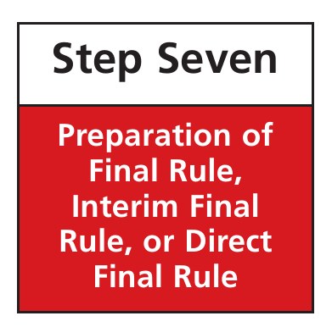

Slide 34
When Do You Need To Re-Notice a Revised Rule?

Slide 35
Taking Chocolate Milk from Children
The agency proposed a rule that would regulate sugary cereals paid for through WIC.
After reviewing comments, the agency added chocolate milk to the banned foods.
Milk producers argued that this was not properly noticed in the proposed rule.
N&C must give adequate notice of the rule being promulgated or it fails.
The court found that the final rule needs to be a logical outgrowth of the proposed rule.
Does that mean that every change needs to be noticed?

Slide 36
Limits on Logical Outgrowth
EPA published a proposed rule that gives Indian tribes the same regulatory rights as states.
State plans are subject to state court judicial review.
Why did the tribes object to this?
The final rule was changed to exempt them from state court review.
Plaintiffs claimed that this change needed new N&C
The court found that anyone familiar with Indian law would know that the tribes had sovereign rights and should have expected that the rule would be modified to recognize those.
The agency can assume familiarity with the applicable law.
These are older cases and judicial review is more searching today. Agencies would be more careful and more likely to renotice any significant changes in the rule.
We will look at this later.

Slide 37
When Can the Record be Supplemented without Triggering New N&C?
Gold mining under the CWA.
EPA added 6000 pages of supporting info when responding to comments.
The agency may supplement the rulemaking record in response to comments asking for explanation.
The agency did not rely on the additional information to justify the rule, only to answer comments.
Endangered Species Act listing.
Agency added a report to the record when it replied to comments, then relied on it in the final rule.
The agency may not add new material and then rely on it without given an opportunity to comment on it.

Slide 38
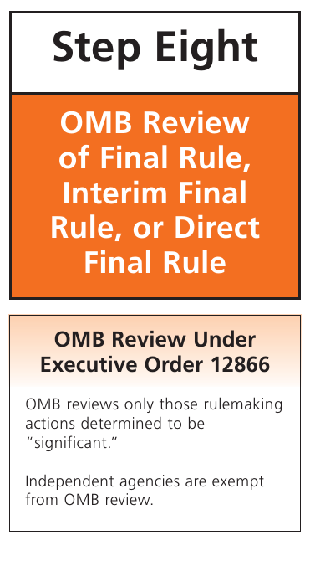

Slide 39
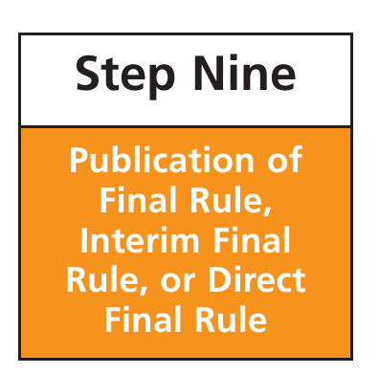

Slide 40
Attacking Rulemaking
Once a rule has been properly promulgated through notice and comment, it can only be attacked by attacking the published basis for the rule, and that must be done relatively soon after promulgation.
Major rules are so complex that there is always a court willing to enjoin the rule as soon it is finalized.

Slide 41
Why Have Public Participation?
Public participation has great political benefit in broadening the acceptability of the rules.
Public comments can identify technical and legal problems with the rules that will cause the rule to be rejected by the courts if not corrected.
Publication of proposed rules allows politicians to become involved to protect the interests of their constituents
Public participation limits executive power and makes it more palatable to the courts to have agencies making laws
While the agency may take comments at public hearings, comments are usually required to be submitted in writing.
This is now done almost exclusively online.

Slide 42
§ 553. Petition for Rulemaking
(e) Each agency shall give an interested person the right to petition for the issuance, amendment, or repeal of a rule.

