Slide 1
Homeowner’s Insurance

Slide 2
The Cases
Flood is not covered
Flood is a common sense term
VLP only applies when the property is totaled from a covered risk
No flood.

Slide 3
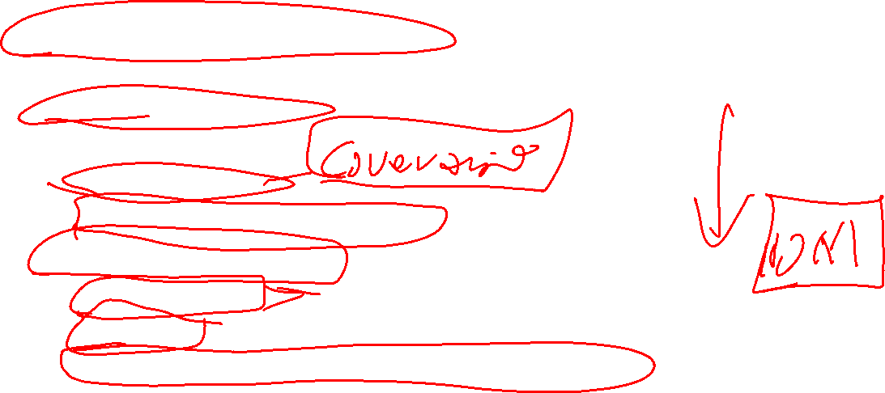
Elements of Insurance
State regulated and chartered.
National umbrella companies, but each state company is separate.
No federal regulation.
State regulator goals
Low premiums.
Pay claims when they are made.
Assets for paying claims
Company capital
Reinsurance
Borrowing through bonds or other financial vehicles.

Slide 4
Financials
Premiums
Based on value of the property and the risk
Set by regulators.
Capital
Higher capital, lower profits
Good investment income, lower premiums
Bad investment income, higher premiums
Level required set by state regulators
Reinsurance
No regulation of the industry
Higher the more risk
Level required set by state regulators.
Higher reinsurance costs or higher requirements for reinsurance levels, higher premiums.

Slide 5
Mass Disaster Problems
Payouts can exceed combined capital and reinsurance.
Company goes bankrupt, claims fall to the state to be paid.
Florida Citizens, Louisiana Citizens.
Not enough adjustors to get the claims paid quickly.
Penalties for unfair claims practices
Is the answer to require constant staffing for mass disasters?

Slide 6
Insurance is Zero Sum Game
The more the company pays out, the higher the premiums going forward, or the company goes bankrupt and the state pays.
State companies have higher rates.
How does the tort world play out?

Slide 7
