Slide 1
Ages of the Earth

Slide 3
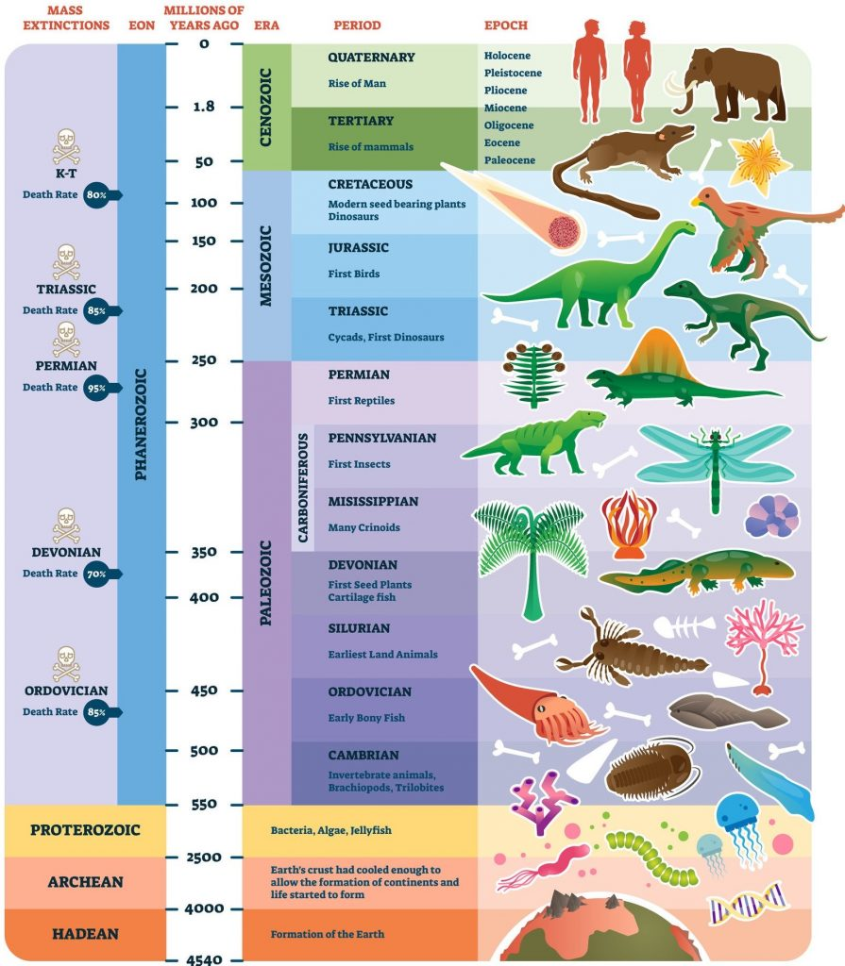

Slide 4
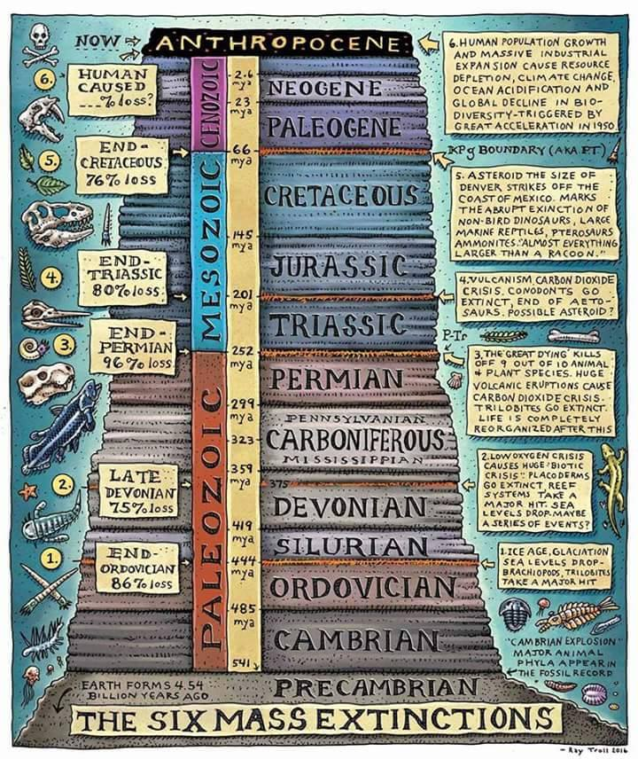

Slide 5
The Carbon Cycle

Slide 6
The Slow Carbon Cycle
Through a series of chemical reactions and tectonic activity, carbon takes between 100-200 million years to move between rocks, soil, ocean, and atmosphere in the slow carbon cycle. On average, 10¹³ to 10¹⁴ grams (10–100 million metric tons) of carbon move through the slow carbon cycle every year. In comparison, human emissions of carbon to the atmosphere are on the order of 10¹⁵ grams, whereas the fast carbon cycle moves 10¹⁶ to 10¹⁷ grams of carbon per year.
The slow cycle returns carbon to the atmosphere through volcanoes. Earth’s land and ocean surfaces sit on several moving crustal plates. When the plates collide, one sinks beneath the other, and the rock it carries melts under the extreme heat and pressure. The heated rock recombines into silicate minerals, releasing carbon dioxide.
When volcanoes erupt, they vent the gas to the atmosphere and cover the land with fresh silicate rock to begin the cycle again. At present, volcanoes emit between 130 and 380 million metric tons of carbon dioxide per year. For comparison, humans emit about 30 billion tons of carbon dioxide per year—100–300 times more than volcanoes—by burning fossil fuels.

Slide 7
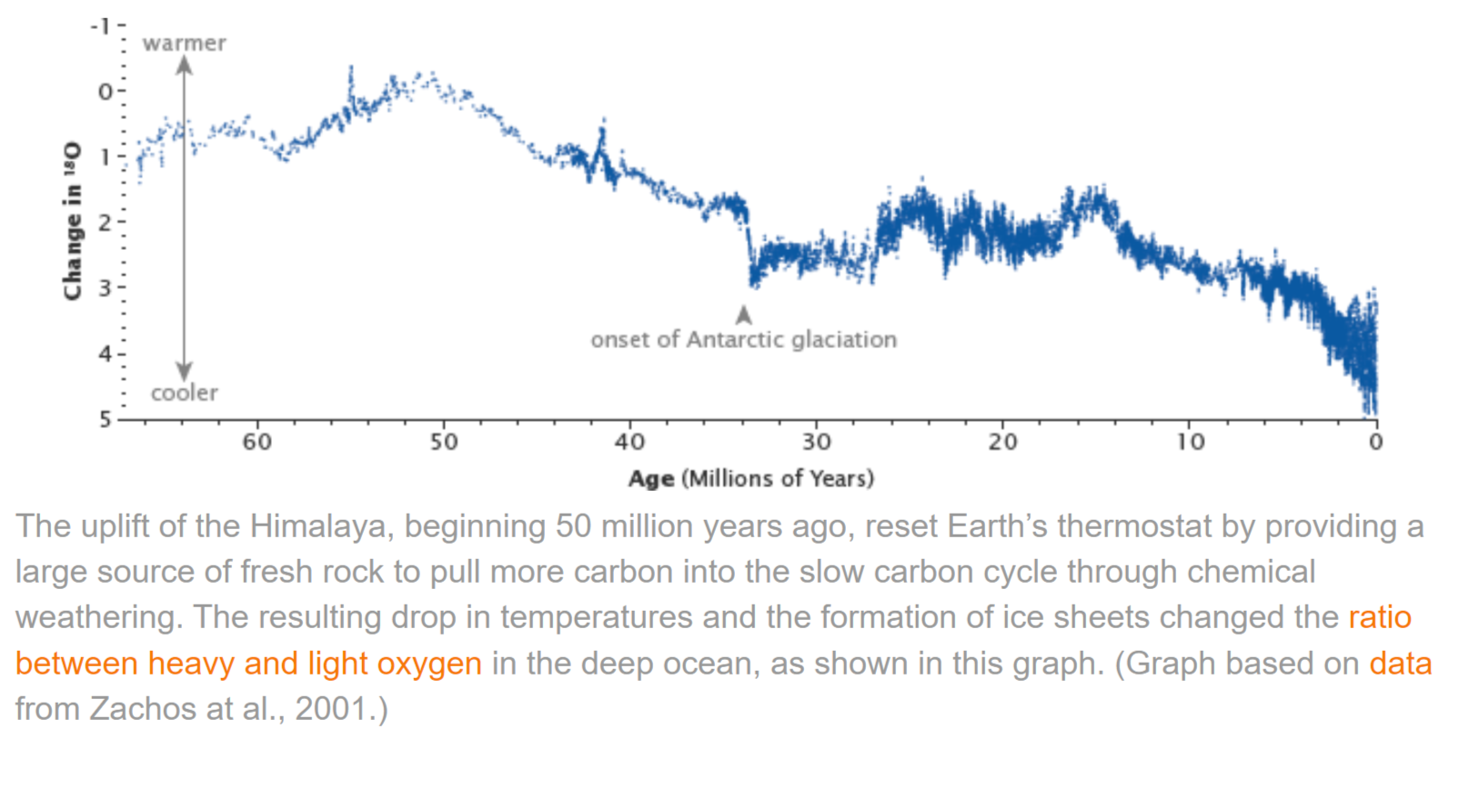

Slide 8
The Fast Carbon Cycle
The time it takes carbon to move through the fast carbon cycle is measured in a lifespan. The fast carbon cycle is largely the movement of carbon through life forms on Earth, or the biosphere. Between 10¹⁵ and 10¹⁷ grams (1,000 to 100,000 million metric tons) of carbon move through the fast carbon cycle every year.
Plants and phytoplankton are the main components of the fast carbon cycle. Phytoplankton (microscopic organisms in the ocean) and plants take carbon dioxide from the atmosphere by absorbing it into their cells.

Slide 9
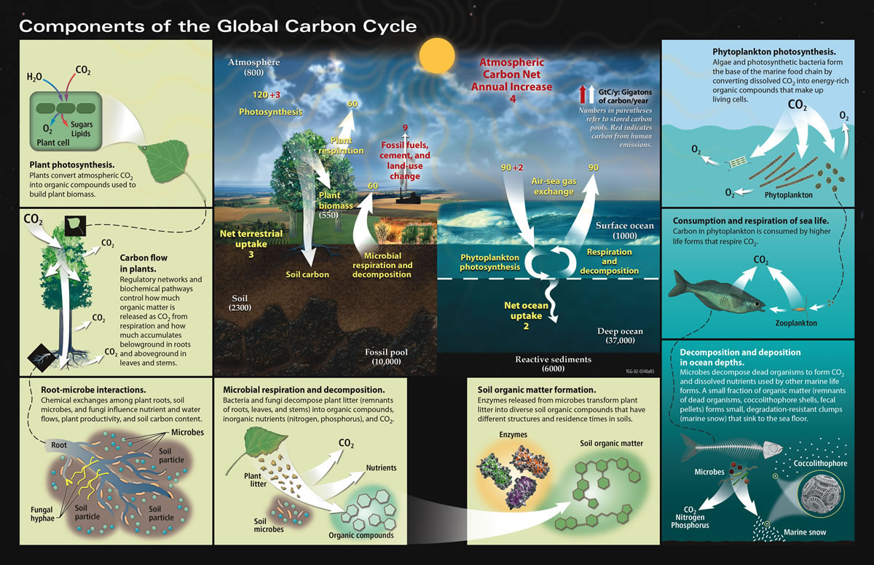

Slide 11
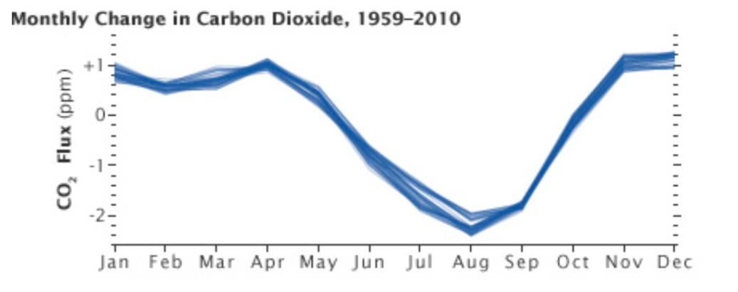
Global Variation of CO2 During the Northern Hemisphere Growing Season

Slide 12
Warming from orbital changes cause the release of CO2, which amplifies the warmings.
Now we are directly releasing the CO2.

Slide 13
Implications of the Carbon Cycle
CO2 has a very long life in the atmosphere
Stopping CO2 emissions does not lower the temperature for a very long time.
The fast natural way to remove CO2 from the atmosphere is to increase the sequestration of carbon in plants that either hold the carbon – trees – or stabilize it as peat – inland marshes and bogs.
Plant sequestration works but requires land that threatens agriculture and natural ecosystems.
Carbon can be removed from the atmosphere and stored in deep rock formations or made into rock.
Scalability and cost and who will pay the costs constrain this CCS.

Slide 14
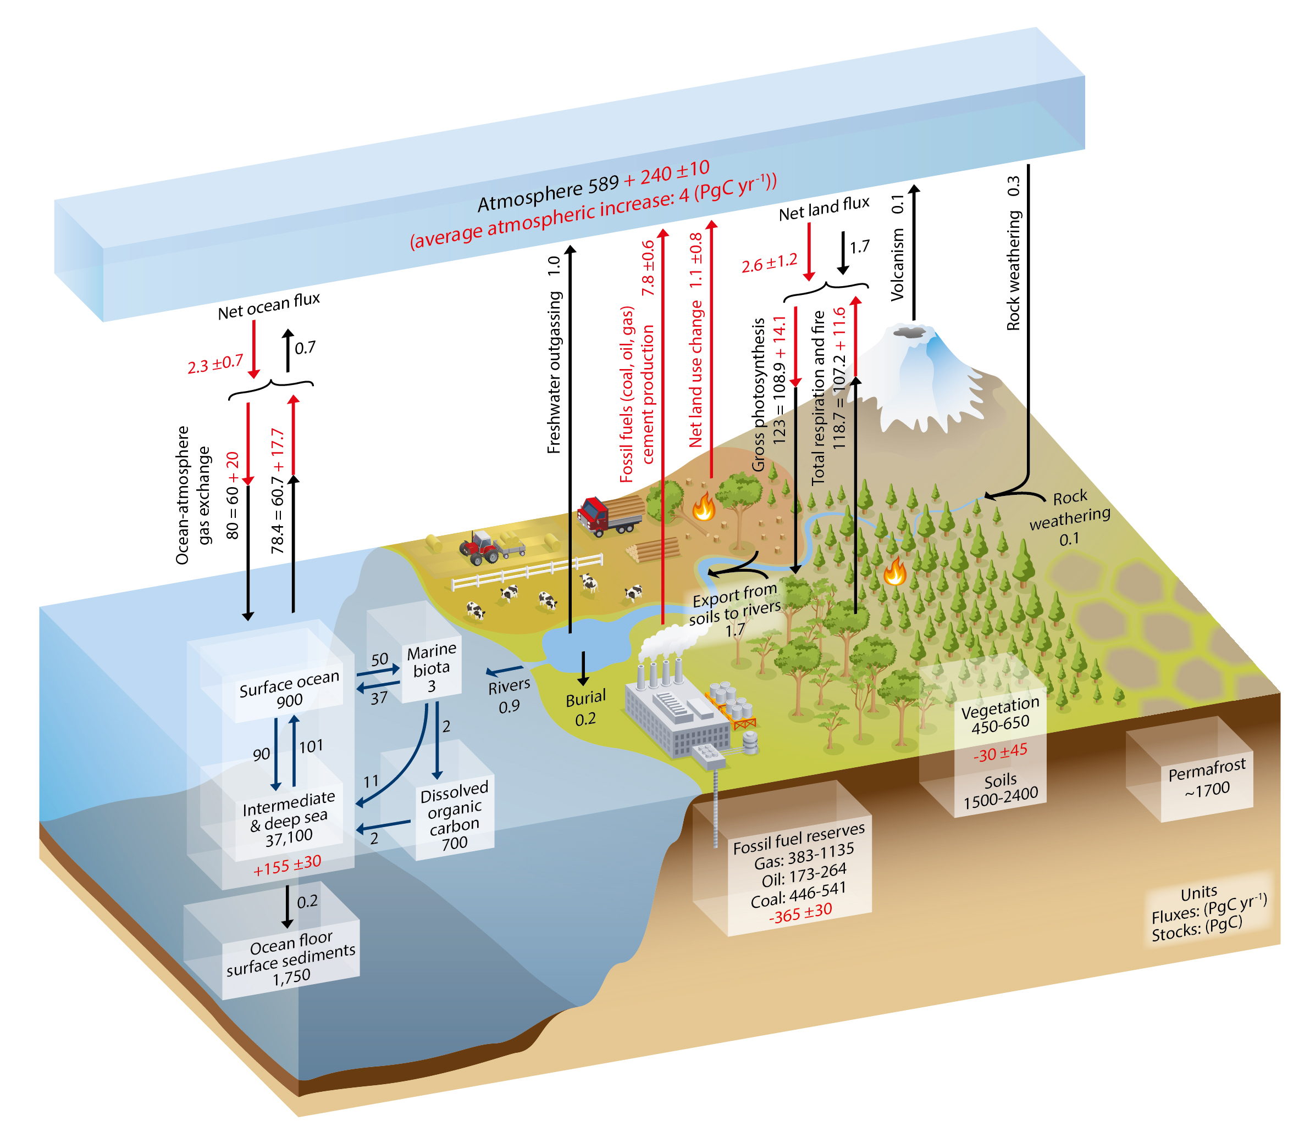
A detailed look at carbon stores CO2 vs CH4

Slide 15
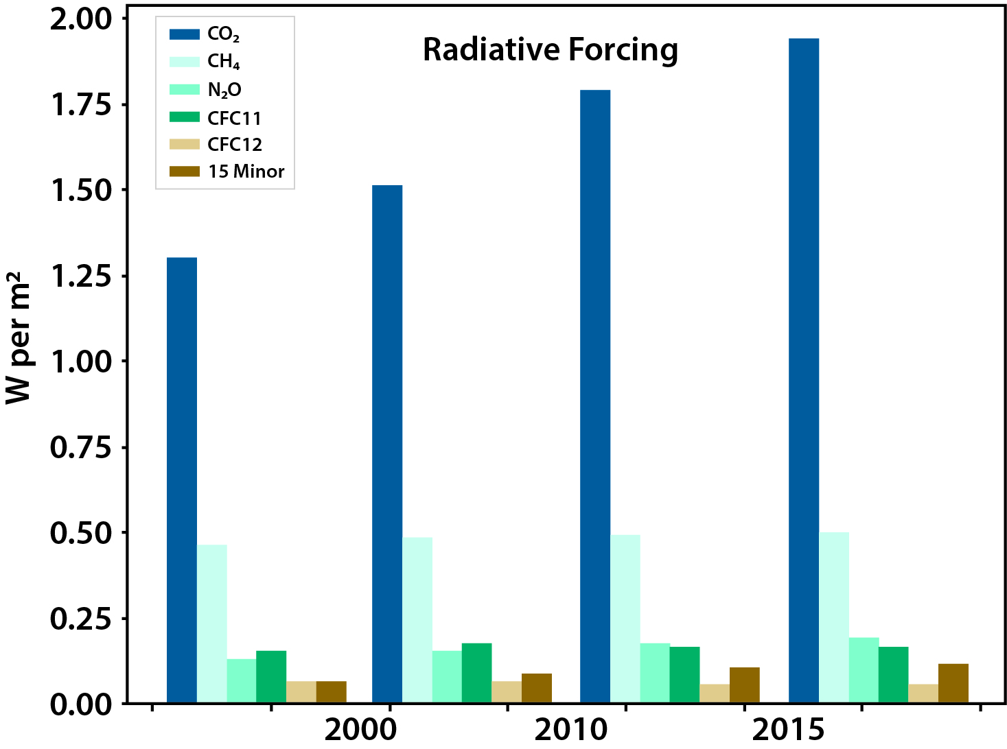
Other GHGs

Slide 16
Go to Methane

Slide 17
Climate Change 2022: Impacts, Adaptation and Vulnerability

Slide 20
Go to PDF

