Slide 1
NEPA in the Courts
The Nuclear Power Cases

Slide 2
NEPA Thumbnail
Triggered by government action.
Procedural, not substantive.
Meant to assure full public information.
Must explicitly consider:
Risks of the project to the environment
Social justice issues of the project
Alternatives to the project, including the alternative of doing nothing.
Must confer with other agencies about risks, such as Fish and Wildlife over potential endangered species issues.
Not self-enforcing
Depends on citizen suits for enforcement.
Buy off the opposition and you can build what you want without worrying about NEPA.

Slide 3
What was the Promise of Nuclear Power?
Economic Cost
Power too cheap to meter
Nuclear fusion – cheap power and no waste
Environmental costs of alternatives
Coal – dirty and dangerous to mine
Wind farms, solar, hydroelectric
Strategic issues
Why did France push for 100% nuclear power?
How does global warming change the analysis?

Slide 4
The Opposition to Nuclear Power

Slide 7
Nuclear Power Plant Permitting in 1970
Building permit
Required before construction
Required full plans
Public hearings were allowed
NEPA added in 1968
Operating permit
After construction.
Public hearings
Allowed a second bite at all the objections

Slide 8
The Problem of Nuclear Waste
Reprocessing fuel
Extract plutonium and reuse the rods.
Higher yield of energy from the fuel and much less final waste.
Used in France, rejected by the US
Direct disposal
Why not just take nuclear waste to the land fill or burn it up?
How long does it last?
Where do we dispose of nuclear power plant waste in the US?
What has stopped the development of a central depository at Yucca Mountain?
Where is the waste kept now?
Waste disposal is a key NEPA issue.
Hard to resolve if you do not know what you are going to do.
Ultimately solved by a rule in Vermont Yankee that put off the decision to the future.

Slide 9
Reactor Safety
Does a Nuclear Submarine Reactor Make a Good Powerplant?

Slide 10
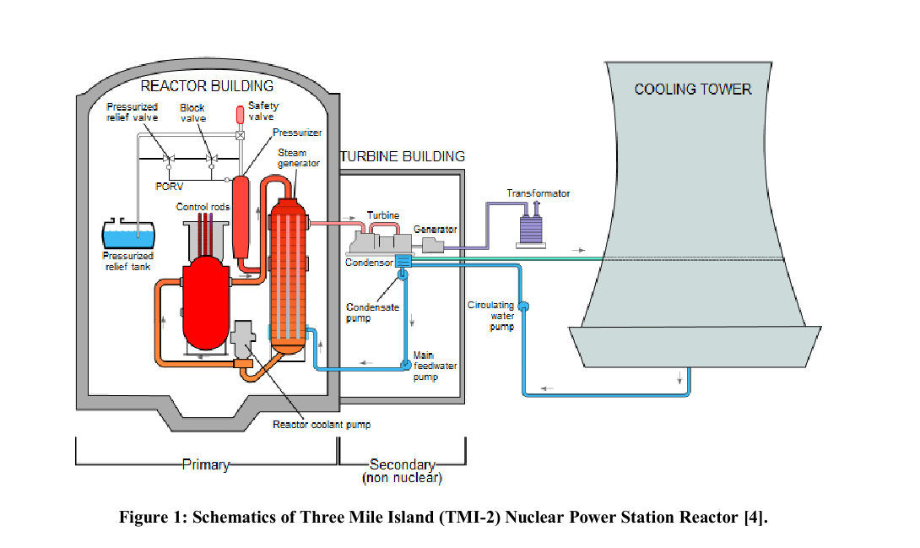
Chima Clement, Fault Tree Analysis of the Three Mile Island (TMI) Nuclear Reactor Partial Nuclear Melt (working paper 2014)

Slide 11
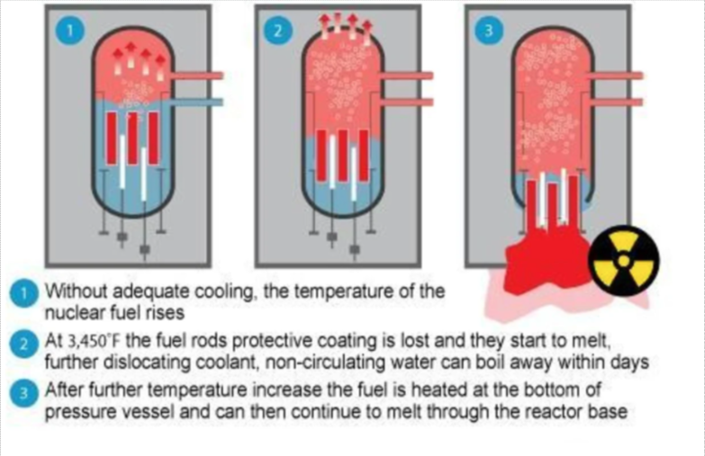
Meltdown

Slide 12
Paying for Accidents
Price-Anderson Act
Allows claims, but limits liability of the industry
1st $300m - private insurance
$300M-$10B - risk pool
Over $13.6B - federal government
What would the costs of a big accident include?
Japan nearly doubles Fukushima disaster-related cost to $188 billion
Who really pays if there is a huge accident?

Slide 13
What Needs to be in the EIS?
The environmental impact of mining for the uranium used for fuel.
The environmental impact of building the plant.
Storage and disposal of nuclear waste.
The potential environmental impact of a serious accident.
The environmental impact of the ultimate decommissioning of the power plant.

Slide 14
CALVERT CLIFFS' COORD. COM. v. AEC, 449 F. 2d 1109 (1971)
This is the first federal appeals case to review agency action under NEPA.
“These cases are only the beginning of what promises to become a flood of new litigation — litigation seeking judicial assistance in protecting our natural environment.”
“Our duty, in short, is to see that important legislative purposes, heralded in the halls of Congress, are not lost or misdirected in the vast hallways of the federal bureaucracy.”

Slide 15
Is NEPA Strict or Flexible?
Thus the general substantive policy of the Act is a flexible one. It leaves room for a responsible exercise of discretion and may not require particular substantive results in particular problematic instances.
However, the Act also contains very important "procedural" provisions — provisions which are designed to see that all federal agencies do in fact exercise the substantive discretion given them. These provisions are not highly flexible. Indeed, they establish a strict standard of compliance.

Slide 16
fullest extent possible
Unlike the substantive duties of Section 101(b), which require agencies to "use all practicable means consistent with other essential considerations," the procedural duties of Section 102 must be fulfilled to the "fullest extent possible."[10] This contrast, in itself, is revealing. But the dispositive factor in our interpretation is the expressed views of the Senate and House conferees who wrote the "fullest extent possible" language into NEPA.

Slide 17
Legislative History
"* * * The purpose of the new language is to make it clear that each agency of the Federal Government shall comply with the directives set out in * * * [Section 102(2)] unless the existing law applicable to such agency's operations expressly prohibits or makes full compliance with one of the directives impossible. * * * Thus, it is the intent of the conferees that the provision `to the fullest extent possible' shall not be used by any Federal agency as a means of avoiding compliance with the directives set out in section 102

Slide 18
The Heart of NEPA Enforcement
“We conclude, then, that Section 102 of NEPA mandates a particular sort of careful and informed decisionmaking process and creates judicially enforceable duties. The reviewing courts probably cannot reverse a substantive decision on its merits, under Section 101, unless it be shown that the actual balance of costs and benefits that was struck was arbitrary or clearly gave insufficient weight to environmental values. But if the decision was reached procedurally without individualized consideration and balancing of environmental factors — conducted fully and in good faith — it is the responsibility of the courts to reverse.

Slide 19
Can the Agency Do the NEPA Review Internally?
The question here is whether the Commission is correct in thinking that its NEPA responsibilities may "be carried out in toto outside the hearing process" — whether it is enough that environmental data and evaluations merely "accompany" an application through the review process, but receive no consideration whatever from the hearing board.
We believe that the Commission's crabbed interpretation of NEPA makes a mockery of the Act. What possible purpose could there be in the Section 102 (2) (C) requirement (that the "detailed statement" accompany proposals through agency review processes) if "accompany" means no more than physical proximity — mandating no more than the physical act of passing certain folders and papers, unopened, to reviewing officials along with other folders and papers?
[NEPA must be part of the public hearing process]

Slide 20
Can NEPA be Set Aside Because We Need to Build New Powerplants?
In the end, the Commission's long delay seems based upon what it believes to be a pressing national power crisis. Inclusion of environmental issues in pre-March 4, 1971 hearings might have held up the licensing of some power plants for a time. But the very purpose of NEPA was to tell federal agencies that environmental protection is as much a part of their responsibility as is protection and promotion of the industries they regulate. Whether or not the spectre of a national power crisis is as real as the Commission apparently believes, it must not be used to create a blackout of environmental consideration in the agency review process.
[Congress can, and does, waive NEPA if wants something built without delay, such as the original border fence legislation.]

Slide 21
Can the Agency Rely on Other Agencies to do the NEPA Review?
The most the Commission will do is include a condition in all construction permits and operating licenses requiring compliance with the water quality or other standards set by such agencies.[32] The upshot is that the NEPA procedures, viewed by the Commission as superfluous, will wither away in disuse, applied only to those environmental issues wholly unregulated by any other federal, state or regional body.
In cases such as this one, the most we should do to interpret clear statutory wording is to see that the overriding purpose behind the wording supports its plain meaning. We have done that here. And we conclude that Section 104 of NEPA does not permit the sort of total abdication of responsibility practiced by the Atomic Energy Commission.

Slide 22
What about Plants that are Already Under Construction?
Petitioners' final attack is on the Commission's rules governing a particular set of nuclear facilities: those for which construction permits were granted without consideration of environmental issues, but for which operating licenses have yet to be issued.
Although the projects in question may have been commenced and initially approved before January 1, 1970, the Act clearly applies to them since they must still pass muster before going into full operation. All we demand is that the environmental review be as full and fruitful as possible.
[NEPA also applies to the operating permit]

Slide 23
Nuclear Power: The Cost of Delay Meets Interest Rates

Slide 24
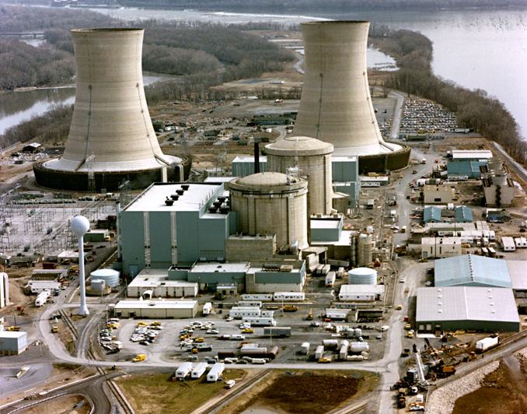
Three Mile Island - March 28, 1979
Location

Slide 25
Whoops! (Washington Public Power Supply System) A $2 Billion Blunder

Slide 26
Chernobyl - 26 April 1986
A graphite reactor without a containment vessel. The reactor itself burned when it melted and created a huge cloud of radioactive particles.

Slide 27
Fukushima Accident 2011
Images

Slide 28
Where are We Now?
See resources

Slide 29
How do you Protect the Environment?
Containment
Seismic and flood safety
Fail safe reactor designs
A future for nuclear energy: pebble bed reactors
Modular reactors
Manage fuel properly
Can you eliminate all risk?
What are the tradeoffs?

Slide 30
NEPA and Climate Change

Slide 31
Sierra Club v. Federal Energy Regulatory Commission, 867 F.3d 1357 (2017)
Environmental groups and landowners have challenged the decision of the Federal Energy Regulatory Commission to approve the construction and operation of three new interstate natural-gas pipelines in the southeastern United States. Their primary argument is that the agency's assessment of the environmental impact of the pipelines was inadequate. We agree that FERC's environmental impact statement did not contain enough information on the greenhouse-gas emissions that will result from burning the gas that the pipelines will carry.

Slide 32
Implications of the Court Ruling
This rule requires the consideration of indirect climate effects, i.e., the burning of the natural gas by power plants that are not part of this permitting action.
The court rejects the government’s argument that since it has no control over the use of the gas by the plants, it should not have to evaluate their environmental effect.

Slide 33
Environmental Justice under NEPA
The court also recognized that the disparate impact of a project on disadvantaged communities must be considered.
An example in this case is building a pumping station in a poor community that is already subject to significant pollution.
The court, found, however, that the agency had adequately considered this impact.

Slide 34
How do Lawyers Use NEPA?
The End of the First Phase of the US Nuclear Power

Slide 35
NEPA is Procedural, not Substantive
You cannot stop a project through findings in NEPA.
You can delay it a long time.
Even if the EIS says that the project is from hell, will cost the Earth, and will make things worse, the test is whether the EIS is complete.
The EIS can affect whether the project is built if cost-benefit is part of the substantive project review and is found wanting.
The role of NEPA is to put an honest appraisal of the project before the public.
The public and politicians then decide whether to permit the project.
If the EIS is as described above, will the public still support building it?

Slide 36
The Practical Aspects of NEPA
It doesn’t matter what is in the EIS if it is not challenged in court.
None of the Louisiana coastal restoration projects have been challenged.
The key use of NEPA litigation is to slow down a project to allow time to build political opposition, get regulatory changes, or to have the markets kill the project.
If the agency puts forward an inadequate EIS, as with Sierra Club v. FERC or the Offshore Lease Sale, the only independent legal evaluation is by the courts triggered by third party litigation.
NEPA litigation, plus challenges to building and operating permits added years of delay to the building and operating of nuclear power plants in the 1970s.
Congress can, and does, suspend NEPA and other environmental laws for certain projects, such as the Mexican border wall and post-Katrina levee construction.

