Slide 1
The Montreal Protocol
The most (only?) successful international climate change treaty.

Slide 2
Discovery of the Ozone Hole
The first paper showing the relationship between CFCs and depletion of upper atmosphere ozone was published in 1974.
Molina, Mario J., and F. Sherwood Rowland. “Stratospheric sink for chlorofluoromethanes: chlorine atom-catalysed destruction of ozone.” Nature 249.5460 (1974): 810.
This was soon confirmed by other scientists.

Slide 3
Impact of Ozone Depletion on People

Slide 4
The Ozone Hole was Transformed into an Acute Human Health Problem.
The increased UV radiation secondary to loss of atmospheric ozone translated into the increased cases of skin cancer, as well as other conditions such as cataracts.
As with the health effects that catalyzed the CAA and the CWA, skin cancer is well understood and feared by the public.
Research predicted increases in these cancers over a relatively few years.
Contrast this with the difficulty of seeing direct effects of climate change.

Slide 5
The Demographics of the Problem
In the 1980s, CFC use was concentrated in the developed world.
The US was by far the biggest offender.
This meant that a treaty could treat developing nations differently from developed nations without significantly reducing the effectiveness of the treaty.
This is a major stumbling point for climate treaties.

Slide 6
The Economics of the Problem
The CFC manufacturers and the manufactures of the cooling units that used them were mostly developed world companies. Many were in the US.
There were ready, more expensive substitutes for the potentially banned chemicals, so the companies saw the replacement of existing equipment and refrigerant as an economic opportunity.
Had the problem been concentrated in the developing world, there would have been more resistance by customers to replacing equipment.

Slide 7
EPA Cost Benefit Analysis of CFC Regulation
The EPA projected net financial benefit to the US even if no other country joined the treaty.

Slide 8
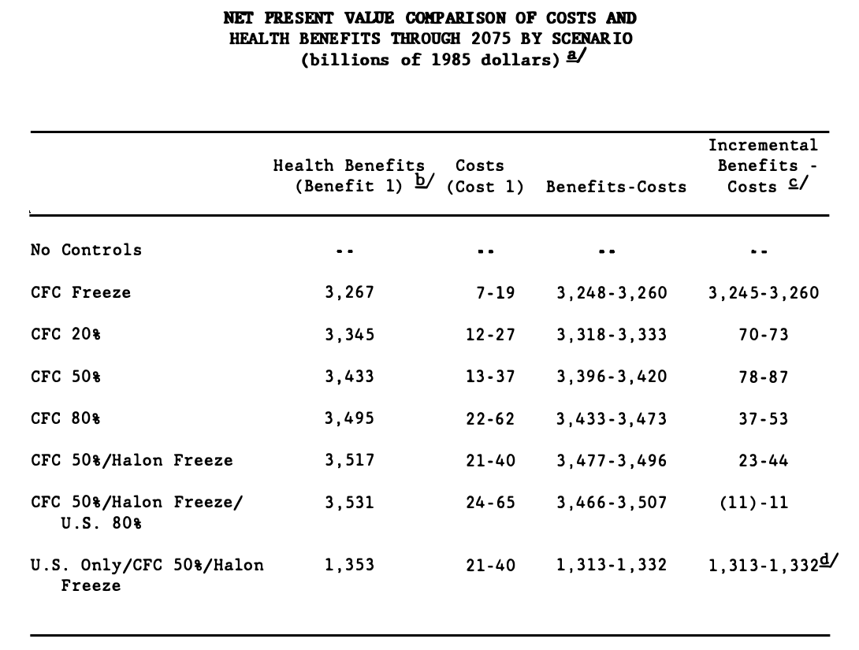
Chart - CFC Regulation - Net Present Value Comparison Of Costs And Health Benefits Through 2075 By Scenario

Slide 9
Structure of the Treaty

Slide 10
The Scope of the Original Treaty
The Montreal Protocol, adopted in 1987, originally identified eight ODS (ozone depleting substances) as controlled substances and set out control measures to freeze and reduce the production and consumption of these controlled substances.

Slide 11
Control Strategies
Articles 2A to 2I of the Montreal Protocol stipulate the control measures governing the consumption and production of controlled substances listed in Annexes A, B, C and E to the Montreal Protocol. These control measures are generally characterized by:
(a) initial freeze on consumption/production – generally tied to an historic consumption/production level;
(b) 100% phase-out by a specified date; and
(c) interim targets (i.e. stepped reductions).

Slide 12
Article 5 - Preferential treatment for developing signatories
Compared with developed countries, developing countries operating under Article 5 of the Montreal Protocol are entitled to a longer phase-out period for most of controlled substances listed in Annexes A, B, C and E7. In particular, they could delay by 10 years the implementation of the control measures agreed at the MOP held in London in 1990.
Against this, Article 5 parties could phase out the consumption and production of the relevant controlled substances in Annexes A and B (except for methyl chloroform ) by 2010, whereas the then corresponding phase-out date for non-Article 5 parties was 2000.

Slide 13
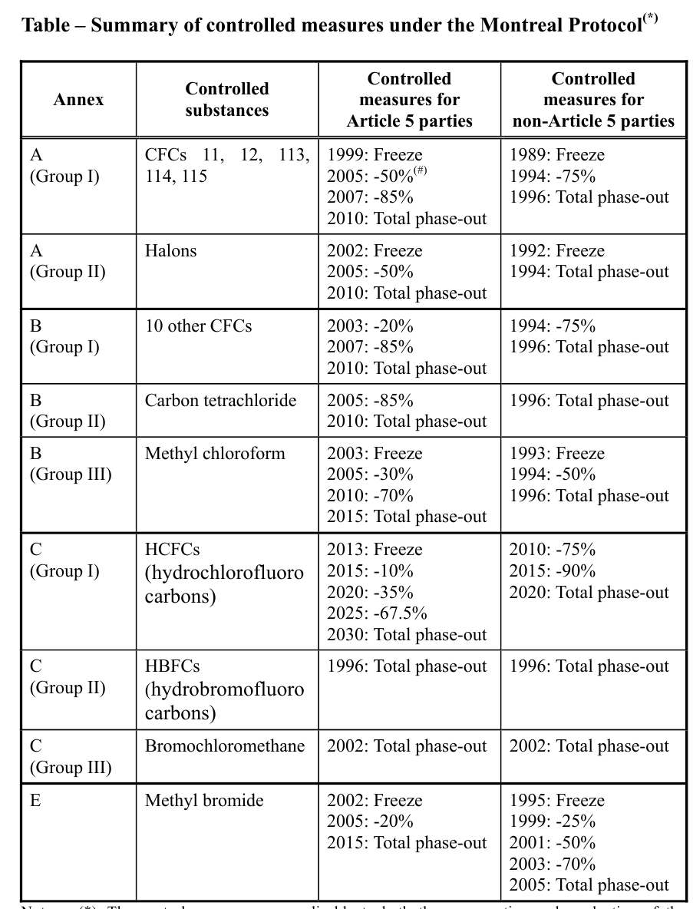

Slide 14
Trade measures under the Montreal Protocol
6.1 Article 4 of the Montreal Protocol prohibits trade in ODS between parties and non-parties to the treaty. According to UNEP, a non-party (with regard to a particular ODS) is any signatory country whose government has not ratified, accepted, approved or accessed the Montreal Protocol or one or more of its specific amendments that have introduced a particular ODS as a controlled substance.

Slide 15
Purpose of the Trade Restrictions
The trade restrictions serve to safeguard that the industries of the signatory countries would not be tempted to circumvent their obligations by importing controlled substances from non-parties, or to escape the phase-out schedules by migrating production to non-parties and then re-exporting the controlled substances for local consumption.
Since nearly every country signed, trade restrictions for non-parties became less important.

Slide 16
Incentivizing Compliance by Article 5 Parties
Under the Montreal Protocol, financial and technical assistance are provided to Article 5 parties to facilitate their compliance with the control measures set out in the treaty. Such an arrangement also serves as an incentive to encourage developing countries to accede to the Montreal Protocol. As to financial assistance, Article 10 of the Montreal Protocol prescribes for the establishment of a "Financial Mechanism" to facilitate the transfer of ODS substitutes and related technology to Article 5 parties.

Slide 17
The Multilateral Fund
The Multilateral Fund finances the "agreed incremental costs" incurred by Article 5 parties in phasing out their consumption and production of ODS9 . Since its commencement in 1991, the Multilateral Fund has undergone replenishment every three years with contributions by non-Article 5 parties.
This was politically acceptable because, at least initially, much of the money went back to developed world companies.

Slide 18
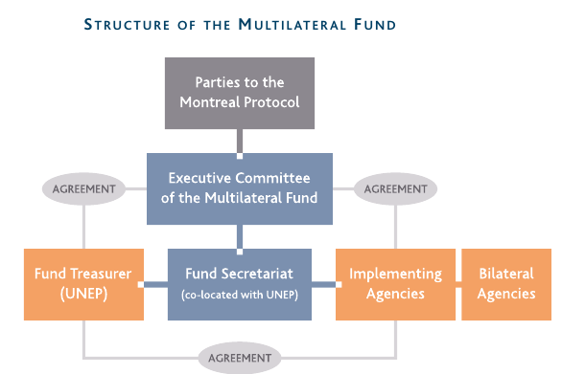

Slide 19
Technology Transfer
Article 10A of the Montreal Protocol further provides for the transfer of technology to Article 5 parties. In particular, all parties to the Montreal Protocol shall take "every practicable step" to ensure that "the best available, environmentally safe substitutes and related technologies are expeditiously transferred" to Article 5 parties "under fair and most favorable conditions".

Slide 20
The Montreal Protocol as a Process
The Montreal Protocol has put in place a mechanism for signatory countries to meet at least every four years to review the control measures prescribed under the Montreal Protocol and to introduce "amendments" and/or "adjustments" to the treaty if necessary . Since 1989, a total of 20 Meetings of the Parties to the Montreal Protocol (MOP) have been held.
After more than 20 years of development, the Montreal Protocol now covers 96 ODS in its list of controlled substances.

Slide 21
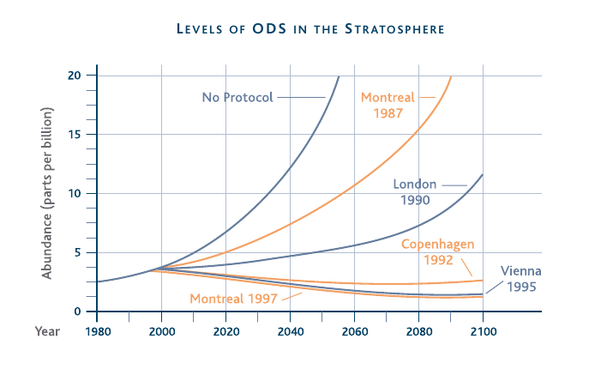

Slide 22
The Kigali Amendment – A Climate Amendment
On October 15, 2016, under American leadership, 197 countries adopted an amendment to phase down HFCs under the Montreal Protocol in Kigali, Rwanda. Countries committed to cut the production and consumption of HFCs by more than 80 percent over the next 30 years. This will avoid more than 80 billion metric tons of carbon dioxide equivalent emissions by 2050—avoiding up to 0.5° Celsius warming by the end of the century—while continuing to protect the ozone layer.
Under the amendment, developed countries will reduce HFC consumption beginning in 2019. Most developing countries will freeze consumption in 2024, with a small number of developing countries with unique circumstances freezing consumption in 2028.

Slide 23
What Makes the Montreal Protocol Successful?
Simple to understand threat to human health
Simple technical fix that only costs money, no change in behavior
Simple to handle developing/developed world division
Not extremely expensive to fix, and most of the money went to powerful companies.
Easy to add new chemicals to the Protocol

Slide 24
Threats to the Montreal Protocol
Since Kigali Amendment explicitly addresses climate change, it was opposed by the Trump Administration. It is supported by a large majority of the Senate, including Louisiana Senator Kennedy and industry.
It has now been approved by the Senate.
The exploding demand for air conditioning in the developing world and China is creating a black market in the cheaper, banned refrigerants and the old equipment that uses them.

