Slide 1
Suing the Government
Mini-Review

Slide 2
Sovereign Immunity – Federal Government
You cannot sue the government without its permission as given through legislation.
Embodied in the constitution in the appropriations clause:
Article I, Section 9, Clause 7
No Money shall be drawn from the Treasury, but in Consequence of Appropriations made by Law; and a regular Statement and Account of the Receipts and Expenditures of all public Money shall be published from time to time.
Limited by the 5th Amendment Takings Clause:
…nor shall private property be taken for public use, without just compensation.
Bivens is not a right to sue the government, but to sue government actors individually.
The government usually pays.

Slide 3
State Governments
State Claims
Most have sovereign immunity for state claims and a parallel appropriations clause.
Louisiana abolished sovereign immunity in the Edward Edwards constitution, but retained the appropriations clause: you can sue, but cannot get paid without an appropriation.
US Constitutional and Statutory limitations
The Takings Clause applies to the states.
Congress can create state liability which is litigated in federal courts
Judgements can be collected through the court’s contempt process, thus overriding state constitutional appropriations clauses.
42 USC 1983 is an example.

Slide 4
Flood Control Act of 1928
Mississippi Flood of 1927 leads to an expanded flood control appropriation in 1928.
There were flood control acts every decade or so to fund flood control efforts.
Flood Control Act of 1928, 33 U. S. C. §702c
"[n]o liability of any kind shall attach to or rest upon the United States for any damage from or by floods or flood waters at any place“
This does not change liability for takings and the federal government could not be sued for torts in 1928.
My best read is that it was a policy statement that the flood control acts do not create a duty to protect against flooding.
The Supreme Court has affirmed (Central Green) that this applies to all flood waters.
The 5th Circuit has refused to accept this ruling, otherwise the Katrina cases would have been dismissed on summary judgement.

Slide 5
Federal Tort Claims Act (1946)
Creates an administrative compensation scheme for tort claims against government employees and government agencies.
Only torts listed in the statute can be compensated under the FTCA
Adopts the law of the state where the claim arises as the controlling tort law.
Katrina cases were plead as Louisiana tort law.
Claims must be filed with the agency within 2 years of occurrence.
No jurisdiction if the claim is not filed with the agency first.
Cannot be waived by the court.
Agency actions on the claims can be appealed to the federal district court when the claim occurred.
If the agency does not act on the claim within 6 months, the claim is deemed denied and the denial can be appealed.
Claims appeals are tried by the judge, with no jury.

Slide 6
The Discretionary Function Exception
Same prima facie case as a state law tort against a private party.
The key difference is the DFE - 28 U.S. Code § 2680 - Exceptions:
(a)Any claim based upon an act or omission of an employee of the Government, exercising due care, in the execution of a statute or regulation, whether or not such statute or regulation be valid, or based upon the exercise or performance or the failure to exercise or perform a discretionary function or duty on the part of a federal agency or an employee of the Government, whether or not the discretion involved be abused.
The DFE prevents using tort claims to challenge policy decisions.
The government is immune from claims based on intentional choices that do not violate a federal statute or agency regulation.
There is no liability for failing to act unless the act is required by statute or regulation.

Slide 7
How to Screw Up an FTCA Claim
Assume that the government will settle.
Don’t comply with the notice provisions and go directly to court.
You must fully notice your claim, you cannot amend it later in court.
Many of the Katrina claims were not properly noticed and would likely have been dismissed if liability had been upheld.
Try to prove that the defendant acted intentionally and thus is a bad actor.
In private tort actions, you usually try to convince the jury that the defendant is a bad actor to generate sympathy and add zeros to the judgement.
There are some exceptions when the only coverage is an insurance policy that excludes intentional torts.
You do this by arguing that the defendant knew that its actions would put the plaintiff at risk, i.e., it was not just an unfortunate accident.
The Katrina lawyers core theory was that the Corps knew the levees were inadequate and did not fix them.
Let New Orleans drown.

Slide 8
Special Issues under the LA Tort Claims Act (Not on the exam.)
Once sovereign immunity was repealed, there is no need for the state’s permission to sue.
The main purpose of the LA TCA is apply the DFE to tort claims against the state.
The LA TCA applies nearly the same DFE as the FTCA.
State law precedent excludes proprietary activities – those that look like what private businesses do – from coverage by the LA TCA.
This means that they are not subject to the DFE.
Road and bridge building and design are an example, thus the successful claim against the state after the 1983 flood that a highway blocked drainage.
The same claim would have been covered by the DFE in an FTCA claim.

Slide 9
Lessons from the New Orleans Hurricane Cases
The courts reject a federal duty to protect communities against flooding.

Slide 12
MRGO
This was originally meant to be a short-cut to the Gulf for shipping on the Mississippi.
That was stopped by not authorizing a full size lock between the MRGO and the connection to the river.
Was then intended to be a place for new industry, modeled after the Houston Ship Channel.
That was impossible because it was built through pudding.
Mostly useless, leaving the Port of NO out of modern shipping.

Slide 16
Hurricane Betsy
1965

Slide 17
Hurricane Betsy Flooding

Slide 18
Impact of Hurricane Betsy
Flooded New Orleans as completely as Katrina
Killed very few people because the city took flooding seriously and was better prepared to evacuate.
The population of New Orleans was significantly higher in 1965 than in 2005 before Katrina.
No levee effect in 1965: people do not take flooding seriously if they are behind a levee.
Created the myth that flooding was due to the MRGO, which had just been completed.
Core to the story that New Orleans would be fine but for the federal government’s actions.

Slide 19
Hurricane Betsy and the MRGO
Hurricane Betsy hit New Orleans in 1965.
The MRGO was effectively finished in 1963.
As with other major storms, Betsy flooded New Orleans, putting as much water into the city as Katrina.
The city was better prepared and fewer people died that in Katrina.
As with all floods, there was a search for someone to blame and the MRGO was targeted.

Slide 20
MRGO and Hurricane Flooding in 1965
In 1965 there were no levees between the city and the MRGO.
The commonly believed theory was that the MRGO funneled water into the city, thus making the flooding worse.
This was also revived as part of the reason the levees failed during Hurricane Katrina.

Slide 23
The Science of the MRGO
Scientific analysis showed that the total cross-sectional volume of the MRGO was only a tiny fraction of the width of the surge front on the east of the city.
This meant that the MRGO could not have significantly increased the flooding during either storm.

Slide 24
Graci v. United States, 456 F.2d 20 (5th Cir. 1971)
Plaintiffs sue Corps under the FTCA claiming the MRGO caused the flooding in NO.
The 5th Cir Analysis of the FCA:
“A reading of the Act and the cases interpreting it all show that the negation of liability of the United States contained in § 702c for flood damage was aimed at flooding occurring in areas involved in actual or potential flood control projects.”
The 5th Circuit reads a flood control structure limit into the FCA.
This was not a crazy reading based on the cases that had been decided by 1967.
Since there were no flood control structures involved in the MRGO flooding claims, the court refused to dismiss the claims, despite the damages being caused by flood waters.

Slide 25
Key Factor that the Katrina Lawyers Missed in the Graci Case
The Graci court treated the FTCA claims as if they were ordinary private tort claims because the court found no negligence.
The DFE only comes up after you satisfy the prima facie case for negligence.
Thus, there was no need to discuss the DFE in the case.
The lawyers in the Katrina cases plead the Graci case in the same court as Graci, including that the Corps intentionally put the city at risk.

Slide 26
Key Hydrologic Finding From Graci on Remand
27. Hurricane Betsy, while unusually ferocious, was not the only hurricane to produce flooding in the areas occupied by plaintiffs' property. Since 1900, 88 hurricanes and tropical storms have traversed through or by the Louisiana coast. Three of these, in 1915, 1947, and 1956, prior to the construction of the MRGO, produced flooding similar to that experienced in Hurricane Betsy.
While the damage caused by Hurricane Betsy was far more severe than that occasioned during prior hurricanes, the severity and track of Hurricane Betsy are responsible therefor as opposed to any manmade construction such as the MRGO. Betsy was so severe that all the Louisiana coastal lowlands experienced some inundation and following Betsy's occurrence the scientific parameters for calculating hurricane protection were, of necessity, recomputed.
[Remember – Subsidence and sea level rise made New Orleans more vulnerable each year since the prior storms, and this continues.]

Slide 27
Basic Flood Control/Levee Concepts
Flood control systems are designed for a defined maximum storm conditions.
When those conditions are exceeded, the systems fail.
The Mississippi River system is intended to fail gracefully by opening flood gates and flooding low value land.
There is no graceful failure mode for hurricane levees.
They are designed to protect property and not to be relied on for life/safety protection.
Providing higher levels of protection comes at a cost
The system costs more, and the cost tends to go up as a power function, i.e., 2x as much protection might cost 10x as much.
Systems that provide higher levels of protection have bigger impacts
Levees have to get wider faster than they get higher. Parts of neighborhoods would be destroyed.
Multiple lines of levees provide much more protection but would carve up the city.

Slide 28
The Escalator/Levee Effect
As you provide statistical protection against risks, people assume that the protection is perfect.
When you build a flood control system, even when it is designed for a low level of protection, people assume that they are perfectly protected against all floods.
A lot of city building codes for flooding only require protection against 10 year floods, which means that you only get protection from routine rains.
The levee effect: building a levee will stimulate higher levels of construction and population density behind the levee.
Before the levee, frequent, low-level flooding inhibits development.
Once the frequent flooding is stopped, people assume that the levee provides perfect protection.
As we will see, the structure of the National Flood Insurance Program encourages this belief.

Slide 29
The Post-Betsy Levee System
Congress approves the construction of a levee system around New Orleans to protect against future storms.
This includes new levees and upgrading existing levees.
Congress is willing to pay for a levee to protect against the “standard storm” as defined in the 1970s. This is approximate a category 1 hurricane.
Remember, the city resisted flood control measures that would have changed the footprint or the existing pumping system.
Congress slow walks the money and the levee system is not completely finished in 2005.
The levee effect takes hold and housing is built up in New Orleans East, which is very low and thus a high-risk area.

Slide 30
What has been Happening Hydrologically in New Orleans Since Hurricane Betsy?
Sea Level has been rising.
The areas where the levees are located is subsiding.
Some levees, such as those between the MRGO and the city, are in a high subsidence zone.
Levees are made of packed clay and are very heavy. They increase the local subsidence rate.
Unless you use specialized GPS techniques, it is difficult to accurately measure small elevation due to subsidence, so the subsidence was not obvious.
The Corps was only funded to build the original levees, not rebuild subsiding levees.

Slide 31
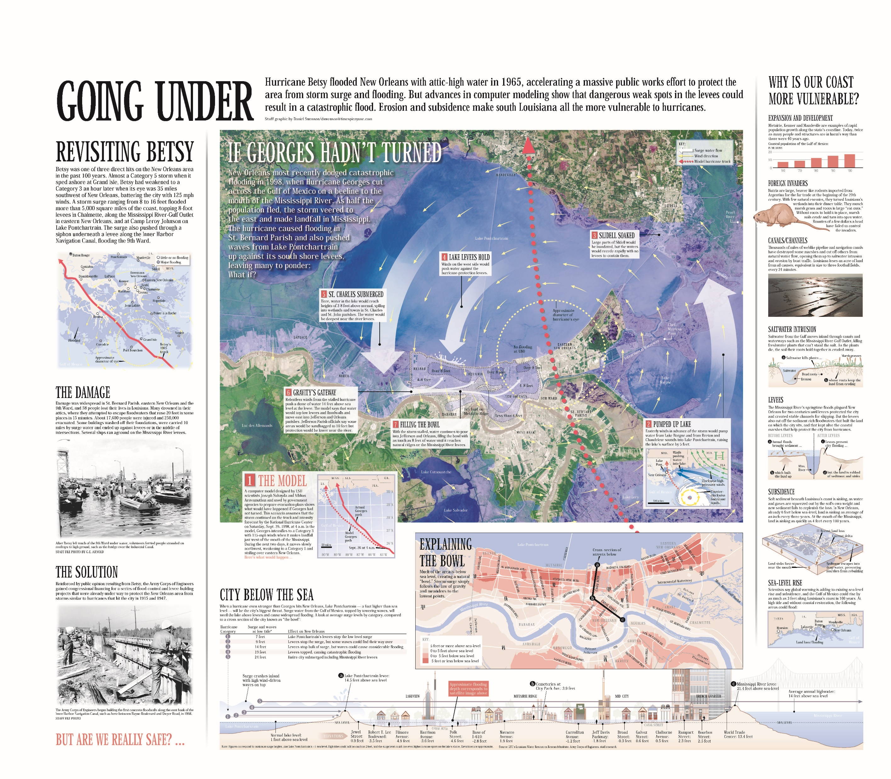

Slide 32
Washing Away: Worst-case scenarios if a hurricane hits Louisiana (2002)

Slide 34
Why did Katrina Flood New Orleans?
The core problem was that Katrina created a much higher and prolonged surge than the levees were designed for.
While much was made of various problems found in the construction of the levees, there is limited evidence that perfect levees would have done better.
The flooding from Lake Pontchartrain through the 17th Street Canal would have been prevented if the city had allowed the Corps to close the canals as it proposed in its original protection plan.
The secondary problem is that the protection provided by a levee starts to decay the day it is built. Levees require maintenance, which was legally the responsibility of the local levee boards.
The levee boards did not do this maintenance. For example, there had been ongoing leaks under the flood walls at 17th street because of poor maintenance and because the city allowed houses to cut into the toe of the levee supporting the flood walls.
The death total was so high because the city did not call for a timely evacuation and because people did not leave on their own.
The mayor never said that the city might flood.
Those who did leave left their treasured possessions because they discounted flooding.
Winds seldom kill – flooding is the killer.

Slide 35
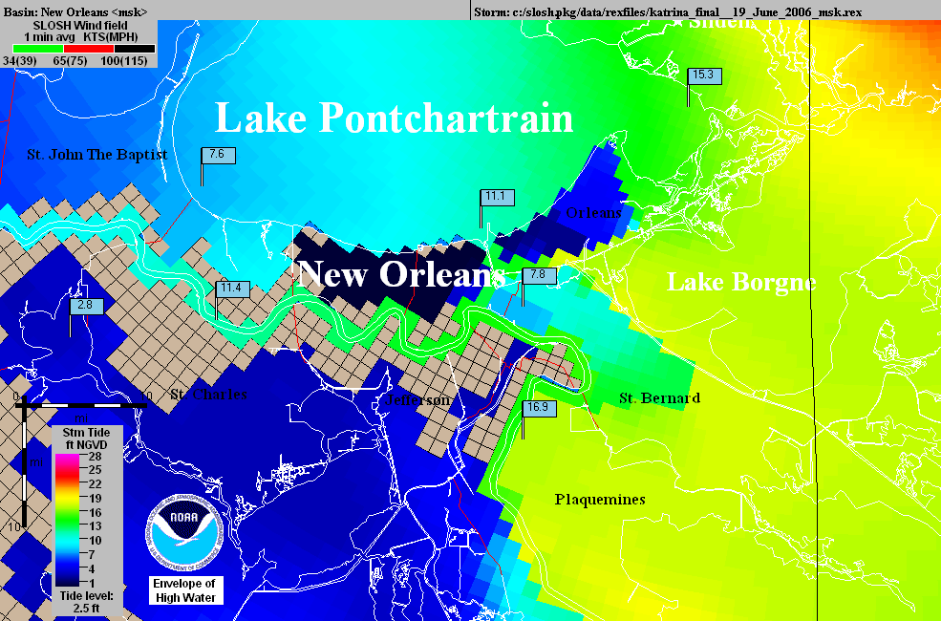
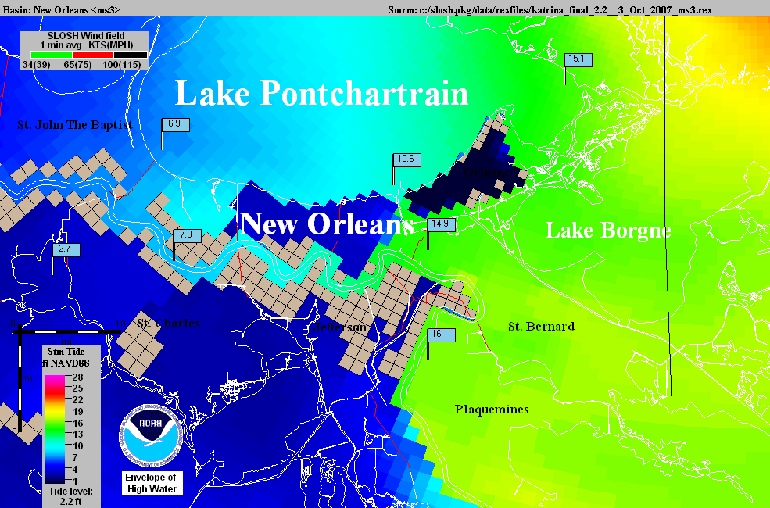
Operational
NHC Katrina
SLOSH model
using outdated
elevations.
The
“Hurricane
Highway”
Katrina SLOSH
hindcast using
accurate
elevations.

Slide 36
The Problems with the Plaintiffs’ Case in the Katrina Levee Breach Litigation
Factually, the plaintiffs’ experts used outdated elevation data for their models, in places assuming the elevation was 3 feet higher than the actual value. This created the illusion of the MRGO funnel that the court relied on.
Legally, the plaintiffs based their case on the theory that the Corps knew that there were problems with the levees and intentionally put New Orleans at risk by not fixing the problems. This claim is the prima facia case for the DFE. While it took the 5th Circuit two tries to figure it out, the case was eventually dismissed.
As a factual matter, this misunderstands the role of the Corps. Once levees are built, except for Mississippi River levees, they are the responsivities of the locals. If the locals want the Corps to work on them, their congresspersons have to put that in an appropriations bill.

Slide 37
The Katrina Mythology
That Katrina flooding was the fault of the federal government.
That all you need are good levees to be safe forever.
You see this in the huge property boom in New Orleans.
That New Orleans will be fine as sea level rises as long as the feds keep raising the levees and the locals do wetlands restoration projects.
The citizens keep voting down tax increases to support levee maintenance which is the local responsibility.
Congress is not good a funding projects between disasters.
Wetlands restoration is fantasy.
Little attention is paid to the risk of flooding from extreme rainfall.
The 2016 rain in New Orleans would flood the city nearly to Katrina levels.
The pumps can only handle ½ an inch an hour of rain, and that only if everything is working correctly and the street drains are clear.

Slide 38
Central Green Co. v. United States, 531 U.S. 425 (2001) – 702 before the USSC
California Water Project - irrigation
Take water from one area and spread it around the state
Land is damaged by seepage from the canal
Is this covered by the flood control act immunity?
The feds say that any flood control purpose puts all water related damages under flood control act immunity

Slide 39
Is there a Flood Control Purpose at All?
What happens when the snow melts too fast or there is a big rain in this system?
Does the irrigation system also handle flood water?
Does this make it entirely a flood control project, so that any damage is immunized?

Slide 40
The Holding in Central Green
The text of the statute does not include the words "flood control project." Rather, it states that immunity attaches to "any damage from or by floods or flood waters . . . ." Accordingly, the text of the statute directs us to determine the scope of the immunity conferred, not by the character of the federal project or the purposes it serves, but by the character of the waters that cause the relevant damage and the purposes behind their release.

Slide 41
Sorting out a Dual Purpose
If water project like an irrigation system also has a flood control purpose, the Act only grants immunity if the damage was caused by flood waters.
A dual-purpose project would be immune it when the damage was caused by flood waters.
Case was remanded to sort damages from leaking irrigation water from damages caused by flood waters in the system.
However, if the only purpose of the project is flood control, such as a levee, are all damages covered by the flood control act immunity?
How do you analyze this?

Slide 42
St Bernard Taking Case From Katrina Flooding
Brought under the Tucker Act.
The taking is the flooding of the plaintiffs’ property caused by not fixing the levees.
Tried in the Court of Federal Claims, essentially on the record from the FTCA case trial
Very flakey trial
Again, based on the MRGO funnel
This time the government presented extensive evidence disproving the funnel theory.
The court ignored the evidence and allowed it to be rebutted by an unqualified expert.
The CFC found that it was a taking, compensable under the Arkansas Game and Fish case which allowed compensation for temporary takings.
Appealed to the Federal Circuit.

Slide 43
St. Bernard Par. Gov’t v. United States, 887 F.3d 1354 (Fed. Cir. 2018)
While the case was reviewed on the record, the court noted in a footnote that the evidence indicated that the MRGO funnel was insignificant.
The court found that a taking must be active, i.e., since the government does not owe a community flood protection, there can not be a taking based on inaction.
The court also held that even if there is a taking, the damage calculation has to take into account the overall benefits of the flood control system.
The government could offset the damages by the diminished value of the property if there was no federal flood protection at all.
For much of New Orleans, the property would have no value without the flood protection systems.
Food for thought – this implies that the government could take down the levees without paying damages, since that would just remove the value of the system.

Slide 44
Developing Issues in Federal Flood Law
Both conservative property rights groups and liberal social justice groups have been pushing the courts to expand the definition of a taking to include flood damage caused by levee breaches and flooding from extreme storms that exceed the capacity of flood control systems.
The intent is to override FCA 702 and FTCA discretionary function immunity, making the federal government the insurer of flood control systems.
These cases have mostly failed so far. A Hurricane Harvey case found that residents who were flooded when the spillway of a dam was opened to prevent the dam from breaching, increasing the flow on the bayou controlled by the dam, could state a floodway easement right or temporary taking. The Court reversed the lower court’s summary judgment for the Corps and remanded for a fact finding.
Milton v. United States, 36 F.4th 1154 (Fed. Cir. 2022)

Slide 45
The Future
The levees were certified to provide 100-year flood protection, thus most people in New Orleans do not have to buy flood insurance.
As people drop flood insurance, there will be less recovery money for future floods.
In a few years, the levees will subside below the 100 year level and the levee board does not have the money to lift the levee.
Risk 2.0 is raising the cost of flood insurance inside and outside of the 100 year zone.
Hurricane damage is raising the cost of homeowner’s insurance.
As the city becomes an island, the levees will be destabilized, and it will be difficult and expensive to maintain to even current levels of protection.
City services are decaying as the economy weakens and jobs leave the city.
Containerized cargo on highly automated ships has eliminated most of the jobs from the port, the traditional jobs engine of port cities.
Company headquarters and financial institutions moved to Atlanta and Houston.
Less federal relief money will be spread over more disasters in the future, as we already see with the last hurricane seasons.
Storms are getting stronger and sea level rise increases flooding.

