Slide 1
Flood Risk and the NFIP

Slide 2
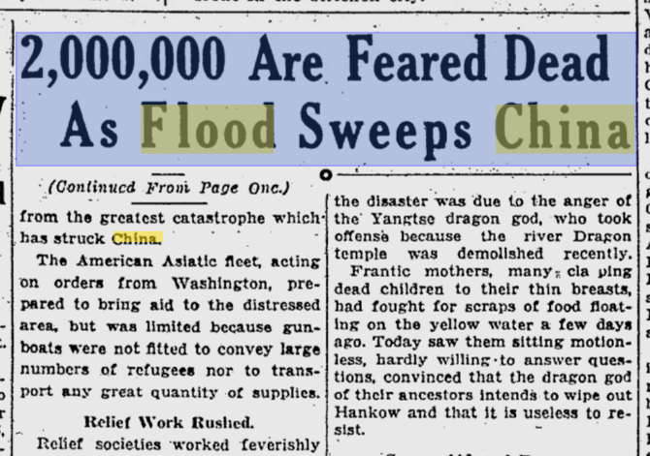

Slide 3
Floods are the Easiest Disasters to Predict and the Hardest to Avoid
Anonymous (frustrated) hydrologist

Slide 4
Determining Extreme Event Frequency
Determining the probably of an extreme weather event by measuring requires that you have a record that twice as long as the projected return period.
100-year event requires at least 200 years of data
500-year event requires at least 1000 years of data
1000-year event requires at least 2000 years of data
In most places in LA, robust rain and flood data goes back less than 100 years.
If you do not have the data, you have to use models.
The models assume that the present is like the past and thus underestimate extreme events. (Too Gaussian)

Slide 5
Expressing The Risk of Extreme Events
100 year
1% chance each year/26% chance during a 30 year mortgage
80% chance during a lifetime
500 year
0.2% per year/> 5% chance during a 30 year mortgage
1000 year
0.1% per year/> 8% chance during an average 83 year life time.
The Cognitive Dissonance problem
0.1% risk per year of a toxic injury would be considered huge and would generate massive regulation and litigation.
Look at the fears over tiny risks of vaccine injuries.

Slide 6
The Public Equates Rainfall to Flood Risk
It does not appreciate the non-linearity of floods

Slide 7
What Natural Factors Drive Flood Depth?
Topography
Flash floods in canyons
Broad, low floods on the pre-leveed Mississippi
Permeability – pavement versus grass
Is the ground already soaked?
Green infrastructure does not matter if you get a lot of rain.
Once the ground is saturated, it is not much different than concrete for absorbing new rain.
Are the drainage channels already flooded?
Near the coast, is storm surge backing up the rivers that drain the area?

Slide 8
Topography of Baton Rouge
Did we have notice of the flood risk before Baton Rouge was developed?

Slide 9
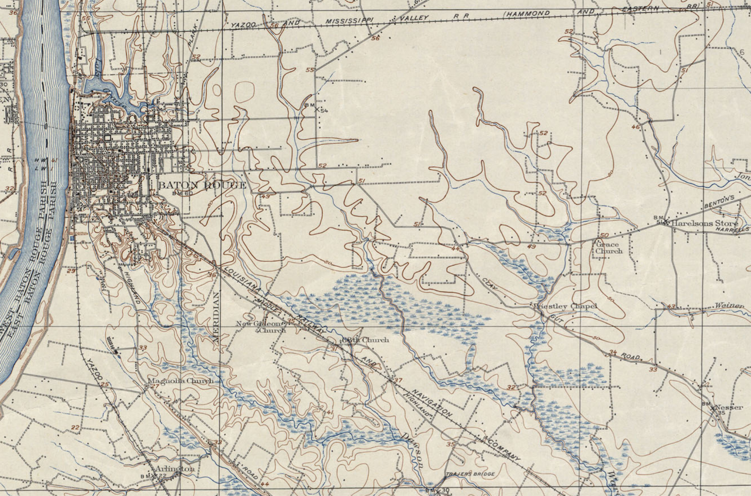
1906

Slide 10
How Does Development Change Topography?
Roads as dams and rivers
New drainage paths are created by ditching
Old drainage paths are filled with houses
Absorbent ground covered by impermeable surfaces
Major drainage projects import water as well as export it
Levees increase subsidence
Levees increase river flood height in the channel, increasing risk when the levees fail

Slide 11
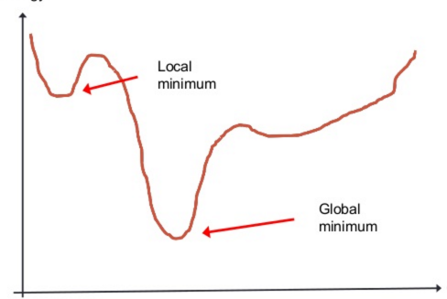
The Public Focus is on Elevation, not Local Minimums not Local Minimums

Slide 12
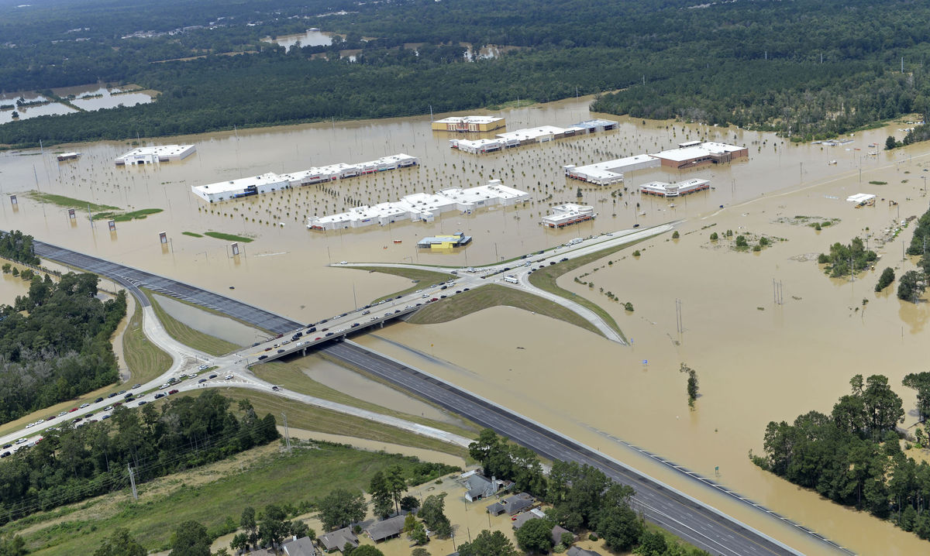

Slide 13
Why Don’t State and Local Governments Limit Development in Flood Zones?

Slide 14
Until the 1960s, Risk Followed Land Use Decisions
Modern disaster relief does not begin until the early 1960s.
There was no flood insurance and only private wind insurance.
Banks would not loan if you were at flood risk.
People did not build in flood zones if they had an alternative.
The Acadians and the indigenous peoples did not build slab on grade houses, they accommodated the flood risk.
While Congress would sometimes provide relief money, most of the cost of disasters fell onto state and local government.
Communities that suffered a very serious event or multiple events often disappeared.
There are several washed away towns in Louisiana.
Federal flood protection efforts were generally tied to navigation, such as the Mississippi River levee system.

Slide 15
The Federalization of Flood Risk
Kennedy expands the 1950s Civil Defense system into general disaster relief after the 1959 Hebgen Lake Earthquake and Hurricanes Donna and Carla.
After Hurricane Betsy in 1965, and additional inland floods, the pressure for federal flood insurance increases.
Congress creates the National Flood Insurance Program in 1968.

Slide 16
Theory of the Original NFIP
Conservative (narrow) definition of a high-risk flood zone.
Intended to be a federal spending power driven national land use plan for high-risk flood areas.
Land use decisions are seen as a local prerogative, both politically and constitutionally.
Communities can participate in the NFIP if their local governments use their zoning powers to limit future development in high-risk flood zones.
Pre-FIRM buildings (buildings built before the flood insurance rate maps) get subsidized rates as an incentive for communities to joint.
Existing and new building outside the high-risk flood zones get access to affordable flood insurance.

Slide 17
Reality of NFIP (Prior to Risk 2.0)
The definition of the high-risk flood zone in a particular place became a political decision.
New DFIRMs in New Orleans showing no risk.
Rejection of flooding as a continuous risk.
In the 100 year zone, you need flood insurance and are regulated
One inch out of the 100 year flood zone, and you do not need insurance and your premium is very low if you elect to buy it.
In theory, legacy pre-FIRM buildings gradually would disappear from the program.
In reality, grandfathering has expanded and includes homes in newly mapped flood risks.
Communities are allowed to game the system using fill.
Enforcement of standards for elevation and reconstruction are left to state and local governments, which benefit from allowing development and not requiring elevation after a flood.

Slide 18
Impact of Federalization of Flood Risk
Massive exodus to high risk riverine and coastal flood zones since 1968.
Creation of the belief that properties outside of the 100-year flood zone have no risk of flooding.
50% of claims come from outside the 100 year zone.
The feds provide relief to people who do not have flood insurance in big disasters.
Road Home, Hurricane Sandy, finally the Lake Charles hurricanes.
The feds provide massive infrastructure rebuilding as part of flood relief.

Slide 19
Disaster Economics
The poor are always worse off after disasters
The middle class and the rich may do fine or better economically after disaster in the United States because of federal programs.
Converting housing into insurance payments or federal relief money is a huge economic boost to construction and engineering businesses, which are very important to local politicians.
Look at the Louisiana economy after Katrina.
Federal relief will rebuild dilapidated governmental infrastructure to new standards at from zero to 35% state/local cost.

Slide 20
Why don’t Cities such as Baton Rouge Try to Reduce High Risk Development?
You make an enemy of every developer and contractor.
Social justice advocates want minority neighborhoods rebuilt in the highest risk areas.
You eliminate your own voters by limiting redevelopment in your district.
Planning usually looks at 10 – 25-year floods to minimize limitations on development.
Ironically, other zoning restrictions put huge restrictions on high density zoning or redeveloping historic districts, pushing more development into high-risk areas.

Slide 21
Does it Make Political Sense to Prevent Disasters?
Stricter flood elevation requirements in building codes reduce development and thus jobs and property taxes.
Local politicians get to play the hero during disasters and bolster their reputations.
Limitations on rebuilding hurt the poor, which provides political cover for allowing rebuilding in flood zones.
When the disaster comes, you get a ton more money if you have dead bodies and/or good disaster scenes for the evening news.
New Orleans would look a lot more like Detroit today without Katrina.
Bottom-line: it does not make political sense to prevent future disasters.
Disasters are good business as long as the feds come to the rescue.

Slide 22
Why the NFIP is Important even if There is Federal Relief
Federal aid money can take a long time to pass and have a lot of strings that makes it slow to roll out.
And it may never come.
NFIP policies are critical during disasters because insured homes will get money relatively quickly and the money can easily be spent on rebuilding.
Puts money in the local economy and get some of the housing back online.
It is to the interest of localities and states to provide incentives to encourage the purchase of flood insurance.

Slide 23
Are FEMA and NFIP Really Bipartisan Jobs Programs?
The FEMA buyback program is run by the states, which take years to do a buyback, assuring that people have to rebuild and thus miss the buyback.
The states get to decide whether properties are more than 50% damaged, requiring them to be meet the current flood standards.
No standards for properties outside the 100-flood zone.
FEMA and Congressional aid outside the NFIP is usually aimed to keeping people in the same place.
Congress often waives the local share for rebuilding projects and the feds seldom try to collect if the states or cities just do not pay what they owe.

Slide 24
Risk 2.0
Long term goal is to reduce or eliminate the subsidy for most flood insurance policies.
Rates all risk, not just risk in the 100-year flood zone.
Premiums for existing policies will rise by a max of 18% a year until they reach an actuarily sound level.
A few properties will see lower rates.
Most will see higher rates, and many will see much higher rates.
No low-income protections
Will create an opportunity for private flood insurance which did not exist for subsidized policies.
Will make it much more expensive to live coastal areas in Louisiana and in inland flood zones.

Slide 25
Louisiana Flood Cases
Both deal with the problems that arise from separating flood insurance from homeowner’s insurance.
Sher v. Lafayette Insurance Co., 988 So.2d 186 (La. 2008)
Is it still a flood if there were human factors in releasing the water, i.e., the theory that Katrina was a man-made flood.
Louisiana uses the commonsense definition of flood and flood waters.
All floods are excluded from homeowner’s coverage.
Nelson v. Americas Ins. Co., No. CV 17-850-JWD-RLB, 2019 WL 5684503 (M.D. La. Nov. 1, 2019)
Under the Louisiana Valued Policy Act, the total loss must come from the covered risk.
You do not get face value if part of the loss was caused by flooding, which is not covered by the policy.

