Slide 1
Hurricane Betsy and the Graci Litigation Recap RE: 702
Betsy flooded the city from the east by pushing water from the Gulf into the east side of New Orleans.
There were no federal levees on the east side, thus no federal flood control project to trigger 702, in the reading of the Graci court.
At the time of this decision, the 5th circuit was not the only circuit to read flood control structure into the Act.

Slide 2
Florida East Coast Railway Co. v. United States, 519 F.2d 1184 (5th Cir. 1975)
[Not in our reading.]
The damages in question here occurred adjacent to a federal flood control project as a consequence of its design and operation. According to the trial judge, one of the contributing factors was a heavy rainfall so extraordinary that the region was declared a flood disaster area.
Notes:
No, it overloaded the ancillary drainage

Slide 3
What is the definition of a flood?
…the term "floods and flood waters" as used in section 702c is sufficiently comprehensive to encompass the extraordinary rising of waters even in a place where water may often be found, such as the swampy area around the K-line. This is particularly true when the site of the rising waters is within a larger region designated a flood disaster area. In both instances the damage done to the railroad, though not the result of inundation of the line itself, resulted from the presence of flood waters around its roadbed.

Slide 4
Does it Matter that the US Was Negligent?
The federal courts, however, have reached a consensus that the United States is protected from liability for damages caused by "floods or flood waters" in connection with flood control projects, even when the government's own negligence has caused or aggravated the losses.
This makes it clear that FCA immunity is stronger than DFE immunity.

Slide 5
Central Green Co. v. United States, 531 U.S. 425 (2001)
California Water Project - irrigation
Take water from one area and spread it around the state.
During some periods of the year, it also acts as a flood control project.
Land is damaged by seepage from the canal
Is this covered by the flood control act immunity?
The feds say that any flood control purpose puts every water related damage under flood control act immunity.

Slide 6
The Question Before the Court
At issue in this case is the meaning of the words “floods or flood waters.” The narrow question presented is whether those words encompass all the water that flows through a federal facility that was designed and is operated, at least in part, for flood control purposes.

Slide 7
History
Accepting petitioner’s submission that the Madera Canal was used for irrigation purposes, the District Court nevertheless dismissed the complaint because the parties agreed that the canal was a part of the Friant Division of the Central Valley Project, and that flood control was one of the purposes of that project. The District Court’s decision was dictated by an earlier Ninth Circuit case, which held that if a ‘“project has flood control as one of its purposes, and the events giving rise to the action were not wholly unrelated to the project,’ ” immunity necessarily attached.
This is broader than Graci, which linked flood waters and a flood control structure.

Slide 8
United States v. James, 478 U. S. 597, 599 (1986)
Central question was whether 702 immunity covered personal injuries as well as property damage. (It does.)
The waters were clearly flood waters. Dicta in the case raised the issue of flood control structures:
"Nor do the terms 'flood' and 'flood waters' create any uncertainty in the context of accidents such as the ones at issue in these cases. The Act concerns flood control projects designed to carry floodwaters. It is thus clear from § 702c's plain language that the terms 'flood' and 'flood waters' apply to all waters contained in or carried through a federal flood control project for purposes of or related to flood control, as well as to waters that such projects cannot control.

Slide 9
The Confusion
The sentence that we have italicized and, in particular, the phrase “related to flood control” have generated conflicting opinions among the Courts of Appeals. In an attempt to make sense of what is admittedly confusing dicta, some courts have focused on whether the damage relates in some, often tenuous, way to a flood control project, rather than whether it relates to “floods or flood waters

Slide 10
The Holding in Central Green
The text of the statute does not include the words "flood control project." Rather, it states that immunity attaches to "any damage from or by floods or flood waters . . . ." Accordingly, the text of the statute directs us to determine the scope of the immunity conferred, not by the character of the federal project or the purposes it serves, but by the character of the waters that cause the relevant damage and the purposes behind their release.

Slide 11
Sorting out a Dual Purpose
If a water project like an irrigation system also has a flood control purpose, the FCA immunity only applies to damage caused by flood waters.
Would this mean that a pure navigation project would be immune if damages came from a flood?
However, if the only purpose of the project is flood control, such as a levee, are all damages covered by the flood control act immunity?
What if the damages are not due to flood waters, but a construction crane falling?

Slide 12
Subsequent History
The case was remanded with instructions to the lower court to sort out damages related to chronic seepage from the system from those caused by flood waters.
There are no reported rulings after remand. The case was likely settled at that point.
After Central Green, it seems clear that the FCA immunity is tied to flood waters, not flood control structures.

Slide 13
The Hurricane Katrina Levee Breach Litigation

Slide 14
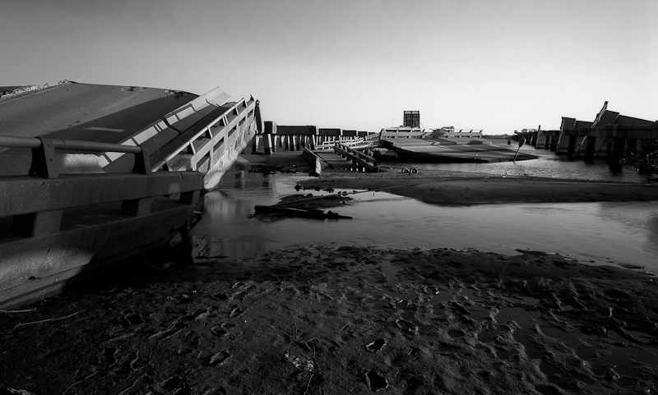

Slide 15
Hurricane Protection for New Orleans
As the Graci court reminded us, New Orleans had flooded three times since 1900.
The Corps had been studying flood control for the city for decades.
As it was building the MRGO, it was also designing a flood protection system for New Orleans

Slide 19
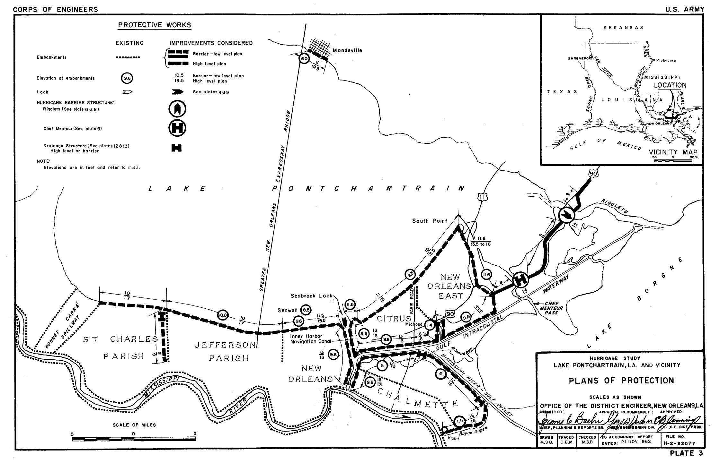
Ring Levees
Barrier Across the opening of Ponchartrain
Close off drainage canals that run to the lake

Slide 20
Post-Betsy Levee System
The Corps is charged with developing a flood protection plan for New Orleans.
It starts with the 1962 draft plan.
The barrier across the mouth of Lake Ponchartrain was challenged in one of the first NEPA lawsuits.
The parishes objected to closing the drainage canals.
It would be more expensive for them to pump the storm sewer water over the levees than to leave cuts in the levees.
The 1962 plan is abandoned in favor of ring levees only.

Slide 21
Weaknesses in the Ring Levee Approach
A failure breach anywhere in the system floods everything in the ring.
The city could be compartmentalized with more levees, but that would eat up residential neighborhoods.
Every drop of rain that is not absorbed has to be pumped out.
The 2016 BR rainfall in NO would look like Katrina because the pumps can only pump 1 inch of rain the first hour and 0.5 inch an hour after that.
Think about Hurricane Harvey.
The pumping hastens the subsidence inside the levee.
The canals to Lake Pontchartrain are left cutting through the levees.
If their walls fail, the lake flows inside the ring levee.

Slide 22
Understanding the Army Corps of Engineers (Corps)
The Corps starts as a purely military unit, with the engineers mostly trained at West Point.
It did military construction as ordered.
While it has expert technical capabilities, it does not make policy - it builds what it told to build.
Engineers build projects within the supplied constraints.
Budget
Time
Other political or strategic constraints
It will build projects that do not work, cause massive damage, and endanger lives, if that is what it is directed to do.

Slide 23
Politics and Corps Projects
The Corps did not build what it saw as the best protection for NO because of political opposition.
The system that was built was a balance of the money available and the political opposition to higher levees.
The base of a levee has to broaden as power function of the height.
Higher levees would have taken much more land and been much more expensive.
When construction was started, Congress slow walked the money, constantly interrupting construction.
Areas were still incomplete when Katrina hit.
Flood control projects are maintained by the locals, not the Corps. The NO levee boards did not do their job.

Slide 24
Changing Conditions
The Corps realized that subsidence was changing the height of the levees as the system was being built.
Congress made no provision for raising already constructed levees.
Although the Corps did not realize it at the time, even the reference elevation benchmarks were low.
The Corps knew that the MRGO would widen over time because of the marsh it was cut through.
It did not attempt to stop this because solutions such as riprap – rock borders – would only sink and the water would get behind them.

Slide 25
Background for MRGO - Graci
Graci told us that FCA immunity does not attach unless a project has a flood control purpose.
MRGO did not have a flood control purpose
FCA immunity did not attach
Still no liability because there was no negligence
Post-Graci the Corps built flood control levees between the city and MRGO
The court has to get the flood water past those levees without trigger the FCA.

Slide 26
In re Katrina Canal Breaches Consolidated Litigation, 647 F.Supp.2d 644 (E.D.La. 2009)
The government defended this case on immunity and presented only limited expert testimony to rebut the facts.
FCA and FTCA
The Court recognizes that it must distinguish this case from the 17th St. Canal cases. It comes up with the rationale on the next slide. (P2 in the case)

Slide 27
The 17th Street Case
Flood walls failed on the 17th St. Canal, leading to the case you read about the FCA immunity.
The 17th Street case established that the 17th St. Canal was a pure flood control structure and that FCA immunity applied under a Graci analysis.
This case court refused to find that FCA immunity applied to the claims involving the levees that protected against MRGO flooding, letting this trial go forward.
Both of these ruling effectively ignored Central Green.

Slide 28
Core Theory of the Case
MRGO, combined with the Intercoastal Canal, created a high pressure funnel that pushed water into the city.
MRGO's widening with time weakened the flood control levees.
The combination lead the levees to fail.
But is this really what happened at all?

Slide 29
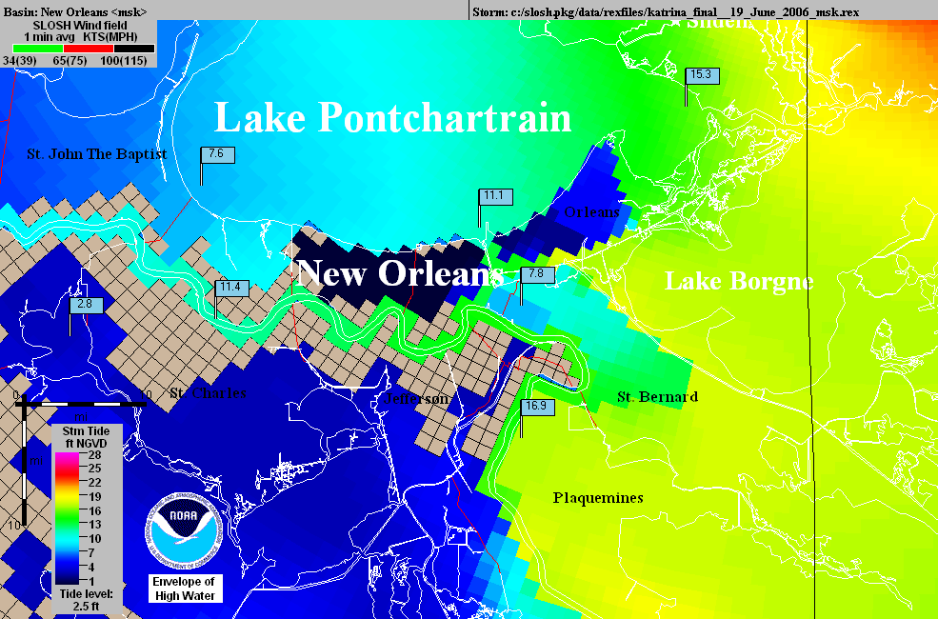
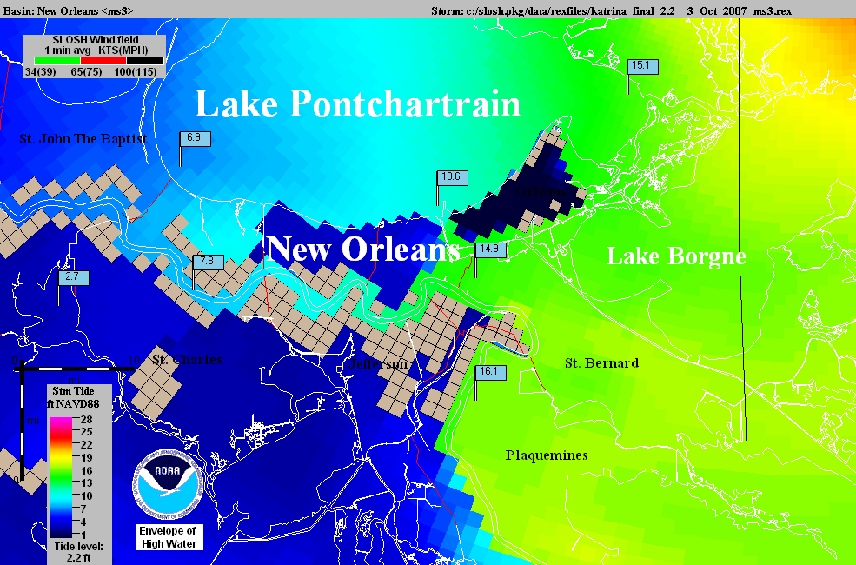
Operational
NHC Katrina
SLOSH model
using outdated
elevations.
The
“Hurricane
Highway”
Katrina SLOSH
hindcast using
accurate
elevations.

Slide 30
Stopped Here

Slide 31
The Rationale For Not Allowing 702 Immunity
“For example, would the United States be immune for all damages if a Navy vessel lost control and broke through a levee where the sole cause of the failure of that levee was the Navy vessel’s negligence?
Thus contrary to the Government’s contention that Central Green broadens the immunity provided by § 702c, in realty Central Green requires the Court to identify the cause of the damage rather than base a decision on the mere fact that a flood control project was involved. Central Green does not answer the question of what nexus to a flood control project is required for floodwaters to trigger immunity.”

Slide 32
Is the Katrina Court’s Reading of Central Green Correct?
"... in realty Central Green requires the Court to identify the cause of the damage rather than base a decision on the mere fact that a flood control project was involved.."
That is correct – Central Green does not rely on flood control structures. It does focus on whether flood waters caused the damage:
Accordingly, in determining whether §702c immunity attaches, courts should consider the character of the waters that cause the relevant damage rather than the relation between that damage and a flood control project. (par 53)
What was the hypothetical ship made of?
What caused the damage once the levee was breached?

Slide 33
MRGO
The first 10 pages discuss the history of the MRGO and outline the construction of the levees between the MRGO and the city
Sec. 3, p10, begins the discussion of how MRGO increased the likelihood of a flood and what the Corps knew about this.
Remember, there is nothing objective in this opinion, the court only has information from the briefs of the parties, and only uses what it chooses.

Slide 34
What did the Corps Know?
The court is trying to bootstrap FTCA liability by using the Corps knowledge to create a theory of a non-flood control project error that would not be subject to FCA immunity.
The problem is that the more the Corps knows, the stronger the DFE immunity.

Slide 35
The Erosion of MRGO
A key to the attack on the FCA immunity is that the real issue is the improper maintenance of MRGO.
According to the court, waves pushed by sea going vessels are a major source of this erosion.
P 14 has evidence of this erosion presented by the Corps
This establishes that the Corps knew this.

Slide 36
Armoring MRGO
The plaintiffs argue, and the court buys this, that the Corps had a duty to put riprap along the navigation channel to prevent erosion.
Are there reasons why the Corps might not do this?
The Corps argues that armoring the MRGO was part of the decisionmaking in the Lake Pontchartain and Vicinity Hurricane Protection Plan (“LPV”), thus tying it to the flood control system.
Should this matter under Central Green?
The Court rejects this, finding:
"The fact remains that the failure to provide foreshore protection worked as the Navy vessel hitting the levee."

Slide 37
Is this a Discretionary Function?
P 25 - The court says that a Corps report acknowledged that MRGO should be armored and that the Corps failed to seek funding.
Is seeking funding from Congress a Corps duty?
Can the Corps be negligent in failing to get Congress to fund a project that Congress knows all about?

Slide 38
The Effect on the Flood Control Levee
From P 41-87 the court moves from the story of the failure to armor MRGO to the effect of this failure on the flood control levees.
The court argues the levees were too low and had other problems because the Corps did not properly factor in effects of the eroding soil related to MRGO on the levees.
The court is using plaintiff's geology. The real problem is that subsidence, plus some ocean rise, has changed the elevations and destabilized the area.
What is the FCA problem with this analysis?
It only matters if flood waters wash the levees away.
The court rejects plaintiffs' argument that the Corps had a duty to build a surge barrier.
The court recognizes this is an FCA issue.

Slide 39
Causation
Based on the foregoing analysis, the Court finds that the Corps’ negligent failure to maintain and operate the MRGO properly was a substantial cause for the fatal breaching of the Reach 2 Levee and the subsequent catastrophic flooding of the St. Bernard Polder occurred. This Court is utterly convinced that the Corps’ failure to provide timely foreshore protection doomed the channel to grow to two to three times its design width and destroyed the banks which would have helped to protect the Reach 2 Levee from front-side wave attack as well as loss of height. In addition, the added width of the channel provided an added fetch which created a more forceful frontal wave attack on the levee.

Slide 40
The Navy Vessel Metaphor
As the court tells us at the beginning, its analysis is based on the dicta in Graci that the government might be liable if a Navy vessel having nothing to do with flood control crashed through a levee. On P 89 the ship comes in:
"Finally, the white encased numbers show the pre-Katrina sill heights and the teal marks show with accuracy and specificity the effect of the Corps’ failures on its own levee–the specific breaches and the resulting sill heights. Indeed, a picture speaks a thousand words. The Corps’ “Navy vessel” devastated this levee."

Slide 41
The Navy Vessel and Central Green
While the Court stepped away from flood control structures earlier, it returns to them as the test for 702:
Thus, the Corps’ decisions were made in the context of the MRGO project, not within the context of the LPV. ...Thus, the failures at issue here are extrinsic to the LPV and are not subject to §702c immunity. There is no reason for the Court to revisit its decision with respect to the Flood Control Act, and it will not do so.
That is all we get.

Slide 42
FTCA and MRGO
The remainder of the opinion, 50 or so pages, is a detailed discussion of how the court decides that the Corps was negligent in the maintenance of MRGO and why not armoring the MRGO was a ministerial (non-discretionary) act.
This is based on the notion that failing to do so put the region at risk and that the Corps had a duty to protect the city - the court dealt with Allen by not even citing it.
Even using the Court’s flood control structure requirement for 702, once the levees were built, the decisions about armoring MRGO became system decisions of the LPV overall flood control plan, which would trigger 702 immunity under the Court’s analysis.

Slide 43
5th Circuit
In spring 2012, a 5th Circuit panel upheld the district court, based on its own analysis in Graci and the trial court’s finding that the Corp had duty to protect NO and thus its decisions about the MRGO were negligent.
The government moved for en banc rehearing.
I published an online article in the Penn Law Review criticizing their opinion, which was otherwise supported by the environmental law bar.
After several months, the original panel withdrew its opinion and substituted a new opinion on its own motion.
This is very unusual.

Slide 44
In re Katrina Canal Breaches Litigation, 696 F.3d 436 (5th Cir.(La.) 2012)
Distinguishing Central Green:
Thus, after Central Green, waters have the immune character of "flood waters" if the government's link to the waters is through flood-control activity. That is to say, the government's acting upon waters for the purpose of flood control is flood-control activity, and flood-control activity is what gives waters an immune "character." We therefore reject the government's interpretation of the scope of Section 702c and conclude, instead, that the United States enjoys immunity under that section only where damages result from waters released by flood-control activity or negligence therein.

Slide 45
Moving Toward Central Green
Thus, for example, if the government had attempted foreshore protection inside MRGO, but that protection (whether by design or negligence) caused or exacerbated flood damage, the district court's rule would grant the Corps no immunity, because MRGO was not a flood-control project. Our rule, by contrast, attaches immunity if the foreshore protection had flood control as its purpose-that is, if installing and maintaining foreshore protection was a flood-control activity regardless of the nature of MRGO, the overall project.

Slide 46
But Not Very Far
Thus, the government cannot claim Section 702c immunity for MRGO's role in breaching the Reach 2 levee. The dredging of MRGO was not a flood-control activity, nor was MRGO so interconnected with the LPV as to make it part of the LPV. Therefore, the flood waters that destroyed the plaintiffs' property were not released by any flood-control activity or negligence therein.

Slide 47
DFE on Armoring
Although the Corps appears to have appreciated the benefit of foreshore protection as early as 1967, the record shows that it also had reason to consider alternatives (such as dredging and levee "lifts") and feasibility before committing to an armoring strategy that, in hindsight, may well have been optimal. The Corps's actual reasons for the delay are varied and sometimes unknown, but there can be little dispute that the decisions here were susceptible to policy considerations. Whatever the actual reasons for the delay, the Corps's failure to armor timely Reach 2 is shielded by the DFE.

Slide 48
Bottom Line
Unfortunately for the Franzes, our application of the DFE moots their causation argument. Because the Corps may not be held liable for damages stemming from MRGO's role in the St. Bernard flooding, we reverse the partial judgment in the Franzes' favor and instead find for the government in full.

Slide 49
The Aftermath
The biggest non-legal problem with this case is that almost all of the geology, hydrology, and ecology in the opinion is junk science. But people will believe it because the court said it is true.
Like the breast implant litigation and many other cases.
Cert. was denied in the case, so, as with Graci, the Corps wins, but for the wrong reason.
It may be that Graci never gets corrected in the 5th Circuit because the Corps will always win on DFE in cases that would trigger 702 under Central Green.

