Slide 1
Chapter 15 – Cyber Operations
Part I

Slide 2
Cyber
“A failure by the Department to secure its systems in cyberspace would pose a fundamental risk to our ability to accomplish defense missions today and in the future.”
                - 2010 Quadrennial Defense Review
“… four key characteristics of cyber space: open to innovation, secure enough to earn people’s trust, globally interoperable, and reliable.”
-2011 International Strategy for Cyberspace

Slide 3
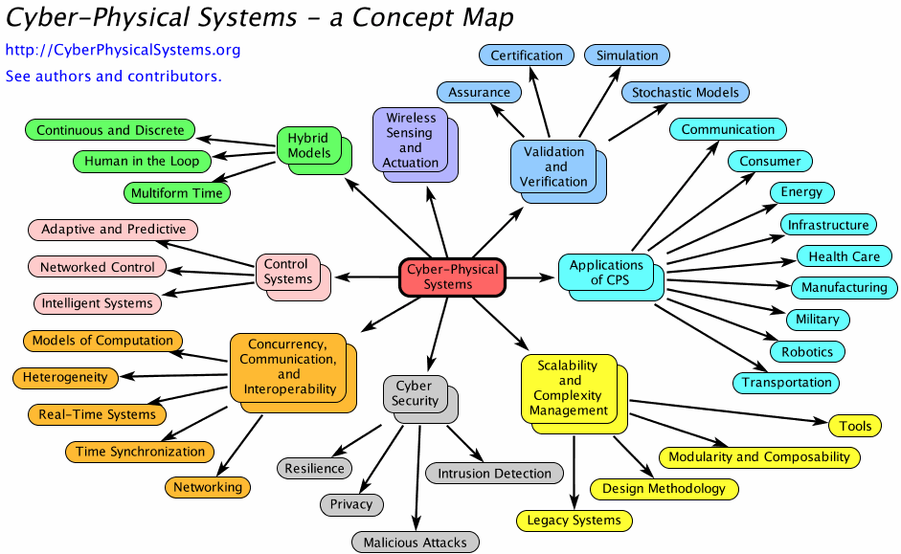
Cyber Physical Systems
Brian Connett, LCDR, USN
US NAVAL ACADEMY

Slide 4
Cyberspace Defined
Ubiquitous, overlapping domains
“A global domain within the information environment consisting of the interdependent network of information technology infrastructures, including the internet, telecommunications networks, computer systems, and embedded processors and controllers …”
“… common usage of the term also refers to the virtual environment of information and interactions between people.”
  National Security Presidential Directive 54/Homeland Security Presidential Directive 23 (NSPD-54/HSPD-23)

Slide 5
Progress of Security Attacks
Threat Type | Year: Example Threats
Experiment | 1984: Fred Cohen publishes “Computer Viruses: Theory and Experiments”
Vandalism | 1988: Jerusalem Virus deletes all executable files on the system, on Friday the 13th. 1991: Michelangelo Virus reformats hard drives on March 6, M’s birthday.
Hactivism | 2010: Anonymous’ Operation Payback hits credit card and communication companies with DDOS after companies refuse to accept payment for Wiki-Leaks.
Cyber-crime | 2007: Zeus Trojan becomes ‘popular’; turns computers into zbots and spyware steals credit card (CC) numbers. 2008-9: Gonzales re-arrested for implanting spyware on WLANs, affecting 171 M CC. 2013: In July 160 M CC numbers are stolen via SQL Attack. In Dec. 70 M CC numbers are stolen through Target stores. 2016-7: Ransomware charges $522 to decrypt your disk; Petya/NotPetya does not. 2017: Cryptocurrency coin mining
Information Warfare | 2007, 2008: Russia launches DDOS attack against Estonia, Georgia news, gov’t, banks 2010: Stuxnet worm disables 1000 of Iran’s nuclear centrifuges. 2016-7: N Korea Lazarus stole $81 M Bangladesh Centralbank, releases WannaCry ransomware to fund military operations.
Surveillance State | 2012: Chinese affiliations attack U.S. businesses to steal intellectual property. 2013: Lavabit closes secure email service rather than divulge corporate private key to NSA without customers’ knowledge.

Slide 6
History of Cyber-WAR
YEAR | FROM -> TO | ATTACK DESCRIPTION
2007 | Russia -> Estonia | DOS attacks on gov’t, financial inst., news
2008 | Russia -> Georgia | DOS attacks on Internet, gov’t websites
2008 | US -> US | Malware to top aides of pres. candidates
2009 | China->Embassies, foreign ministries | GhostNet malware: Command & Control software
2012 | US, Israel -> Iran | Stuxnet Worm disables nuclear facilities
2010 | India <->Pakistan | Hacker groups hit gov’t websites
2011 | China -> Canada | Spyware virus causes shutdown of economic agencies
2012 | -> Iran, Middle East | Flame cyber-espionage malware
2013 | N. Korea -> S. Korea | Dark Seoul Malware hits TV, banks; makes computers unusable.
This and related slides, with thanks to Susan Lincke

Slide 7
Types of Attackers

Slide 8
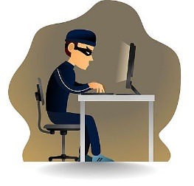


Crackers
System Administrators
Some scripts are useful
to protect networks…
Get info from hacker
bulletin boards
Cracker:
Computer-savvy
programmer creates
attack software
Dark Web
For Sale:
Credit Cards
Medical Insurance
Identification
Malware
Script Kiddies:
Know how to
execute programs
Criminals:
Create & sell botnets -> spam
Sell credit card numbers,…
Nation States:
Cyber-warfare, spying, extortion, DDOS
Crimeware or
Attack Kit=$1K-2K
1 M Email addresses = $8
10,000 PCs = $1000

Slide 9
Other Hackers/Crackers:
Cyberterrorists
Cyberwar: National governments attack IT
Espionage: Accused: Russia, North Korea, China, France, South Korea, Germany, Israel, India, Pakistan, US.

Slide 10
Types of Attacks

Slide 11



Social Engineering
I need a password reset. What is the passwd set to?
Email:
ABC Bank has
noticed a
problem with
your account…
This is John, the System Admin. What is your password?
I have come to repair your machine…
What ethnicity are you? Your mother’s maiden name?
and have some software patches
Notes:
Always be sure who you’re talking to before you give out information

Slide 12
Social Engineering
Phishing
Gain Foothold
Malware>67%
Pretexting
Dialogue
Technique:
Financial 59%
Spying 41%
Techniques:
Goals:
Obtain info, influence
Malware 10%
CEO impersonation
Goals:
Financial: 95%
Human resources: W2 info->fraudulent tax returns
Finance: transfer $
93% of Breaches
Prominent technique: email 96%
  Malicious attachment
  Link to pharming website
78% do not click a single phish all year;
4% phish acceptance rate
Verizon 2018 Data Breach Investigations Report

Slide 13
Phishing =
Fake Email
ABC BANK
Your bank account password is about to expire.
Please login…
Spearfishing
John:
Could you send Automated Services $1200?
Joe (CEO)
The bank has found
problems with your
account.
Please contact …”
Notes:
“Greetings to good sir in USA. I am here wishing to offer you a good bargain in exchange for your help. You understand, I must now leave my home country of Nigeria where I have the ten million Euros in the bank, but I need a new place where to transfer it so when I reach my new home I can still feed my children. If you would please to offer me your bank number and information I will immediately send to you one million of the Euros…”

Slide 14
Stopped here

Slide 15

Pharming = Fake web pages
Pharming:
A fake web page may lead to a real web page
The fake web page looks like the real thing
  Extracts account information
www.abc.com
www.abcBank.com
Login
Passwd
Welcome
To ABC
Bank

Slide 16
Drive-By Download
Games:
Vampires and Wolfmen
Planet of the Apes
Dungeons and Dragons
A web site exploits a vulnerability in the visitor’s browser when the site is viewed

Slide 17
Malware
Malware is a term used to describe malicious software, including spyware, ransomware, viruses, and worms. Malware breaches a network through a vulnerability, typically when a user clicks a dangerous link or email attachment that then installs risky software. Once inside the system, malware can do the following:
  Blocks access to key components of the network (ransomware)
  Installs malware or additional harmful software
  Covertly obtains information by transmitting data from the hard drive (spyware)
  Disrupts certain components and renders the system inoperable

Slide 18
Man-in-the-middle attack
Man-in-the-middle (MitM) attacks, also known as eavesdropping attacks, occur when attackers insert themselves into a two-party transaction. Once the attackers interrupt the traffic, they can filter and steal data.
Two common points of entry for MitM attacks:
  1. On unsecure public Wi-Fi, attackers can insert themselves between a visitor’s device and the network. Without knowing, the visitor passes all information through the attacker.
  2. Once malware has breached a device, an attacker can install software to process all of the victim’s information.

Slide 19
Denial-of-service attack
A denial-of-service attack floods systems, servers, or networks with traffic to exhaust resources and bandwidth. As a result, the system is unable to fulfill legitimate requests. Attackers can also use multiple compromised devices to launch this attack. This is known as a distributed-denial-of-service (DDoS) attack.

Slide 20
Distributed-denial-of-service, or DDoS, attack
A distributed-denial-of-service, or DDoS, attack is the bombardment of simultaneous data requests to a central server. The attacker generates these requests from multiple compromised systems.
In doing so, the attacker hopes to exhaust the target’s Internet bandwidth and RAM. The ultimate goal is to crash the target’s system and disrupt its business.

Slide 21
SQL injection
A Structured Query Language (SQL) injection occurs when an attacker inserts malicious code into a server that uses SQL and forces the server to reveal information it normally would not. An attacker could carry out a SQL injection simply by submitting malicious code into a vulnerable website search box

Slide 22
Zero-day exploit
A zero-day exploit hits after a network vulnerability is announced but before a patch or solution is implemented. Attackers target the disclosed vulnerability during this window of time. Zero-day vulnerability threat detection requires constant awareness.
Most military and government software is the same COTS (commercial off the shelf) software that you use.
Microsoft Update Tuesday

Slide 23
Advanced Persistent Threat
Advanced: Combination of custom & common malware
  Target: Business or Gov’t data/operation
Persistent: Extended period attack until target is compromised – often data is mined until the attack is detected.
Threat: Organized, capable, well-funded attacker
  Source: Gov’t or criminal enterprise

Slide 24
Information War/Cyber War

Slide 25
Russian-US Example
Is an escalated state of cyber conflict between or among states in which cyber attacks are carried out by state actors against cyber infrastructure as part of a military campaign
  Declared: that is formally declared by an authority of one of the parties.
  De Facto: with the absence of a declaration.
Cyber conflict: is a tense situation between or among nation-states or organized groups where unwelcome cyber attacks result in retaliation.
Cyber attack: is an offensive use of a cyber weapon intended to harm a designated target.
Cyber infrastructure: is the aggregation of people, processes and systems that constitute cyberspace.

Slide 26
Estonia, 2007?
Attacks came from 178 countries, including large botnets
Attacker could not be definitively attributed to a nation-state
CERT-EE and NATO classified it as a “cyber riot”
Did not trigger NATO Art. 5, requiring “armed attack”
Ultimately characterized as “patriotic hacking”
Estonian government chose to treated as cyber crime
Attempted to use MLAT and letters rogatory but Russia refused
Notes:
CERT-EE is Computer Emergency Response Team-Estonia

Slide 27
Sources of IW Threats and Attacks
Nation-States
Cyberterrorists
Corporations
Activists
Criminals
Hobbyists

Slide 28
Nation-States: China
People’s Republic of China major actor
  People’s Liberation Army doctrine explicitly includes information warfare
  Widespread evidence of
  massive probes and attacks
  originating from China
  through state sponsorship
  Formal training for cadres
Other countries involved in information warfare
  ECHELON (SIGINT) organized by UK-USA Security Agreement (Australia, Canada, New Zealand, the United Kingdom, and the United States)

Slide 29
Nation-States: Stuxnet (2010)
Written to subvert SCADA for
Siemens centrifuge programmable
logic controllers (PLCs)
  Damaged Uranium-enrichment
  centrifuges in Iran
  Spun too fast – crashed physically
60% of Stuxnet infections were in Iran
Speculations that US & Israel
wrote Stuxnet Worm
  No direct proof
  Circumstantial evidence includes codes and dates that might be related to Israel
  Documents supporting view that US involved were released by Edward Snowden in July 2013

Slide 30
Critical Infrastructure Attacked
Volz, D. (2016-02-25). “U.S. government concludes cyber attack caused Ukraine power outage.” Reuters < http://tinyurl.com/hsf47hl >
2015-12-23
  225,000 people affected
  1st known successful cyberattack on a grid
  Likely from Russian Sandworm group
Installed malware that switched breakers off
DoS on customer-service phones
  Prevented real customers from reporting outages

Slide 31
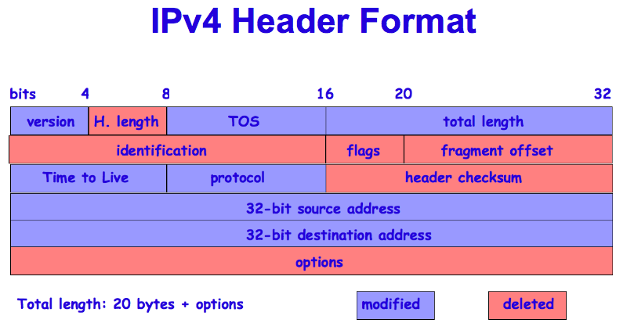
Fundamental Problems (1) Attribution
A fundamental flaw in today’s Internet:
  THERE IS NO GUARANTEE OF AUTHENTICITY IN IPV4
  Origination IP addresses can be spoofed!
  A 12 year old hacker can make packets coming from her computer look like they come from Albania
  IPv6 does
  include strong
  authentication
    But it isn’t
    yet widely
    implemented

Slide 32
Fundamental Problems (2)
Criminals & hostile forces can use distributed attacks
  Botnets created by commandeering poorly-secured computers owned by amateurs
  Botnets can have 10,000 zombies
Distributed networks are impervious to take-down
  Multiple connectivity
  Multiple replication
  Shut down one TOR node, no one notices*

Slide 33
Asymmetric Warfare
Defense more expensive than attack
Probability of at least 1 weakness
  Increases as number of potential attack points grows
P(system breach) = 1 – (1 - p)^{n} where
  p = probability of unit failure &
  n = number of independent possible breach points or
P = 1 – Π(1 - p_{i}) where
  Π is multiplication
  p_{i} = probability of failure of unit i

Slide 34
Cyber Arms Control Treaty Proposal
Developing international standards of conduct for the Internet
Sharing information about each country's cyber security laws
Helping less-developed nations strengthen their computer defenses
Countries involved: United States, Russia, China, Belarus, Brazil, Britain, Estonia, France, Germany, India, Israel, Qatar, South Africa and South Korea.

Slide 35
Attribution: Legal Issues (1)
Laws may slow the attribution process
  Attribution outside victim state generally requires foreign state/international cooperation
  International
    Letters rogatory
    Mutual Legal Assistance Treaties (w/ 64 of 193 countries)
    24/7 POCs under Cyber Crime Convention (~30 countries)
    Data retention (EU law)
    Data preservation (US law, 2703(f) order)
Technology can help obfuscate attribution
  Still many technical challenges (e.g., spoofing, anonymizers, hotspots)

Slide 36
Attribution: Legal Issues (2)
If nations can act anonymously, accepted rules of behavior can be largely ignored
Levels of attribution
  IP address
  Computer associated with that IP address
  Controlling computer
  Person behind the controlling computer
  Sponsor of the person (nation-state, terrorist org, criminal org, etc.)

Slide 37
Examination of a Third, ‘Other-Than-War’ Mode
“There is no clear, internationally agreed upon definition of what would constitute a cyber war. In fact, there is considerable confusion.”
Where does it fit?
  Jus ad bellum – right to wage war
  Jus in bello – law of war

Slide 38
Consideration of the Geneva Protocol Principles for Cyber Weaponry
“Russian and U.S. governments must be open to the possibility that some weapon attributes may be unacceptable because they are offensive to the principles of humanity and from dictates of public conscience.”
Currently prohibited weapons:
  Generally: Those that cause unnecessary suffering or widespread, long-term and severe damage to the natural environment
  Cyber analogs to specifically prohibited weapons are unclear.

Slide 39
Recognizing New Non-State Actor and Netizen Power Stature
“The digital revolution has unleashed non-state actors and individuals to occupy, control and operate in cyber territory. This creates new power asymmetries and magnifies the clout of new participants who can violate Convention principles on a massive scale.”
Traditional application of LOAC to state actors
Common Article 3 of Geneva
Post-9/11 application of LOAC to non-state actors
  Application to netizens?

Slide 40

Application of the Distinctive Geneva Emblem Concept in Cyberspace
“The Geneva and Hague Conventions direct that protected entities, protected personnel and protected vehicles be marked in a clearly visible and distinctive way. This recommendation
proposes analogous markers in cyberspace to designate protected entities, personnel and other assets.”
  What of IP-based attacks?
  What of identifying “hospital” in URL?
  How does it protect medical telepresence?
  Who bears costs?
  What’s the incentive?

Slide 41
Detangling Protected Entities in Cyberspace
“[P]romote the preservation of the observed principles of the [Hague and Geneva] Conventions that protect humanitarian critical infrastructure and civilians.”
U.S.: 95% of military Internet communications traverse commercial infrastructure
“Dot-secure” network for essential services?
  Banking, aviation, public utility systems
  Cost, connectivity to rest of Internet
  Physical attacks

Slide 42
Applying Geneva and Hague Conventions to Cyberspace
Detangling Protected Entities in Cyberspace
Application of the Distinctive Geneva Emblem Concept in Cyberspace
Recognizing New Non-State Actor and Netizen Power Stature
Consideration of the Geneva Protocol Principles for Cyber Weaponry
Examination of a Third, ‘Other-Than-War’ Mode
Notes:
1. Detangling Protected Entities in Cyberspace: “promote the preservation of the observed principles of the [Hague and Geneva]
Conventions that protect humanitarian critical infrastructure and civilians”.
2. Application of the Distinctive Geneva Emblem Concept in Cyberspace: “The Geneva and Hague Conventions direct that
protected entities, protected personnel and protected vehicles be marked in a clearly visible and distinctive way. This recommendation
proposes analogous markers in cyberspace to designate protected entities, personnel and other assets.
3. Recognizing New Non-State Actor and Netizen Power Stature: “The digital revolution has unleashed non-state actors and
individuals to occupy, control and operate in cyber territory. This creates new power asymmetries and magnifies the clout of new
participants who can violate Convention principles on a massive scale.”
4. Consideration of the Geneva Protocol Principles for Cyber Weaponry: “Russian and U.S. governments must be open to the
possibility that some weapon attributes may be unacceptable because they are offensive to the principles of humanity and from dictates
of public conscience.”
5. Examination of a Third, ‘Other-Than-War’ Mode: “There is no clear, internationally agreed upon definition of what would constitute a cyber war. In fact, there is considerable confusion.”

Slide 43
Is it covered by the Law of Armed Conflict?
How does it fit under the UN Charter
  Article 2(4)
    “Threat or use of force against the territorial integrity or political independence of any state”?
  Article 39
    “Threat to the peace, breach of the peace, or act of aggression” permitting Security Council action?
  Article 41
    “Armed force” permitting Security Council action?
  Article 51
    “Armed attack” permitting self-defense?

