Slide 1
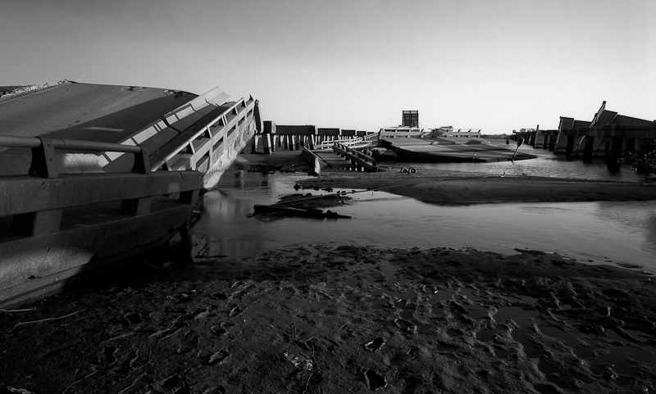

Slide 2
From Hurricane Betsy to Hurricane Katrina to Hurricane ??
The Hurricane Katrina Levee Breach Litigation

Slide 3
What Happened Between Betsy in 1965 and Katrina in 2005?
Geology

Slide 4
Fort Proctor

Slide 6
Subsidence Monitoring Station at Shell Beach

Slide 11
Post-Betsy Levee System
The plan to build flood gates to prevent the storm surge from entering Lake Ponchartrain is challenged in an early NEPA lawsuit.
Corps initial plans to protect New Orleans are rejected in favor of ring levees.
Critically, canals to Lake Pontchartrain are left open because the City does not want to pay for pumping stations to get the water pumped out of the city over the levees.
Lots of issues in construction
Huge problem of lack of maintenance – not the Corp’s responsibility, moves to the locals.

Slide 12
Katrina - not just levees breaking
Overtopping - there would have been a lot of flooding without a levee break.
The 2016 BR rainfall in New Orleans would look like the flooding from Katrina because of the limited capacity of the pumps on the storm sewers.

Slide 13
In Re Katrina Canal Breaches Consolidated Litigation
District Court Opinion Finding Liability

Slide 14
Background for MRGO - Graci
Graci told us that FCA immunity does not attach unless a project has a flood control purpose.
MRGO did not have a flood control purpose.
FCA immunity did not attach.
Still no liability because there was no negligence.
Post-Graci the Corps built flood control levees between the city and MRGO.
The court has to get the flood water past those levees without triggering the FCA.

Slide 15
Katrina
Levees were overtopped in many parts of the city
Flood walls failed on the 17th St. Canal, the Industrial Canal (9th Ward), and levees between MRGO and the city.
Previous litigation established that the 17th St. Canal was a pure flood control structure and that FCA immunity applied even under a Graci analysis
The court refused to find that FCA immunity applied to the claims involving the levees that protected against MRGO flooding, letting this trial go forward.
Both of these ruling effectively ignored Central Green.

Slide 16
Plaintiffs’ Theory of the Case
MRGO, combined with the Intercoastal Canal, created a high pressure funnel that pushed water into the city.
MRGO's widening since Betsy weakened allowed waves to weaken the flood control levees.
The combination led the levees to fail.
But is this really what happened at all?

Slide 17
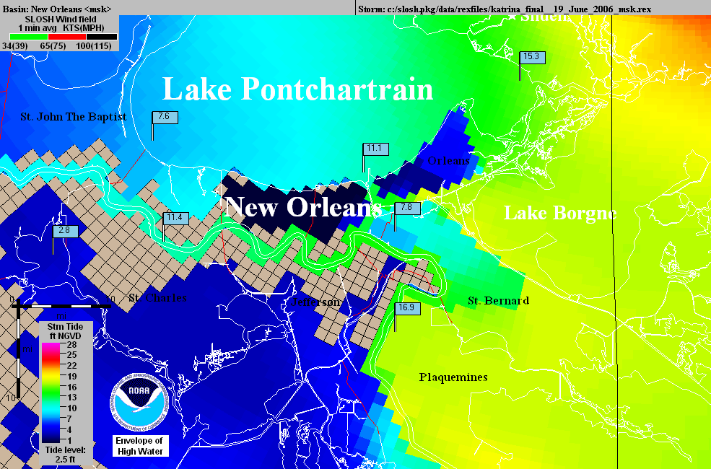
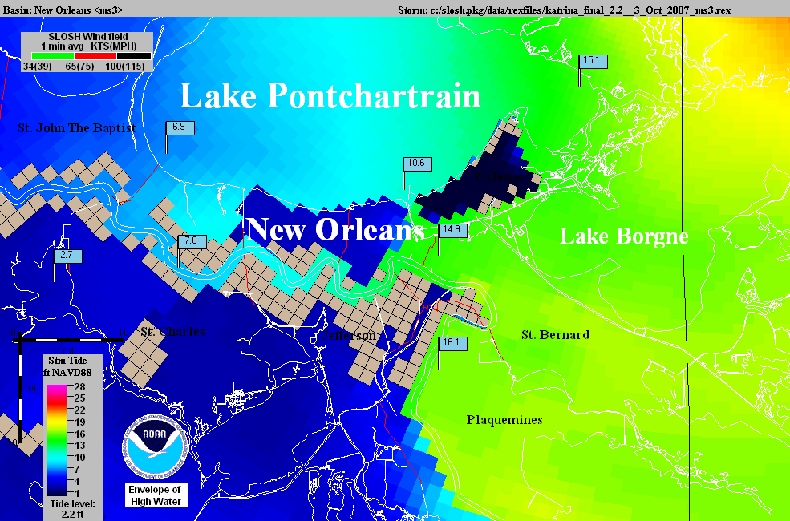
Operational
NHC Katrina
SLOSH model
using outdated
elevations.
The
“Hurricane
Highway”
Katrina SLOSH
hindcast using
accurate
elevations.

Slide 18
In re Katrina Canal Breaches Consolidated Litigation, 647 F.Supp.2d 644 (E.D.La. 2009)
The government defended this case on immunity and presented only limited expert testimony to rebut the plaintiffs’ facts.
FCA and FTCA
The Court recognizes that it must distinguish this case from the 17th St. Canal cases. It comes up with the rationale on the next slide. (P2 in the case)

Slide 19
The Rationale
“For example, would the United States be immune for all damages if a Navy vessel lost control and broke through a levee where the sole cause of the failure of that levee was the Navy vessel’s negligence?
Thus contrary to the Government’s contention that Central Green broadens the immunity provided by § 702c, in realty Central Green requires the Court to identify the cause of the damage rather than base a decision on the mere fact that a flood control project was involved. Central Green does not answer the question of what nexus to a flood control project is required for floodwaters to trigger immunity.”

Slide 20
Reading Central Green
"... in realty Central Green requires the Court to identify the cause of the damage rather than base a decision on the mere fact that a flood control project was involved.."
Was that really the key holding in Central Green?
“Accordingly, in determining whether §702c immunity attaches, courts should consider the character of the waters that cause the relevant damage rather than the relation between that damage and a flood control project.” (par 53)
What caused the hypothetical ship to breach the levee?
What caused the damage once the levee was breached?
Why would this be different at 17th Street?

Slide 21
The MRGO
The first 10 pages discuss the history of the MRGO and outline the construction of the levees between the MRGO and the city
Sec. 3, p10, begins the discussion of how the MRGO increased the likelihood of a flood and what the Corps knew about this.
Remember, there is nothing objective in this opinion, the court only has information from the briefs of the parties, and only uses what it chooses.

Slide 22
What did the Corps Know?
Is this relevant to FCA immunity?
The court is trying to bootstrap FTCA liability by using the Corps knowledge to create a theory of a non-flood control project error that would not be subject to FCA immunity.
What is the balance between showing what the Corps knows and avoiding the discretionary function exception?
What does Berkowitz tell us is the best way to defeat the defense?

Slide 23
The Erosion of the Sides of the MRGO
A key notion in the attack on the FCA immunity is that the real issue is the improper maintenance of MRGO.
According to the court, waves pushed by sea going vessels are a major source of this erosion.
P 14 has evidence of this erosion presented by the Corps
This establishes that the Corps knew this

Slide 24
Armoring MRGO
The plaintiffs argue, and the court buys this, that the Corps had a duty to put riprap along the navigation channel to prevent erosion.
Why might the Corps not do this?
The Corps argues that armoring the MRGO was part of the decisionmaking in the Lake Pontchartain and Vicinity Hurricane Protection Plan (“LPV”).
The Court rejects this, finding:
"The fact remains that the failure to provide foreshore protection worked as the Navy vessel hitting the levee."

Slide 25
Is this a Discretionary Function?
P 25 - The court says that a Corps report acknowledged that MRGO should be armored, and that the Corps failed to seek funding.
Is seeking funding from Congress a Corps duty?
Can the Corps be negligent in failing to get Congress to fund a project that Congress knows about and has decided to not fund?

Slide 26
The Effect on the Flood Control Levee
From P 41-87 the court moves from the story of the failure to armor MRGO to the effect of this failure on the flood control levees.
The court argues the levees were too low and had other problems because the Corps did not properly factor in effects of the eroding soil related to MRGO on the levees.
The court is using plaintiff's geology. The real problem is that subsidence, plus some ocean rise, has changed the elevations and destabilized the area.
What is the FCA problem with this analysis?
The court rejects plaintiffs' argument that the Corps had a duty to build a surge barrier
The court recognizes this is an FCA issue.

Slide 27
Causation
Based on the foregoing analysis, the Court finds that the Corps’ negligent failure to maintain and operate the MRGO properly was a substantial cause for the fatal breaching of the Reach 2 Levee and the subsequent catastrophic flooding of the St. Bernard Polder occurred. This Court is utterly convinced that the Corps’ failure to provide timely foreshore protection doomed the channel to grow to two to three times its design width and destroyed the banks which would have helped to protect the Reach 2 Levee from front-side wave attack as well as loss of height. In addition, the added width of the channel provided an added fetch which created a more forceful frontal wave attack on the levee.

Slide 28
The Navy Vessel Metaphor
As the court tells us at the beginning, its analysis is based on the dicta in Graci that the government might be liable if a Navy vessel having nothing to do with flood control crashed through a levee. On P 89 the ship comes in:
"Finally, the white encased numbers show the pre-Katrina sill heights and the teal marks show with accuracy and specificity the effect of the Corps’ failures on its own levee–the specific breaches and the resulting sill heights. Indeed, a picture speaks a thousand words. The Corps’ “Navy vessel” devastated this levee."

Slide 29
The Navy Vessel and Central Green
What is the Navy vessel in the court's metaphor made of?
What did Central Green tell us was the key question in a flood control case?
How did the court address this?
Thus, the Corps’ decisions were made in the context of the MRGO project, not within the context of the LPV. ...Thus, the failures at issue here are extrinsic to the LPV and are not subject to §702c immunity. There is no reason for the Court to revisit its decision with respect to the Flood Control Act, and it will not do so.
That is all we get.

Slide 30
FTCA and MRGO
The remainder of the opinion, 50 or so pages, is a detailed discussion of how the court decides that the Corps was negligent in the maintenance of MRGO and why not armoring the MRGO was a ministerial (non-discretionary) act.
(Even though the feds do not recognize that Louisiana distinction.)
This is based on the notion that failing to do so put the region at risk and that the Corps had a duty to protect the city - the court dealt with Allen by not even citing it.
More fundamentally, once the levees were built, the decisions about armoring MRGO became system decisions of the LPV plan – overall flood control plan – which would clearly trigger 702 immunity.

Slide 31
5th Circuit
In spring 2012, the 5th Circuit basically upheld the case, based entirely on its own analysis in Graci.
The government moved for en banc rehearing.
After several months, the original panel withdrew its opinion and substituted a new opinion.

Slide 32
In re Katrina Canal Breaches Litigation, 696 F.3d 436 (5th Cir.(La.) 2012) (second opinion)
Distinguishing Central Green:
Thus, after Central Green, waters have the immune character of "flood waters" if the government's link to the waters is through flood-control activity. That is to say, the government's acting upon waters for the purpose of flood control is flood-control activity, and flood-control activity is what gives waters an immune "character." We therefore reject the government's interpretation of the scope of Section 702c and conclude, instead, that the United States enjoys immunity under that section only where damages result from waters released by flood-control activity or negligence therein.

Slide 33
Moving Toward Central Green
Thus, for example, if the government had attempted foreshore protection inside MRGO, but that protection (whether by design or negligence) caused or exacerbated flood damage, the district court's rule would grant the Corps no immunity, because MRGO was not a flood-control project. Our rule, by contrast, attaches immunity if the foreshore protection had flood control as its purpose-that is, if installing and maintaining foreshore protection was a flood-control activity regardless of the nature of MRGO, the overall project.

Slide 34
But Not Very Far
Thus, the government cannot claim Section 702c immunity for MRGO's role in breaching the Reach 2 levee. The dredging of MRGO was not a flood-control activity, nor was MRGO so interconnected with the LPV as to make it part of the LPV. Therefore, the flood waters that destroyed the plaintiffs' property were not released by any flood-control activity or negligence therein.

Slide 35
DFE on Armoring
Although the Corps appears to have appreciated the benefit of foreshore protection as early as 1967, the record shows that it also had reason to consider alternatives (such as dredging and levee "lifts") and feasibility before committing to an armoring strategy that, in hindsight, may well have been optimal. The Corps's actual reasons for the delay are varied and sometimes unknown, but there can be little dispute that the decisions here were susceptible to policy considerations. Whatever the actual reasons for the delay, the Corps's failure to armor timely Reach 2 is shielded by the DFE.

Slide 36
Bottom Line
Unfortunately for the Franzes, our application of the DFE moots their causation argument. Because the Corps may not be held liable for damages stemming from MRGO's role in the St. Bernard flooding, we reverse the partial judgment in the Franzes' favor and instead find for the government in full.

Slide 37
The Aftermath
The biggest non-legal problem with this case is that almost all of the geology, hydrology, and ecology in the opinion is junk science. But people believe it because the court said it is true.
Like the breast implant litigation and many other cases.
Cert. was denied in the case, so, as with Graci, the Corps wins on DFE so the FCA 702 question conflict with Central Green is not resolved by the Supreme Court.

