Slide 1
Climate Change Effects on Agriculture
Edward P. Richards, JD, MPH
Director, Climate Change Law and Policy Project
Clarence W. Edwards Professor of Law
LSU Law School
richards@lsu.edu
http://biotech.law.lsu.edu
http://sites.law.lsu.edu/coast/
http://ssrn.com/author=222637

Slide 2
Why Am I Talking about Plant Physiology?

Slide 3
What do Plants Need?
Light
CO2 and O2
Water
Temperature
Nutrients – Nitrogen, Phosphorus, Calcium, etc.
Micro Nutrients – Iron, Magnesium, Selenium
Climate affects the first 4

Slide 4
C3 Plants – Cool, Moist
Most plants are considered “C3 Plants”.
“C3” refers to the fact that two 3-carbon molecules are produced during the Calvin Cycle.
About 85% of plants are C3 plants, including most cereal grains such as wheat, rice, soybeans, and oats.
While most plants are C3 plants, these kinds of plants have a major disadvantage.
In hot, dry conditions the rate of photosynthesis of these plants will slow or stop as plants cut off their supply of CO₂ by closing their stomata.
If C3 plants do not close their stomata, they risk losing too much water.

Slide 5
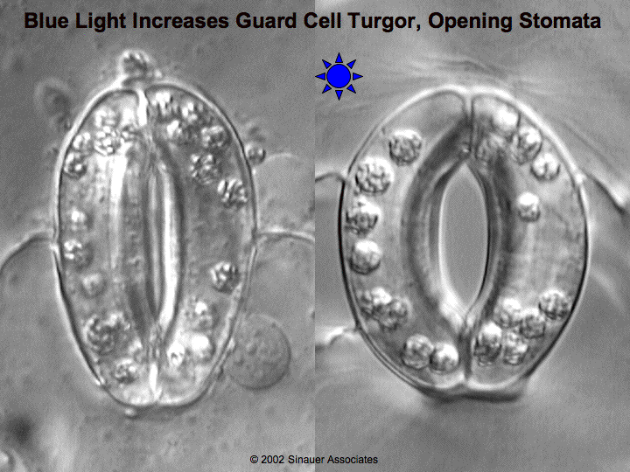
C3 Plants in Hot Weather
Rates of photosynthesis in C3 plants will decrease in hot weather because of two reasons.
First, if a plant is losing water, it will close its stomata.
With its stomata closed, a plant cannot absorb CO₂.
Secondly, when CO₂ concentrations in the plant cells drop below 50 ppm, the plant starts grabbing oxygen instead of CO_{2.}
An enzyme called Rubisco normally takes CO₂ from the air and joins it to RuBP.
However, in low CO₂ conditions, the Rubisco grabs oxygen instead of CO_{­2­.}
When CO₂ levels inside a plant’s cells are low due to closed stomata, a plant will burn sugar instead of producing it.

Slide 6
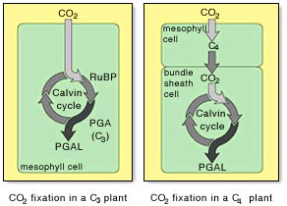
C4 Plants – Hot and Drier
Some plants have adapted to avoid low CO₂ levels that can result when they close their stomata.
These plants are called C4 plants.
Examples of C4 plants include corn and sugar cane.
In C4 plants, CO₂ is absorbed by specialized cells with a thin wall.
Inside these specialized cells, the C4 plants convert the CO­₂ into malic acid or other carbon- based molecules.
This enables the C4 plant to store carbon for later use.
Malic acid is a 4-carbon compound.
This is why these plants are known as C4 plants.
Source: www.mhhe.com

Slide 7
C4 Plants in Dry Conditions
Because C4 plants can “store” carbon in the form of malic acid, it also means that C4 plants can close the stomata in their leaves to prevent water loss without affecting the Calvin Cycle.
A C3 plant will stop photosynthesizing in hot, dry weather because it has to close its stomata, cutting off its CO₂ supply.
A C4 plant will also close its stomata in hot, dry weather, but it can continue to photosynthesize because of its stored malic acid.
C4 plants often are more efficient in hot dry conditions because they are able to continue to photosynthesize when light levels are greatest.

Slide 8
C3 vs. C4 plants
The downside of being a C4 plant is that it takes a lot of ATP to pump the 4-carbon malic acid into the chloroplast.
In hot, dry, sunny climates, C4 plants will have the advantage.
However, C3 plants will out-perform C4 plants when it is wet or cool.
As long as C3 plants do not have to close their stomata, they will have access to plentiful levels of CO­₂­ and will outperform a C4 plant.
However, once conditions force a C3 plant to close their stomata, C4 plants have the advantage.

Slide 9
CAM Plants
CAM (Crassulacean acid metabolism) plants are special plants that are similar to C4 plants and are usually found only in extremely hot and dry environments (such as deserts).
Cacti and pineapples are common examples of CAM plants.
A normal C3 plant could never survive in a desert because it wouldn’t be able to acquire enough water.
A C4 plant would have to open its stomata at some point during the day, resulting in large water losses.
CAM plants are similar to C4 plants except that they only open their stomata at night to take in CO2
Because their stomata are only open at night, CAM plants use far less water than C4 plants.
Source: www.mhhe.com

Slide 10
Effect of Temperature on Plant Productivity

Slide 11
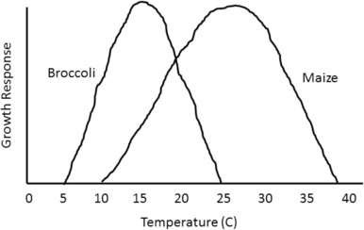
Broccoli (C3) v Maize (C4) With Increasing Temperature
http://dx.doi.org/10.1016/j.wace.2015.08.001

Slide 12
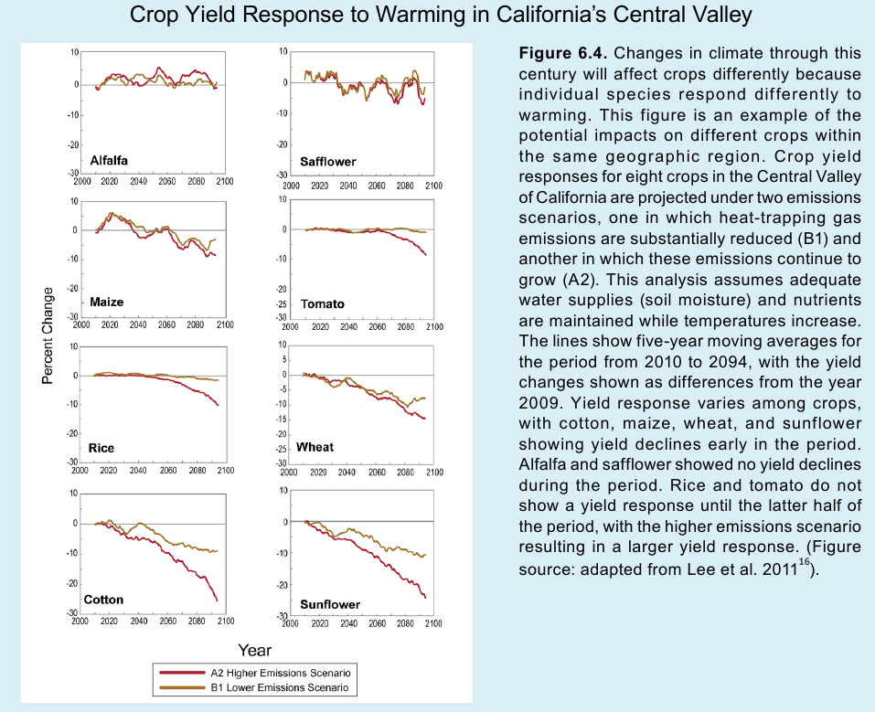

Slide 13
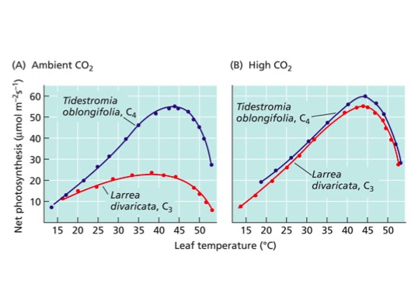
Effect of CO2 and Temperature on C3 and C4 Plants

Slide 14
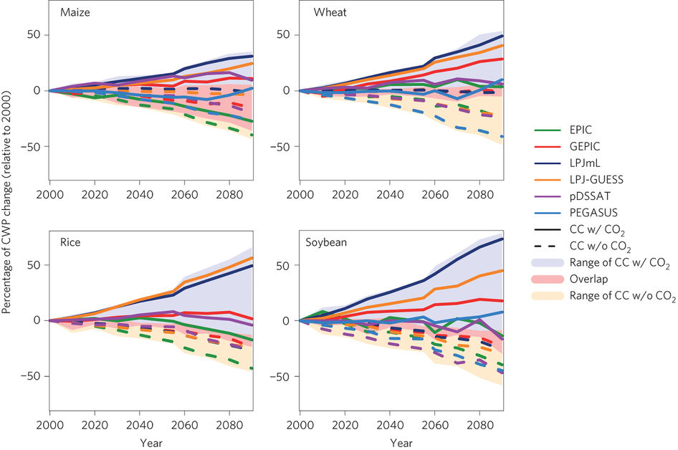
Effect of CO2 on Crop Water Productivity (biomass per unit water)
Solid Lines – Inceasing CO2
Dashed Lines – Constant CP2
Figure 4 | Global average CWP (%) relative to 2000 simulated under RCP 8.5 for each GGCM driven by five diferent GCMs. Solid lines show median CWP under both climate change and CO2efects, whereas dashed lines show median CWP under climate change effects only—that is, with constant [CO2].

Slide 15
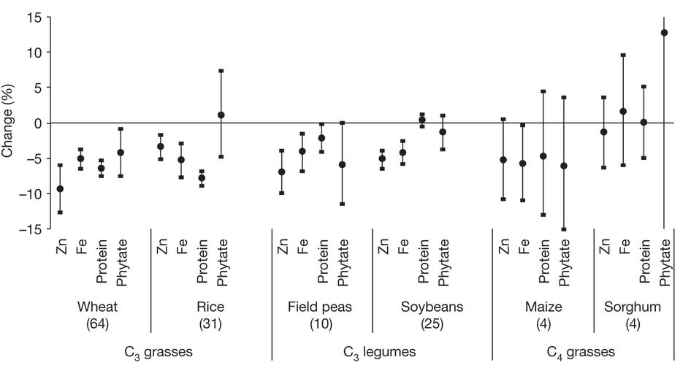
Effect of Increased CO2 on Nutrients in Foods

Slide 16
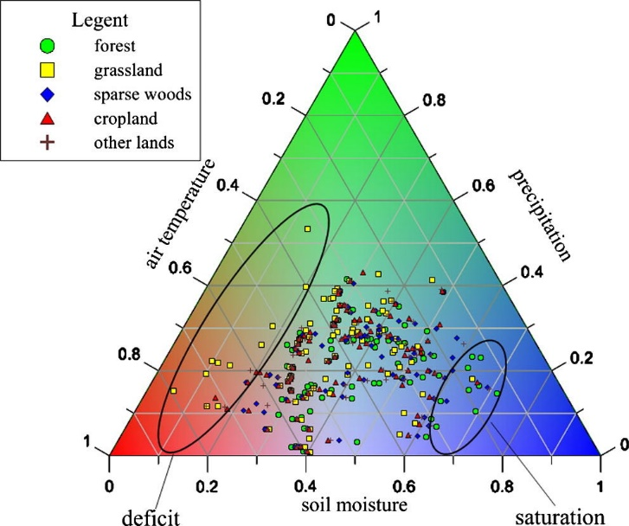

Slide 17
What Happens With Climate Change?
Not water limited
C3 plant cultivation moves to cooler areas
C4 plant cultivation will do better in many places and will expand north.
Water limited
C3 plants need even cooler areas and may not survive
C4 plants do less well
With increased CO2
Both do better, but can become water limited.

Slide 18
Winners and Losers

Slide 19
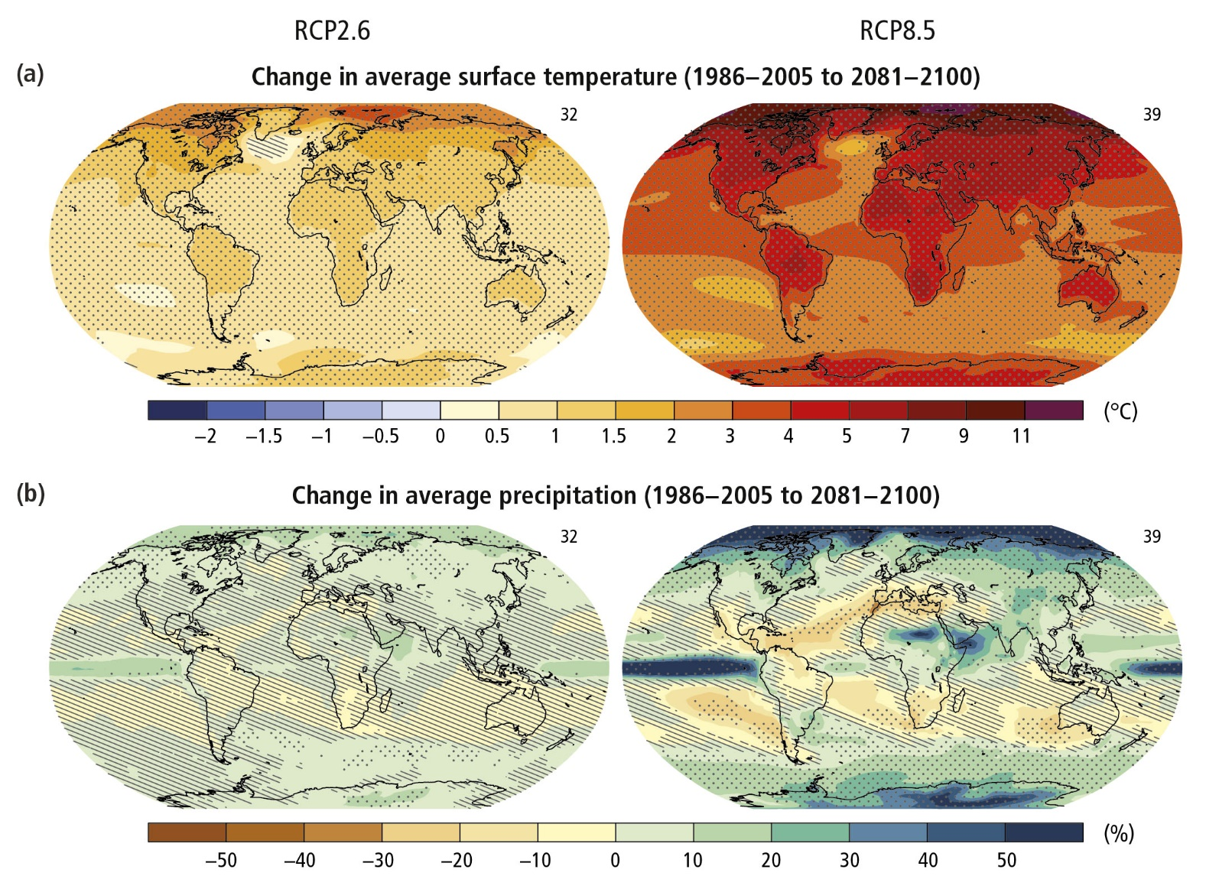

Slide 20
How Agriculture will Change
Crops will need to be adapted and new crops planted
Growing areas will shift with temperature and rainfall
Cultural patterns will be difficult to change
State boundaries and property rights will prevent farmers from following growing zones.
There will be massive problems in food maldistribution, even though there may enough land that can grow food.

Slide 21
Food Insecurity in the Middle East and National Security

Slide 23
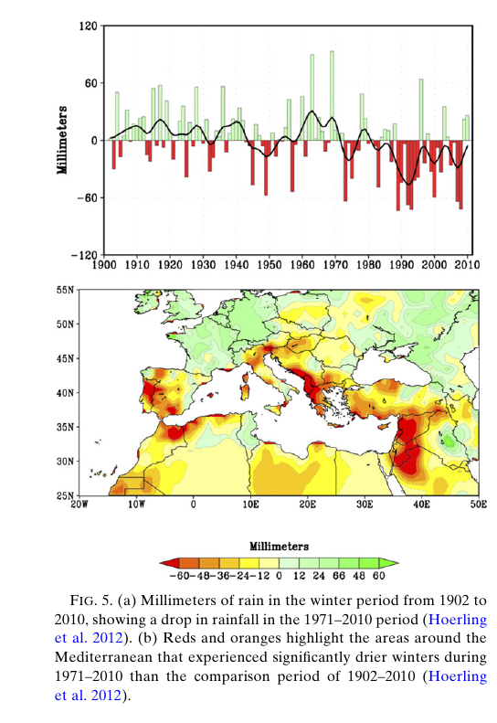
Roots of the Syrian Conflict
Drought drove farmers into the cities.

