Slide 1
Coastal Triage Establishing Criteria For Sustainable Coastal Development in the Face of Sea Level Rise
Edward P. Richards, JD, MPH
Director, Program in Law, Science, and Public Health
LSU Law School
richards@lsu.edu
Blog - http://sites.law.lsu.edu/coast/
http://ssrn.com/author=222637
Graphics and Geology by Chris McLindon, additional Geology by Kathy Haggar
Notes:
Next 3 slides
Environmentalists think of preservation and sustainability
in short-term, steady state earth terms.
Looking back at paleo climate and geologic cycles
allows us to look forward in time.
Our horizon should be at least 100 years.
This talk will show how looking forward 100 years
changes the notion of sustainability for the
Mississippi Delta

Slide 2
Notes:
Environmentalists think of preservation and sustainability
in short-term, steady state earth terms.
Looking back at paleo climate and geologic cycles
allows us to look forward in time.
Our horizon should be at least 100 years.
This talk will show how looking forward 100 years
changes the notion of sustainability for the
Mississippi Delta

Slide 3
Notes:
Environmentalists think of preservation and sustainability
in short-term, steady state earth terms.
Looking back at paleo climate and geologic cycles
allows us to look forward in time.
Our horizon should be at least 100 years.
This talk will show how looking forward 100 years
changes the notion of sustainability for the
Mississippi Delta

Slide 4
Notes:
The disappearing land has spawned
scientifically crazy lawsuits to shift the
blame away from the delta cycle and
climate change.
Without someone to blame, politicians
and the public would have to face
the reality of climate change on the
Delta.

Slide 5
Today
2100
Notes:
Louisiana with 1 meter of relative sea level rise
caused by subsidence and sea level rise.
This is a conservative view.
It assumes no major hurricanes.
These would breach the levees
and free the river.
They will also flood New Orleans
more dramatically than Katrina.

Slide 6
Notes:
The best example of the steady state earth
thinking is the Coastal Restoration Authority.
It wants to turn back time and deny
sea level rise though huge and
environmentally damaging engineering
projects.
Sadly, many national environmental groups
and most local environmentalists support this.

Slide 7
Floating Houses

Slide 8
Coastal Restoration – NYC Style

Slide 9
California

Slide 12
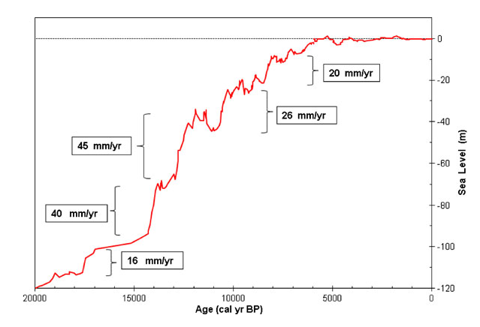
.
Notes:
Donoghue, Joseph F. “Sea Level History of the Northern Gulf of Mexico Coast and Sea Level Rise Scenarios for the near Future.” Climatic Change 107, no. 1–2 (2011): 17–33

Slide 13
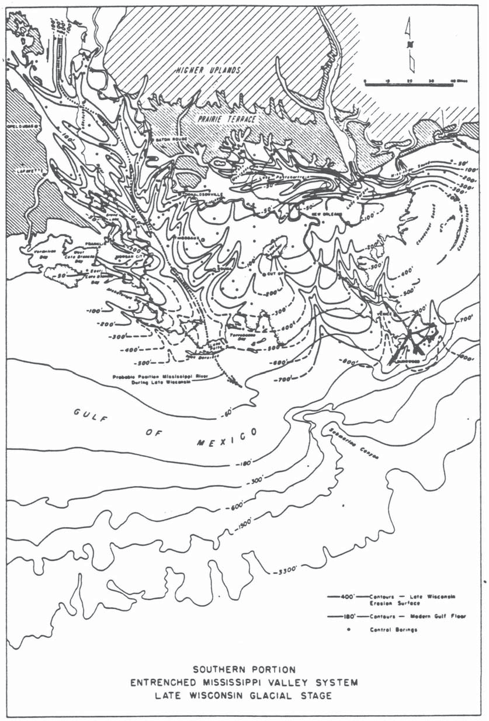
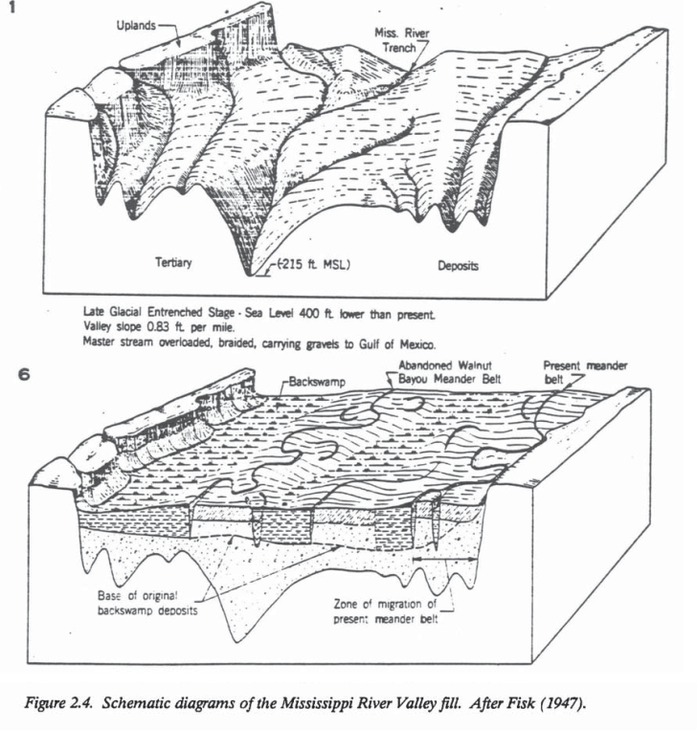
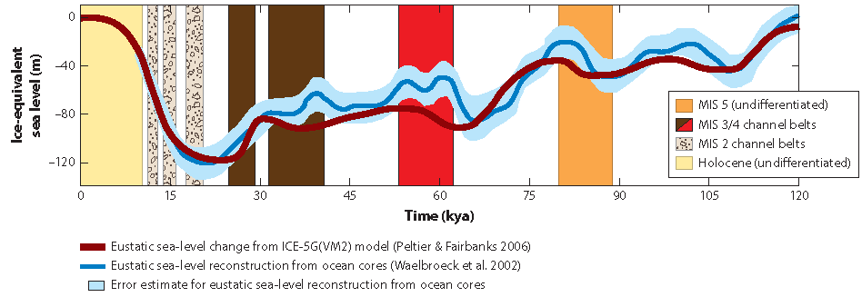
When Sea Level is Low, the Delta is Far out in the Gulf at the Continental Shelf
Higher Uplands
Pleistocene Terrace
Pleistocene erosional surface
Exposed Shelf
Shelf-edge
Delta
Shoreline
BLUM & ROBERTS, 2011
FISK, 1944

Slide 14
As Sea Level Rises, the Coast Migrates Inland
Higher Uplands
Braided stream aggradation
Pleistocene Terrace
Holocene delta deposits
BLUM & ROBERTS, 2011
FISK, 1944
Notes:
What Happened When the Ice Melts?
The Mississippi becomes a flooding torrent for thousands of years and carries much more sediment than at any other time.
Despite this mountain of sediment, the coastal edge – what we call the delta – retreats inland.
Lesson for sea level rise from climate change: sea level rise trumps sediment.

Slide 15
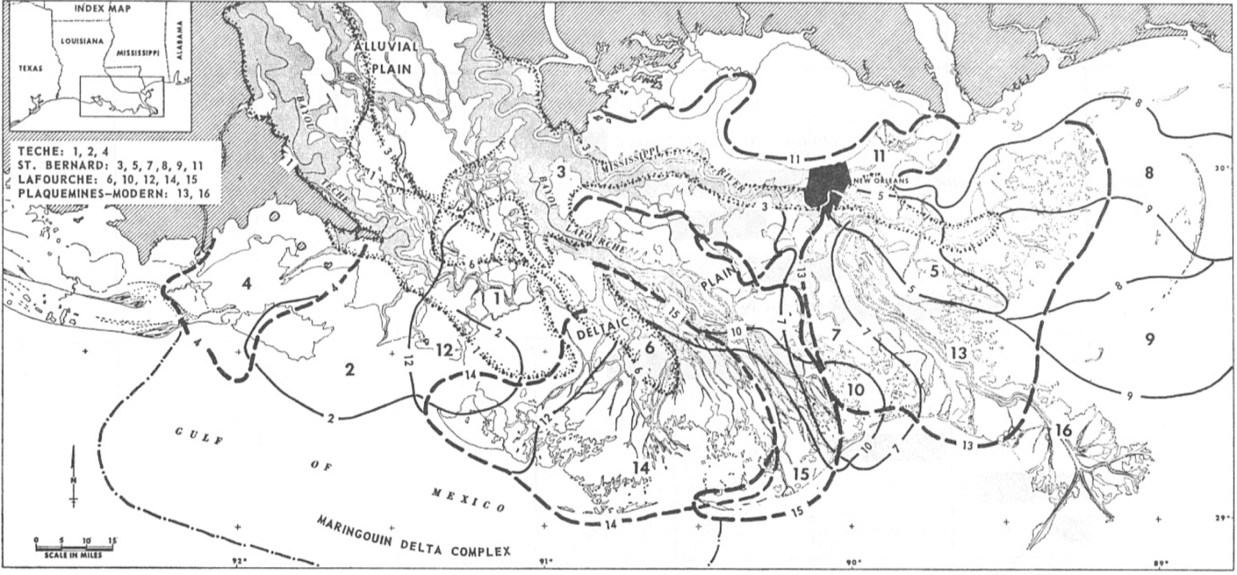
Delta instability with stable sea level
Notes:
Recent Deltatic Deposits of the Mississippi River:
Their development and chronology – David E. Frazier, 1967

Slide 16
Subsidence is constant. Abandoned lobes sink below the water and new lobes can overlap them.

Slide 17
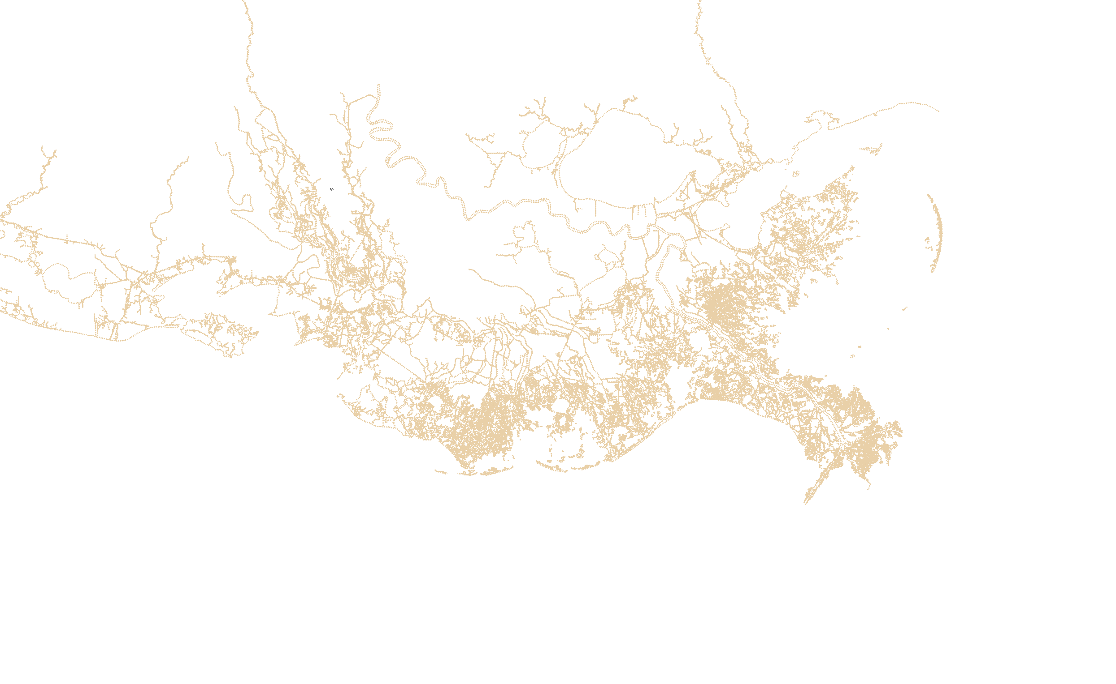
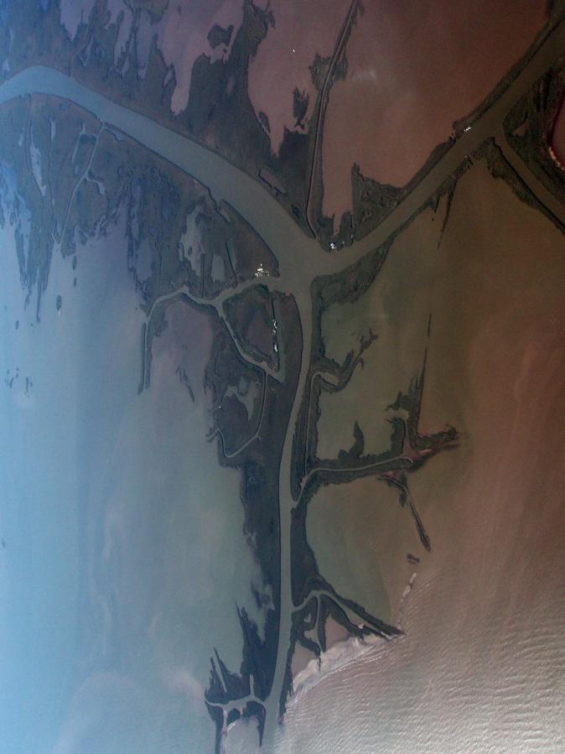
Land Lost before 1932 – Little Sea Level Rise
Zone 1
Aggrading Delta deposits on firm Pleistocene Substratum
Zone 2
Spreading Delta deposits on Holocene braided stream Substratum
Zone 3
Protruding Delta deposits on Holocene marine clay Substratum
2
~10,000
mi
Total estimated submergence prior to 1932
This land was lost without human intervention

Slide 18
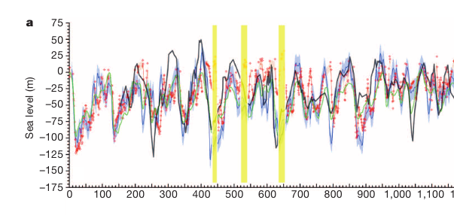
Climate cycles move the coast as sea level rises and falls. This is sea level for the last 1,000,000 years
Rohling, EJ, GL Foster, KM Grant, G Marino, AP Roberts, ME Tamisiea, and F Williams. “Sea-Level and Deep-Sea-Temperature Variability over the Past 5.3 Million Years.” Nature, 2014.

Slide 19
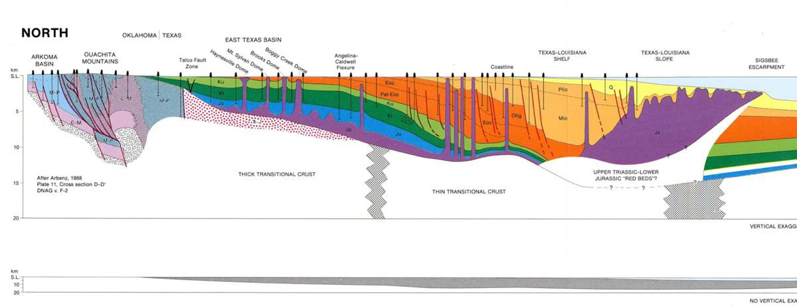
The geologic Delta: 200 million years of sedimentation and subsidence
15km
~60,000 ft thick→stack of 10 Grand Canyon sections.
The “Depositional Space Problem” – making room
Sea level rise (range = ~1000 feet)
Salt evacuation due to differential loading.
Bending of the crust and flow of underlying mantle.

Slide 20
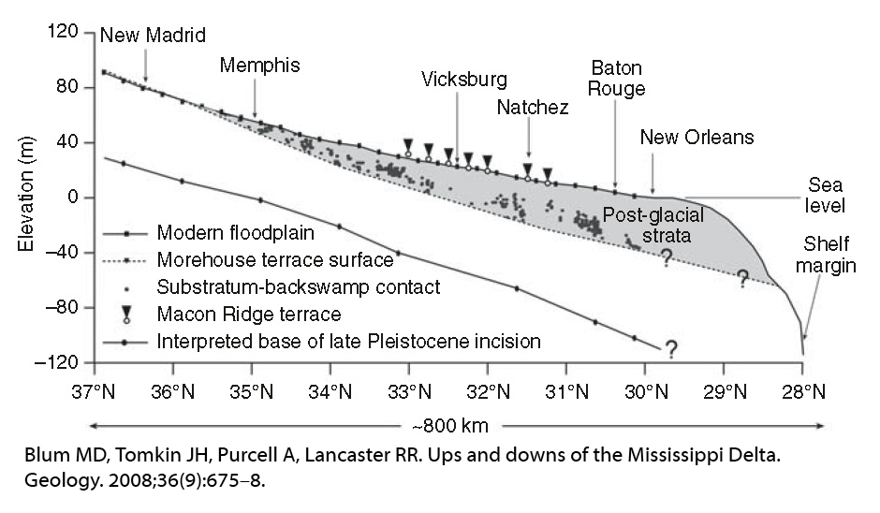
The Layman’s Delta is the Intertidal Zone. This is Defined by Sea Level, Not Sediment

Slide 21
Contemporary Subsidence

Slide 22
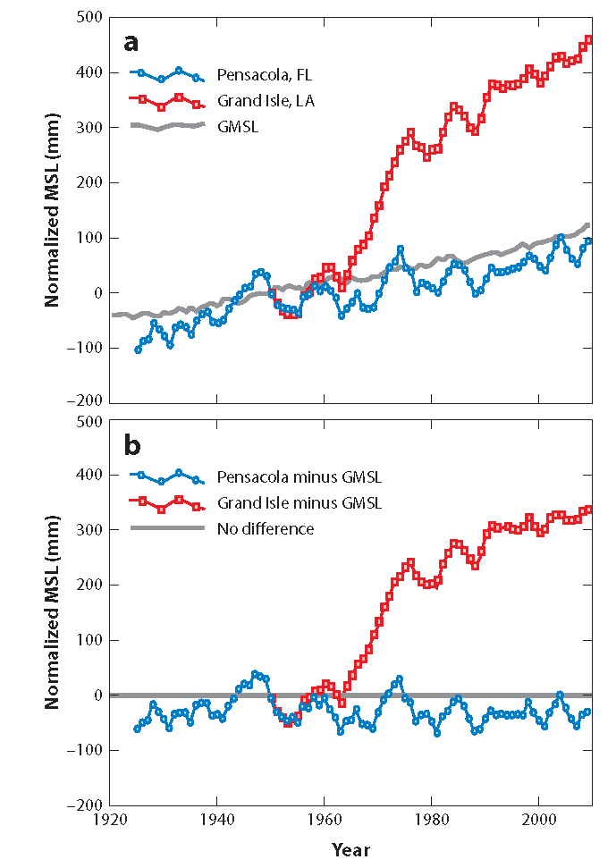
Relative sea level from tidal gauge data. Blue is Pensacola, FL (stable) Red is Grand Isle, LA (subsiding)
total relative sea level rise
subsidence
Notes:
Blum, M.D. and Roberts, H.H., 2012, The Mississippi Delta Region: Past, Present, and Future, Annual Review of Earth and Planetary Sciences, v. 40, p. 655‐683

Slide 23
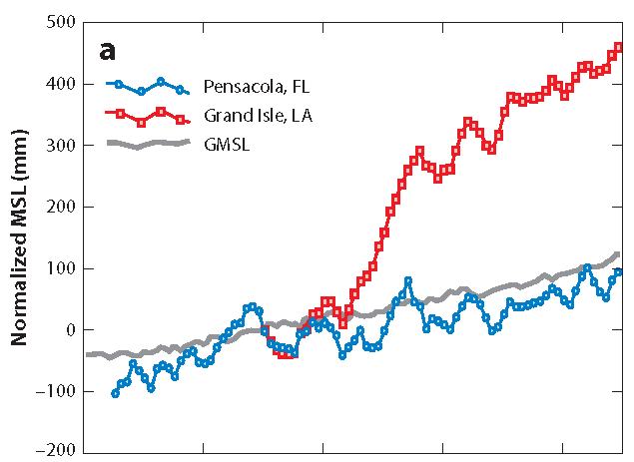
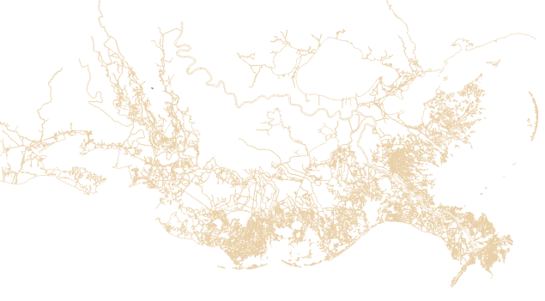
20” of Relative Sea Level Rise at Grand Isle Since 1932
500 mm = 20”
total relative sea
level rise since 1932
subsidence
sea level rise
1932

Slide 24
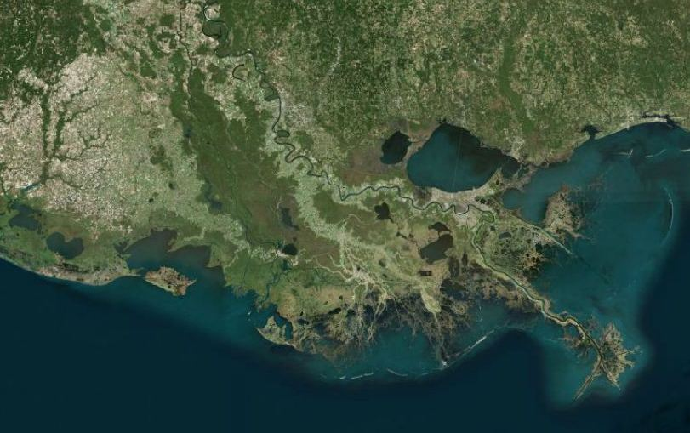
Port Fourchon

Slide 25
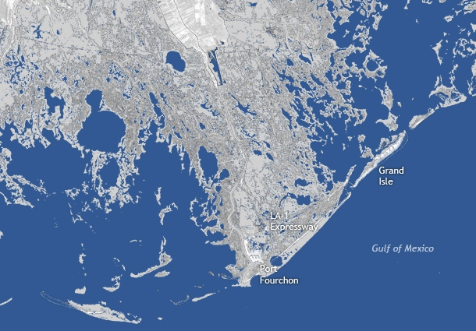
1932
GILL, 2013

Slide 26
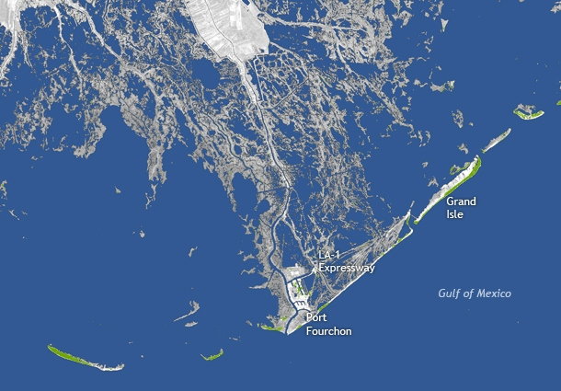
2010
GILL, 2013

Slide 27
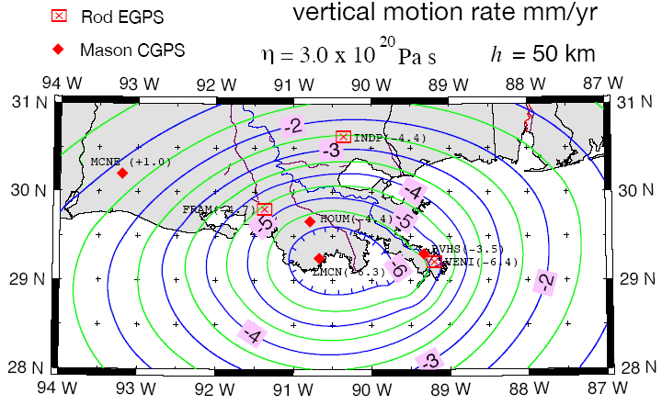
Subsidence by CORS GPS, excluding faulting.
Ivins et al (2006)
GULFNet station at
Cocodrie, LA
→sinking 6.3 mm/yr

Slide 29
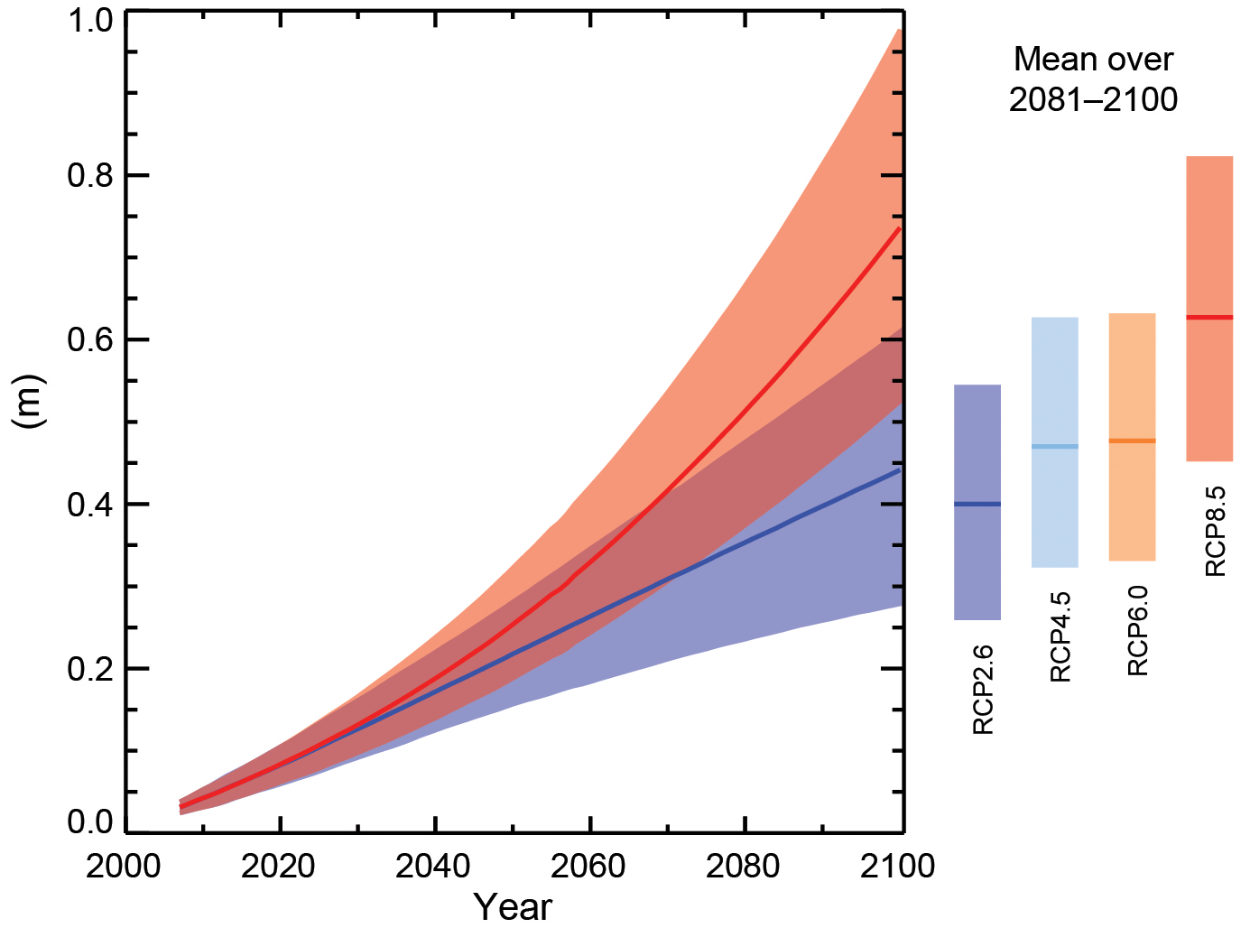
IPCC Sea Level Projections

Slide 30
2100 – Minimum Sea Level Rise + Subsidence (subsidence + sea level rise = 1 meter)

Slide 32
Mississippi Delta Restoration Schemes are not Sustainable
Looking back at the geologic and paleoclimate data shows that the Mississippi Delta must recede with the rising sea level that is already baked into current levels of GHGs.
Coastal restoration schemes and attempts to shift the blame for land loss to localized actors deny the long term reality of climate change on the Mississippi Delta.

Slide 33
The General Problem of Coastal Restoration
Beach and dune geology is like delta geology, in that they also move inland with sea level rise, and this cannot be stopped by building hardned structures and pumping sand.
Wetlands have no impact on major hurricane surge.
The data is from tsunamis
Coastal forests are a surrogate for elevation

Slide 34
What are the Risk Factors?
Elevation (wetlands as elevation surrogate)
Onshore Slope (NYC v New Orleans)
Reach (offshore slope) – determines surge
Relative sea level rise
Hurricane risk with global warming
Substrate (porous limestone, granite, jello)
Value (CBA of hardened structures)

Slide 35
The Fundamental Trade Off
Protecting coastal communities in their current location will require increasing extensive hardened structures.
As the coast recedes and meets these structures, all natural coastal ecology – wetlands and beaches – will be lost.
In most cases, the protections will ultimately fail, leaving death and destruction and no natural environment.

