Slide 1
In Re Katrina Canal Breaches Consolidated Litigation

Slide 2
Background for MRGO
Graci told us that FTC liability does not attach unless a project has a flood control purpose.
MRGO did not have a flood control purpose
FTC immunity did not attach
Still no liability because there was no failure of discretionary authority
Post-Graci the Corps built flood control levees between the city and MRGO

Slide 3
Katrina
Levees were overtopped in many parts of the city
Levees failed (ruptured) on the 17th St. Canal, the Industrial Canal (9th Ward), and levees associated with MRGO
Previous litigation established that the 17th St. Canal was a pure flood control structure and that FCA immunity applied.
The court refused to find that FCA immunity applied to the claims involving the levees that protected against MRGO flooding, letting this trial go forward.

Slide 4
Core Theory of the Case
MRGO, combined with the Intercoastal Canal, created a high pressure funnel that pushed water into the city.
MRGO's widening with time weakened the flood control levees.
The combination lead the levees to fail.
But is this really what happened at all?

Slide 5
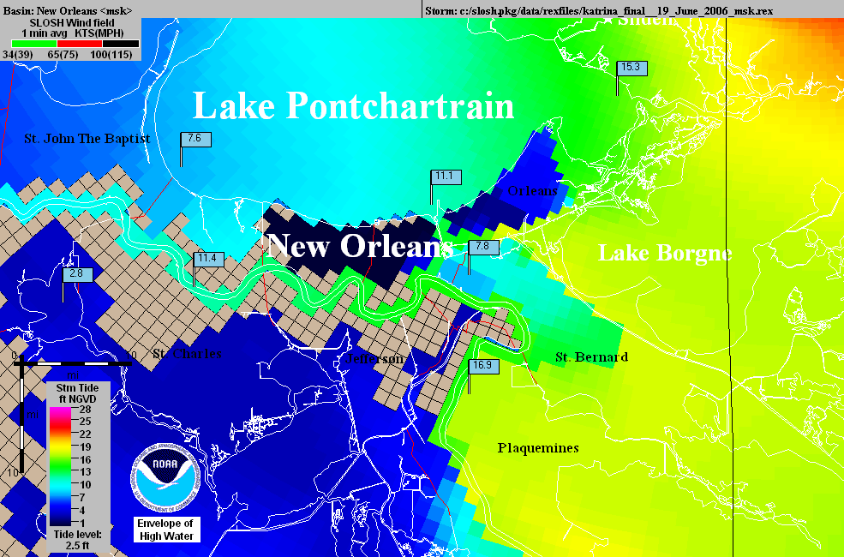
Operational
NHC Katrina
SLOSH model
using outdated
topography
The
“Hurricane
Highway”
Katrina SLOSH
hindcast using
accurate
topography

Slide 6
The Litigation
The Court recognizes that it must distinguish this case from the 17th St. Canal cases. It states its premise on P2.
Is this sustainable?

Slide 7
The Rationale
.[T]he Government’s position ignores the fact that even the Supreme Court in Central Green opened the possibility of a segregation of damages–those for which the Government would be immune under § 702c and those for which immunity would not attach. Indeed, the Government even concurred with this reading at oral argument. ... For example, would the United States be immune for all damages if a Navy vessel lost control and broke through a levee where the sole cause of the failure of that levee was the Navy vessel’s negligence? Thus contrary to the Government’s contention that Central Green broadens the immunity provided by § 702c, in realty Central Green requires the Court to identify the cause of the damage rather than base a decision on the mere fact that a flood control project was involved. Central Green does not answer the question of what nexus to a flood control project is required for floodwaters to trigger immunity.

Slide 8
Reading Central Green
"... in realty Central Green requires the Court to identify the cause of the damage rather than base a decision on the mere fact that a flood control project was involved.."
Was that really the key holding in Central Green?
Accordingly, in determining whether §702c immunity attaches, courts should consider the character of the waters that cause the relevant damage rather than the relation between that damage and a flood control project. (par 53)
What caused the damage from the levee break?

Slide 9
MRGO
The first 10 pages discuss the history of the MRGO and outline the construction of the levees between the MRGO and the city
Sec. 3, p10, begins the discussion of how MRGO increased the likelihood of a flood and what the Corps knew about this.
Remember, there is nothing objective in this opinion, the court only has information from the briefs of the parties, and only uses what it chooses.

Slide 10
What did the Corps Know?
Is this relevant to FCA immunity?
The court is trying to bootstrap FTCA liability by using the Corps knowledge to create a theory of a non-flood control project error that would not be subject to FCA immunity.
What is the balance between showing what the Corps knows and succeeding in defeating the discretionary function defense?
What does Berkowitz tell us is the best way to defeat the defense?

Slide 11
The Erosion of MRGO
A key notion in the attack on the FCA immunity is that the real issue is the improper maintenance of MRGO.
According to the court, waves pushed by sea going vessels are a major source of this erosion.
P 14 has evidence of this erosion presented by the Corps
This establishes that the Corps knew this

Slide 12
Armoring MRGO
The plaintiffs argue, and the court buys this, that the Corps had a duty to put riprap along the navigation channel to prevent erosion.
Why might the Corps not do this?
The Corps argues that armoring the MRGO was part of the decisionmaking in the Lake Pontchartain and Vicinity Hurricane Protection Plan (“LPV”).
The Court rejects this, finding:
"The fact remains that the failure to provide foreshore protection worked as the Navy vessel hitting the levee."

Slide 13
Is this a Discretionary Function?
The next section of the opinion attempts to show that the Corps had a duty to armor MRGO.
P 25 - The court says that a Corps report acknowledged that MRGO should be armored and that the Corps failed to seek funding.
Is seeking funding from Congress a Corps duty?
Can the Corps be negligent in failing to get Congress to fund a project that Congress knows all about?

Slide 14
The Effect on the Flood Control Levee
From P 41-87 the court moves from the story of the failure to armor MRGO to the effect of this failure on the flood control levees.
The court argues the levees were too low and had other problems because the Corps did not properly factor in effects of the eroding soil related to MROG on the levees.
The court is using plaintiff's geology. The real problem is subsidence, plus some ocean rise, has changed the elevations and destabilized the area.
What is the FCA problem with this analysis?
The court rejects plaintiffs' argument that the Corps had a duty to build a surge barrier
The court recognizes this is an FCA issue.

Slide 15
Causation
Based on the foregoing analysis, the Court finds that the Corps’ negligent failure to maintain and operate the MRGO properly was a substantial cause for the fatal breaching of the Reach 2 Levee and the subsequent catastrophic flooding of the St. Bernard Polder occurred. This Court is utterly convinced that the Corps’ failure to provide timely foreshore protection doomed the channel to grow to two to three times its design width and destroyed the banks which would have helped to protect the Reach 2 Levee from front-side wave attack as well as loss of height. In addition, the added width of the channel provided an added fetch which created a more forceful frontal wave attack on the levee.

Slide 16
The Navy Vessel Metaphor
As the court tells us at the beginning, its analysis is based on the dicta in Graci that the government might be liable if a Navy vessel having nothing to do with flood control crashed through a levee. On P 89 the ship comes in:
"Finally, the white encased numbers show the pre-Katrina sill heights and the teal marks show with accuracy and specificity the effect of the Corps’ failures on its own levee–the specific breaches and the resulting sill heights. Indeed, a picture speaks a thousand words. The Corps’ “Navy vessel” devastated this levee."

Slide 17
The Navy Vessel and Central Green
What is the Navy vessel in the court's metaphor made of?
What did Central Green tell us was the key question in a flood control case?
How did the court address this?
Thus, the Corps’ decisions were made in the context of the MRGO project, not within the context of the LPV. ...Thus, the failures at issue here are extrinsic to the LPV and are not subject to §702c immunity. There is no reason for the Court to revisit its decision with respect to the Flood Control Act, and it will not do so.
That is all we get.

Slide 18
FTCA and MRGO
The remainder of the opinion, 50 or so pages, is a detailed discussion of how the court decides that the Corps was negligent in the maintenance of MRGO and why not armoring the MRGO was a ministerial (non-discretionary) act.
This is based on the notion that failing to do so put the region at risk and that would be wrong - the court dealt with Allen by not even citing it.
More fundamentally, once the levees were built, the decisions about armoring MRGO became system decisions of the LPV plan - which the court does not want to hear.

Slide 19
5th Circuit
This spring the 5th Circuit basically upheld the case, based entirely on its own analysis in Graci.
The government lawyers did not do a terrific job on this case.
The Corps basically buys the plaintiff's geology by not putting on rebuttal evidence at trial
More fundamentally, the Corps believes that levees are the answer to every problem dealing with flooding.

Slide 20
The Aftermath
I think the case is headed to the United States Supreme Court. If it is not overturned, it will create liability in every coastal community with any navigation projects, i.e., all of them.
The biggest non-legal problem is that almost all of the geology, hydrology, and ecology in the opinion is junk science. But people will believe it because the court said it is true.
Like the breast implant litigation and many other cases.

