Slide 1
The WGI Contribution to the
IPCC 5th Assessment Report
Thomas Stocker & Qin Dahe
259 Authors from 39 Countries
WGI Technical Support Unit Team
Notes:
This powerpoint presentation is produced by IPCC Working Group I for outreach purposes. It is based on the figures and approved text from the Working Group I Summary for Policymakers with some additional information on the process. The IPCC Working Group I website www.climatechange2013.org provides comprehensive access to all products generated by Working Group I during the fifth assessment cycle of the IPCC.

Slide 2
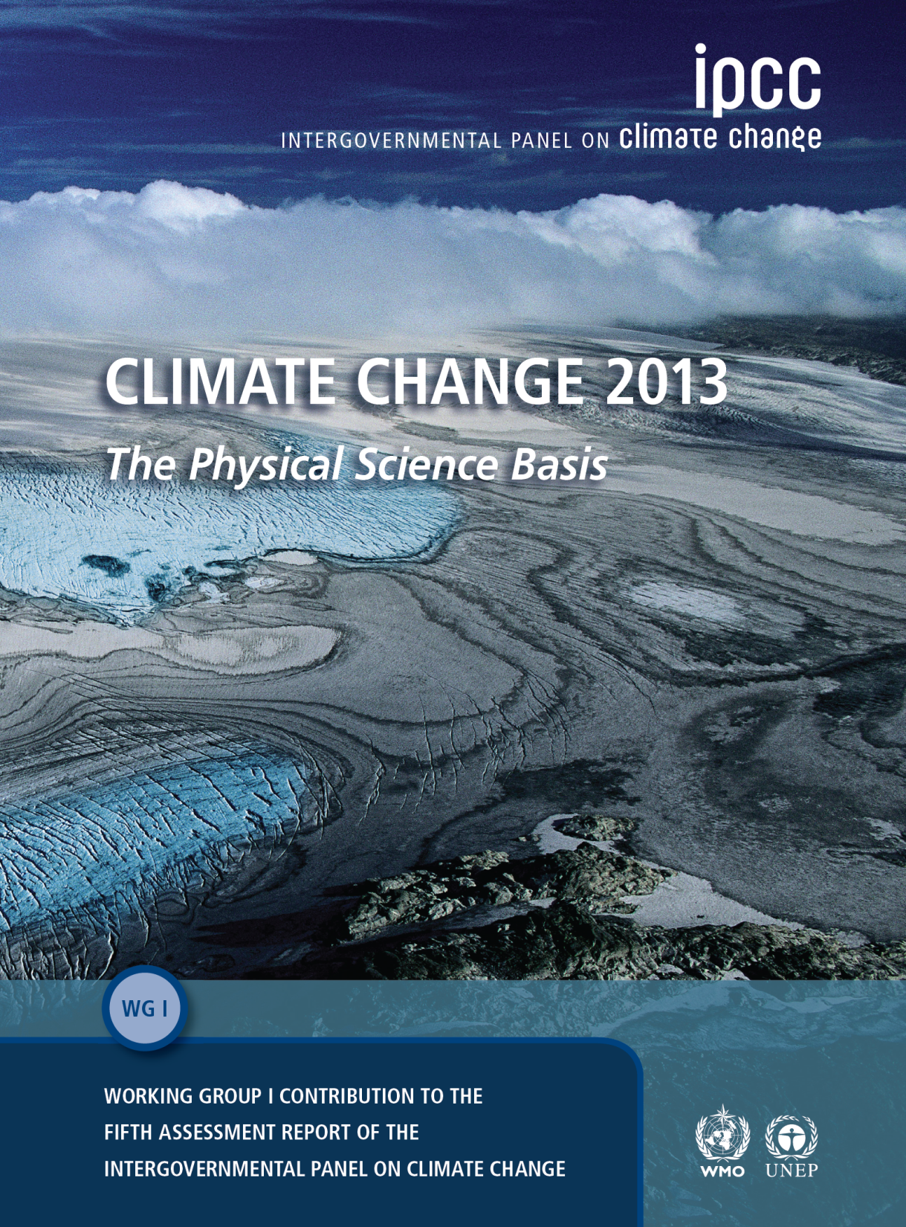
Key SPM Messages
19 Headlines
on less than 2 Pages
Summary for Policymakers
ca. 14,000 Words
14 Chapters Atlas of Regional Projections
54,677 Review Comments by 1089 Experts
2010: 259 Authors Selected
2009: WGI Outline Approved
Notes:
More information available from the IPCC Working Group I website www.climatechange2013.org

Slide 3
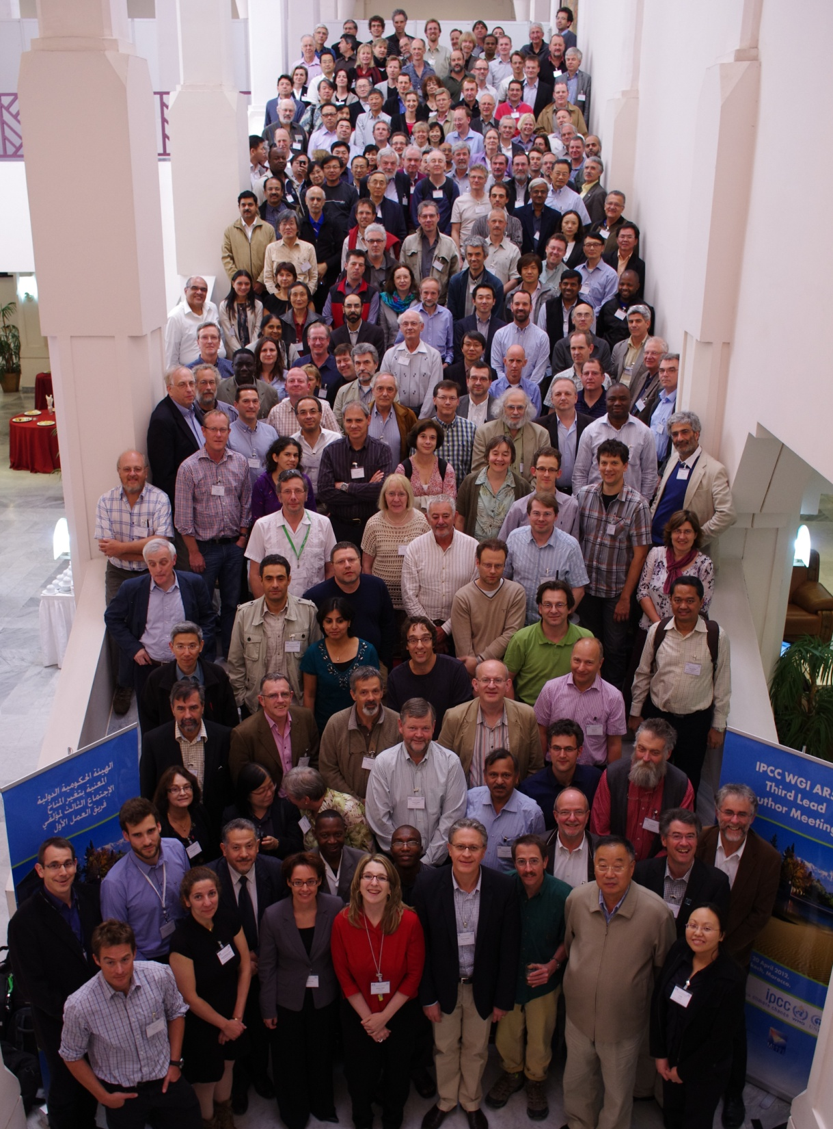
Key SPM Messages
19 Headlines
on less than 2 Pages
Summary for Policymakers
ca. 14,000 Words
14 Chapters Atlas of Regional Projections
54,677 Review Comments by 1089 Experts
2010: 259 Authors Selected
2009: WGI Outline Approved
3rd Lead Author Meeting, Marrakech, Morocco, April 2012
Notes:
More information available from the IPCC Working Group I website www.climatechange2013.org

Slide 4
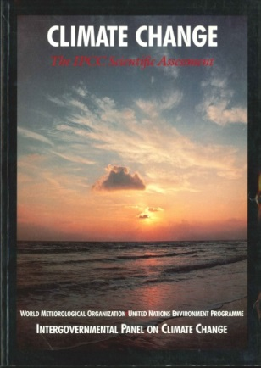
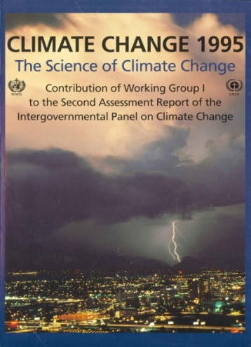
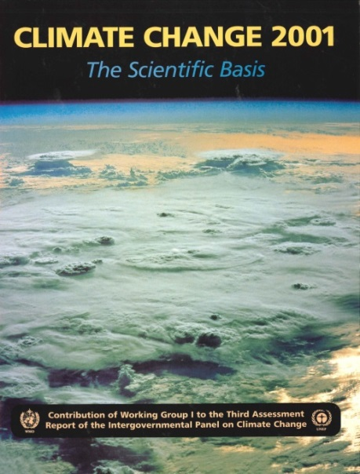
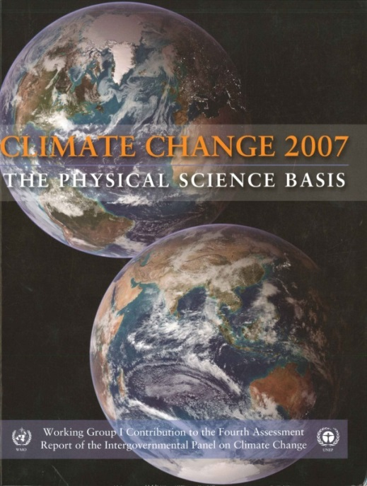
IPCC Assessment Reports since 1990: WGI Contribution
1990
1995
2001
2007
2013
Notes:
All IPCC Assessment Reports are available at www.ipcc.ch

Slide 5
Development Process of the WGI Contribution to the IPCC 5th Assessment Report
Science Community
Lead Authors of WGI
Governments
2008
Election of WG Bureau
2009
Scoping of Outline of Assessment
Approval of Outline
2010
Nomination and Selection of Experts
2011
Informal Review
Zero Order Draft
Expert Review
First Order Draft
2012
Expert Review
Second Order Draft
Government Review
2013
Final Draft
Government Review
Sept 2013
Approval of SPM and Acceptance of Report
Notes:
IPCC assessment process for the development of the Working Group I contribution to the IPCC 5th Assessment Report

Slide 6
WGI Summary for Policymakers
Figures
Notes:
All Figures from the IPCC Working Group I contribution to the IPCC 5th Assessment Report, including the Summary for Policymakers, are available as high-resolution JPEG files from the IPCC Working Group I website www.climatechange2013.org

Slide 7
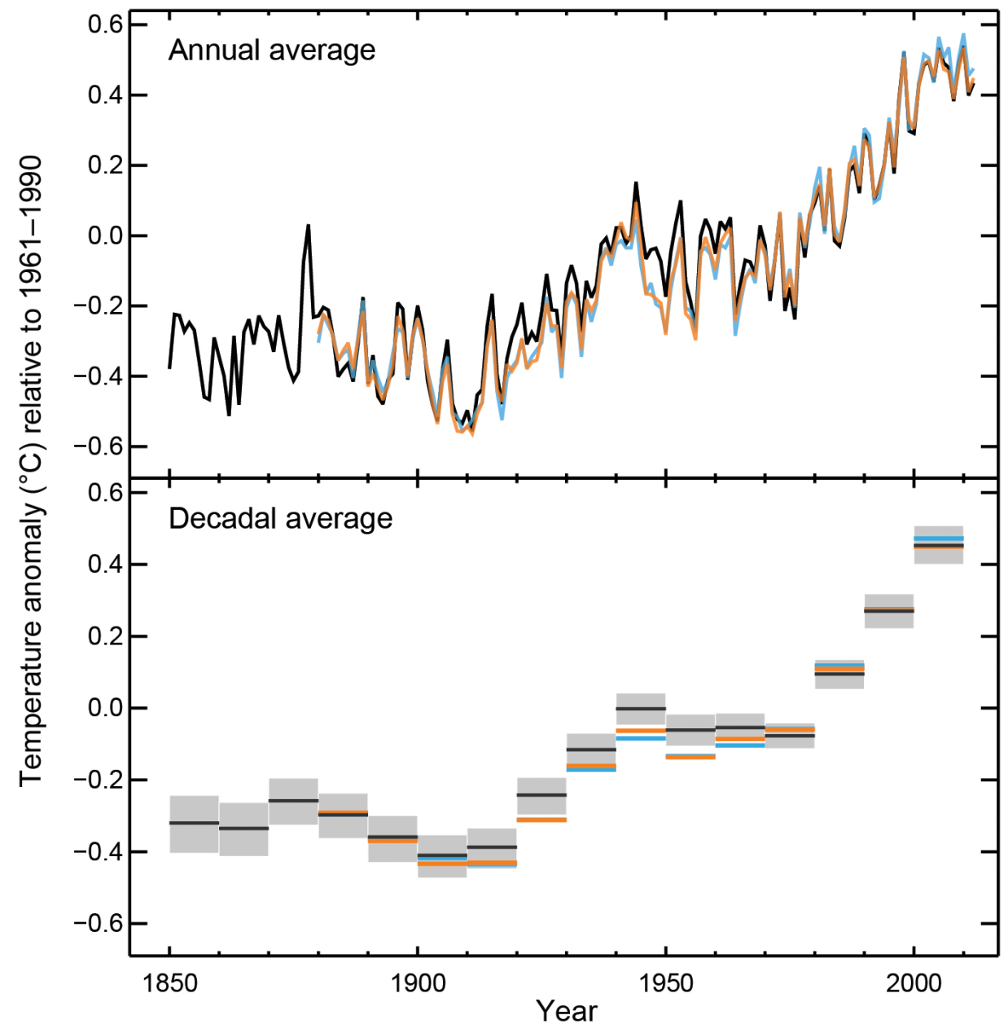
Figure SPM.1a Observed globally averaged combined land and ocean surface temperature anomaly 1850-2012
All Figures © IPCC 2013
Notes:
Figure SPM.1, Panel a
Complete caption of Figure SPM.1:
Figure SPM.1 | (a) Observed global mean combined land and ocean surface temperature anomalies, from 1850 to 2012 from three data sets. Top panel: annual mean values. Bottom panel: decadal mean values including the estimate of uncertainty for one dataset (black). Anomalies are relative to the mean of 1961−1990. (b) Map of the observed surface temperature change from 1901 to 2012 derived from temperature trends determined by linear regression from one dataset (orange line in panel a). Trends have been calculated where data availability permits a robust estimate (i.e., only for grid boxes with greater than 70% complete records and more than 20% data availability in the first and last 10% of the time period). Other areas are white. Grid boxes where the trend is significant at the 10% level are indicated by a + sign. For a listing of the datasets and further technical details see the Technical Summary Supplementary Material. {Figures 2.19–2.21; Figure TS.2}

Slide 8
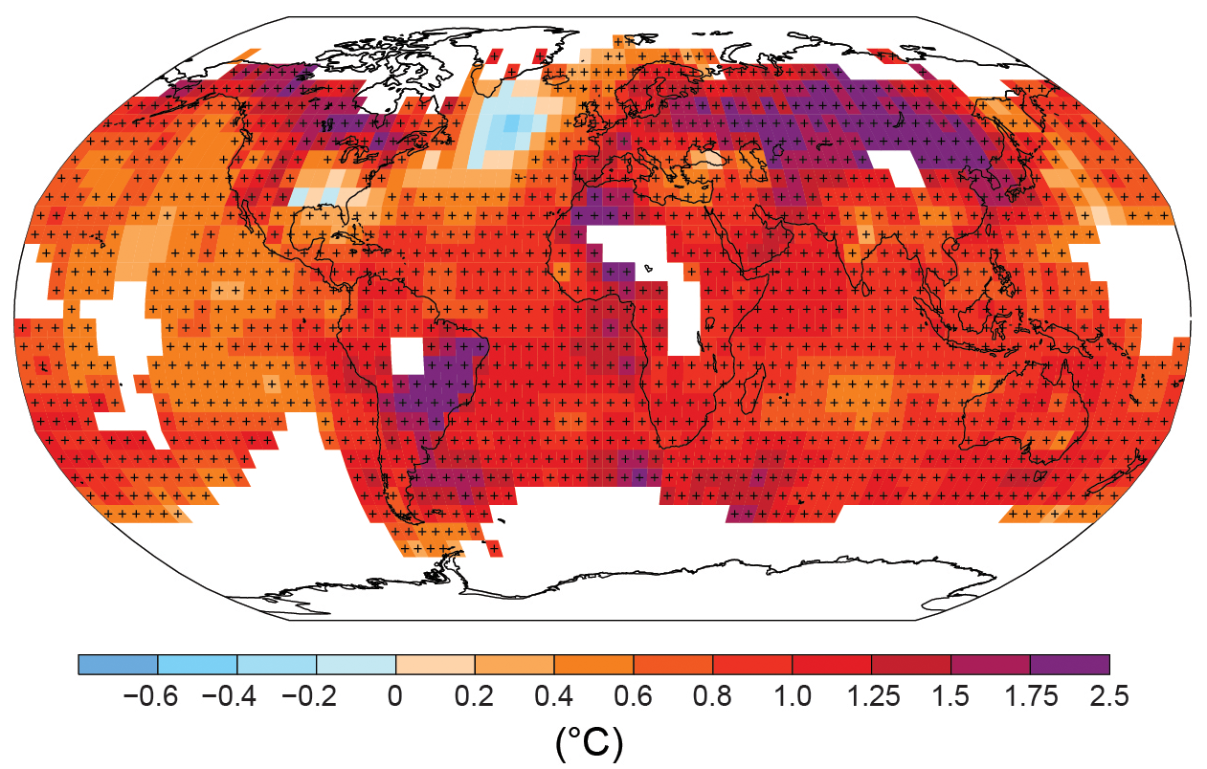
Figure SPM.1b Observed change in surface temperature 1901-2012
All Figures © IPCC 2013
Notes:
Figure SPM.1, Panel b
Complete caption of Figure SPM.1:
Figure SPM.1 | (a) Observed global mean combined land and ocean surface temperature anomalies, from 1850 to 2012 from three data sets. Top panel: annual mean values. Bottom panel: decadal mean values including the estimate of uncertainty for one dataset (black). Anomalies are relative to the mean of 1961−1990. (b) Map of the observed surface temperature change from 1901 to 2012 derived from temperature trends determined by linear regression from one dataset (orange line in panel a). Trends have been calculated where data availability permits a robust estimate (i.e., only for grid boxes with greater than 70% complete records and more than 20% data availability in the first and last 10% of the time period). Other areas are white. Grid boxes where the trend is significant at the 10% level are indicated by a + sign. For a listing of the datasets and further technical details see the Technical Summary Supplementary Material. {Figures 2.19–2.21; Figure TS.2}

Slide 9
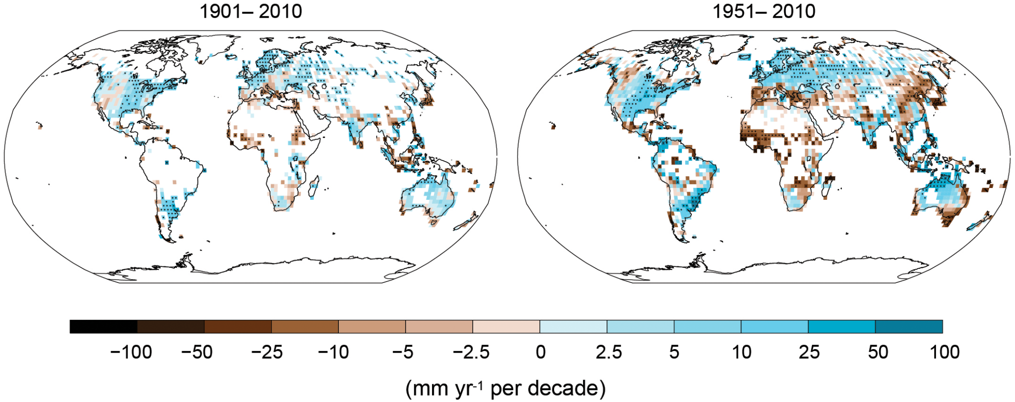
Figure SPM.2 Observed change in annual precipitation over land
All Figures © IPCC 2013
Notes:
Figure SPM.2 | Maps of observed precipitation change from 1901 to 2010 and from 1951 to 2010 (trends in annual accumulation calculated using the same criteria as in Figure SPM.1) from one data set. For further technical details see the Technical Summary Supplementary Material. {TS TFE.1, Figure 2; Figure 2.29}

Slide 10
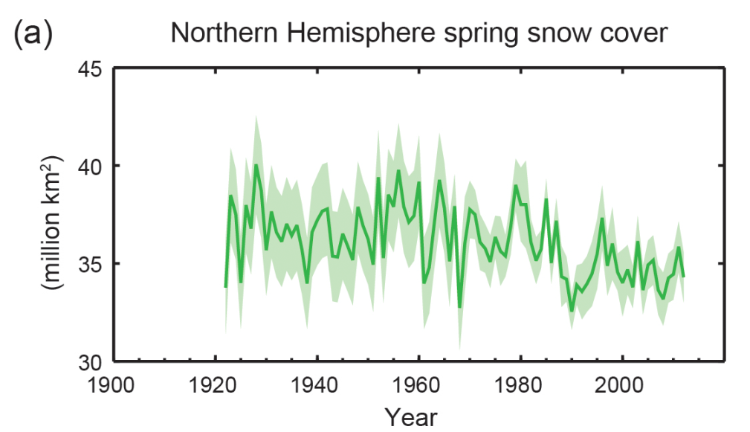
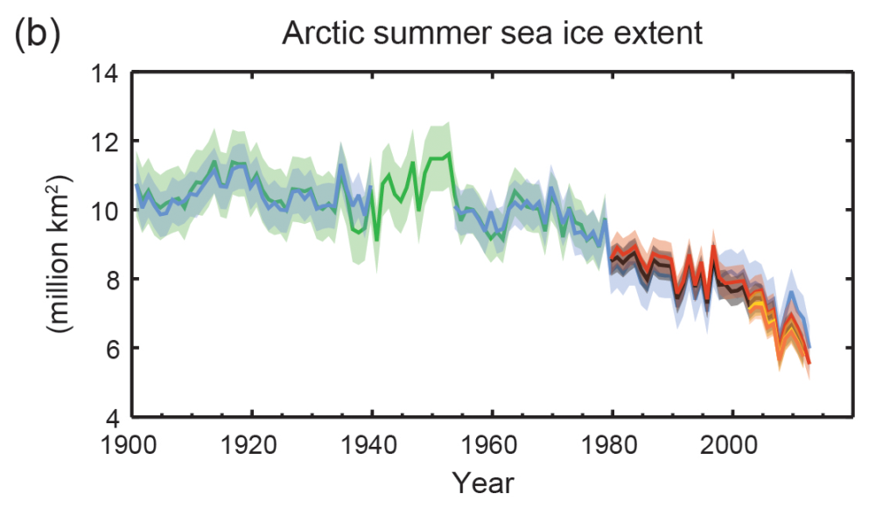
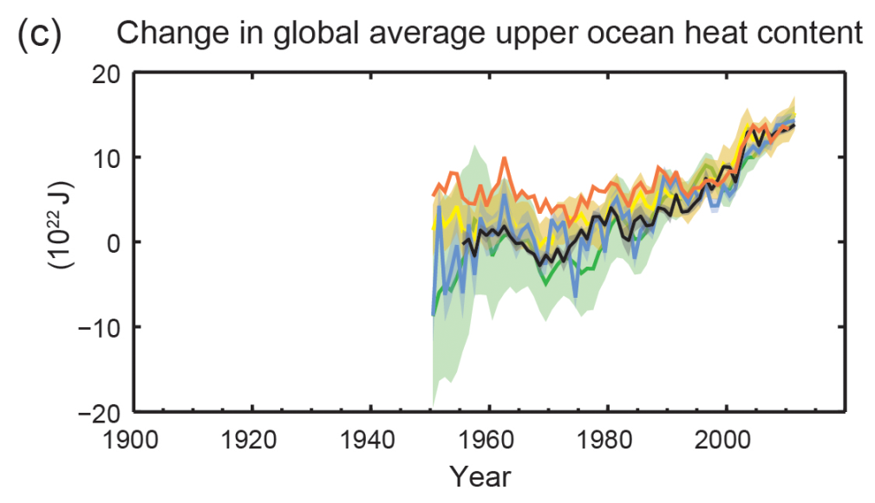
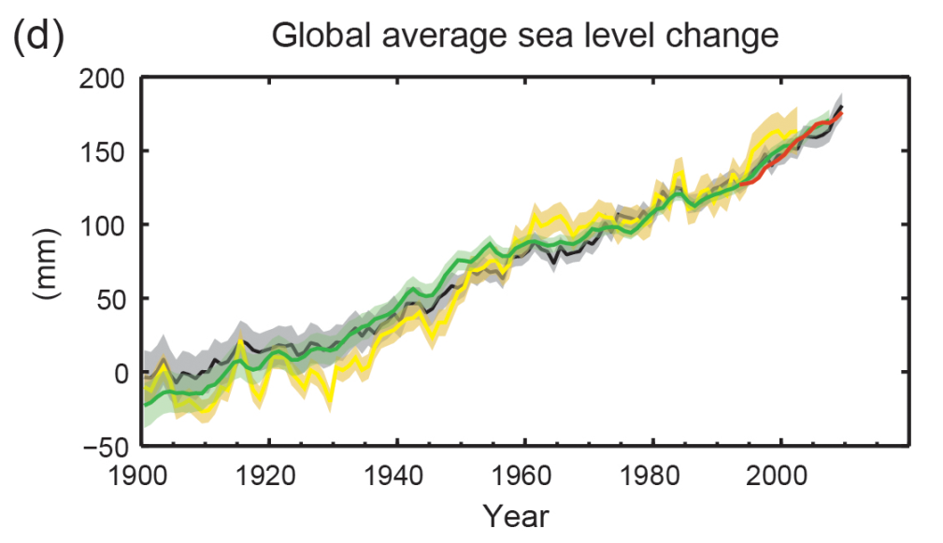
Figure SPM.3 Multiple observed indicators of a changing global climate
All Figures © IPCC 2013
Notes:
Figure SPM.3 | Multiple observed indicators of a changing global climate: (a) Extent of Northern Hemisphere March-April (spring) average snow cover; (b) extent of Arctic July-August-September (summer) average sea ice; (c) change in global mean upper ocean (0–700 m) heat content aligned to 2006−2010, and relative to the mean of all datasets for 1970; (d) global mean sea level relative to the 1900–1905 mean of the longest running dataset, and with all datasets aligned to have the same value in 1993, the first year of satellite altimetry data. All time-series (coloured lines indicating different data sets) show annual values, and where assessed, uncertainties are indicated by coloured shading. See Technical Summary Supplementary Material for a listing of the datasets. {Figures 3.2, 3.13, 4.19, and 4.3; FAQ 2.1, Figure 2; Figure TS.1}

Slide 11
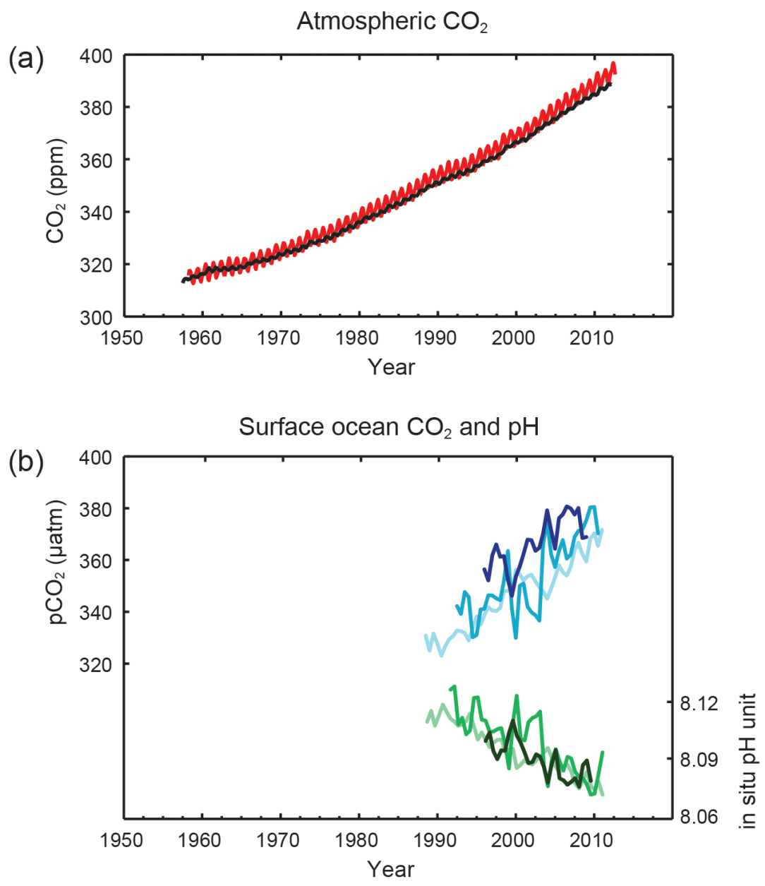
Figure SPM.4 Multiple observed indicators of a changing global carbon cycle
All Figures © IPCC 2013
Notes:
Figure SPM.4 | Multiple observed indicators of a changing global carbon cycle: (a) atmospheric concentrations of carbon dioxide (CO2) from Mauna Loa (19°32’N, 155°34’W – red) and South Pole (89°59’S, 24°48’W – black) since 1958; (b) partial pressure of dissolved CO2 at the ocean surface (blue curves) and in situ pH (green curves), a measure of the acidity of ocean water. Measurements are from three stations from the Atlantic (29°10’N, 15°30’W – dark blue/dark green; 31°40’N, 64°10’W – blue/green) and the Pacific Oceans (22°45’N, 158°00’W − light blue/light green). Full details of the datasets shown here are provided in the underlying report and the Technical Summary Supplementary Material. {Figures 2.1 and 3.18; Figure TS.5}

Slide 14
Volcanos

Slide 15
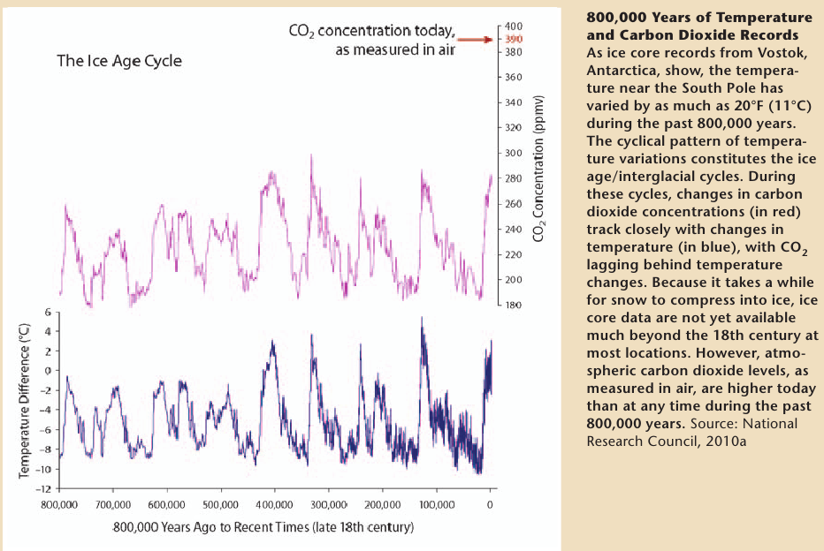

Slide 17
Climate Models

Slide 18
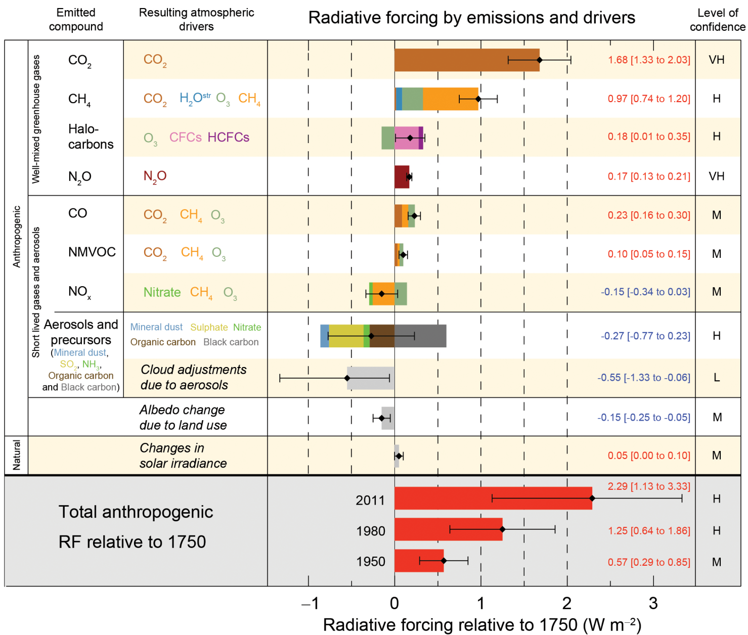
Figure SPM.5 Radiative forcing estimates in 2011 relative to 1750
All Figures © IPCC 2013
Notes:
Figure SPM.5 | Radiative forcing estimates in 2011 relative to 1750 and aggregated uncertainties for the main drivers of climate change. Values are global average radiative forcing (RF, Footnote 14), partitioned according to the emitted compounds or processes that result in a combination of drivers. The best estimates of the net radiative forcing are shown as black diamonds with corresponding uncertainty intervals; the numerical values are provided on the right of the figure, together with the confidence level in the net forcing (VH – very high, H – high, M – medium, L – low, VL – very low). Albedo forcing due to black carbon on snow and ice is included in the black carbon aerosol bar. Small forcings due to contrails (0.05 W m–2, including contrail induced cirrus), and HFCs, PFCs and SF6 (total 0.03 W m–2) are not shown. Concentration-based RFs for gases can be obtained by summing the like-coloured bars. Volcanic forcing is not included as its episodic nature makes is difficult to compare to other forcing mechanisms. Total anthropogenic radiative forcing is provided for three different years relative to 1750. For further technical details, including uncertainty ranges associated with individual components and processes, see the Technical Summary Supplementary Material. {8.5; Figures 8.14–8.18; Figures TS.6 and TS.7}
Footnote 14: The strength of drivers is quantified as Radiative Forcing (RF) in units watts per square metre (W m–2) as in previous IPCC assessments. RF is the change in energy flux caused by a driver, and is calculated at the tropopause or at the top of the atmosphere. In the traditional RF concept employed in previous IPCC reports all surface and tropospheric conditions are kept fixed. In calculations of RF for well-mixed greenhouse gases and aerosols in this report, physical variables, except for the ocean and sea ice, are allowed to respond to perturbations with rapid adjustments. The resulting forcing is called Effective Radiative Forcing (ERF) in the underlying report. This change reflects the scientific progress from previous assessments and results in a better indication of the eventual temperature response for these drivers. For all drivers other than well-mixed greenhouse gases and aerosols, rapid adjustments are less well characterized and assumed to be small, and thus the traditional RF is used. {8.1}

Slide 19
The Missing Gas – Water Vapor
A major greenhouse gas
What affects the concentration of water vapor?
Temperature of the atmosphere affects how much water the air can hold
Temperature of the water affects how fast water can evaporate
Air pressure affects both, but tends to constant.

Slide 21
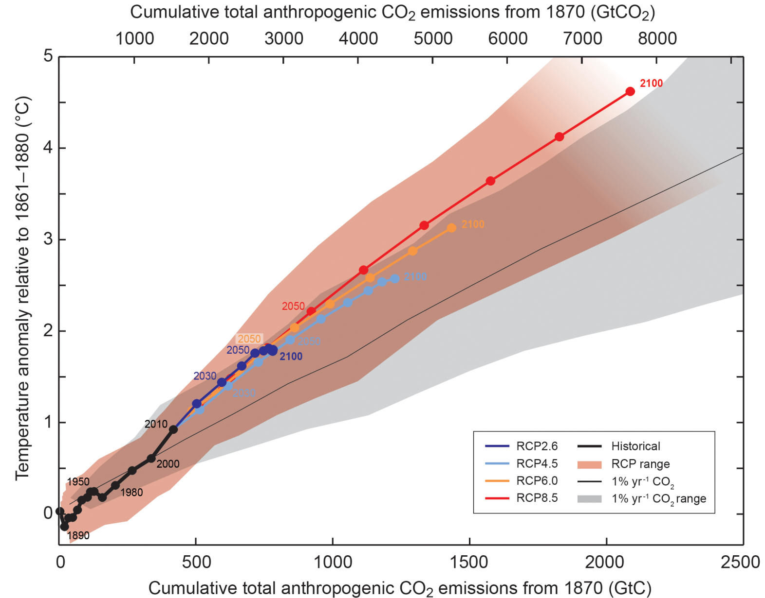
Figure SPM.10 Temperature increase and cumulative carbon emissions
All Figures © IPCC 2013
Notes:
Figure SPM.10 | Global mean surface temperature increase as a function of cumulative total global CO2 emissions from various lines of evidence. Multi-model results from a hierarchy of climate-carbon cycle models for each RCP until 2100 are shown with coloured lines and decadal means (dots). Some decadal means are labeled for clarity (e.g., 2050 indicating the decade 2040−2049). Model results over the historical period (1860 to 2010) are indicated in black. The coloured plume illustrates the multi-model spread over the four RCP scenarios and fades with the decreasing number of available models in RCP8.5. The multi-model mean and range simulated by CMIP5 models, forced by a CO2 increase of 1% per year (1% yr–1 CO2 simulations), is given by the thin black line and grey area. For a specific amount of cumulative CO2 emissions, the 1% per year CO2 simulations exhibit lower warming than those driven by RCPs, which include additional non-CO2 forcings. Temperature values are given relative to the 1861−1880 base period, emissions relative to 1870. Decadal averages are connected by straight lines. For further technical details see the Technical Summary Supplementary Material. {Figure 12.45; TS TFE.8, Figure 1}

Slide 22
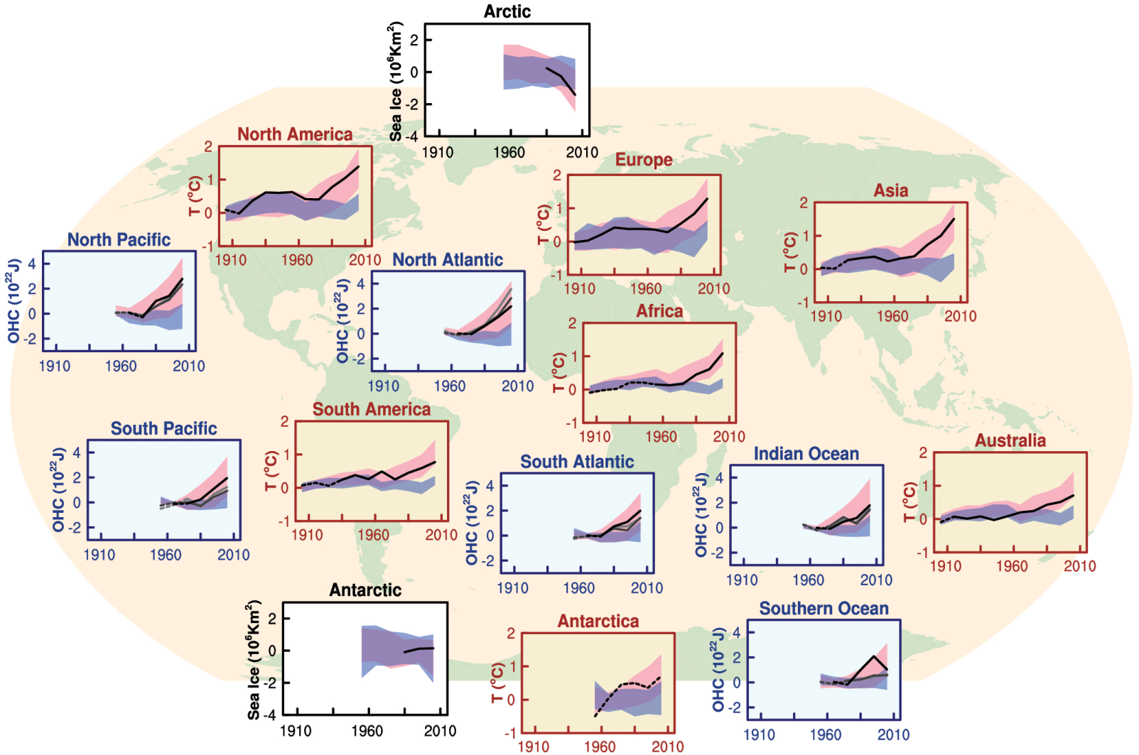
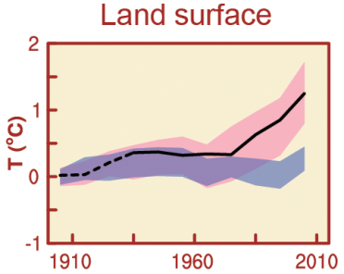
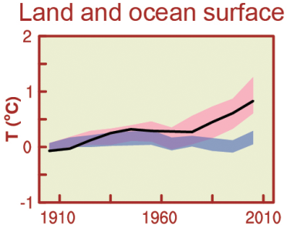
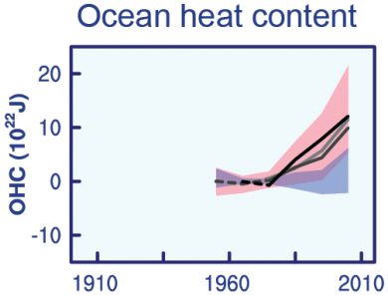
Figure SPM.6 Comparison of observed and simulated climate change
All Figures © IPCC 2013
Notes:
Figure SPM.6 | Comparison of observed and simulated climate change based on three large-scale indicators in the atmosphere, the cryosphere and the ocean: change in continental land surface air temperatures (yellow panels), Arctic and Antarctic September sea ice extent (white panels), and upper ocean heat content in the major ocean basins (blue panels). Global average changes are also given. Anomalies are given relative to 1880–1919 for surface temperatures, 1960–1980 for ocean heat content and 1979–1999 for sea ice. All time-series are decadal averages, plotted at the centre of the decade. For temperature panels, observations are dashed lines if the spatial coverage of areas being examined is below 50%. For ocean heat content and sea ice panels the solid line is where the coverage of data is good and higher in quality, and the dashed line is where the data coverage is only adequate, and thus, uncertainty is larger. Model results shown are Coupled Model Intercomparison Project Phase 5 (CMIP5) multi-model ensemble ranges, with shaded bands indicating the 5 to 95% confidence intervals. For further technical details, including region definitions see the Technical Summary Supplementary Material. {Figure 10.21; Figure TS.12}

Slide 23
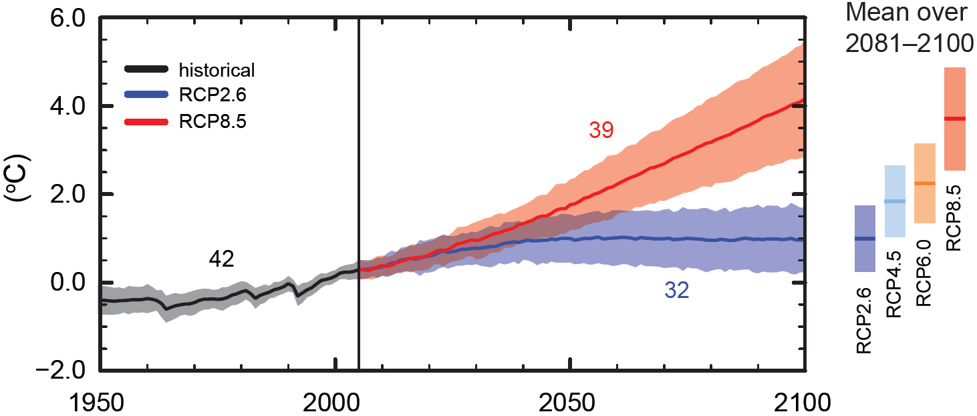
Figure SPM.7a Global average surface temperature change
All Figures © IPCC 2013
Notes:
Figure SPM.7, Panel a
Complete caption of Figure SPM.7:
Figure SPM.7 | CMIP5 multi-model simulated time series from 1950 to 2100 for (a) change in global annual mean surface temperature relative to 1986–2005, (b) Northern Hemisphere September sea ice extent (5-year running mean), and (c) global mean ocean surface pH. Time series of projections and a measure of uncertainty (shading) are shown for scenarios RCP2.6 (blue) and RCP8.5 (red). Black (grey shading) is the modelled historical evolution using historical reconstructed forcings. The mean and associated uncertainties averaged over 2081−2100 are given for all RCP scenarios as colored vertical bars. The numbers of CMIP5 models used to calculate the multi-model mean is indicated. For sea ice extent (b), the projected mean and uncertainty (minimum-maximum range) of the subset of models that most closely reproduce the climatological mean state and 1979 to 2012 trend of the Arctic sea ice is given (number of models given in brackets). For completeness, the CMIP5 multi-model mean is also indicated with dotted lines. The dashed line represents nearly ice-free conditions (i.e., when sea ice extent is less than 106 km2 for at least five consecutive years). For further technical details see the Technical Summary Supplementary Material {Figures 6.28, 12.5, and 12.28–12.31; Figures TS.15, TS.17, and TS.20}

Slide 24
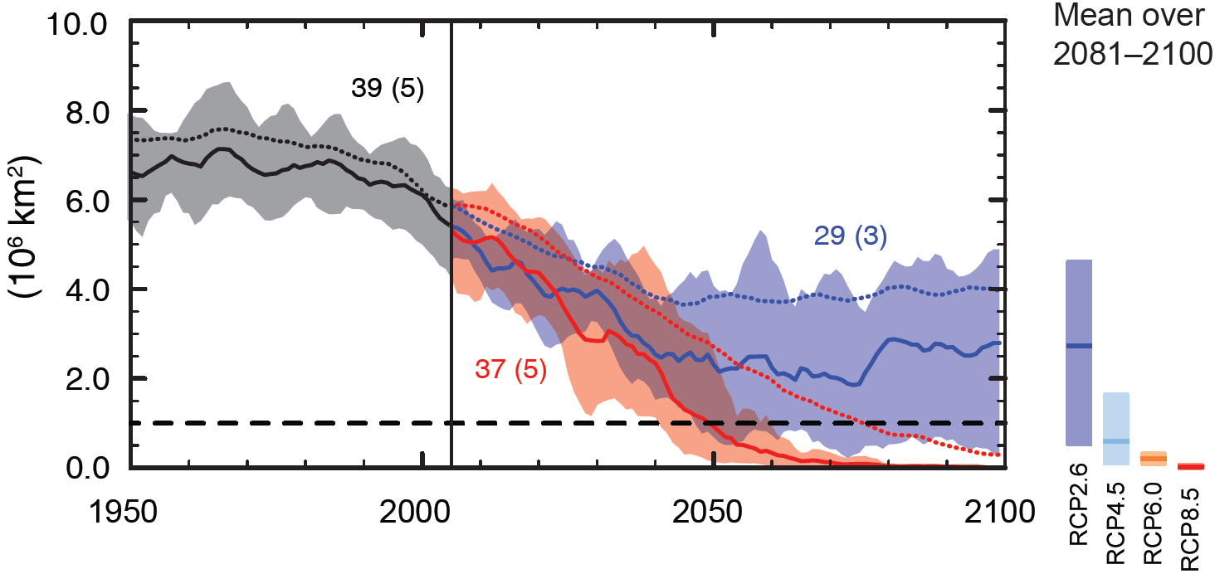
Figure SPM.7b Northern Hemisphere September sea ice extent
All Figures © IPCC 2013
Notes:
Figure SPM.7, Panel b
Complete caption of Figure SPM.7:
Figure SPM.7 | CMIP5 multi-model simulated time series from 1950 to 2100 for (a) change in global annual mean surface temperature relative to 1986–2005, (b) Northern Hemisphere September sea ice extent (5-year running mean), and (c) global mean ocean surface pH. Time series of projections and a measure of uncertainty (shading) are shown for scenarios RCP2.6 (blue) and RCP8.5 (red). Black (grey shading) is the modelled historical evolution using historical reconstructed forcings. The mean and associated uncertainties averaged over 2081−2100 are given for all RCP scenarios as colored vertical bars. The numbers of CMIP5 models used to calculate the multi-model mean is indicated. For sea ice extent (b), the projected mean and uncertainty (minimum-maximum range) of the subset of models that most closely reproduce the climatological mean state and 1979 to 2012 trend of the Arctic sea ice is given (number of models given in brackets). For completeness, the CMIP5 multi-model mean is also indicated with dotted lines. The dashed line represents nearly ice-free conditions (i.e., when sea ice extent is less than 106 km2 for at least five consecutive years). For further technical details see the Technical Summary Supplementary Material {Figures 6.28, 12.5, and 12.28–12.31; Figures TS.15, TS.17, and TS.20}

Slide 25
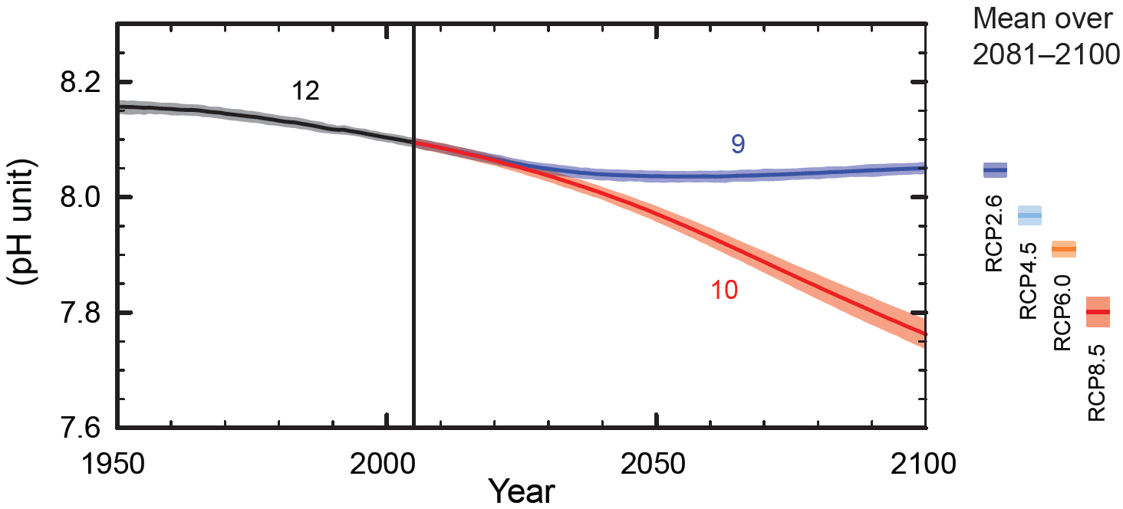
Figure SPM.7c Global ocean surface pH
All Figures © IPCC 2013
Notes:
Figure SPM.7, Panel c
Complete caption of Figure SPM.7:
Figure SPM.7 | CMIP5 multi-model simulated time series from 1950 to 2100 for (a) change in global annual mean surface temperature relative to 1986–2005, (b) Northern Hemisphere September sea ice extent (5-year running mean), and (c) global mean ocean surface pH. Time series of projections and a measure of uncertainty (shading) are shown for scenarios RCP2.6 (blue) and RCP8.5 (red). Black (grey shading) is the modelled historical evolution using historical reconstructed forcings. The mean and associated uncertainties averaged over 2081−2100 are given for all RCP scenarios as colored vertical bars. The numbers of CMIP5 models used to calculate the multi-model mean is indicated. For sea ice extent (b), the projected mean and uncertainty (minimum-maximum range) of the subset of models that most closely reproduce the climatological mean state and 1979 to 2012 trend of the Arctic sea ice is given (number of models given in brackets). For completeness, the CMIP5 multi-model mean is also indicated with dotted lines. The dashed line represents nearly ice-free conditions (i.e., when sea ice extent is less than 106 km2 for at least five consecutive years). For further technical details see the Technical Summary Supplementary Material {Figures 6.28, 12.5, and 12.28–12.31; Figures TS.15, TS.17, and TS.20}

Slide 26
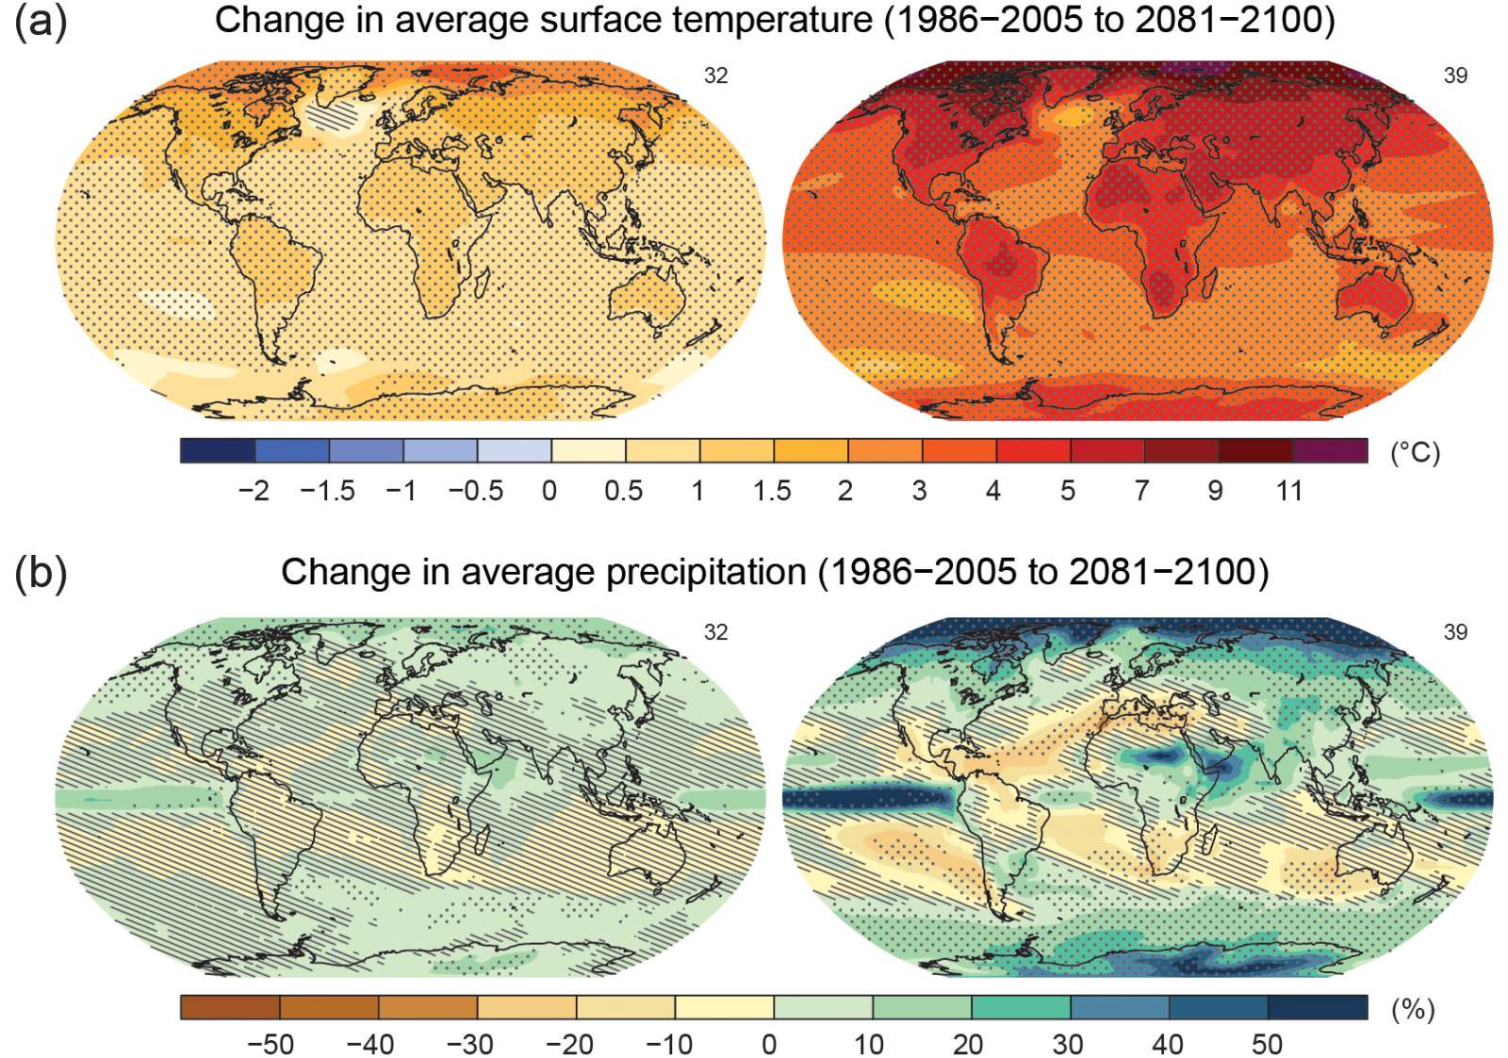
Figure SPM.8a,b Maps of CMIP5 multi-model mean results
All Figures © IPCC 2013
Notes:
Figure SPM.8, Panels a and b
Complete caption of Figure SPM.8:
Figure SPM.8 | Maps of CMIP5 multi-model mean results for the scenarios RCP2.6 and RCP8.5 in 2081–2100 of (a) annual mean surface temperature change, (b) average percent change in annual mean precipitation, (c) Northern Hemisphere September sea ice extent, and (d) change in ocean surface pH. Changes in panels (a), (b) and (d) are shown relative to 1986–2005. The number of CMIP5 models used to calculate the multi-model mean is indicated in the upper right corner of each panel. For panels (a) and (b), hatching indicates regions where the multi-model mean is small compared to natural internal variability (i.e., less than one standard deviation of natural internal variability in 20-year means). Stippling indicates regions where the multi-model mean is large compared to natural internal variability (i.e., greater than two standard deviations of natural internal variability in 20-year means) and where at least 90% of models agree on the sign of change (see Box 12.1). In panel (c), the lines are the modelled means for 1986−2005; the filled areas are for the end of the century. The CMIP5 multi-model mean is given in white colour, the projected mean sea ice extent of a subset of models (number of models given in brackets) that most closely reproduce the climatological mean state and 1979 to 2012 trend of the Arctic sea ice extent is given in light blue colour. For further technical details see the Technical Summary Supplementary Material. {Figures 6.28, 12.11, 12.22, and 12.29; Figures TS.15, TS.16, TS.17, and TS.20}

Slide 27
Figure SPM.8c Maps of CMIP5 multi-model mean results
All Figures © IPCC 2013
RCP 2.6
RCP 8.5
Notes:
Figure SPM.8, Panel c
Complete caption of Figure SPM.8:
Figure SPM.8 | Maps of CMIP5 multi-model mean results for the scenarios RCP2.6 and RCP8.5 in 2081–2100 of (a) annual mean surface temperature change, (b) average percent change in annual mean precipitation, (c) Northern Hemisphere September sea ice extent, and (d) change in ocean surface pH. Changes in panels (a), (b) and (d) are shown relative to 1986–2005. The number of CMIP5 models used to calculate the multi-model mean is indicated in the upper right corner of each panel. For panels (a) and (b), hatching indicates regions where the multi-model mean is small compared to natural internal variability (i.e., less than one standard deviation of natural internal variability in 20-year means). Stippling indicates regions where the multi-model mean is large compared to natural internal variability (i.e., greater than two standard deviations of natural internal variability in 20-year means) and where at least 90% of models agree on the sign of change (see Box 12.1). In panel (c), the lines are the modelled means for 1986−2005; the filled areas are for the end of the century. The CMIP5 multi-model mean is given in white colour, the projected mean sea ice extent of a subset of models (number of models given in brackets) that most closely reproduce the climatological mean state and 1979 to 2012 trend of the Arctic sea ice extent is given in light blue colour. For further technical details see the Technical Summary Supplementary Material. {Figures 6.28, 12.11, 12.22, and 12.29; Figures TS.15, TS.16, TS.17, and TS.20}

Slide 28
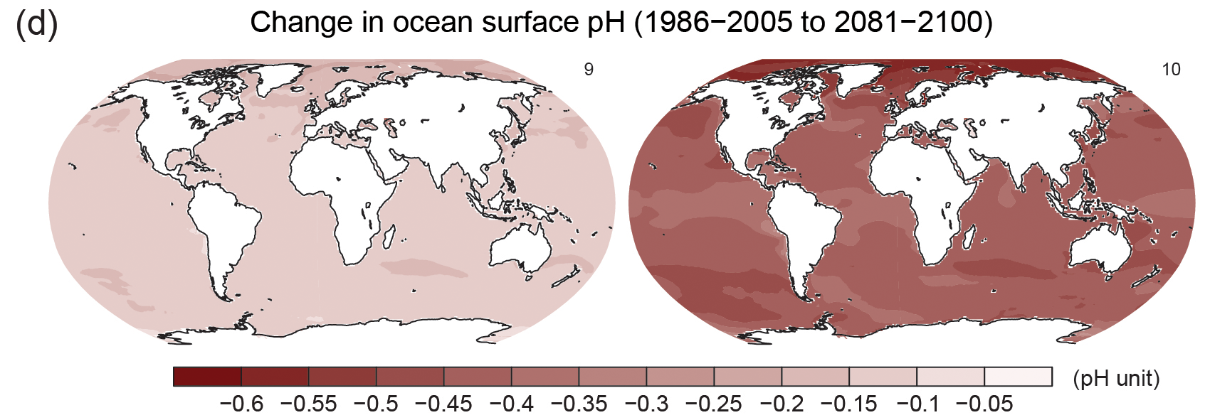
Figure SPM.8d Maps of CMIP5 multi-model mean results
All Figures © IPCC 2013
Notes:
Figure SPM.8, Panel d
Complete caption of Figure SPM.8:
Figure SPM.8 | Maps of CMIP5 multi-model mean results for the scenarios RCP2.6 and RCP8.5 in 2081–2100 of (a) annual mean surface temperature change, (b) average percent change in annual mean precipitation, (c) Northern Hemisphere September sea ice extent, and (d) change in ocean surface pH. Changes in panels (a), (b) and (d) are shown relative to 1986–2005. The number of CMIP5 models used to calculate the multi-model mean is indicated in the upper right corner of each panel. For panels (a) and (b), hatching indicates regions where the multi-model mean is small compared to natural internal variability (i.e., less than one standard deviation of natural internal variability in 20-year means). Stippling indicates regions where the multi-model mean is large compared to natural internal variability (i.e., greater than two standard deviations of natural internal variability in 20-year means) and where at least 90% of models agree on the sign of change (see Box 12.1). In panel (c), the lines are the modelled means for 1986−2005; the filled areas are for the end of the century. The CMIP5 multi-model mean is given in white colour, the projected mean sea ice extent of a subset of models (number of models given in brackets) that most closely reproduce the climatological mean state and 1979 to 2012 trend of the Arctic sea ice extent is given in light blue colour. For further technical details see the Technical Summary Supplementary Material. {Figures 6.28, 12.11, 12.22, and 12.29; Figures TS.15, TS.16, TS.17, and TS.20}

Slide 29
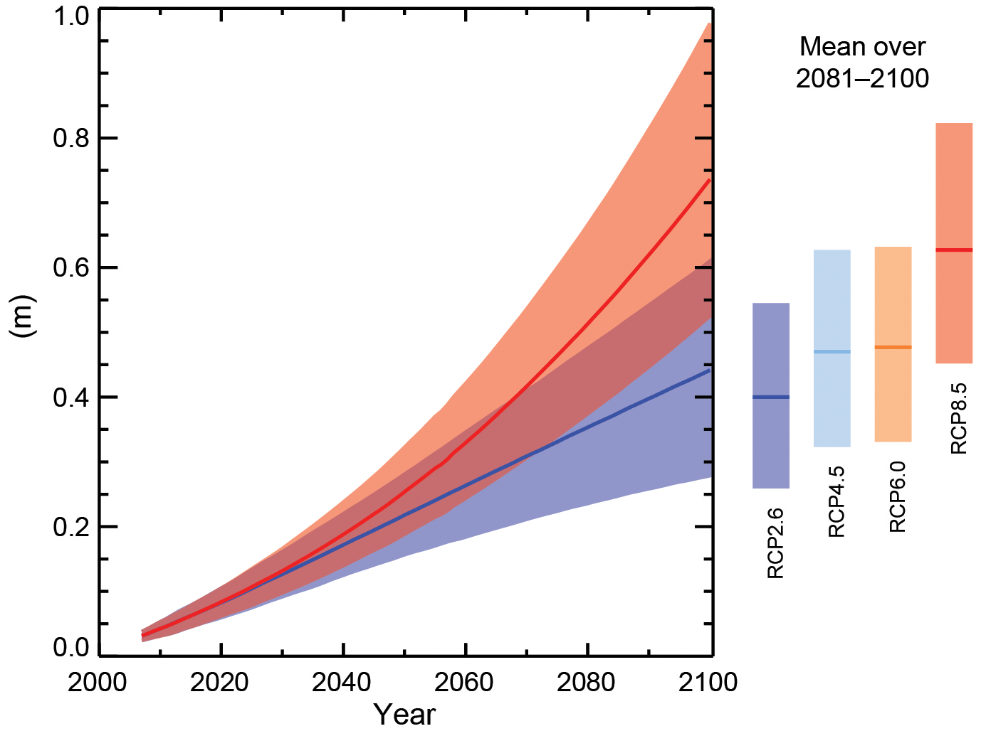
Figure SPM.9 Global mean sea level rise
All Figures © IPCC 2013
Notes:
Figure SPM.9 | Projections of global mean sea level rise over the 21st century relative to 1986–2005 from the combination of the CMIP5 ensemble with process-based models, for RCP2.6 and RCP8.5. The assessed likely range is shown as a shaded band. The assessed likely ranges for the mean over the period 2081–2100 for all RCP scenarios are given as coloured vertical bars, with the corresponding median value given as a horizontal line. For further technical details see the Technical Summary Supplementary Material {Table 13.5, Figures 13.10 and 13.11; Figures TS.21 and TS.22}

Slide 30
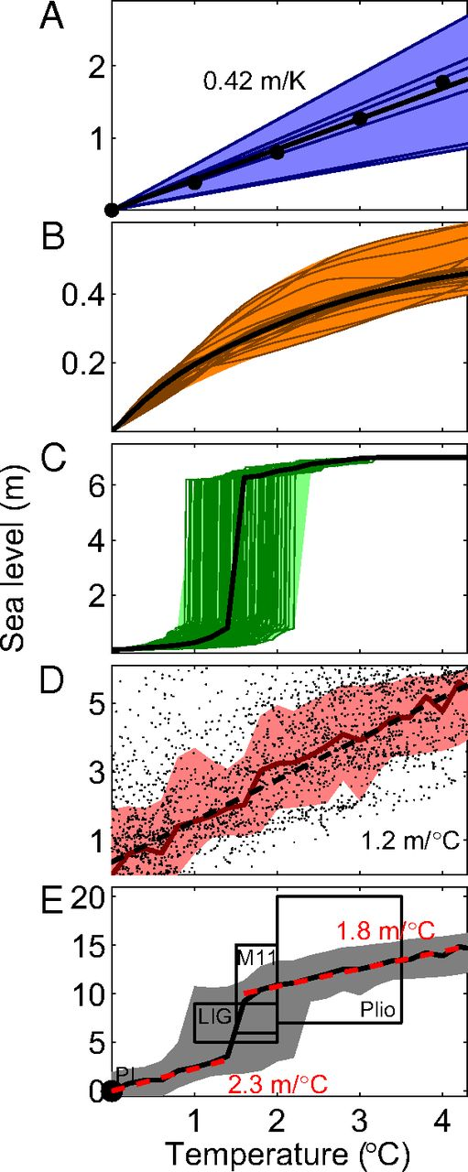
Sea-level commitment per degree of warming as obtained from physical model simulations of (A) ocean warming, (B) mountain glaciers and ice caps, and (C) the Greenland and (D) the Antarctic Ice Sheets.
Anders Levermann et al. PNAS 2013;110:13745-13750
©2013 by National Academy of Sciences
Notes:
Sea-level commitment per degree of warming as obtained from physical model simulations of (A) ocean warming, (B) mountain glaciers and ice caps, and (C) the Greenland and (D) the Antarctic Ice Sheets. (E) The corresponding total sea-level commitment, which is consistent with paleo-estimates from past warm periods (PI, preindustrial, Plio, mid-Pliocene; see text for discussion). Temperatures are relative to preindustrial. Dashed lines and large dots provide linear approximations: (A) sea-level rise for a spatially homogeneous increase in ocean temperature; (A, D, E) constant slopes of 0.42, 1.2, and 1.8 and 2.3 m/°C. Shading as well as boxes represent the uncertainty range as discussed in the text. (A–C) Thin lines provide the individual simulation results from different models (A and B) or different parameter combinations (C). The small black dots in D represent 1,000-y averages of the 5-million-year simulation of Antarctica following ref. 36.

Slide 31
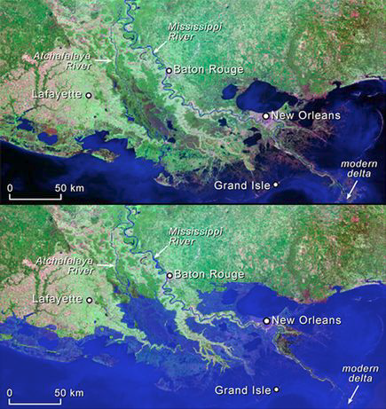
One Meter Contour

Slide 32
WGI Summary for Policymakers
Headline Statements
Notes:
In order to facilitate the accessibility of the findings of the Working Group I assessment for a wide readership and to enhance their usability for stakeholders, each section and subsection of the Working Group I Summary for Policymakers has a highlighted headline statement. Taken together, these 19 headline statements provide an overarching summary in simple and quotable language that is supported by the scientists and approved by the member governments of the IPCC. The four headline statements in boxes are those summarizing the assessment in sections B, C, D and E of the Summary for Policymakers.

Slide 33
Observed Changes in the Climate System (1/2)
Warming of the climate system is unequivocal, and since the 1950s, many of the observed changes are unprecedented over decades to millennia. The atmosphere and ocean have warmed, the amounts of snow and ice have diminished, sea level has risen, and the concentrations of greenhouse gases have increased.
Each of the last three decades has been successively warmer at the Earth’s surface than any preceding decade since 1850. In the Northern Hemisphere, 1983–2012 was likely the warmest 30-year period of the last 1400 years (medium confidence).
Ocean warming dominates the increase in energy stored in the climate system, accounting for more than 90% of the energy accumulated between 1971 and 2010 (high confidence). It is virtually certain that the upper ocean (0–700 m) warmed from 1971 to 2010, and it likely warmed between the 1870s and 1971.
Over the last two decades, the Greenland and Antarctic ice sheets have been losing mass, glaciers have continued to shrink almost worldwide, and Arctic sea ice and Northern Hemisphere spring snow cover have continued to decrease in extent (high confidence).
Notes:
In order to facilitate the accessibility of the findings of the Working Group I assessment for a wide readership and to enhance their usability for stakeholders, each section and subsection of the Working Group I Summary for Policymakers has a highlighted headline statement. Taken together, these 19 headline statements provide an overarching summary in simple and quotable language that is supported by the scientists and approved by the member governments of the IPCC. The four headline statements in boxes are those summarizing the assessment in sections B, C, D and E of the Summary for Policymakers.

Slide 34
Observed Changes in the Climate System (2/2)
The rate of sea level rise since the mid-19th century has been larger than the mean rate during the previous two millennia (high confidence). Over the period 1901 to 2010, global mean sea level rose by 0.19 [0.17 to 0.21] m.
The atmospheric concentrations of carbon dioxide, methane, and nitrous oxide have increased to levels unprecedented in at least the last 800,000 years. Carbon dioxide concentrations have increased by 40% since pre-industrial times, primarily from fossil fuel emissions and secondarily from net land use change emissions. The ocean has absorbed about 30% of the emitted anthropogenic carbon dioxide, causing ocean acidification.
Notes:
In order to facilitate the accessibility of the findings of the Working Group I assessment for a wide readership and to enhance their usability for stakeholders, each section and subsection of the Working Group I Summary for Policymakers has a highlighted headline statement. Taken together, these 19 headline statements provide an overarching summary in simple and quotable language that is supported by the scientists and approved by the member governments of the IPCC. The four headline statements in boxes are those summarizing the assessment in sections B, C, D and E of the Summary for Policymakers.

Slide 35
Drivers of Climate Change (1/1)
Total radiative forcing is positive, and has led to an uptake of energy by the climate system. The largest contribution to total radiative forcing is caused by the increase in the atmospheric concentration of CO₂ since 1750.
Notes:
In order to facilitate the accessibility of the findings of the Working Group I assessment for a wide readership and to enhance their usability for stakeholders, each section and subsection of the Working Group I Summary for Policymakers has a highlighted headline statement. Taken together, these 19 headline statements provide an overarching summary in simple and quotable language that is supported by the scientists and approved by the member governments of the IPCC. The four headline statements in boxes are those summarizing the assessment in sections B, C, D and E of the Summary for Policymakers.

Slide 36
Understanding the Climate System and its Recent Changes (1/1)
Human influence on the climate system is clear. This is evident from the increasing greenhouse gas concentrations in the atmosphere, positive radiative forcing, observed warming, and understanding of the climate system.
Climate models have improved since the AR4. Models reproduce observed continental-scale surface temperature patterns and trends over many decades, including the more rapid warming since the mid-20th century and the cooling immediately following large volcanic eruptions (very high confidence).
Observational and model studies of temperature change, climate feedbacks and changes in the Earth’s energy budget together provide confidence in the magnitude of global warming in response to past and future forcing.
Human influence has been detected in warming of the atmosphere and the ocean, in changes in the global water cycle, in reductions in snow and ice, in global mean sea level rise, and in changes in some climate extremes. This evidence for human influence has grown since AR4. It is extremely likely that human influence has been the dominant cause of the observed warming since the mid-20th century.
Notes:
In order to facilitate the accessibility of the findings of the Working Group I assessment for a wide readership and to enhance their usability for stakeholders, each section and subsection of the Working Group I Summary for Policymakers has a highlighted headline statement. Taken together, these 19 headline statements provide an overarching summary in simple and quotable language that is supported by the scientists and approved by the member governments of the IPCC. The four headline statements in boxes are those summarizing the assessment in sections B, C, D and E of the Summary for Policymakers.

Slide 37
Future Global and Regional Climate Change (1/2)
Continued emissions of greenhouse gases will cause further warming and changes in all components of the climate system. Limiting climate change will require substantial and sustained reductions of greenhouse gas emissions.
Global surface temperature change for the end of the 21st century is likely to exceed 1.5°C relative to 1850 to 1900 for all RCP scenarios except RCP2.6. It is likely to exceed 2°C for RCP6.0 and RCP8.5, and more likely than not to exceed 2°C for RCP4.5. Warming will continue beyond 2100 under all RCP scenarios except RCP2.6. Warming will continue to exhibit interannual-to-decadal variability and will not be regionally uniform.
Changes in the global water cycle in response to the warming over the 21st century will not be uniform. The contrast in precipitation between wet and dry regions and between wet and dry seasons will increase, although there may be regional exceptions.
The global ocean will continue to warm during the 21st century. Heat will penetrate from the surface to the deep ocean and affect ocean circulation.
Notes:
In order to facilitate the accessibility of the findings of the Working Group I assessment for a wide readership and to enhance their usability for stakeholders, each section and subsection of the Working Group I Summary for Policymakers has a highlighted headline statement. Taken together, these 19 headline statements provide an overarching summary in simple and quotable language that is supported by the scientists and approved by the member governments of the IPCC. The four headline statements in boxes are those summarizing the assessment in sections B, C, D and E of the Summary for Policymakers.

Slide 38
Future Global and Regional Climate Change (2/2)
It is very likely that the Arctic sea ice cover will continue to shrink and thin and that Northern Hemisphere spring snow cover will decrease during the 21st century as global mean surface temperature rises. Global glacier volume will further decrease.
Global mean sea level will continue to rise during the 21st century. Under all RCP scenarios, the rate of sea level rise will very likely exceed that observed during 1971 to 2010 due to increased ocean warming and increased loss of mass from glaciers and ice sheets.
Climate change will affect carbon cycle processes in a way that will exacerbate the increase of CO₂ in the atmosphere (high confidence). Further uptake of carbon by the ocean will increase ocean acidification.
Cumulative emissions of CO₂ largely determine global mean surface warming by the late 21st century and beyond. Most aspects of climate change will persist for many centuries even if emissions of CO₂ are stopped. This represents a substantial multi-century climate change commitment created by past, present and future emissions of CO₂.
Notes:
In order to facilitate the accessibility of the findings of the Working Group I assessment for a wide readership and to enhance their usability for stakeholders, each section and subsection of the Working Group I Summary for Policymakers has a highlighted headline statement. Taken together, these 19 headline statements provide an overarching summary in simple and quotable language that is supported by the scientists and approved by the member governments of the IPCC. The four headline statements in boxes are those summarizing the assessment in sections B, C, D and E of the Summary for Policymakers.

Slide 39
Notes:
The IPCC Working Group I website www.climatechange2013.org provides comprehensive access to all products generated by Working Group I during the fifth assessment cycle of the IPCC. This includes the adopted report, the review drafts, all comments collected during the review process and the author responses, as well as background material consisting of Reports of IPCC Expert Meetings and Workshops, and Guidance Papers resulting from such meetings. In addition, outreach material, presentations and speeches are made available on this site.

