Slide 1

Session Block IV - Room 213 / 2:25 – 2:50 pm
Using Oil and Gas Industry Data to Achieve Coastal Sustainability
Chris McLindon
New Orleans Geological Society

Slide 2
Axioms of Coastal Sustainability
Long term sustainability will be primarily determined by rates of relative sea level rise (RSLR)
More sustainable areas are tectonically stable areas – away from subsidence hot spots
Achieving sustainability will require making predictive models of the impacts of RSLR
Accurate predictive models must be constructed from accurate geological models

Slide 3
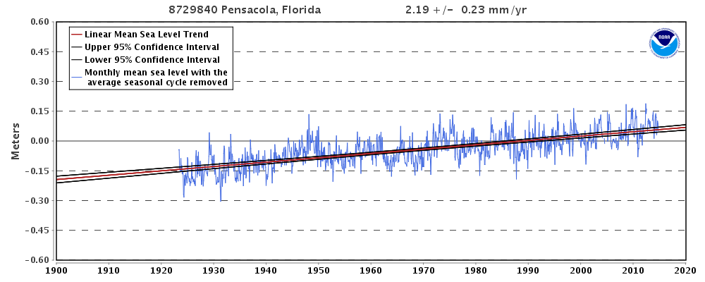
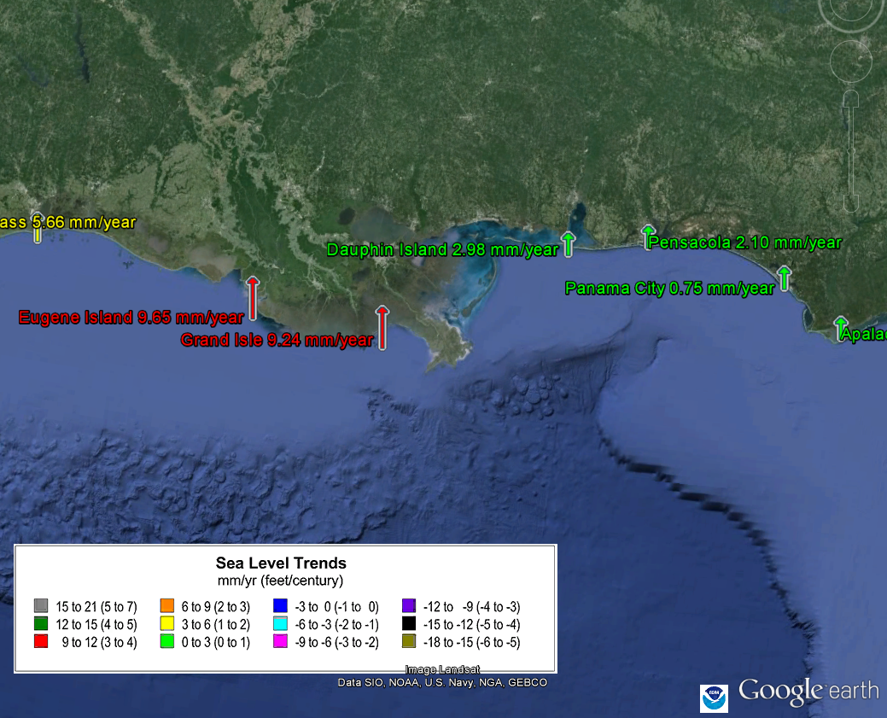
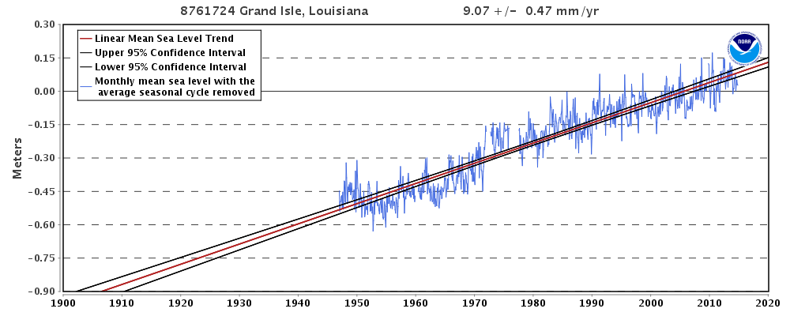
Relative Sea Level Rise
NOAA

Slide 4
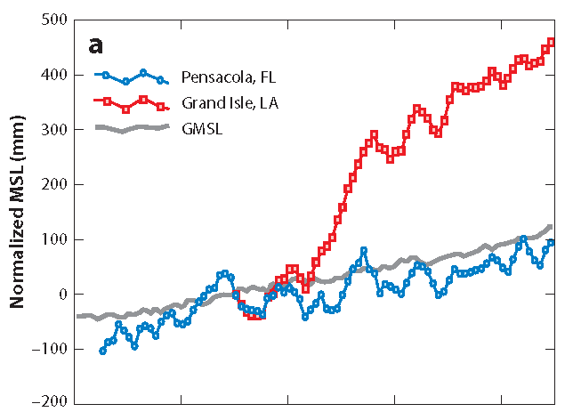
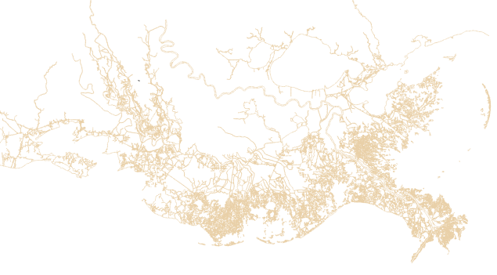

Relative Sea Level Rise
9.24 mm/yr
500 mm = 20”
total relative sea
level rise since 1932
subsidence
sea level rise
1932
Blum and Roberts, 2012
NOAA

Slide 5
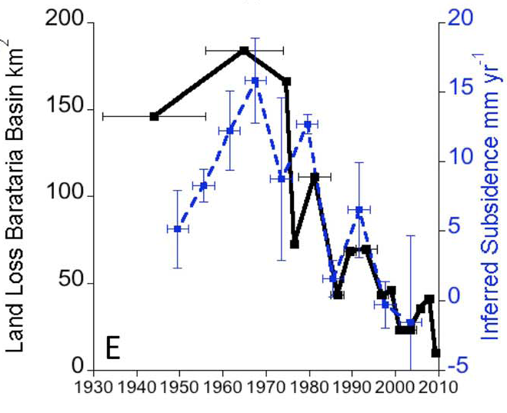
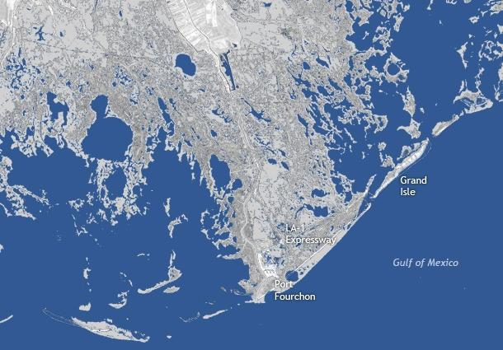
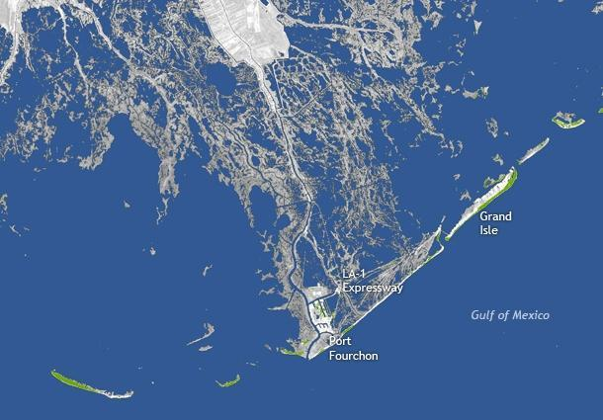
Relative Sea Level Rise
1932
2010
“Subsidence, coupled with reduced sediment loads and global sea level rise, leads to an elevation deficit, leading to submergence of marshes and conversion of land into open water.”
Kolker,et.al.,2011
Grand Isle Tidal Gauge
Gill, 2013

Slide 6
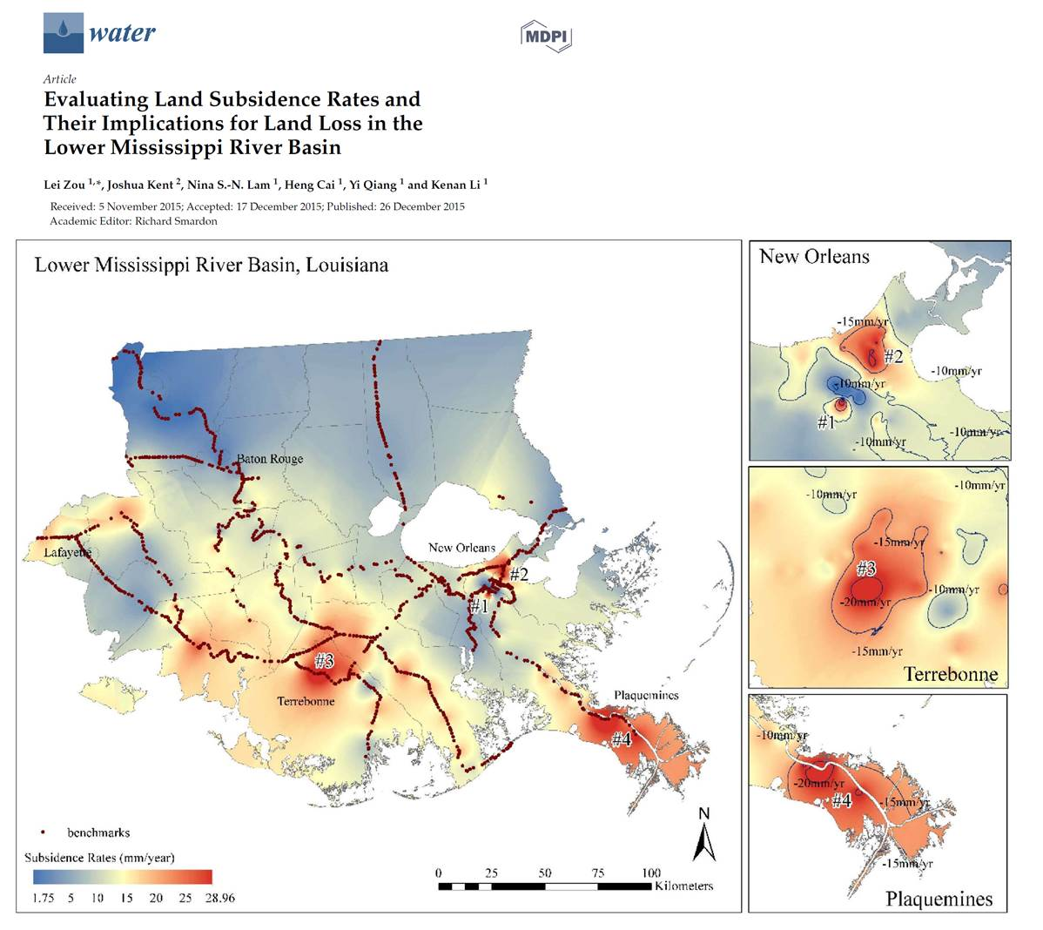
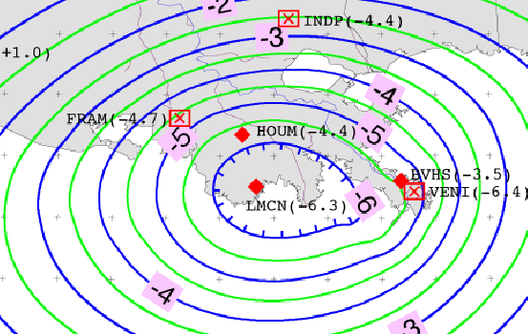
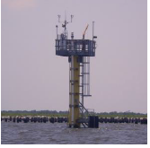
Subsidence
“Background”
“Hot Spot”
Zou, et al., 2016
Ivins, et al., 2007
Longer Term
Lower Rates
Broader Area
Shorter Term
Higher Rates
Focused Areas
6.3 mm/yr in CORS at Cocodrie
> 20 mm/yr in geodetic leveling surveys

Slide 7
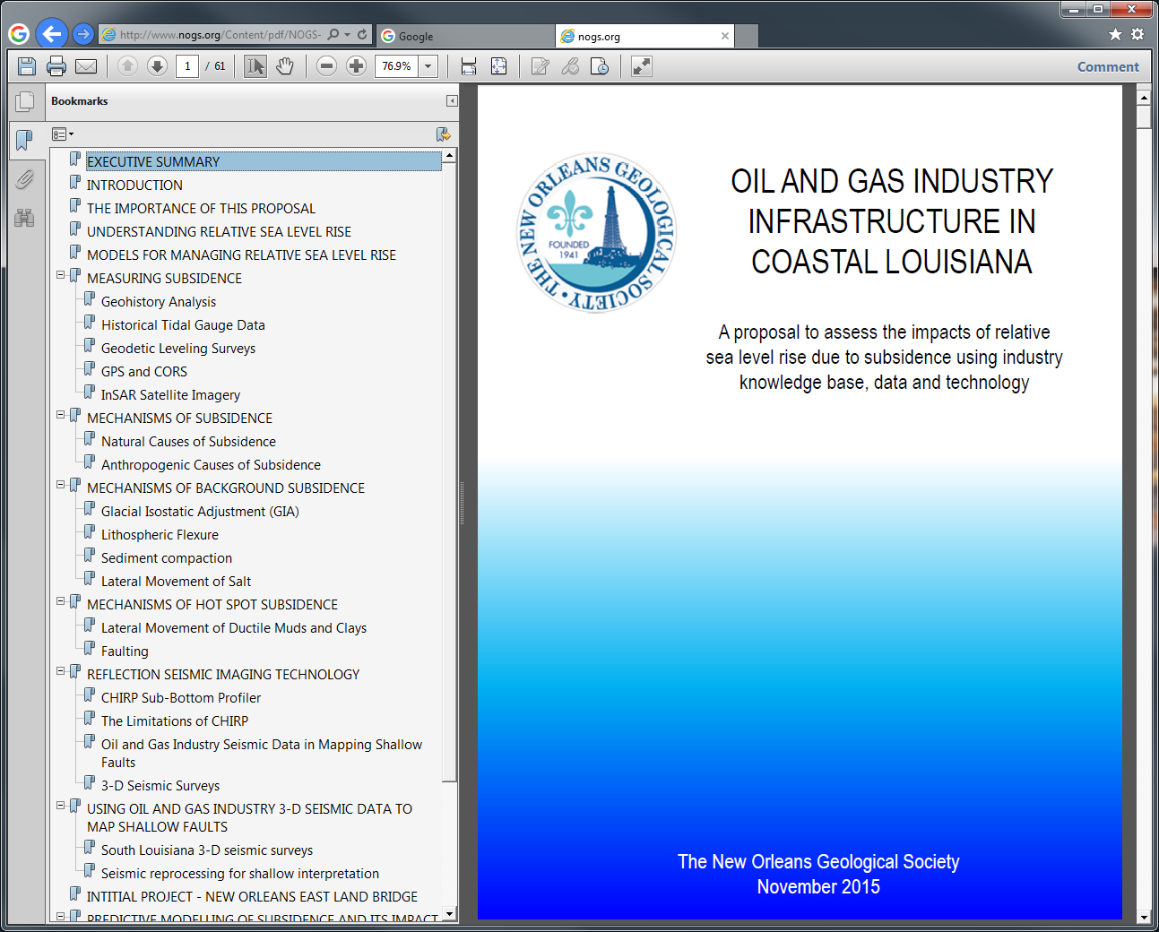
Working Towards a Predictive Model

Slide 8
The oil and gas industry and coastal sustainability
To date the Industry has (IMHO):
Tended to address the issue of wetlands loss through public relations
Failed to engage its own earth science capabilities, knowledge base and data sets
Not fully recognized its vested financial interest in working to achieve sustainability

Slide 9
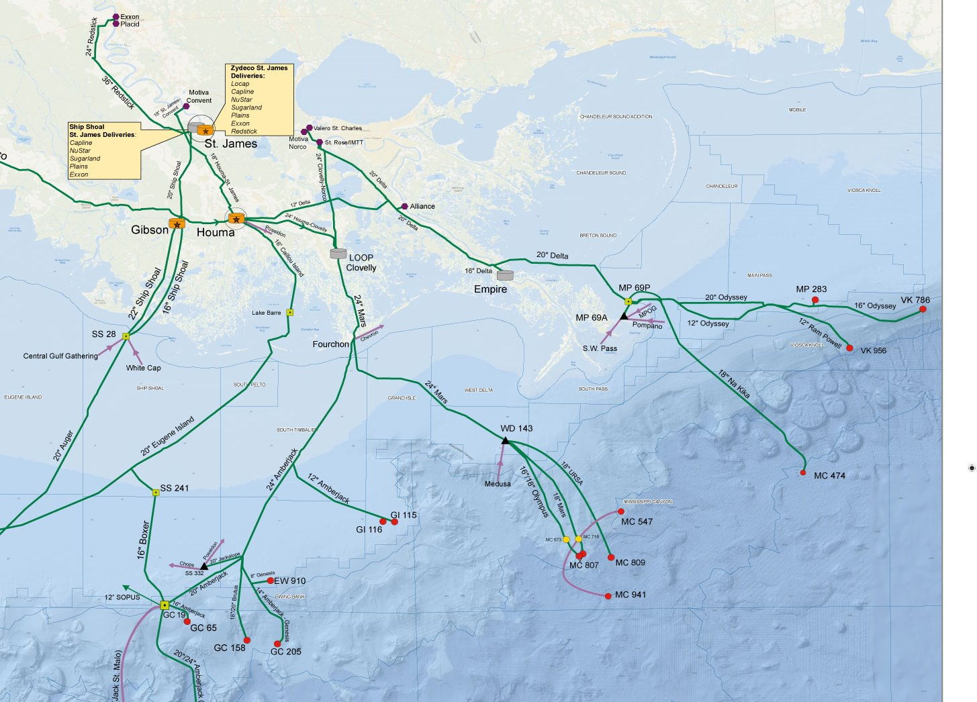
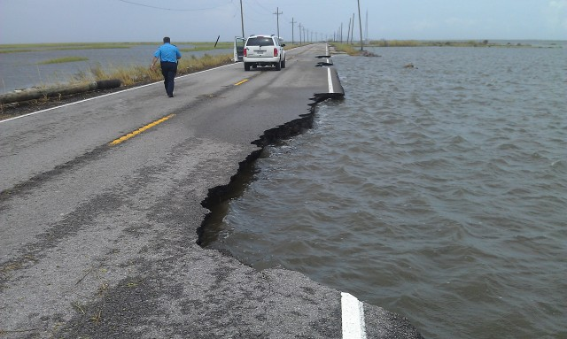
The oil and gas industry vested interest in coastal sustainability

Slide 10
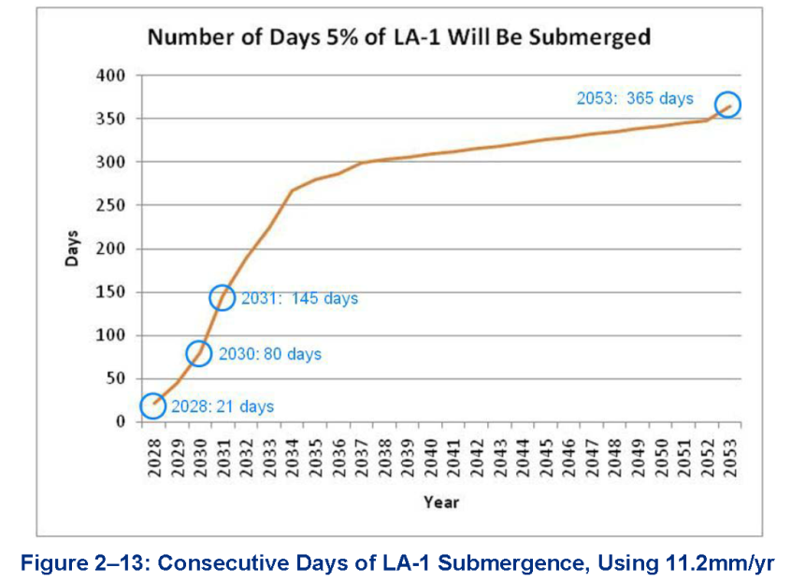

The oil and gas industry vested interest in coastal sustainability
Impact of 21day disruption of Port Fourchon
  $11.23 billion in sale at US firms
  $3.16 billion in household earnings
  65,502 jobs in the nation
  Loren Scott & Assoc. 2014

Slide 11
The oil and gas industry and coastal sustainability

Slide 12
The role of geology in coastal restoration
“As important as wetlands are, their function is limited by the sediment platform on which they grow, a platform that formed over 6,000 years of net deposition of Holocene mineral sediments from the Mississippi River. Since its very inception in 1989 Louisiana’s coastal restoration program (later renamed protection and restoration) has been dominated by coastal wetland ecologists like me, folks who deal in relatively short term surface processes, not the long term geophysical and riverine processes that underlie the delta. In other words, the planning expertise has been dominated by those who deal primarily with surface processes on the visible veneer of the delta, not the riverine hydrodynamics and sedimentary processes that created the delta and the underlying tectonic processes and shallow and deep subsidence to which the delta ultimately responds.
It’s a pity that the folks who described in great detail the ontogeny of the largest delta in North America and who performed the forensic work on delta dysfunction were only recently invited to the planning table…after key restoration plans had already been drawn up. Better late than never, I suppose.”
Dr. Len Bahr, LaCoastPost, May 2013

Slide 13
The role of geology in coastal restoration
“As important as wetlands are, their function is limited by the sediment platform on which they grow, a platform that formed over 6,000 years of net deposition of Holocene mineral sediments from the Mississippi River. Since its very inception in 1989 Louisiana’s coastal restoration program (later renamed protection and restoration) has been dominated by coastal wetland ecologists like me, folks who deal in relatively short term surface processes, not the long term geophysical and riverine processes that underlie the delta. In other words, the planning expertise has been dominated by those who deal primarily with surface processes on the visible veneer of the delta, not the riverine hydrodynamics and sedimentary processes that created the delta and the underlying tectonic processes and shallow and deep subsidence to which the delta ultimately responds.
It’s a pity that the folks who described in great detail the ontogeny of the largest delta in North America and who performed the forensic work on delta dysfunction were only recently invited to the planning table…after key restoration plans had already been drawn up. Better late than never, I suppose.”
Dr. Len Bahr, LaCoastPost, May 2013

Slide 14
The role of geology in coastal restoration
“As important as wetlands are, their function is limited by the sediment platform on which they grow, a platform that formed over 6,000 years of net deposition of Holocene mineral sediments from the Mississippi River. Since its very inception in 1989 Louisiana’s coastal restoration program (later renamed protection and restoration) has been dominated by coastal wetland ecologists like me, folks who deal in relatively short term surface processes, not the long term geophysical and riverine processes that underlie the delta. In other words, the planning expertise has been dominated by those who deal primarily with surface processes on the visible veneer of the delta, not the riverine hydrodynamics and sedimentary processes that created the delta and the underlying tectonic processes and shallow and deep subsidence to which the delta ultimately responds.
It’s a pity that the folks who described in great detail the ontogeny of the largest delta in North America and who performed the forensic work on delta dysfunction were only recently invited to the planning table…after key restoration plans had already been drawn up. Better late than never, I suppose.”
Dr. Len Bahr, LaCoastPost, May 2013

Slide 15

Oil and Gas Industry
need to address coastal sustainability
Coastal Restoration Program
need to include long term geophysical processes

Slide 16

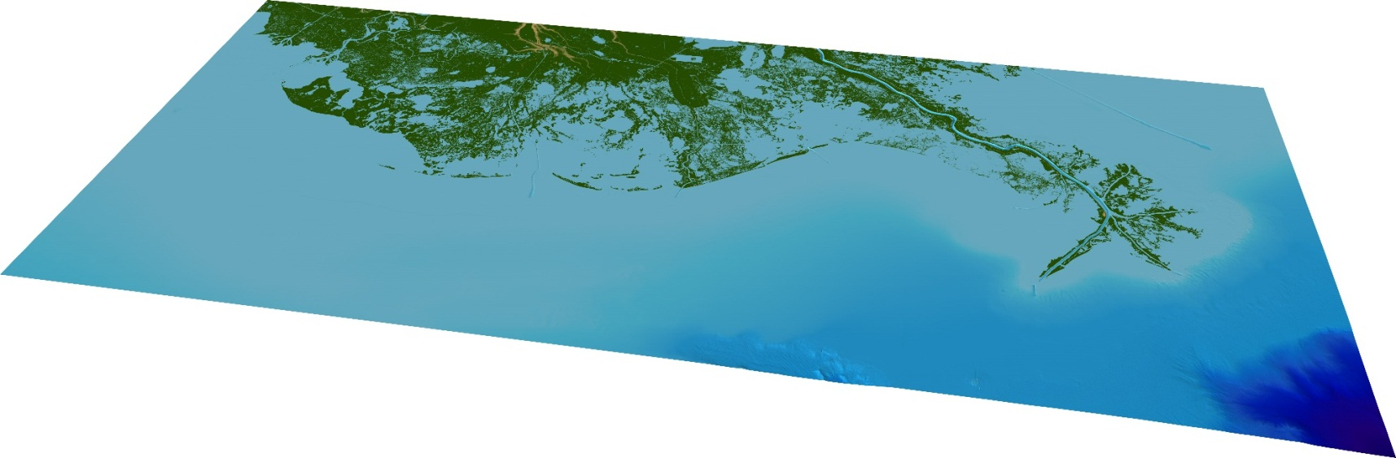
South Louisiana Below the Surface

Slide 17


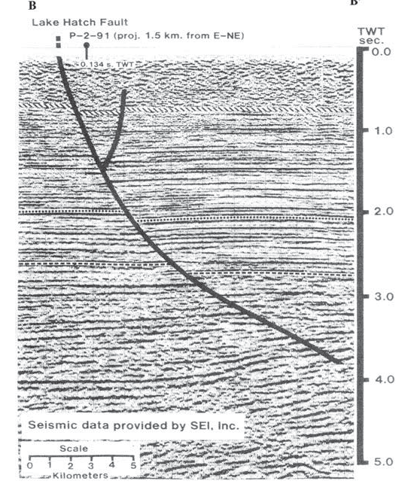

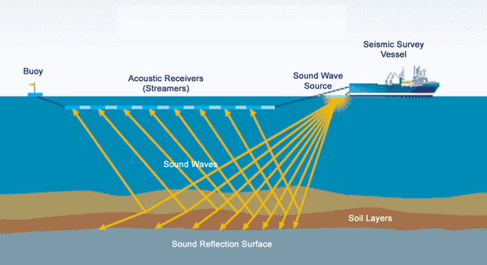
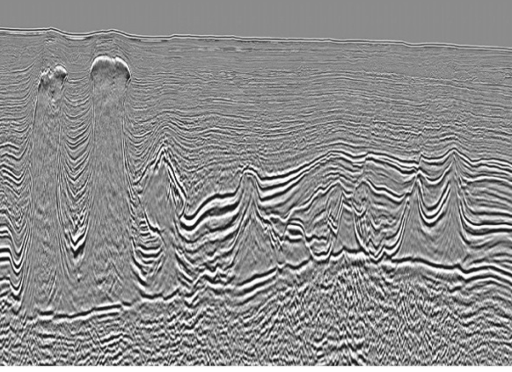
Geological Substructure of the Coast

Slide 18
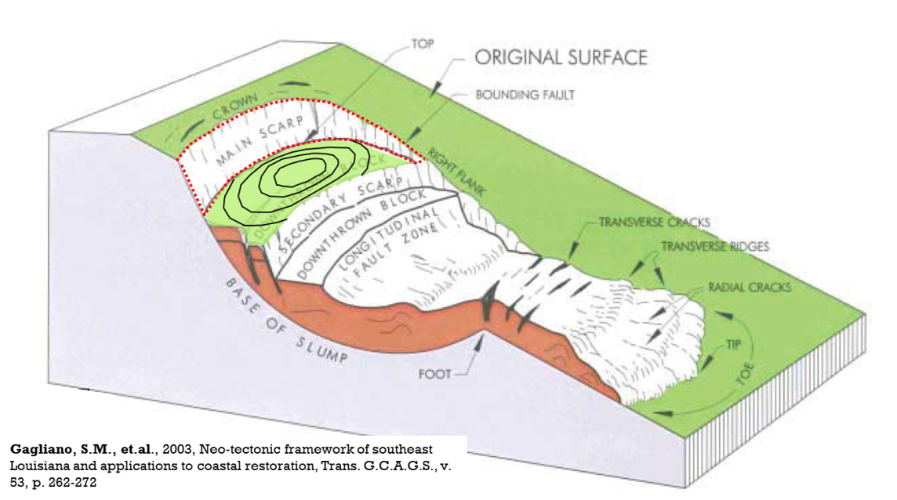
What is a Fault ?

Slide 19
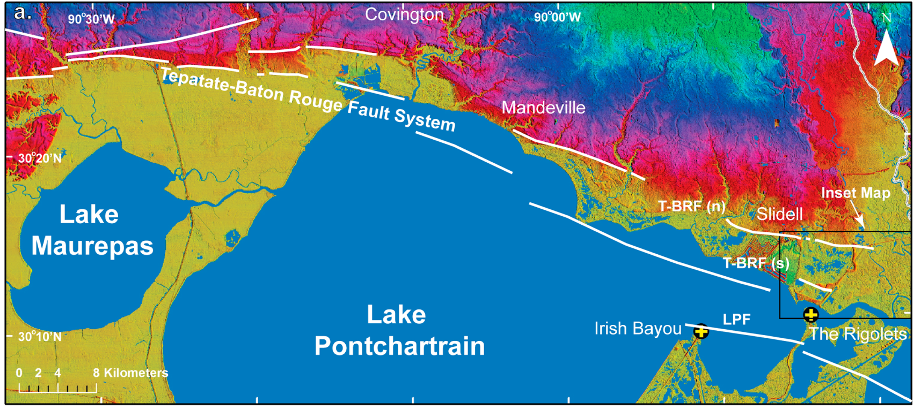
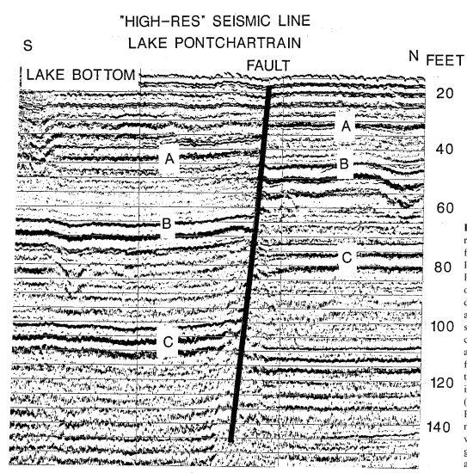
Surface Fault Escarpments
LIDAR Elevation
Dokka, 2011

Slide 20
Lake Bottom
Fault
USGS data
Lopez et al., 1997

Slide 21
Lake Bottom
Fault

Slide 22
Lake Bottom
Fault

Slide 23
Lake Bottom
Fault

Slide 24
Lake Bottom
Fault

Slide 25
Lake Bottom
Fault

Slide 26
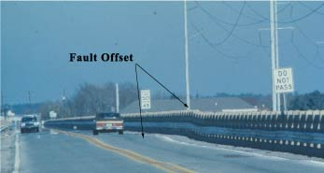
Lake Bottom
Fault

Slide 27
South Louisiana Below the Surface

Slide 28
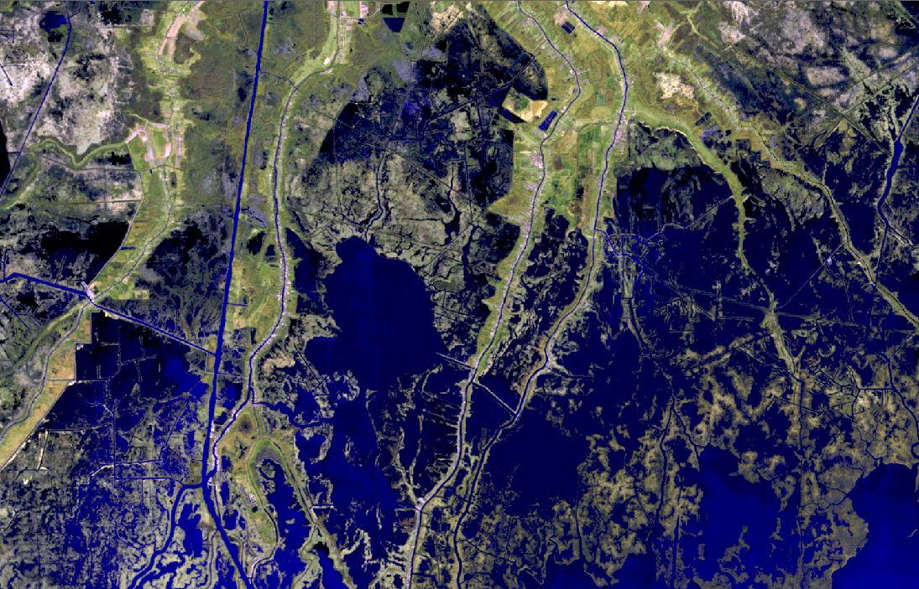
Faulting and Subsidence
Houma Navigational Canal
MONTEGUT
Bayou Jean le Charles
CHAVIN
Bayou Pointe au Chien
Bayou Dularge
Falgout Canal
Lake Boudreaux
Bayou Terrebonne
DULAC
Notes:
Gagliano examined these same fault systems in his 2003 study. He showed that the altered hydrology is actually due to a rotation of the marsh surface by the movement of the faults. Instead of the commonly stated model of the canals opening up the interior marshes to saltwater intrusion, it is actually the slope of the marsh surface that allows the saltwater to flow into the subsided areas. The juxtaposition of the low areas holding more saline water is what killed the cypress trees. Gagliano also shows in comparative photographs that the area of continuous unbroken marsh in 1953 is bisected by the fault and only the downthrown side is converted to open water.

Slide 29
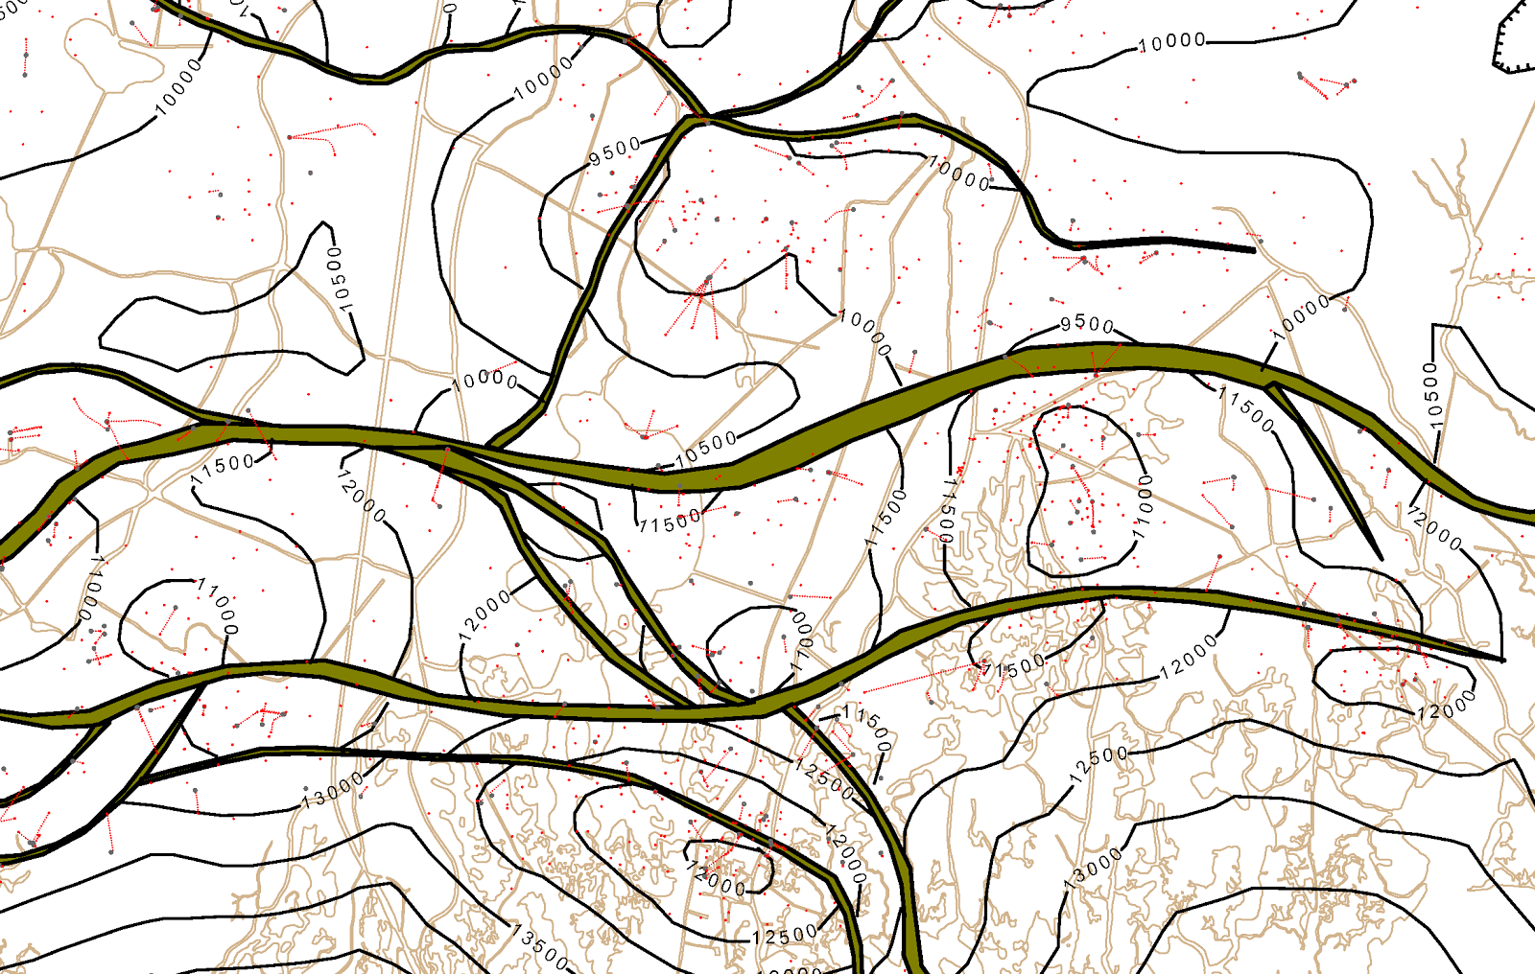
Middle Miocene Fields
CHAVIN
LIRETTE
BAYOU RAMBIO
LAPEYROUSE

Slide 30

Lake Boudreaux
Delarge
Lake Gero
Bayou Rambio
Lapeyrouse

Slide 31
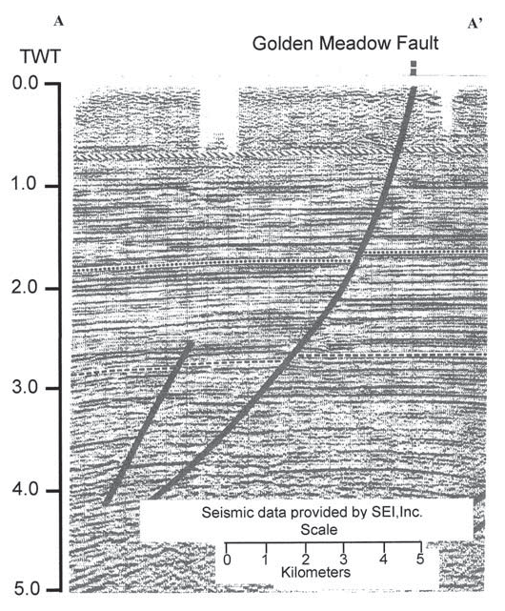
A’
A

Slide 32
Surface Trace
A’
A

Slide 33
Middle Miocene Fields
A
A’
B
CHAVIN
B
B’
A’
B’
LIRETTE
BAYOU RAMBIO
A
LAPEYROUSE

Slide 34
Fault Traces at the Surface

Slide 35
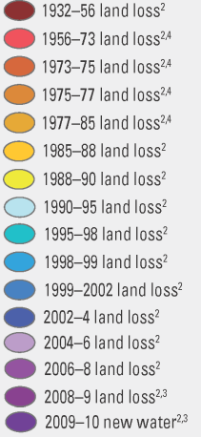
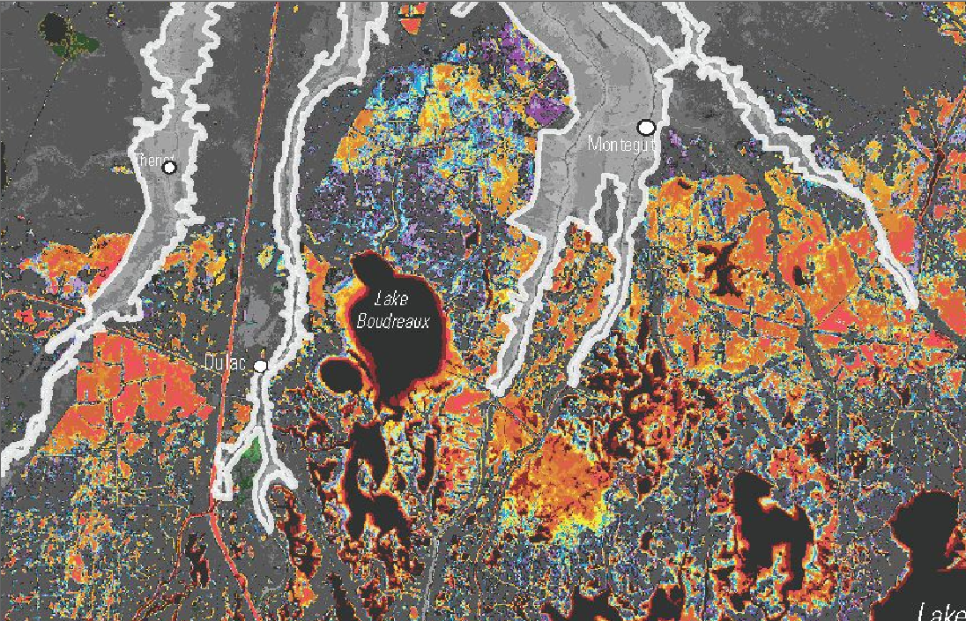
Land Loss Due to Fault-Induced Subsidence
COUVILLION, et.al., 2011
Notes:
The sequence of inset photographs shows the evolution within the area of the white square since 1971. As can be seen on the land area change map, the upthrown side of the fault shows very little change through the time interval, while the downthrown side is progressively converted to open water by subsidence. Gagliano show various patterns by which fault may subsided the marsh surface. The area around Wonder Lake has a multiple fault signature.
A couple of points of interest on this slide. The yellow line on the photographs is the proposed alignment of the Morganza to the Gulf Levee, and the lower right corner of the white box on the land area change map is the approximate location of Bayou le Jean Charles, which was the subject of a documentary about people being displaced from their village by coastal erosion caused by oil and gas operations.

Slide 36
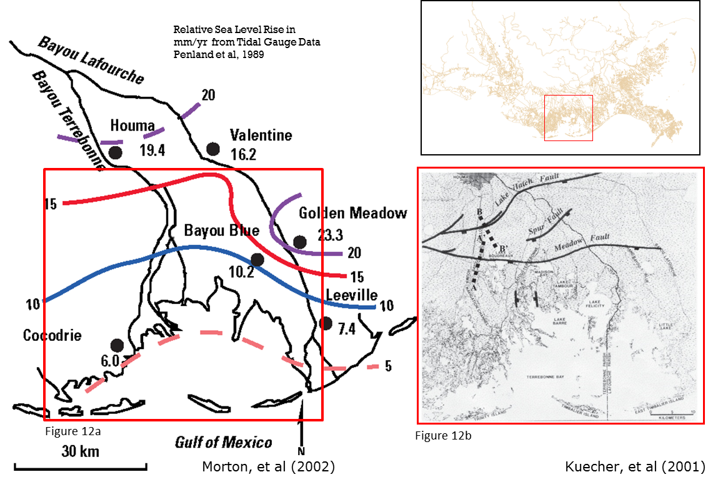
Grand Isle Tidal Gauge

Slide 37

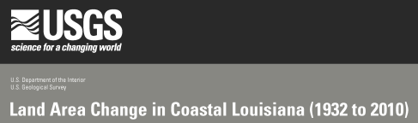
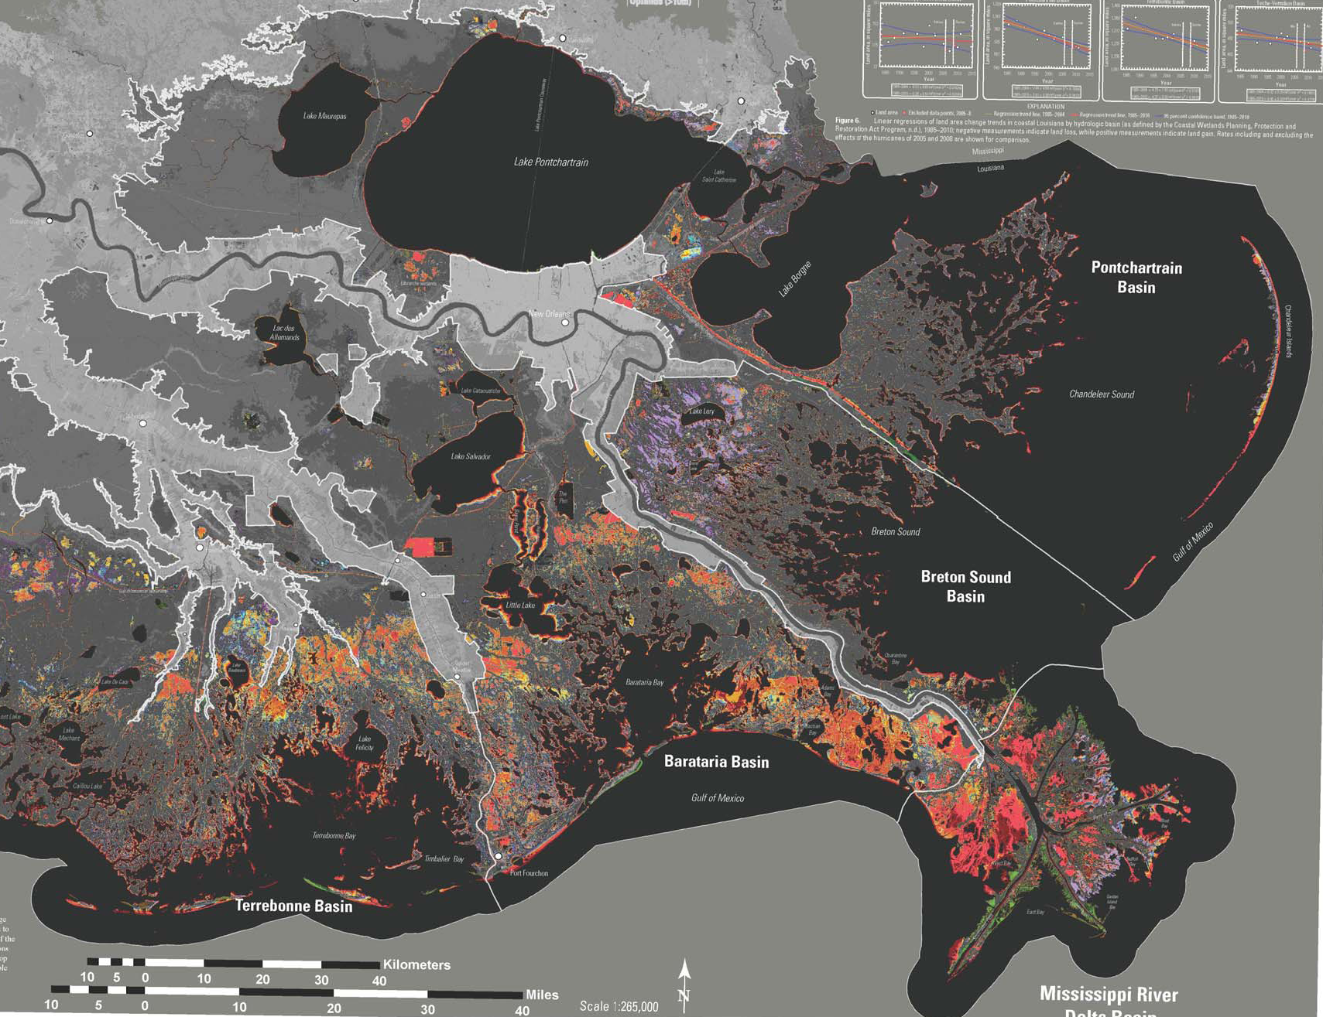
Hot Spots of Land Loss
COUVILLION, et.al., 2011

Slide 38
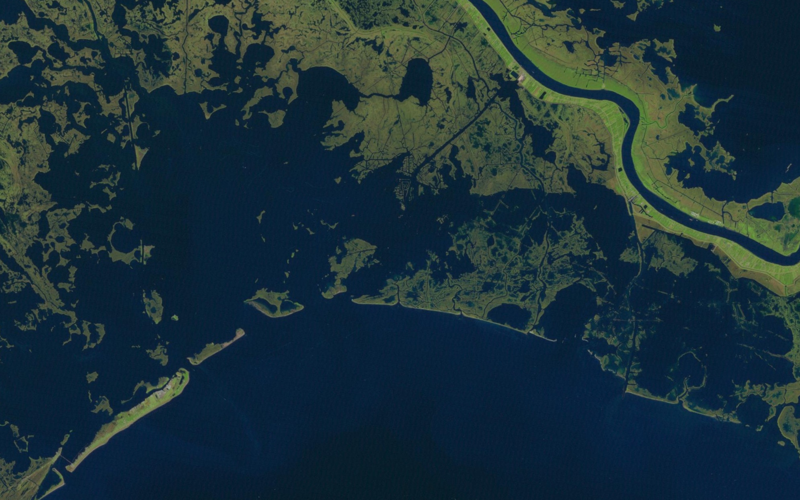
Subsidence and Faulting
Grand Isle
Tidal Gauge

Slide 39
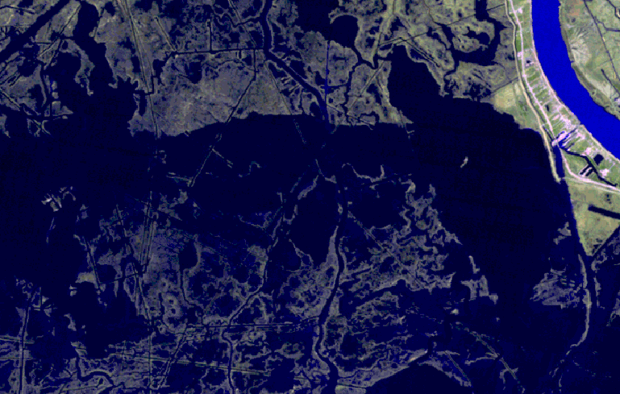
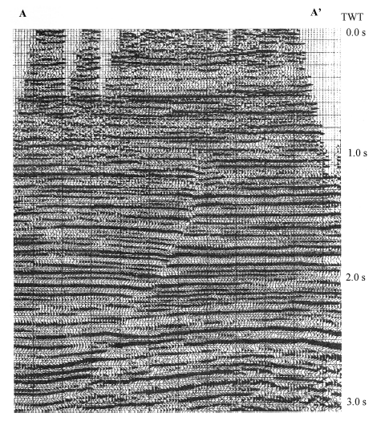
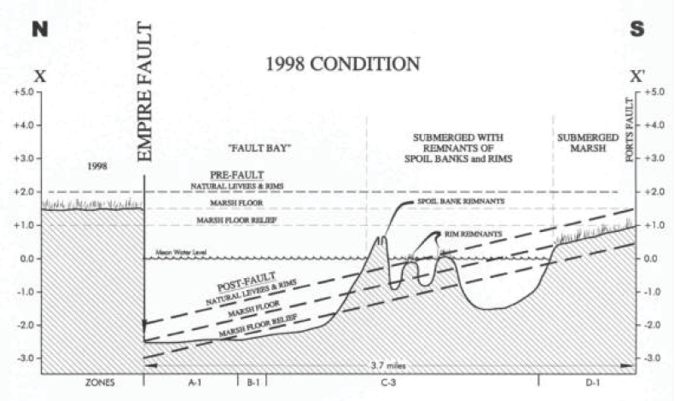
Faulting and Seismic Data
A’
Empire Fault
“The Empire marsh break formed between 1976 and 1977. This according to Greg Linscombe, a biologist for the LDWF who was flying low transects over the area during this time for the purposes of making counts of migratory waterfowl
Martin, 2006
A
Gagliano et.al., 2003

Slide 40
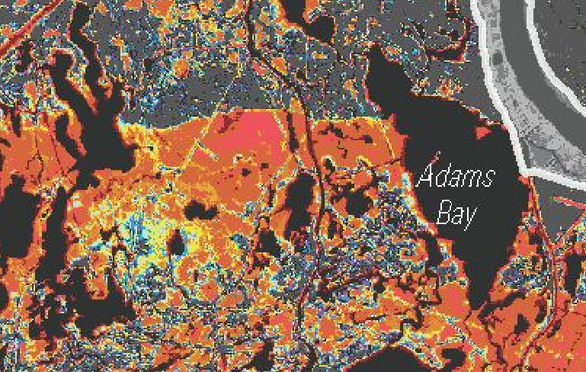
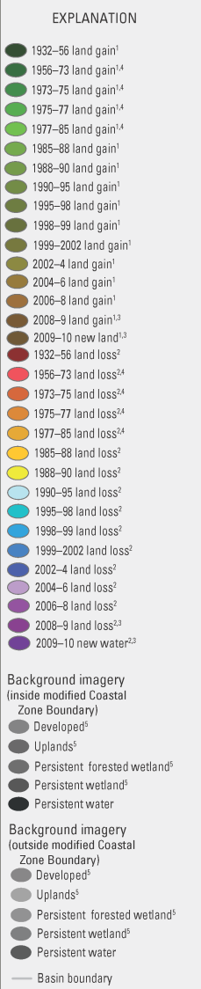
Faulting and Subsidence
Empire Fault

Slide 41
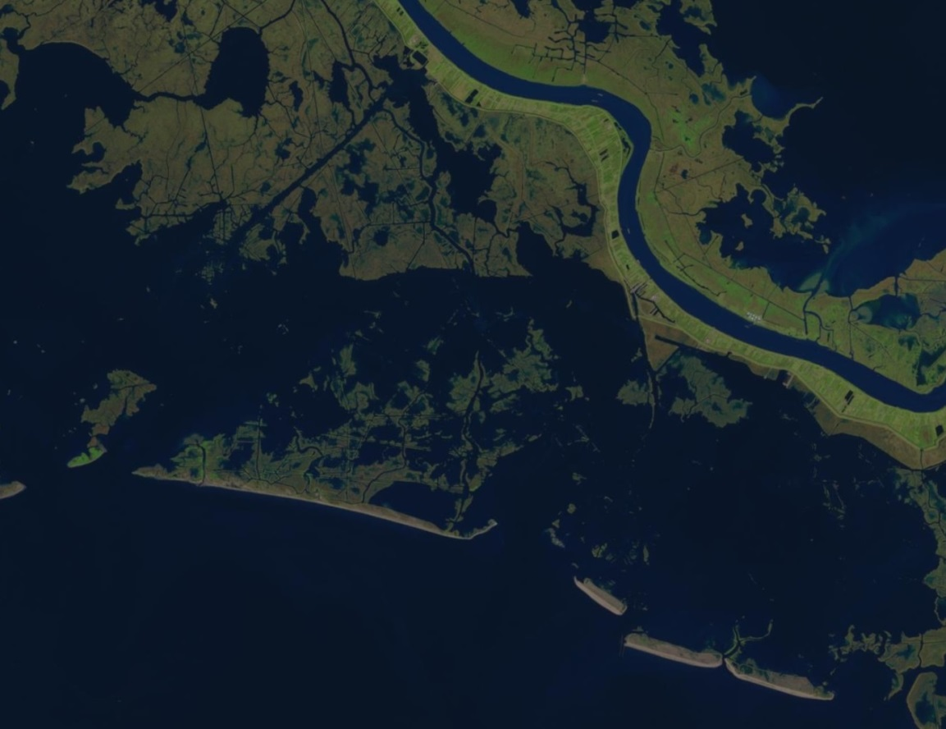
Faulting and Subsidence
2013
Empire Fault
Bastian Bay Fault

Slide 42
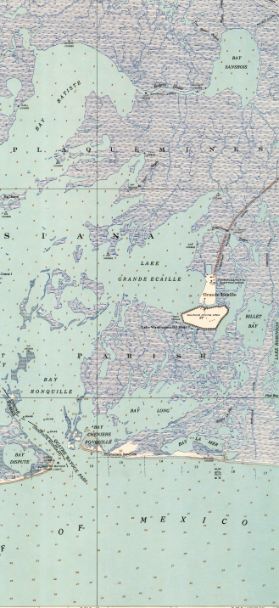
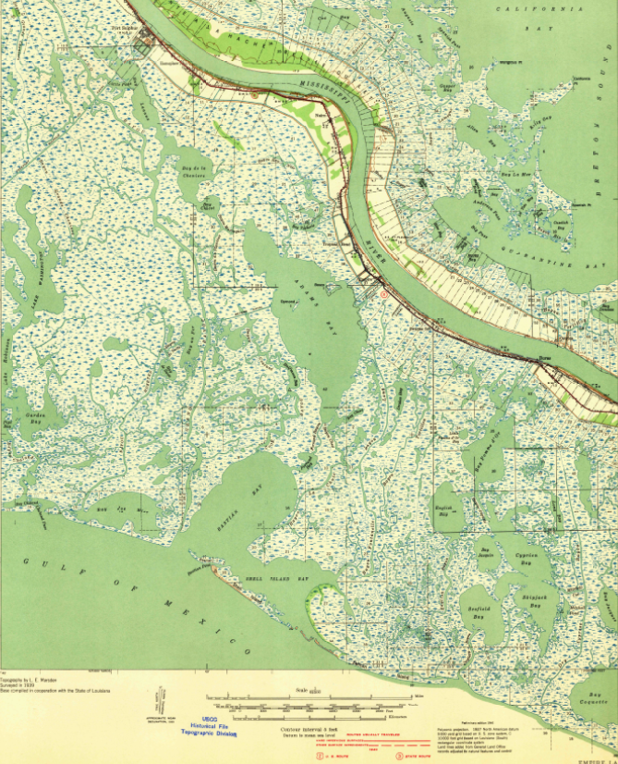


Faulting and Subsidence
1941
Empire Fault
Bastian Bay Fault

Slide 43
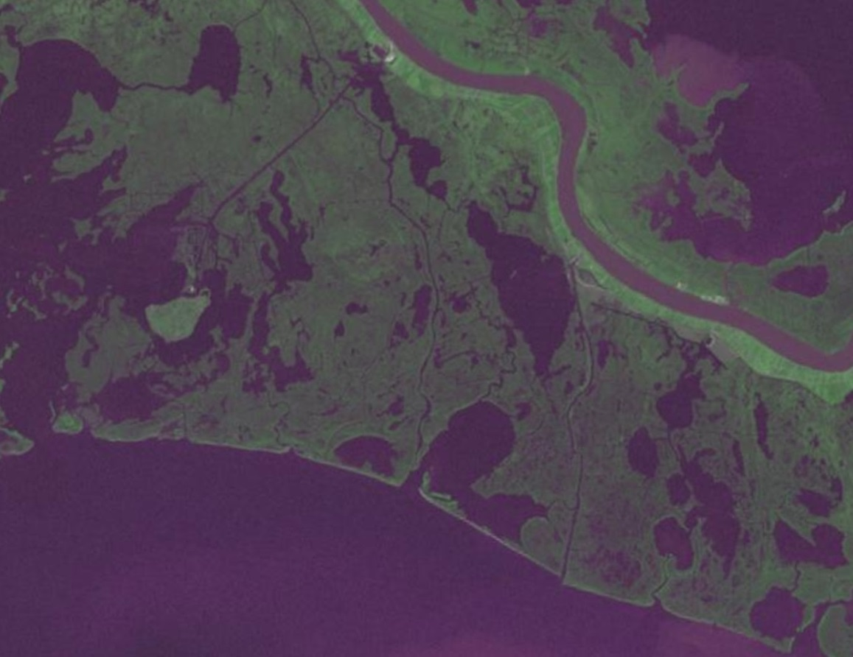
Faulting and Subsidence
1973

Slide 44
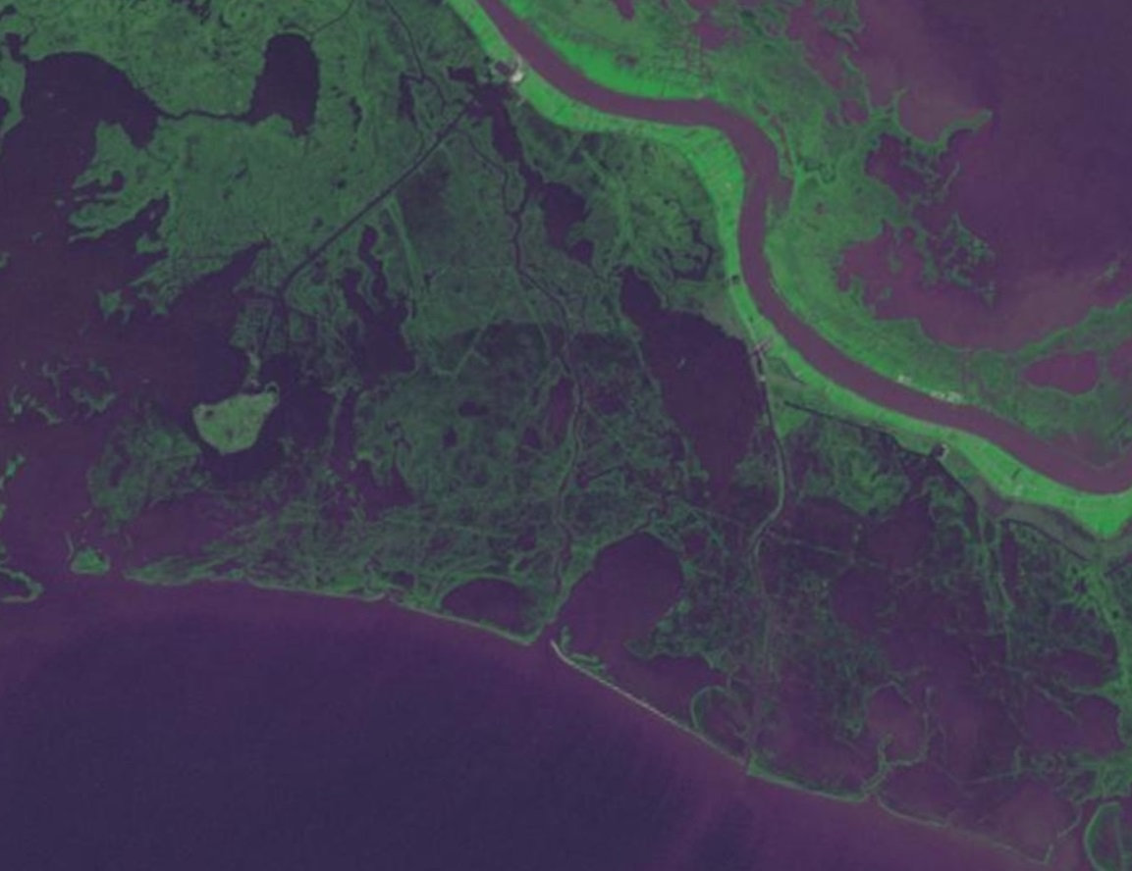
Faulting and Subsidence
1978

Slide 45
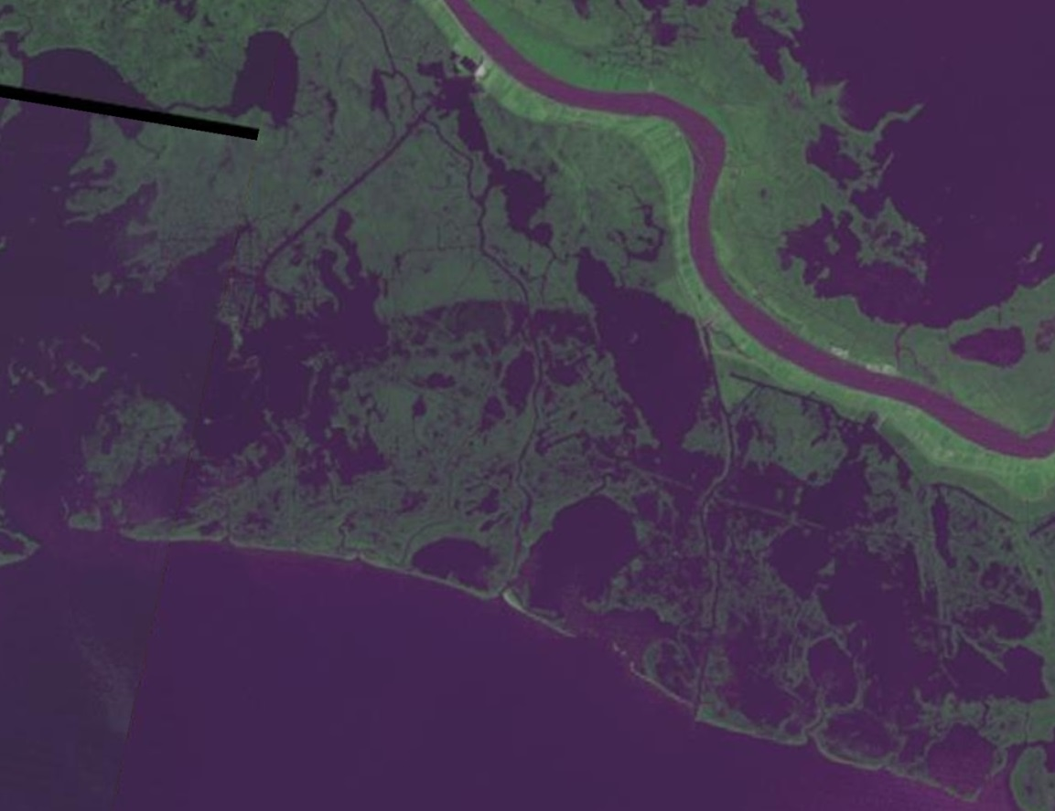
Faulting and Subsidence
1985

Slide 46
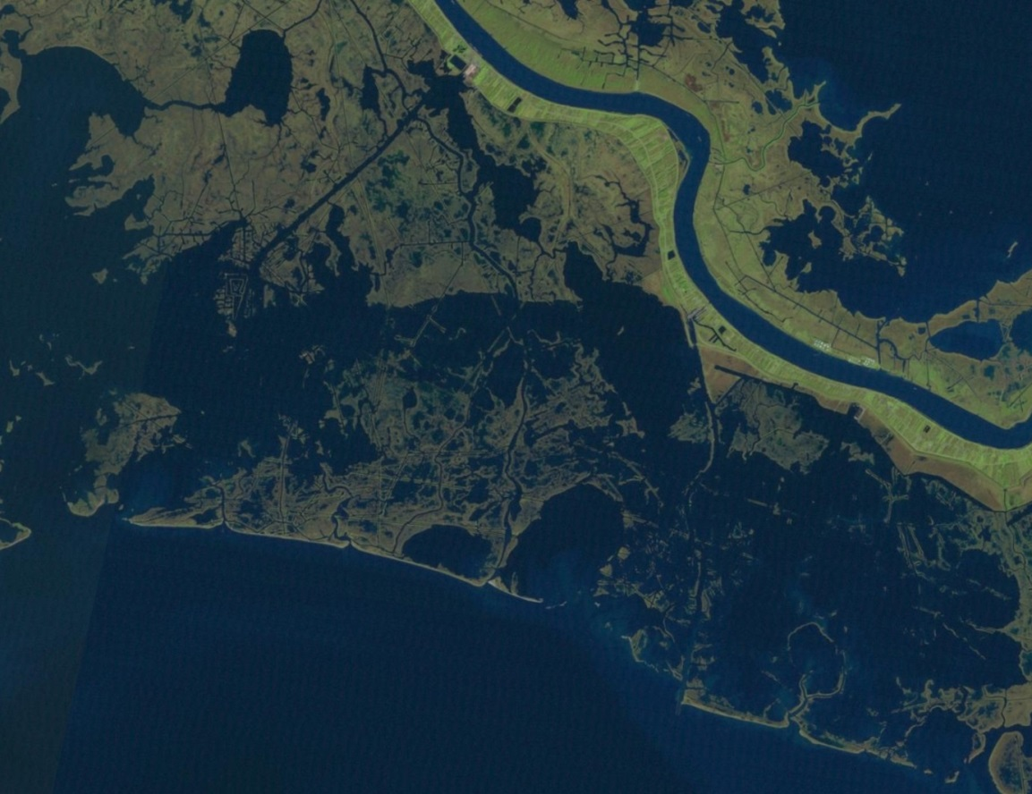
Faulting and Subsidence
1995

Slide 47
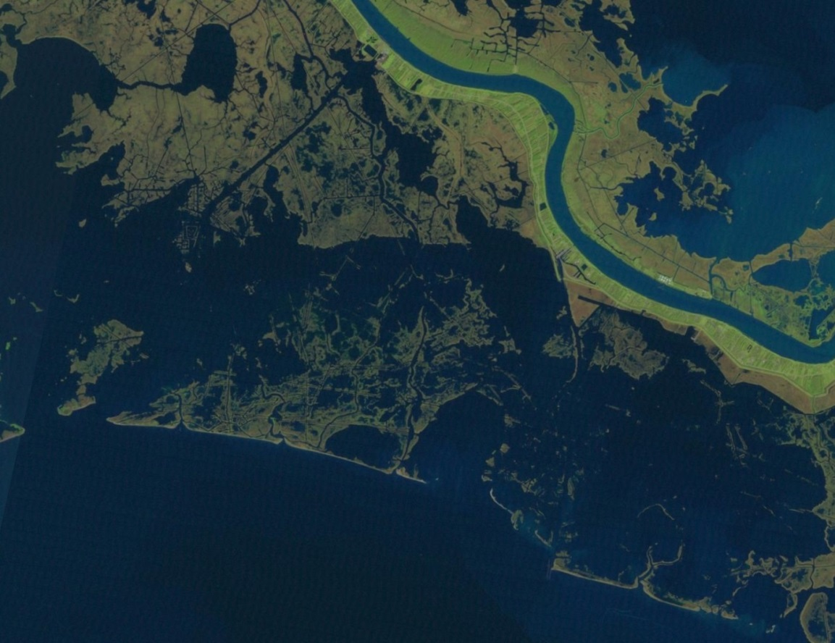
Faulting and Subsidence
1997

Slide 48
Faulting and Subsidence
2013

Slide 49
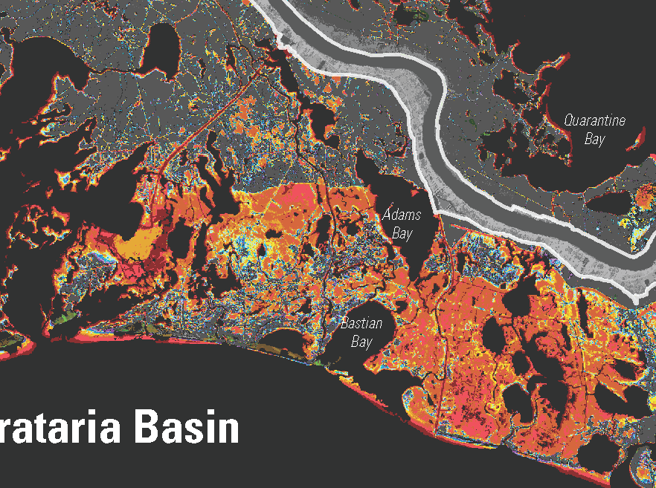
Faulting, Subsidence and Land Loss
4’ from 1930 to 1998
0.71 inches/yr.
17 mm/yr

Slide 50
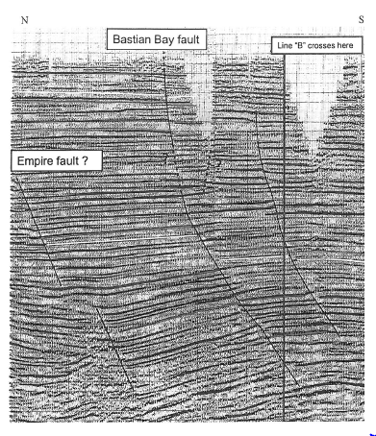
Subsidence and Faulting
N
S
N
Bastian Bay Fault
S
Grand Isle
Tidal Gauge
Martin, 2006

Slide 51
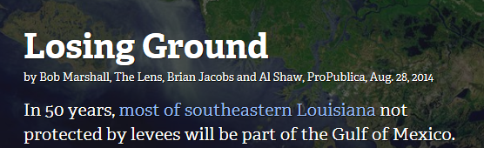
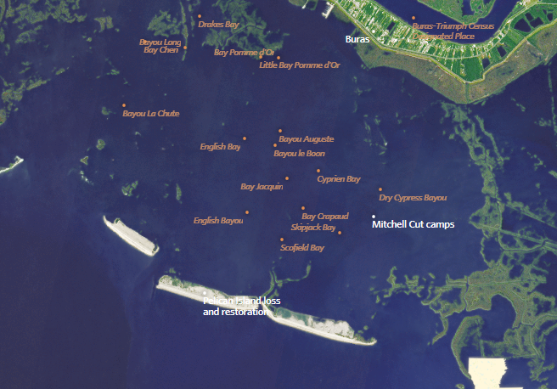
Faulting, Subsidence and Land Loss
2009
subsidence
sea level rise

Slide 52
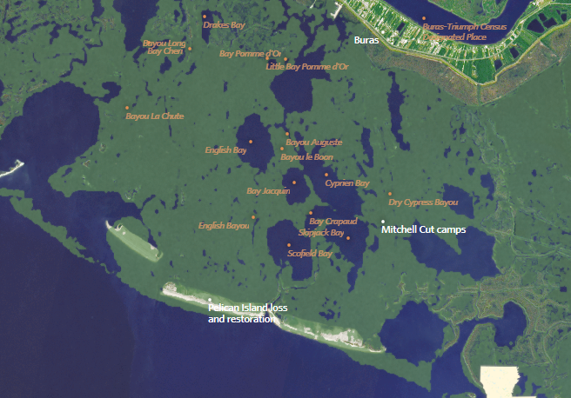
Faulting, Subsidence and Land Loss
1932
subsidence
sea level rise

Slide 53

Faulting, Subsidence and Land Loss
1956
subsidence
sea level rise

Slide 54

Faulting, Subsidence and Land Loss
1973
subsidence
sea level rise

Slide 55

Faulting, Subsidence and Land Loss
1975
subsidence
sea level rise

Slide 56

Faulting, Subsidence and Land Loss
1977
subsidence
sea level rise

Slide 57

Faulting, Subsidence and Land Loss
1985
subsidence
sea level rise

Slide 58

Faulting, Subsidence and Land Loss
1988
subsidence
sea level rise

Slide 59

Faulting, Subsidence and Land Loss
1990
subsidence
sea level rise

Slide 60

Faulting, Subsidence and Land Loss
1995
subsidence
sea level rise

Slide 61

Faulting, Subsidence and Land Loss
1999
subsidence
sea level rise

Slide 62

Faulting, Subsidence and Land Loss
2004
subsidence
sea level rise

Slide 63

Faulting, Subsidence and Land Loss
2006
subsidence
sea level rise

Slide 64
Faulting, Subsidence and Land Loss
2009
subsidence
sea level rise

Slide 65
Faulting, Subsidence and Land Loss
COUVILLION, et.al., 2011

Slide 66

Faulting, Subsidence and Land Loss
Houma Fault
Lafitte Fault
Magnolia Fault
Lake Hatch Fault
Empire Fault
Golden Meadow Fault
Bastian Bay Fault
West Delta Fault
West Bay Fault
Notes:
Most of the major fault systems have been mapped in detail, and several of them have been continuously active throughout the history of the basin, and they cut to the surface as shown on the cross section. The surface traces of these shallow cutting faults have also been mapped in some detail as shown by the red dashed lines, but there is much work that can be done to refine the detail of how they cross the marsh.

Slide 67

Faulting, Subsidence and Land Loss
Land Loss in Southeast Louisiana

Slide 68

The first 3-D survey in coastal research
“This seismic volume images approximately 28 faults. Most of these faults extend up to the modern land surface, and several correspond to abrupt shifts from emergent wetlands to fully submerged open bodies of water”
Armstrong, et.al., 2014
Armstrong, C, et.al.., 2014,
COUVILLION, et.al., 2011

Slide 69


The NOGS Proposal

Slide 70

The NOGS Proposal

Slide 71
Status of the NOGS Proposal
Schlumberger
Lake Borgne
UNO
Schlumberger
Lake Hermitage
UNO
Schlumberger
Grand Lake
UT Austin
Castex
UL Lafayette
Seitel
Lapeyrouse
Tulane
ConocoPhillips
Empire
(requested)
Chevron
Terrebonne Bay
UNO (committed)
COUVILLION, et.al., 2011

Slide 72

UNO Research Projects
Lake Hermitage Marsh Creation Project
3-D survey used by Armstrong, et.al., 2014
Magnolia Fault
Schlumberger 3-D
Empire Pipeline Terminal
Empire Fault
ConocoPhillips 3-D
Bastian Bay Fault

Slide 73


Empire - Ostricha
Pipeline Terminal

Slide 74


Magnolia site for the proposed
Lower Barataria Sediment Diversion
Lake Hermitage Marsh Creation Project
“Future diversions will be most successful if they can yield West Bay-­style sediment accumulation rates in systems with substantially slower subsidence rates.”
Kolker et al., 2016 SOC
X
Empire Pipeline Terminal
X’

Slide 75
Constructing A Geological Model

Slide 76
Session Block IV - Room 213 / 2:25 – 2:50 pm
Thank-you
Questions?
chris_mclindon@att.net
504-756-2003

