Slide 1
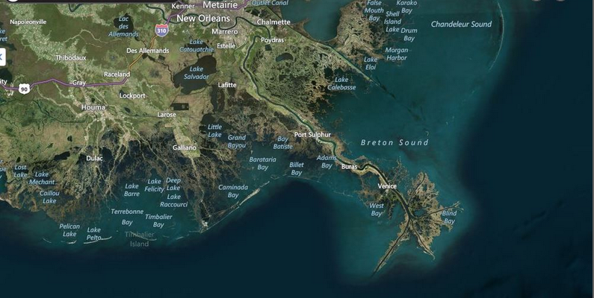
The Realities of the Coast and It’s Populations

Slide 2
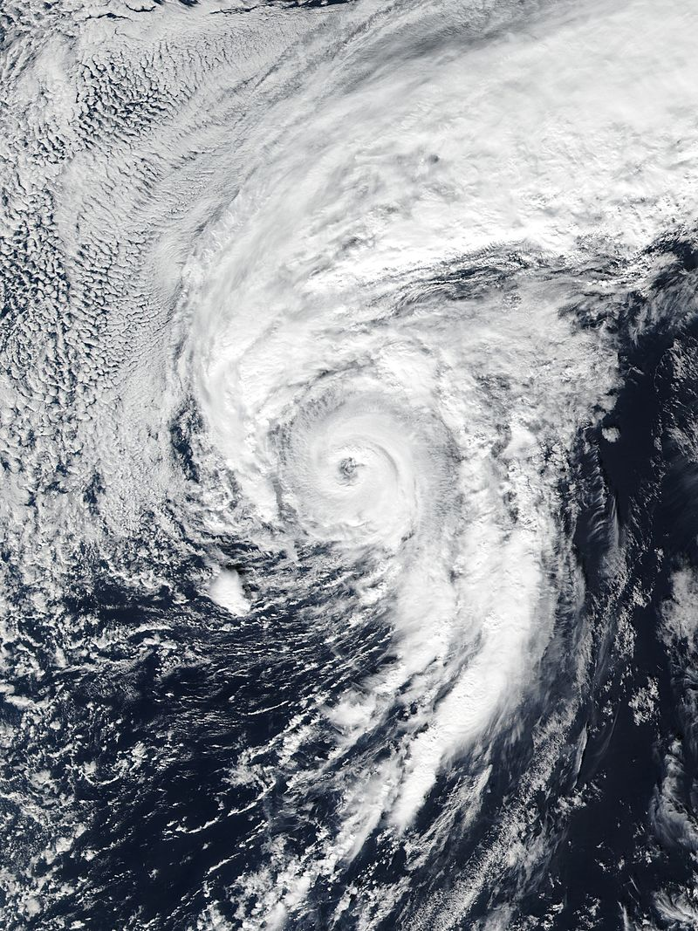
2016 Atlantic Basin Storm Names
National Weather Service
Lake Charles, Louisiana
Alex Hermine Otto
Bonnie Ian Paula
Colin Julia Richard
Danielle Karl Sharry
Earl Lisa Tobias
Fiona Matthew Virginie
Gaston Nicole Walter
Hurricane Alex January 14, 2016
weather.gov/lch
NWSLakeCharles
@NWSLakeCharles
NWSLakeCharles

Slide 3
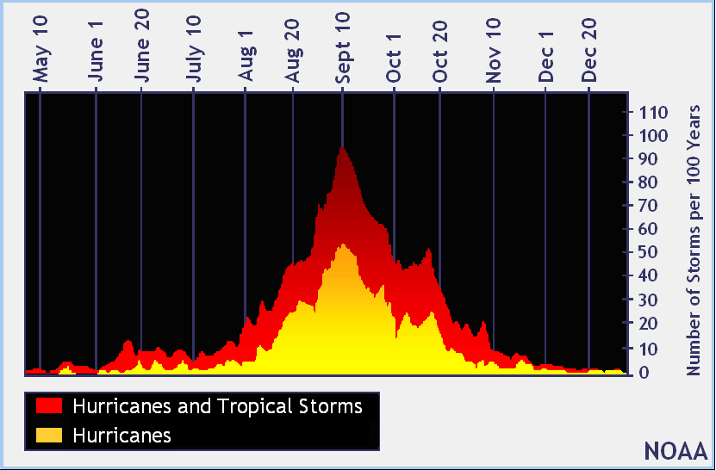
Tropical Cyclone Climatology
Atlantic Hurricane Season: June 1st – November 30th
Average Peak of Season Date: September 10th

Slide 4
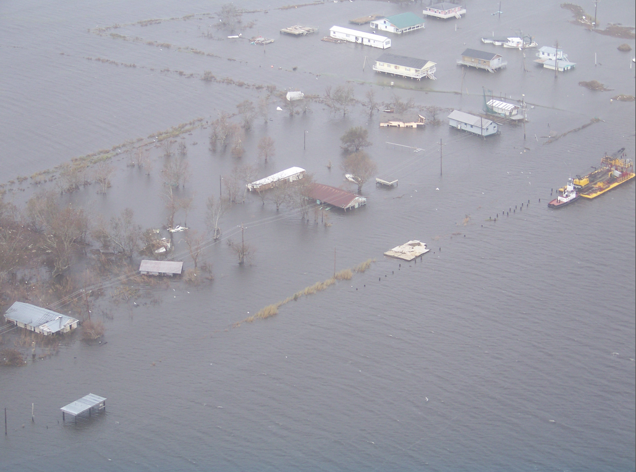
Local Impacts
The ‘Big Four’
Surge
#1 Killer!
Wind
Inland Flooding
Tornadoes
WAVES!- A Fifth
Impact to Consider

Slide 5
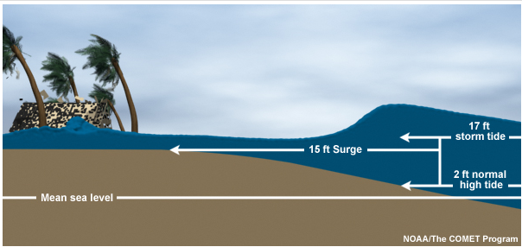
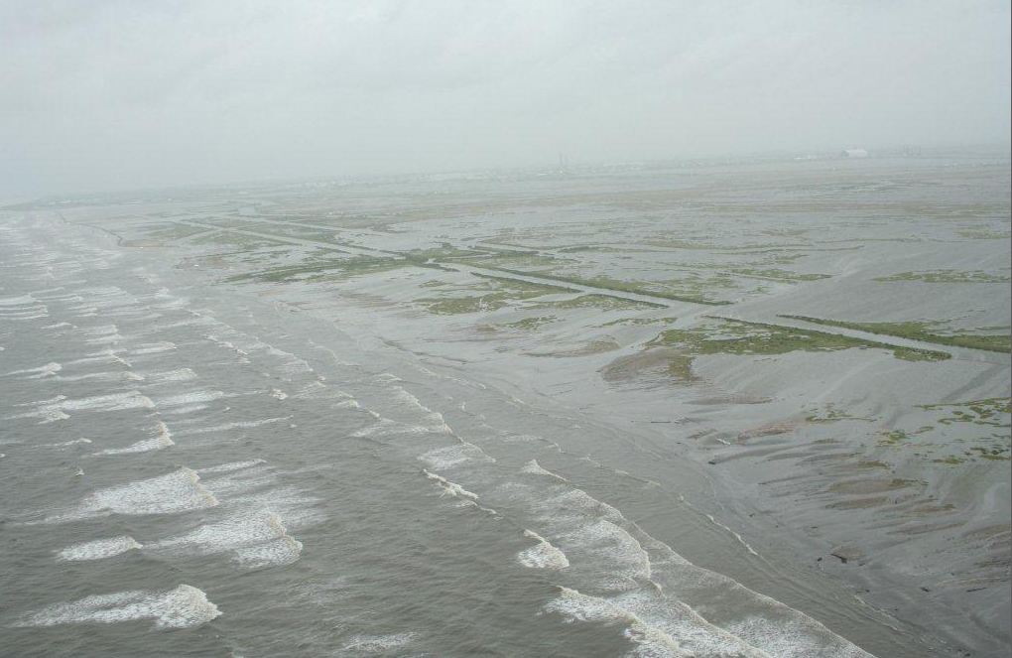
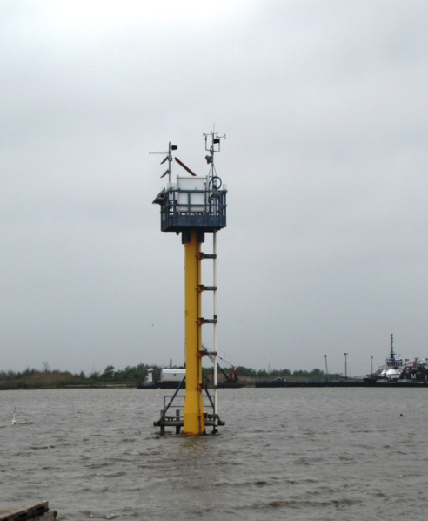
Storm Surge and Waves

Slide 6
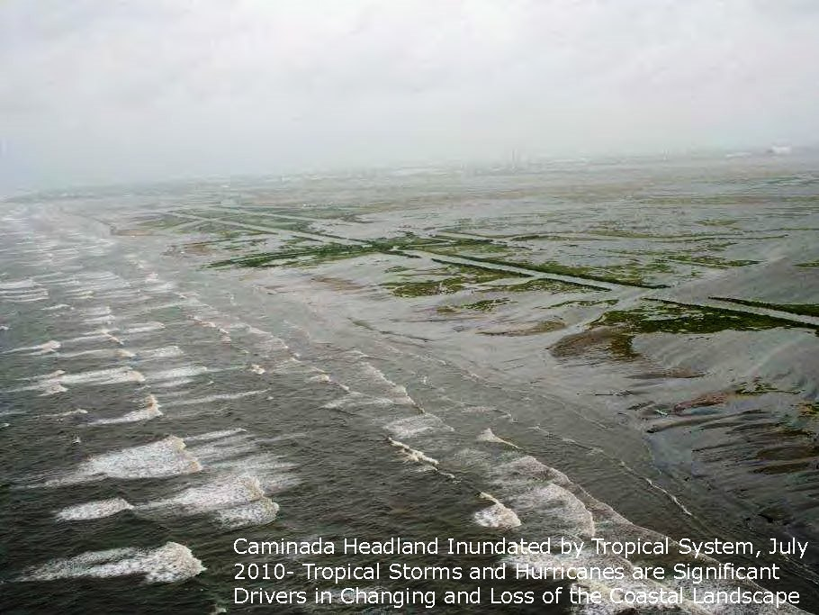

Slide 7
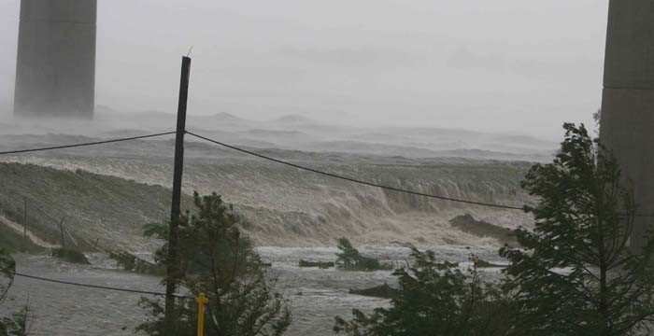
Example of Wave Action on Top of Storm Tide, Hurricane Katrina St. Bernard Parish

Slide 8
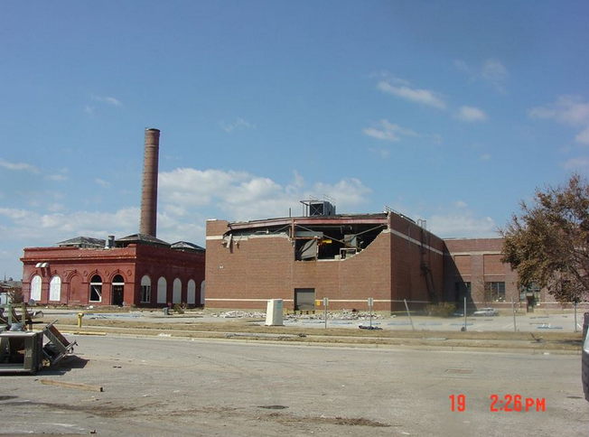
Pensacola Naval Air Station Building and Wave Damage

Slide 9
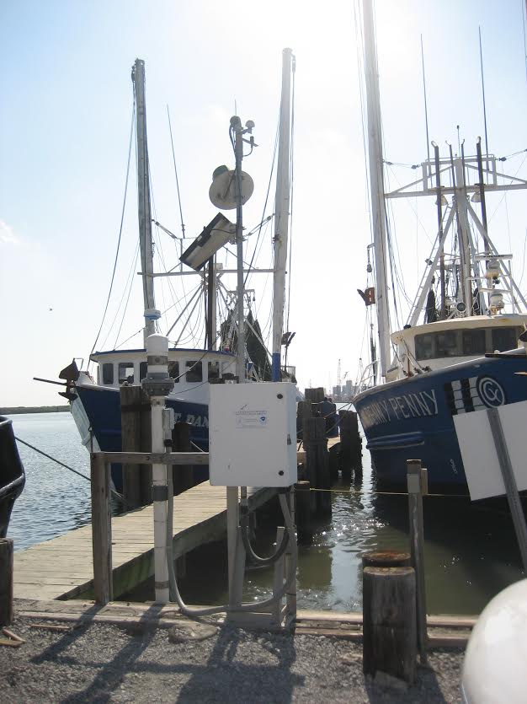
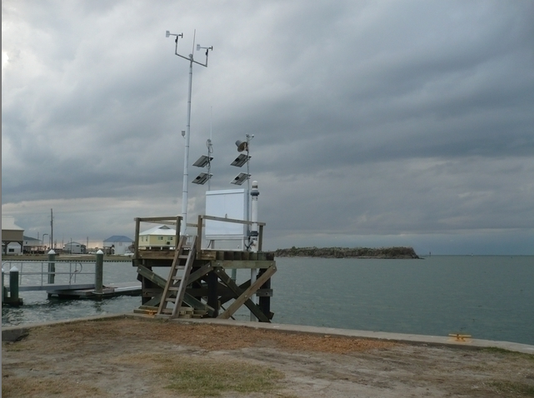
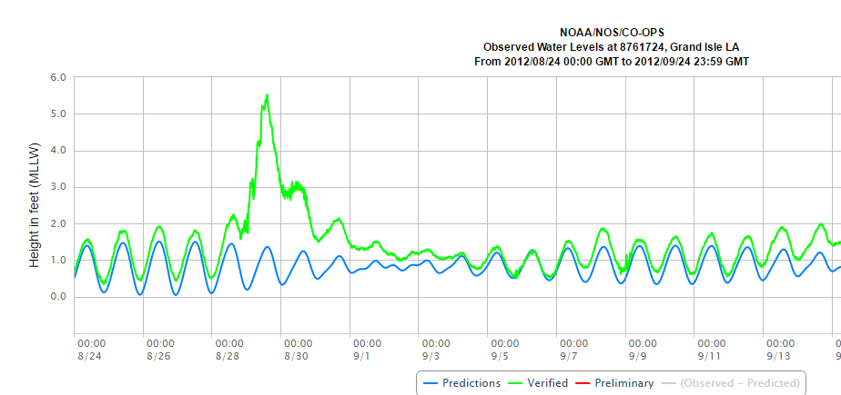
NOAA Coastal Observations In Real Time
Hurricane Issac, 2012

Slide 10
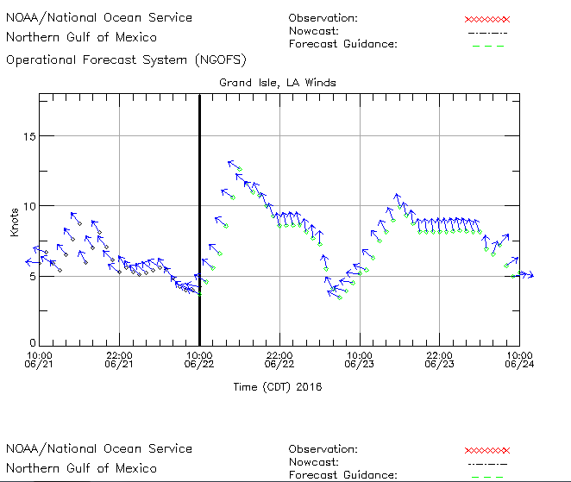
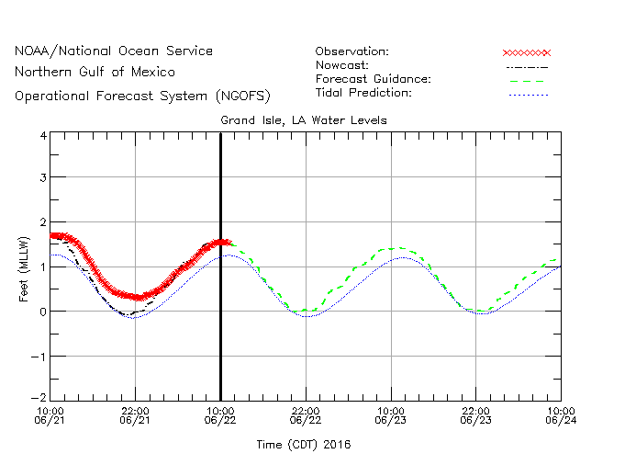
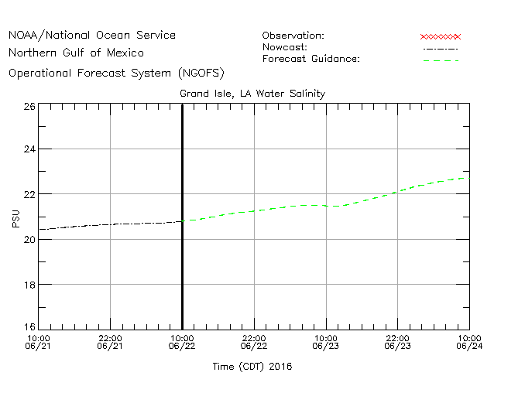
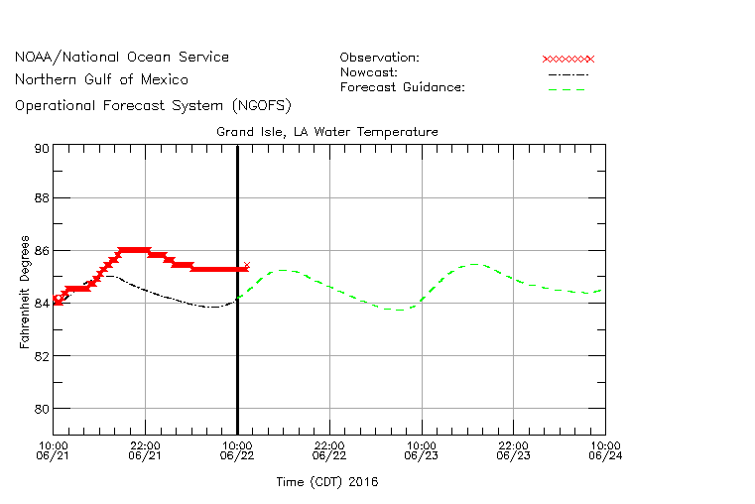
Grand Isle NOAA Station Real Time Observations and Forecasted W/L, Winds, Temp, Salinity
Observed-Forecasted
Observed-Forecasted

Slide 11
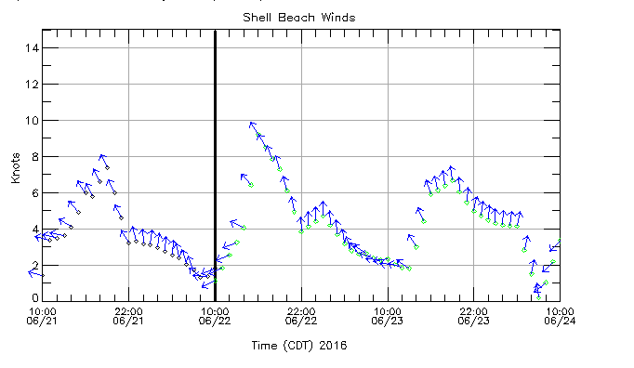
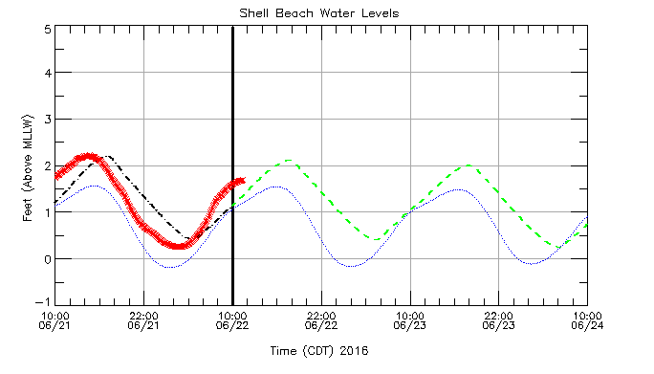
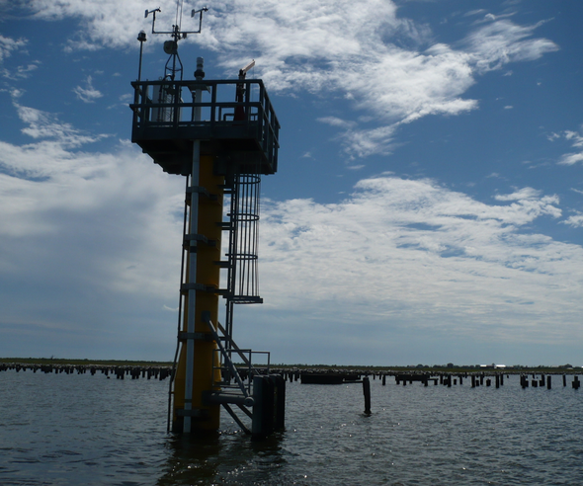
Shell Beach, St Bernard Parish- NOAA Real Time Coastal Observations and Operational Forecast Model Guidance
Observed-Forecasted
Observed-Forecasted

Slide 12
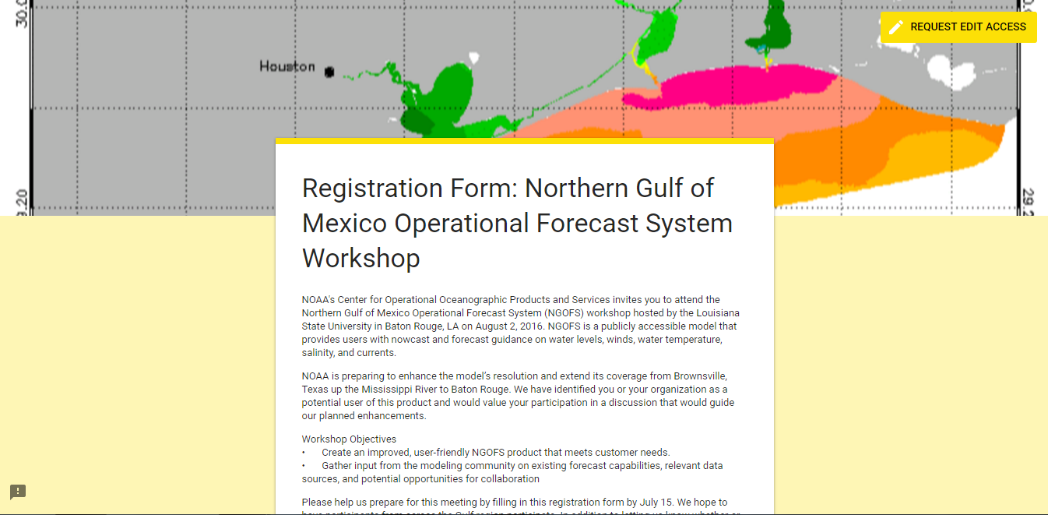
NOAA Northern Gulf Operational Forecast System Modeling Meeting
LSU- August 2nd

Slide 13
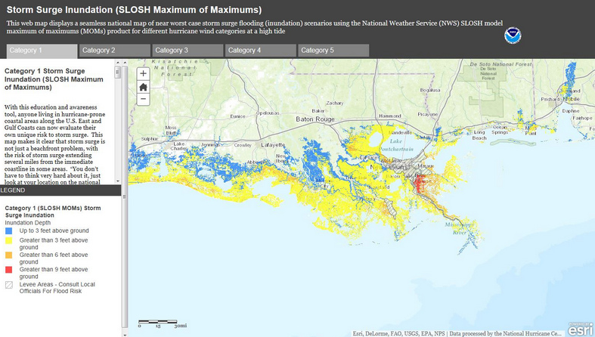

Slide 14
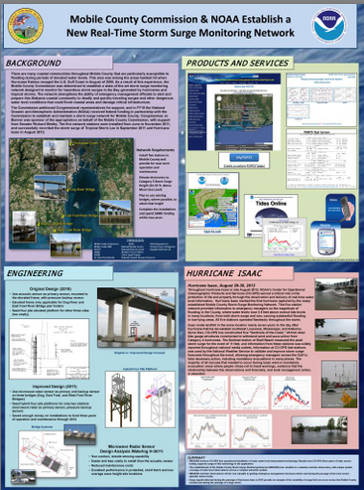

Slide 15
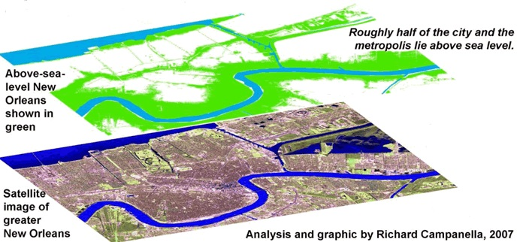
New Orleans- Present Day, Approximately 50% at or Below Sea Level in Elevation

Slide 17
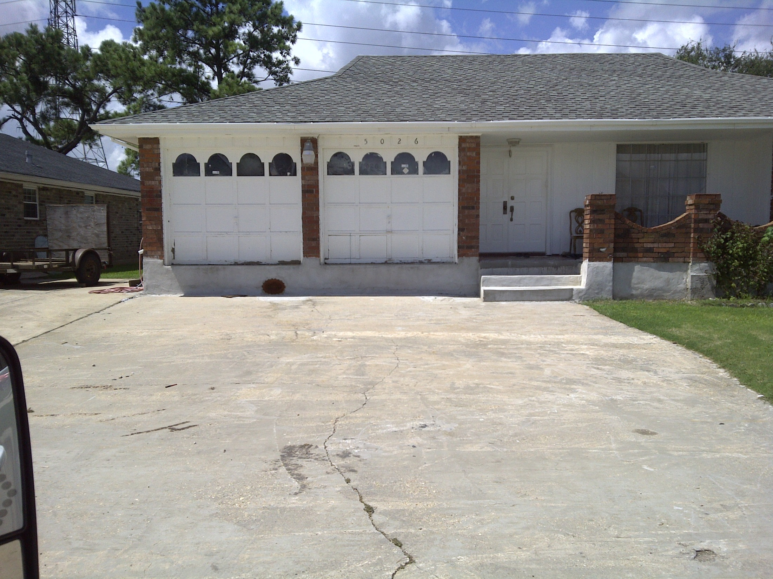
A Home in New Orleans East- Subsidence of the Ground has left the home (supported by piles underneath the house) perched well above the surrounding landscape

Slide 20
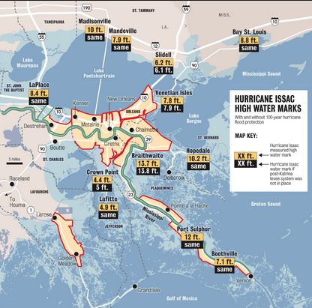
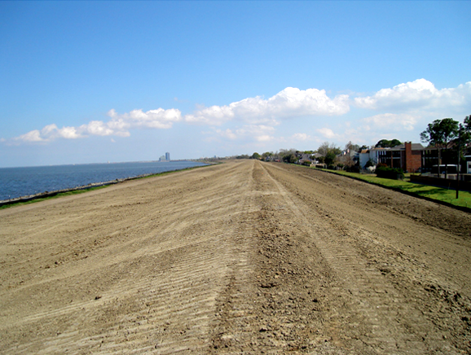
Dynamic Considerations in the Operation and Maintenance and Enhancements of Flood Protection Levees and Structures Relative to Changing Coastal Elevations and Rising Sea Levels

Slide 21
Absolute Gravity Studies Supported by NOAA- Showing 9.1 mm of Subsidence in the New Orleans Area (not counting ~2.5 mm of SLR)

Slide 22
NOAA’s Resources in the Measuring and Reporting of Sea Level Rise Trends is a National Effort Joined into an International Collaboration to Observe and Report on Sea Level Trends

Slide 23
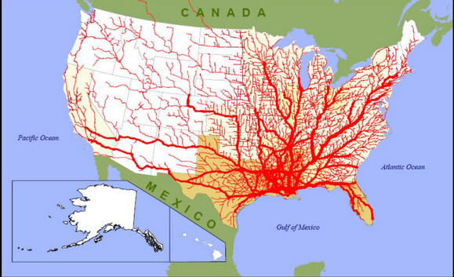
Critical to the Economy of SE Louisiana

Slide 24
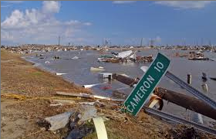
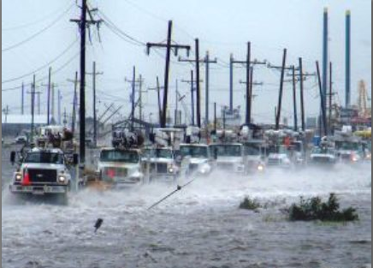
Key Element to SE Louisiana Sustainability Flood Protection

Slide 25
Use of these Trends and the Analysis of Coastal Elevations has assisted the State and Lafourche Parish and Port Fourchon Assess the Flooding Outlook of Louisiana LA-1 for the Unelevated Section below Golden Meadow

Slide 26
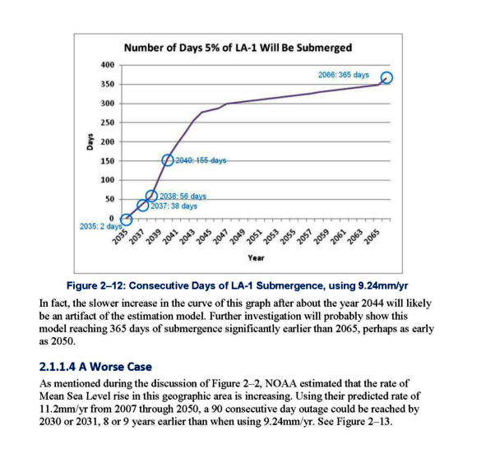
Impact of Rising Water Level Values Being Updated by NOAA on Critical Infrastructure- Louisiana Highway LA-1 – The Only Road Access to Port Fourchon and Grand Isle
NOAA studies of the rise of water and subsidence of the land in south Lafourche Parish shows that Louisiana Highway LA-1 (from Golden Meadow to Leeville) will be closed over 150 days a year from high tides by 2040, and 365 days of the year by 2066
Increasing Rate of Flooding and Closures of Louisiana LA-1 South of Golden Meadow as Water Levels Rise

Slide 27
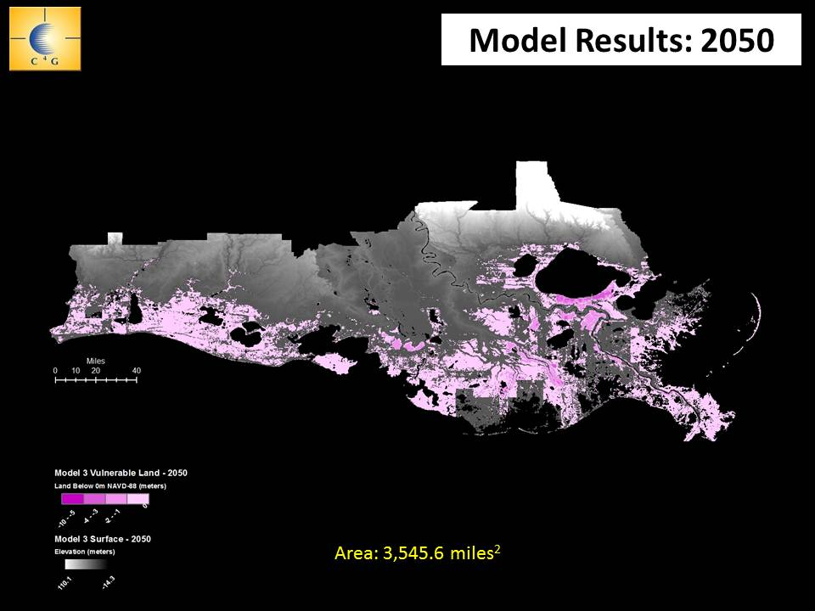
Use of NOAA’s Relative Sea Level Rise Rates are used to Project the Coastal Land Areas that will be at or below Sea Level in elevation by 2050

Slide 28
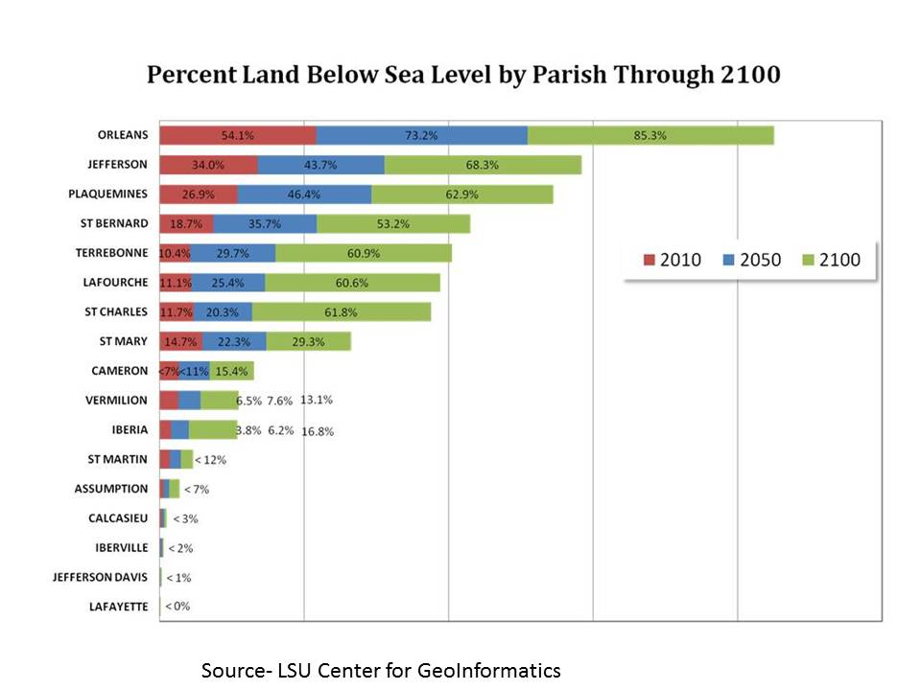
Looking Forward at the Future of the Coast, 7 Large Parishes are Projected to have well over the majority of their land areas at or below sea level in elevation

Slide 29
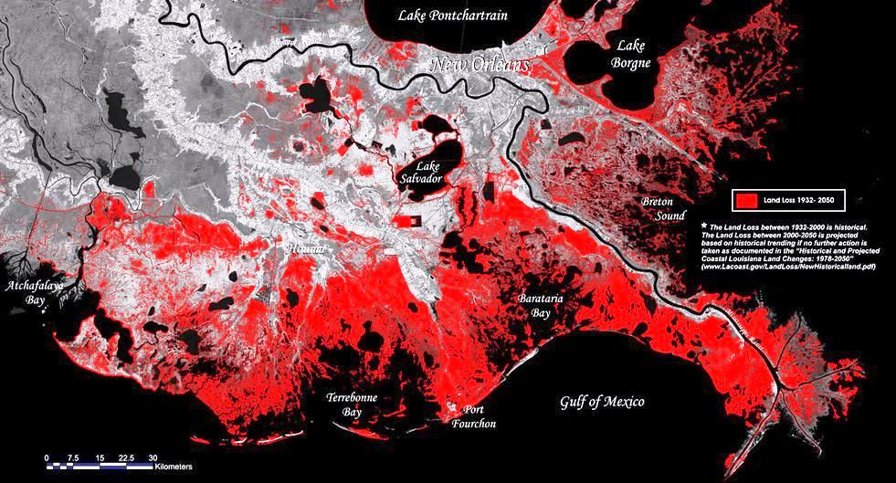
Indeed, A Lot of Discussion Around this High Rate of Relative Change is Very Common

