Slide 1
Global Carbon Budget
2014
Published on 21 September 2014
PowerPoint version 1 (released 21 September 2014)

Slide 2
Contributors 88 people - 68 organisations - 12 countries
Corinne Le Quéré Tyndall Centre for Climate Change Research, Uni. of East Anglia, UK
Róisín Moriarty Tyndall Centre for Climate Change Research, Uni. of East Anglia, UK
Robbie Andrew Center for International Climate & Environmental Research - Oslo (CICERO), Norway
Glen Peters Center for International Climate & Environmental Research - Oslo (CICERO), Norway
Pierre Friedlingstein College of Engineering, Mathematics & Physical Sciences, Uni. of Exeter, UK
Mike Raupach Climate Change Institute, Australian National University, Australia
Pep Canadell Global Carbon Project, CSIRO Marine & Atmospheric Research, Australia
Philippe Ciais LSCE, CEA-CNRS-UVSQ, France
Steve Jones Tyndall Centre for Climate Change Research, Uni. of East Anglia, UK
Stephen Sitch College of Life & Environmental Sciences Uni. of Exeter, UK
Pieter Tans Nat. Oceanic & Atmospheric Admin., Earth System Research Laboratory (NOAA/ESRL), US
Almut Arneth Karlsruhe Inst. of Tech., Inst. Met. & Climate Res./Atmospheric Envir. Res., Germany
Tom Boden Carbon Dioxide Information Analysis Center (CDIAC), Oak Ridge National Laboratory, US
Laurent Bopp LSCE, CEA-CNRS-UVSQ, France
Yann Bozec CNRS, Station Biologique de Roscoff, Roscoff, France
Frédéric Chevallier LSCE, CEA-CNRS-UVSQ, France
Cathy Cosca Nat. Oceanic & Atmospheric Admin. & Pacific Mar. Env. Lab. (NOAA/PMEL), US
Harry Harris Climatic Research Unit (CRU), Uni. of East Anglia, UK
Mario Hoppema AWI Helmholtz Centre for Polar and Marine, Bremerhaven, Germany
Skee Houghton Woods Hole Research Centre (WHRC), US
Jo House Cabot Inst., Dept. of Geography, University of Bristol, UK
Atul Jain Dept. of Atmospheric Sciences, Uni. of Illinois, US
Truls Johannessen Geophysical Inst., Uni. of Bergen & Bjerknes Centre for Climate Research, Norway
Etsushi Kato Center for Global Envir. Research (CGER), Nat. Inst. for Envir. Studies (NIES), Japan
Ralph Keeling Uni. of California - San Diego, Scripps Institution of Oceanography, US
Kees Klein Goldewijk PBL Netherlands Envir. Assessment Agency & Utrecht Uni., Netherlands
Vassillis Kitidi Plymouth Marine Laboratory, Plymouth, UK
Charles Koven Earth Sciences Division, Lawrence Berkeley National Lab, US
Camilla Landa Geophysical Inst., Uni. of Bergen & Bjerknes Centre for Climate Research, Norway
Peter Landschützer Environmental Physics Group, IBPD, ETH Zürich, Switzerland
Andy Lenton CSIRO Marine and Atmospheric Research, Hobart, Tasmania, Australia
Ivan Lima Woods Hole Oceanographic Institution (WHOI), Woods Hole, US
Gregg Marland Research Inst. for Environment, Energy & Economics, Appalachian State Uni., US
Jeremy Mathis Nat. Oceanic & Atmospheric Admin. & Pacific Mar. Env. Lab. (NOAA/PMEL), US
Nicholas Metzl Sorbonne Universités, CNRS, IRD, MNHN, LOCEAN/IPSL Laboratory, Paris, France
Yukihiro Nojiri Center for Global Envir. Research (CGER), Nat. Inst. for Envir. Studies (NIES), Japan
Are Olsen Geophysical Inst., Uni. of Bergen & Bjerknes Centre for Climate Research, Norway
Tsuneo Ono Fisheries Research Agency, Japan
Wouter Peters Department of Meteorology and Air Quality, Wageningen Uni., Netherlands
Benjamin Pfeil Geophysical Inst., Uni. of Bergen & Bjerknes Centre for Climate Research, Norway
Ben Poulter LSCE, CEA-CNRS-UVSQ, France
Pierre Regnier Dept. of Earth & Environmental Sciences, Uni. Libre de Bruxelles, Belgium
Christian Rödenbeck Max Planck Institute for Biogeochemistry, Germany
Shu Saito Marine Division, Global Environment & Marine Dept., Japan Meteorological Agency, Japan
Joe Sailsbury Ocean Processes Analysis Laboratory, Uni. of New Hampshire, US
Ute Schuster College of Engineering, Mathematics & Physical Sciences, Uni. of Exeter, UK
Jörg Schwinger Geophysical Inst., Uni. of Bergen & Bjerknes Centre for Climate Research, Norway
Roland Séférian CNRM-GAME, Météo-France/CNRS, Toulouse, France
Joachim Segschneider Max Planck Institute for Meteorology, Germany
Tobias Steinhoff GEOMAR Helmholtz Centre for Ocean Research, Kiel, Germany
Beni Stocker Physics Inst., & Oeschger Centre for Climate Change Research, Uni. of Bern, Switzerland
Adrianna Sutton Joint Inst. for the Study of the Atm. & Ocean, Uni. of Washington & NOAA/PMEL, US
Taka Takahashi Lamont-Doherty Earth Observatory of Columbia University, Palisades, US
Brönte Tilbrook CSIRO Marine & Atm. Res., Antarctic Cli. & Ecosystems Co-op. Res. Centre, Australia
Guido van der Werf Faculty of Earth and Life Sciences, VU University Amsterdam, The Netherlands
Nicolas Viovy LSCE, CEA-CNRS-UVSQ, France
Ying-Ping Wang CSIRO Ocean and Atmosphere, Victoria, Australia
Rik Wanninkhof NOAA/AOML, US
Andy Wiltshire Met Office Hadley Centre, UK
Ning Zeng Department of Atmospheric and Oceanic Science, Uni. of Maryland, US
Freidlingstein et al. 2014, Raupach et al. 2014 & Fuss et al. 2014 (not already mentioned above)
J Rogelj Inst. for Atm. and Climate Science ETH Zürich, Switzerland & IIASA, Laxemburg, Austria
R Knutti Inst. for Atm. and Climate Science ETH Zürich, Switzerland
G Luderer Potsdam Institute for Climate Impact Research (PIK), Potsdam, Germany
M Schaefer Climate Analytics, Berlin, Germany & Env. Sys. Anal. Agency, Wageningen Uni., Netherlands
Detlef van Vuuren PBL Netherlands Env. Assess. Agency, Bilthoven & CISD,Utrecht Uni., Netherlands
Steven David Department of Earth System Science, University of California, California, US
Frank Jotzo Crawford School of Public Policy, Australian National University, Canberra, Australia
Sabine Fuss Mercator Research Institute on Global Commons & Climate Change, Berlin, Germany
Massimo Tavoni FEEM, CMCC & Politecnico di Milano, Milan, Italy
Rob Jackson School of Earth Sci., Woods Inst. for the Env., & Percourt Inst. for Energy, Stanford Uni, US.
Florian Kraxmer IIASA, Laxemburg, Austria
Naki Nakicenovic IIASA, Laxemburg, Austria
Ayyoob Sharifi National Inst. For Env. Studies, Onogawa, Tsukuba Ibaraki, Japan
Pete Smith Inst. Of Bio. & Env. Sciences, Uni. Of Aberdeen, Aberdeen, UK
Yoshiki Yamagata National Inst. For Env. Studies, Onogawa, Tsukuba Ibaraki, Japan
Science Committee | Atlas Engineers at LSCE, France (not already mentioned above)
Philippe Peylin | Anna Peregon | Patrick Brockmann | Vanessa Maigné | Pascal Evano
Atlas Designers WeDoData, France
Karen Bastien | Brice Terdjman | Vincent Le Jeune | Anthony Vessière
Communications Team
Asher Minns | Owen Gaffney | Lizzie Sayer | Michael Hoevel

Slide 3
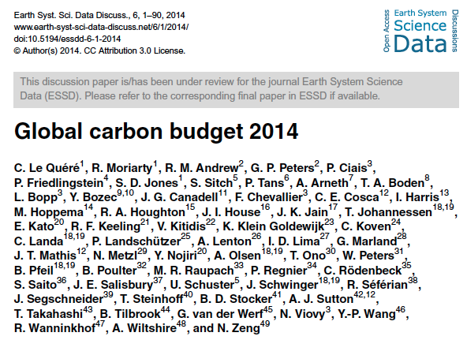
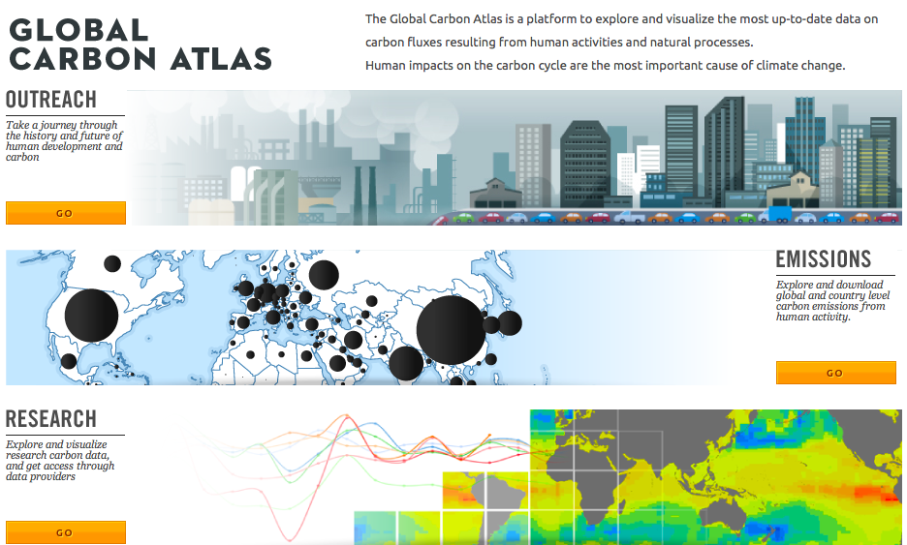
Data Access
More information, data sources and data files:
www.globalcarbonproject.org
Contact: c.lequere@uea.ac.uk
More information, data sources and data files:
www.globalcarbonatlas.org
Contact: philippe.ciais@lsce.ipsl.fr

Slide 4
All the data is shown in billion tonnes CO₂ (GtCO₂)
1 Gigatonne (Gt) = 1 billion tonnes = 1×10¹⁵g = 1 Petagram (Pg)
1 kg carbon (C) = 3.664 kg carbon dioxide (CO₂)
1 GtC = 3.664 billion tonnes CO₂ = 3.664 GtCO₂
Disclaimer
The Global Carbon Budget and the information presented here are intended for those interested in learning about the carbon cycle, and how human activities are changing it. The information contained herein is provided as a public service, with the understanding that the Global Carbon Project team make no warranties, either expressed or implied, concerning the accuracy, completeness, reliability, or suitability of the information.

Slide 5
Executive Summary

Slide 6
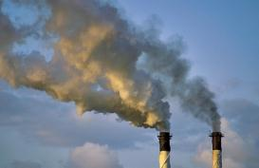
Fossil Fuel and Cement Emissions
Global fossil fuel and cement emissions: 36.1 ± 1.8 GtCO₂ in 2013, 61% over 1990
Projection for 2014 : 37.0 ± 1.9 GtCO₂, 65% over 1990
Uncertainty is ±5% for one standard deviation (IPCC “likely” range)
Estimates for 2011, 2012, and 2013 are preliminary Source: CDIAC; Le Quéré et al 2014; Global Carbon Budget 2014

Slide 7
Observed Emissions and Emissions Scenarios
Emissions are on track for 3.2–5.4ºC “likely” increase in temperature above pre-industrial
Large and sustained mitigation is required to keep below 2ºC
Data: CDIAC/GCP/IPCC/Fuss et al 2014
Over 1000 scenarios from the IPCC Fifth Assessment Report are shown Source: Fuss et al 2014; CDIAC; Global Carbon Budget 2014

Slide 8
Top Fossil Fuel Emitters (Absolute)
The top four emitters in 2013 covered 58% of global emissions
China (28%), United States (14%), EU28 (10%), India (7%)
Bunkers fuel used for international transport is 3% of global emissions Statistical differences between the global estimates and sum of national totals is 3% of global emissions Source: CDIAC; Le Quéré et al 2014; Global Carbon Budget 2014

Slide 9
Top Fossil Fuel Emitters (Per Capita)
China’s per capita emissions have passed the EU28 and are 45% above the global average
Per capita emissions in 2013
Source: CDIAC; Le Quéré et al 2014; Global Carbon Budget 2014

Slide 10
Consumption-based emissions (carbon footprint)
Allocating emissions to the consumption of goods and services provides an alternative perspective on emission drivers
Consumption-based emissions are calculated by adjusting the standard production-based emissions to account for international trade Source: Le Quéré et al 2014; Peters et al 2011;Global Carbon Project 2014

Slide 11
Alternative Ranking of Countries
Depending on perspective, the significance of individual countries changes
GDP: Gross Domestic Product in Market Exchange Rates (MER) and Purchasing Power Parity (PPP) Source: CDIAC; United Nations; Le Quéré et al 2014; Global Carbon Budget 2014

Slide 12
Anthropogenic Perturbation of the Global Carbon Cycle
Perturbation of the global carbon cycle caused by anthropogenic activities, averaged globally for the decade 2004–2013 (GtCO₂/yr)
Data: CDIAC/NOAA-ESRL/GCP
Source: CDIAC; NOAA-ESRL; Le Quéré et al 2014; Global Carbon Budget 2014

Slide 13
Global Carbon Budget
Emissions are partitioned between the atmosphere, land, and ocean
Source: CDIAC; NOAA-ESRL; Houghton et al 2012; Giglio et al 2013; Joos et al 2013; Khatiwala et al 2013; Le Quéré et al 2014; Global Carbon Budget 2014

Slide 14
Global Carbon Budget
The cumulative contributions to the Global Carbon Budget from 1870 Contributions are shown in parts per million (ppm)
Figure concept from Shrink That Footprint Source: CDIAC; NOAA-ESRL; Houghton et al 2012; Giglio et al 2013; Joos et al 2013; Khatiwala et al 2013; Le Quéré et al 2014; Global Carbon Budget 2014

Slide 15
Atmospheric Concentration
The global CO₂ concentration increased from ~277ppm in 1750 to 395ppm in 2013 (up 43%) Mauna Loa registered the first daily measurements above 400pm in May 2013
Globally averaged surface atmospheric CO₂ concentration Data from: NOAA-ESRL after 1980; the Scripps Institution of Oceanography before 1980 (harmonised to recent data by adding 0.542ppm) Source: NOAA-ESRL; Scripps Institution of Oceanography; Global Carbon Budget 2014

Slide 16
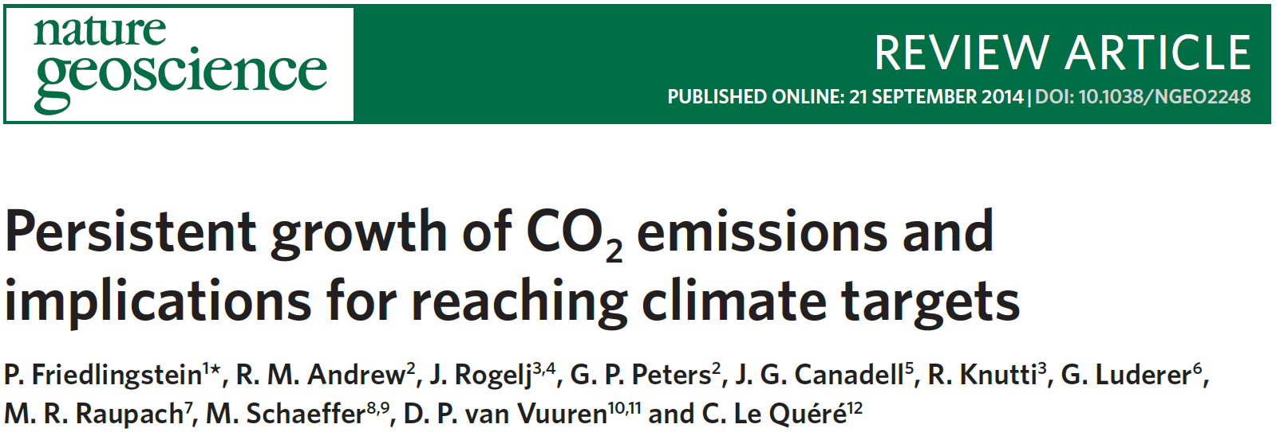
Remaining CO₂ emission quota

Slide 17
Persistent Growth – Global
Assuming emissions follow projected GDP growth and accounting for improvement in carbon intensity, we project fossil fuel and cement emissions to grow 3.1%/yr to reach 43.2 GtCO₂/yr by 2019
Economic growth based on IMF projections, fossil fuel intensity based on 10-year trend Source: CDIAC; Friedlingstein et al 2014

Slide 18
Carbon Intensity of Economic Activity – Global
GDP and carbon intensity trends are relatively stable over time, leading to stable emission growth Step changes in emission intensity are required for emission trends to change for a given GDP
Economic growth based on IMF projections, fossil fuel intensity based on 10-year trend Source: CDIAC; Friedlingstein et al 2014

Slide 19
Persistent Growth – Regional
Continued trends suggest that by 2019 China’s emissions could exceed the USA, EU28 and India combined, and India could emit more than the EU28
Economic growth based on IMF projections, fossil fuel intensity based on 10-year trend Source: CDIAC; Friedlingstein et al 2014

Slide 20
Top Fossil Fuel Emitters (Per Capita)
The divergence between EU28 and Chinese per capita emissions is likely to continue USA continues with high and India with low per capita emissions
Economic growth based on IMF projections, fossil fuel intensity based on 10-year trend Source: CDIAC; Friedlingstein et al 2014

Slide 21
Carbon Intensity of Economic Activity – Regional
GDP in China and India is growing faster than improvements in carbon intensity of GDP, with the opposite in the USA and EU
Economic growth based on IMF projections, fossil fuel intensity based on 10-year trend Source: CDIAC; Friedlingstein et al 2014

Slide 22
Remaining emissions budget
Cumulative CO₂ emissions should remain below about 3200 Gt for a 66% chance of staying below 2°C At present emissions rates the remaining budget would be used up in about 30 years
(Uncertainty is about ±300 GtCO₂)
If emissions continue to grow as projected to 2019 and then continue at the 2019 rate, the remaining budget would be used up about 22 years from 2019 Source: Friedlingstein et al 2014

Slide 23
Sharing the CO₂ emission quota

Slide 24
Sharing the CO₂ emission quota
The share of an available CO₂ emission quota allocated to countries A ‘blended’ option gives more feasible mitigation rates, without penalising developing regions
Inertia (current emissions), equity (population), blended (50-50 split) Emissions trading would allow additional sharing of the quota, together with financial transfers Source: Raupach et al 2014

Slide 25
Mitigation rates become infeasible under some schemes
The necessary mitigation rates can change significantly for some countries ‘Blended’ effort sharing can strike a balance between fairness and feasibility
For comparison, the nuclear transitions in some European countries led to ~4%/yr reductions for 10-year periods Source: Raupach et al 2014

Slide 26
Global Quotas, Committed Emissions, Fossil-Fuel Reserves
To keep temperatures below 2°C requires two-thirds of fossil fuels to remain in the ground* Committed emissions in existing infrastructure represents 50% of the remaining quota*
*Assuming a 50% chance to stay below 2°C and no carbon-capture and storage Source: Raupach et al 2014

Slide 27
Regional Quotas, Committed Emissions, Fossil-Fuel Reserves
With population-based (equity) sharing & committed emissions, the USA and China have already exceeded their 2°C quotas
Trade in fossil fuels redistributes the emissions from fossil-fuel reserves amongst nations Source: Raupach et al 2014

Slide 28
Betting on Negative Emissions

Slide 29
BECCS is necessary, but not sufficient for 2ºC
BECCS is used in over half of scenarios, but ~40% have net positive emissions in 2100 ~90% of 2ºC and ~35% of other mitigation scenarios have net negative emissions in 2100
Data: Fuss et al 2014/IPCC
BECCS = Bioenergy with Carbon Capture and Storage; Scenarios from IPCC Fifth Assessment Report Source: Fuss et al 2014

Slide 30
Four components of consistent negative emissions narratives
The viability of BECCS as a climate change mitigation option is unproven and its widespread use in climate stabilization scenarios might become a dangerous distraction
Source: Fuss et al 2014

Slide 31
Supplementary Budget Slides

Slide 32
Fossil Fuel and Cement Emissions

Slide 33
Emissions from Coal, Oil, Gas, Cement
Share of global emissions in 2013: coal (43%), oil (33%), gas (18%), cement (6%), flaring (1%, not shown)
Source: CDIAC; Le Quéré et al 2014; Global Carbon Budget 2014

Slide 34
Fossil Fuel and Cement Emissions Growth
Coal accounted for 59% of the growth in global emissions in 2013, oil 18%, gas 10%, and cement 12%.
Source: CDIAC; Le Quéré et al 2014; Global Carbon Budget 2014

Slide 35
Fossil Fuel and Cement Emissions Growth
Much of the growth in emissions in 2013 was in China, the USA, and India, while Europe’s emissions declined
Figure shows the top four countries contributing to emissions changes in 2013 Source: CDIAC; Le Quéré et al 2014; Global Carbon Budget 2014

Slide 36
Breakdown of Global Emissions by Country
Emissions from Annex B countries have slightly declined since 1990 Emissions from non-Annex B countries have increased rapidly in the last decade
Annex B countries have emission commitments in the Kyoto Protocol (excluding Canada and USA) Source: CDIAC; Le Quéré et al 2014; Global Carbon Budget 2014

Slide 37
Historical Cumulative Emissions by Country
Cumulative emissions from fossil-fuel and cement were distributed (1870–2013): USA (26%), EU28 (23%), China (11%), and India (3%) covering 63% of the total share
Cumulative emissions (1990–2013) were distributed USA (20%), China (20%), EU28 (14%), India (5%) ‘Other’ includes all other countries along with bunker fuels and statistical differences Source: CDIAC; Le Quéré et al 2014; Global Carbon Budget 2014

Slide 38
Historical Cumulative Emissions by Region
Cumulative emissions from fossil-fuel and cement (1870–2013) North America and Europe responsible for most cumulative emissions, but Asia growing fast
The figure excludes bunker fuels and statistical differences Source: CDIAC; Le Quéré et al 2014; Global Carbon Budget 2014

Slide 39
Carbon Intensity of Economic Activity – Global
Financial crises have little lasting effect on emissions Carbon intensity has had minimal improvements since 2000
Source: CDIAC; Le Quéré et al 2014; Global Carbon Budget 2014

Slide 40
Annex B versus non-Annex B Countries
There is not a clear distinction between Annex B and non-Annex B countries based on economic activity per capita or emissions per capita
GDP is measured in Market Exchange Rates Source: United Nations; CDIAC; Le Quéré et al 2014; Global Carbon Budget 2014

Slide 41
Key Statistics
 | Emissions 2013
Region/Country | Per capita | Total |  | Growth 2012-13
 | tCO₂ per person | GtCO₂ | % | GtCO₂ | %
Global (with bunkers) | 5.0 | 36.13 | 100 | 0.706 | 0.0
 | Developed Countries (Annex B)
Annex B | 7.5 | 13.05 | 36.1 | 0.019 | 0.4
USA | 16.4 | 5.23 | 14.5 | 0.134 | 2.9
EU28 | 6.8 | 3.48 | 9.6 | -0.073 | -1.8
Russia | 12.7 | 1.81 | 5.0 | -0.016 | -0.6
Japan | 9.8 | 1.25 | 3.4 | -0.009 | -0.4
Canada | 14.3 | 0.50 | 1.4 | 0.003 | 1.0
 | Developing Countries (Non-Annex B)
Non-Annex B | 3.5 | 21.04 | 58.2 | 0.637 | 3.4
China | 7.2 | 9.98 | 27.6 | 0.376 | 4.2
India | 1.9 | 2.41 | 6.7 | 0.111 | 5.1
South Korea | 12.5 | 0.62 | 1.7 | 0.009 | 1.7
Iran | 7.9 | 0.61 | 1.7 | 0.013 | 2.4
Saudi Arabia | 18.0 | 0.52 | 1.4 | 0.014 | 3.0
 | International Bunkers
Aviation and Shipping | - | 2.04 | 5.6 | 0.050 | 2.5
Source: CDIAC Data; Le Quéré et al 2014; Global Carbon Project 2014

Slide 42
Consumption-based Emissions
Consumption–based emissions allocate emissions to the location that goods and services are consumed
Consumption-based emissions = Production/Territorial-based emissions minus emissions embodied in exports plus the emissions embodied in imports

Slide 43
Consumption Emissions per the Kyoto Protocol
The net emissions transfers into Annex B countries more than offsets the Annex B emission reductions achieved within the Kyoto Protocol
In Annex B, production-based emissions have had a slight decrease while consumption-based emissions have grown at 0.5% per year, and emission transfers have grown at 11% per year Source: CDIAC; Peters et al 2011; Le Quéré et al 2014; Global Carbon Budget 2014

Slide 44
Major Flows from Production to Consumption
Start of Arrow: fossil-fuel combustion End of arrow: goods and services consumption
Values for 2007. EU is treated as one region. Units: MtCO₂ Source: Peters et al 2012

Slide 45
Major Flows from Extraction to Consumption
Start of Arrow: fossil-fuel extraction End of arrow: goods and services consumption
Values for 2007. EU is treated as one region. Units: MtCO₂ Source: Andrew et al 2013

Slide 46
Land-Use Change Emissions

Slide 47
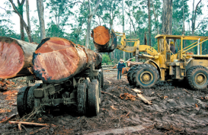
Land-Use Change Emissions
Global land-use change emissions are estimated 3.3 ± 1.8 GtCO₂ during 2004–2013 The data suggests a general decrease in emissions since 1990
Indonesian peat fires
Three different estimation methods have been used, indicated here by different shades of grey Land-use change also emits CH₄ and N₂O which are not shown here Source: Houghton et al 2012; Giglio et al 2013; Le Quéré et al 2014; Global Carbon Budget 2014

Slide 48
Total Global Emissions
Total global emissions: 39.4 ± 3.4 GtCO₂ in 2013, 42% over 1990 Percentage land-use change: 36% in 1960, 19% in 1990, 8% in 2013
Three different methods have been used to estimate land-use change emissions, indicated here by different shades of grey Source: CDIAC; Houghton et al 2012; Giglio et al 2013; Le Quéré et al 2014; Global Carbon Budget 2014

Slide 49
Total Global Emissions by Source
Land-use change was the dominant source of annual CO₂ emissions until around 1950 Coal consumption continues to grow strongly
Others: Emissions from cement production and gas flaring Source: CDIAC; Houghton et al 2012; Giglio et al 2013; Le Quéré et al 2014; Global Carbon Budget 2014

Slide 50
Historical Cumulative Emissions by Source
Despite reductions in land-use change, it represents about 27% of cumulative emissions in 2013 Coal represents about 35%, oil 26%, gas 10%, and others 3%
Others: Emissions from cement production and gas flaring Source: CDIAC; Houghton et al 2012; Giglio et al 2013; Le Quéré et al 2014; Global Carbon Budget 2014

Slide 51
Closing the Carbon Budget

Slide 52
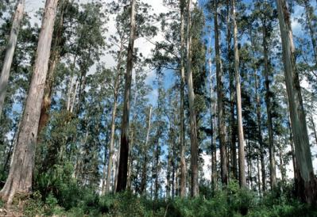
Fate of Anthropogenic CO₂ Emissions (2004-2013 average)
32.4±1.6 GtCO₂/yr 91%
15.8±0.4 GtCO₂/yr
44%
+
10.6±2.9 GtCO₂/yr
29%
Calculated as the residual
of all other flux components
3.3±1.8 GtCO₂/yr 9%
26%
9.4±1.8 GtCO₂/yr
Source: CDIAC; NOAA-ESRL; Houghton et al 2012; Giglio et al 2013; Le Quéré et al 2014; Global Carbon Budget 2014

Slide 53
Changes in the Budget over Time
The sinks have continued to grow with increasing emissions, but climate change will affect carbon cycle processes in a way that will exacerbate the increase of CO₂ in the atmosphere
Data: GCP
Source: CDIAC; NOAA-ESRL; Houghton et al 2012; Giglio et al 2013; Le Quéré et al 2014; Global Carbon Budget 2014

Slide 54
Atmospheric Concentration
The atmospheric concentration growth rate has shown a steady increase The growth in 2013 reflects the growth in fossil emissions, with small changes in the sinks
Source: NOAA-ESRL; Global Carbon Budget 2014

Slide 55
Ocean Sink
Ocean carbon sink continues to increase 9.4±1.8 GtCO₂/yr for 2004–2013 and 10.5±1.8 GtCO₂/yr in 2013
Data: GCP
this carbon budget
individual ocean models
data products
Source: Le Quéré et al 2014; Global Carbon Project 2014
Individual estimates from Buitenhuis et al. (2010); Aumont and Bopp (2006); Doney et al. (2009); Assmann et al. (2010); Ilyiana et al. (2013); Sérérian et al. (2013); Oke et al. (2013);
Landschützer et al. (2014); Park et al. (2010); Rödenbeck et al. (2014). References provided in Le Quéré et al. (2014).

Slide 56
Terrestrial Sink
The residual land sink is increasing with time to 9.2±1.8 GtCO₂/yr in 2013, with large variability Total CO₂ fluxes on land (including land-use change) are constrained by atmospheric inversions
Data: GCP
this carbon budget
individual land models
fire-based estimate
this carbon budget
individual land models
this carbon budget
individual land models
atmospheric inversions (colours)
Source: Le Quéré et al 2014; Global Carbon Project 2014
Individual estimates from Zhang et al. (2013); Oleson et al. (2013); Jain et al. (2013); Clarke et al. (2011); Smith et al. (2001); Sitch et al. (2003); Stocker et al. (2013); Krinner et al. (2005);
Zeng et al. (2005); Kato et al. (2013); Peters et al. (2010); Rodenbeck et al. (2003); Chevallier et al. (2005). References provided in Le Quéré et al. (2014).

Slide 57
References Used in this Presentation
Global Carbon Budget (2014) More information, data sources and data files at http://www.globalcarbonproject.org/carbonbudget/
C. Le Quéré, R. Moriarty, R.M. Andrew, G.P.Peters, P. Ciais, P. Friedlingstein, S.D. Jones, S. Sitch, P.Tans, A. Arneth, T.A. Boden, L. Bopp, Y. Bozec, J.G. Canadell, F. Chevallier, C.E. Cosca, I. Harris, M. Hoppema, R.A. Houghton, J.I. House, J.K Jain, T. Johannessen, E. Kato, R.F. Keeling, V. Kitidis, K. Klein Goldewijk, C. Koven, C. Landa, P. Landschützer, A. Lenton, I.D. Lima, G. Marland, J.T. Mathis, N. Metzl, Y. Nojiri, A. Olsen, T. Ono, W. Peters, B. Pfeil, B. Poulter, M.R. Raupach, P. Regnier, C. Rödenbeck, S. Saito, J.E. Salisbury, U. Schuster, J. Schwinger, R. Séférian, J. Segschneider, T. Steinhoff, B.D. Stocker, A.J. Sutton, T. Takahashi, B. Tilbrook, G.van der Werf, N. Viovy, Y.P. Wang, R. Wanninkhof, A. Wiltshire, N. Zeng (2014) “Global Carbon Budget 2014”, Earth System Science Data Discussions (in review), http://dx.doi.org/10.5194/essdd-7-521-2014
R. Andrew, G.P. Peters, S. Davis (2013) “Climate Policy and Dependence on Traded Carbon” Environmental Research Letters, http://dx.doi.org/10.1088/1748-9326/8/3/034011, DOI:10.1088/1748-9326/8/3/034011
T. Boden, G. Marland, R. Andres (2013) “Global, Regional, and National Fossil-Fuel CO₂ Emissions in Trends”, Carbon Dioxide Information Analysis Center (CDIAC), http://cdiac.ornl.gov/trends/emis/meth_reg.html
E. Dlugokencky and P. Tans (2013) “Trends in Atmospheric Carbon Dioxide”, National Oceanic & Atmosphere Administration, Earth System Research Laboratory (NOAA-ESRL), http://www.esrl.noaa.gov/gmd/ccgg/trends/
L. Giglio, J.T. Randerson, G.R. van der Werf (2014) “Analysis of daily, monthly, and annual burned area using the fourth-generation global fire emissions database (GFED4)”, Journal Geophysical Research Biogeosciences, 118, TS10, 2013, http://onlinelibrary.wiley.com/doi/10.1002/jgrg.20042/abstract, DOI:10.1002/jgrg.20042
R.A. Houghton, J.I. House, J. Pongratz, G.R. van der Werf, R.S. DeFries, M.C. Hansen, C. Le Quéré, N. Ramankutty (2012), “Carbon emissions from land use and land-cover change”, http://www.biogeosciences.net/9/5125/2012/bg-9-5125-2012.html, DOI:10.5194/bg-9-5125-2012
F. Joos, R. Roth, J.Fuglestvedt, G. Peters, I. Enting, W. von Bloh, V. Brovkin, E. Burke, M. Eby, N. Edwards, T. Friedrich, T. Frölicher, P. Halloran, P. Holden, C. Jones, T. Kleinen, F. Mackenzie, K. Matsumoto, M. Meinshausen, G.-K. Plattner, A. Reisinger, J. Segschneider, G. Shaffer, M. Steinacher, K. Strassmann, K. Tanaka, A. Timmermann, and A. Weaver (2013) “Carbon dioxide and climate impulse response functions for the computation of greenhouse gas metrics: a multi-model analysis“, Atmospheric Chemistry and Physics, http://www.atmos-chem-phys.net/13/2793/2013/acp-13-2793-2013.html, DOI: 0.5194/acp-13-2793-2013
S. Khatiwala, T. Tanhua, S. Mikaloff Fletcher, M. Gerber, S. Doney, H. Graven, N. Gruber, G. McKinley, A. Murata, A. Rios, C. Sabine (2013), “Global ocean storage of anthropogenic carbon”, Biogeosciences, http://www.biogeosciences.net/10/2169/2013/bg-10-2169-2013.html, doi:10.5194/bg-10-2169-2013
G.P. Peters, J. Minx, C. Weber, O. Edenhofer (2011) “Growth in emission transfers via international trade from 1990 to 2008”, Proceedings of the National Academy of Sciences, www.pnas.org/content/108/21/8903 DOI:10.1073/pnas.1006388108
G.P. Peters, S. Davis, R. Andrew (2012) “A synthesis of carbon in international trade”, Biogeosciences, http://www.biogeosciences.net/9/3247/2012/bg-9-3247-2012.html, DOI:10.5194/bg-9-3247-2012
UN (2014) United Nations Statistics Division http://unstats.un.org/unsd/default.htm

Slide 58
Global Carbon Atlas
Explore CO₂ emissions at the global and country levels, compare among countries, visualize, and download data and illustrations (“Emissions” application). Also explore “Outreach” and “Research”.
www.globalcarbonatlas.org

Slide 59
Acknowledgements
The work presented in the Global Carbon Budget 2014 has been possible thanks to the contributions of hundreds of people involved in observational networks, modeling, and synthesis efforts. Not all of them are individually acknowledged in this presentation for reasons of space (see slide 2 for those individuals directly involved).
Additional acknowledgement is owed to those institutions and agencies that provide support for individuals and funding that enable the collaborative effort of bringing all components together in the carbon budget effort.
UK Natural Environment Research Council
Norwegian Research Council
US Department of Energy
Australian Climate Change Science Program
European Union Seventh Framework Programme
The Leverhulme Trust, UK
Ministry of Environment of Japan
LSCE, France
PNB-Paribas
We also thank the sponsors of the GCP and GCP support/liaison offices

