Slide 1
The Carbon Cycle and Ocean Acidification

Slide 4
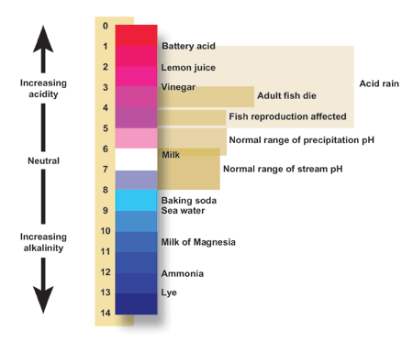

Slide 9
The Climate Skeptic View

