Slide 1
Careers in Administrative Law and Regulatory Practice
Jonathan J. Rusch
Chair, Administrative Law and Regulatory Practice Section
American Bar Association
Deputy Chief for Strategy and Policy
Fraud Section, Criminal Division
U.S. Department of Justice
Baton Rouge, LA
February 1, 2011
Note: The views expressed herein are solely those of the speaker, and do not necessarily represent the views of any component or officer of the federal government or any component or official thereof

Slide 2
Background

Slide 3
Continuing Volatility in Legal Profession Responses to Economy
National Law Journal, November 2010:
Nation’s top 250 law firms decreased in size by 1,400 lawyers
1.1 percent in 2010 (4 percent in 2009)
Associates decreased by nearly 1,000 (1.5 percent)
American Lawyer Survey of Midlevel Associates (3rd, 4th, 5th Year) (September 2010)
Nearly 80 percent said they were not worried about being laid off
Complaints:
Reduced benefits and salaries
Poor communications by firms (especially about becoming partner)
Heavier workloads
New promotion models (e.g., based on performance reviews and mastery of certain skill sets)

Slide 4
Law Students’ Responses
“Why Are They Doing This to Me?”
It’s not personal – really
Economics of law practice
Partners own the business, associates are mere employees
Focus on more profitable work
Supply of work diminished
Overcapacity of legal staff
Need to Focus on New Realities of Practice
That was then, this is now

Slide 5
Realities Include Regulatory Work
BTI Consulting Group Forecast (October 2010)
Legal market for regulatory work expected to see slight (1.2 percent) but steady growth in 2011
Regulatory legal market estimated at $5.53 billion
Regulatory work will still command some of highest rate premiums in current legal market
Predicted growth concentrated in key industries, including energy, transportation, and industrial manufacturing
Also financial services, health care, accounting regulations, environmental, oil and gas regulations (post-Deepwater Horizon)

Slide 6
Possible Areas of Regulatory Practice
Agriculture
Antitrust and Trade Regulation
Banking and Financial Services
Benefits
Beverage Alcohol Practice
Communications
Consumer Products Regulation
Criminal Process
Education
Elections
Energy
Environmental and Natural Resources Regulation
Food and Drug
Government Personnel
Health and Human Service

Slide 7
Possible Areas of Regulatory Practice
Government Affairs and Legislative Process (i.e., Lobbying)
Government Information and Right to Privacy
Homeland Security and National Defense
Housing and Urban Development
Immigration and Naturalization
Insurance
Intellectual Property
International Law
International Trade and Customs
Labor and Employment
Postal Matters
Securities, Commodities, & Exchanges
Transportation
Veterans Affairs

Slide 8
Possible Types of Regulatory Practice
Private Practice
Not just Big Law in big cities
Successful regulatory practices include solo firms through megafirms
Corporations
More companies taking more work in-house
Self-Regulatory Organizations
Securities and commodities (FINRA, National Futures Association)

Slide 9
Possible Types of Regulatory Practice
Government Agencies
Local
State
Regional
Agencies created by interstate compact (e.g., Metro)
U.S. Government-created corporations (e.g., St. Lawrence Seaway Development Corporation, Tennessee Valley Authority)
Federal
Bi- and Multinational (e.g., European Union)
Public Interest Organizations

Slide 10
A Strategy for Law Students

Slide 11
Key Points
Career Management Is Critical
“[B]egin managing your career during law school” (Alison Bernard and Niki Kopsidas, New York Law Journal, July 20, 2010)
“For a successful long-term career, do not look to your company or industry to take care of you. As in every other arena of life, you must take care of yourself.” (Dr. Judith Sills)
Career Management Begins with Branding and Business Intelligence

Slide 12
Branding
Branding Critical to Increasing Your Marginal Value to Employers
Dr. Judith Sills: You are your own brand
“. . . the professional identity you create in the minds of others” (http://www.psychologytoday.com/rss/index.php?term=20080118-000009&page=1)
Branding includes more than just your “professional name”
It may include –
Demonstrating potential niche expertise
Sending clear signals about key attributes (e.g., consistency, reliability, delivering on time)

Slide 13
Developing Branding
Look for Opportunities to Start Developing Niche Expertise
Law review note or development
Research for law professor or legal organization
Do good work on summer employment topic, then ask supervisor (partner/supervising attorney) what else you could learn about the topic

Slide 14
Business Intelligence
Intelligence That Identifies Profitable Areas of Practice That You Are Interested in Pursuing
You Are Your Own Intelligence Unit
Intelligence about –
Your possible/prospective employers
Areas of regulatory knowledge important to them
Continuing trends in legal profession and economy

Slide 15
Developing Business Intelligence
Research on Areas of Practice Relevant to Employers
Firm, agency summaries, resumes
Google Alerts - http://www.google.com/alerts?hl=en
Set delivery frequency
Legal blogs and newssites
Above the Law - http://abovethelaw.com/
Am Law Daily Blog - http://amlawdaily.typepad.com/amlawdaily/
Law Blog Law.com - http://www.law.com/jsp/law/index.jsp
Newswire - http://store.law.com/registration/register.asp?subscribeto=nw
Legal Pad - http://legalpad.typepad.com/
Overlawyered - http://overlawyered.com/
Wall Street Journal Law Blog- http://blogs.wsj.com/law/
Business publications
Financial Times - http://www.ft.com/home/us
Wall Street Journal - http://online.wsj.com/home-page (includes Careers section)

Slide 16
Developing Business Intelligence
Research on Areas of Practice Relevant to Employers
ABA Administrative Law and Regulatory Practice Resources
Section Blog – Notice and Comment: http://regulatorypractice.blogspot.com
“Followers” Wanted

Slide 17
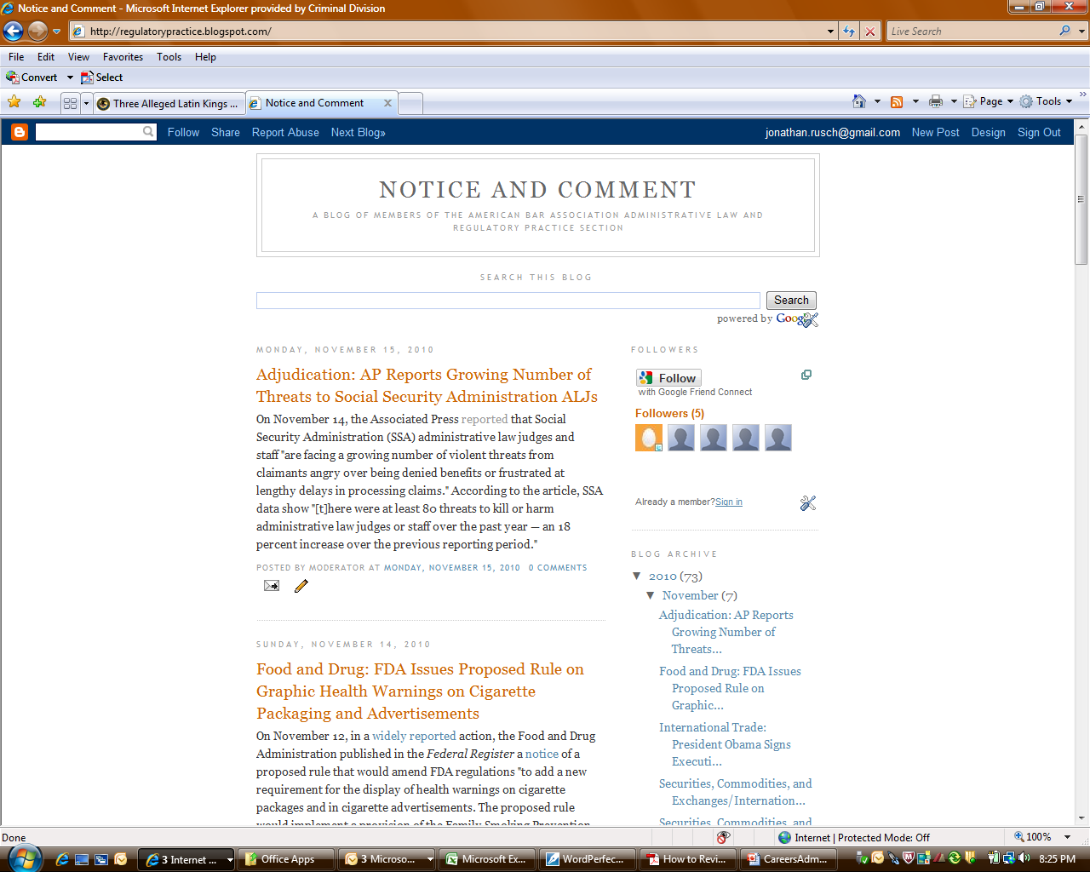

Slide 18
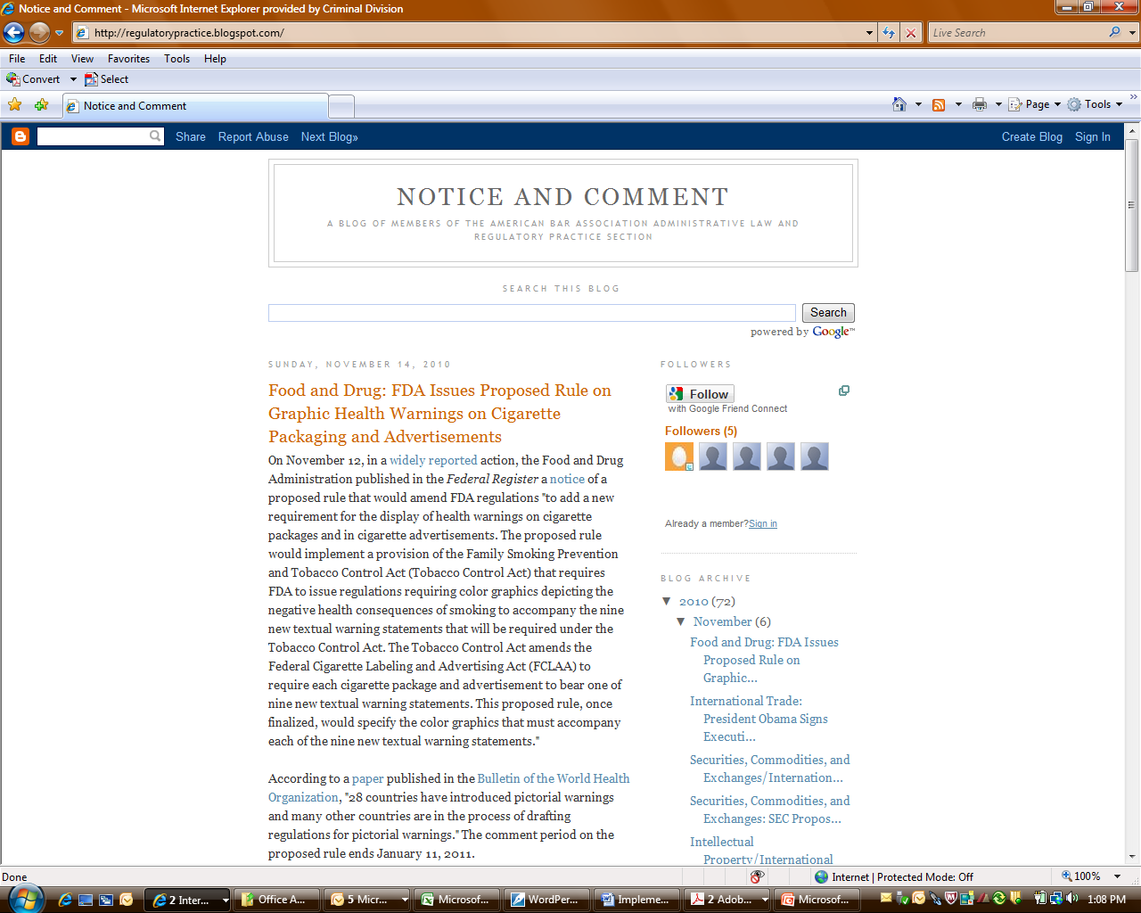

Slide 19
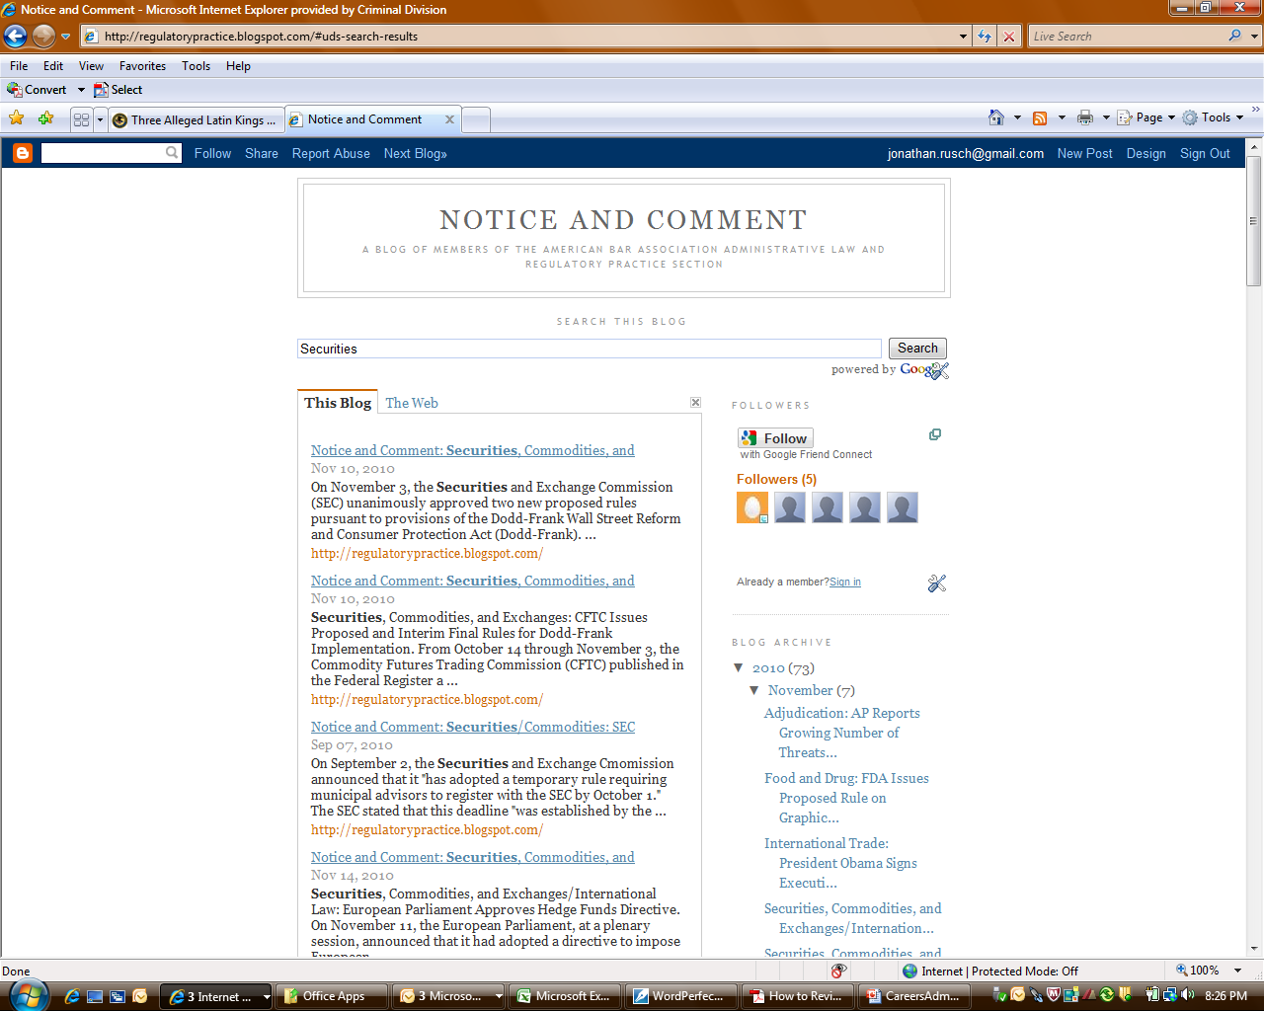

Slide 20
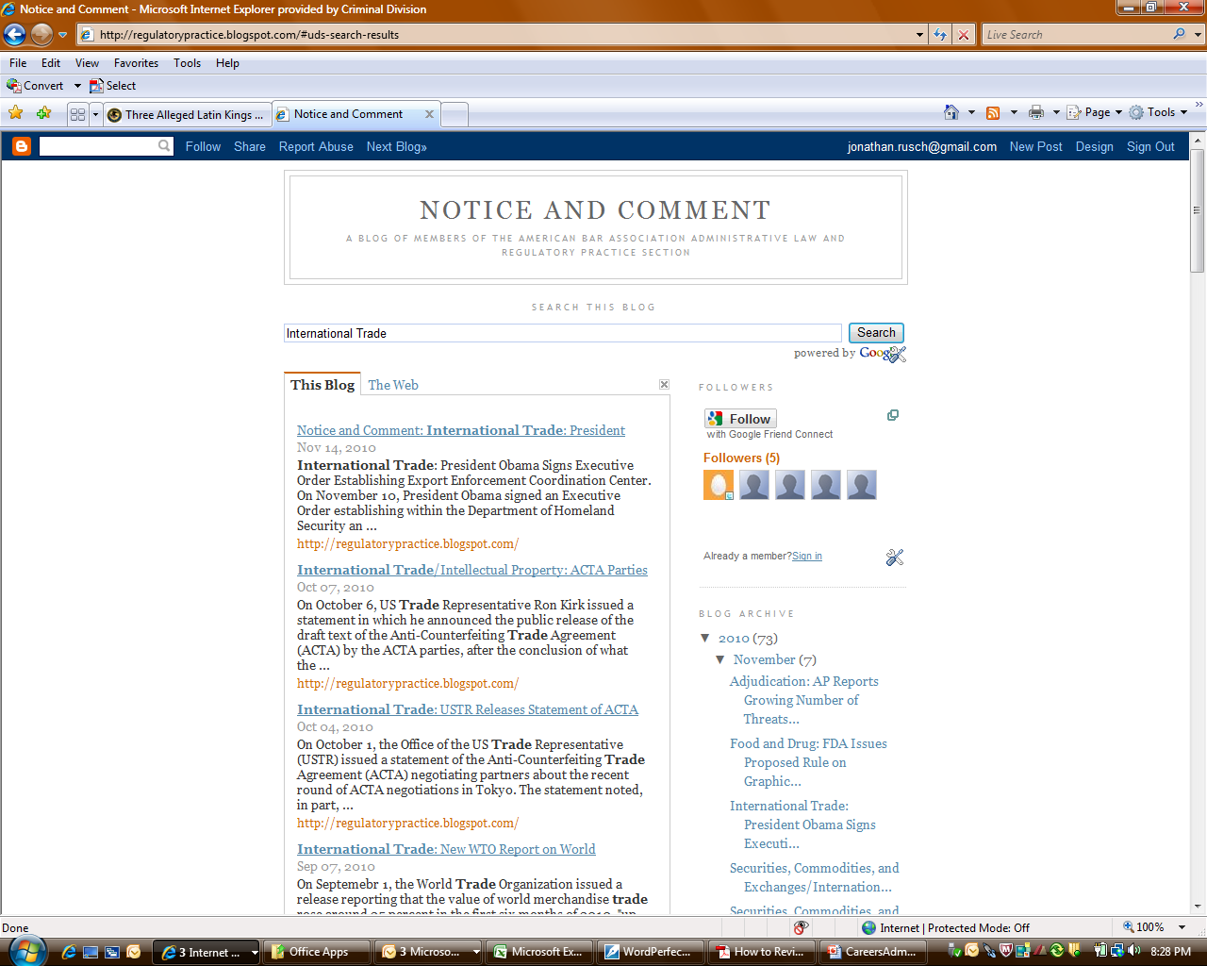

Slide 21
Developing Business Intelligence
Research on Areas of Practice Relevant to Employers
Section Facebook Page

Slide 22
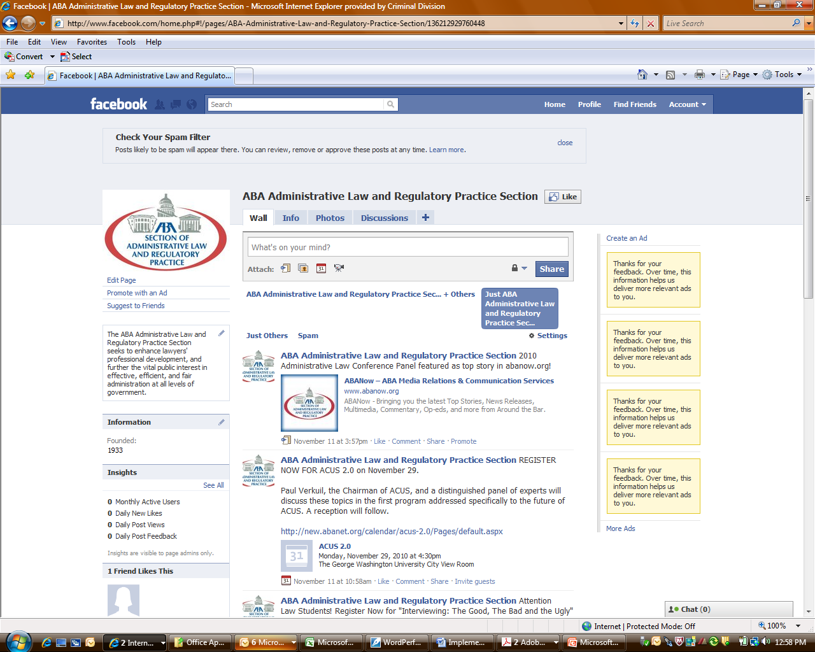

Slide 23
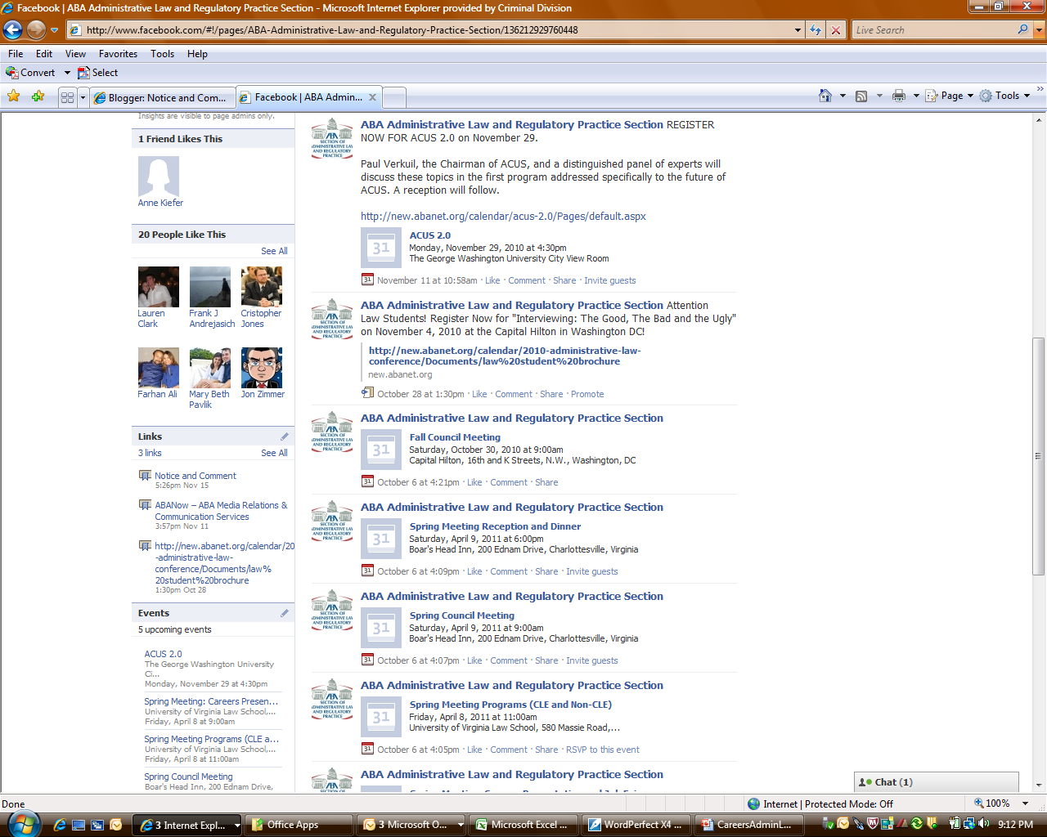

Slide 24
Applying Business Intelligence
Know What Kind of Work Constitutes “Regulatory Practice” Before You Apply
Rulemaking
Drafting regulations
Identifying policy goals that regulation is designed to advance
Determining how well regulation advances those goals
Identifying incentives and disincentives for compliance
Does regulation create externalities (e.g., ambiguities in coverage, disproportionate burdens)?
Revising proposed regulation in light of public comment and policy goals

Slide 25
Applying Business Intelligence
Know What Kind of Work Constitutes “Regulatory Practice”
Rulemaking
Interpreting Regulations
For agency
For regulated entities
For other agencies

Slide 26
Applying Business Intelligence
Know What Kind of Work Constitutes “Regulatory Practice”
Adjudication
Litigation counsel
Before agency adjudicators (e.g., administrative law judges)
Before appellate courts
Adjudicators
Adversary litigation
Dispute resolution

Slide 27
Applying Business Intelligence
Identify Alternative Possibilities for Employment
Geographic: Other cities/states
Private and public sector opportunities vary widely region to region
Firm/agency size: Solo, small firms and smaller agencies may be more adaptable, flexible in response to changing conditions
“Find a job . . . even if it may not be what you had hoped or expected. Get in somewhere.” (Partner)

Slide 28
Merging Branding and Business Intelligence
Start Networking During Law School
Within employer(s)
Supervisors as potential mentors
Beyond employer
Mandatory and voluntary bar associations
Specialty areas of practice
Improvements in legal system
General bar associations (e.g., ABA, state or local bars)

Slide 29
Merging Branding and Business Intelligence
Explore Where You Want to Be in Two to Three Years Out of Law School
“As in every other arena of life, you must take care of yourself.” (Dr. Judith Sills)

Slide 30
Further Guidance
James T. O’Reilly, Careers in Administrative Law and Regulatory Practice (2010)

Slide 31
Contact Data
Jonathan.Rusch2@usdoj.gov
202-514-0631

